Slide 1
Shepard’s Valley Cowboy Church Web Server File Download Problem Analysis
Last Update 2013.06.16 1.0.0

Slide 2
The Problem
Shepard’s Valley Cowboy Church makes audio recordings of the sermon for each Sunday available for streaming or downloading from their website within a few days of its delivery at the service
Often whenever someone attempts to download the entire sermon which is typically 35 to 40 MBs and 30 minutes long, the actual file is truncated

Slide 3
The Analysis
We will use this to illustrate how one analyzes problems in the communication between two devices

Slide 4
Stated File Size
Let’s first look at the file size the web server thinks it is downloading for us
Here is the page view and then a close-up so we can see the stated file size

Slide 5
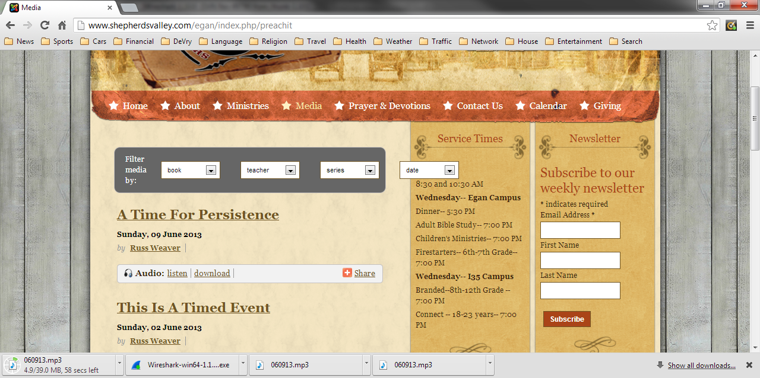
Stated File Size

Slide 6
Stated File Size
Notice that the web server
says the file is 39 MB

Slide 7
Actual File Size
But as we see next the size is actually 8MB
The running time is 7 minutes

Slide 8
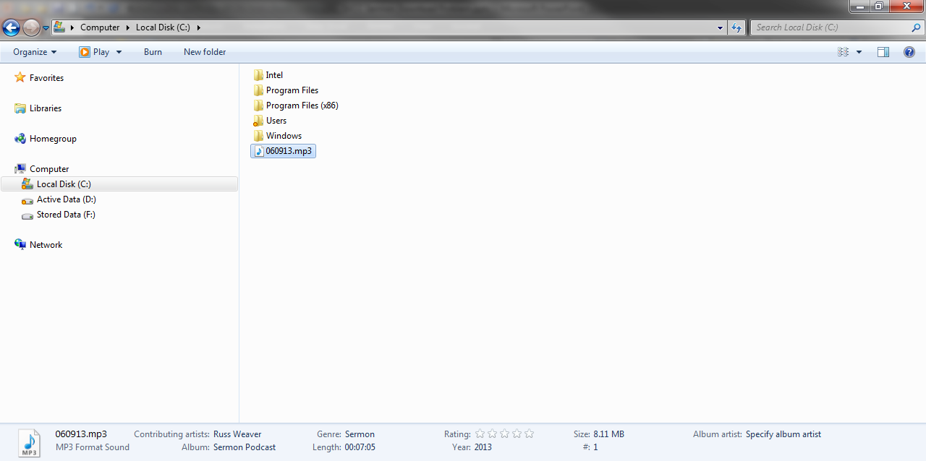
Why Is This
But the actual size is 8 MB

Slide 9
Why Is This
The question is why does this occur over and over each week
Let’s look at what happened as the file was downloaded from the web server to the end user’s computer
The web server’s IP address is 69.72.163.23
The end user device’s IP address is 192.168.1.80

Slide 10
Why Is This
The overall process for downloading a file such as this from a web server is to use TCP and HTTP as the protocols that will control the transfer
The steps are
Establish a reliable connection using TCP
Issue a request for the file using HTTP
Transfer the file using TCP
Close the connection using TCP

Slide 11
Establish the Connection
First TCP is used to establish a reliable connection between the end user and the web server
As in all cases where TCP is used the end user’s device sends out a SYN
We can see it here in the capture file of the download beginning with frame 28

Slide 12
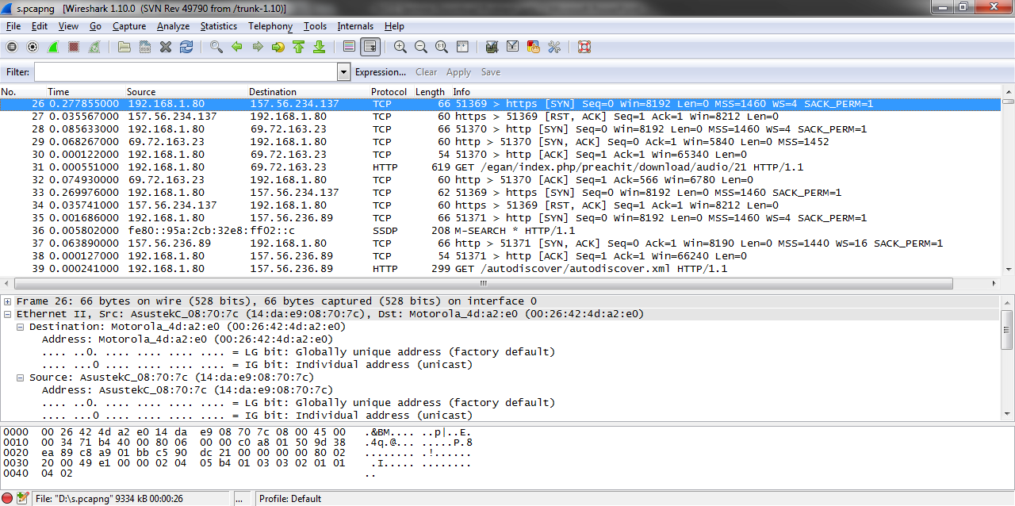
Establish the Connection

Slide 13
Establish the Connection
In frame 28 the end device at 192.168.1.80 has sent the first frame of the TCP three way handshake – the SYN - to the web server at 69.72.163.23

Slide 14
Establish the Connection
There is no appreciable delay in the response from the web server as it issues the SYN ACK in .0682 seconds as seen in frame 29
Finally in frame 30 we see the last step of the three way handshake when the end user device issues the ACK in .0001 seconds

Slide 15
Establish the Connection
Clearly the problem is not a delay in the initial connection between the end user device and the web server
They now have a TCP connection established

Slide 16
Request the File
The next step is for the end user device to initiate the transfer of the desired file by issuing the GET command with the file name included
We see this in frame 31

Slide 17
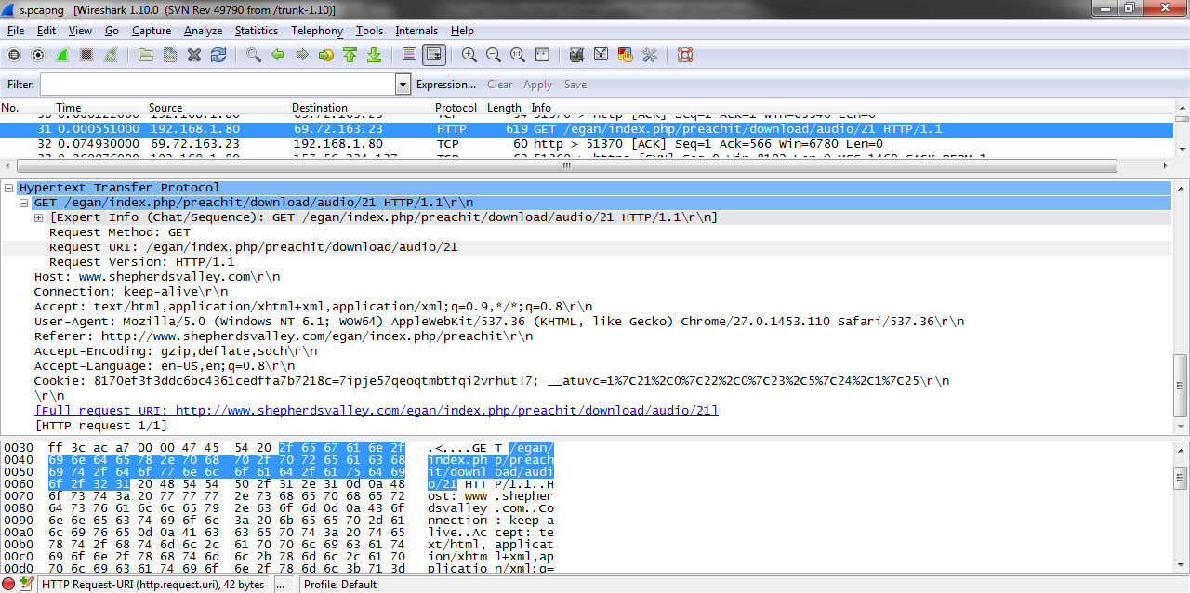
Request the File

Slide 18
Request the File
At that point the file transfer process begins with frame 71
As we can see in frame 71 the file name to be downloaded is 060913.mp3
The stated size is 40920414
It is by Russ Weaver

Slide 19
Request the File
It is a sermon podcast using iTunes version11
It will be a binary transfer

Slide 20
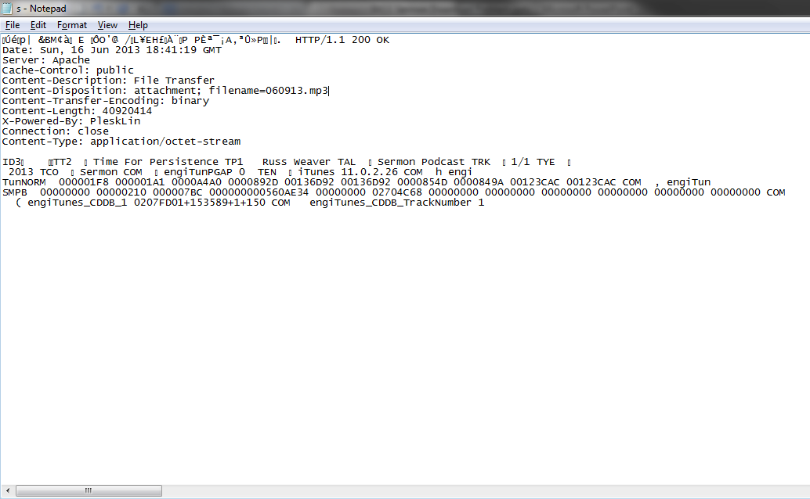
Request the File

Slide 21
The Transfer
The transfer itself goes on until frame 8941 when the web server sends the last of the data
However notice in the TCP details of this frame that the size of the segment data is 1452 bytes as are all of the frames above this one

Slide 22
The Transfer
It could be that the file can be divided exactly by 1452, but it is more likely that the last of the data frames would be of some size less than this
This calls for additional analysis

Slide 23
The Transfer
Let’s look at the transfer from the other side where the source is not the web server, but the end user device
This process proceeds along in a normal fashion
The last of the data appears in frame 8942

Slide 24
Close the Connection
The FIN ACK to close the transfer is in frame 8943
The question is why does the transfer stop here before the complete file is sent
Because in frame 8941 the web server turns on the FIN PSH ACK flags to tell the end user device that it has all the data it requested

Slide 25
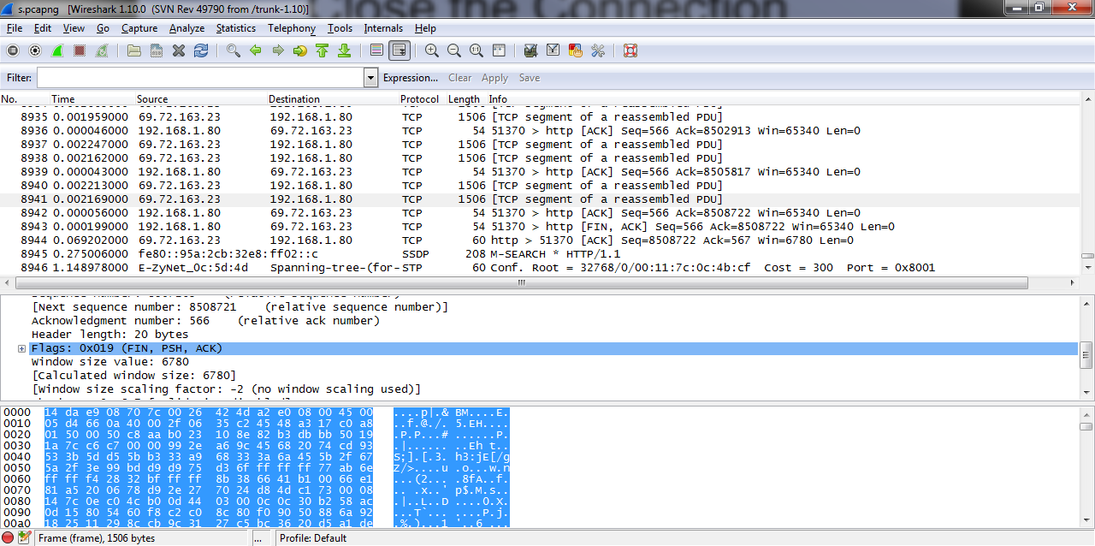
Close the Connection

Slide 26
The Connection
Not knowing any better the end user device sends an ACK back saying fine in frame 8942
Then in frame 8943 the end user device asks to close the connection as it believes the transfer is complete
Finally in frame 8944 the web server says fine let’s close the connection

Slide 27
Close the Connection
In frame 8493 the end user device issues the FIN ACK to close the connection
.0692 seconds later the web server closes the connection in frame 8494 when it issues the ACK for the FIN ACK

Slide 28
What Is The Problem
So what is the problem
Why is the file size alleged to be 40 MB but only 8 MB are downloaded
Good question
There is nothing wrong with the transfer itself
No errors appear before during or after the transfer

Slide 29
What Is The Problem
I believe it is time to talk to the folks that control the server that houses the file at 69.72.163.23
Who might that be
It looks like these folks are the source of the problem

Slide 30
What Is The Problem

