Slide 1
Inspecting Cabling Last Update 2010.03.07 1.0.0

Slide 2
Objectives
Learn what properly installed cabling looks like

Slide 3
Good v Bad
The following photographs will show cabling that has been properly installed by following the structured cabling standards as well as the design and installation guidelines produced by BICSI
The photographs will also show common bad practices to be avoided
The good is shown first, then one or more bad examples

Slide 4
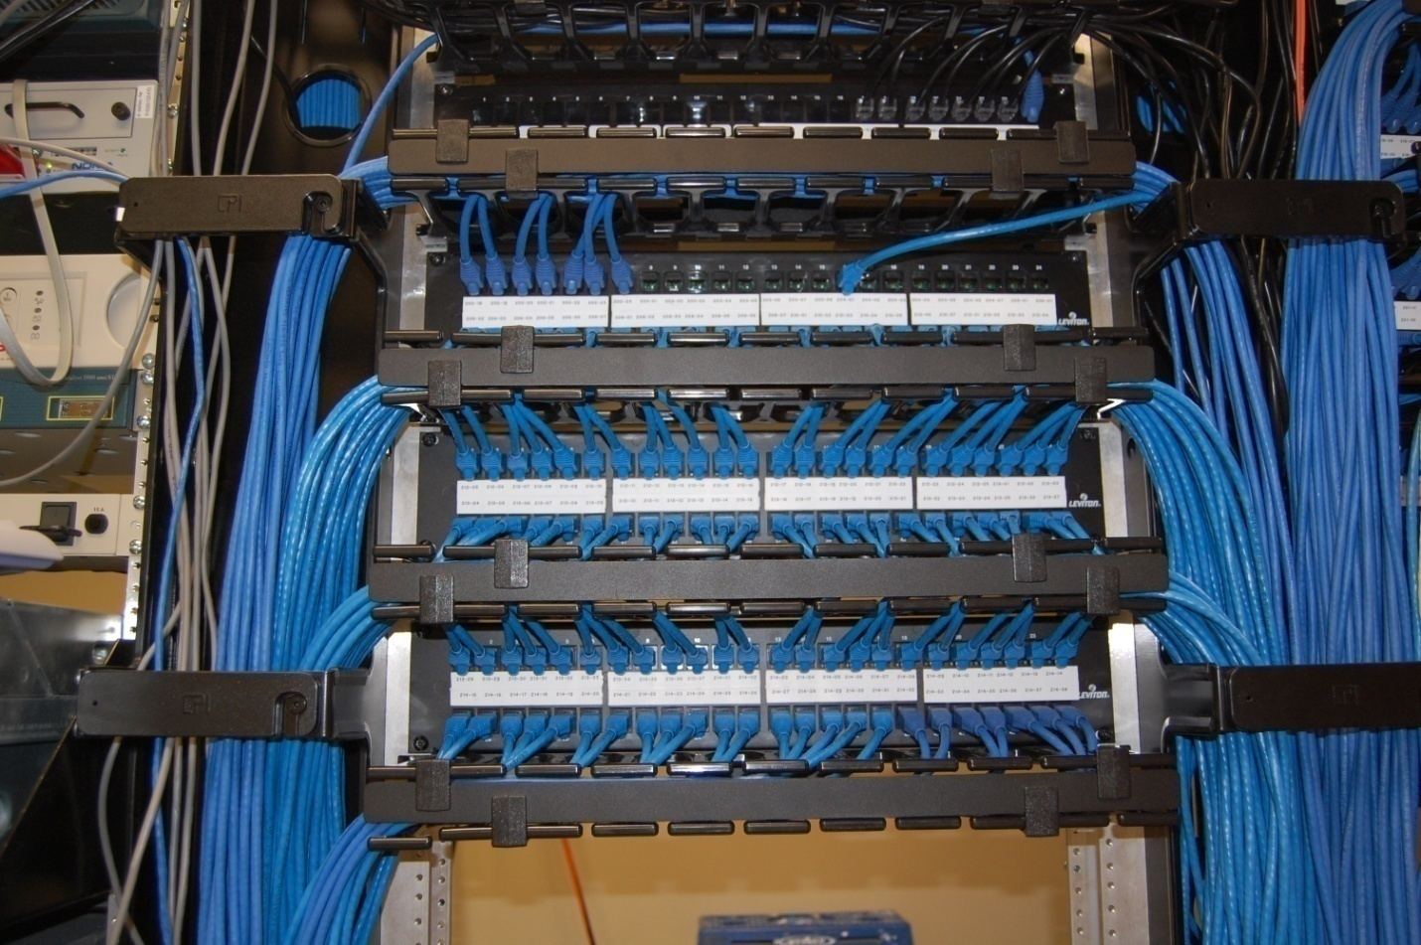
Wire Management Front

Slide 5
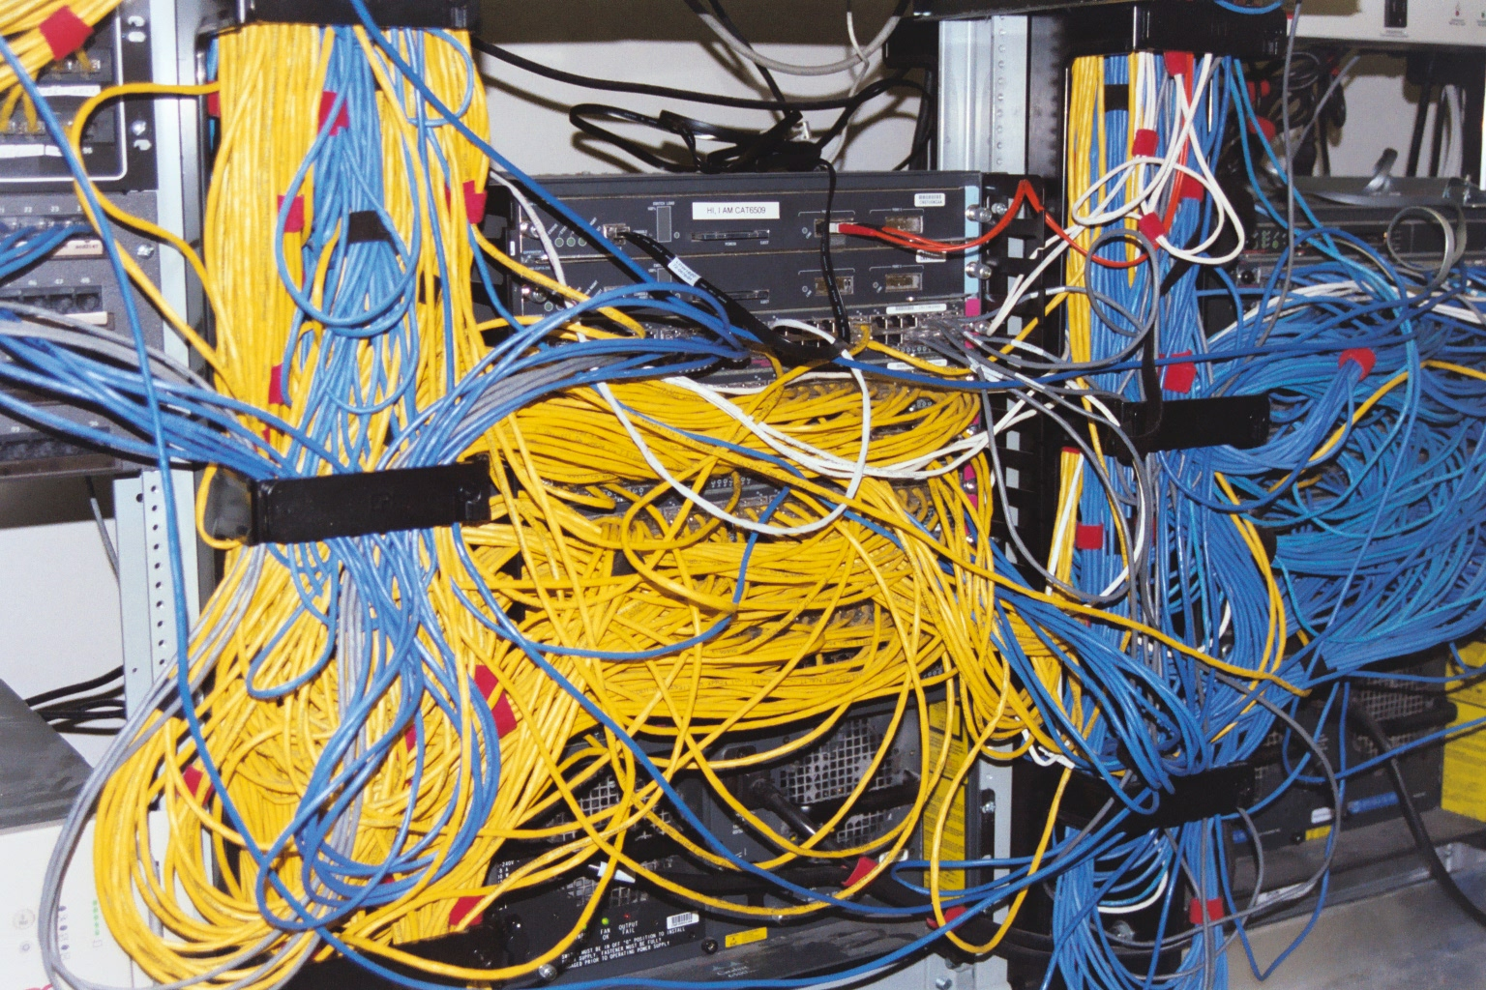
Wire Management Front

Slide 6
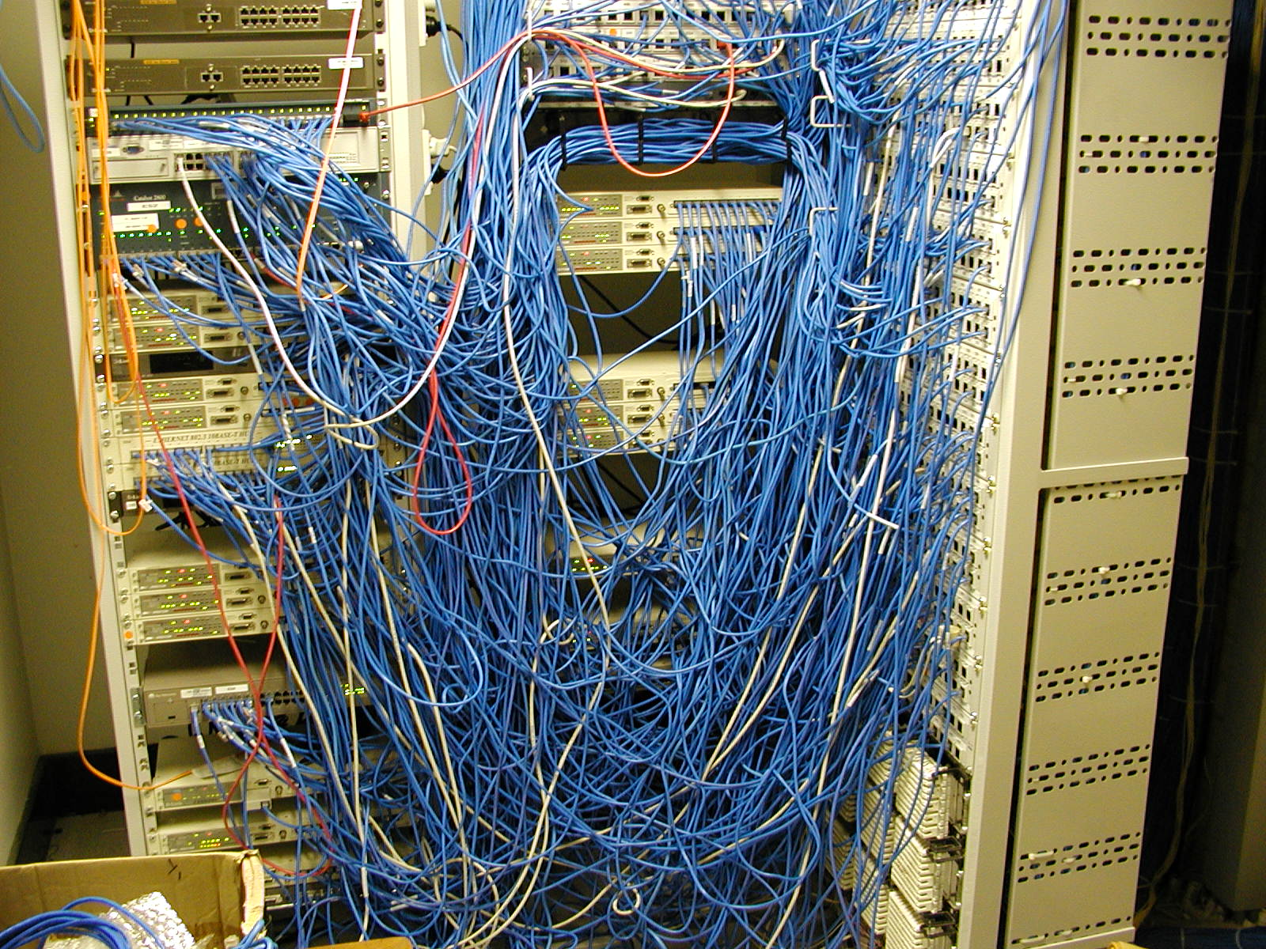
Wire Management Front

Slide 7
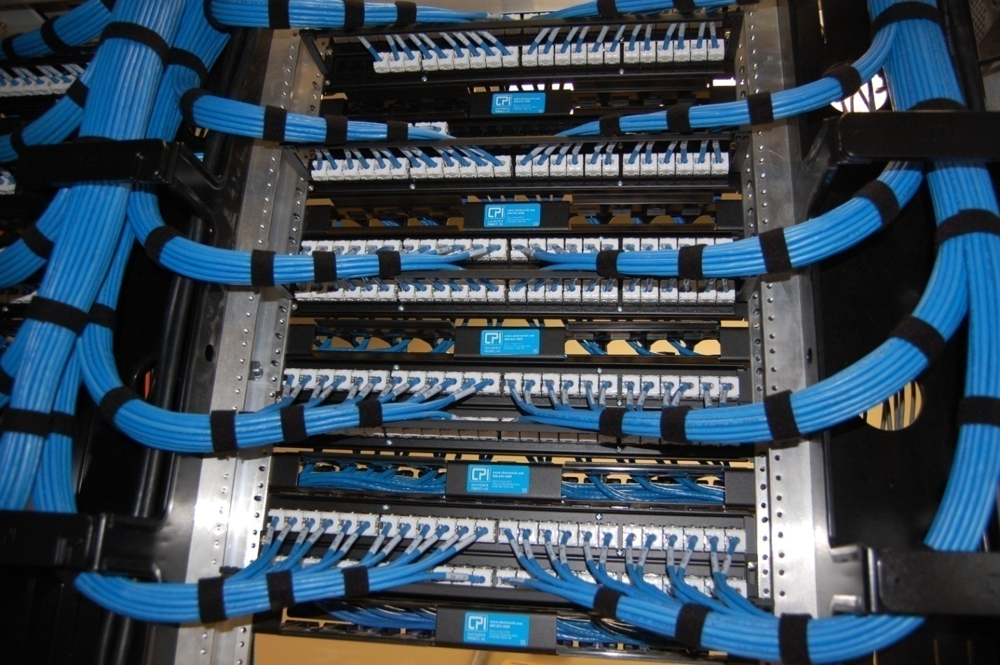
Wire Management Back

Slide 8
Wire Management Back

Slide 9
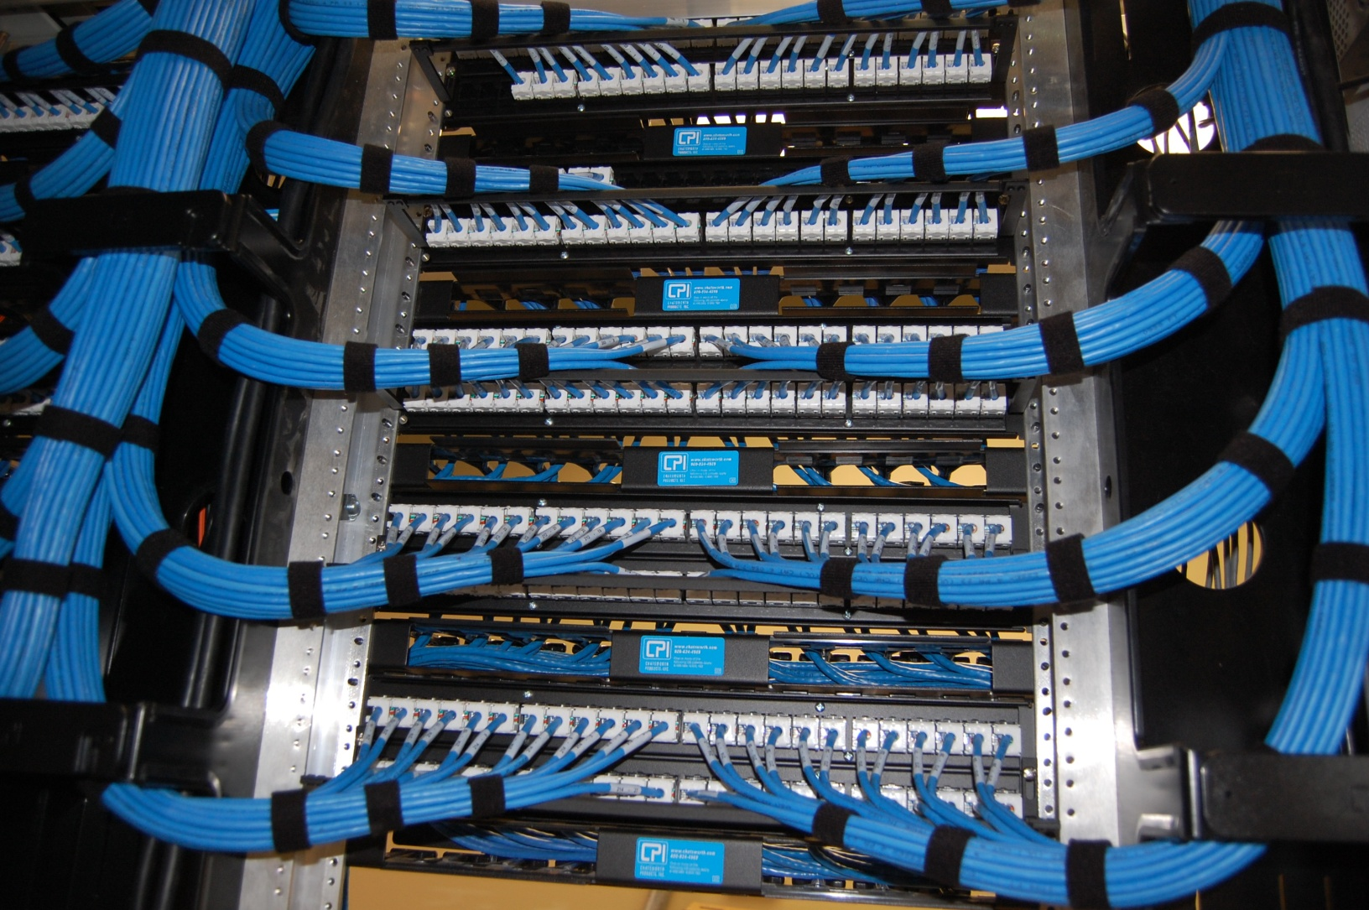
Patch Panel Termination

Slide 10
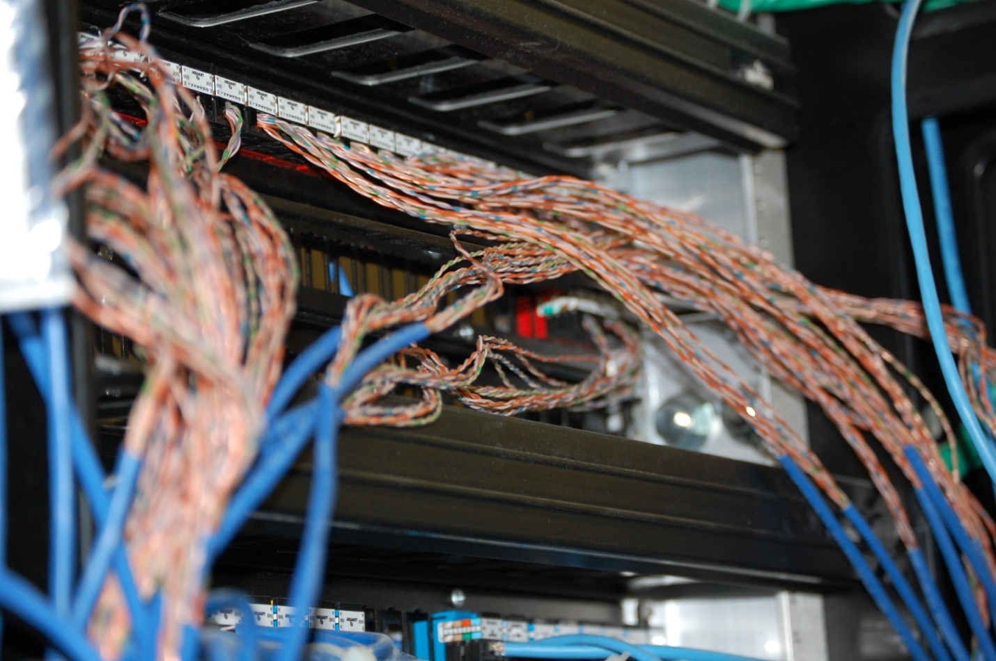
Patch Panel Termination

Slide 11
Patch Panel Termination

Slide 12
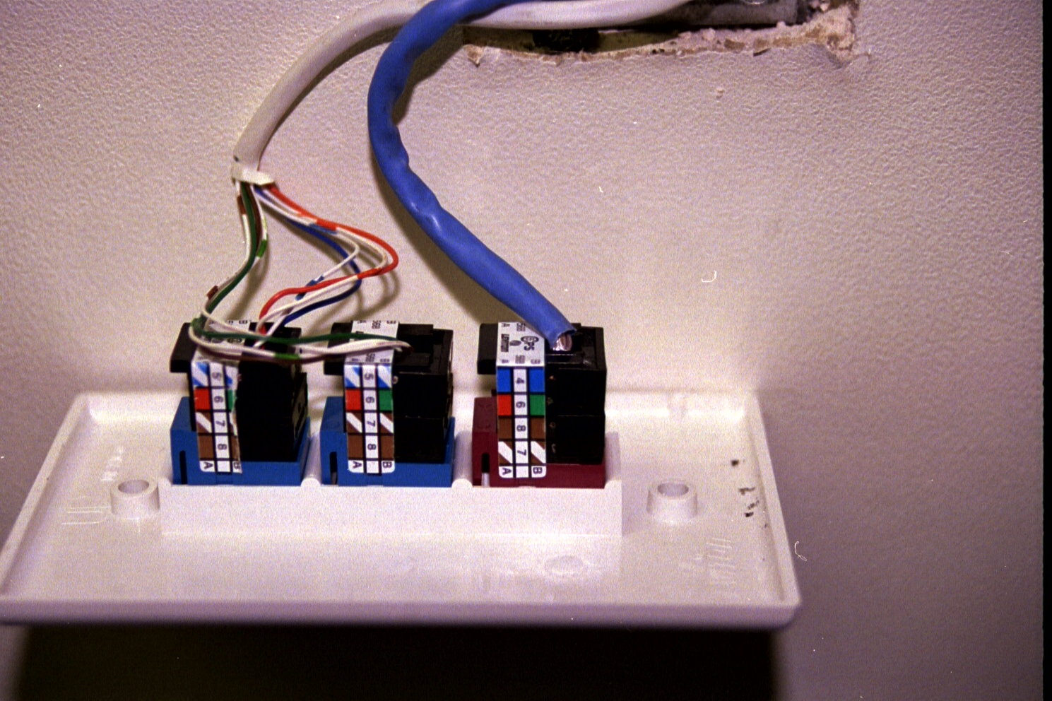
Work Area Termination

Slide 13
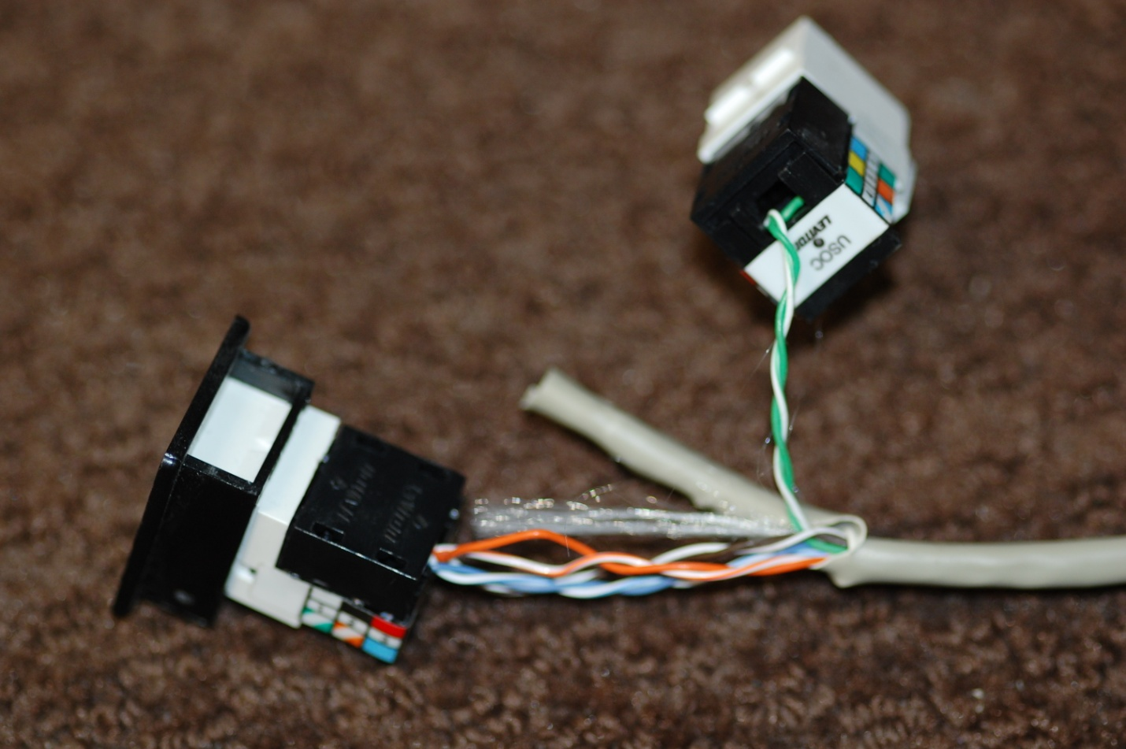
Work Area Termination

Slide 14
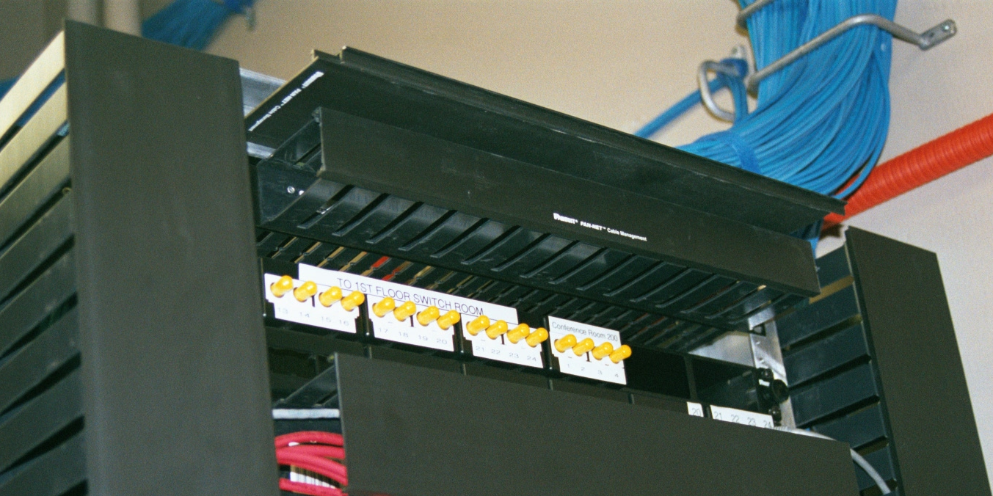
Fiber Optic Cable Patch Panel

Slide 15
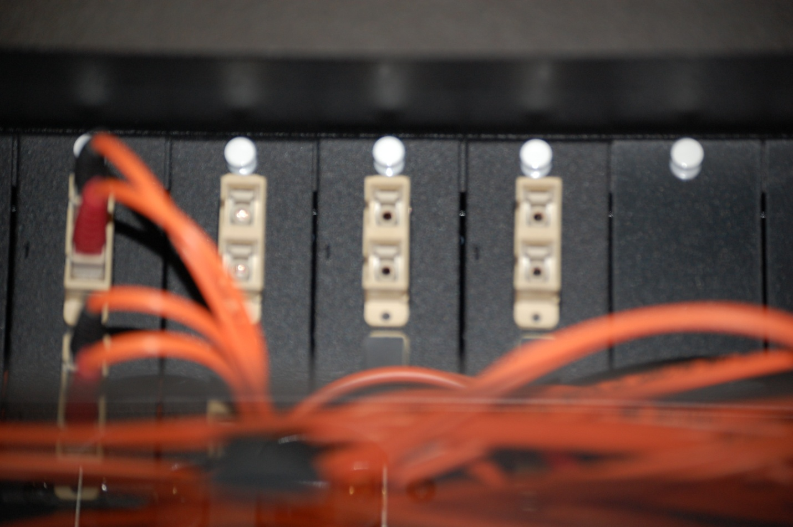
Fiber Optic Cable Patch Panel

Slide 16
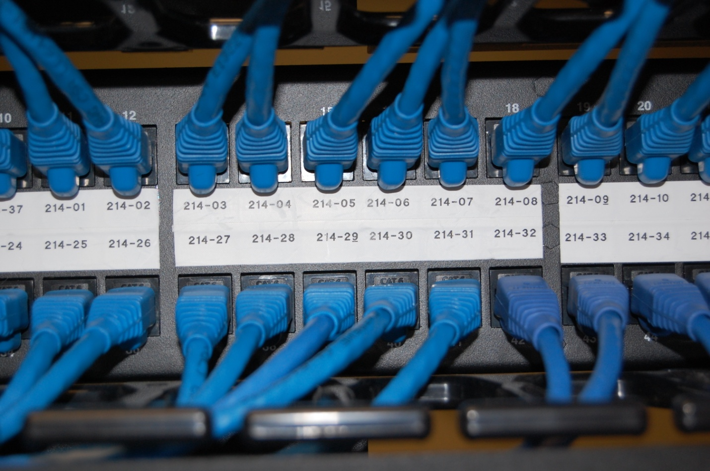
Patch Panel Labeling

Slide 17
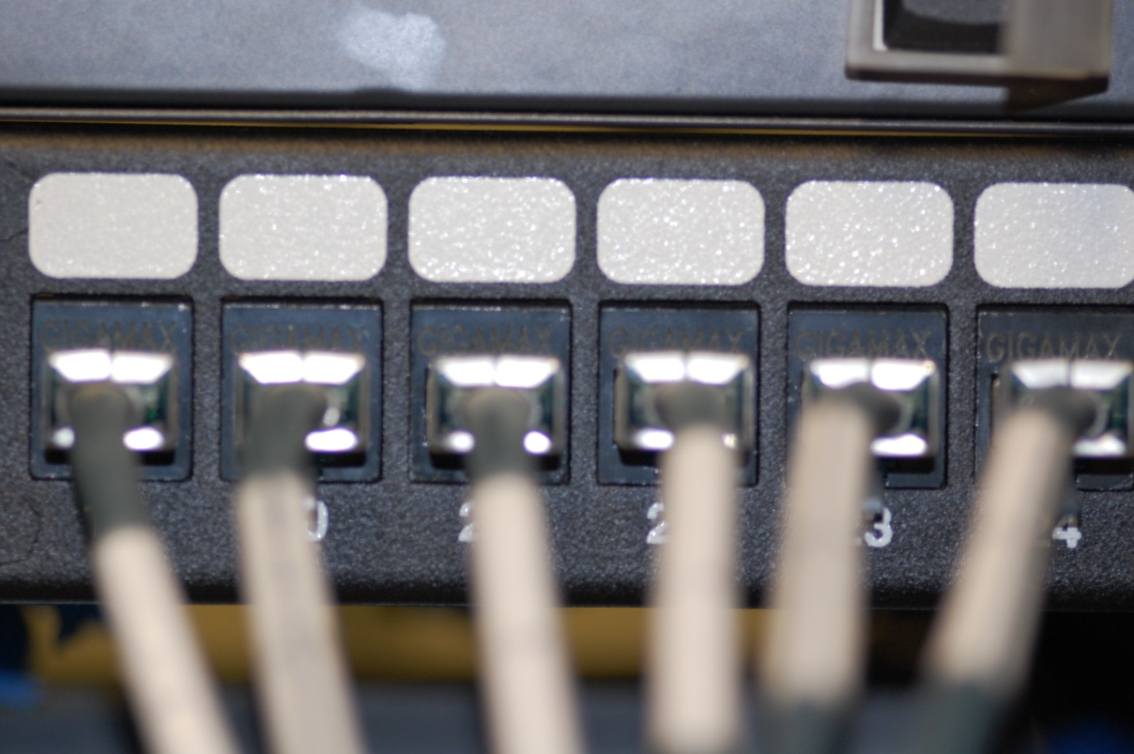
Patch Panel Labeling

Slide 18
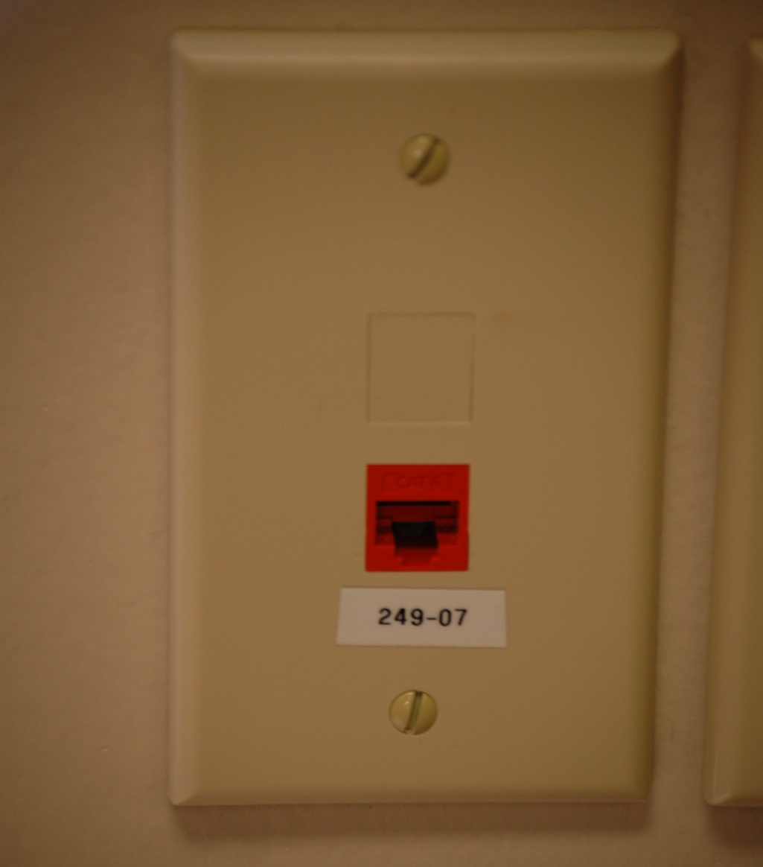
Work Area Labeling

Slide 19
Work Area Labeling

Slide 20
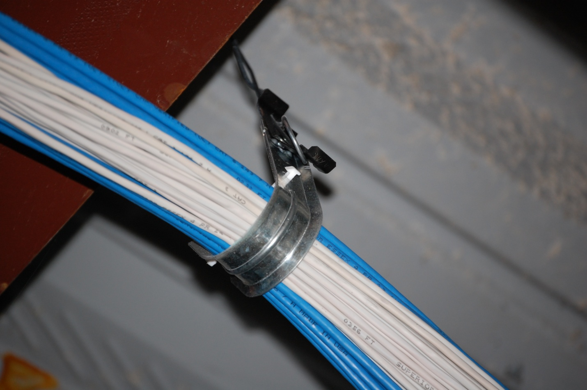
Horizontal Cable Installation

Slide 21
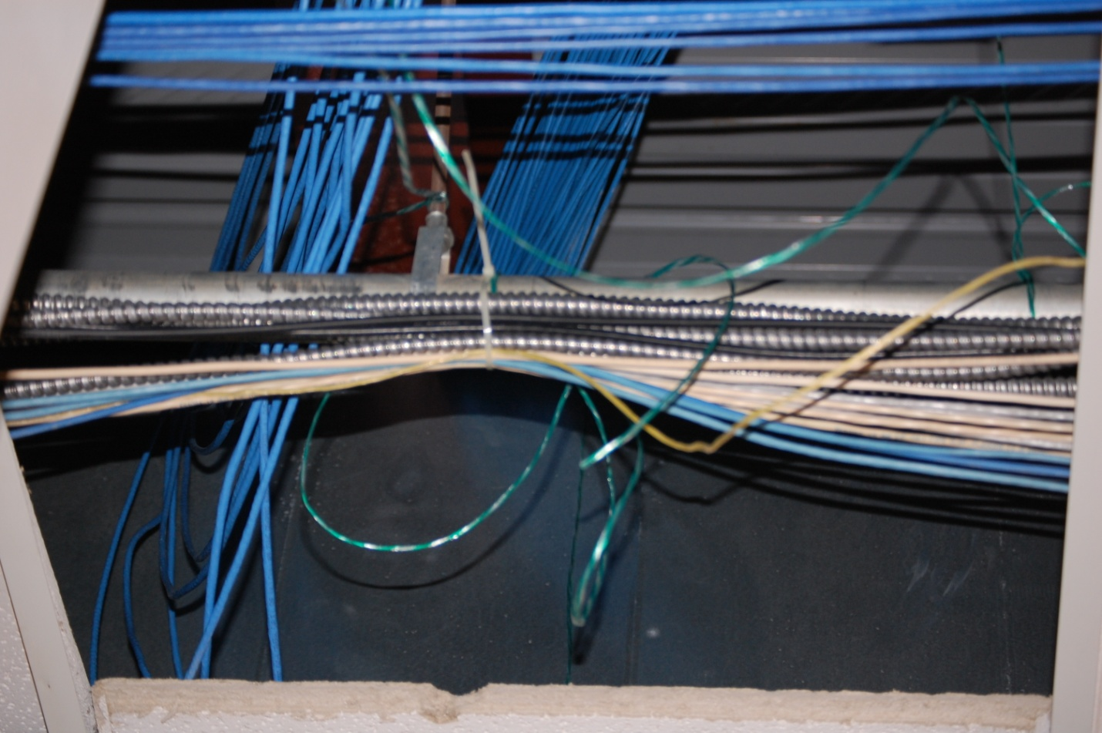
Horizontal Cable Installation

Slide 22
Abandoned Cable
There is no photograph because when cabling will no longer be used it should be removed
Therefore there should be nothing to see

Slide 23
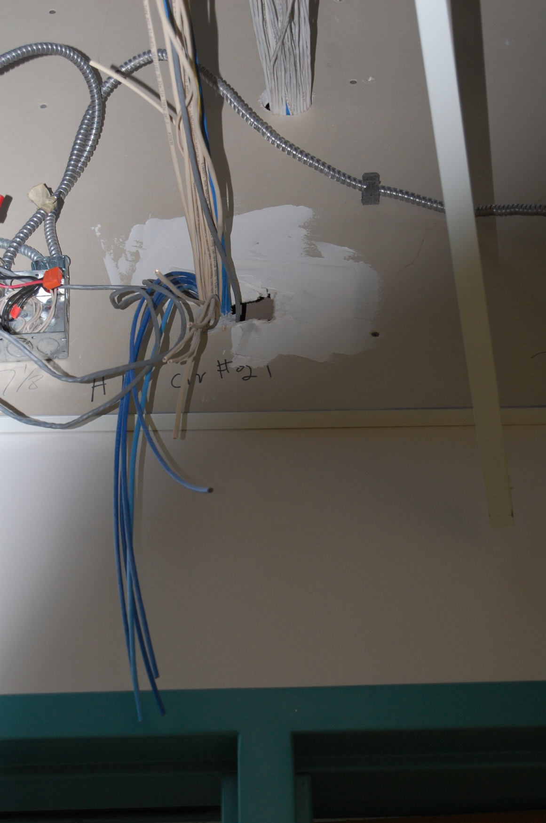
Abandoned Cable

Slide 24
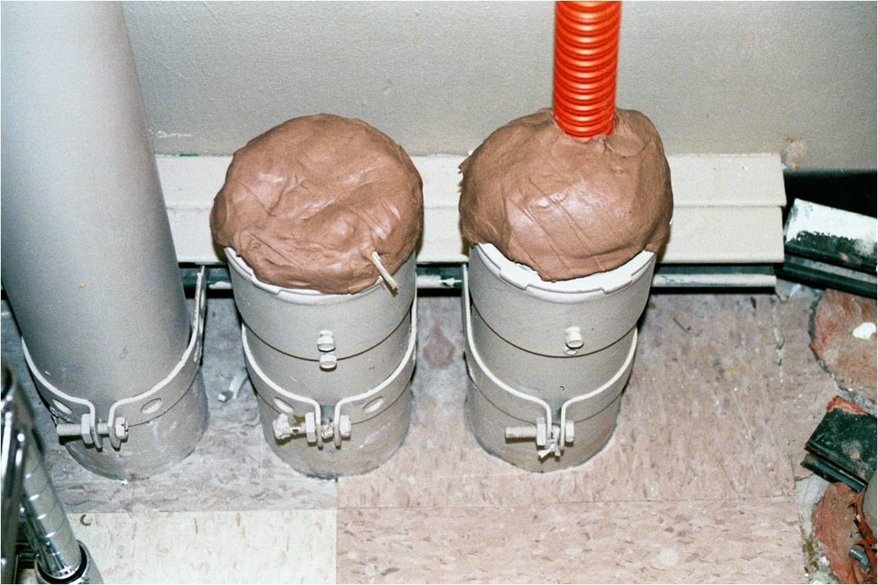
Riser Tube

Slide 25
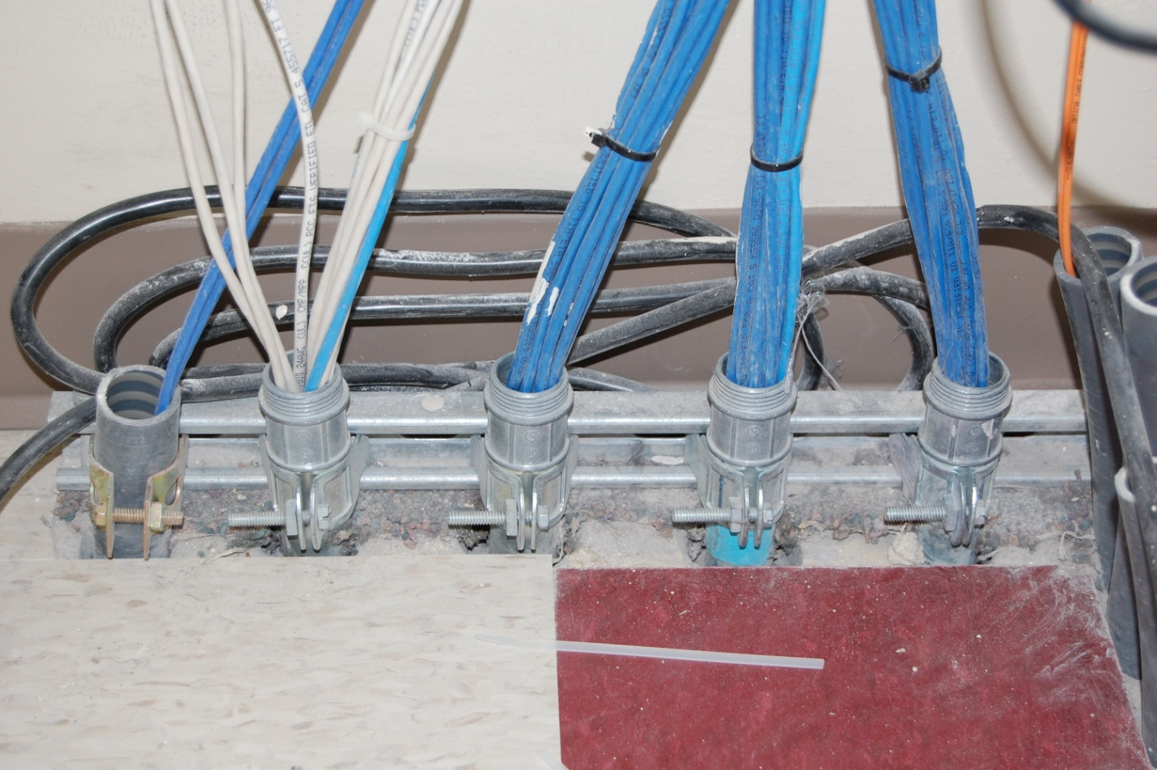
Riser Tube

Slide 26
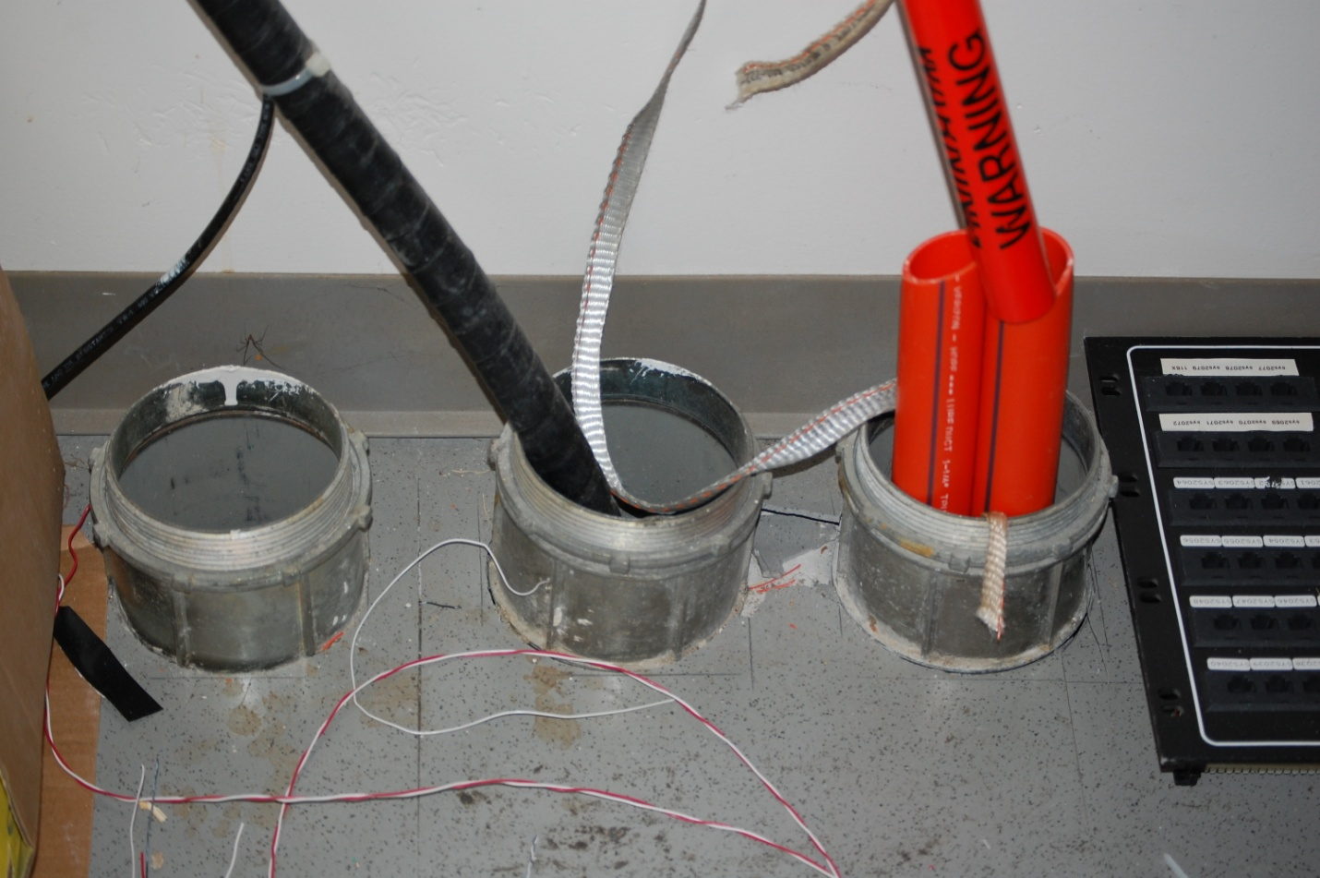
Riser Tube

Slide 27
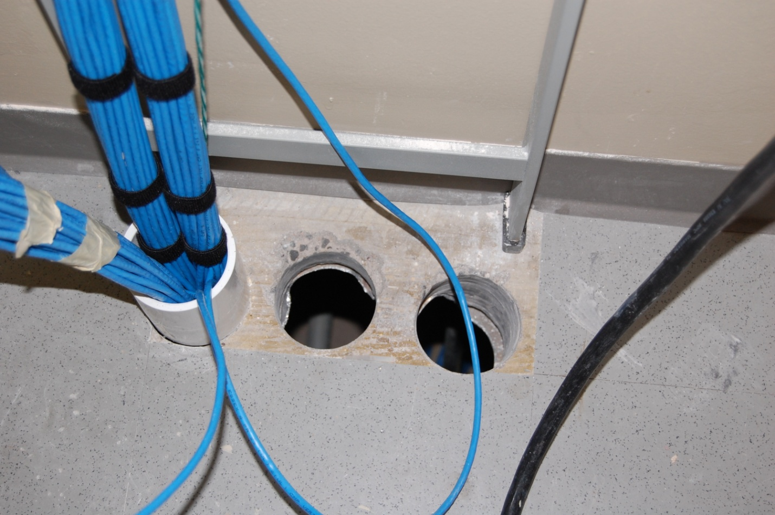
Riser Tube

Slide 28
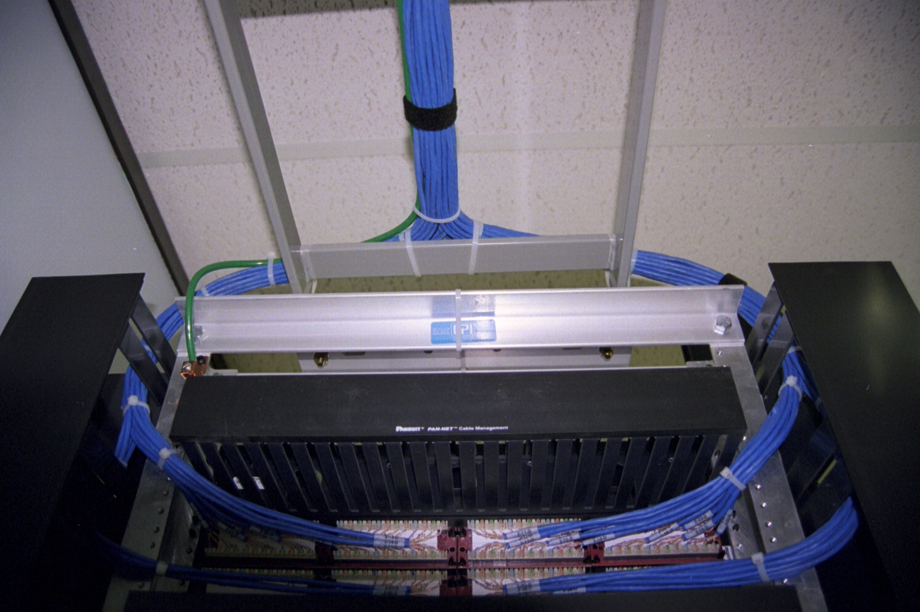
Equipment Ground

Slide 29
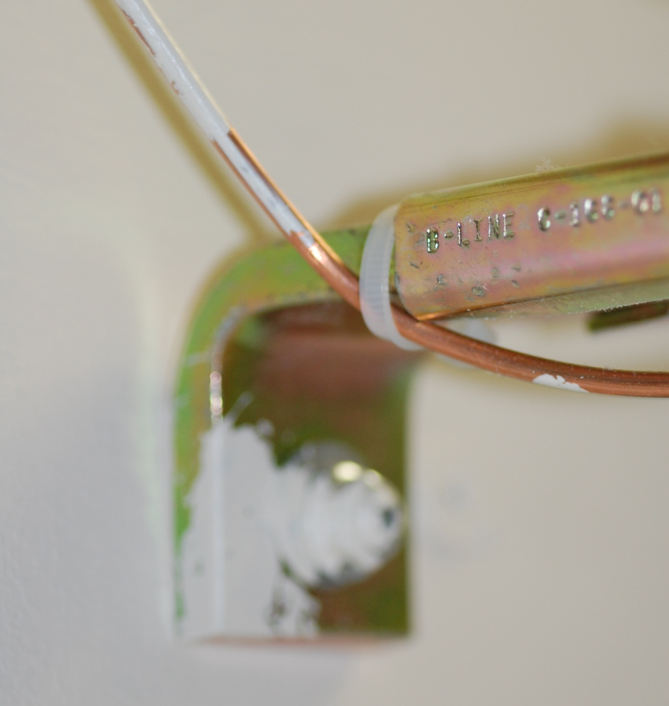
Equipment Ground

Slide 30
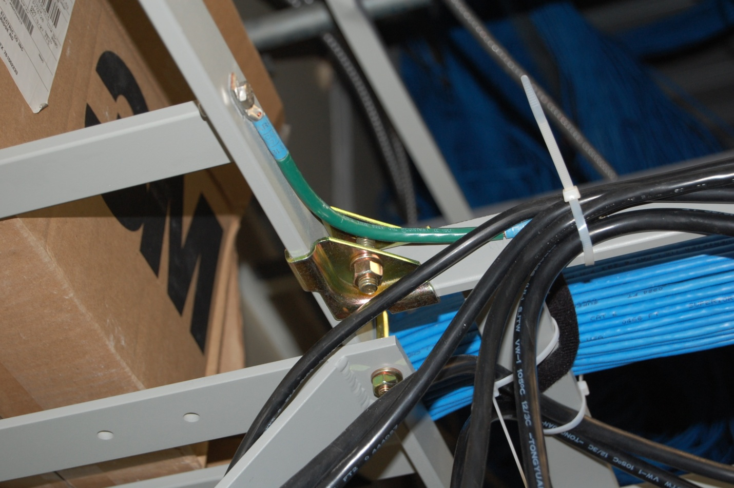
Ladder Rack Ground

Slide 31
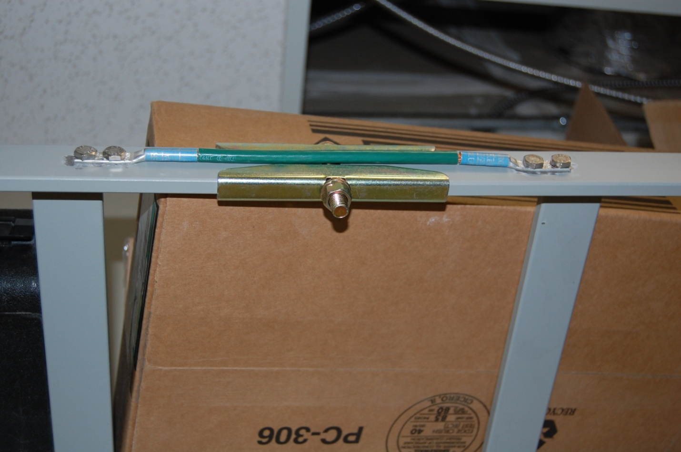
Ladder Rack Ground

Slide 32
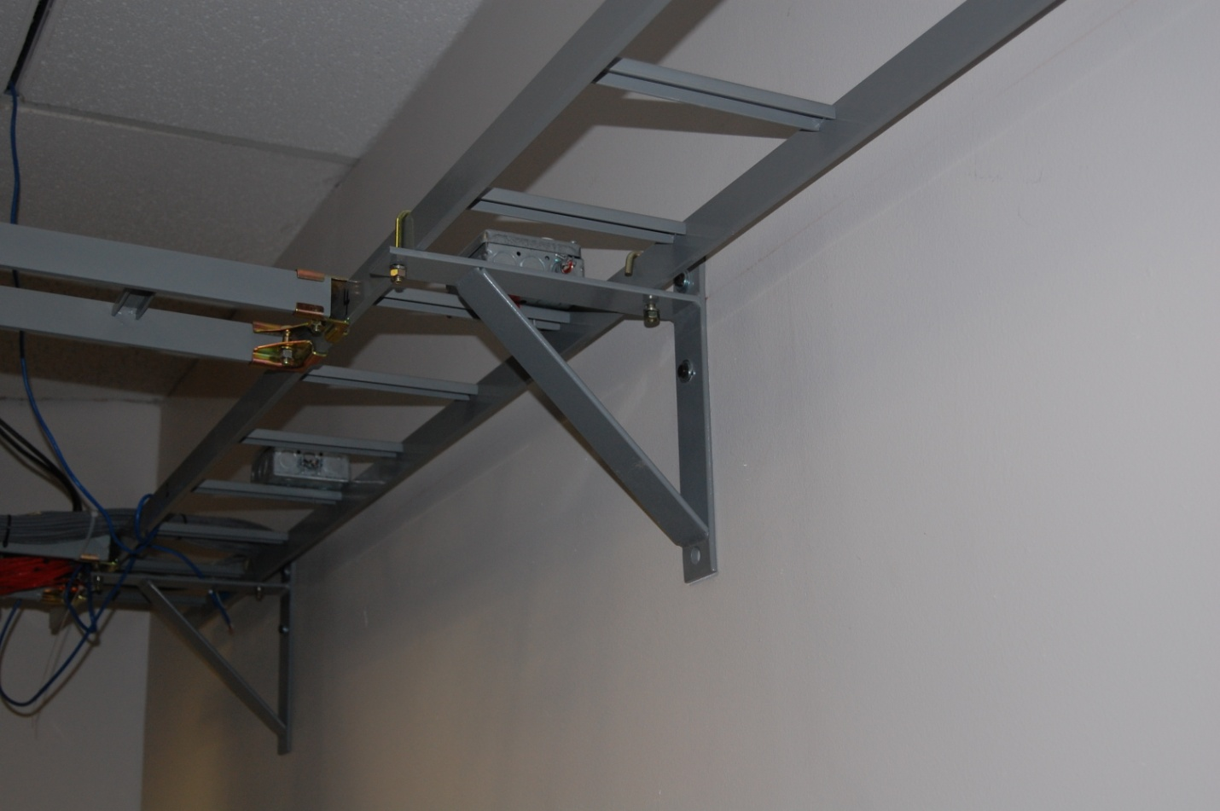
Ladder Rack Ground

Slide 33
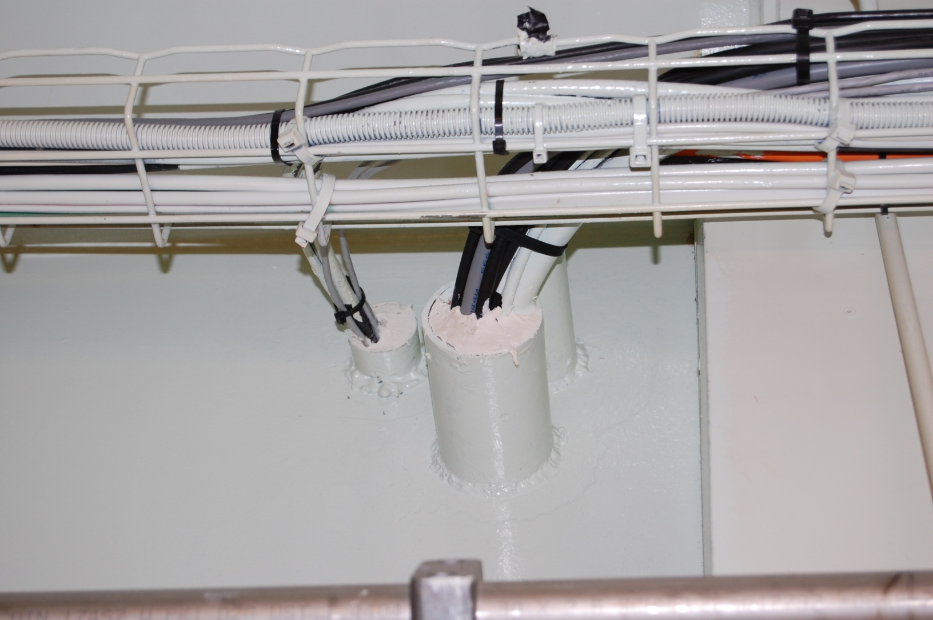
Firewall Penetration

Slide 34
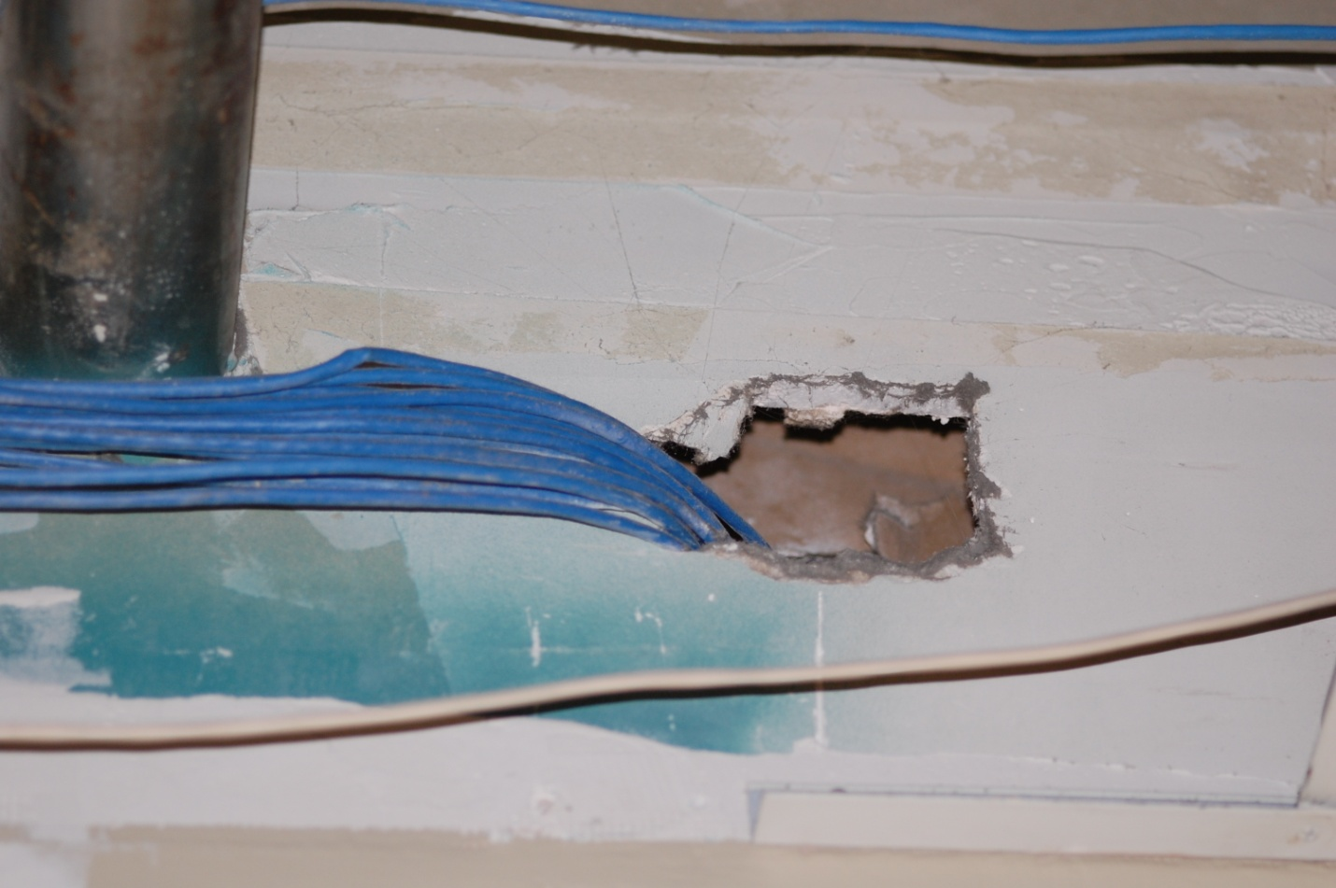
Firewall Penetration

