Slide 1
Using a Network Analyzer To Examine a Network
Last Update 2014.06.01 1.10.0

Slide 2
Objective
Learn what problems commonly occur on networks as well as how to discover if they are occurring on your network

Slide 3
Sources
Most of this is copied or adapted from a series of seminars and labs by Laura Chappell or a white paper from Fluke Networks
The retransmission filter is from Network Analysis Using Wireshark Cookbook by Yoram Orzach

Slide 4
Basic Steps
There are certain basic analysis tasks that need to be done on any network
Some of these are done when the network is working correctly and some when it is not
These include
Baselining the network for troubleshooting
Isolating the source of a problem
Identifying security scans and breaches

Slide 5
Baselining the Network
A baseline is a record of the normal operation
In this case the normal operation of a network
With the baseline record a reported problem can be compared to it to assist in determining the cause of the problem

Slide 6
Baselining the Network
The elements of a network baseline for troubleshooting purposes include recording and being familiar with the normal operation of each of these
Broadcast and Multicast Types and Rates
Bootup Sequence
Login Sequence
Protocols and Applications in Use
Launch and Use of Common Applications

Slide 7
Baselining the Network
Web Browsing
Throughput
Idle Time Traffic
Connectivity Tests Through the Network
Logoff Sequence
Let’s list each of these in more detail as suggested by Laura Chappell

Slide 8
Broadcast and Multicast Traffic
Who is broadcasting
What applications are broadcasting
What is the rate in packets per second
Who is multicasting
What applications are multicasting
What is the rate in packets per second

Slide 9
Bootup Sequence
Examine the DHCP process
See what applications are started automatically

Slide 10
Login Sequence
What discovery process takes place
What server is contacted
What login processes take place
How many packets are required

Slide 11
Protocols and Applications
What applications are running
What protocols are being used
What ports are in use
What routing protocols are being used
What does the routing update process look like
What ICMP traffic is seen

Slide 12
Launch and Use of Applications
What discovery process does the application use
Does the application use UDP or TCP
What ports are used
What devices are contacted
How many packets are required
How long does it take
Is cleartext used

Slide 13
Web Browsing
What DNS servers are used
How long does DNS take
What is the round trip time to the server
What is the application response time to the page request
What servers are contacted
Are any HTTP errors produced

Slide 14
Throughput
What application is being used for the test
What are the configurations of the test devices
What packet sized is being used
What is the Mbps both ways
What is the packet loss both ways

Slide 15
Idle Time Traffic
What protocols and applications are seen
What hosts are contacted

Slide 16
Connectivity
Record ping times between devices

Slide 17
Logoff Sequence
What logoff processes take place
How many packets are required

Slide 18
Isolating the Problem Domain
The first step in solving any problem is to isolate the problem domain
That is ignore extraneous matters, identify the specific area in which the problem is occurring, and then fix that problem
Let’s see where problems are most likely to occur and how we isolate the exact source of the problem

Slide 19
Common Sources of Problems
In a 2008 white paper titled Application Troubleshooting Guide Fluke Networks presented a useful procedure for determining the source of a problem
In their view network problems are due to one of three possible problems with Laura Chappell who does training on network analysis suggesting two more

Slide 20
Common Sources of Problems
The common problem areas are
Network
Server
Application
Client
User

Slide 21
Causes of Poor Performance
Regardless of the exact location of the problem Laura Chappell lists these as the top causes of poor performance
High latency times
Misconfiguration of a device
Slow processing by a device
Packet loss
Traffic redirection
Small payload sizes

Slide 22
Causes of Poor Performance
Congestion
Application faults

Slide 23
Common Sources of Problems
Let’s look at each of these five common sources of problems one at a time

Slide 24
The Network as the Problem
The network can be the source of the problem for several reasons including
Network Design
Improper Media Installation
The Protocols Used
The Equipment Used
Let’s look at each one of these

Slide 25
Network Design
Network design in detail is the topic of another course
It is also not related directly to troubleshooting as we are discussing here
However there are some design issues that would cause delay in the network including

Slide 26
Network Design
Too many hops between end points
Improper routing
Under powered devices

Slide 27
Improper Media Installation
Structured cabling in detail is also the topic for another course even though we will discuss it in this course to some extent as a troubleshooting issue
Basically if cabling or whatever type of media such as wireless is used is installed incorrectly it may cause delays on the network due to the frames being dropped causing retransmissions

Slide 28
The Protocols Used
The nature of the protocols commonly used on networks these days can cause numerous problems on the network
The protocols in question include
TCP
Protocols Involved in Application Flow

Slide 29
TCP
Recalling the functions of the four layers of the TCP/IP model, TCP is the main protocol that creates and maintains the data flow across the network
At the transport layer TCP carries about 90% of the traffic on a network and UDP most of the rest
For example as Fluke says

Slide 30
TCP
If you segment the traffic on a corporate network into categories determined by the purpose of that traffic, you would probably find a break down something like this: email (10%), transaction processing (25%), http web traffic (35%), broadcast and control (10%) and other traffic (20%)
The only part of the mix that is based primarily on UDP is in the “other” category
The remainder use mostly TCP

Slide 31
TCP
TCP is an adaptive protocol in that it adjusts to changes in throughput
Unfortunately these changes in throughout can be due to network, server, or application problems that produce undesirable results in TCP’s reactions
As TCP adjusts due to these problems it will mask the underlying source of the problem

Slide 32
TCP
Why is this
Let’s look at how frames move back and forth when utilizing TCP at the transport layer
In this example data is being sent from a client to a server

Slide 33
TCP
Laura Chappell explains the process this way
At the client computer
To begin the TCP protocol that is part of the TCP/IP stack on the client computer first determines how much data it can send
This is usually 1460 bytes
This segment created by the TCP protocol is delivered to the IP protocol at the Network layer where the IP addresses of the sender and receiver are added

Slide 34
TCP
Then the IP software contacts the operating system to say an outgoing message is ready to be sent
When the operating system gives the okay, the outgoing packet is moved to the NIC by handing it off to the Data Link layer
In this entire process, the performance of the client’s processor is critical to how fast this all can take place
Slow computer – slow transfer

Slide 35
TCP
Across the network
Packets can follow a short, fast route, a slow, long route or any combination of links
It is common for a packet to traverse 10-20 individual network links when going over an Internet connection
Like the adage about the strength of a chain depending on the weakest link, the speed through the network depends on the slowest link
More often than not, the slowest link is the access link into the network and the egress link out of the network

Slide 36
TCP
At the server
Just like the client end how fast the server processes the request impacts the round trip time of the transaction
Slow server – slow transfer

Slide 37
TCP Flags
The flag field in the TCP header can provide some useful troubleshooting information
Let’s look at the eight flags used by TCP as discussed by Chris Greer in a series of articles from Fluke Networks
They are

Slide 38
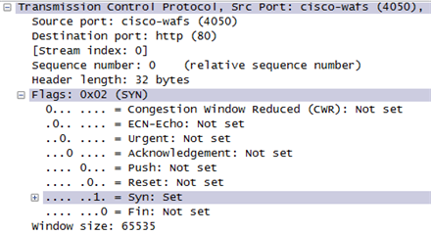
TCP Flags

Slide 39
TCP Flags
Congestion Window Reduced
ECN-Echo
Urgent
Acknowledgment
Push
Reset
Syn
Fin

Slide 40
TCP Flags
Congestion Window Reduced and ECN-Echo
These two flags are used together when used, but then they are very rarely seen in practice
They were meant to indicate congestion
Urgent
As it seems, process this data now

Slide 41
TCP Flags
Acknowledgment
This field indicates that the data has been successfully received
It is also used when establishing and tearing down TCP connections
Often every packet in a TCP connection has the ACKs flag after the initial SYN

Slide 42
TCP Flags
Push
Sometimes set at the end of a block of data to tell the receiver to process the block now
Reset
This tells the receiver that the sender has unexpectedly terminated the connection
Although some applications will due this on purpose

Slide 43
TCP Flags
Syn
Used as part of the three way TCP handshake to open the connection
Fin
Used to properly terminate the TCP connection

Slide 44
TCP Flags
Lets see what the Fluke white paper has to say about how these flags can be used to troubleshoot the network
If using Wireshark, applying the display filter tcp.analysis.flags will display only symptomatic packets
This is a great filter to use when looking at these issues

Slide 45
TCP Flags
SYN Attack
This is a type of denial of service attack where a host sends repeated SYN packets to a server, often on the same port
If the server responds to all these SYNs with a TCP handshake, eventually the server resources will be taken up and it will no longer respond to further SYNs

Slide 46
TCP Flags
Duplicate ACKs
When there is packet loss in a TCP Stream, it is possible to see several duplicate ACKs
When selective acknowledgements are used, the sender of the ACKS (the receiver of the data) will send these to indicate which packet was lost, while acknowledging subsequent packets

Slide 47
TCP Flags
Window Update and Zero Window
These are ACK packets sent to indicate the size of the receive buffer of the host who sent it
If a TCP window is at zero, this informs the other side of the connection that no more room is available in the TCP buffer, and data should stop until further notice
If a station has window problems, data transfer will be slow

Slide 48
TCP Flags
Abrupt Resets
If users are being disconnected from an application, check for RST packets
We have seen these sent by incorrectly configured load balancers, as well as applications that are mishandling their TCP stacks

Slide 49
TCP Inefficiency
All in all TCP is an inefficient protocol as it imposes considerable overhead on each transaction
The assumption being that a lengthy stream of conversation will ensue whenever TCP is used
Overhead of up to 50% is common
Further, TCP reacts very aggressively to lost packets

Slide 50
Application Flow
Next let’s look at the protocols used at the other layers in the overall flow of data when a client requests data from a server
In this example the request is to a web based application
The overall process is
DNS lookup
ARP resolution
Route to the Server

Slide 51
Application Flow
Establishing the TCP connection
Flow of Data
Closing the TCP connection

Slide 52
DNS Lookup
Problems that can occur when the server request is made to a web site based application begins with the DNS lookup
Application servers are specified by name, not IP address
Computers connect to each other using IP addresses
Therefore the IP address of the server must be determined

Slide 53
DNS Lookup
This requires a private or public DNS server be asked for the IP address of the application server
If the DNS server addresses listed for the primary and secondary DNS servers are incorrect or point to hard to reach servers the whole process will begin slowly as the client seeks a DNS server that can respond to its query

Slide 54
DNS Lookup
Being hard to reach could be due to the use of incorrect or poorly configured routes that would not even be evident when examining the problem from a purely local level

Slide 55
ARP Resolution
Once again we see the need to translate an IP address when the data is sent around in a frame on a local area network
In this case the device has the IP address of the device it needs to talk to
But an IP address cannot be used on a LAN
So ARP is used to find the MAC address of the device

Slide 56
Route to the Server
Just as the route to the DNS server may be slow and inefficient or even fail, so might this be true of the route to the server itself
This might be due to a route traveling over slow links or a route that traverses too many hops
This may be due to the network design or the routing protocol used

Slide 57
TCP Connection
Before data can be transferred over the connection, certain parameters of operation must be agreed upon by the sending and receiving TCP software modules
Recall that TCP is responsible for flow control, reliable delivery, and error control

Slide 58
TCP Connection
In order to agree on how this will be handled, each TCP stack exchanges certain information during this three-way handshake
For example, in order to establish the maximum number of bytes that will be permitted in each packet, the sender includes a statement of the intended MTU

Slide 59
TCP Connection
While this is normally 1460 bytes, it isn’t mandatory that value be used
If the other TCP module receives this indication and doesn’t like the value and thinks it should be lower, it simply doesn’t acknowledge that it received it
The sender must take the hint and lower the value

Slide 60
TCP Connection
A second thing that must be established is how many bytes the receiver can receive in total in its receive buffer
This value, called the window advertisement, is also indicated in the first packet exchanged in the handshake

Slide 61
TCP Connection
Another value that must be established is the point at which each end will begin to count bytes of data
This is a random value called the initial sequence number and each announces their value in the first two steps of the handshake

Slide 62
Sequence and Acknowledgment
There are two numbers used to monitor the flow of data back and forth
These are the sequence and acknowledgment numbers
These 32 bit numbers are used to track data that has been sent, received, and still outstanding

Slide 63
Sequence and Acknowledgment
TCP tracks the data by assigning a sequence number to each byte sent, then it uses an acknowledgement number to determine if any data was lost in transit
When the TCP connection is established each side will use an Initial Sequence Number computed from a unique clock value from 0 to 4,294,967,295

Slide 64
Lab
Let’s look at the normal TCP connection process called the handshake sequence
Start Wireshark
Open trace05.pcap
Filter for the TCP traffic

Slide 65
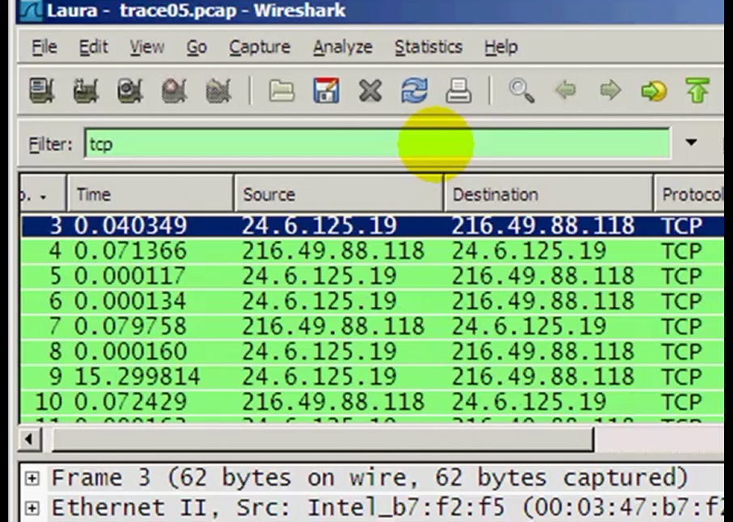
Lab

Slide 66
Lab
Recall that the handshake sequence is
SYN
SYN-ACK
ACK
Let’s look at each one
Expand the TCP header in each one

Slide 67
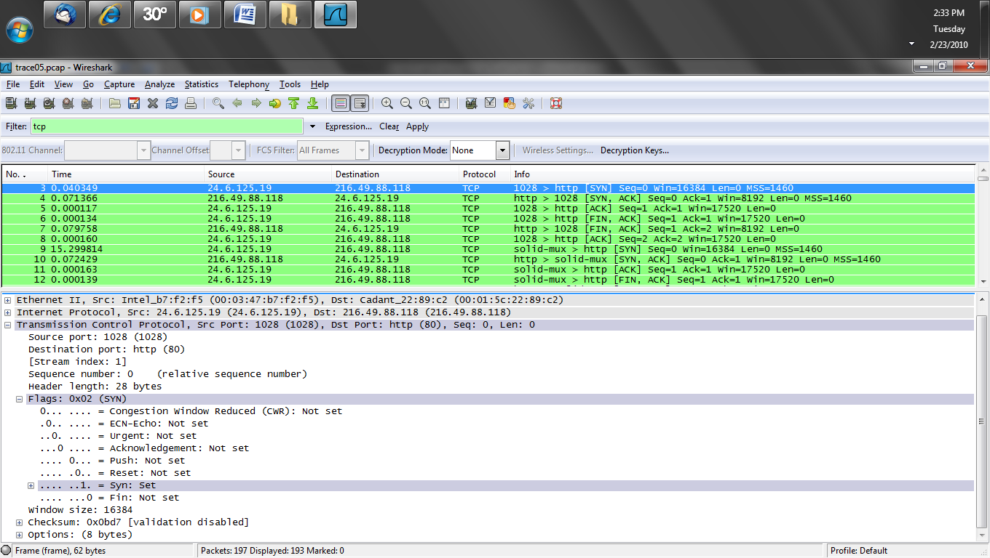
Lab

Slide 68
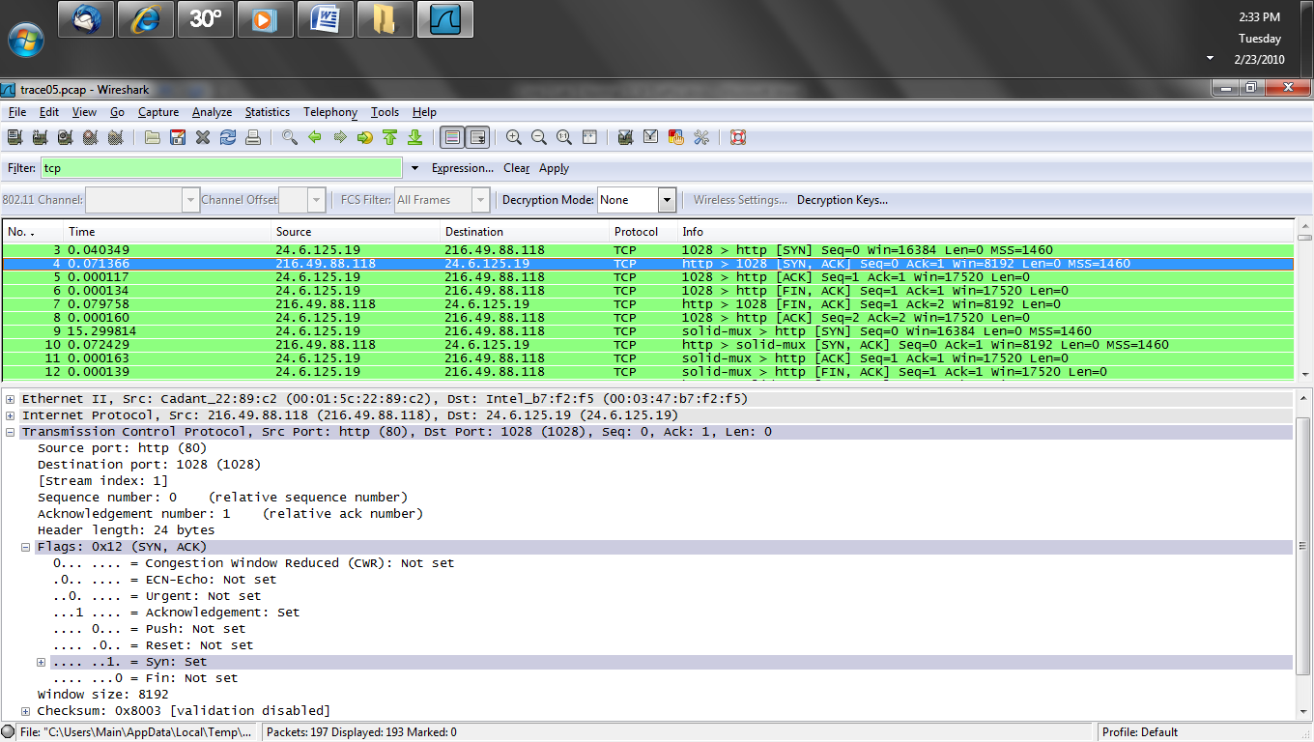
Lab

Slide 69
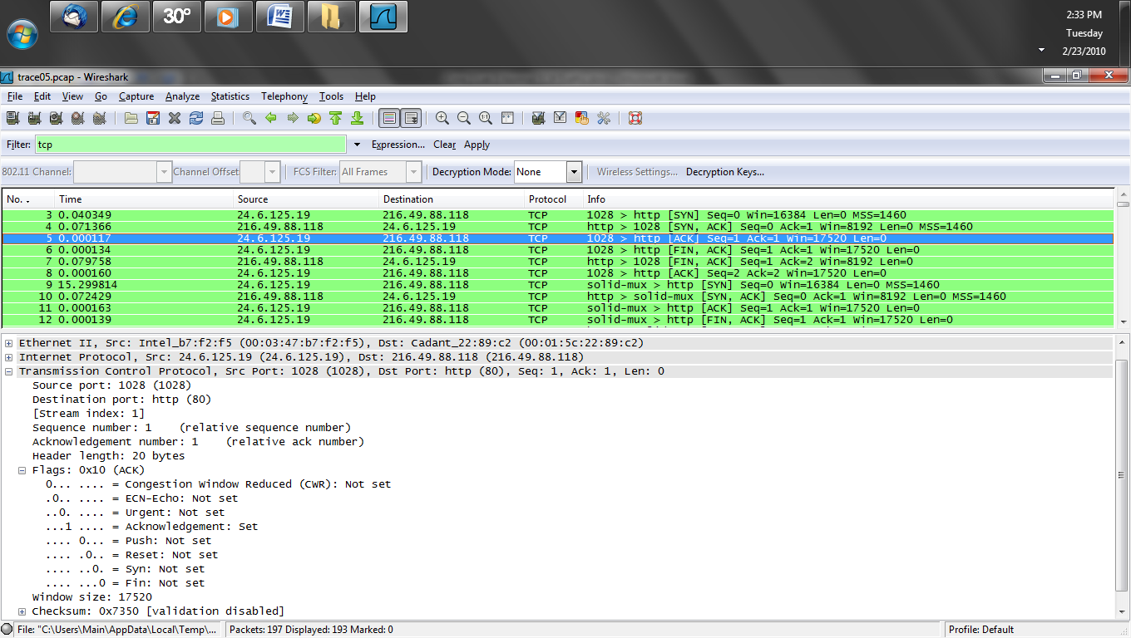
Lab

Slide 70
Connection Quality
A common metric of performance of the network application is the round trip time
This is the time from when the SYN is sent and the SYN/ACK is returned
This value is one of the things the sending TCP stack uses to determine how much data should be offered to the network
If the RTT is low, the network appears to be fast

Slide 71
Connection Quality
If the RTT is high, the network or the server appears to be slow and the TCP stack will adjust accordingly

Slide 72
Measure RTT
One way to examine this is to use the Round Trip Time graph in Wireshark
This graph created by Wireshark gives a good overall view of the time for a client request to reach the server
If there is a delay it does not say where the delay occurred
But it does show whether further investigation is called for

Slide 73
Lab
Start Wireshark
Let’s do this lab developed by Laura Chappell
Open download-good.pcap
Pick a server to client packet
Select
Statistics – TCP Stream Graph – Round Trip Time Graph

Slide 74
Lab
In this example there is a delay that causes the axis to set itself to 200 milliseconds
There is a set of packets at 130 milliseconds
The majority are at the bottom

Slide 75
Lab

Slide 76
Lab

Slide 77
Lab

Slide 78
Lab
Vertical strips in a graph like this are another indication of a problem
This is due to packet loss and a high number of duplicate ACKs
This also occurs when data is held by a router, then released

Slide 79
Lab
Start Wireshark
Open download-bad.pcap
Create the same type of graph
A one second Y axis is very bad

Slide 80
Flow of Data
TCP has a long list of rules that the sending and receiving protocol software must follow
The method used in the complete implementation of the protocol is beyond the scope of this document

Slide 81
Flow of Data
However, here are a few of the rules that help in understanding the relationship between how TCP behaves and the network performance
Delayed acknowledgements occur when packets are received out of order, the last segment isn’t acknowledged until the missing segments are received

Slide 82
Flow of Data
If a sender doesn’t receive an acknowledgement of a segment, it doesn’t immediately resend the segment as it could still be in transit
It waits until it receives three duplicate acknowledgements of the previously received segment
At that point it assumes the next segment was lost and proceeds with the retransmission

Slide 83
Flow of Data
To do this it uses a technique called slow start
In this procedure one or two segments are sent and the acknowledgements are awaited
If they return quickly, the sender increases the block size - the number of segments it sends simultaneously

Slide 84
Flow of Data
It will continue to increase the block size until one of two things happens: either there is a time out because an acknowledgement isn’t received, such as when a segment has been discarded, or the total data sent is one-half the receiver’s advertised window value

Slide 85
Flow of Data
This example points out several important features of applications that are using TCP
First, they will appear to adapt to the speed of the network
If the response of the server and the speed of the network are both good, TCP sends more and more data until either the link or the recipient has been saturated with information

Slide 86
Flow of Data
TCP reacts very aggressively when data is lost in that it slows way down
Now this slowing may be due to only a single bit being damaged
Yet if even one bit is damaged the entire frame is discarded
Therefore TCP is a poor choice for high error environments such as wireless links and poorly cabled networks

Slide 87
Flow of Data
Yet we have no other choice than to use it, even there
This slow down could also be due to a slow application or slow server rather than a slow network
For example in the last lab you could see that

Slide 88
Flow of Data
If the server was quickly processing the incoming data, it would respond on or before the 200 ms wait time
Instead, the server uses 230 ms to acknowledge that it received the two segments
Then it sends ACK3
In step three, the client’s calculation of round trip time (RTT) tells TCP that this situation involves either a slow network or slow server

Slide 89
Flow of Data
One of the two is not operating optimally
So, rather than increase its outgoing number of segments as it did in the other examples, the client sends two segments again, segments four and five
In step 3, the server is still operating sub optimally, so it takes it 280 ms to determine that it received two more segments
Then the server sends ACK5

Slide 90
Flow of Data
In the final step illustrated, step 4, the client still realizes the RTT is high, so it proceeds to send only two segments again
After these segments are delivered, if the server would happen to increase its performance, the RTT would be a lower value
The client’s calculation would indicate that it can increase the number of simultaneous segments it is sending

Slide 91
Flow of Data
This example points out an additional important point
A subtle point is illustrated by the fact that the client never aggressively increased the number of segments being simultaneously sent
This indicated slowness somewhere
The turn-around time at the server was high

Slide 92
Flow of Data
This indicated an inability to keep up with the rate at which it was receiving data
It is obvious that the server is the issue here

Slide 93
Lab
Let’s look at this flow of data process and what it looks like when it goes wrong
Start Wireshark
Open download-bad.pcap
The information in the Expert Composite Info window provides areas to examine to narrow down the problem

Slide 94
Lab
To see the expert analysis click on the yellow circle at the lower left corner of Wireshark
The expert window pops up

Slide 95
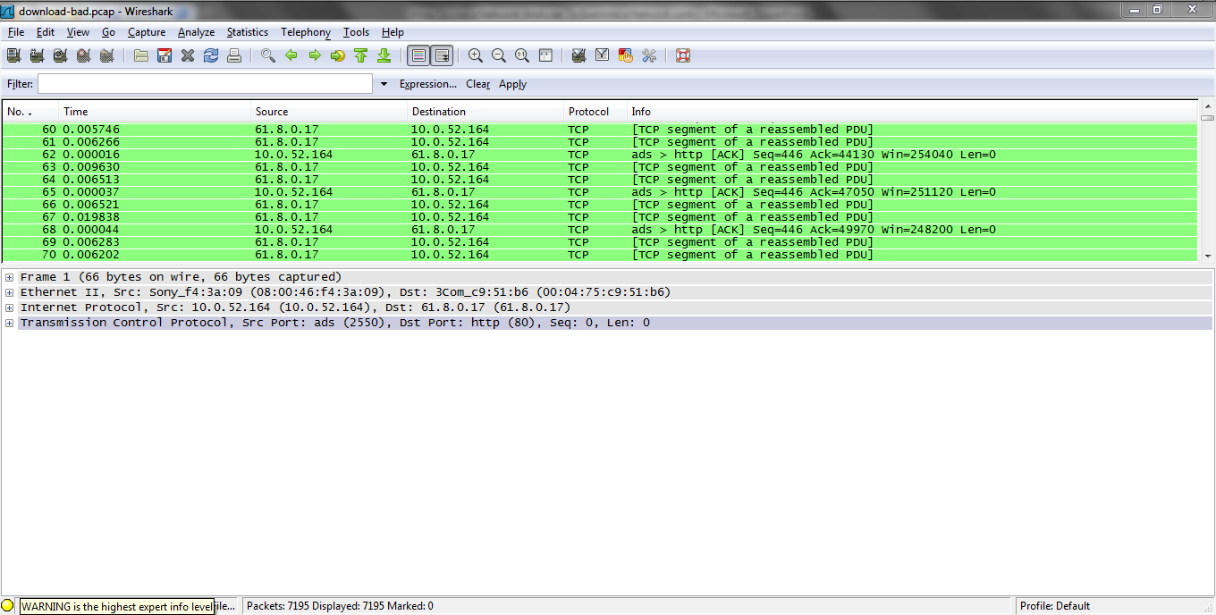
Lab

Slide 96
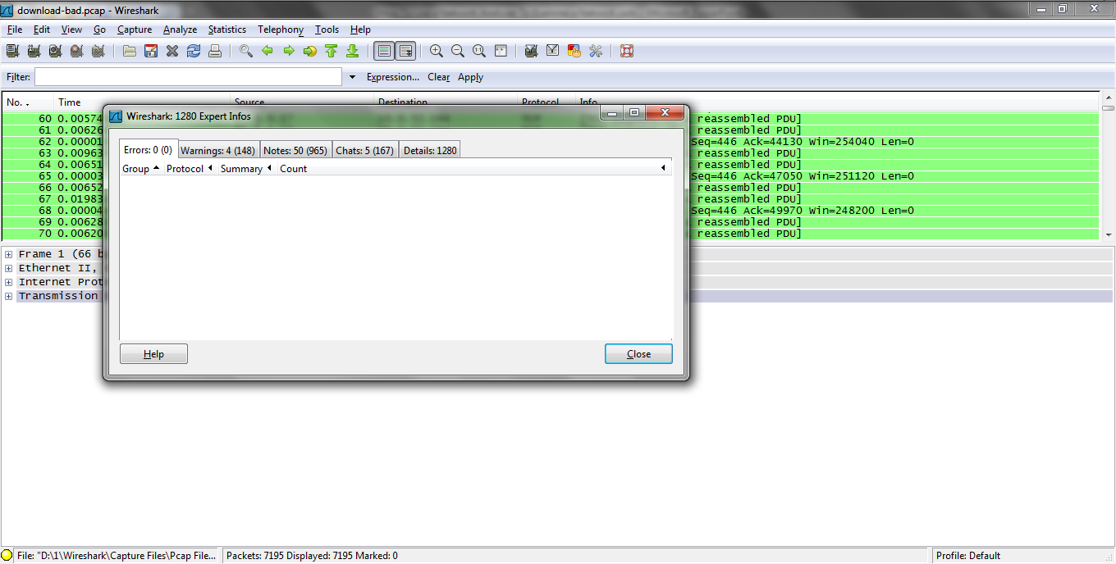
Lab

Slide 97
Lab
Look at what it say under the Notes tabs, duplicate ACKs are sent when an expected packet is not received
The receiver asks for it again by acknowledging the packet prior to the missing packet

Slide 98
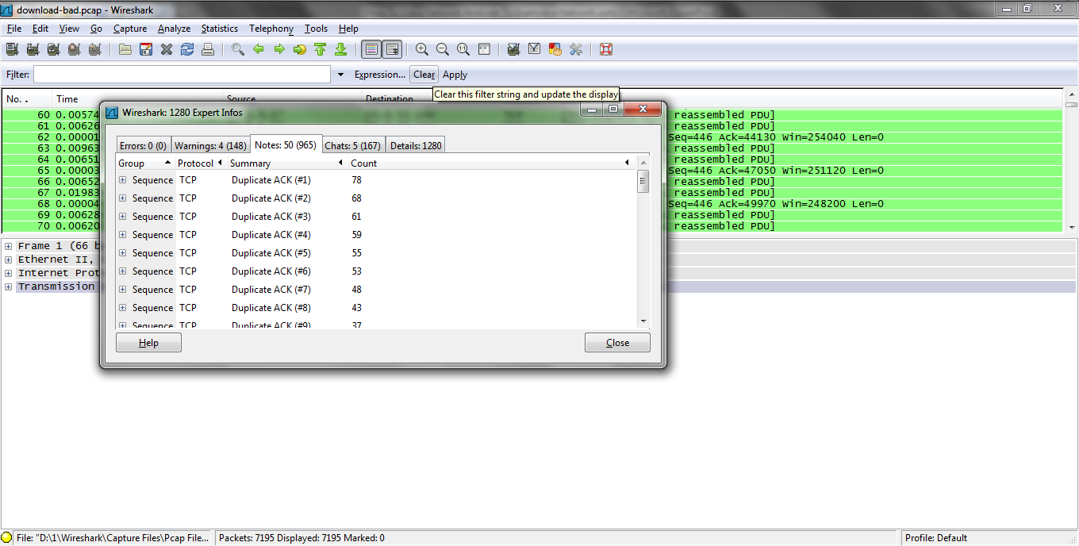
Lab

Slide 99
Lab
Keep Alive packets keep the connection up when the window size is zero
Expand one of these
Click on it to go to the packet in Wireshark

Slide 100
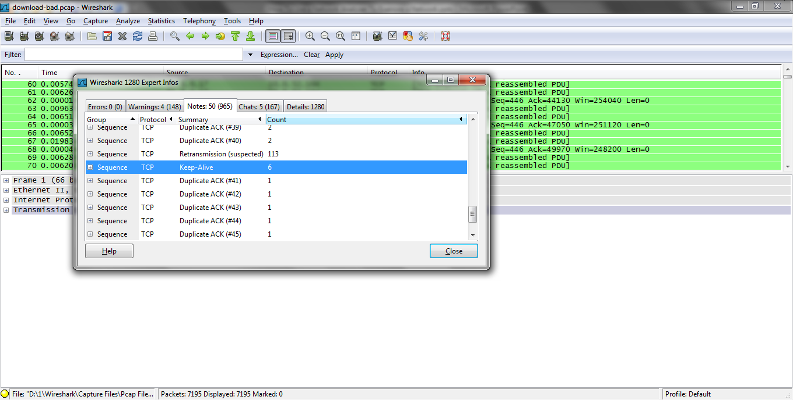
Lab

Slide 101
Closing the Connection
The last step is to close the TCP connection
This usually works without problem

Slide 102
Isolating the Problem Domain
If the problem appears to be in part of the network the next question is in what part
In other words the exact problem domain needs to be isolated
Let’s see this procedure in operation

Slide 103
Lab
Start Wireshark
Open the trace02.pcap file
In this lab an example of how to determine where a problem exists in the network is illustrated
Isolating the problem domain using Wireshark on a full duplex network can be difficult as only one side of the conversation is seen

Slide 104
Lab
An aggregating tap is a better way to collect the data for this type of analysis
If one is not available this method can be substituted
The indication being looked for is when a retransmission is seen, was the original frame also seen

Slide 105
Lab
If it is, then packet loss has not yet occurred
The problem is downstream from where the analyzer is currently connected to the network
Upstream is toward the sender of the data
Downstream is the receiver direction

Slide 106
Lab
To isolate the device or link causing the problem move the analyzer from section to section from the sender end down toward the receiver end until you no longer see both the original packet and the retransmission
When you only see the retransmission this is the area of the problem

Slide 107
Lab
As you are now downstream from the packet loss
To do this go to the expert composite window
Under the Notes tab select a retransmission warning packet
Highlight the sequence number in the TCP header

Slide 108
Lab
Use this to create a filter by selecting the sequence number line, then right click and select Apply as Filter - Selected
If any other packets show then we have seen both the original and the retransmitted segments in this section
Therefore we are upstream from the problem area

Slide 109
Lab
If we do not, then we are downstream
In that case we need to move upstream toward the sender end

Slide 110
Lab

Slide 111
Filtering for Retransmissions
Another way to look for retransmissions is to use a display filter
tcp.analysis.retransmissions
For the trace02.pcap file this display filter shows this

Slide 112
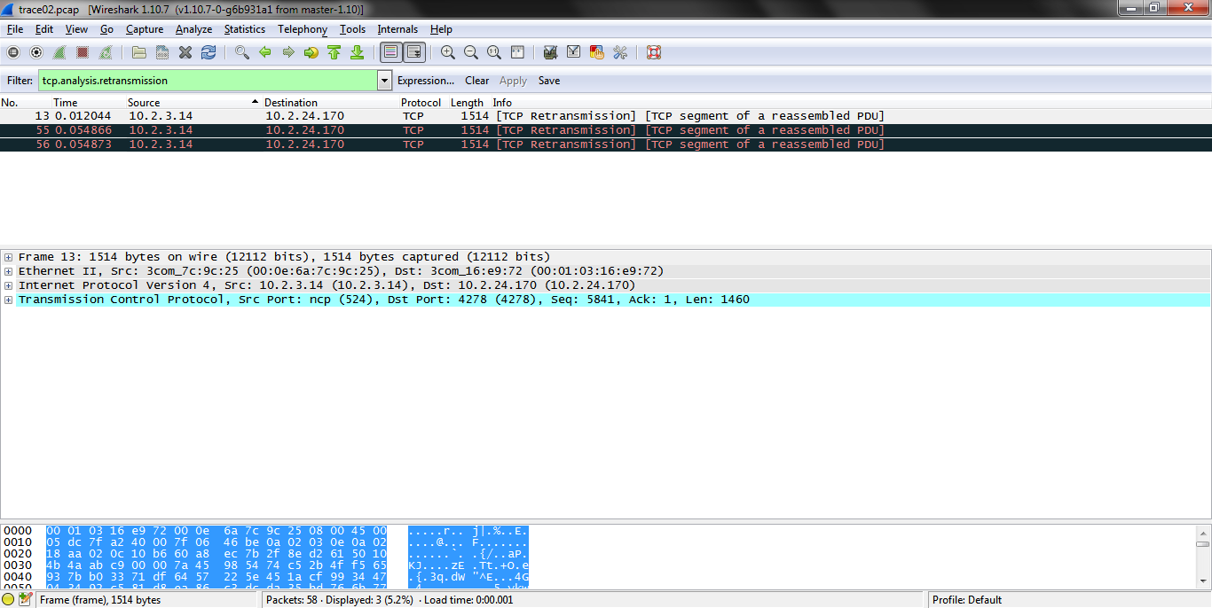
Filtering for Retransmissions

Slide 113
Filtering for Retransmissions
The area of interest is seen when the fields under TCP and [SEQ/ACK analysis] is expanded
This shows the following

Slide 114
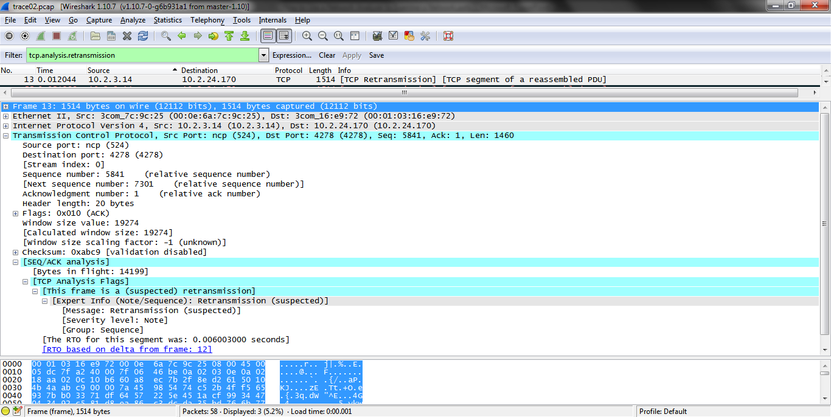
Filtering for Retransmissions

Slide 115
Filtering for Retransmissions
Look at the lines under TCP Analysis Flags
The time since the original frame is retransmitted is .006 in this example
Below this is the frame that was retransmitted is shown
It is 12 here

Slide 116
Filtering for Retransmissions
Typically the Retransmission Time Out (RTO) timer will be around 0.2 seconds for local connections, and up to 0.3 to 0.4 seconds for international connections

Slide 117
How Applications Fail
As mentioned above applications can fail due to several factors such as
DNS Failures
ARP Failures
Routing Problems
Problems Creating a Connection
Slow Responses

Slide 118
DNS Failures
When a client application needs the address of a server, its DNS software called the resolver creates a query and forwards it to the local DNS server
The local DNS server is normally listed in its IP configuration

Slide 119
DNS Failures
If the local DNS server knows the address corresponding to the name, the server returns it and we say the name has been resolved
If the local DNS server does not know the name, it has two choices: forward the query up the tree to the next DNS server or ask each server successively going up the tree to resolve the name on its behalf

Slide 120
DNS Failures
Either way this takes time and slows the connection attempt
As discussed above improper listing of the DNS server IP addresses will slow this process

Slide 121
Lab
Let’s look at normal DNS traffic
Start Wireshark
Open trace03.pcap
Filter for just DNS traffic

Slide 122
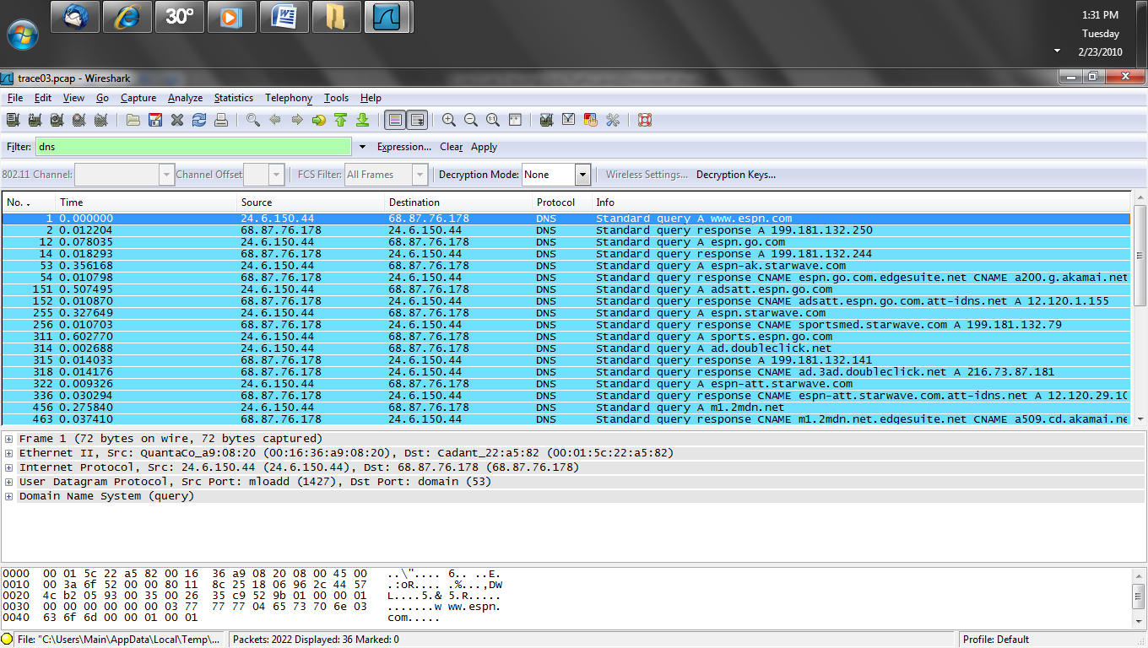
Lab

Slide 123
Lab
Let's look at the first packet
This is a standard recursive query asking for the IP address of www.espn.com
At the bottom of this section are the four main DNS questions

Slide 124
Lab
These are
Questions
Answer Resource Records
Authority Resource Records
Additional Resource Records
Next is a response packet
Note Questions is set to 1 and Answers is set to 1

Slide 125
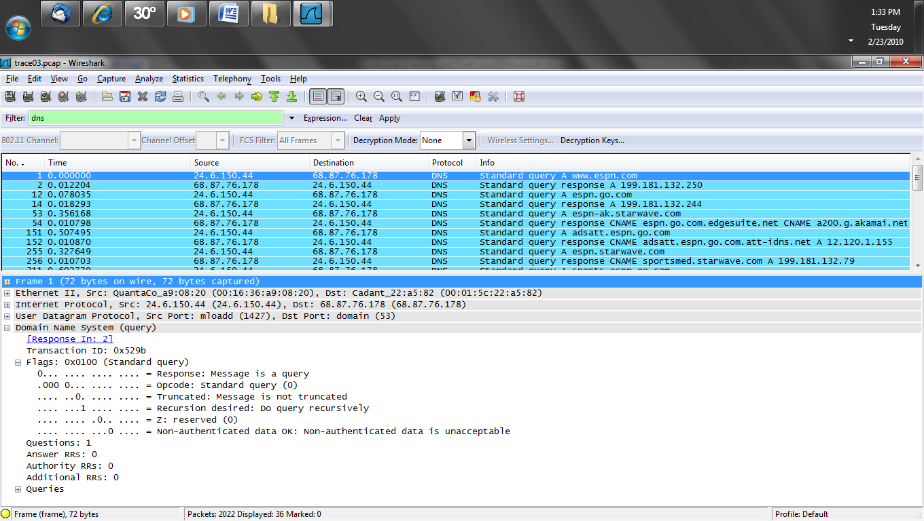
Lab

Slide 126
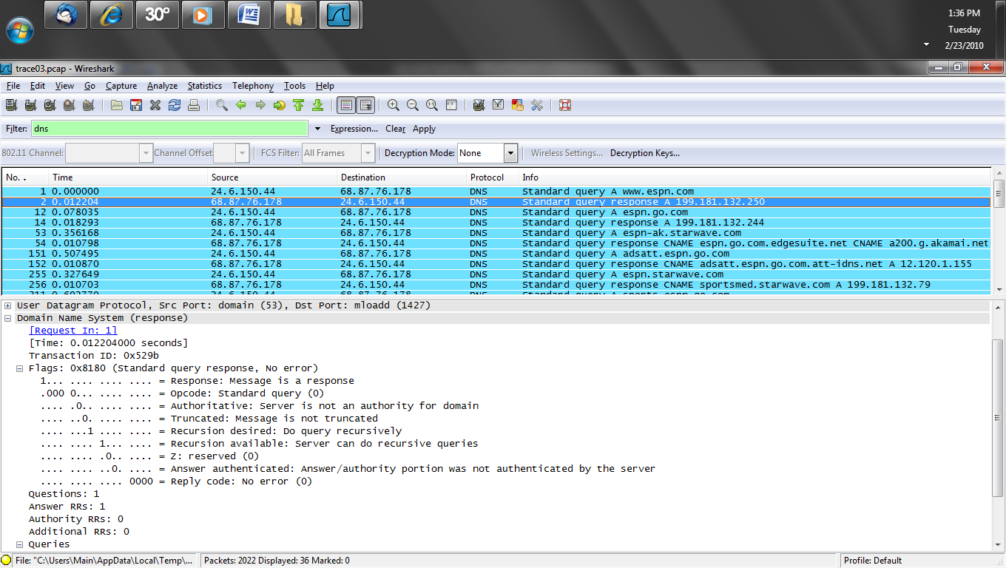
Lab

Slide 127
Lab
In packet 54 we can see a conical name response
This is where the DNS query asks for a site, but the site says no, go here instead
In other words it redirects it to another web server for what it wants

Slide 128
Lab
This is common for sites where the data is placed on distributed servers nearer to the user, such as on the Akamai network

Slide 129
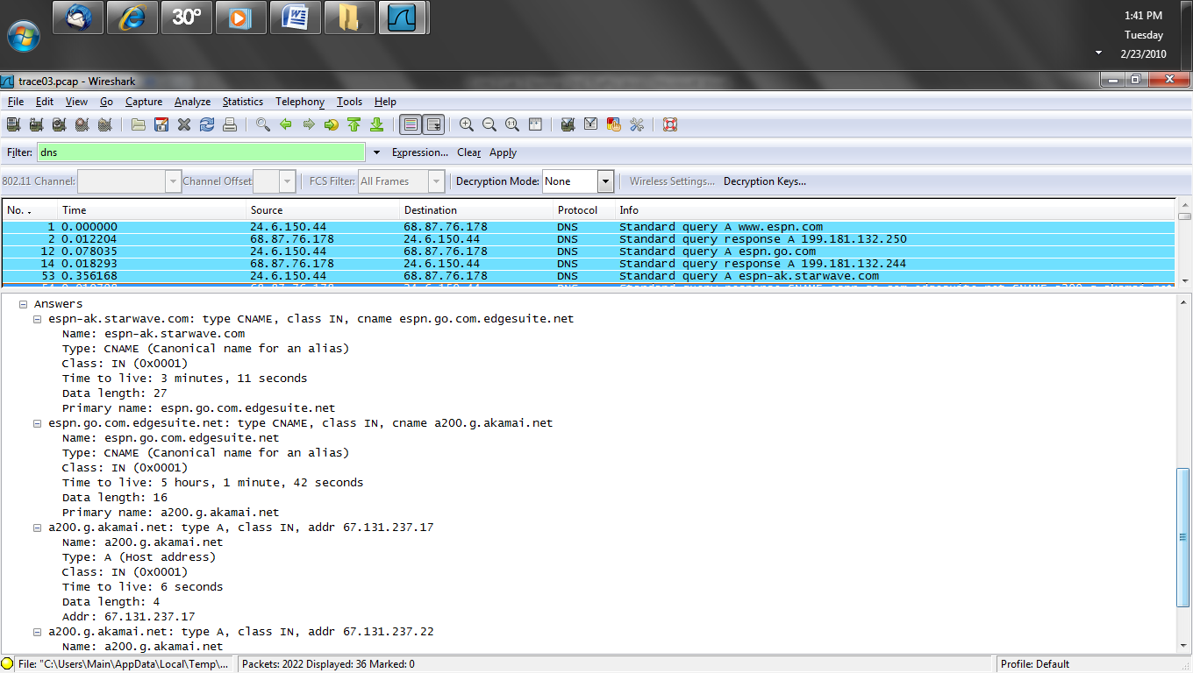
Lab

Slide 130
Lab
Next we will examine abnormal DNS traffic
Start Wireshark
Open trace12.pcap
In this example the client tries all three DNS servers it has received an IP address for from the DHCP server
As you can see none of them respond

Slide 131
Lab
In this specific case the problem was a misconfigured router

Slide 132
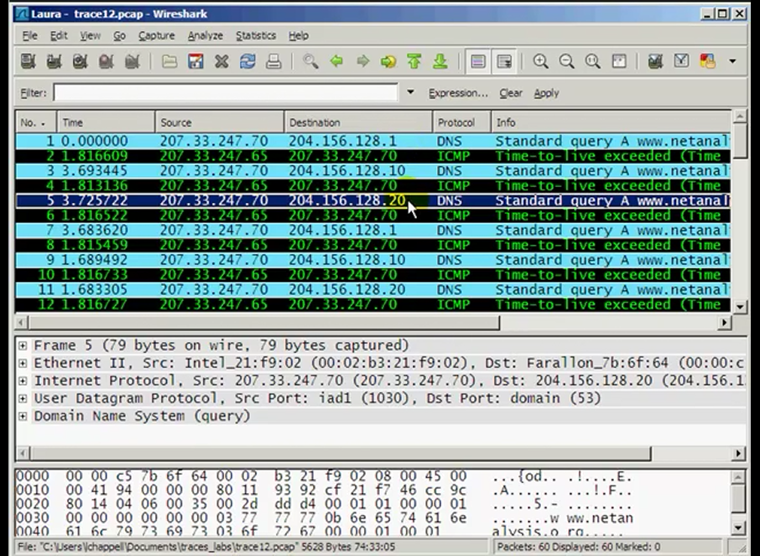
Lab

Slide 133
ARP Failures
When ARP fails it is commonly due to duplicate IP addresses or the wrong IP address for the default gateway listed in the configuration

Slide 134
Routing Failures
Routing failures can be due to several factors such as
Poor route selection over unreliable or slow links
Poor selection of the routing protocol used
Routers discarding packets
A router might discard a packet due to corruption in the packet or more insidiously due to the router being overloaded

Slide 135
Connection Creation
The most common problem here is the client asking for a service the server does not provide
When this occurs the client specifies a port for a service, the server ignores the request as that port is not open on the server

Slide 136
Looking for Causes
What tools and procedures do we use then to determine why we are seeing these sorts of errors
The first thing to do is to eliminate the network as the cause of the problem
Doing this involves looking for the problems discussed above
Let’s see how we do this

Slide 137
TCP/IP Stack Configuration
First check to see if the values the client has are correct
IP address
Subnet mask
Default gateway
DHCP server
DHCP lease time
DNS server addresses

Slide 138
TCP/IP Stack Configuration
These values are checked from the command line with
ipconfig /all

Slide 139
Lab
If these values are incorrect then perhaps the DHCP process needs to be examined
In this lab we will look at a normal DHCP process
Start Wireshark
Open the trace04.pcap
Here is a normal DHCP exchange

Slide 140
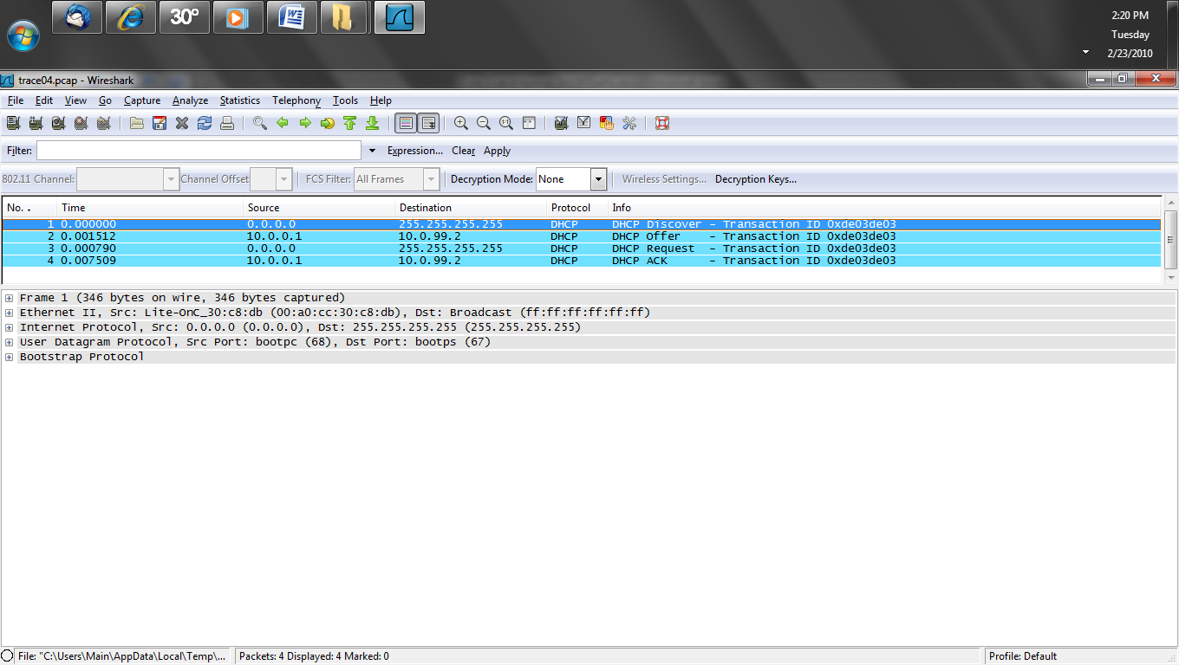
Lab

Slide 141
Lab
If the device has never received an IP address or if it is outside of the lease time then all four of the frames shown above will exist
If the device is still inside of the lease time when it boots up, then only the Request and ACK will be seen
The same Transaction ID number is used for the entire process

Slide 142
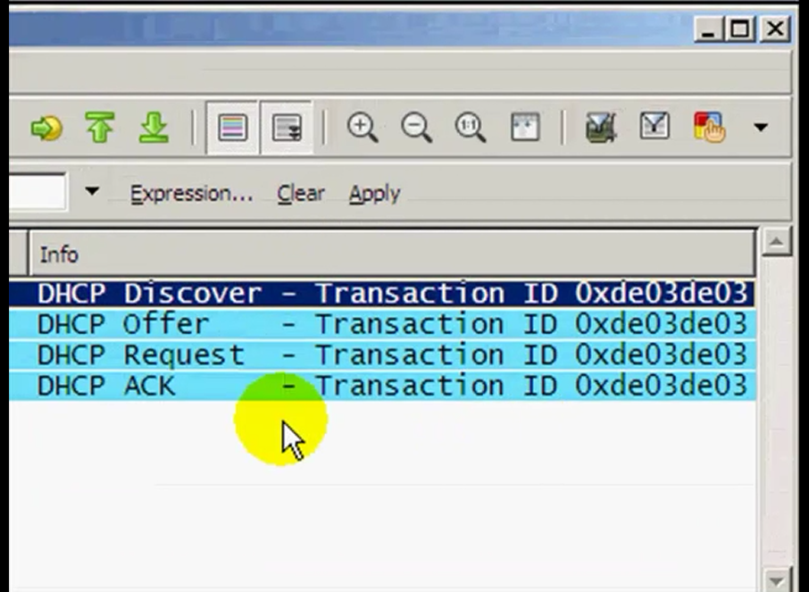
Lab

Slide 143
Lab
Here are the details of the DHCP Request
The Parameter Request is the additional information the device wants from the server if the server can supply it

Slide 144
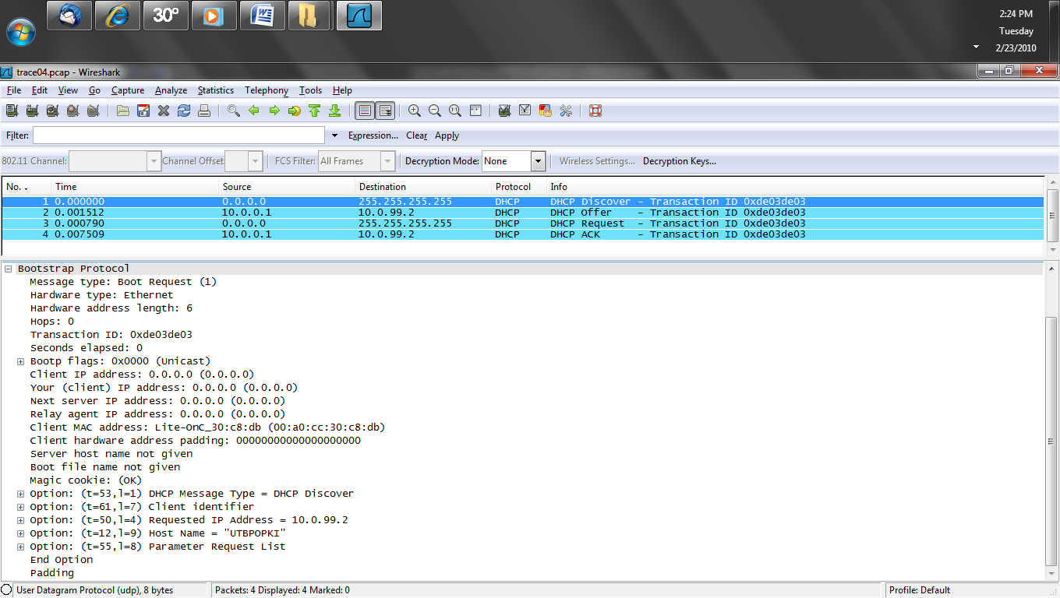
Lab

Slide 145
Lab
Here is the initial response Offer
The IP address in this Offer is the address being offered to the client in this case 10.0.99.2
The hops field shows how far away the DHCP server is and the address of the relay agent if one is needed
In this case the server is on the same network as the hop count is 0

Slide 146
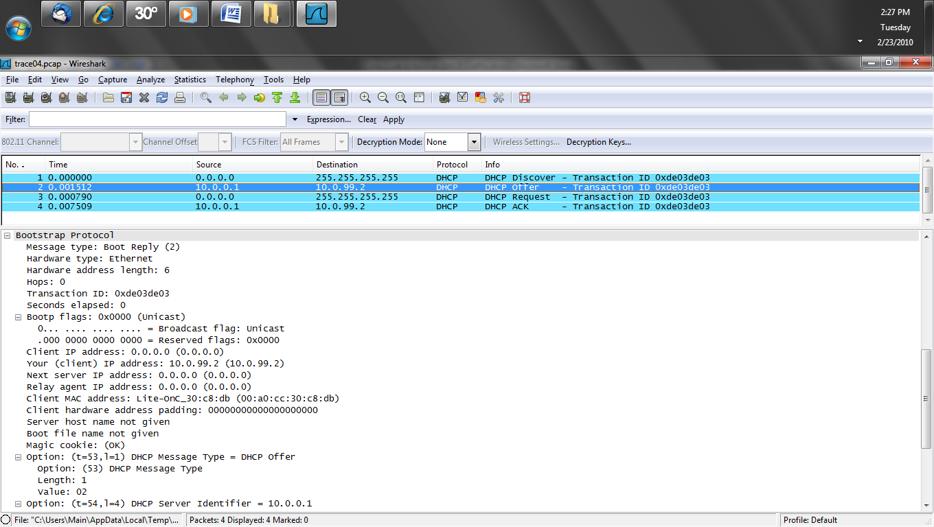
Lab

Slide 147
Lab
The device says fine, let me have that address

Slide 148
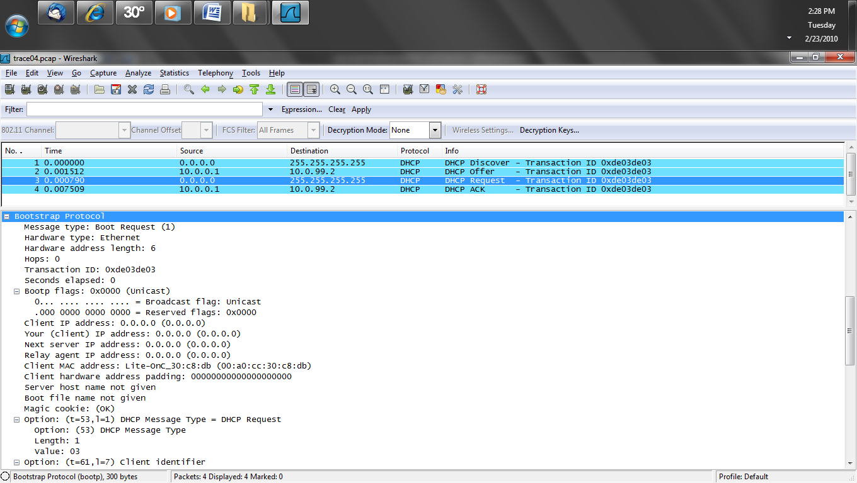
Lab

Slide 149
Lab
The server says ok here it is
The only thing provided in the Offer is the IP address
Now the rest of the information the client wanted that the server can provide is given to it in the ACK

Slide 150
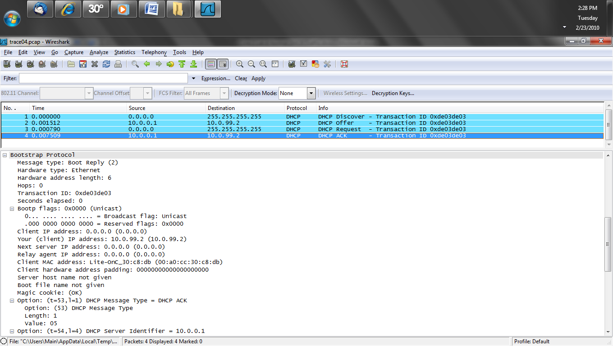
Lab

Slide 151
Lab
A clue that the DHCP server or the connection to it is experiencing some problem would be the appearance of more than one Discover from the client
Each Discover would have a different process ID
Typically any eventual answer to the first Discover that timed out would be ignored by the client

Slide 152
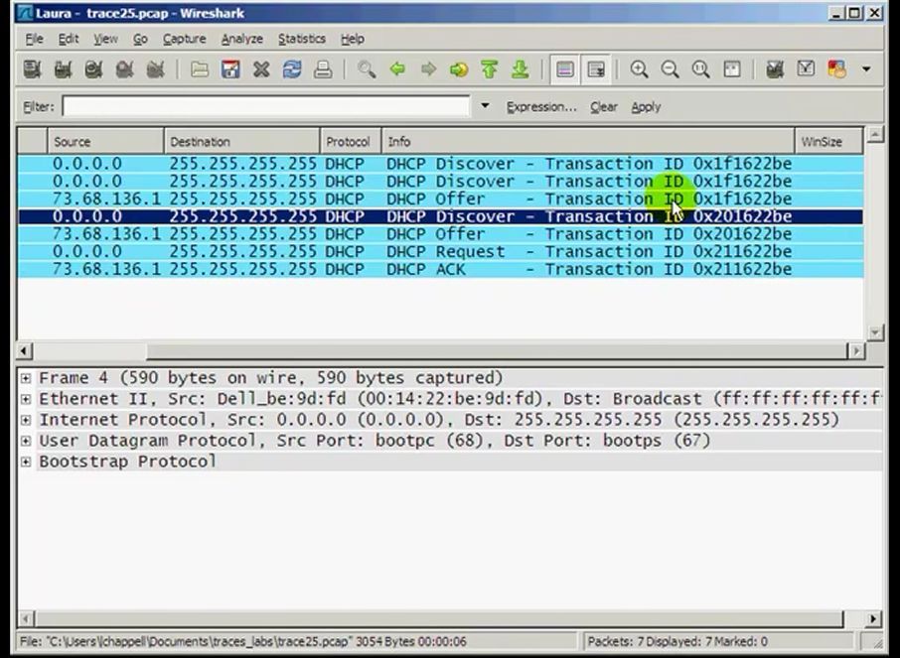
Lab

Slide 153
Lab
If the device is within its lease time a Discover is not sent, just a Request

Slide 154
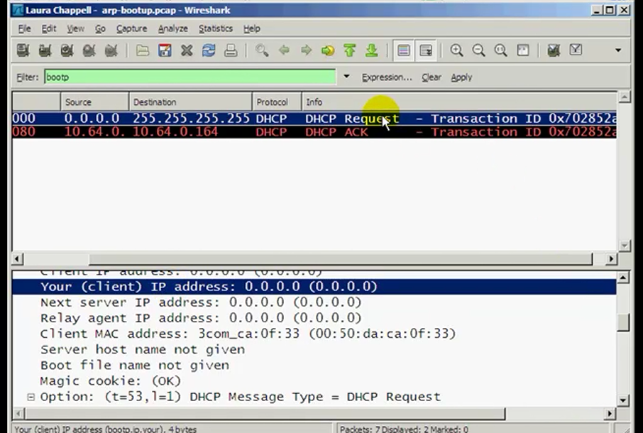
Lab

Slide 155
Lab
Start Wireshark
Open dhcp-renewtorebind.pcap
When the lease is about to expire the client attempts to renew the lease
After 50 percent of the lease time has expired the client sends a Request
If the server is going to renew the lease it returns an ACK

Slide 156
Lab
If the client does not receive an ACK at 50 percent, then at 87.5 percent it attempts rebinding
This is where the client looks for another DHCP server
The client makes two requests to the original DHCP server
Then it broadcasts four requests for the same server

Slide 157
Lab
Finally to starts the process again with a Discover frame

Slide 158
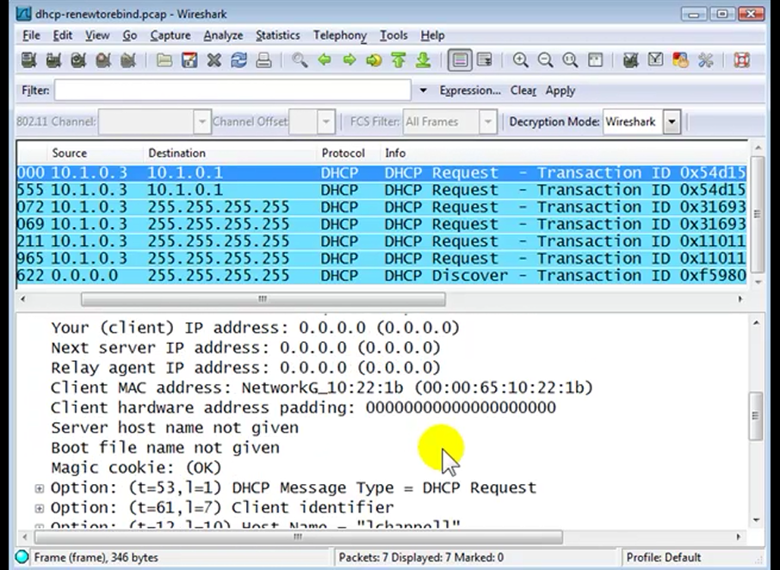
Lab

Slide 159
Lab
Start Wireshark
Open arp-bootup.pcap
After receiving the address the client will use a series of Gratuitous ARP requests to see if anyone else is already using that address

Slide 160
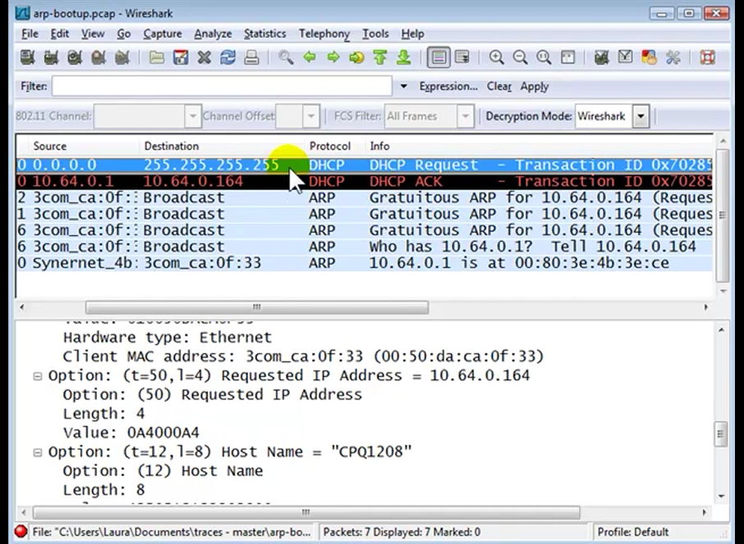
Lab

Slide 161
Lab
Notice that the sender and target IP addresses are the same
This is a gratuitous ARP

Slide 162
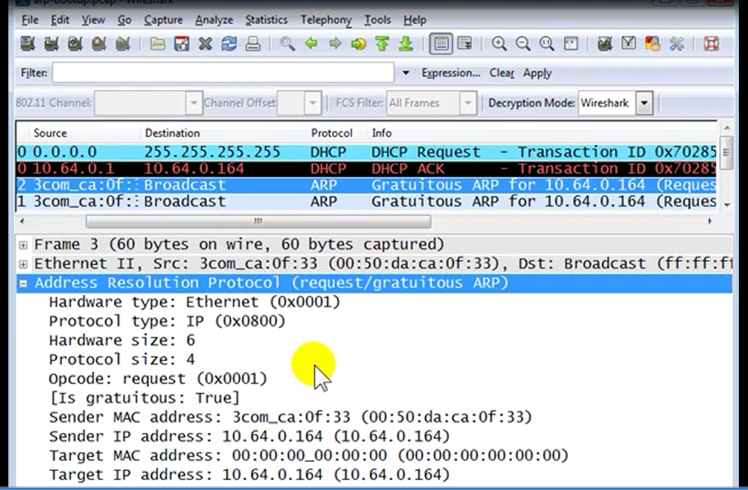
Lab

Slide 163
Finding Rogue DHCP Servers
Wireshark can be used to find rogue DHCP servers by capturing the stream of frames back and forth from the client with the problem to the rogue DHCP server
Within this capture the MAC address of the rogue server can be seen
The MAC address tables of the switches can be queried to see what switch and port the rogue DHCP server is attached to

Slide 164
DNS Resolution
To see if DNS queries are being resolved properly use a command line tool
The command line tool for this is
nslookup
This is not always useful as nslookup is used by hackers so many servers ignore it

Slide 165
Isolating the Problem Domain
When the network is slow the cause might be the network, the server, the application running on the server, or the client
Here is an illustration from Laura Chappell showing this

Slide 166
Isolating the Problem Domain

Slide 167
Isolating the Problem Domain
Let’s look at these causes as well as application causes in more detail

Slide 168
Is the Network the Problem
The basic way to see if the network is the problem is to measure the Round Trip Time from end to end
This is the latency in the network
More than 40 milliseconds is too slow for most users
The worst they can tolerate is 100 milliseconds

Slide 169
Latency
To further examine why this Round Trip Time would be high let’s look at an example from a Laura Chappell presentation
The first six packets in this screenshot show the latency
The time from 1 to 2 show that there is network latency

Slide 170
Latency
See the difference from 1 to 2 is 167 milliseconds
The server is not the problem as after the ACK in 5 to the data flowing in 6 is very short at .002 milliseconds

Slide 171
Latency

Slide 172
Latency
Another indicator of latency would be a high number of duplicate ACKs indicating packet loss and high round trip latency

Slide 173
Latency
Changing the time setting through
View – Time Display Format
To Seconds Since Previously Displayed Packet can be useful to show high latency
Then sort this column to identify frames with large delays between them

Slide 174
The Equipment Used
If the equipment such as the routers and switches used in the network cannot handle the load of the packets and frames flying around the media, then drops will be common
Further, misconfigurations and poorly chosen routing protocols can also cause delays

Slide 175
The Server as the Problem
If the slowness is not in the network, then the cause may be the server
The time from the initial GET to the server’s ACK is an indication of the server response time
In this example, there is a .15554 second delay before the GET is responded to with an ACK from the server

Slide 176
The Server as the Problem

Slide 177
The Server as the Problem
So any delay is not due to the server being slow to fulfill the client request

Slide 178
The Server as the Problem
Another indication of the server being the problem is a large delay between the ACK after the GET and the initial flow of data
A delay here may be due to processor latency
As Chappell shows

Slide 179
The Server as the Problem

Slide 180
The Server as the Problem
In this example the data begins flowing within .001938 seconds as seen in packet 6

Slide 181
The Server as the Problem

Slide 182
Lab
Let’s look at some normal server responses to a request
We will look at normal traffic for
HTTP
POP
SMTP

Slide 183
Lab
Start Wireshark
Open trace06.pcap
After the usual TCP handshake process seen in the first three packets the client issues a GET for the HTTP data it wants
Then the details of the GET are shown

Slide 184
Lab
Next the server says the information has been moved, which does not always happen, but is also not unusual
Finally the server says, here is the data
The last step is the signoff, the details of which can vary

Slide 185
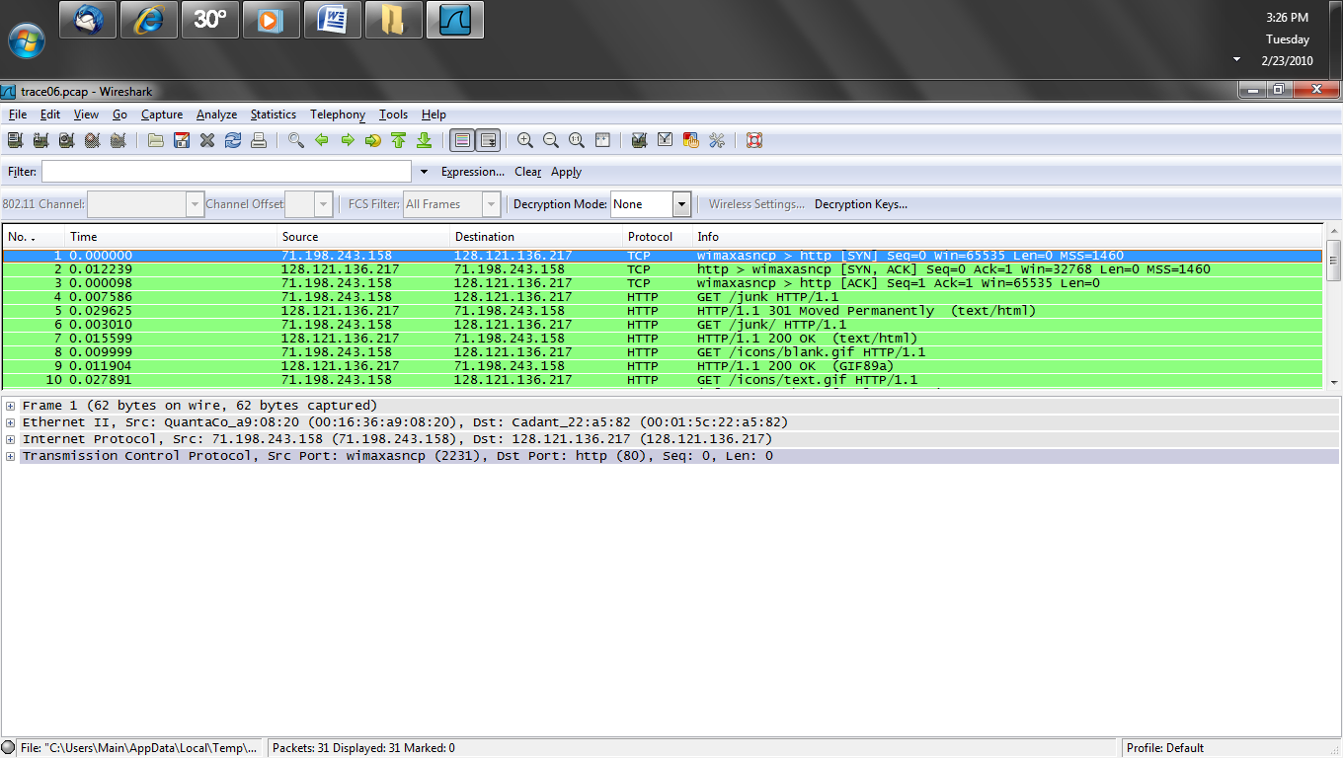
Lab

Slide 186
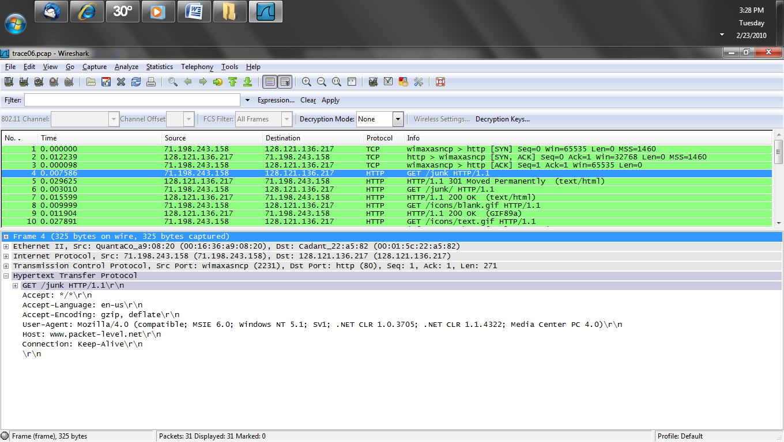
Lab

Slide 187
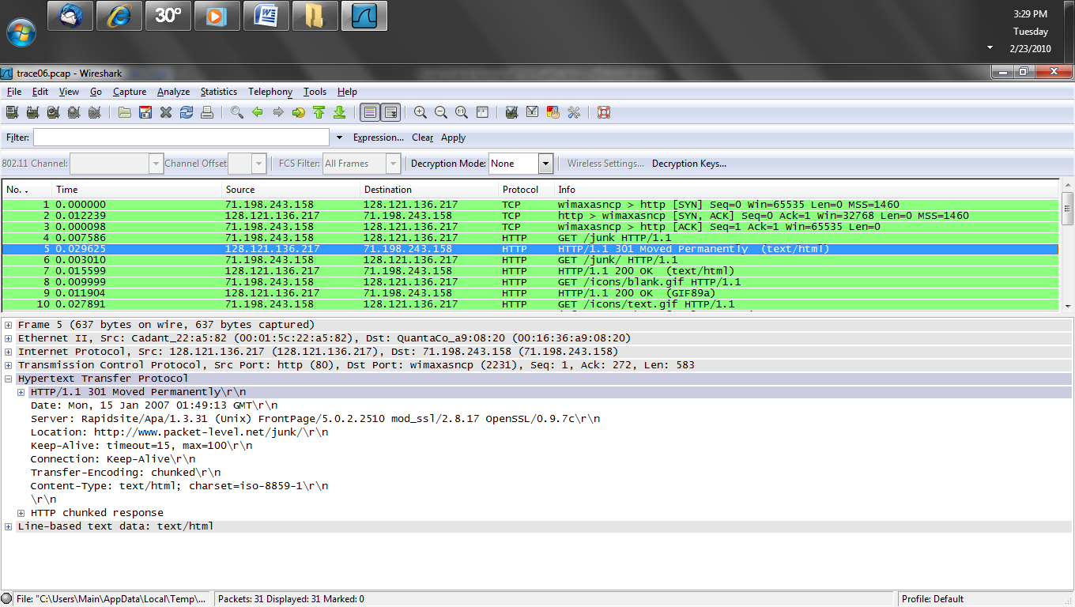
Lab

Slide 188
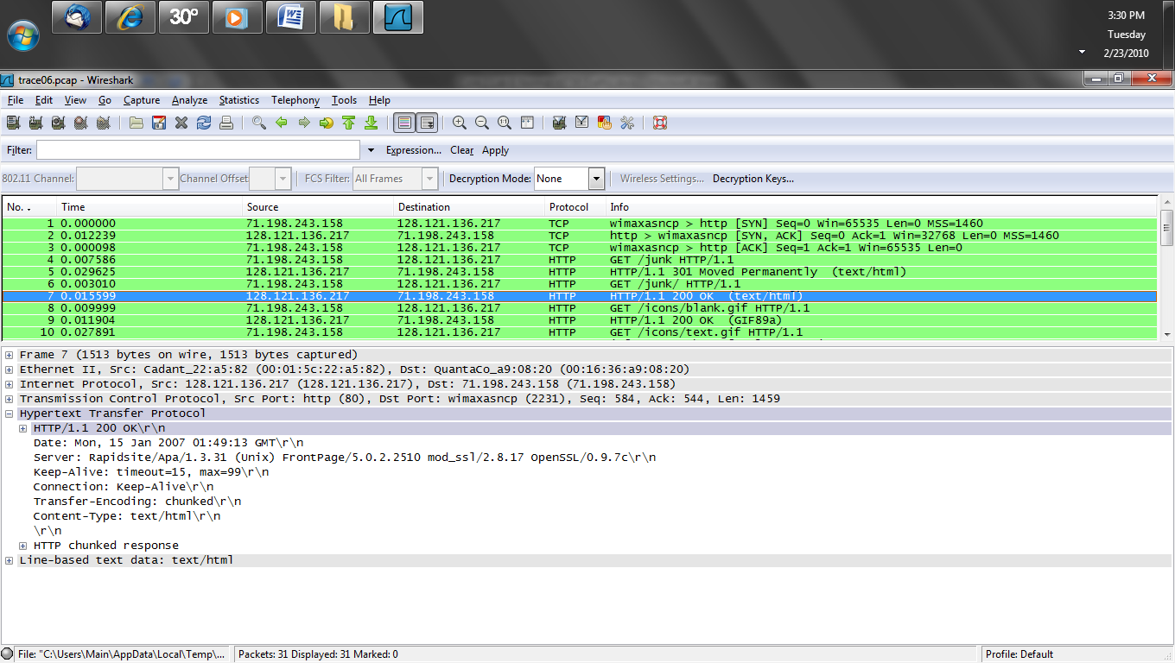
Lab

Slide 189
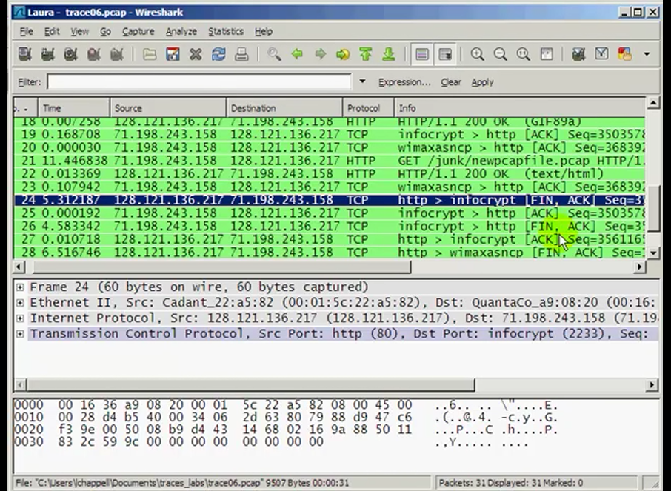
Lab

Slide 190
Lab
Now for normal POP traffic
We will use a function of Wireshark called Follow Stream to make seeing the entire process easier
Start Wireshark
Open trace08.pcap
The connection is made
Here is the start of the process

Slide 191
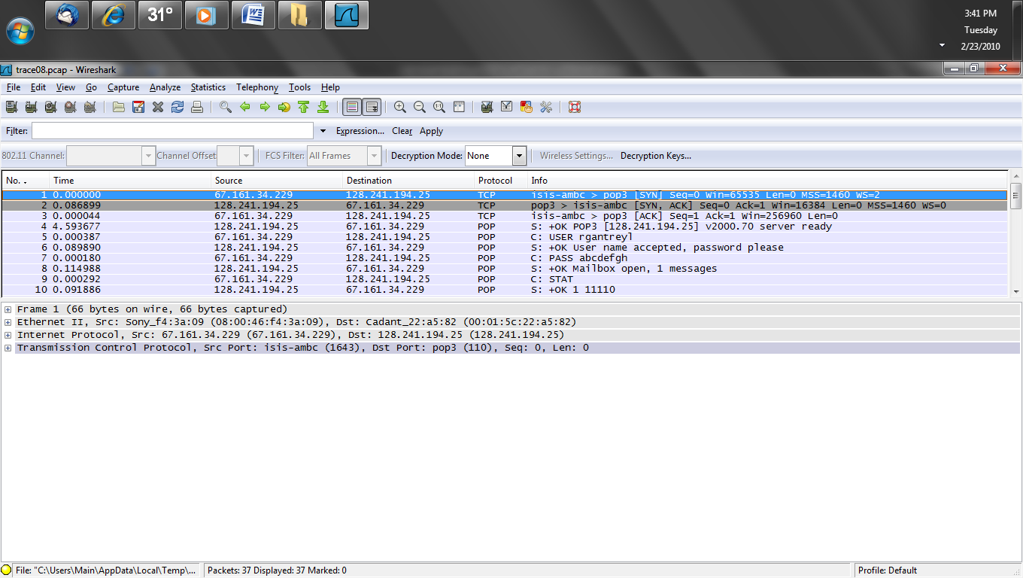
Lab

Slide 192
Lab
Select the top packet
Right click and select Follow TCP Stream to see the entire process POP uses

Slide 193
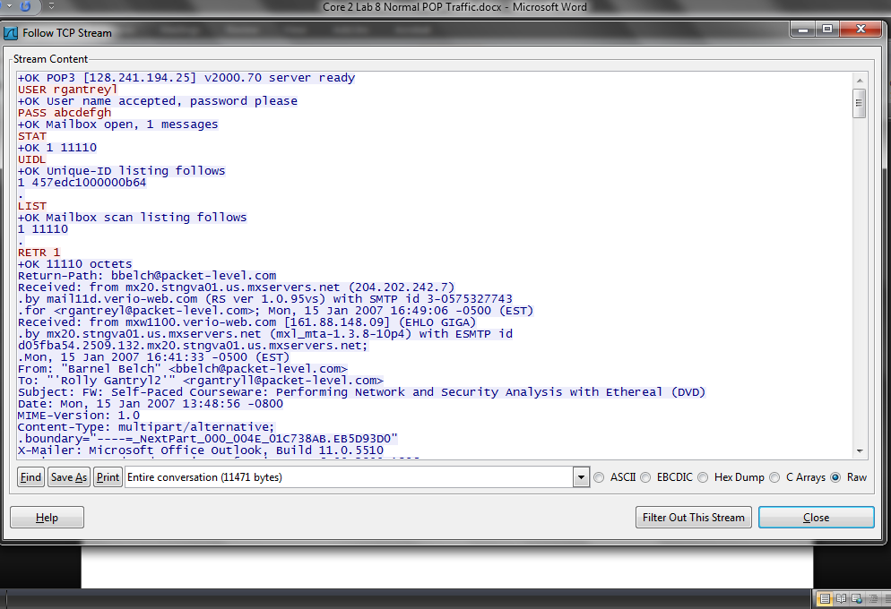
Lab

Slide 194
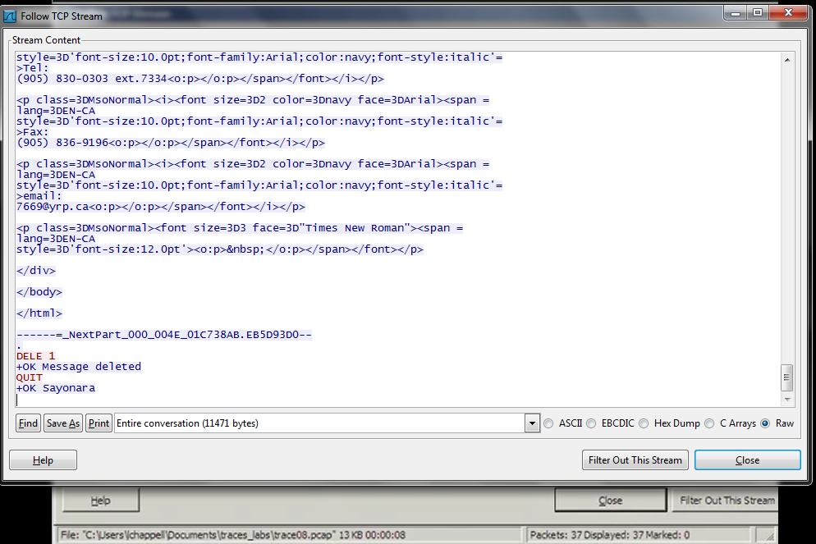
Lab

Slide 195
Lab
Now for normal SMTP traffic
We will use the same Follow Stream function to make seeing the entire process
Start Wireshark
Open trace09.pcap
The connection is made
Here is the start of the process
Then data flows

Slide 196
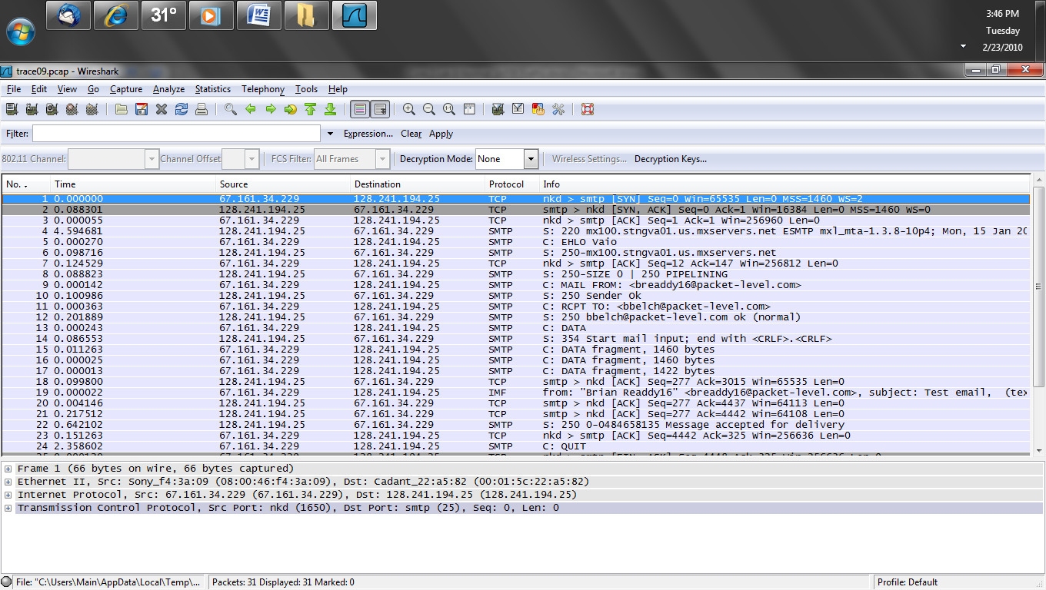
Lab

Slide 197
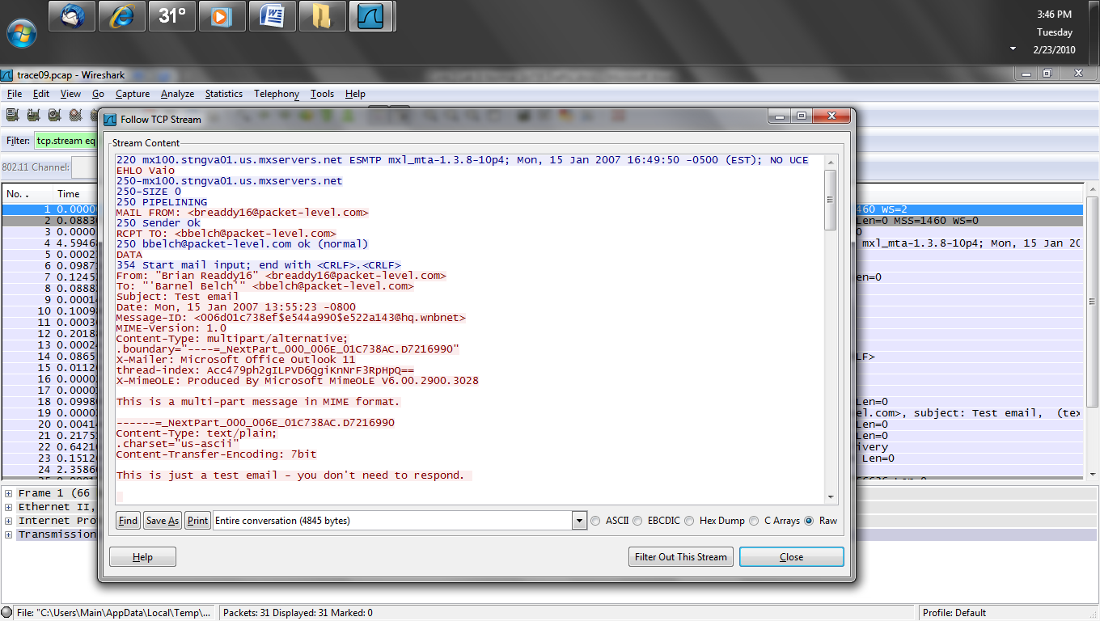
Lab

Slide 198
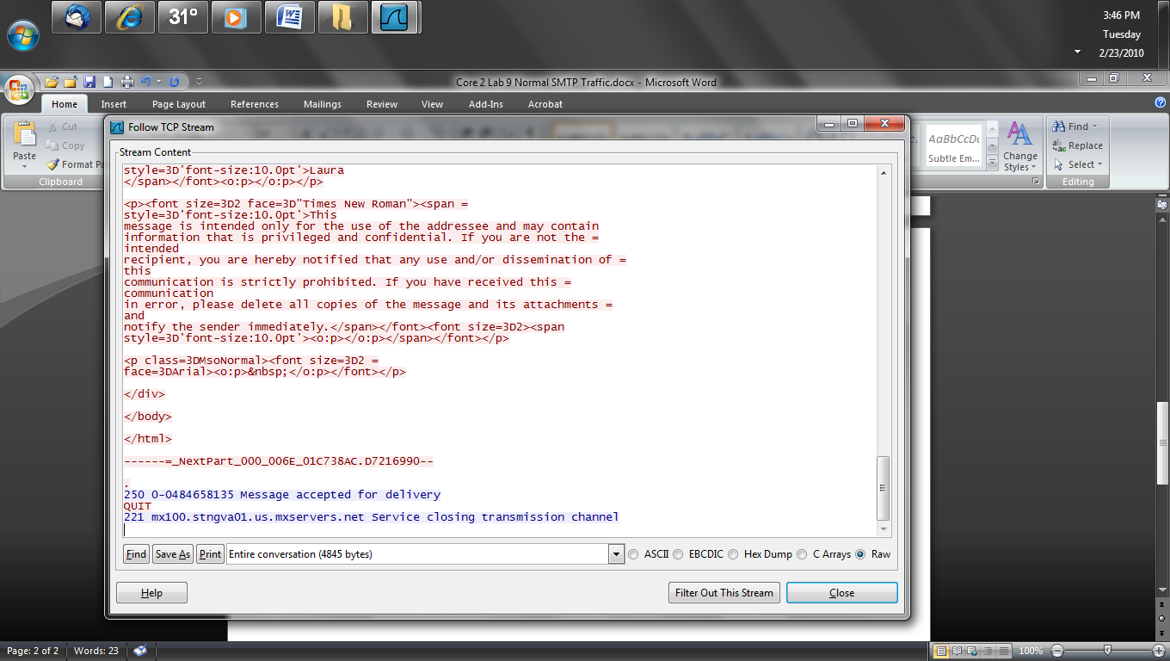
Lab

Slide 199
The Server as the Problem
Common statistics to examine on a server to see if it is causing the slow response include
Dropped frames
CPU utilization

Slide 200
The Application as the Problem
A problem with an application running on a server is seen in
Small data sizes sent and received
High CPU utilization
Excessive redirections
Excessive use of multiple servers for the same application

Slide 201
Lab
The user says the network is slow
Let’s look at an example where the network is not the problem, rather the way the application is designed is
In this case it is illustrated by a web site access that requires the client receive responses from multiple servers

Slide 202
Lab
Start Wireshark
Open http-espn.pcap
With this capture file open select
Statistics – HTTP – Load Distribution
Click the Create Stat button

Slide 203
Lab
Examine the result
How many HTTP servers did the client end up talking to
Are the IP addresses of these servers all near to each other
In other words are these servers all at the same place or on different, perhaps widely distributed networks
Look at the server names are all of them controlled by the same organization

Slide 204
Lab
Select
Statistics – HTTP – Packet Counter
Click the Create Stat button
Expand the HTTP Response Packets section
What does it show any problems in terms of
??? Broken
1xx Informational
2xx Success
3xx Redirection
4xx Client Error
5xx Server Error

Slide 205
HTTP Stream
To more clearly see the HTTP GET requests and the corresponding response codes in the Packet List pane disable the TCP preference
Allow subdissector to reassemble TCP streams

Slide 206
Graph HTTP Traffic Flows
To troubleshoot slow web browsing sessions create a flow graph by selecting
Statistics – Flow Graph
This shows each target host on a column and every packet in a row

Slide 207
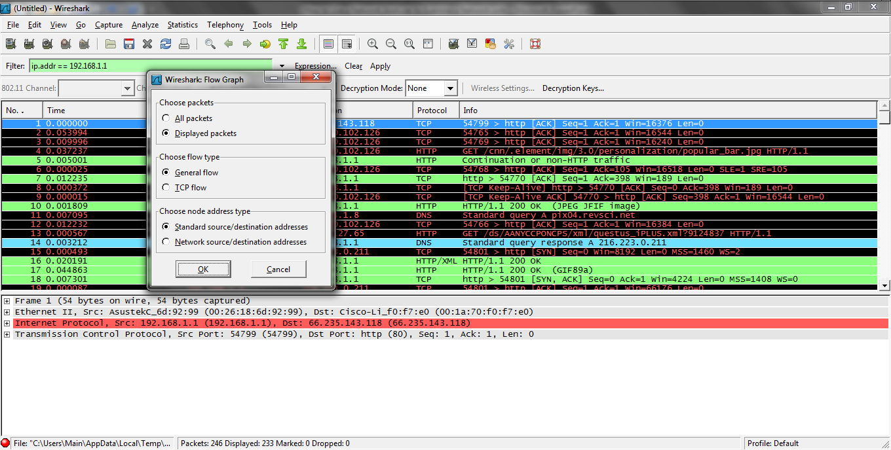
Graph HTTP Traffic Flows

Slide 208
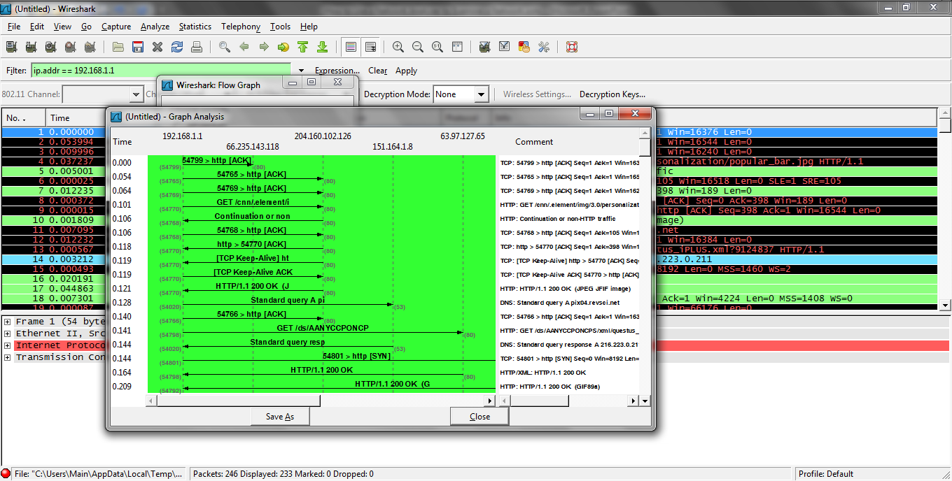
Graph HTTP Traffic Flows

Slide 209
HTTP Requests
The HTTP Requests statistic is also useful to examine the flow
To produce this select
Statistics – HTTP - Requests

Slide 210
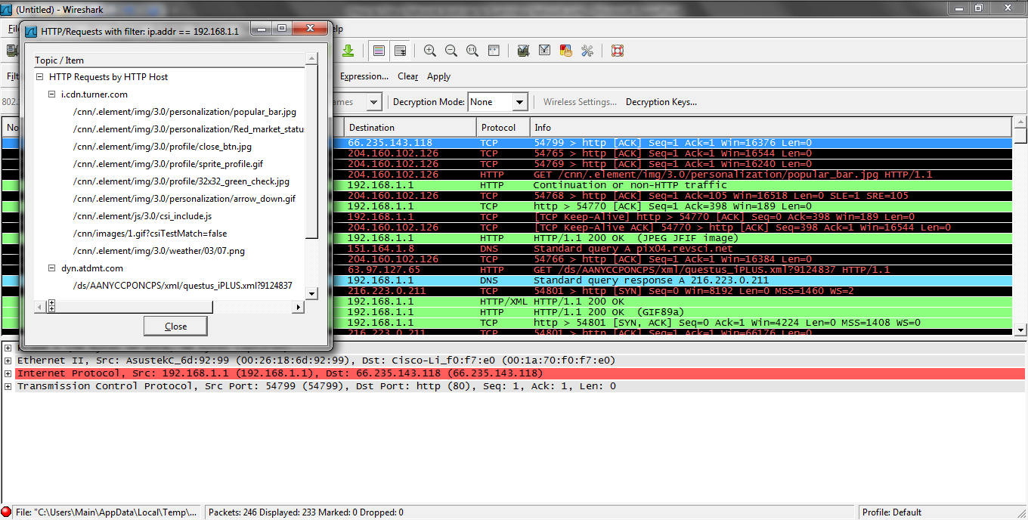
HTTP Requests

Slide 211
The Client as the Problem
The first indication that the client might be the problem is after the handshake how long did it take for the client to issue a GET request to the server for data in whatever form that GET request might be
If the GET is not immediately issued, then examine the client as the cause of the delay

Slide 212
An Example of This
Here is an perfect example of this type of problem and why being abele to do this type of analysis is so important
This is from Jeremy Stretch of PacketLife.net
He wrote in a post titled The Importance of Watching the Wire on April 3, 2013

Slide 213
An Example of This
I came across an interesting problem today that I think serves as an excellent example of why packet analysis is such a critical skill for network engineers
A few days ago, the internal network belonging to one of my employer's customers was compromised by a malicious party

Slide 214
An Example of This
Since the customer had connectivity into our network by way of a VPN tunnel and we didn't want to knowingly expose ourselves or other customers to the threat, we saw fit to temporarily sever the VPN while the breach was tended to by another party
We also upgraded the site's core switch to better support a feature useful in the analysis of the breach

Slide 215
An Example of This
Shortly thereafter, we began receiving reports of problems with Internet connectivity from the site
Everything was reachable, it was just... Slow
And worse, the issue seemed not to have any uniform effect
One person experiencing the issue might sit next to someone else who was completely immune and who noticed no difference from the day before

Slide 216
An Example of This
This of course made troubleshooting frustrating, to say the least
First we tried reversing the firmware upgrade on the core switch, as it was reasonable to suspect we may have encountered some obscure bug, but this was quickly revealed to be a red herring as the issue persisted

Slide 217
An Example of This
On-site engineers verified that they could still reach everything excluding of course our internal resources which were no longer reachable as a result of severing the VPN and speed tests showed mostly normal results
There was no correlation between affected users and any access switch, VLAN, or IP subnet

Slide 218
An Example of This
We also confirmed about seventeen times that Internet traffic was in fact traveling from end hosts through the firewall directly to the Internet, with no proxy or caching servers in between
Frustrated with the lack of progress in isolating the issue, I asked for a packet capture to be performed at the site

Slide 219
An Example of This
The testing procedure was as follows:
Open a web browser
Navigate to about:blank
This ensures that the test begins with a clean slate and guards against any rogue HTTP requests resulting from leaving the prior page
Start a promiscuous packet capture in Wireshark
Navigate to packetlife.net and wait for the page to completely load
Stop and save the capture

Slide 220
An Example of This
My motivation for choosing packetlife.net as the test target was more than mere vanity
When you load a major web site like yahoo.com or cnn.com, you're actually generating a huge number of HTTP requests under the hood for content from a dozen or so sources such as content delivery networks, embedded advertisements

Slide 221
An Example of This
By using a simple, familiar site I knew what sort and number of HTTP requests to expect, which makes the job of analyzing each packet in the capture a good deal easier
After quickly sanity-checking the packet capture to ensure that the test was completed as designed, my first step was to isolate the initial TCP session triggered by the web request

Slide 222
An Example of This
A quick way to do this if you know the IP address of the remote server is to apply a display filter showing only traffic to or from that IP:
ip.addr==174.143.213.184
Then, right-click on the first TCP packet (the one with only the SYN flag set) and select "Follow TCP Stream“

Slide 223
An Example of This
This will apply a new display filter showing only packets which belong to that TCP session
It will also generate a new dialog showing the contents of the HTTP request, which in many cases can be quite handy but wasn't of interest at this time
I reviewed the TCP exchange and everything appeared normal, until I noticed the packet timestamps

Slide 224
An Example of This
After the initial three-way TCP handshake SYN, SYN/ACK, ACK completed, there was a delay of about five seconds before the HTTP GET request was transmitted between packets #32 and #101 in the figure below
Under normal conditions, there should be practically zero delay between the handshake completion and the initial HTTP request, so I knew I was on to something

Slide 225
An Example of This

Slide 226
An Example of This
The delta time column in the screenshot was added to the default column set to show the difference in seconds between each packet and the one displayed immediately before it
One important clue to note is that the delay here is almost exactly five seconds; a round number to us humans

Slide 227
An Example of This
This suggests that some process triggered by or in parallel with the TCP connection is intelligently timing out at five seconds, at which point the HTTP request proceeds
I cleared the display filter and begin sifting through the packets which were captured between the establishment of the TCP session and the first HTTP request
Most of it is ambient noise

Slide 228
An Example of This
There's nothing terribly interesting except for a few unanswered TCP requests from the local host to a remote server that used to be accessible via the VPN tunnel we disconnected earlier
The requests were destined for port 5274; a quick google of the port number yielded no clues

Slide 229
An Example of This
But the answer finally clicked when I looked up the destination IP address: It was a Trend Micro antivirus server
What does an antivirus application have to do with Internet connectivity
One of the services provided by Trend Micro and countless other AV products is the ability to filter URLs and block access from the local machine to questionable web sites

Slide 230
An Example of This
As I understand it and I could be wrong, as we're well outside my area of expertise now, the client software hijacks the web browser's HTTP request and sends the URL to a central server which compares it against a blacklist
In this scenario, that server is no longer accessible, and the connection attempt times out after - you guessed it - five seconds

Slide 231
An Example of This
The client then "fails open," meaning that the HTTP request is allowed to continue despite receiving no response from the filtering server
In hindsight, a big red error page complaining about AV software issues would have all but eliminated our time spent troubleshooting

Slide 232
An Example of This
Five seconds may not seem like a substantial amount of time, but remember how I mentioned earlier that large sites tend to pull content from myriad sources just to render a single page
If several of those request are being hijacked and delayed one after another, the cumulative delay can quickly grow to the point where angry phone calls are placed

Slide 233
An Example of This
This explanation also reveals why some users were immune to the issue: They were using an alternate antivirus product, or didn't have the URL filtering feature enabled
Fortunately, the resolution for this issue ended up being trivial to implement

Slide 234
An Example of This
But how long do you suppose troubleshooting might have gone on had we not taken the time to inspect the wire directly
Hone your packet analysis skills well, as the investment will quickly pay off

Slide 235
The Client as the Problem
A good indication that the client is the source of the problem is a large number of packets with the window size set to zero
This means the client is overloaded
It cannot currently accept any more data
Watch for this as this will slow the data flow by watching the TCP ACK packets of the receiver

Slide 236
The Client as the Problem
As the client does not respond to the server the server sends keep alive packets to maintain the TCP connection

Slide 237
The Client as the Problem

Slide 238
The Client as the Problem

Slide 239
Receiver Congestion
This window size zero issue can occur at either the client or the server end
Let’s see how this happens
In this example the receiver, a server in this example, has buffer space for four segments
As the server receives segments the buffers are filled

Slide 240
Receiver Congestion
At some point if the application cannot pull the segments from the buffers eventually they will all fill up
The receiver will respond to this by sending a Window Size of 0

Slide 241
Receiver Congestion

Slide 242
Receiver Congestion
Here comes the first segment of 1460 bytes
It takes up buffer space

Slide 243
Receiver Congestion

Slide 244
Receiver Congestion
An ACK goes back

Slide 245
Receiver Congestion

Slide 246
Receiver Congestion
Here comes more data
More buffer space is gone

Slide 247
Receiver Congestion

Slide 248
Receiver Congestion
More data and less buffer space

Slide 249
Receiver Congestion

Slide 250
Receiver Congestion
Now all the buffer space is gone

Slide 251
Receiver Congestion

Slide 252
Receiver Congestion
As the ACKs go back for each segment the Window Size is also sent
It drops as the buffer space is used up until finally there is no buffer space and the Window Size is set to zero telling the sender to stop sending

Slide 253
Receiver Congestion

Slide 254
Receiver Congestion
It is not just window size zero that is a problem
You must watch for small window sizes as well these have the same effect
For example this client says it has only 576
This causes a 2.75 second delay until the client says here is a larger window size

Slide 255
Receiver Congestion

Slide 256
Receiver Congestion
In this example either the server cannot process fast enough or the application is too slow in processing the data it receives

Slide 257
Lab
Let’s look at an example of the problem a window size of zero creates by examining a capture that also shows how when this occurs the backoff timer that is part of TCP increases exponentially with each window zero packet arrives
Start Wireshark
Open trace21.pcap

Slide 258
Lab
Scroll down to packet 30
Look at the time column for 30 through 39
Notice the constant increase

Slide 259
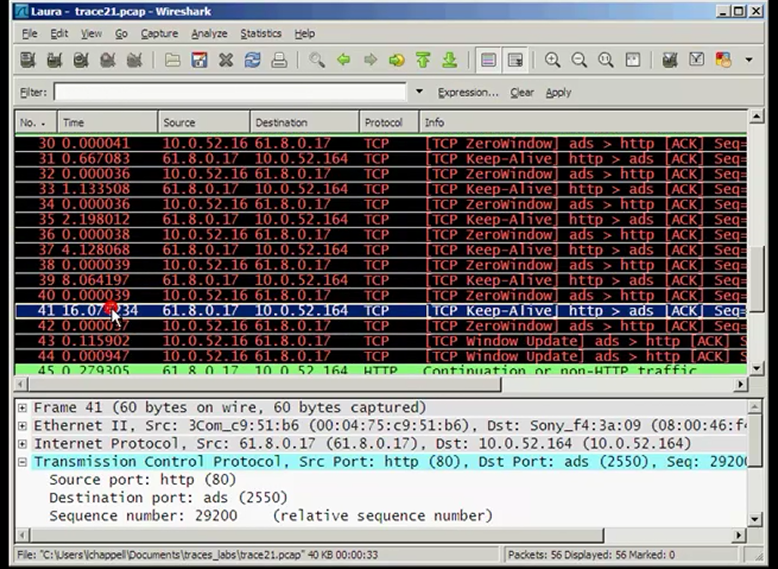
Lab

Slide 260
Display Host Protocols
Examining the protocols and applications in use by a host can be useful to identify possible causes of slow reactions by the host
To do this
Apply a display filter, such as by IP address, to limit the display to a single host
The select Statistics – Protocol Hierarchy

Slide 261
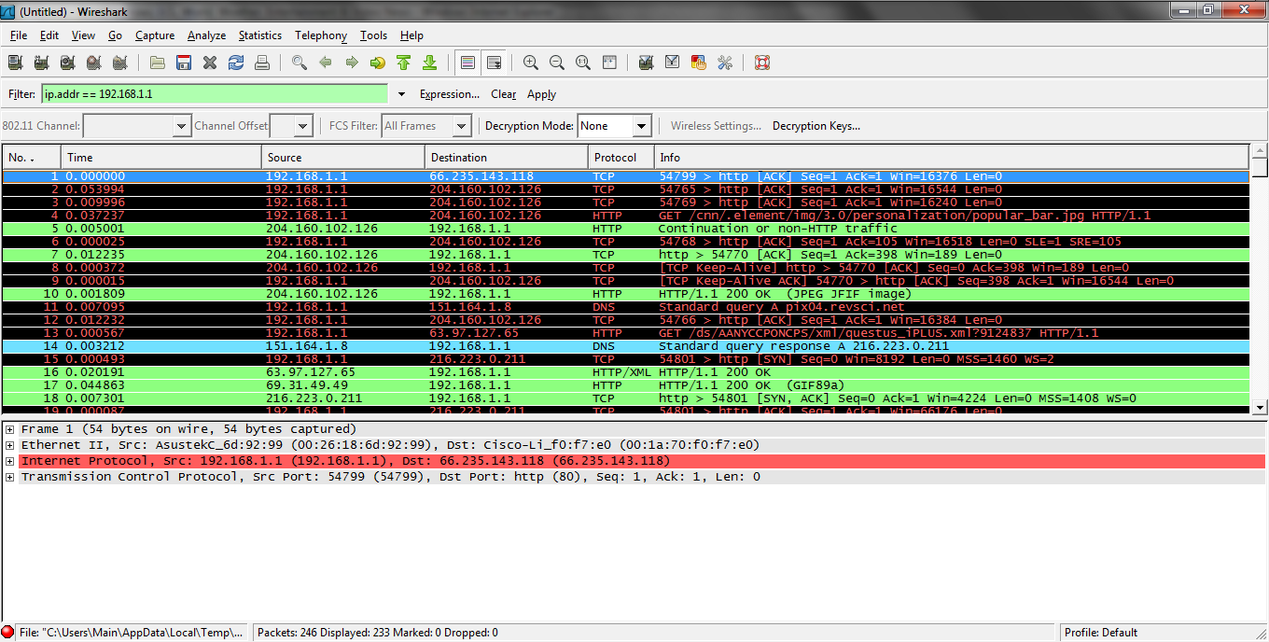
Display Host Protocols

Slide 262
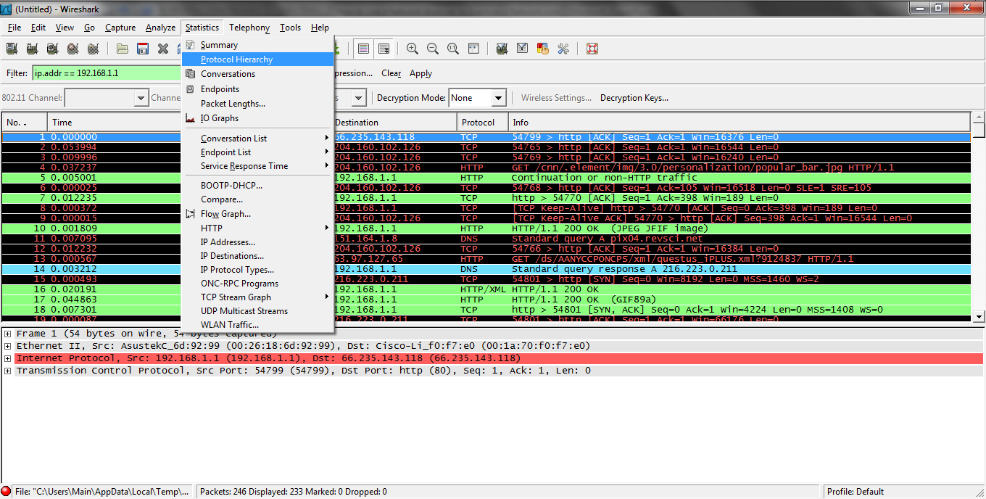
Display Host Protocols

Slide 263
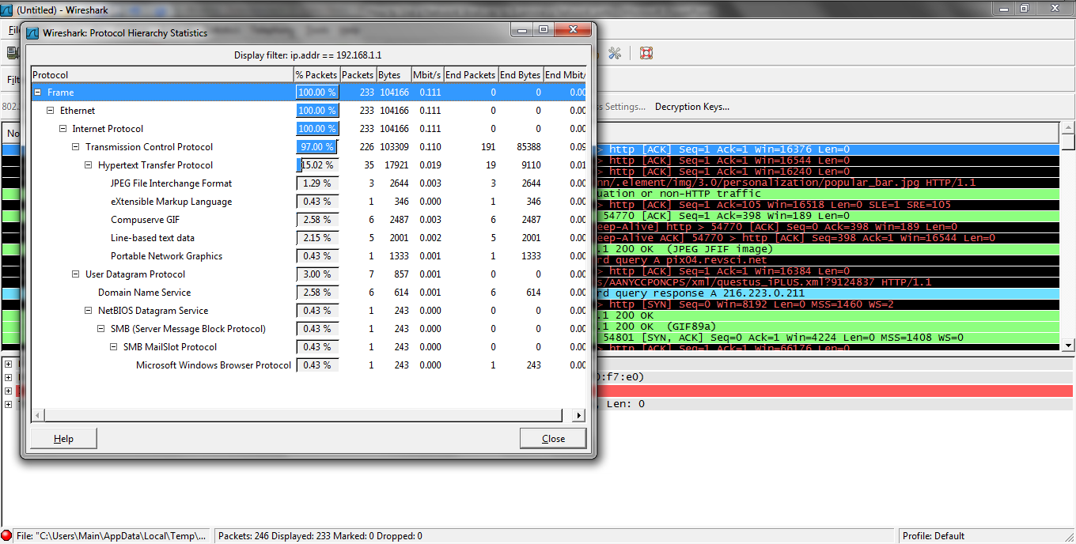
Display Host Protocols

Slide 264
The User as the Problem
Pesky users are a common problem
If we could just get rid of them, but I believe we are stuck with them
Here is Laura Chappell’s list of common user related problems

Slide 265
The User as the Problem

Slide 266
Security Scans and Breaches
The process of guarding a network from simple scanning for holes to plugging security breaches is beyond the scope of this presentation focusing on troubleshooting
The details of this important topic are covered elsewhere

Slide 267
Another View of Response Time
Wild Packets in a 2010 webinar presented a similar view of application response time
In their view application response time is made-up of
network response time + transaction response time

Slide 268
Network Response Time
Wild Packets sees network response time as being composed of
payload divided by bandwidth + application turns times round trip response time
These parts are defined as
Payload – bytes of information in the typical frame going back and forth
Bandwidth – minimal link speed

Slide 269
Network Response Time
Application Turns – Number of back and forth frames needed to complete an action the user sees
Round Trip Response Time – The time from the client to the server

Slide 270
Transaction Response Time
Wild Packets says the transaction response time is
Server Response Time plus Client Response Time
These two are
Server Response Time – Processing time required by the server
Client Response Time – Processing time required by the client

Slide 271
Server Response Time
Server Response Time consists of
Server Latency – Time needed for the server to process a request which is dependent on the memory, disk system, CPU, and load on the server
Application Latency – Time for the application to perform its job, which is mostly dependent on the software design

Slide 272
Server Response Time
Database Latency – Database aspects such as layout and the software design of the program
Browser Workstation Latency – The client processing ability
Protocol Latency – Some protocols work better than others, such as the TCP problems detailed above

Slide 273
Summary
As you can see there are a large number of areas where problems may arise in a network
Using these procedures the first step is to isolate the problem to one area
Then seek the solution to the problem

