Slide 1
How to Use a Spectrum Analyzer Wi-Spy Version Last Update 2011.09.30 1.3.0

Slide 2
Objectives
Learn how to use a spectrum analyzer

Slide 3
What is a Spectrum Analyzer
Sometimes we need to see the electromagnetic waves used by wireless systems to send data
Similar to an oscilloscope that is used to examine an electrical signal as it varies over time, a spectrum analyzer is used to capture and display the waveforms of radio frequency signals

Slide 4
What is a Spectrum Analyzer
This is a graphical representation of the signal's amplitude or signal energy as a function of frequency, not time
The spectrum analyzer is to the frequency domain as the oscilloscope is to the time domain

Slide 5
What is a Spectrum Analyzer
With an oscilloscope when measuring in the time domain, all frequency components of the signal are summed together and displayed
In the frequency domain, complex signals that are made up of more than one frequency are separated into their frequency components, and the signal level at each frequency is displayed

Slide 6
What is a Spectrum Analyzer
The spectrum analyzer is a passive device
It does not do anything to the signal
It just displays it

Slide 7
Types of Spectrum Analyzers
There are two basic types of spectrum analyzers
Standalone Units
USB Based

Slide 8
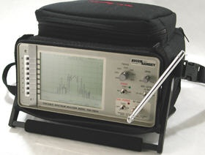
Standalone Unit

Slide 9
Signal Patterns
Let’s look at some common signal patterns as seen on a spectrum analyzer
Here are the FM radio stations in the DFW area

Slide 10
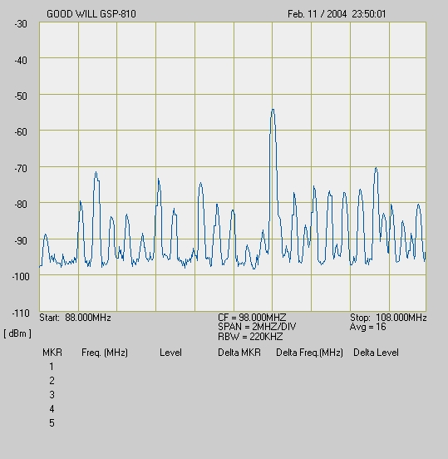
Signal Patterns

Slide 11
WiFi Signals
Unlike the other signals the DSSS – Direct Sequence Spread Spectrum signal used by WiFi systems is characterized by a low level signal that is spread over a wide range
As such it looks very much like transient noise

Slide 12
WiFi Signals
To actually see this type of signal on the spectrum analyzer the peak hold function of the spectrum analyzer must be activated
This function keeps each signal on the screen as long as the peak hold function is activated
By doing this a pattern of the signal begins to appear

Slide 13
WiFi Signals
To see the entire ISM 900 MHz span from 902 to 928 MHz set the center frequency to 915 MHz
Set the span control to produce a span of 3 MHz
To use a spectrum analyzer in the 2.4GHz band for 802.11b signals set the center frequency to 2437 MHz and a 5 MHz per division span

Slide 14
WiFi Signals
The spectrum analyzer display will be centered on 802.11b channel 6
Each of the five vertical grid lines on either side of the center one will represent that respective channels from channel 1 on the far left to channel 11 on the far right
To see the entire UNII 5.3 GHz span from 5.250 to 5.350 GHz set the center frequency to 5300 GHz

Slide 15
WiFi Signals
Set the span control to produce a span of 10 MHz
To see the entire UNII 5.8 GHz span from 5.725 to 5.825 GHz set the center frequency to 5775 GHz
Set the span control to produce a span of 10 MHz

Slide 16
WiFi Signals
To see the entire UNII 5.3 GHz span from 5.250 to 5.350 GHz set the center frequency to 5300 GHz
Set the span control to produce a span of 10 MHz

Slide 17
Signal Pattern
Here is an example of a DSSS signal

Slide 18
Signal Pattern

Slide 19
Standalone Units
The main problem with standalone units is the cost
They typically range from $3,000 to $20,000

Slide 20
USB Analyzer
A lower cost option is the USB spectrum analyzer
A example of these is the unit from MetaGeek
These cost from $200 to $600
For example

Slide 21
USB Analyzer

Slide 22
Interface
Here is the interface

Slide 23
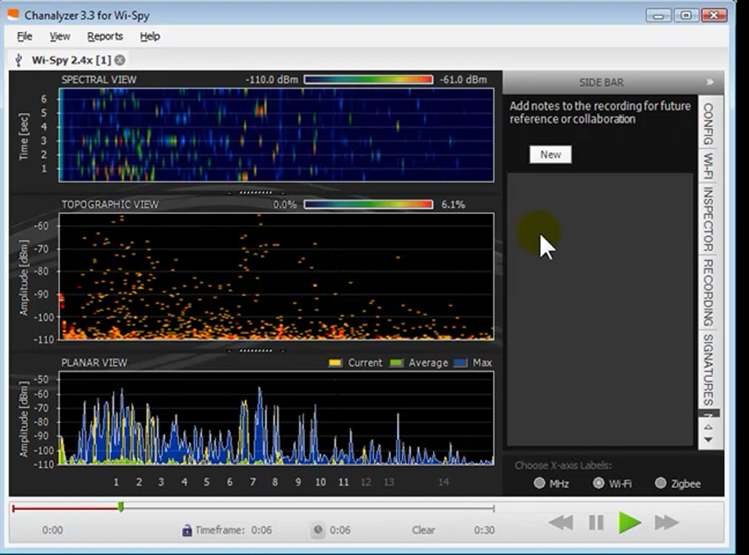
Interface

Slide 24
Time of Capture
The moving line at the bottom shows how long the data has been captured
This time line can be locked into a specific amount of time by dragging each of the endpoint colored dots inward
This allows a rolling data collection where the data is overwritten with new data for the time period selected

Slide 25
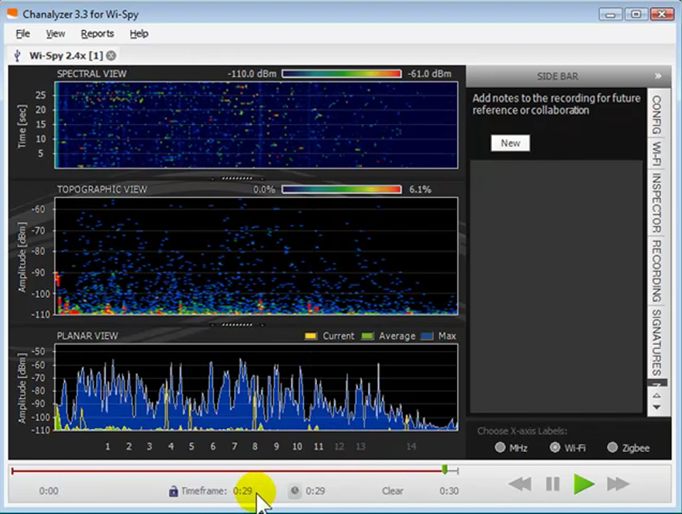
Time of Capture

Slide 26
Spectral View
The top third of the interface is the Spectral View

Slide 27
Spectral View

Slide 28
Color Bars
The color bar at the top of the Spectral View shows the signal strength
The number on the left is the weakest seen
The number on the right is the strongest seen
The colors in this view represent the signal strength

Slide 29
Vertical Stripes
Vertical stripes in the top section indicate a steady signal
The color of the stripes show how strong the signal is
In this case it shows a weak but constant signal

Slide 30
Vertical Stripe

Slide 31
Topographic View
The middle section, the Topographic View, shows the signal patterns again using a color code
On the left is the signal strength in dBs

Slide 32
Topographic View

Slide 33
Planar View
The bottom panel is the Planar View
It shows the
Current signal in yellow
Average signal in green
Maximum signal in blue
The signal strength in dBs is shown on the left

Slide 34
Planar View

Slide 35
Indicators
Each of these three can be turned off
When looking for interference it is best to turn off all except the yellow current signal strength indicator

Slide 36
Indicators

Slide 37
Signal Signatures
Some signal signatures can be accessed by clicking on the Signatures tab on the right side of the interface
These can be selected, then moved over the signal shown to try to identify a pattern

Slide 38
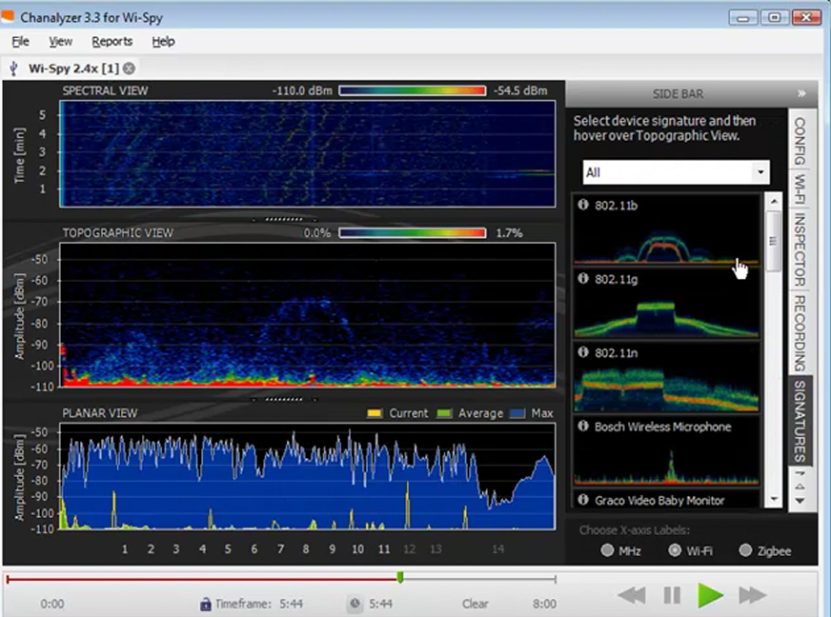
Signal Signatures

Slide 39
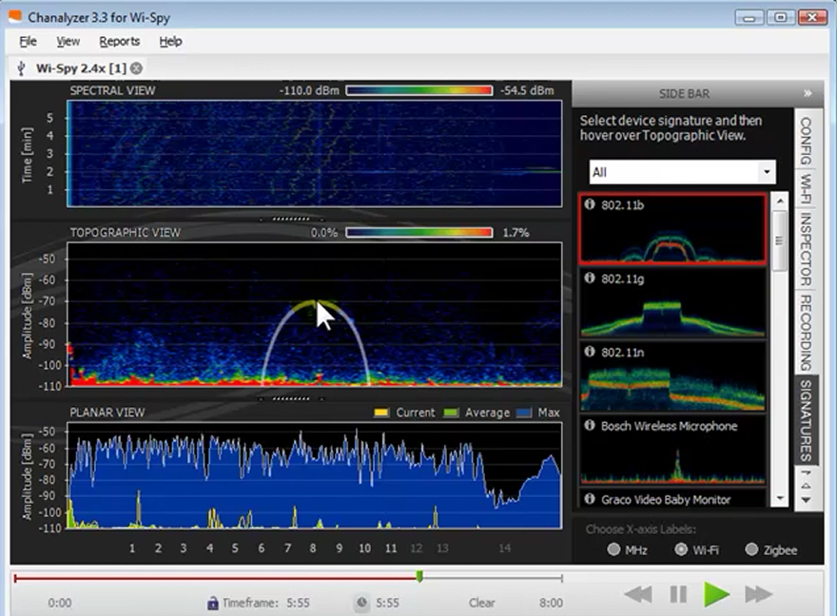
Signature Matching

Slide 40
Networks Overlay
Any wireless NIC in the same unit can be used to overlay the 802.11 wireless networks it sees over the spectrum display
Select the WiFi tab, then click Start Scanning
Once the network list is complete, select the ones to show on the spectrum display by clicking the boxes
By hovering over the list some details can be seen

Slide 41
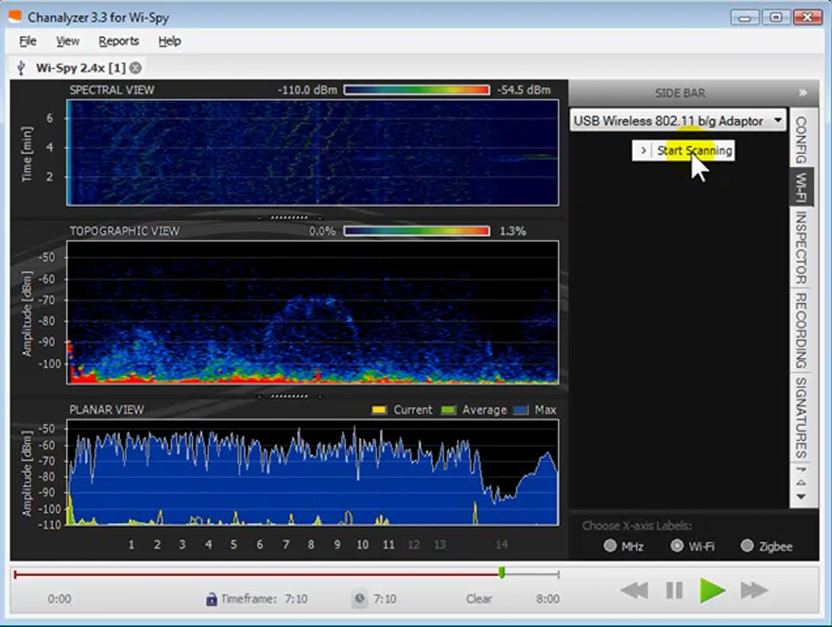
Networks Overlay

Slide 42
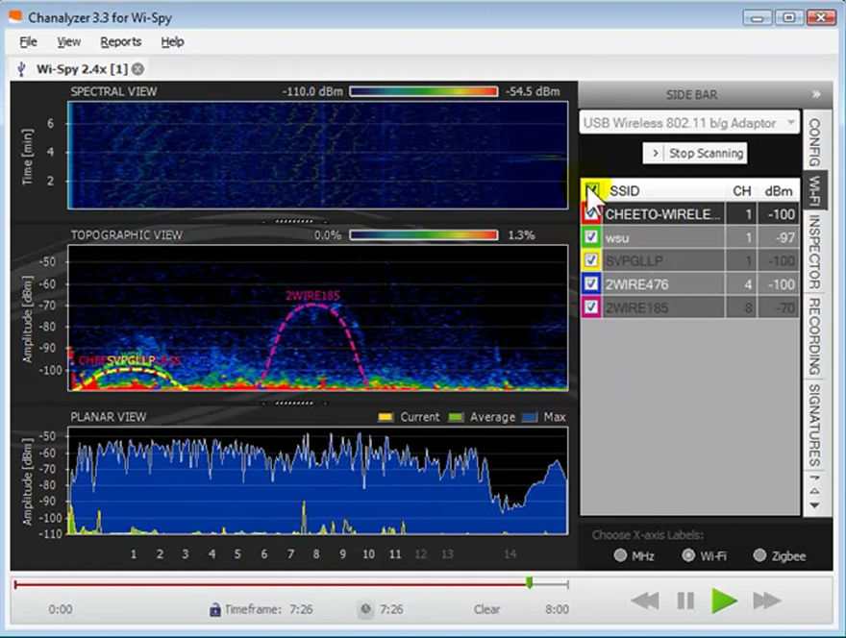
Networks Overlay

Slide 43
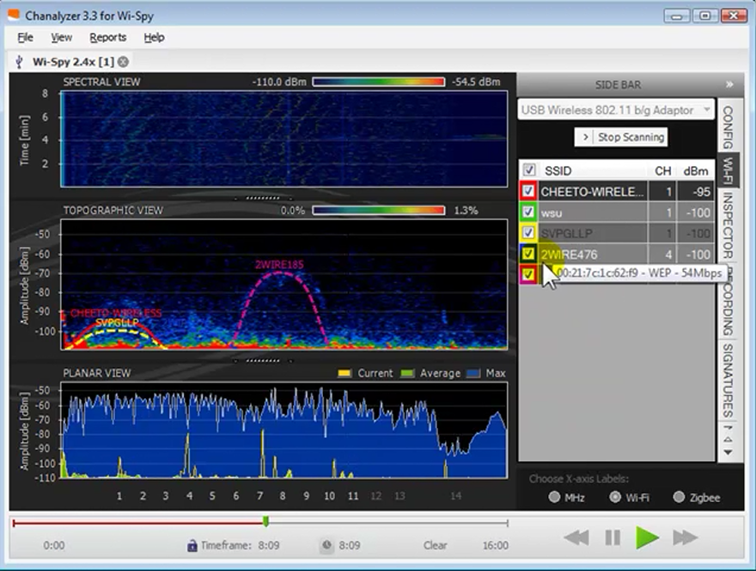
Networks Overlay

Slide 44
Noise
The only indication of the noise level in the area is the low level signal shown at the bottom of the Topographic View

Slide 45
Noise

Slide 46
Sample Recordings
Some sample recordings of common network views can be downloaded for comparison purpose

Slide 47
Long Term Data Capture
In order to capture intermittent interference Chanalyzer may be left running for a period of time
This will require about 50MB of disk space per 10 hours
A specific part of the capture can be viewed by adjusting the time line by dragging each of the endpoint colored dots inward

Slide 48
Long Term Data Capture
The entire capture can be examined by sliding the section between the dots back and forth
The time line can also be double clicked to jump to that time period

Slide 49
Chanalyzer Lite
There is a second version of Chanalyzer called Chanalyzer Lite
Why is not clear
This version shows the data in a 3D view
For example

Slide 50
Chanalyzer Lite

Slide 51
Chanalyzer Lite
This view is very useful when tracking down devices
Notice in the screen shot above the red peak
As you move closer and closer to the device the amount of red will increase
As you move away from it, the red will decrease

Slide 52
Interpreting the Results
In a September 2011 webinar Fluke using their AirMagnet spectrum analyzer provided some excellent examples of how to interpret the results of typical spectrum captures
Let’s see what they had to say

Slide 53
Interpreting the Results

Slide 54
Interpreting the Results

Slide 55
Interpreting the Results

Slide 56
Interpreting the Results

Slide 57
Interpreting the Results

Slide 58
Interpreting the Results

Slide 59
Interpreting the Results

Slide 60
Interpreting the Results

Slide 61
Interpreting the Results

Slide 62
Interpreting the Results

