Slide 1
How to Use a Channel Usage Tool Insidder Version Last Update 2010.03.07 1.0.0

Slide 2
Objectives
Learn how to use a channel usage tool

Slide 3
What is a Channel Usage Tool
A channel usage tool will detect and display all of the access points and infrastructure devices broadcasting in the selected wireless band
With this tool it is easier to locate an unused channel
For example

Slide 4
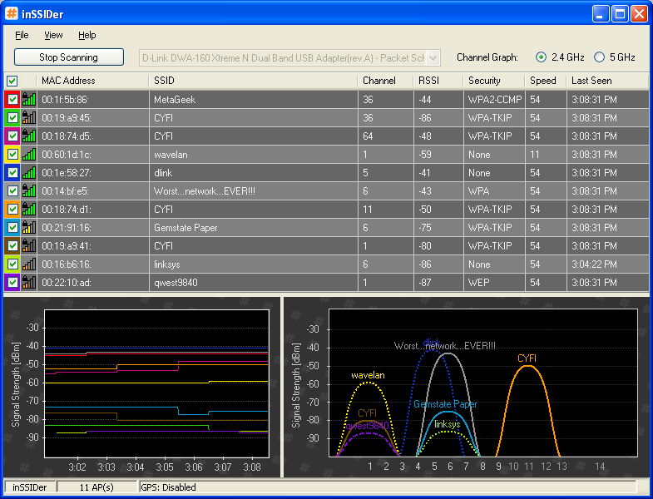
Channel Usage

Slide 5
Channel Usage
In this example there are no unused channels
However, channel 11 is the least used of the three available channels

