Slide 1
How to Use the Wireshark Protocol Analyzer
Last Update 2013.03.11 1.12.0

Slide 2
What is a Protocol Analyzer
A protocol analyzer, such as Wireshark, is used to copy frames off of an active network
These frames are like the cars on the highway
They are the reason for the highway or network
These frames carry the information in the case of a network

Slide 3
What is a Protocol Analyzer
They carry the people and cargo in the case of a highway
By capturing and examining these frames we can see exactly what is happening on the network
Then when the network stops working as we expect, we can use this same tool to determine why it is not working

Slide 4
Let’s Look at Wireshark
Wireshark, once called Ethereal, is an open source network analyzer
It looks like this

Slide 5
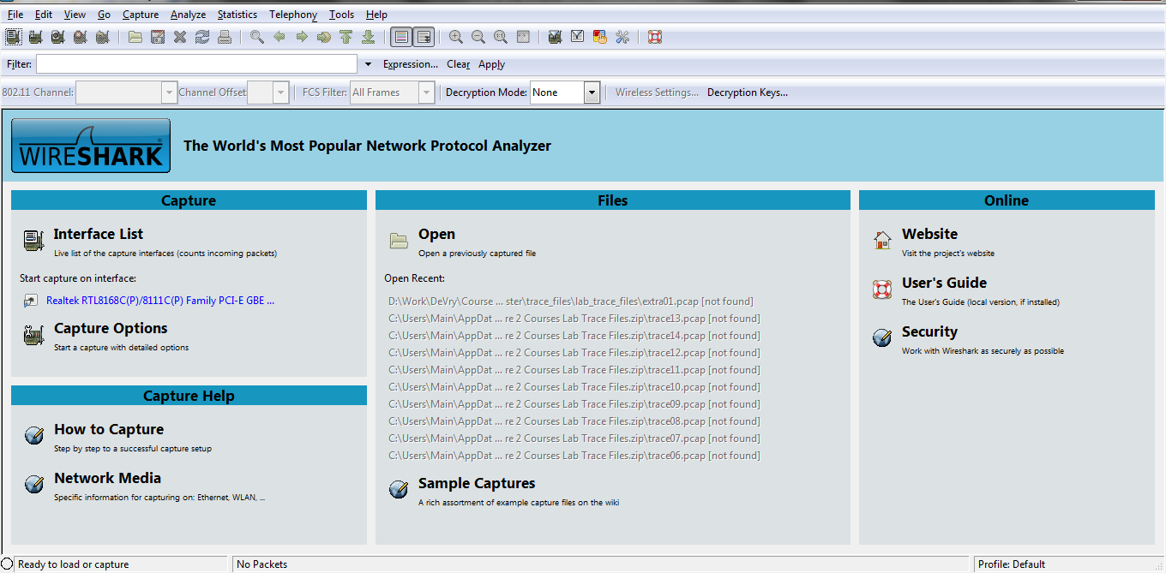
Wireshark

Slide 6
Wireshark
Not very interesting is it
It is of more interest after it has captured a frame or two
For example

Slide 7
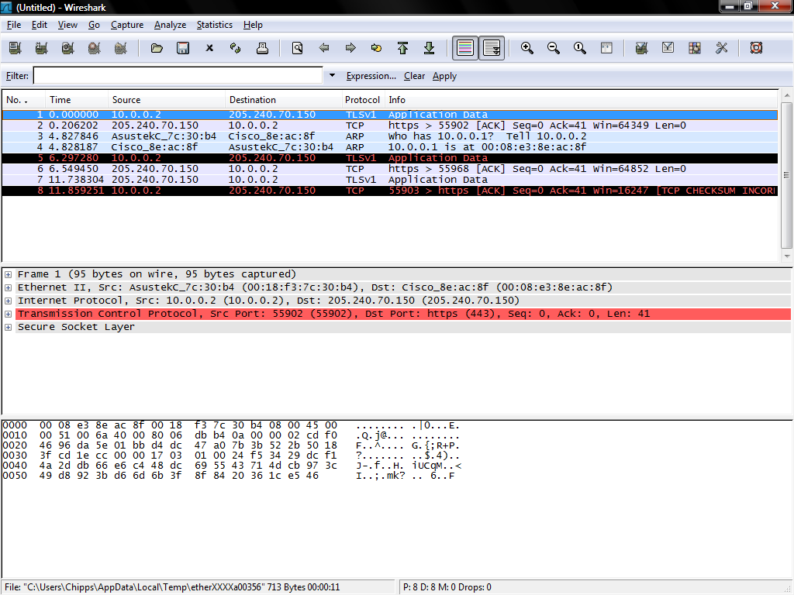
Wireshark

Slide 8
Wireshark
What are we seeing here

Slide 9
Wireshark
The frames that were captured
The layers in the currently selected frame
The contents of the current layer in hex and ASCII

Slide 10
The Layers
As you will recall from the OSI model there are several layers that each do different functions that are part of the captured frame
This is also true of the TCP/IP model which all current networks use
It is divided up into these layers

Slide 11
TCP/IP Model

Slide 12
The Layers
Let’s look more closely at the layers in one of the frames shown above

Slide 13
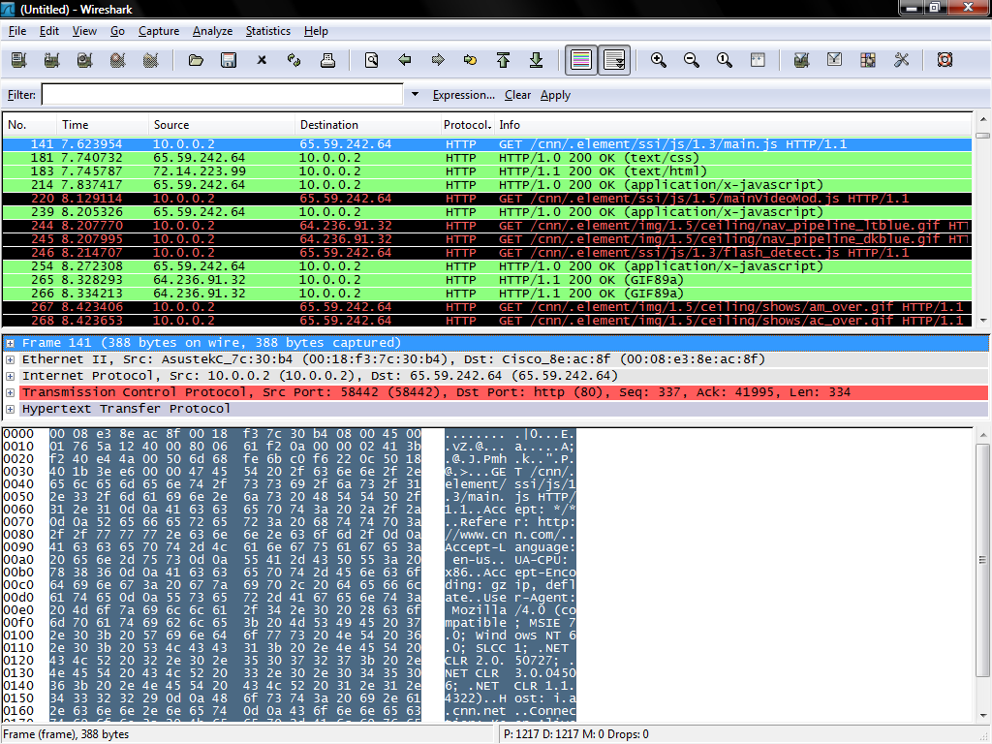
The Layers
The frame shown in detail below
All the layers in this frame
The contents in hex
The contents in ASCII
The contents of the selected layer

Slide 14
The Network Access Layer
Recall that the Network Access layer is two layers in the OSI model
Physical
Data Link
Wireshark cannot show the physical layer
For that an oscilloscope is required
On such a device the physical layer for an Ethernet based network looks like this

Slide 15
The Physical Layer

Slide 16
The Data Link Layer
The first layer that Wireshark can display is the top of the Network Access layer
This is the Data Link layer as shown next
Then after it the Network layer, the Transport layer, and the Application layer

Slide 17
The Data Link Layer

Slide 18
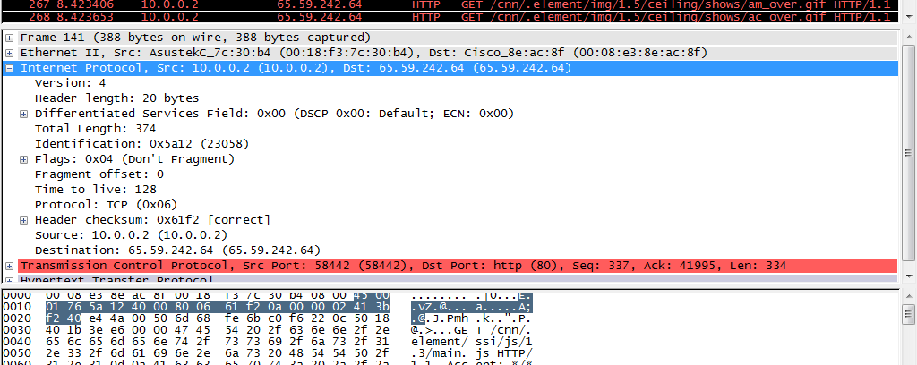
The Network Layer

Slide 19
The Transport Layer

Slide 20
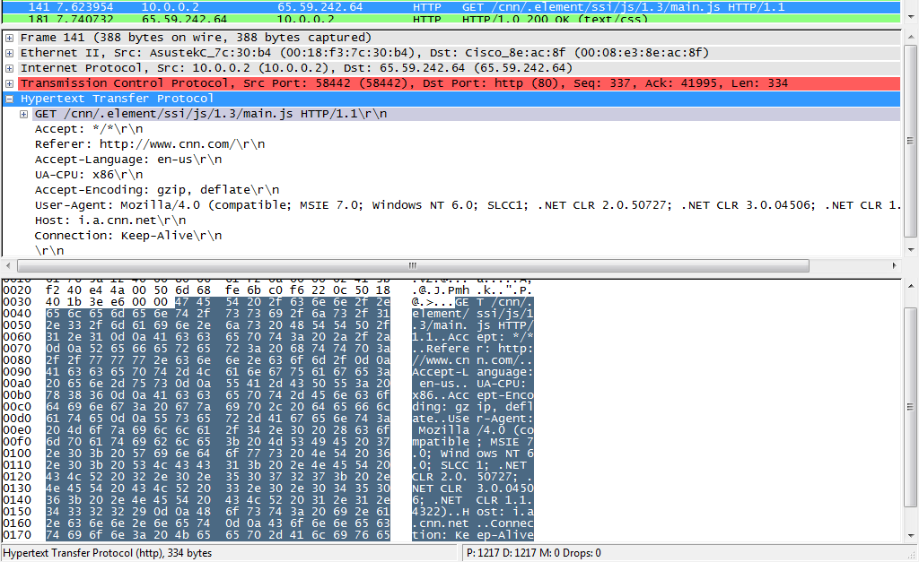
The Application Layer

Slide 21
To Capture Frames
Let’s capture some frames now
Select
Capture
Interfaces
Click Start beside the interface that is showing activity

Slide 22
To Capture Frames

Slide 23
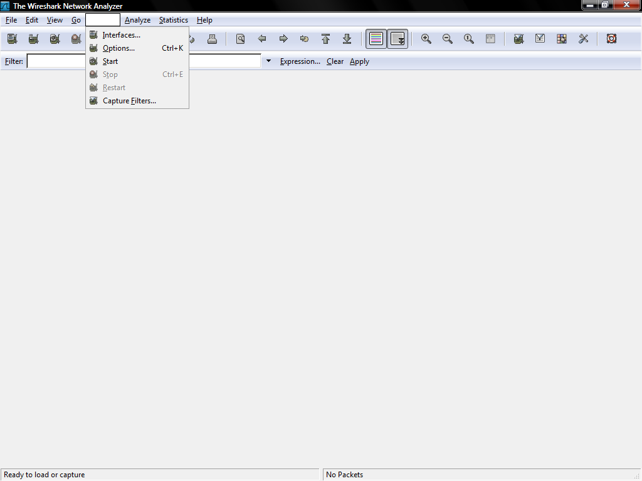
To Capture Frames

Slide 24
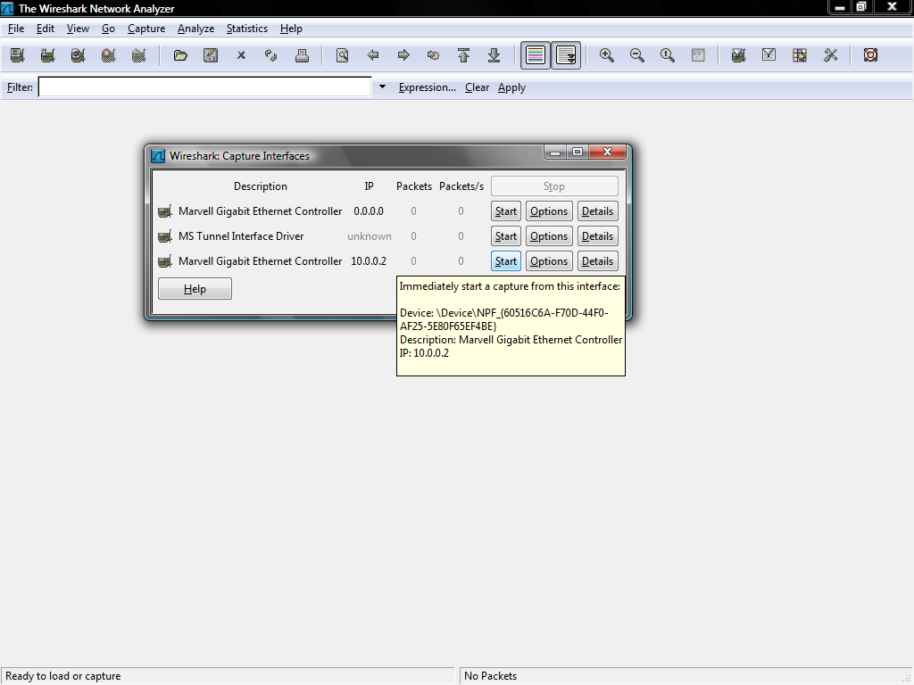
To Capture Frames

Slide 25
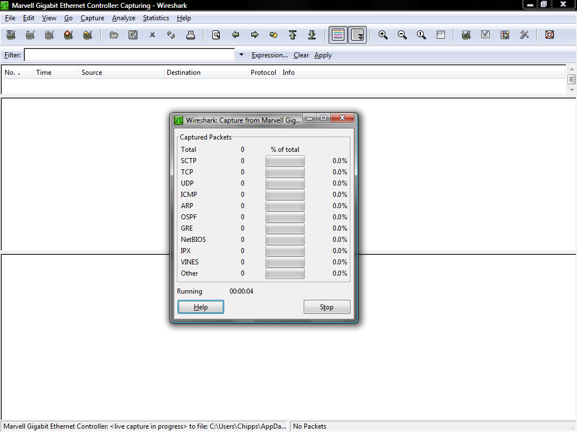
To Capture Frames

Slide 26
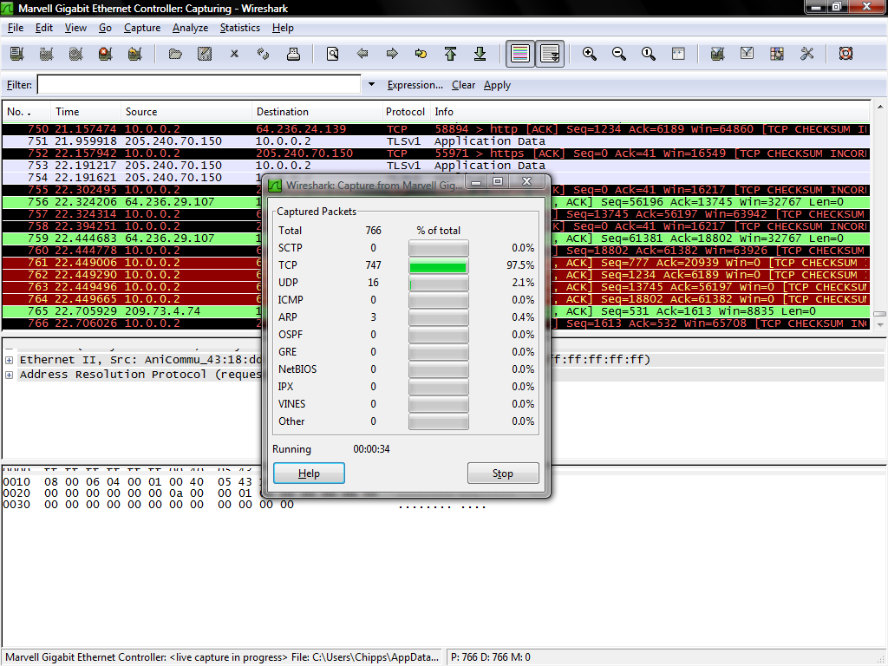
To Capture Frames

Slide 27
Statistics
Wireshark can also show some statistics about the network
For example to see the packets per second select
Statistics – IO Graphs

Slide 28
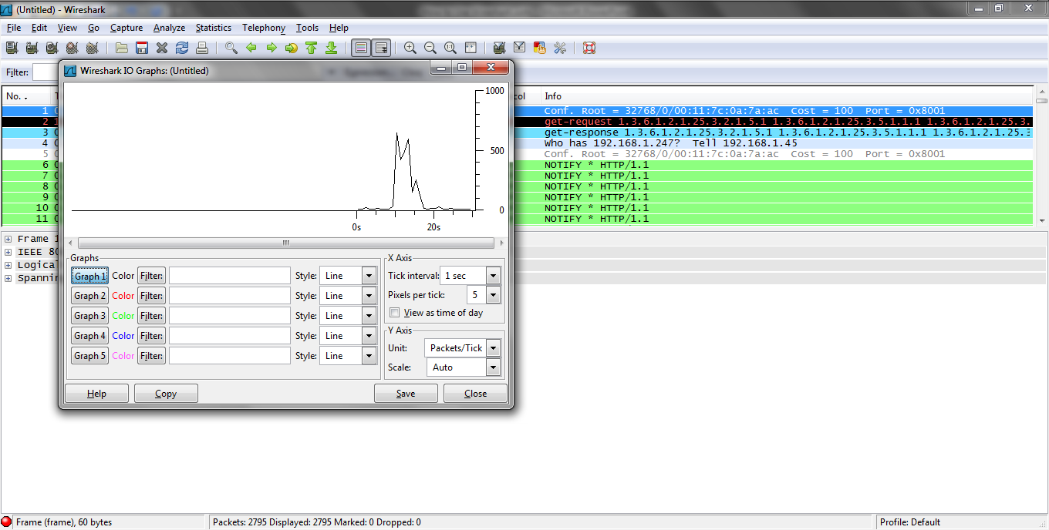
Packets per Second

Slide 29
Statistics
The data rate can be shown
Statistics – Summary
Average Mbit per second for example

Slide 30
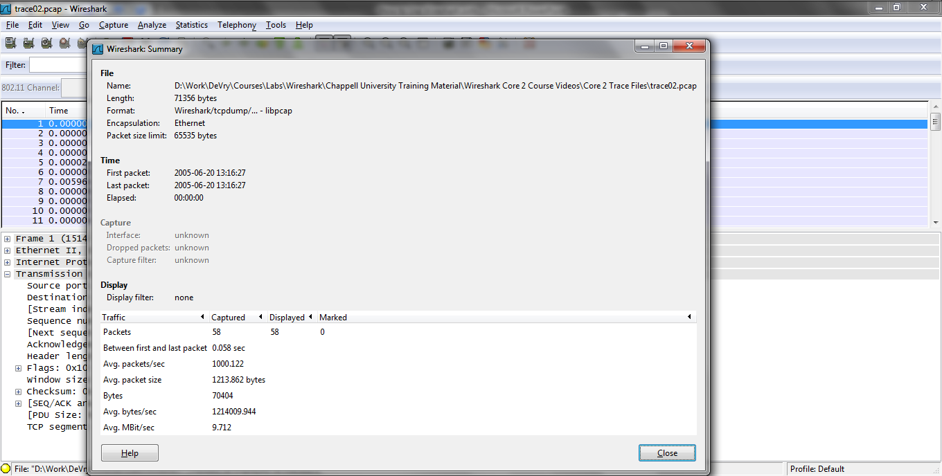
Data Rate

Slide 31
Protocol Hierarchy
A list of the protocols in use can be created by selecting
Statistics – Protocol Hierarchy
This should be examined for unexpected protocols or the excessive use of a protocol

Slide 32
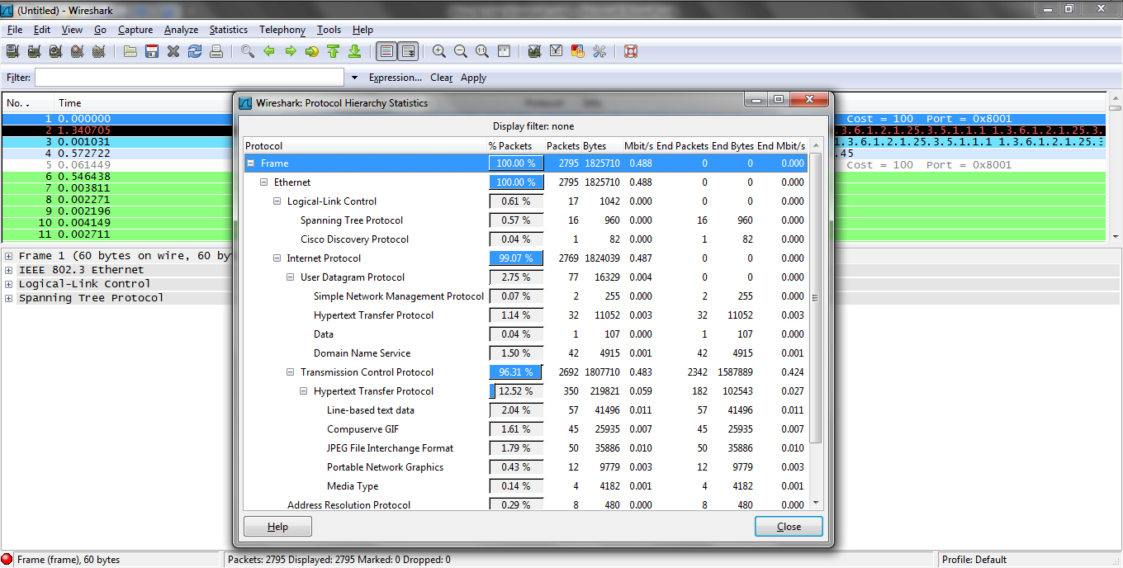
Protocol Hierarchy

Slide 33
Who is Talking
A list of the top talkers as well as who is talking to whom can be created
Statistics – Conversations
Along with a list of MAC addresses and IP addresses

Slide 34
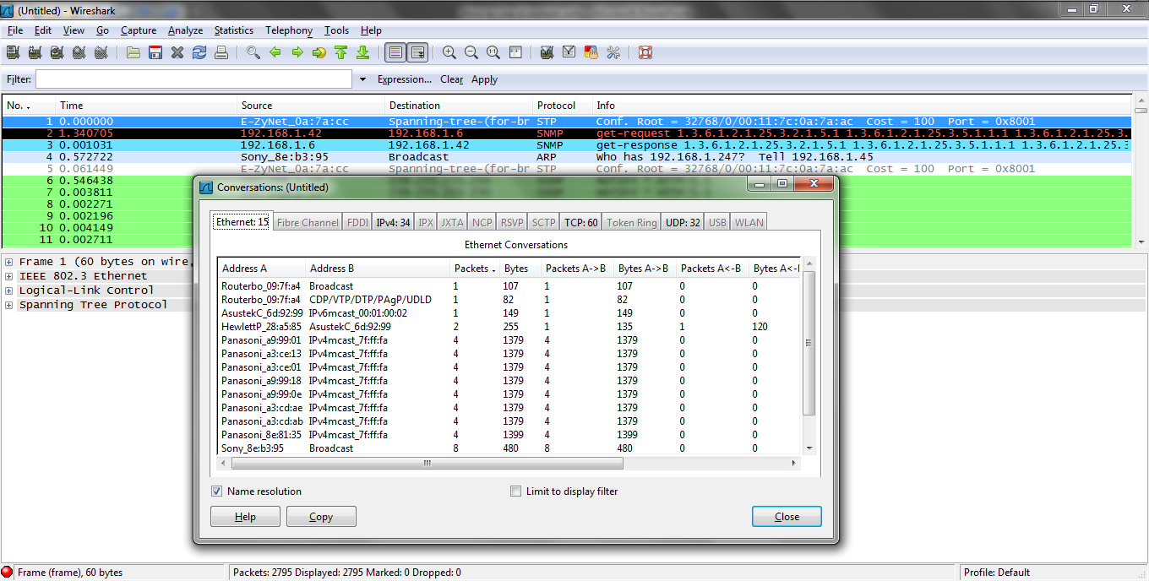
Who is Talking

Slide 35
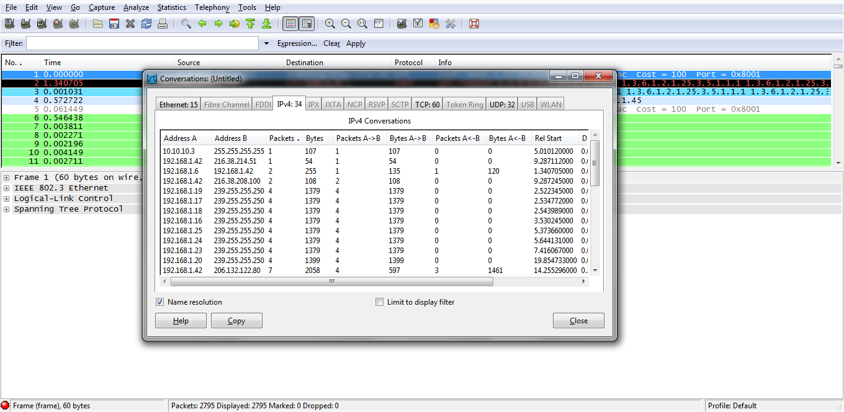
Who is Talking

Slide 36
IP Addresses
To se all of the IP addresses select
Statistics – IP Addresses

Slide 37
IP Destinations
To see the destinations select
Statistics – IP Destinations

Slide 38
Ports Used
To see the ports used select
Statistics – IP Protocol Types

Slide 39
Packet Length
The distribution of packet lengths can be shown

Slide 40
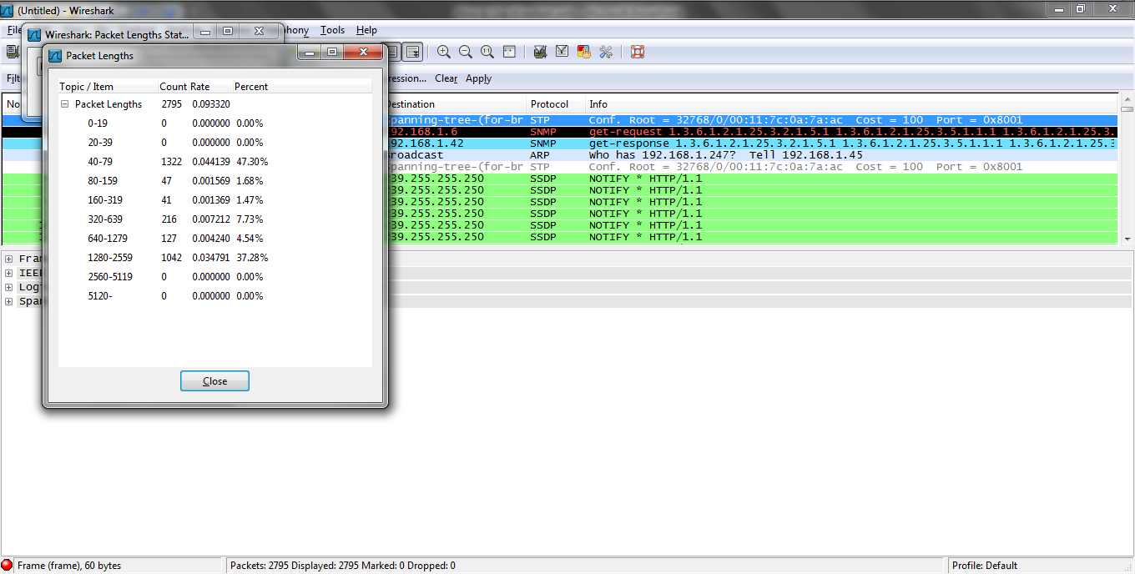
Packet Length

Slide 41
Flow Graph
A graph of the flow of a conversation can be created by selecting
Statistics – Flow Graph

Slide 42
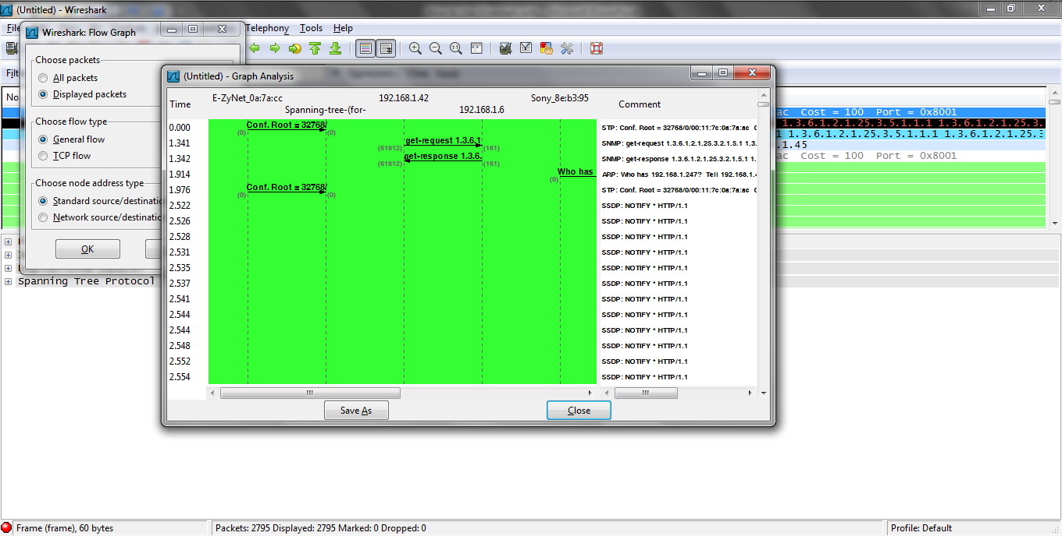
Flow Graph

Slide 43
TCP Trace Graph
As Laura Chappell who provides training on network analysis discusses in one of her labs a TCP Trace Graph is used to locate any problem in the flow of data
This graph should proceed upward from the bottom left corner to the top right corner at a steady pace
The sequence numbers are on the left which should constantly increase

Slide 44
TCP Trace Graph
Time is along the bottom axis
There are two lines
The lower darker line is the data flow
The upper lighter line is the window size

Slide 45
TCP Trace Graph

Slide 46
TCP Trace Graph
In most cases a flat area indicates a problem

Slide 47
TCP Trace Graph

Slide 48
TCP Trace Graph
These flat areas occur when the two lines intersect
This means the window size has gone to zero
This is never good as it slows the traffic way down
The reason could be a transmission problem or just that the server is waiting for the user to type something

Slide 49
TCP Trace Graph
The gray line is the Window Size

Slide 50
TCP Trace Graph

Slide 51
TCP Trace Graph
As you zoom in very closely the I bars that appear represent the data crossing the link
Each one is a segment
The vertical gray line beside them represents the ACK
The gap in the vertical I bars is a lost segment
The flat line to the side are duplicate ACKs

Slide 52
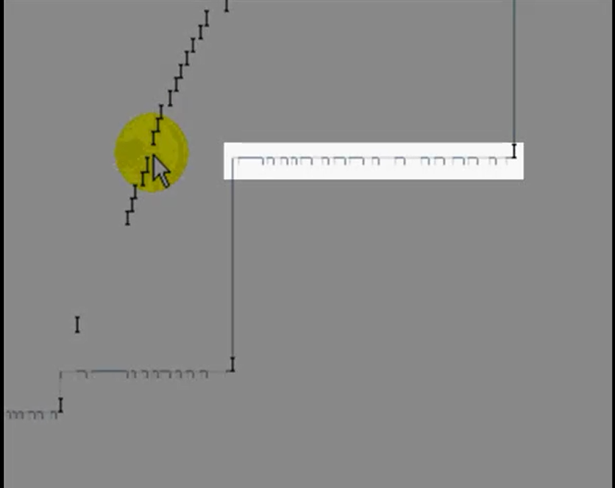
TCP Trace Graph

Slide 53
TCP Trace Graph
Bumps or rat's nests on the data line are also bad
These indicate data loss
This can be seen more clearly by zooming in on that section of the line

Slide 54
Capture and Decode Process
Wireshark can bring frames in from a live capture or from a capture file stored on a drive
Let’s see how these two processes work

Slide 55
Live Capture

Slide 56
Live Capture
During a live capture off of a network the frames are feed by the NIC driver to one of the Wireshark entry points
WinPcap
Wired Windows based connection
AirPcap
Wireless Windows based connection
libpcap
Wired or wireless Linux and some other OSs

Slide 57
Live Capture
A capture filter can be applied at this point to limit what reaches Wireshark
This is to be avoided if possible as whatever this filter drops cannot be recovered
The last step is the frames being feed to the capture engine to be sent on to the decoding section

Slide 58
Capture Filter
In Laura Chappell’s view the most useful capture filters are

Slide 59
Capture Filters

Slide 60
Capture Filters
Here are some other useful ones from the Wireshark mailing list
These all go on one line so ignore the line wrapping
To divide up a capture file too large to read into Wireshark
“c:\Program Files\Wireshark\tshark.exe" -r 500MB_capture_file.cap -R "ip.addr==127.0.0.1" -w output_file_name.cap

Slide 61
Capture Filters
For multiple VLAN capture assuming you can see the traffic for multiple VLANs
vlan and (ether[14:2]&0x0fff = 102 or ether[14:2]&0x0fff = 103)

Slide 62
Capture File

Slide 63
Capture File
If an existing capture file is used the frames are feed straight into the library for presentation to the decoding process
In this case a live capture driver is not required

Slide 64
Connecting to the Network
For the capture from the network to be effective the network analyzer must be properly connected to the network
Regardless of the method used to make the connection in general connect as near to the user experiencing the problem as possible

Slide 65
Connecting to a Network
The type of network from which the frames need to be captured affects how Wireshark should be attached to that network
The two basic types are
Wired
Wireless
Then within wired networks are those at layer 1 v layer 2

Slide 66
Connecting to a Wired Network
Connecting to a hub based wired network that lives solely at layer 1 is easy
Just plug into an unused hub port
Connecting to a switch based layer 2 network is much more difficult
In fact there is no easy, low cost solution to this problem
Here are some possibilities

Slide 67
Connect to the Network
Keep in mind that once a switch learns a MAC address on a port, it forwards traffic for this MAC address directly to the corresponding port
On a switch, after host B's MAC address is learned, unicast traffic from A to B is only forwarded to B's port, and therefore not seen by the analyzer

Slide 68
Connect to the Network

Slide 69
Insert a Hub
A hub may be inserted between the switch port and the device under study
However, one still only sees the traffic back and forth to that device, not all the traffic
Hubs are no longer produced
Those that are available are limited to 10 or 100 mbps

Slide 70
Insert a Hub
Three common problems take place when a hub is inserted into the link
If the link was originally forced to full-duplex, then a new problem has been introduced into the link, as the hub will be operating in half duplex
If the hub used is actually a partial or full bridge and not a true hub as was common as hubs were being phased out nothing is gained

Slide 71
Insert a Hub
The link already had one or more hubs and the Ethernet architecture is now illegal, which causes late collisions

Slide 72
Span or Mirror a Port
To watch traffic on a switch based network, plug the cable from the computer running the analyzer software into any standard port on the switch
Then set the switch port to span or monitor mode

Slide 73
Span or Mirror a Port
In such a mode instead of the port just seeing the traffic directed to the MAC address of the computer on that port, the broadcast traffic, and the multicast traffic it will see all of the traffic on the local network
As in

Slide 74
Span or Mirror a Port

Slide 75
Span or Mirror a Port
To do this on the Cisco Catalyst 2950 switch for example the Switched Port Analyzer or SPAN feature, also called port mirroring or port monitoring, selects network traffic for analysis by a network analyzer
This is called creating a Span port

Slide 76
Span or Mirror a Port
The Catalyst 2950 Switches can have only one SPAN session active at a time and can monitor only source ports, it can not monitor VLANs

Slide 77
Span or Mirror a Port
To create such a port, access the command line interface for the operating system then enter
C2950#config t
C2950(config)#monitor session 1 source interface fastEthernet 0/2
!-- Interface fa 0/2 is configured as source port

Slide 78
Span or Mirror a Port
C2950(config)#monitor session 1 destination interface fastEthernet 0/3
!-- Interface fa0/3 is configured as destination port
C2950(config)#Ctrl Z
To check this enter
C2950#show monitor session 1
Session 1
---------

Slide 79
Span or Mirror a Port
Source Ports:
RX Only: None
TX Only: None
Both: Fa0/2
Destination Ports: Fa0/3
To clear this
C2950#config t
C2950#no monitor session session 1

Slide 80
Span or Mirror a Port
Catalyst 2950 Switches are able to span source port traffic in the
Receive direction only - Rx span or ingress span
Transmit direction only - Tx span or egress span
Both directions

Slide 81
Span or Mirror a Port
Keep in mind the way most switches work these days in that if the switch receives a corrupted packet, the ingress port usually drops it, so you won't see it on the egress port
It is then true that a switch is not completely transparent when it is a matter of capturing traffic

Slide 82
Span or Mirror a Port
So when you see a corrupted packet, the errors where generated on the egress segment

Slide 83
Insert a Tap
In copper based UTP cable networks a tap is similar to a hub
There are two types of UTP taps, standard and aggregating

Slide 84
Standard Tap
Using standard taps means that the monitoring tool either sees the request or the response, but not both
In order to see both the request and the response the monitoring tool needs two analysis input ports, one for the TX path and one for the RX path

Slide 85
Standard Tap
A standard tap provides a copy of all traffic on the link, including any errors that may be present
A standard tap does not experience oversubscription because it has a separate output for each direction

Slide 86
Standard Tap
This permits the monitoring tool to have access on par with a hub in series without the drawback of forcing the link to half-duplex or creating a duplex mismatch
However, to see both streams of traffic two analyzers are required
Then the two capture files must be synchronized and combined

Slide 87
Aggregating Tap
Aggregating taps provide both the request and response by design
Aggregating taps often also provide configurable ingress capability
The monitoring tool can send and receive through the tap output port
Aggregating taps may also offer more than one output port, so that two or more test tools can receive the same output traffic

Slide 88
Aggregating Tap
The latest generation of aggregating taps uses a bridging function to combine the data streams from the RX and TX data paths

Slide 89
Aggregating Tap

Slide 90
Aggregating Tap
As a modified bridge link aggregating taps are subject to the oversubscription problem
Bursty traffic, which is common to networking, may or may not exceed the buffer inside the aggregating tap
The presence of the buffer may obscure some data loss, and would be a very significant concern for forensic analysis

Slide 91
Aggregating Tap
Most reactive troubleshooting would not be affected greatly by data loss through oversubscription or by having a burst exceed the buffer, as the cause of a reactive troubleshooting problem is usually related to the majority of the traffic present
Filtering applied by the aggregating tap may be discarding the traffic of interest

Slide 92
Aggregating Tap
A filter applied for a prior event may still be active, which would affect both troubleshooting and forensic activities
In addition, the act of filtering may cause the aggregating tap to drop additional frames due to CPU overhead in the tap
MAC Layer errors are dropped because bridges do not forward errors

Slide 93
Aggregating Tap
Everything else is flooded to the monitor port
This is perceived as a significant drawback by the industry since standard taps forward errors, and aggregating tap vendors are working hard to correcting this limitation

Slide 94
Aggregating Tap
Typically, only aggregation taps that support injection - ingress traffic from the monitoring tool - have support for Power over Ethernet, so inserting a standard tap will often turn off a PoE powered station
This is most noticeable when troubleshooting VoIP and wireless access points, which are likely to rely on PoE

Slide 95
Fiber Optic Cable Tap
When the cabling being used in the network is fiber optic cable then a different construction must be used for the tap
A fiber optic cable tap takes a single input of light and splits between the intended destination port and the tap
These taps have a split ratio of either 70/30 or 50/50

Slide 96
Fiber Optic Cable Tap
Where either 30 percent or 50 percent of the single goes to the tap
This light splitting can be done in one of two ways
Fused bionic taper splitter
The most common method
Reflective splitter
These look like this

Slide 97
Fiber Optic Cable Tap

Slide 98
Span Port or Tap
Fluke performed a test to see which was the better method to use to connect to a network for analysis
Should one use a span port or invest in a tap
They ran the test on a Cisco Catalyst switch using one port for the tap and another port set to spanning

Slide 99
Span Port or Tap
Using iPerf to fully load each port one at a time they achieved a data rate of 93.1 Mbps for 10 seconds
On the span port 125,221 frames were captured
But on the tap 133,126 frames were captured

Slide 100
Span Port or Tap
Clearly a tap is a better method to use to connect to a heavily loaded network
Fluke recommends that if the data stream will load the span port to 50 percent or more of its capacity, then use a tap instead

Slide 101
Connecting to the Network
There are ways to collect information from switch based networks other than using a protocol analyzer that will be covered elsewhere

Slide 102
Connecting From Both Sides
Another connection problem occurs when data must be captured at both sides of a link such as both sides of a WAN
Two analyzers are required
Then the two capture files must be synchronized and combined
A NTP server is one way to do this

Slide 103
Connecting From Both Sides

Slide 104
Wireless Network Connections
For wireless networks unless a hardware device such as an AirPcap adaptor from Cace Technologies is used there will be a significant limit to the wireless traffic seen
As the Wireshark FAQ points out this is because the driver for the wireless NIC must be placed in promiscuous mode just like a NIC on a wired network in order to capture wireless traffic

Slide 105
Wireless Network Connections
To see traffic on networks other than the one the device is attached to the NIC must also be placed in monitor or RF Mon mode
Even with these settings non data frames may be ignored
There are a large number of non data frames on a wireless network
When in RF Mon mode it stops acting like a normal NIC

Slide 106
Wireless Network Connections
Therefore some default settings for Wireshark must be changed to avoid problems when capturing wireless frames, such as name resolution settings
This means that you should disable name resolution when capturing in monitor mode

Slide 107
Wireless Network Connections
Otherwise, when Wireshark tries to display IP addresses as host names, it will probably block for a long time trying to resolve the name because it will not be able to communicate with any DNS or NIS servers

Slide 108
Wireless Network Connections
Wireshark will only see some if any wireless frames without a special adapter from Cace Technology
Their AirPcap USB adapter looks like this

Slide 109
AirPcap Adapter

Slide 110
AirPcap Adapter
A capture of wireless frames in Wireshark using the AirPcap device looks like this

Slide 111
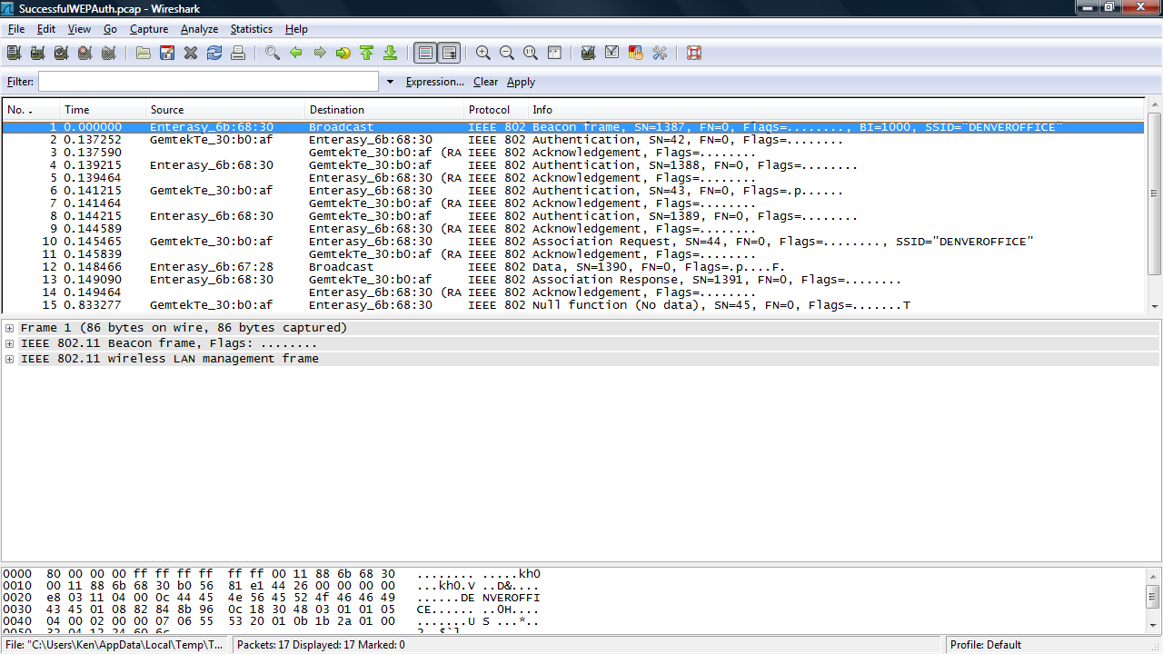
Wireless Frames

Slide 112
AirPcap Adapter
To use the AirPcap adapter with Wireshark it must be set based on the network under study
Here are the common elements to set as illustrated by Laura Chappell

Slide 113
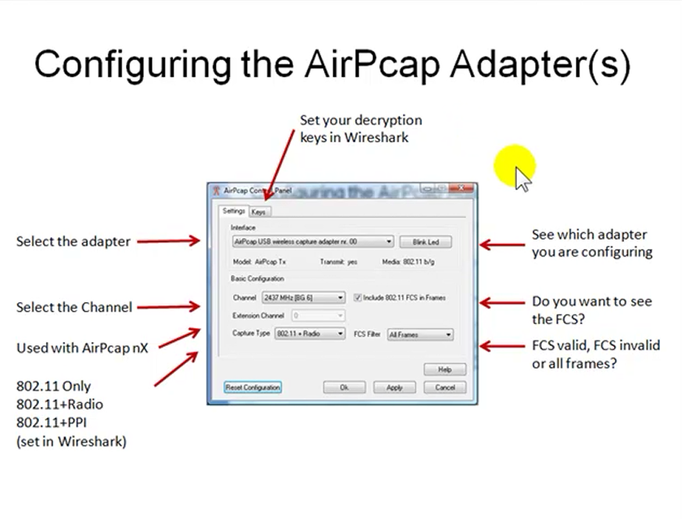
AirPcap Adapter Setup

Slide 114
AirPcap Adapter Setup
And a closer look at the main things to set

Slide 115
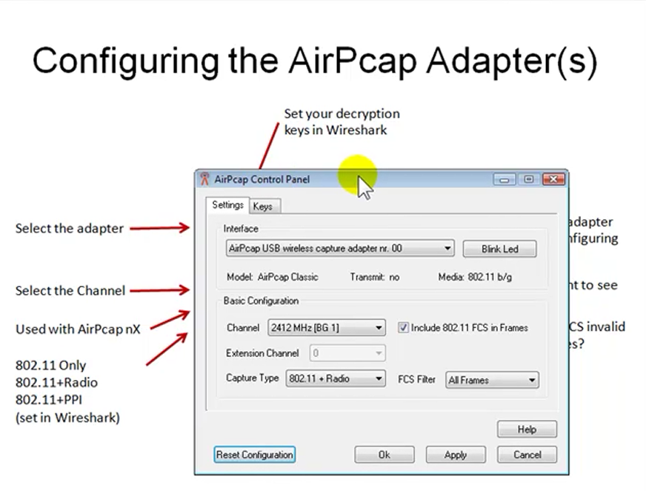
AirPcap Adapter Setup

Slide 116
AirPcap Adapter Setup
The first thing to do is to select the adapter as there can be up to three installed at one time
This is done in the dropdown section under Interface
Next the selected adapter is set to a channel in the dropdown section under Basic Configuration – Channel

Slide 117
AirPcap Adapter Setup
If channel bonding is being used the Extension Channel dropdown can select the channel just before the one specified above by using -1 or the one just after by using +1
The Capture Type dropdown selection tells the adapter what types of frames to capture
These include as the documentation says

Slide 118
AirPcap Adapter Setup
Capture Type
802.11 frames only
802.11 frames plus radio information by using radiotap
802.11 frames plus the Per-Packet Information (PPI) header

Slide 119
AirPcap Adapter Setup
PPI and radio information includes additional information not contained in the 802.11 frame, such as transmit rate, signal power, signal quality, channel, and (for PPI) multiple antenna information
The radio information comes from the radiotap addition
It is defined as

Slide 120
AirPcap Adapter Setup
The ieee80211_radiotap definitions provide a device-independent bpf(4) attachment for the capture of information about 802.11 traffic which is not part of the 802.11 frame structure
For example as mentioned above
Transmit rate, signal power, signal quality, channel
The PPI information is defined as

Slide 121
AirPcap Adapter Setup
When capturing live network data, it is often useful to collect out-of-band information and provide it along with in-band packet data
The traditional method of doing this is to prefix each PDU with a meta-information header (often called a pseudoheader)
Current implementations include such information as 802.11 radio information, access server user IDs, and point-to-point link direction

Slide 122
AirPcap Adapter Setup
The Per-Packet Information (PPI) Header is a general and extensible meta-information header format originally developed to provide 802.11n radio information, but can handle other information as well
PPI is intended to supplement individual packets received from a hardware or software engine with interesting data in a light-weight fashion

Slide 123
AirPcap Adapter Setup
Often such data of interest pertains to the PHY layer, but this need not always be the case
Whatever the carried information may be, the intent is that the information contained is only added to data captured in real-time, not stored packets

Slide 124
AirPcap Adapter Setup
The last main setting is whether to capture the FCS or not
This is done by selecting
Include 802.11 FCS Frames
And then the types to capture under the FCS Filter dropdown selection
The possibilities include

Slide 125
AirPcap Adapter Setup
All Frames: the adapter will capture all the frames regardless of whether the FCS is valid or not
Valid Frames: the adapter will only capture frames that have a valid FCS
Invalid Frames: the adapter will only capture frames that have an invalid FCS

Slide 126
AirPcap Adapter Setup
If required the next step is to enter a WEP key if you want to do this in AirPcap
This key along with WPA and WPA2 settings can also be done directly in Wireshark if they are needed

Slide 127
AirPcap Adapter Setup

Slide 128
Wireless Toolbar
Wireshark has a toolbar specific for wireless networks
This is off by default
To turn it on select
View – Wireless Toolbar

Slide 129
Wireless Toolbar
The AirPcap says this about the setup of the wireless toolbar

Slide 130
Wireless Toolbar

Slide 131
Wireless Toolbar
Most of the settings are the same as described above
But if decrypting traffic keep this in mind about the possible settings
None
No decryption is performed, neither at the driver level nor in Wireshark

Slide 132
Wireless Toolbar
Wireshark
The driver doesn’t perform any decryption of the captured packets, and they are decrypted by Wireshark while displaying them
This has the advantage of minimizing the CPU load during the capture process
Moreover, the driver doesn’t manipulate the packets, so the captured data is a precise picture of the network traffic
However, capture filters (also known as BPF filters) on TCP/IP fields or packet payloads will not work

Slide 133
Wireless Toolbar
Since this kind of decryption is done by the analyzer, when you turn it on or off, you will see the changes immediately reflected in the Wireshark window
Driver
The packets are decrypted by the driver before reaching Wireshark
This option has two advantages: capture filters on TCP/IP fields or packet payloads will work; when logging the network traffic to disk, it will be unencrypted

Slide 134
Wireless Toolbar
This will make it easier for third party applications to understand them
Since this kind of decoding is done during the capture, the changes you make will be effective starting with the next capture

Slide 135
Wireless Setup
Laura Chappell suggests these additional steps when working with a wireless network

Slide 136
Wireless Setup

Slide 137
Decoding
Once the frames are acquired one way or the other the information must be decoded

Slide 138
Decoding

Slide 139
Decoding
This part of the process consists of
Core Engine
Dissectors
Plugins if any
Display Filters if any
The dissectors do the work of interpreting what is seen in the frames
The result is sent to the GUI, GTK in this case

Slide 140
Expert Composite Info
Wireshark has a basic expert analysis function
These are just indications, not absolutes
The expert system is activated by Wireshark when it notices errors
This is accessed by either of two ways
From the Analyze – Expert Info Composite
By clicking the button in the lower left corner

Slide 141
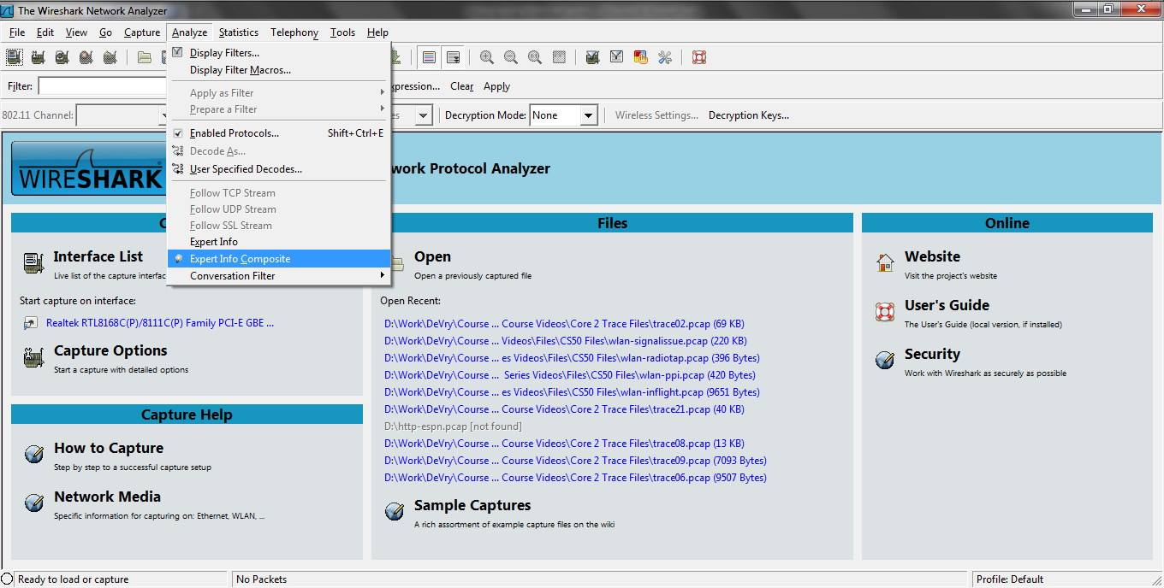
Expert Composite Info

Slide 142
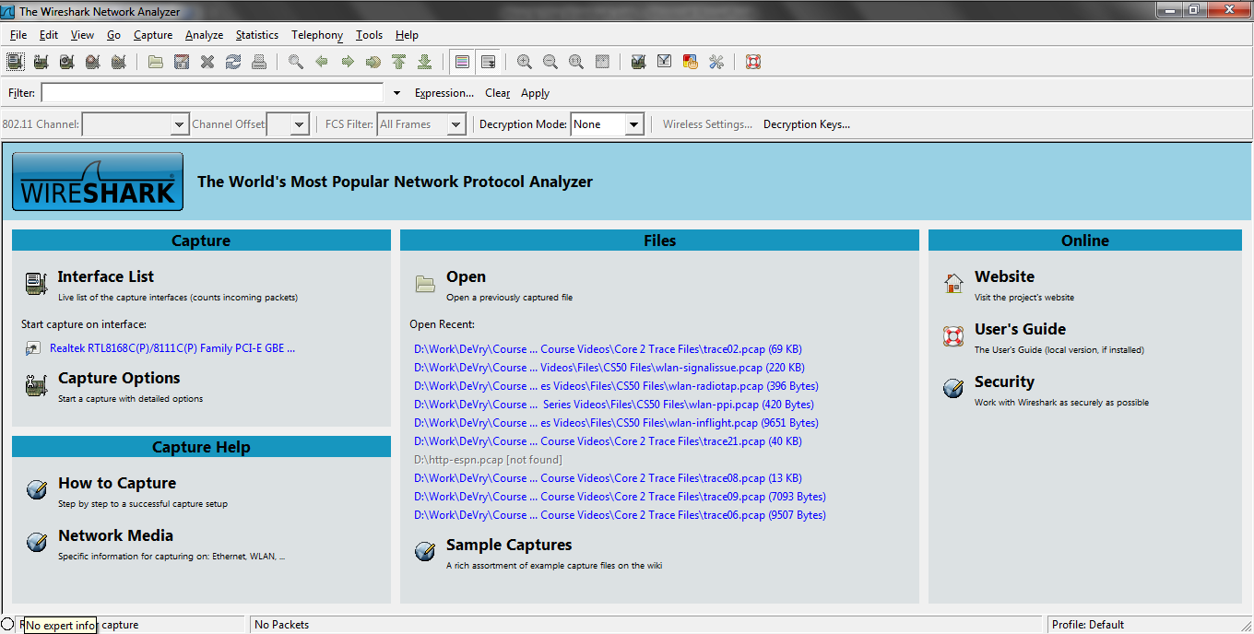
Expert Composite Button

Slide 143
Expert Composite Button
The color of the button tells us something about what has been detected
Red
Errors were found
Yellow
Warnings are noted
Light Blue
Notes are shown

Slide 144
Expert Composite Button
Blue
Chats are shown
Gray
Nothing was detected

Slide 145
Expert Composite Info
More specifically these levels indicate
Errors are packet or dissector errors
Warnings are unusual responses from the application or transport layers
Notes are unusual responses from the application or transport layers or they maybe a recovery process from a Warning
Chats are information about the workflow

Slide 146
Expert Composite Info
These can be filtered on to display them
expert.severity==error
expert.severity==warn
expert.severity==note
expert.severity==chat
The Notes and Warnings for TCP traffic can be displayed by filtering on
tcp.analysis.flags
This will show TCP related problems

Slide 147
Expert Composite Info
Warnings and Notes are related but different
A Warning is a problem with a communication, such as a lost packet
A Note is normal reaction traffic, such as a retransmission
The note maybe indicate a problem, but is still an expected activity due to something else happening first

Slide 148
Expert Composite Info
Wireshark will report retransmissions and fast retransmissions
These are the same thing
Ignore the difference
Treat them the same

Slide 149
While Using Wireshark
When using Wireshark some aspects of it should be kept in mind
Such as
Hiding Wireshark
Colorization of Frames
Display Filters
Not Me Capture Filter

Slide 150
Hiding Wireshark
Any protocol analyzer should be invisible on the network
This is both good and bad
Good because we do not want extraneous data flowing on the network that will make analysis more difficult
Bad because pesky users can place these on the network as well

Slide 151
Hiding Wireshark
Wireshark does not need an IP address assigned to the device on which it is running

Slide 152
Hiding Wireshark
To keep Wireshark from sending data out on the network turn off all name resolution
Edit – Preferences – Name Resolution
Enable MAC name resolution
Enable network name resolution
Enable transport name resolution
The only one that is likely to send anything out is network name resolution

Slide 153
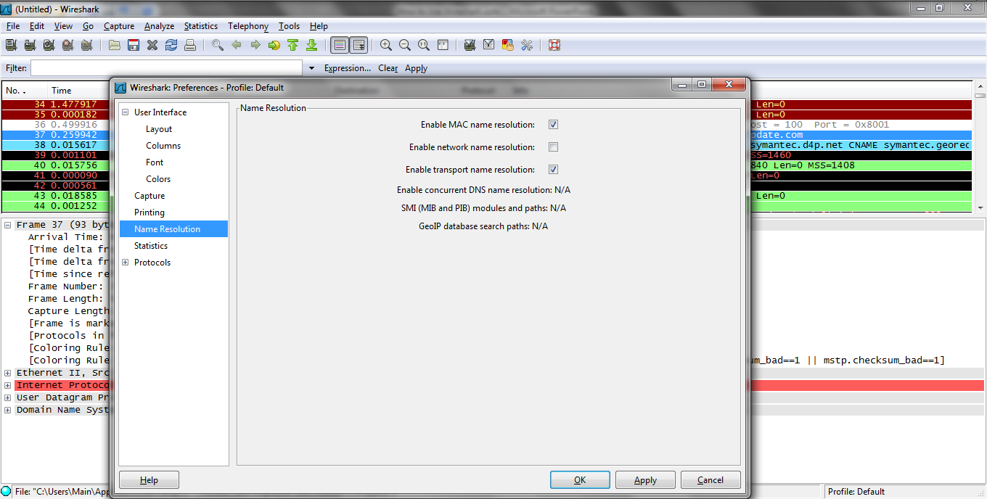
Hiding Wireshark

Slide 154
Colorization
Wireshark makes extensive use of color to identify different types of frames and the parts of those frames
Some or all of the colorization rules can be turned off
However, the colorization notes inside the frame decode cannot
Here is an example of this type of note

Slide 155
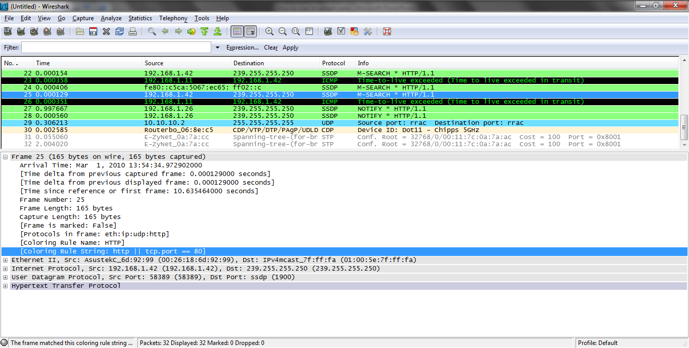
Colorization

Slide 156
Colorization
The first coloring rule that is true is the only one applied
To be sure a rule of interest is used move it up the list of coloring rules

Slide 157
Colorization
An individual conversation can be colorized by
Right Click – Colorize Conversation

Slide 158
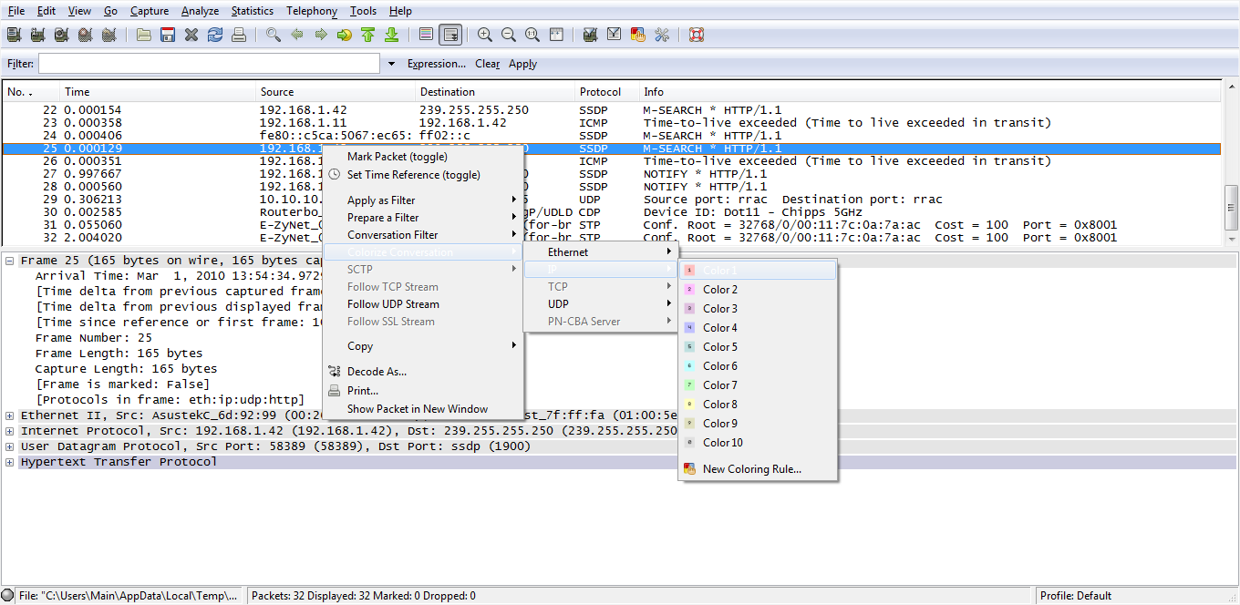
Colorization

Slide 159
Colorization
To turn this off
View – Colorize Packet List

Slide 160
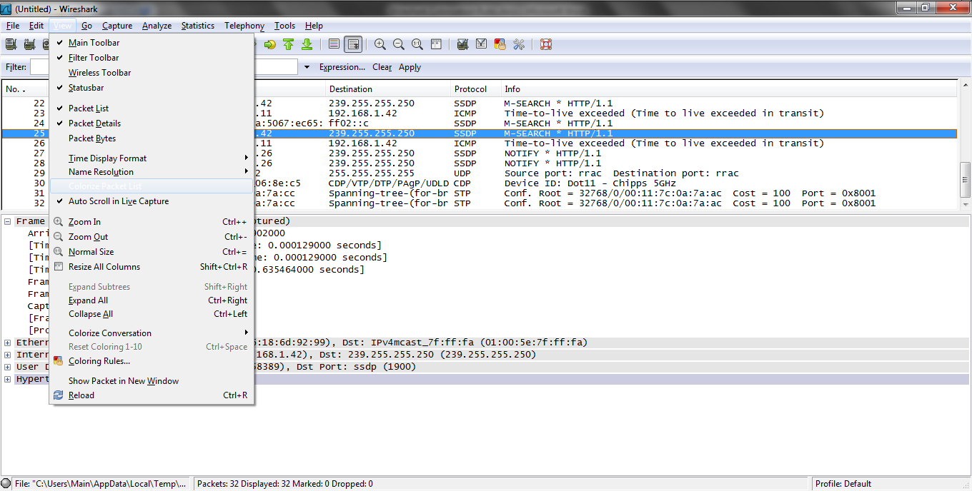
Colorization

Slide 161
Display Filters
If only a certain type of traffic is of interest it is generally best to capture all traffic then use a display filter to view the traffic of interest
For example to see only DNS traffic
Enter dns is the capture filter box
Click Apply

Slide 162
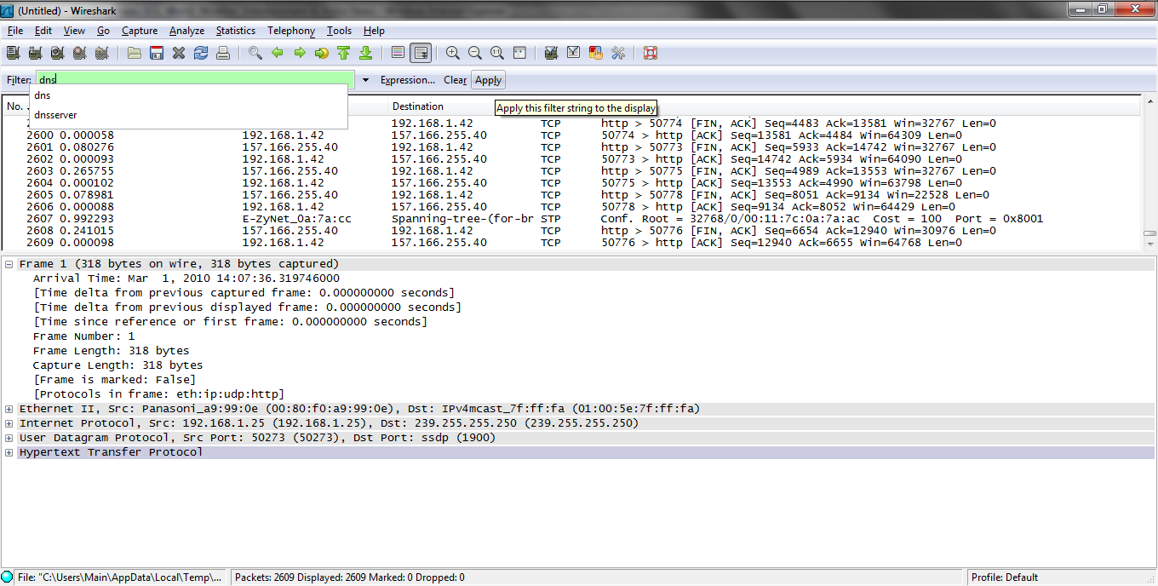
Display Filters

Slide 163
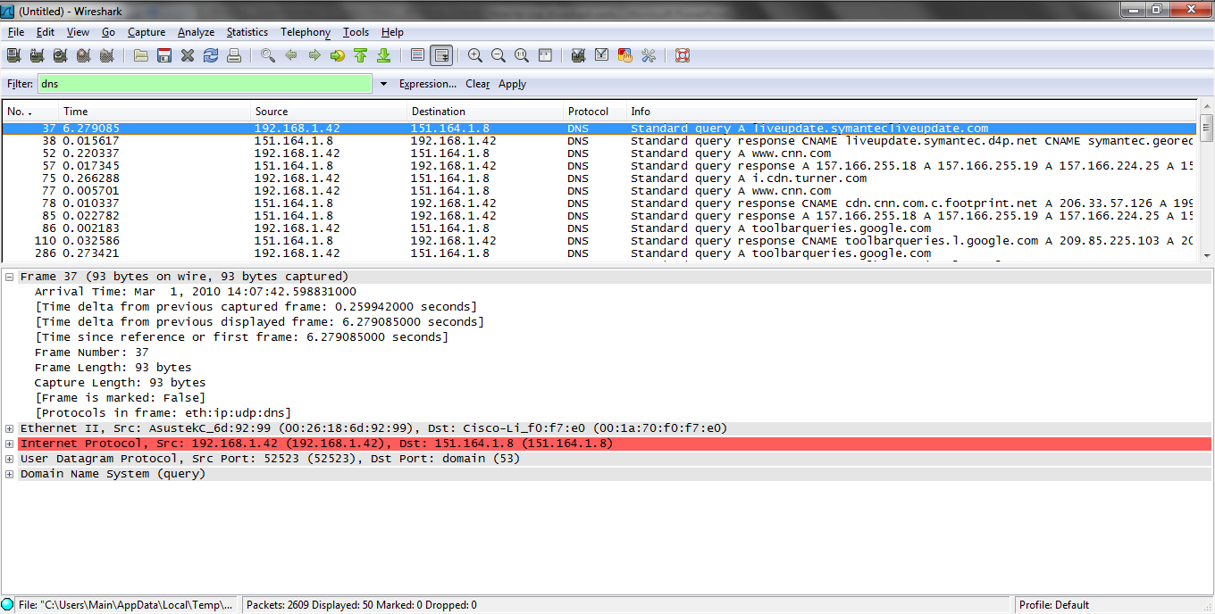
Display Filters

Slide 164
Not Me Capture Filter
Create a Not Me capture filter to filter out traffic back and forth from your own PC
The syntax is
not ether host XX:XX:XX:XX:XX:XX
Where the Xs are your PC’s MAC address

Slide 165
Problems With Wireshark
When using Wireshark some common problems seen include
Dropping Frames
Checksum Errors
Decrypting Wireless Frames
Showing Errors in Frames

Slide 166
Dropping Frames
If there are a large number of frames across the link on which Wireshark is capturing traffic it can be overwhelmed
This results in it dropping frames
This could be due to a number of issues including the limitations of the device on which Wireshark is running
To alleviate this try the following

Slide 167
Increase Buffer Size
Increase the buffer size by selecting
Capture – Options
Buffer size

Slide 168
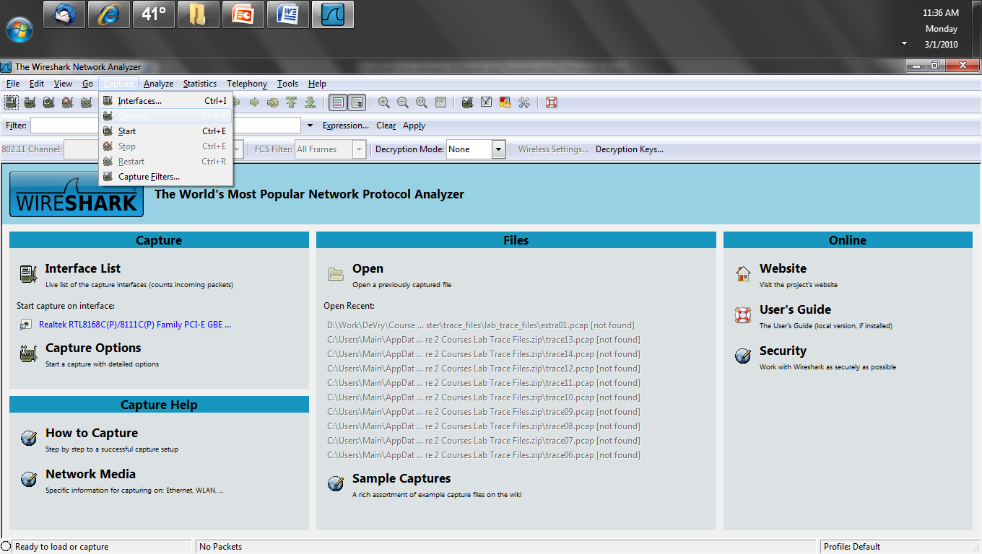
Increase Buffer Size

Slide 169
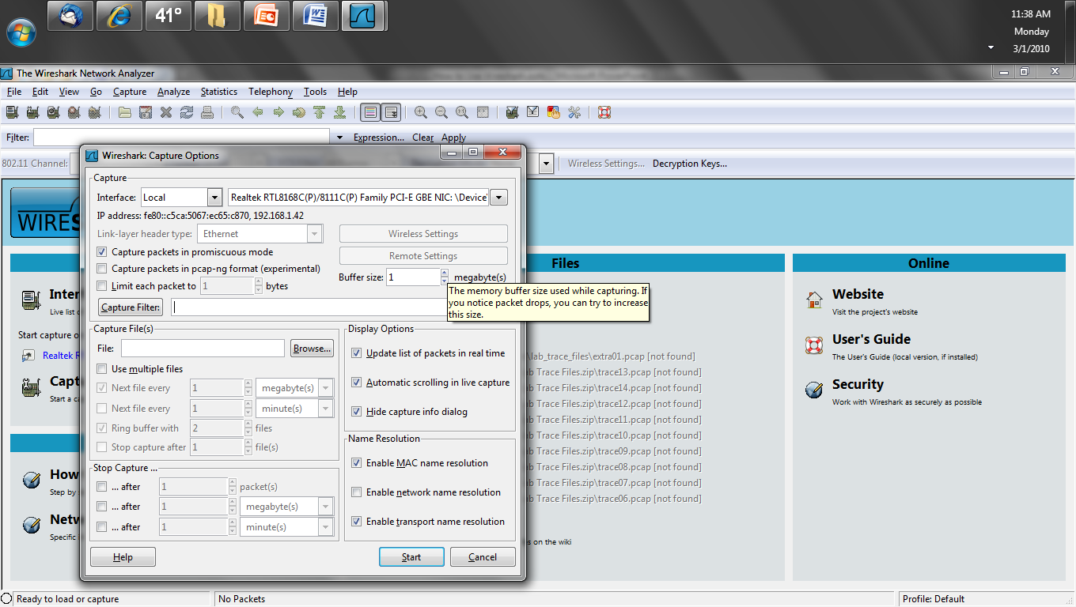
Increase Buffer Size

Slide 170
Packets in Real Time
Turn off update packets in real time
Capture – Options
Update list of packets in real time

Slide 171
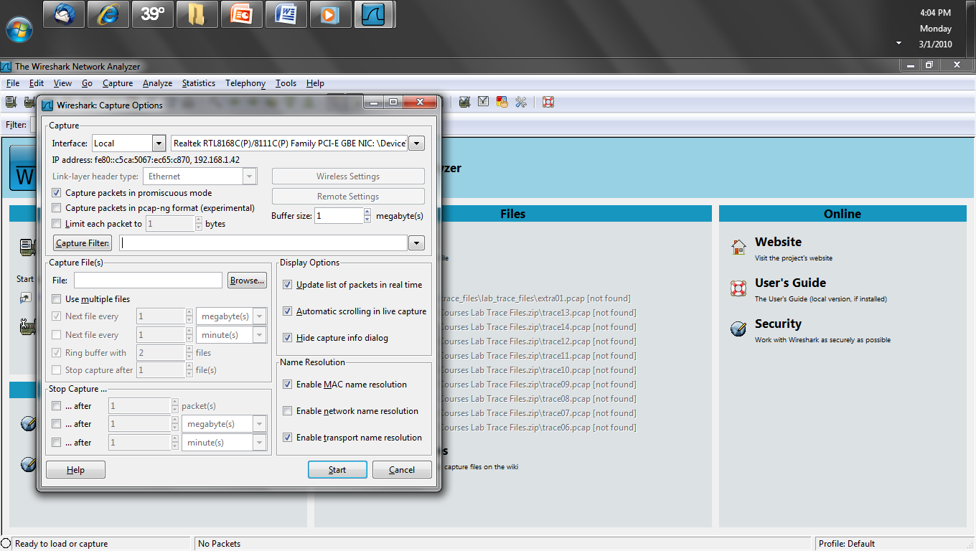
Packets in Real Time

Slide 172
Name Resolution
Turn off enable name resolution
Capture – Options
Enable network name resolution

Slide 173
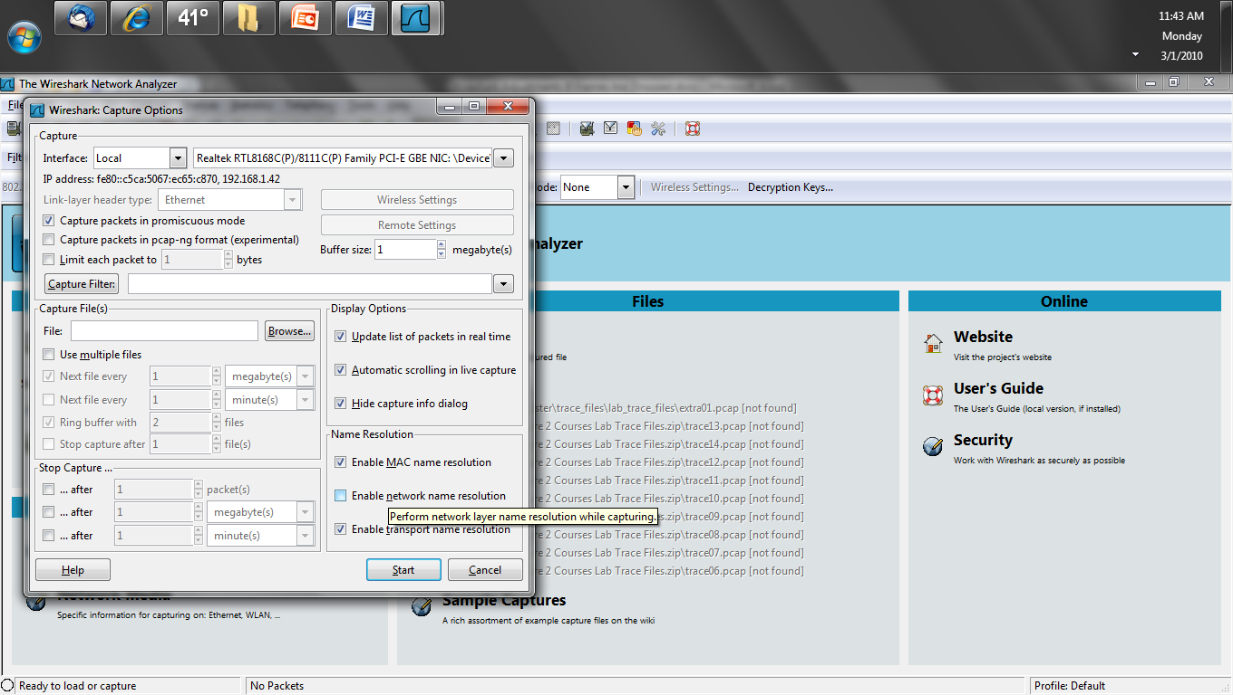
Name Resolution

Slide 174
TCP Checksum Validation
Turn off TCP checksum validation
Edit – Preferences – Protocols – TCP
Validate the TCP checksum if possible

Slide 175
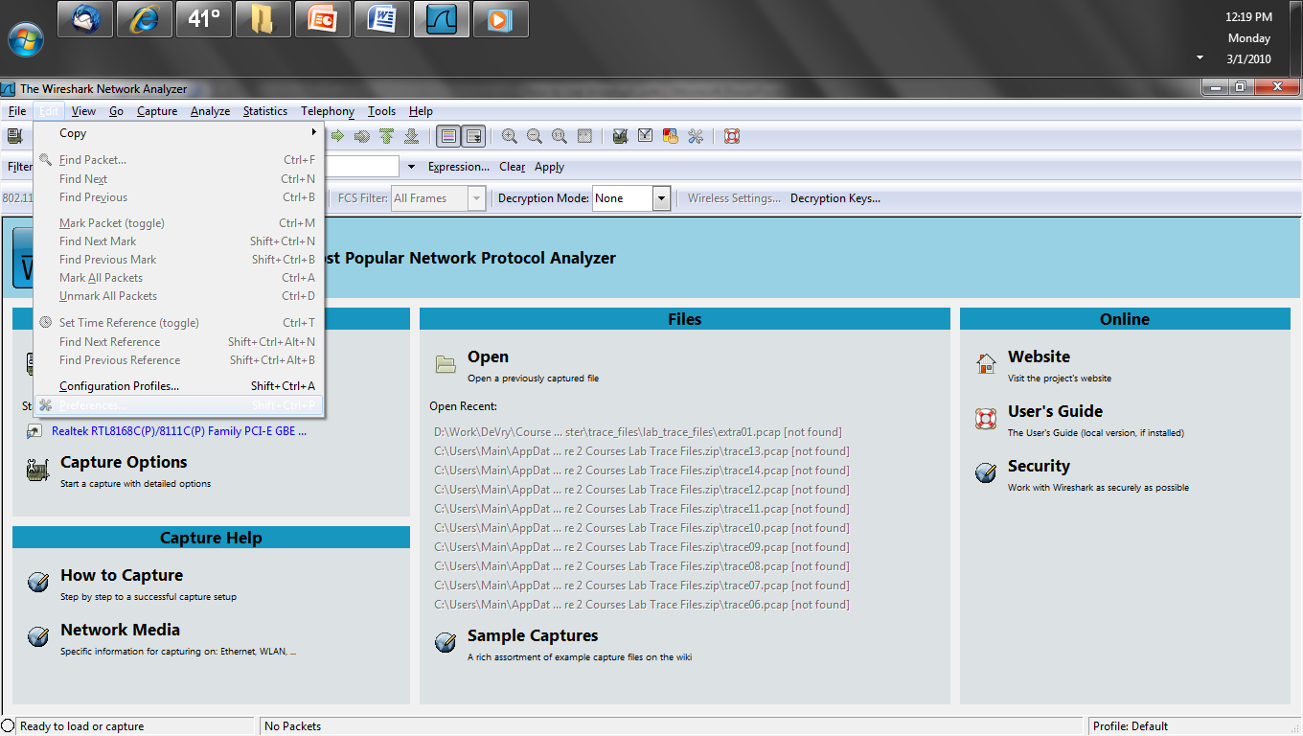
TCP Checksum Validation

Slide 176
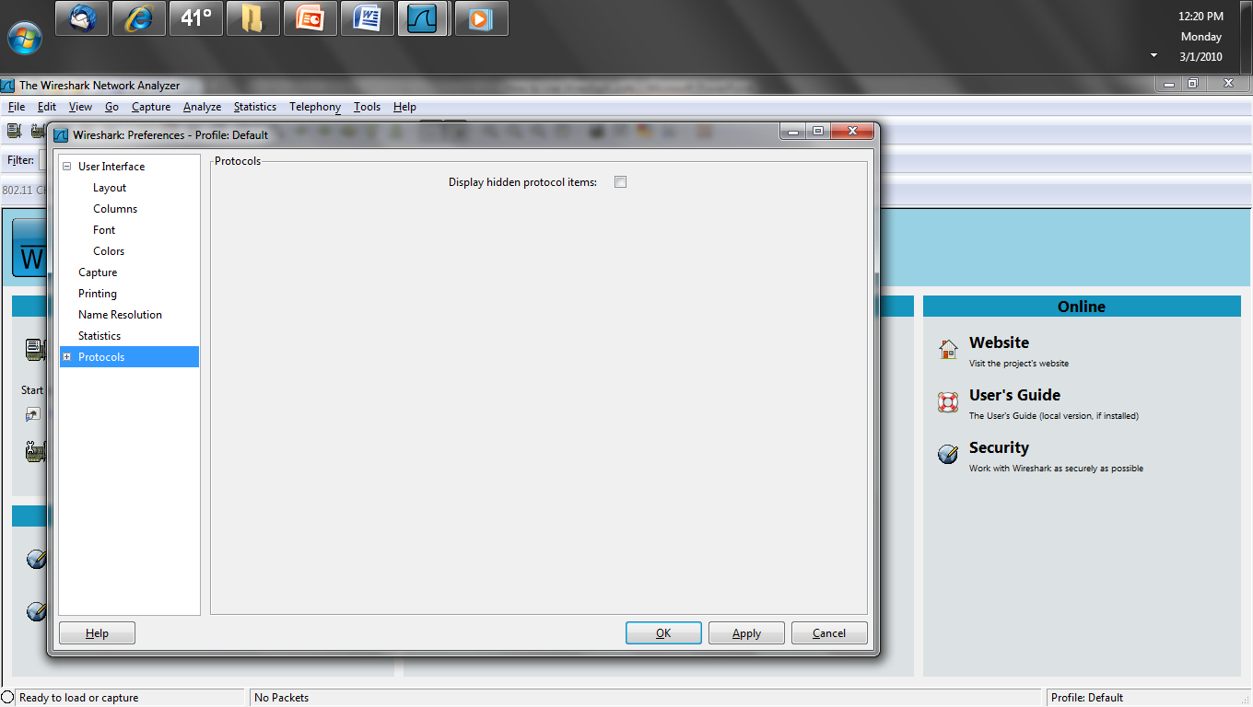
TCP Checksum Validation

Slide 177
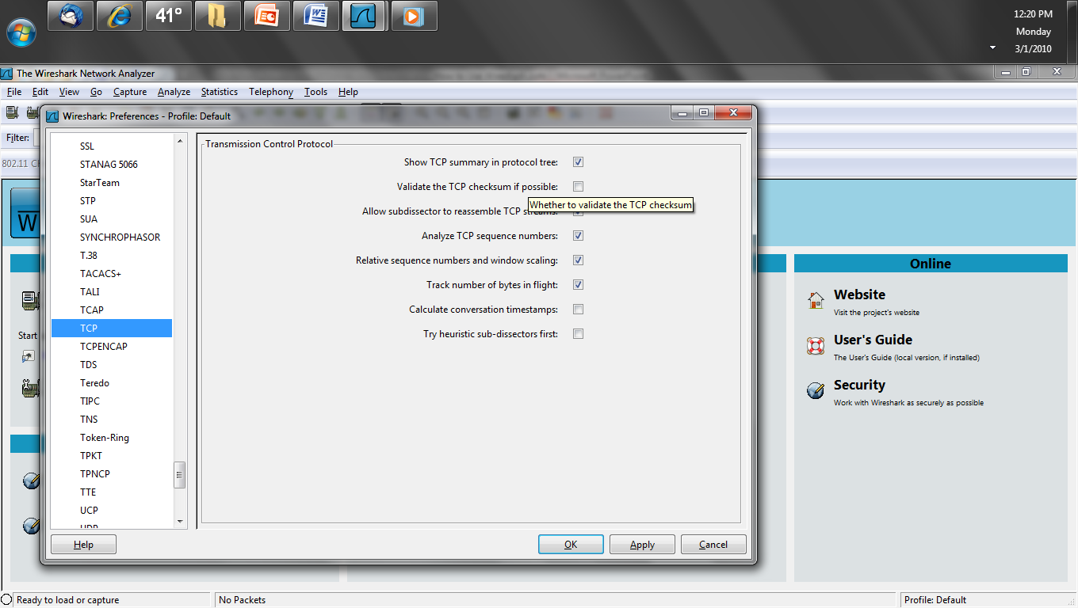
TCP Checksum Validation

Slide 178
Remove Unneeded Columns
Remove any columns that do not provide currently useful information
Edit – Preferences – Protocols – TCP
Columns

Slide 179
Remove Unneeded Columns

Slide 180
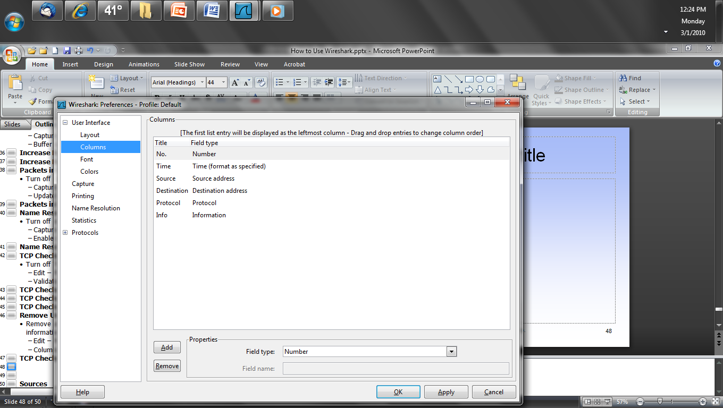
Remove Unneeded Columns

Slide 181
Use Tshark Instead
If the GUI version of Wireshark is overwhelmed, then try capturing from the command line using Tshark
The capture file can be opened in Wireshark for analysis

Slide 182
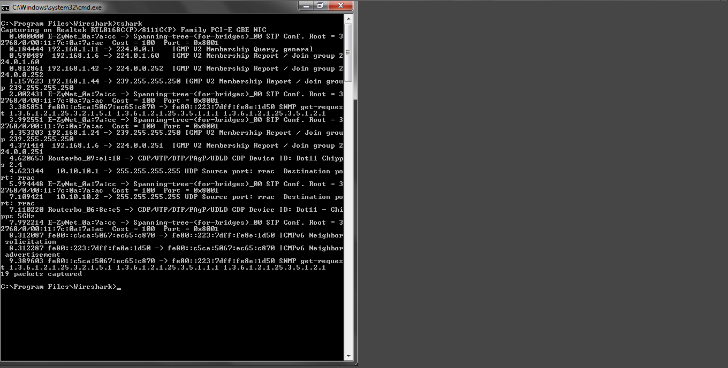
Use Tshark Instead

Slide 183
Odd Results Seen in Wireshark
There some common results seen in Wireshark that appear to be problems but are not, such as checksum errors

Slide 184
Checksum Errors
Wireshark will commonly report many checksum errors that are not really checksum errors
The reason they might be invalid is when Wireshark is being run on the device reporting the bad checksums the problem is likely not bad checksums, but checksum offloading

Slide 185
Checksum Errors
This occurs when Wireshark captures the frames before the checksum has been computed
These look like this

Slide 186
Checksum Errors

Slide 187
Checksum Errors
If responses to these packets are seen, then the checksum is likely good
Wireshark says this concerning this problem
If the packets that have incorrect TCP checksums are all being sent by the machine on which Wireshark is running, this is probably because the network interface on which you're capturing does TCP checksum offloading

Slide 188
Checksum Errors
That means that the TCP checksum is added to the packet by the network interface, not by the OS's TCP/IP stack
When capturing on an interface, packets being sent by the host on which you're capturing are directly handed to the capture interface by the OS, which means that they are handed to the capture interface without a TCP checksum being added to them

Slide 189
Checksum Errors
The only way to prevent this from happening would be to disable TCP checksum offloading, but that might not even be possible on some OSs
However, you can disable the check that Wireshark does of the TCP checksum, so that it won't report any packets as having TCP checksum errors, and so that it won't refuse to do TCP reassembly due to a packet having an incorrect TCP checksum

Slide 190
Checksum Errors
That can be set as an Wireshark preference by selecting "Preferences" from the "Edit" menu, opening up the "Protocols" list in the left-hand pane of the "Preferences" dialog box, selecting "TCP", from that list, turning off the "Check the validity of the TCP checksum when possible" option, clicking "Save" if you want to save that setting in your preference file, and clicking "OK"

Slide 191
Checksum Errors
Both Wireshark and the information on the NIC from the operating system will show this

Slide 192
Checksum Errors
To look at this in Wireshark select Details under the Capture menu
Capture – Interfaces – Details – Task Offload

Slide 193
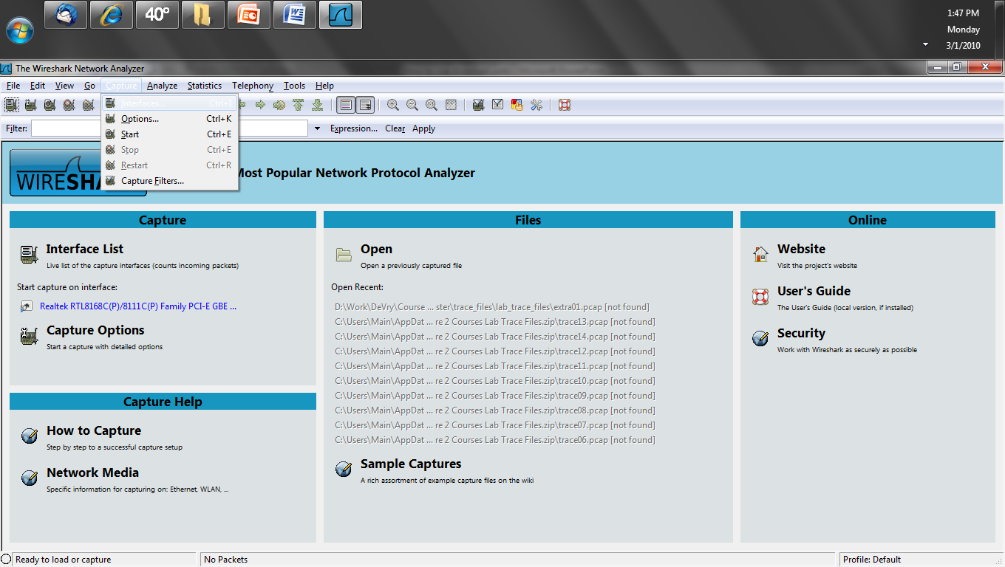
Checksum Errors

Slide 194
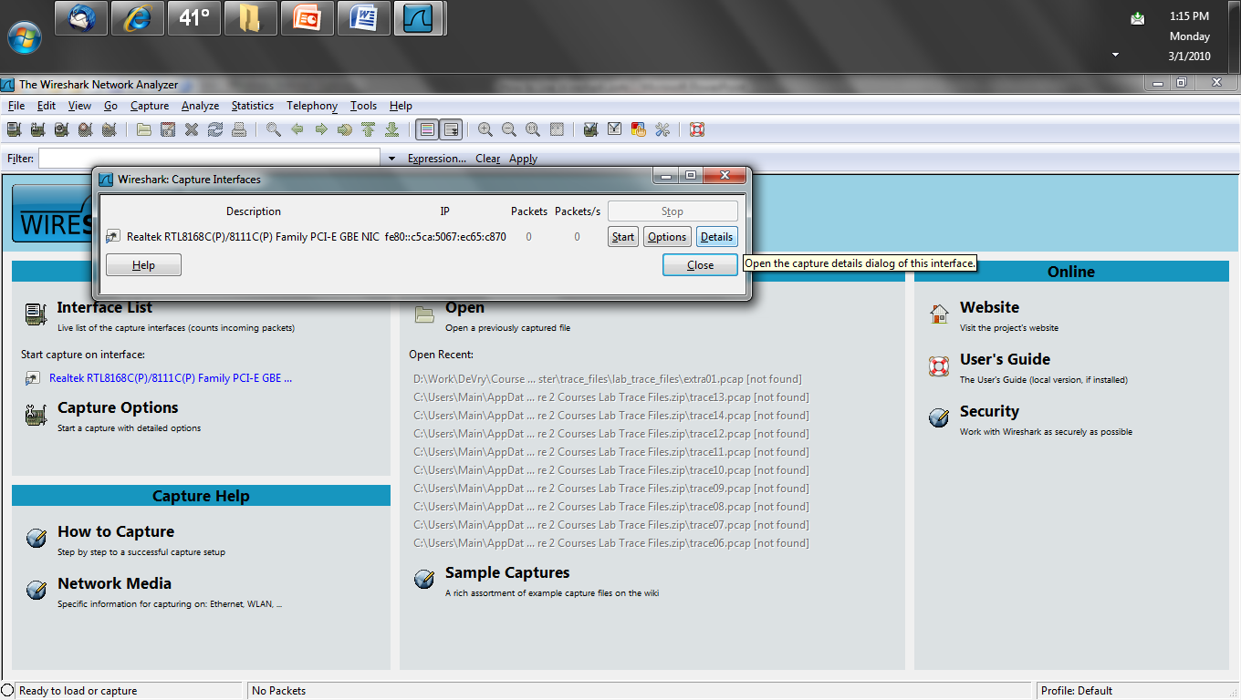
Checksum Errors

Slide 195
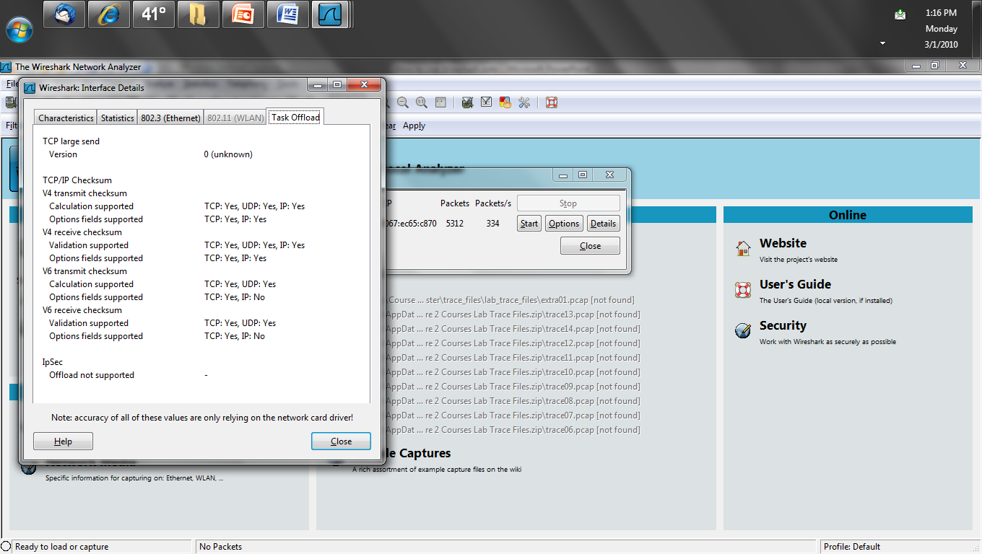
Checksum Errors

Slide 196
Checksum Errors
In the OS, Windows for example, look at
Device Manager
Network Adaptor
Properties
IPv4 Checksum Offload

Slide 197
Checksum Errors

Slide 198
Checksum Errors
This coloring rule can be turned off, but the text in the capture file cannot be removed
To turn off the coloring rule
View – Coloring Rules
Checksum Errors
Disable

Slide 199
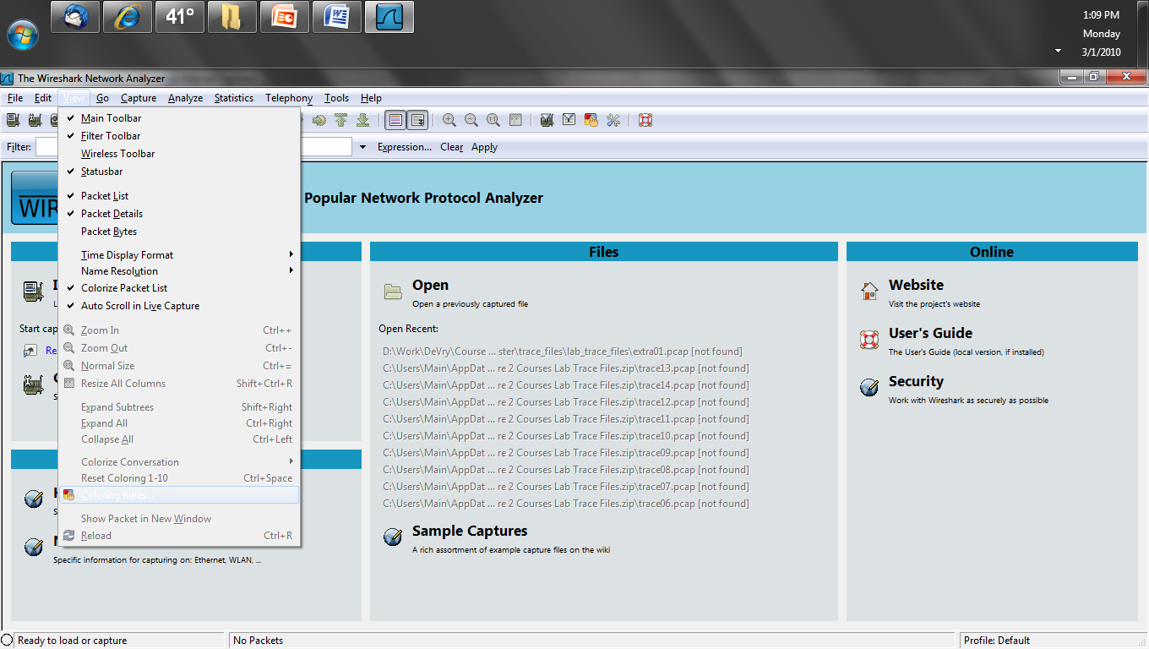
Checksum Errors

Slide 200
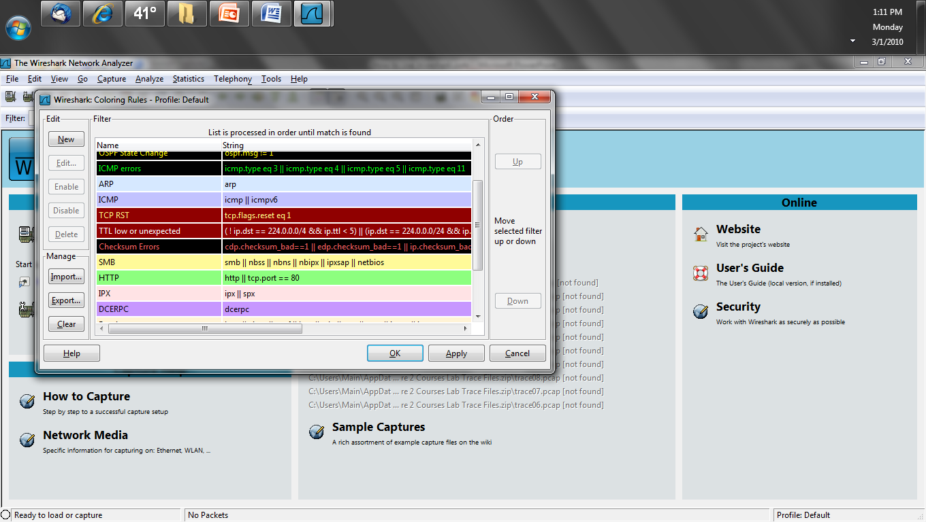
Checksum Errors

Slide 201
Decrypting Wireless Frames
Wireshark can only decrypt WEP, WPA, WPA2 in pre-shared key mode
The enterprise version that uses a RADIUS server is not supported

Slide 202
Showing Errors in Frames
Unlike hardware based analyzers Wireshark is limited in several areas especially as related to showing errors on the network
Lacking a set of drivers designed for the NICs out there Wireshark can only read in the frames the standard NIC driver presents to it
Standard NIC drivers do not read in errors

Slide 203
Showing Errors in Frames
Here is what the Wireshark FAQ says about this issue
Unless the OS always supplies packets with errors such as invalid CRCs to the raw packet capture mechanism, or can be configured to do so, Wireshark - and other programs that capture raw packets, such as tcpdump - cannot capture those packets
Most OSs probably do not support capturing packets with invalid CRCs on Ethernet

Slide 204
Showing Errors in Frames
This is also true of invalid FCS fields at the end of the frame
To which the Wireshark FAQ says
Unless the OS supplies the FCS of a frame as part of the frame, or can be configured to do so, Wireshark - and other programs that capture raw packets, such as tcpdump - cannot capture the FCS of a frame
Most OSs do not support capturing the FCS of a frame on Ethernet

Slide 205
Showing Errors in Frames
This means the network will appear to be error free at the physical and data link layers when it may not be
This is a significant limitation of Wireshark
Other than using a hardware based analyzer, the only way to see these errors is to check the error counters in each switch

Slide 206
Command Line Tools
As mentioned above Wireshark has several command line non-GUI tools, such as
tshark
capinfos
editcap
mergecap
text2pcap
These do the following

Slide 207
Command Line Tools
Tshark captures files without the added burden on the hardware of a GUI interface
Capinfos prints information about capture files
Editcap edits capture files
Mergecap merges capture files
Text2pcap converts raw hex dumps into pcap files

Slide 208
Detecting Wireshark
There is no absolutely certain way to detect a protocol analyzer running on a network as these are passive devices
This is a major problem with this sort of tool, which is free to anyone
The best thing to do is to search the web using a phrase such as
detecting sniffers
then try what they say

Slide 209
Detecting Wireshark
The basic technique is to attempt to discover NICs set to promiscuous mode as there is no reason for a NIC to be set to this unless the device is running a network analyzer of some sort
However, this does not work when one of these is attached to a spanned or rspanned port

Slide 210
Detecting Wireshark
But if someone has this level of physical access to the network, you have bigger problems than a network analyzer

Slide 211
Sources
A considerable amount of this is based on various articles and training material produced by Laura Chappell
If you want to learn abut Wireshark or network analysis she is the place to go

Slide 212
Sources
The discussion of fiber optic cable taps is from an article in Cabling Installation and Maintenance magaine by Kozischek and Iery of Corning Cable Systems March 2013

