Slide 1
How to Use SNMP to Collect Network Data Last Update 2013.04.18 1.1.0

Slide 2
Objectives
Learn how to collect data with SNMP to use in baselining and troubleshooting a network

Slide 3
What is SNMP
SNMP is the Simple Network Management Protocol
It is used to collect and then report information on devices such as routers and switches attached to the network
To accomplish this an SNMP agent must be running on the device that will be monitored

Slide 4
What is SNMP
Then a program called a NMS – Network Management System must be installed to access and display this information on another device
SNMP is defined by several RFCs including these

Slide 5
SNMP RFCs
1155 - Structure and identification of management information for TCP/IP−based internets
1156 - Management information base for network management of TCP/IP−based internets (MIB I)
1157 - Simple network management protocol

Slide 6
SNMP RFCs
1213 - Management information base for network management of TCP/IP−based internets (MIB II)
1441 - Introduction to version 2 of internet−standard network management framework
1452 - Coexistence between version 1 and version 2 of the internet−standard network management framework

Slide 7
SNMP RFCs
2578 - Structure of Management Information Version 2
3414 - User−based Security Model for version 3 of the Simple Network Management Protocol
3584 - Coexistence between Version 1, Version 2, and Version 3 of the internet−standard network management protocol

Slide 8
Enable SNMP on the Device
The device to be examined must have SNMP enabled and configured
In this example SNMP will be enabled and configured on Windows
The exact sequence will depend on the version of Windows
For example to do this on Windows 7 follow these steps

Slide 9
Enable SNMP on the Device
From the Control Panel select
Programs and Features
Select
Turn Windows features on and off
Scroll down to
Simple Network Management Protocol (SNMP)
Select the checkbox to activate it

Slide 10
Enable SNMP on the Device
Click Ok
Close out the Control Panel

Slide 11
Configure SNMP on the Device
Most defaults will work in the typical installation
In the real world the community string – password – should be changed as everyone knows the default password
In the example here – Windows 7 – there is no community string so one will be entered

Slide 12
Configure SNMP on the Device
To do this from the Control Panel select
Administrative Tools
Then select
Services
Scroll down to SNMP Service
Double click it
Select the Security tab
Select Add under the Community box

Slide 13
Configure SNMP on the Device
Put in a password
Click
Accept SNMP packets from any host
Close out all dialog boxes

Slide 14
Install an SNMP NMS
There are a large number of NMS programs
In this example PRTG Traffic Grapher from Paessler will be used
Download the program
Install the program using the defaults and the free version

Slide 15
Setup the Sensor
After the program is installed a sensor must be added to access the information available form the device to be monitored
In this case we will look at the bandwidth used by the NIC card in the computer
Click
Add
The following dialog boxes appear

Slide 16
Setup the Sensor
Accept the defaults and click next for both

Slide 17
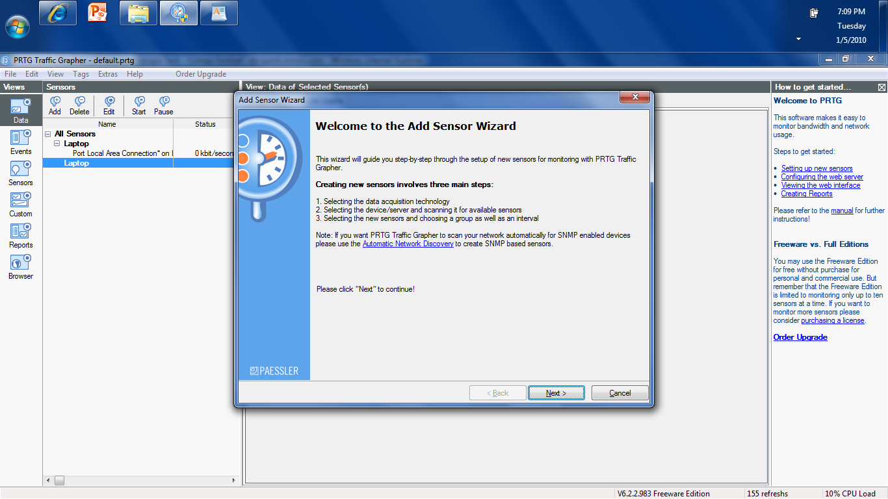
Setup the Sensor

Slide 18
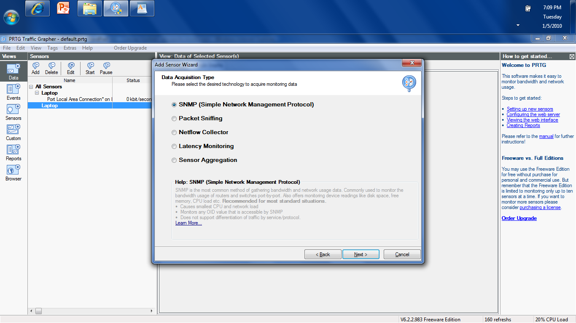
Setup the Sensor

Slide 19
Setup the Sensor
In the next dialog box
Enter a name for the device
Enter the password
Click
Next

Slide 20
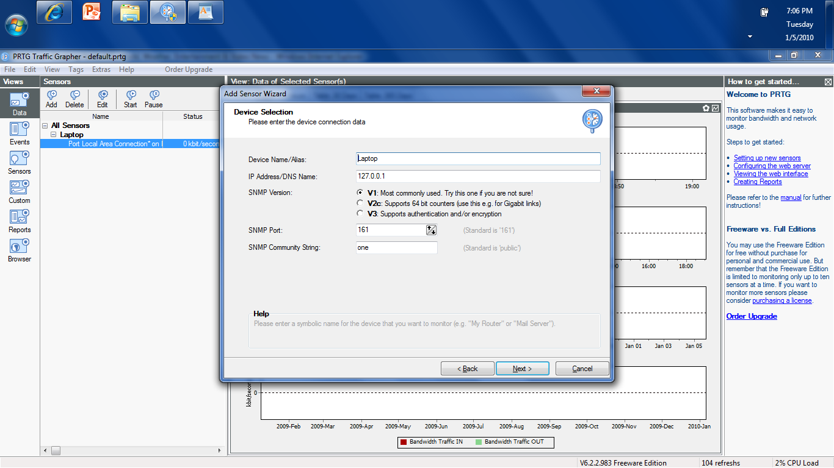
Setup the Sensor

Slide 21
Setup the Sensor
On the Sensor Selection list select the
Local Area Connection Ethernet Connected
at the bottom of the list of these
Click
Next

Slide 22
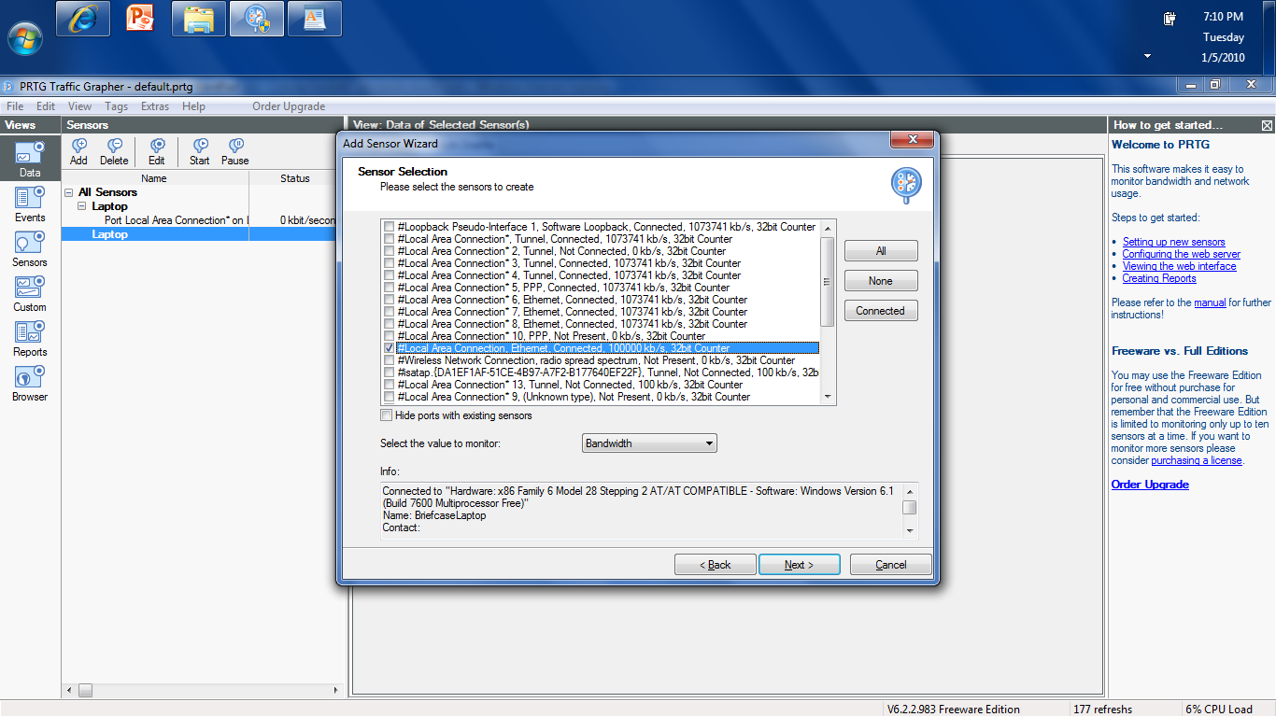
Setup the Sensor

Slide 23
Setup the Sensor
In the next dialog box change the Scanning Interval to 1 second Click
Finish

Slide 24
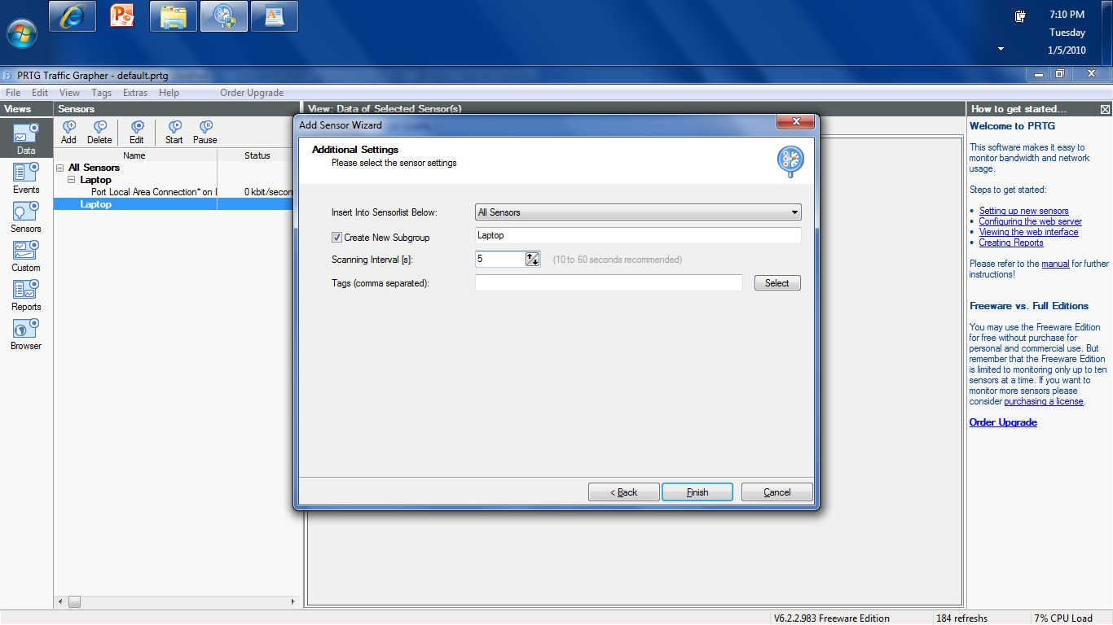
Setup the Sensor

Slide 25
Display the Data
On the next screen a set of graphs will appear

Slide 26
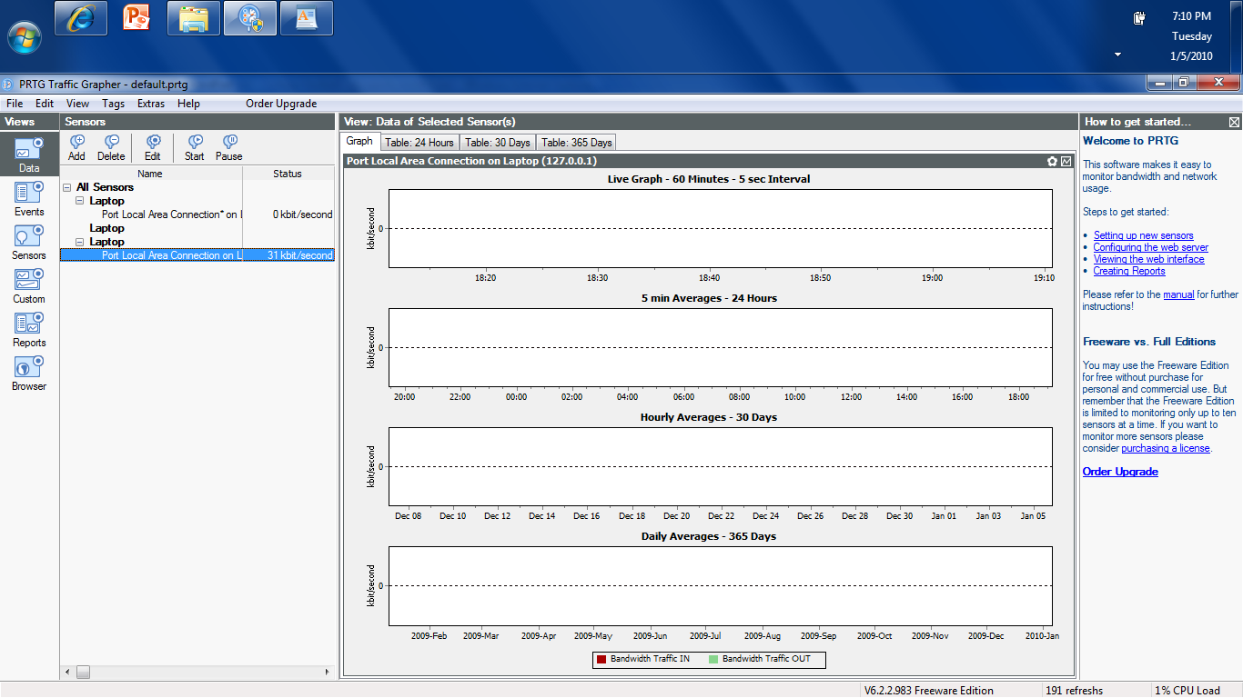
Display the Data

Slide 27
Display the Data
To see something here surf the web
Then switch back
Something like this will appear

Slide 28
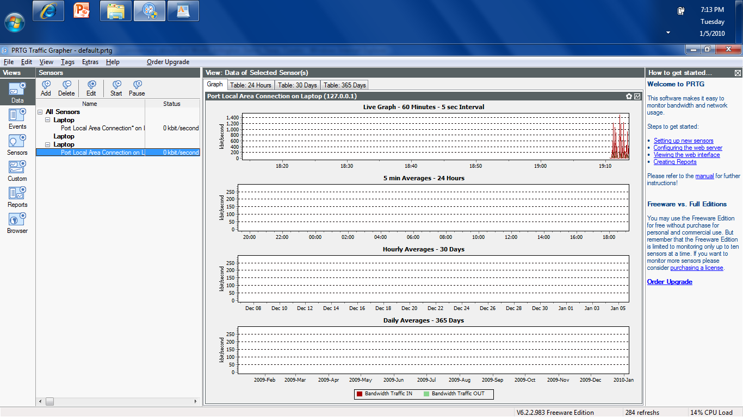
Display the Data

