Slide 1
Checking Connectivity
Last Update 2010.03.07
1.0.0

Slide 2
Objectives
Learn how to check for connectivity through the network

Slide 3
Tools
Ping
Traceroute
Netstat

Slide 4
Ping
This tool is like radar or sonar
It sends out a ICMP echo requests
The other end sees the packet and answers back to the sender
Simple and effective
Ping can return a number of different responses depending on the implementation

Slide 5
Ping
More specifically ping sends a special packet of information to a specific IP address and then listens for a reply
This special packet is called the ICMP - Internet Control Message Protocol echo request packet
ICMP packets are IP control messages that two systems on a TCP/IP network use to communicate various things

Slide 6
Ping
When a system receives an echo request, it answers back with an echo reply, which includes the original echo request packet in the data field of the echo reply

Slide 7
Lab
Start Wireshark
Open icmp.pcap
Examine the process shown

Slide 8
Ping
When testing a connection, ping tracks
  Number of packets sent
  Number of replies received
  Percentage of packets lost
  Amount of time required for the packets to reach the destination and for replies to be received
  Number of hops from here to there
For example

Slide 9
Windows Ping Output
C:\>ping www.chipps.com
Pinging chipps.com [161.58.165.159] with 32 bytes of data:
Reply from 161.58.165.159: bytes=32 time=123ms TTL=242
Reply from 161.58.165.159: bytes=32 time=124ms TTL=242
Reply from 161.58.165.159: bytes=32 time=123ms TTL=242
Reply from 161.58.165.159: bytes=32 time=124ms TTL=242
Ping statistics for 161.58.165.159:
Packets: Sent = 4, Received = 4, Lost = 0 (0% loss),
Approximate round trip times in milli-seconds:
Minimum = 123ms, Maximum = 124ms, Average = 123ms

Slide 10
Lab
Start Packet Tracer
Setup the network shown on the board
Ping from the PC to the Router
Leave this network in place

Slide 11
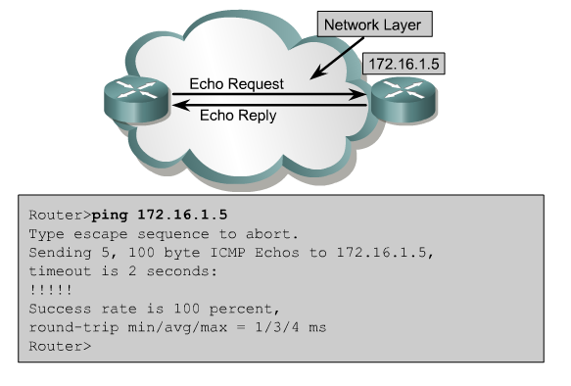
Cisco Ping Output

Slide 12
Ping
It first resolves the name to an IP address, if a name is used
Then it reports the size of the reply, here 32 bytes
Next is the time for the round trip, which may be different for each attempt

Slide 13
Ping
Last is the TTL – Time to Live
  This is the number or hops or routers subtracted from 255
  In other words in this case 13 routers were crossed
The summary information comes at the end
Each implementation is different
Many Unix boxes just return Is alive!

Slide 14
Ping
Here is what some common responses mean

Slide 15
Ping
100% Packet Loss
  You’re getting no where fast

Slide 16
Ping
Network Unreachable
  The network portion of the address is different from the local network
  You cannot get there from here
  The local system does not have a route
  The host is not connected to the network

Slide 17
Ping
Destination Host Unreachable
  One of two things are occurring
    The local system has no route to the destination
    The remote router has no route to the destination
  They can be distinguished by the message
    If it says Destination Host Unreachable it relates to the local host
    If it says Relay From XXX.XXX.XXX.XXX: Destination Host Unreachable then the remote router has no route

Slide 18
Ping
Unknown Host
  The DNS cannot be found
  The DNS server is down
Request Timed Out
  No echo replies were received from the other end of the line
  Use Traceroute to find the source of the stoppage

Slide 19
Ping
Ping has a number of options depending on the operating system

Slide 20
Ping
-t Ping the specified host until stopped.
To see statistics and continue - type Control-Break;
To stop - type Control-C
-a Resolve addresses to hostnames
-n count Number of echo requests to send
-l size Send buffer size
-f Set Don't Fragment flag in packet
-i TTL Time To Live
-v TOS Type Of Service
-r count Record route for count hops
-s count Timestamp for count hops
-j host-list Loose source route along host-list
-k host-list Strict source route along host-list
-w timeout Timeout in milliseconds to wait for each reply

Slide 21
Lab
Back in Packet Tracer
  Ping until told to stop
  Then look at the extended ping options

Slide 22
Extended Ping
The Cisco IOS includes a very powerful option for the ping command called an extended ping command
The extended ping command allows the CLI to specify many different parameters about how the ping command works
When in enable mode, the user can simply type ping and press Enter

Slide 23
Extended Ping
Then the router prompts the user for a wide variety of parameters, such as the number of echo requests to send, the time to wait to receive a reply, and the IP address from which to send the echo request packets

Slide 24
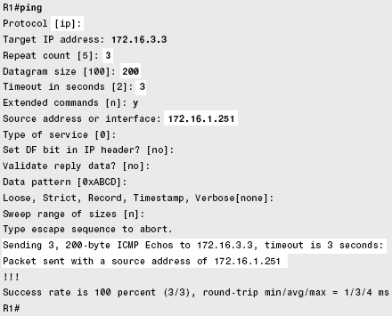
Extended Ping

Slide 25
Ping
Some versions allow patterns to be set
This is done for testing of a particular type of network such as a T1 for example
  0x0000
    To show line code mismatches
  0xFFFF
    To show repeater power problems
  0x4040
    To show timing problems
  The 0x means the characters are in hex

Slide 26
Ping
The procedure to use to isolate the problem domain when using pong is to first ping your way out, then ping your way back in
Here is the procedure

Slide 27
Ping Your Way Out
Ping your way out
  Ping the loopback address – 127.0.0.1
  Ping this host by number
  Ping a host on the same network by number
  Ping the default gateway device, by number
    Ping the inside interface of the router
    Ping the external interface of the router
    Ping all the other router interfaces
  Ping a host off the network by number
  Ping this host by name

Slide 28
Lab
From the command line run
  ipconfig /all
Record the information for
  IP address
  Default gateway
  DHCP server
  Both DNS servers
Ping your way out

Slide 29
Ping Your Way Back In
Ping your way in
  Sometimes you may want to reverse the process to see if anyone in the outside world can see you
  This is what a Looking Glass is for
  For example

Slide 30

Looking Glass Ping

Slide 31
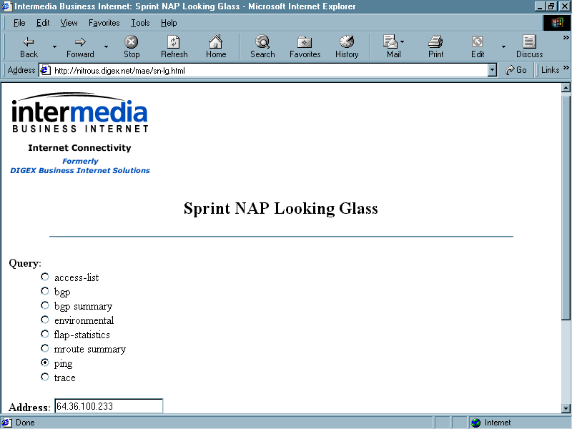
Looking Glass Ping

Slide 32
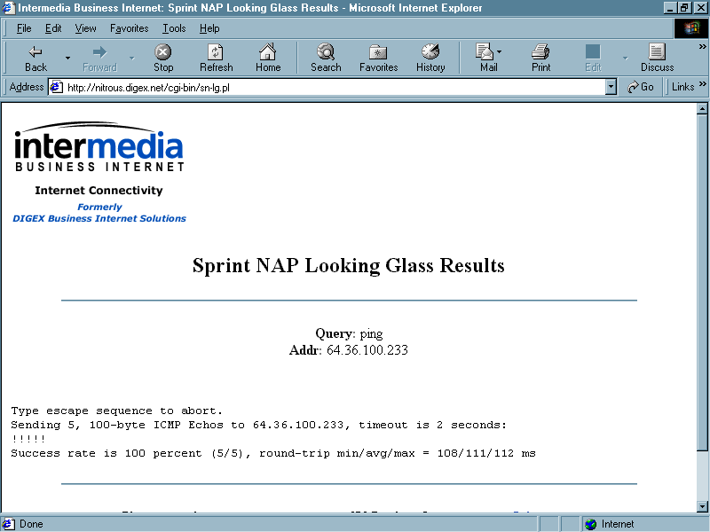
Looking Glass Ping

Slide 33
Lab
Go to a looking glass site
Ping your way back to the DeVry DNS servers

Slide 34
Traceroute
Traceroute provides a general round-trip measurement from the originating point to each router in the path from that point to the destination
With most implementations, three results for each router and the destination are shown
Traceroute can be used as a rough estimate of the time to reach a destination

Slide 35
Traceroute
It is most useful, however, as a method for checking the path to a remote destination
Traceroute is used to display the routers traversed to reach a destination host
Traceroute uses UDP data packets with incrementing TTL values and an invalid port number to build the traceroute list of routers

Slide 36
Traceroute
It proceeds in this manner
  The host originating the traceroute starts out by sending a data packet with a destination address of the remote host and a TTL value of 1
  The first router that receives the packet, will decrease the TTL value by 1
  Since the TTL value is now 0, the router sends back an ICMP Timeout Exceeded message to the originating host

Slide 37
Traceroute
  The originating host then adds that router to the traceroute list and sends out another data packet with a TTL value of 2
  The first router will receive the packet and decrease the TTL value by 1 and forward the packet to the next hop
  When that router receives the packet, it decreased the TTL value by 1

Slide 38
Traceroute
  Now the TTL value is 0 and the router sends back an ICMP Timeout Exceeded message back to the originating host
  When the originating host receives the ICMP message, it adds that router to the traceroute list and sends out another data packet with a TTL value of 3

Slide 39
Traceroute
  This process continues, each time the TTL value is 0, the router replies with an ICMP message and the originating host adds it to the list and sends out another data packet with an increased TTL value
  Once the destination host receives the data packet, it sees that the port number is invalid and sends back an ICMP Unreachable Port message back to the originating host

Slide 40
Traceroute
  When the originating host receives this message, it knows that the host has been reached and ends the traceroute
  A graph of this process is next

Slide 41
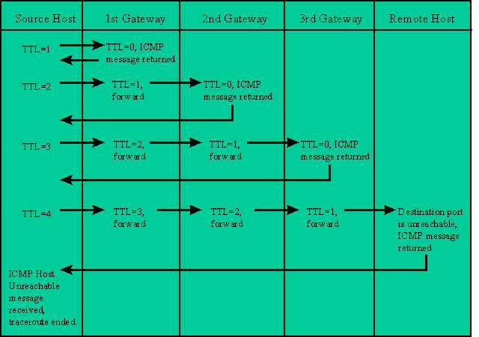
Traceroute

Slide 42
Traceroute
This continues until the destination is reached or the maximum number of tries has been reached
This maximum is usually 30 hops

Slide 43
Traceroute
Unfortunately, traceroute is not dependable
Some routers do not send back time exceeded messages
Also, some end systems do not send the port unreachable message which means that traceroute waits for a long time before timing out

Slide 44
Traceroute
Finally, some service providers purposely change the results of traceroute to hide internal hops
Microsoft’s version of traceroute sends an ICMP ping rather than an UDP probe packet

Slide 45
Traceroute
The only real difference is that when the message reaches the final destination, the destination normally responds to the ping, rather than sending a port unreachable message

Slide 46
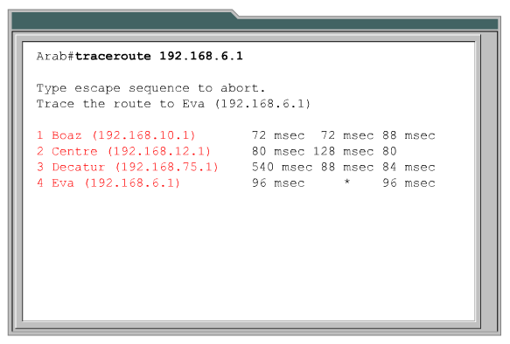
Cisco Traceroute

Slide 47
Lab
Start Wireshark
Open icmp-traceroute-normal.pcap
Examine the trace route process

Slide 48
Lab
Traceroute to www.chipps.com

Slide 49
Looking Glass Traceroute
A Looking Glass can also be used for a traceroute
This may tell you where things are falling apart

Slide 50
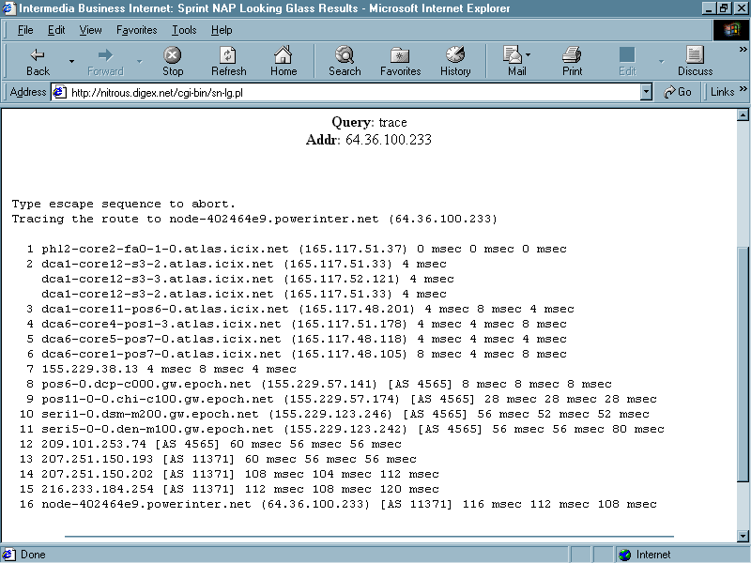
Looking Glass Traceroute

Slide 51
Lab
From a looking glass site traceroute back to the DeVry DNS server

Slide 52
Netstat
Netstat - NETwork STATe is an old part of the TCP/IP suite of tools
It's mentioned as far back as 1972, when it was known also as who is up
Netstat is used to display not completely related information about current network connections

Slide 53
Netstat
Netstat is defined in RFC 1147 as
  … a program that accesses network related data structures within the kernel, then provides an ASCII format at the terminal
  Netstat can provide reports on the routing table, TCP connections, TCP and UDP "listens," and protocol memory management
  Netstat provides this information for the moment at which one executes the command
  That information might change even as Netstat is running

Slide 54
Netstat
C:\>netstat /?
Displays protocol statistics and current TCP/IP network connections.
NETSTAT [-a] [-e] [-n] [-s] [-p proto] [-r] [interval]
-a Displays all connections and listening ports.
-e Displays Ethernet statistics. This may be combined with the -s
option.
-n Displays addresses and port numbers in numerical form.
-p proto Shows connections for the protocol specified by proto; proto
may be TCP or UDP. If used with the -s option to display
per-protocol statistics, proto may be TCP, UDP, or IP.
-r Displays the routing table.
-s Displays per-protocol statistics. By default, statistics are
shown for TCP, UDP and IP; the -p option may be used to specify
a subset of the default. interval Redisplays selected statistics, pausing interval seconds
between each display. Press CTRL+C to stop redisplaying
statistics. If omitted, netstat will print the current
configuration information once.

Slide 55
Lab
Run netstat -a

