Slide 1
Capturing VLAN Tags Last Update 2012.04.10 1.0.0

Slide 2
Objectives
Learn how to capture VLAN tags for analysis using a network analyzer

Slide 3
The Problem
I do not believe there is anything harder than figuring out how to capture VLAN tags using a network analyzer such as Wireshark or Omnipeek
This is mostly due to the lack of clear detailed instructions for specific equipment operating system sets as well as the failure of NIC manufacturers to build this capability into their device drivers

Slide 4
The Problem
Further most of the examples only work on certain models of hardware and certain versions of software
The specifics as to these are often missing
Therefore, here I will provide several examples of exactly how to do this with defined equipment sets that I have access to

Slide 5
The Problem
If you have some other type of hardware or software, well tough luck I cannot help you as I have wasted enough time getting this to work
Once you get it working, let me know the details
I will add it here

Slide 6
The Problem
There are three main areas of failure that will keep you from capturing the VLAN tags
First, the driver for your NIC is stripping off the VLAN fields added to the Ethernet II header when the port this computer is attached to is added to a VLAN

Slide 7
The Problem
Second, the configuration of the switch is not providing frames with this information to the port that the computer running the network analyzer is attached
Third, the configuration of everything is correct, but the switch wants a partner to connect to before providing the information to the port that the computer running the network analyzer is attached to

Slide 8
The Problem
All of this makes figuring out exactly where the problem is a little tricky
Let’s deal with these problems one at a time

Slide 9
NIC Driver Problem
Wireshark has some guidance on this subject which is both right and wrong
It is right when it says some NICs do not strip the tags
It is right when it says some NICs can be adjusted in the Windows registry to no longer strip the tags

Slide 10
NIC Driver Problem
It is wrong when it says
If the OS or the network adapter driver won't allow the VLAN tags to be captured, set up port mirroring (or "port spanning", as Cisco calls it) on the VLAN switch and connect an independent system, such as a laptop, to the mirror port, and don't configure the interface attached to that port as a member of a VLAN

Slide 11
NIC Driver Problem
You'll definitely see the VLAN tags, regardless of what OS the independent system is running or what type of network adapter you're using
This does not work

Slide 12
NICs That Work
The NICs I have verified that retain and allow the display of the VLAN tags
No modification required
Trendnet TE100-PCIWN Version 2.21
This is the Realtek RTL8139/810x chipset
Wireshark says this should work and it does work without any modification required
The driver is
Microsoft
5/30/2008
6.111.530.2008

Slide 13
NICs That Work
Modification required
Intel 82567LM Gigabit NIC
This is a Intel chipset in a Dell laptop
Wireshark says this should work with a registry change
It does work once the registry is changed
The driver is
Microsoft
8/18/2008
10.0.22

Slide 14
NICs That Do Not Work
The NICs I have verified do not work no matter what you do to them are
Intel 82579V Gigabit NIC built into an Asus P8Z68-V Pro
The driver is
Intel
3/15/2012
11.16.96.0
Intel does not explicitly say whether this one should work after the registry value is added

Slide 15
NICs That Do Not Work
Intel PRO/1000 GT PCI NIC
The driver is
Microsoft
5/28/2008
8.4.1.0
Intel says this NIC should work after the registry value is added
You are thinking the driver is the problem since it is from Microsoft, but Intel claims they have no Windows 7 64 bit driver for this NIC

Slide 16
NICs That Do Not Work
As there are some reports that Intel server NICs will work without modification I tested one of these
Intel PRO/1000 PT Dual Port Server Adapter
The driver is
Intel
3/23/2012
17
It does not work out of the box

Slide 17
NICs That Do Not Work
Intel says this NIC should work after the registry value is added
In this case MonitorMode as this is a PCI Express card
On these types of cards there are three possible values 0, 1, and 2
None of these values work

Slide 18
NICs That Do Not Work
Therefore I conclude that just like Wireshark Intel’s information is not to be trusted
Does no one test this stuff
How hard does this need to be

Slide 19
NIC Modification Required
The modification required to the Intel NIC chipsets to pass the required data is described in
http://www.intel.com/support/network/sb/CS-005897.htm
Regedit is used to do what is described
Keep in mind that this may work, and then again it may not

Slide 20
NIC Modification Required
This document says
Allow tagged frames to be passed to your packet capture software by going into the registry and either add a registry DWORD and value or change the value of the registry key

Slide 21
NIC Modification Required
The bus type of your network adapter you dictate the keyword used, either "MonitorModeEnabled" for PCI/PCI-X Network Adapters, or "MonitorMode" for PCI-e based Network Adapters The new key (DWORD) should be placed at:
HKEY_LOCAL_MACHINE\SYSTEM\ControlSet001\Control\Class\{4D36E972-E325-11CE-BFC1-08002BE10318}\00nn

Slide 22
NIC Modification Required
This part of the instructions are clear as far as they go
But then it further says
ControlSet001 may need to be CurrentControlSet or another 00x number
In most cases there are two of these 001 and 002
See

Slide 23
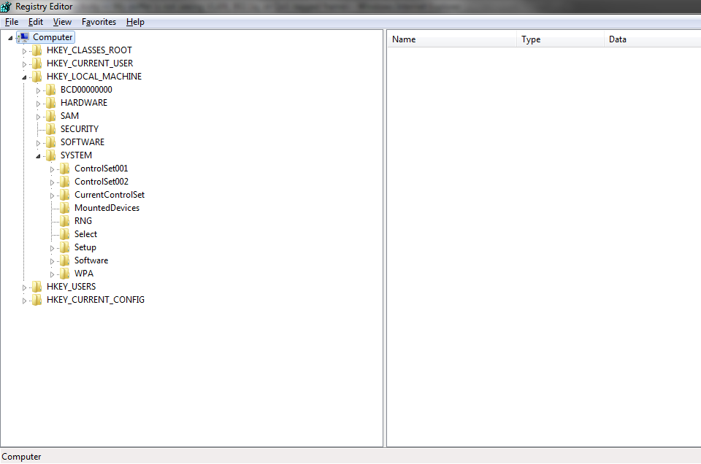
NIC Modification Required

Slide 24
NIC Modification Required
So which one is it
ControlSet001
or
ControlSet002
In the one I changed that then worked I made the change to ControlSet001
In the one I changed that did not work I tried it in 001 only, 002 only, both 001 and 002

Slide 25
NIC Modification Required
Intel goes on to say
The registry DWORD for a PCI or PCI-X Network Adapter is
MonitorModeEnabled
Set the DWORD value to one of the following options:
0 - disabled (Do not store bad packets, Do not store CRCs, Strip 802.1Q VLAN tags)
1 - enabled (Store bad packets. Store CRCs. Do not strip 802.1Q VLAN tags)

Slide 26
NIC Modification Required
The registry DWORD for a PCI-Express Network Adapter the registry DWORD is
MonitorMode
Set the DWORD value to one of the following options:
0 - disabled (Do not store bad packets, Do not store CRCs, Strip 802.1Q VLAN tags)
1 - enabled (Receive bad/runt/invalid CRC packets. Leave CRCs attached to the packets. Strip VLAN tags and ignore packets sent to other VLANs as per normal operation.)

Slide 27
NIC Modification Required
2 - enabled strip VLAN (Receive bad/runt/invalid CRC packets. Leave CRCs attached to the packets. Pass all VLAN packets to the host, even those sent to other VLANs. Leave VLAN tags attached to the packets. This mode is likely to break VLAN)
Intel just does not bother to say exactly where under this ControlSet this new DWORD goes
It says it goes right under
{4D36E972-E325-11CE-BFC1-08002BE10318}\00nn

Slide 28
NIC Modification Required
Where nn is the NIC
Huh
As you can see there are quite a few lines with this exact same heading

Slide 29

NIC Modification Required

Slide 30
NIC Modification Required
You first have to look over in the right panel to see which one of these identical heading lines defines the NICs
As you work your way down the lines you find a little ways down several with the name network in them
The one you want is named
Network adapters

Slide 31

NIC Modification Required

Slide 32
NIC Modification Required
One might think the DWORD goes here
Oh no, expand the lines under this
This where the elusive 00nn referred to above lives
Once we do this we see

Slide 33

NIC Modification Required

Slide 34
NIC Modification Required
Now scroll down that list from 0000 until you find the line for the NIC of interest
Here is mine
In this case the 00nn is 0016
You can tell this by seeing the name of the NIC in the right panel
In this case
Intel PRO/1000 GT Desktop Adaptor

Slide 35
NIC Modification Required
To add the required DWORD right click in the right panel
This appears

Slide 36

NIC Modification Required

Slide 37
NIC Modification Required
Select DWORD (32 bit) Value

Slide 38
NIC Modification Required
A new line appears at the bottom

Slide 39

NIC Modification Required

Slide 40
NIC Modification Required
Change the name of the line to MonitorModeEnabled or MonitorMode as directed above
The value by default is 00000000 in hex or 0 in decimal
Right click on this line and select Modify

Slide 41

NIC Modification Required

Slide 42
NIC Modification Required
Change the value to 1
Intel does not bother to say whether this change should be Hexadecimal or Decimal or whether it really makes a difference
I used Decimal

Slide 43
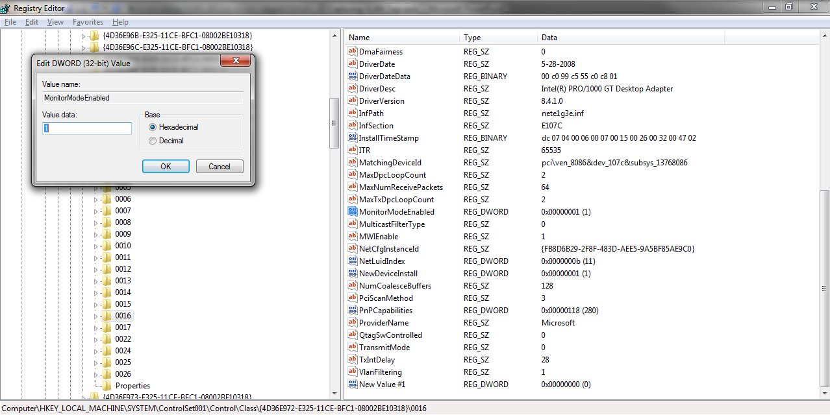
NIC Modification Required

Slide 44
NIC Modification Required
Click OK
Exit out of Regedit

Slide 45
Switch Configuration
The only equipment I deal with is Cisco so this discussion of equipment sets and configurations will be limited to Cisco stuff
As is often the case with Cisco the configuration to use depends on the model and the IOS version
Some that should work, do not

Slide 46
Switch Configuration
In some places you will find statements that a certain model will work, but only later will you find an obscure note that says it really does not, but then on testing you find it really does after all
This is the case with the very common 2950 line of switches
Let’s see what does work and does not work based on actual testing

Slide 47
Using 2960 Switches
This setup is based on a discussion of this problem by an unidentified person here
http://dot1x.blogspot.com/2010/03/sniffing-dot1q-tags-with-wireshark.html
The first set I got to work was two Cisco 2960 switches with these characteristics
WS-C2960-24TT-L 12.2(44)SE6 C2960-LANBASE9-M

Slide 48
Using 2960 Switches
The physical setup is next with the switches shown vertically just to make the lines easier to see

Slide 49
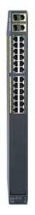

Switch
Cisco 2960
Named
SwitchOneWireshark
Switch
Cisco 2960
Named
SwitchTwo
On Each Switch
FA0/23
is Connected to
FA0/23
Laptop One
Connected to FA0/1
In VLAN 2
On SwitchOneWireshark
Laptop Two
Connected to FA0/1
In VLAN 2
On SwitchTwo
Laptop Three
Connected to FA0/24
On SwitchOneWireshark

Slide 50
Using 2960 Switches
Here is the configuration for the switches

Slide 51
Switch One Wireshark
!Switch One Wireshark Connected
enable
config t
hostname SwitchOneWireshark
vlan 2
int fa0/1
switchport mode access
switchport access vlan 2

Slide 52
Switch One Wireshark
interface fa0/23
switchport mode trunk
switchport trunk allowed vlan all
monitor session 1 source interface fa0/23
monitor session 1 destination interface fa0/24 encap replicate
end

Slide 53
Switch Two
!Switch Two
enable
config t
hostname SwitchTwo
vlan 20
int fa0/1
switchport mode access
switchport access vlan 2

Slide 54
Switch Two
interface fa0/23
switchport mode trunk
switchport trunk allowed vlan all
end

Slide 55
Laptop One
Laptop One is connected to the switch named SwitchOneWireshark at port Fa0/1
IP Address 10.0.0.1
Subnet Mask 255.255.255.0

Slide 56
Laptop Two
Laptop Two is connected to the switch named SwitchTwo at port Fa0/1
IP address 10.0.0.2
Subnet mask 255.255.255.0

Slide 57
Laptop Three
Laptop Three is connected to the switch named SwitchOneWireshark at port Fa0/24
IP Address 10.0.0.3
Subnet Mask 255.255.255.0
This computer is running Wireshark 1.6.5

Slide 58
Use of IP Addresses
The IP addresses were assigned to the computers in order to check connectivity before the VLANs were created and then the lack of connectivity once the VLANs were created

Slide 59
Use of IP Addresses
In addition a continuous ping was run from Laptop One to Laptop Two to provide some traffic over the trunk link from port Fa0/23 on switch SwitchOneWireshark to Fa0/23 on switch SwitchTwo
Laptop Three was attached to port Fa0/24 on switch SwitchOneWireshark
This is the span or monitor port

Slide 60
The Result
The result was

Slide 61
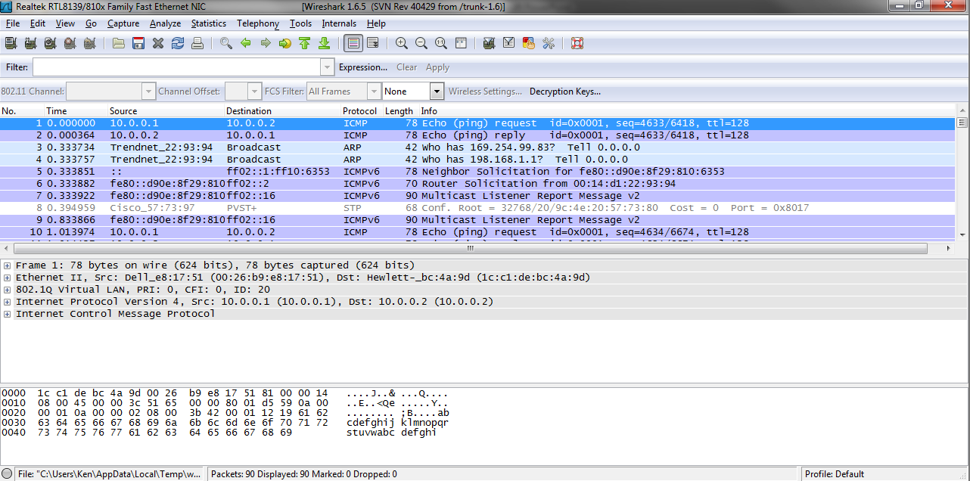
The Result

Slide 62
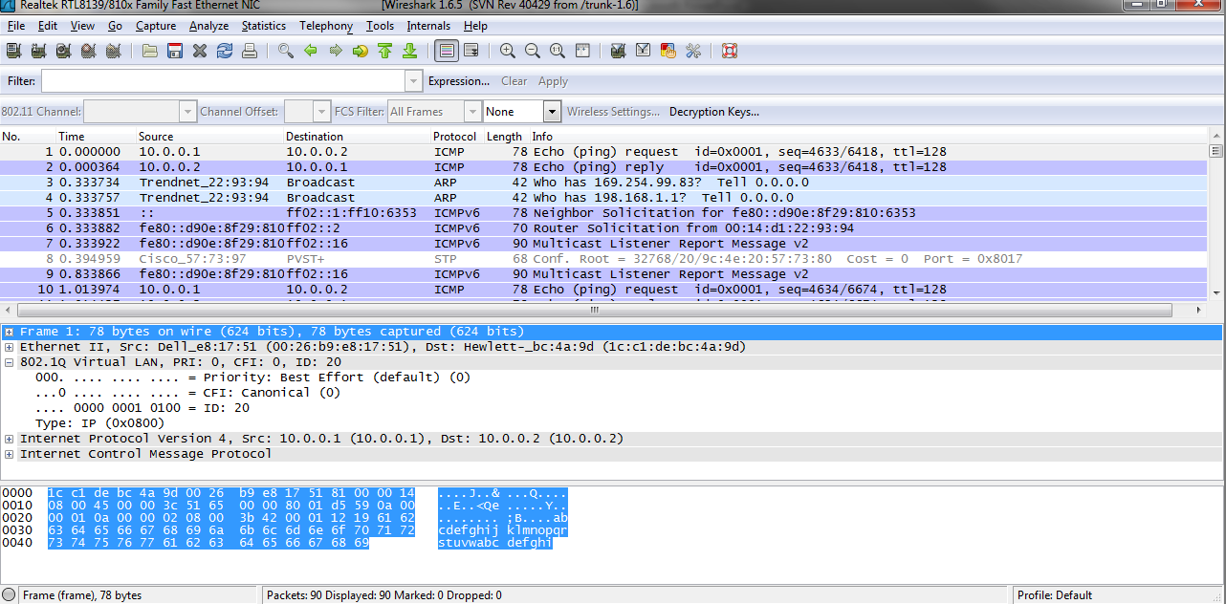
The Result

Slide 63
The Result
Now we have VLAN tagged frames caught in the wild to use to illustrate such things

Slide 64
Using One 2960 Switch
The monitor port in SwitchOneWireshark does not receive many frames at all when the trunk cable is disconnected from the second switch named SwitchTwo
There is definitely no sign of ICMP traffic
Of course the computer at 10.0.0.2 could not answer as it is attached to the now isolated switch since the cable between the two switches is disconnected

Slide 65
Using One 2960 Switch
What if the computer at 10.0.0.2 is moved to the switch named SwitchOneWireshark to a port in the same VLAN as the computer at 10.0.0.1 with the other switch disconnected
This does not work
Very little traffic is seen at the monitoring port

Slide 66
Using One 2960 Switch
What if we get rid of the trunking and switch the monitoring source to the port in VLAN 2 that is the target of the pings
Using this configuration
monitor session 1 source interface fa0/2
monitor session 1 destination interface fa0/24 encapsulation replicate
The pings work, but no VLAN data is seen

Slide 67
Using One 2960 Switch
What if we eliminate the monitoring session as well
Then place the computer with Wireshark installed into the same VLAN as the other two computers
The pings work, but no VLAN data is seen

Slide 68
Using Two 2950 Switches
The procedure detailed above for the 2960 switches will work using 2950 switches instead with the following changes
The cable connecting the two switches to each other, the trunk cable from Fa0/23 to Fa0/23, must be a crossover cable as the 2950 is unable to change a port to handle a straight through cable

Slide 69
Using Two 2950 Switches
The configuration line that reads
monitor session 1 destination interface fa0/24 encapsulation replicate
Must be changed to say
monitor session 1 destination interface fa0/24 encapsulation dot1q
Everything else stays as described in the 2960 section of this presentation

Slide 70
Router on a Stick
Instead of two switches VLAN captures can be done with one switch and a router with the router acting as a Router On A Stick as seen in this example

Slide 71
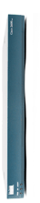
Switch
Cisco 2960
Named
SwitchWireshark
Router
Cisco 2600
Named
RouterOnStick
Laptop One
Connected to FA0/1
In VLAN 2
On SwitchWireshark
On The Switch
FA0/23
is Connected to
FA0/0
On The Router
Laptop Two
Connected to FA0/2
In VLAN 3
On SwitchWireshark
Laptop Three
Connected to FA0/24

Slide 72
The Configurations
Here is the configurations for each device
Notice that a default gateway is added to Laptop One and Laptop Two

Slide 73
Switch
!Switch Wireshark Connected
enable
config t
hostname SwitchWireshark
vlan 2
vlan 3

Slide 74
Switch
int fa0/1
switchport mode access
switchport access vlan 2
int fa0/2
switchport mode access
switchport access vlan 3

Slide 75
Switch
interface fa0/23
switchport mode trunk
switchport trunk allowed vlan all
monitor session 1 source interface fa0/23
monitor session 1 destination interface fa0/24 encapsulation replicate
end

Slide 76
Router
!Router On A Stick
enable
config t
hostname RouterOnStick
int fa0/0.2
encapsulation dot1q 2
ip address 192.168.1.1 255.255.255.0

Slide 77
Router
int fa0/0.3
encapsulation dot1q 3
ip address 192.168.2.1 255.255.255.0
int fa0/0
no shutdown
exit
ip route 0.0.0.0 0.0.0.0 fa0/0
end

Slide 78
Laptop One
Laptop One is connected to the switch named SwitchWireshark at port Fa0/1
IP Address 192.168.1.2
Subnet Mask 255.255.255.0
Default Gateway 192.168.1.1

Slide 79
Laptop Two
Laptop Two is connected to the switch named SwitchWireshark at port Fa0/2
IP address 192.168.2.2
Subnet mask 255.255.255.0
Default Gateway 192.168.2.1

Slide 80
Laptop Three
Laptop Three is connected to the switch named SwitchWireshark at port Fa0/24
This computer is running Wireshark 1.6.5

Slide 81
Configuration Oddities
There are some confusing configurations that one will run across while researching this topic
One is the configuration line that says in part
encapsulation 8021q
This relates back to older equipment that supported the Cisco propriety protocol ISL

Slide 82
Configuration Oddities
The newer IOSs do not have that command as there are no options anymore
Everyone already uses 8021q

