Slide 1
Coding Modulating Multiplexing On Wireless Media
Last Update 2012.04.21
2.0.0

Slide 2
Objectives
Learn how data is carried on wireless media

Slide 3
Sending Data
Data can be sent over the media by
Varying - modulating - an electrical signal as it passes over a copper wire
Varying - modulating - the power of light as it is sent over a glass optical fiber
Varying – modulating - the radio waves sent through space, which is commonly referred to as a wireless communications system

Slide 4
Modulating
Modulating the signal is how a useful signal is applied to and carried over a wireless link
The two methods currently in use are
FHSS
Frequency Hopping Spread Spectrum
DSSS
Direct Sequence Spread Spectrum

Slide 5
FHSS
FHSS or frequency hopping is the original method used
It is still seen in low data rate applications, such as warehouse information signals
In the case of 802.11, FHSS spreads the signal to be carried over 79 MHz of the 83.5 MHz of bandwidth, with the rest used for guard frequencies

Slide 6
FHSS
It does this using 79 channels
The carrier changes frequency, called hopping, according to a pseudorandom sequence
This sequence is a list of the frequencies to use
The time used for this hop is called the hop time

Slide 7
FHSS
The dwell time is the time a frequency is used for transmission before jumping to the next frequency
A longer dwell time will yield a higher data rate as the dwell time is when data is actually being sent out
These two times then define the total time to cycle through the frequencies

Slide 8
FHSS
Then the sequence is repeated
This hop pattern is called a channel
FHSS works well, but the lack of a standard that supports greater than a 3 Mbps data rate has prevented its widespread use

Slide 9
FHSS
It is possible to generate more non-overlapping channels out of a FHSS system than DSSS, but the maximum data rate still is not as high
Another problem with FHSS is that it is a line of sight technology

Slide 10
FHSS
Following is an example of a frequency hopper on a spectrum analyzer
In the following slide the blue line is a peak hold capture of a frequency hopping device that has used at one time or the other a wide range of the spectrum

Slide 11
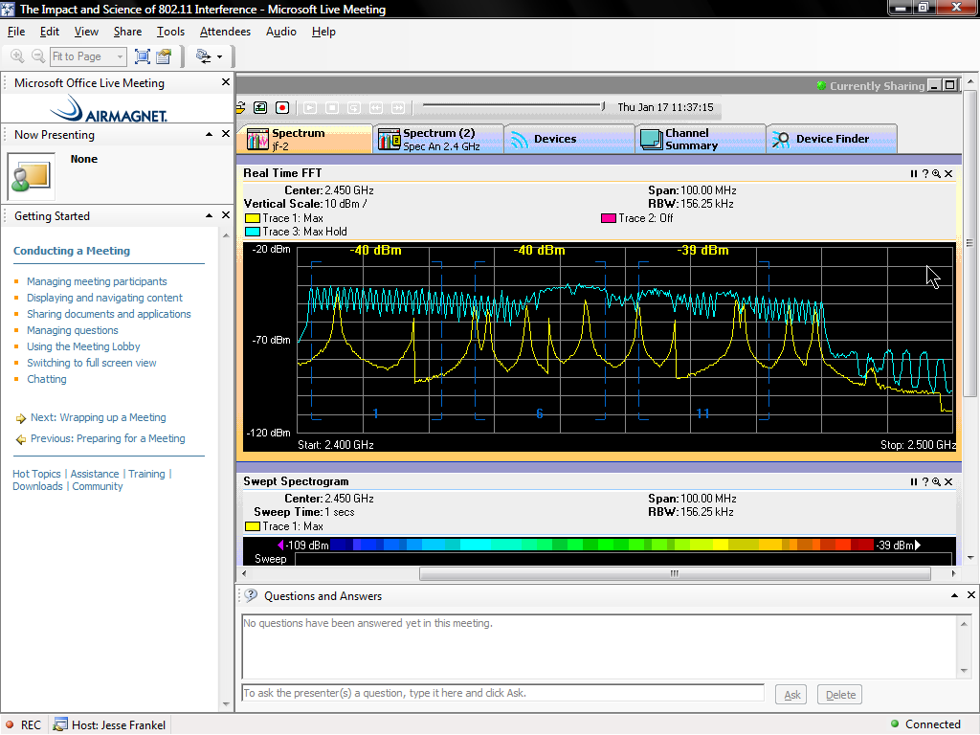
FHSS

Slide 12
The Spread Spectrum Concept
Spread spectrum is a communication technique that is characterized by wide bandwidth and low peak power
These signals are noise-like
Therefore they are hard to detect, and even harder to intercept or demodulate without the correct equipment

Slide 13
The Spread Spectrum Concept
This is why it was originally used by the military
The main requirement then for a signal to be spread spectrum is that the bandwidth is much wider than is needed to actually send the information

Slide 14
The Spread Spectrum Concept
This is in contrast to the more typical narrowband method that uses a small slice of the spectrum and high peak power
This higher power is needed to raise the signal above the noise floor

Slide 15
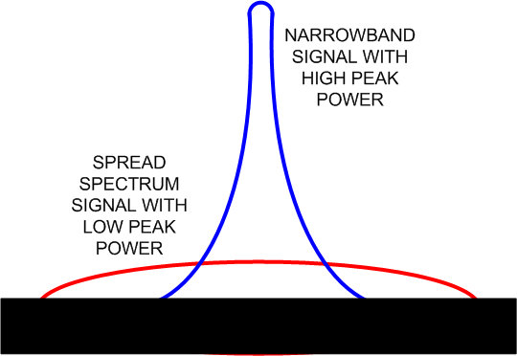
The Spread Spectrum Concept

Slide 16
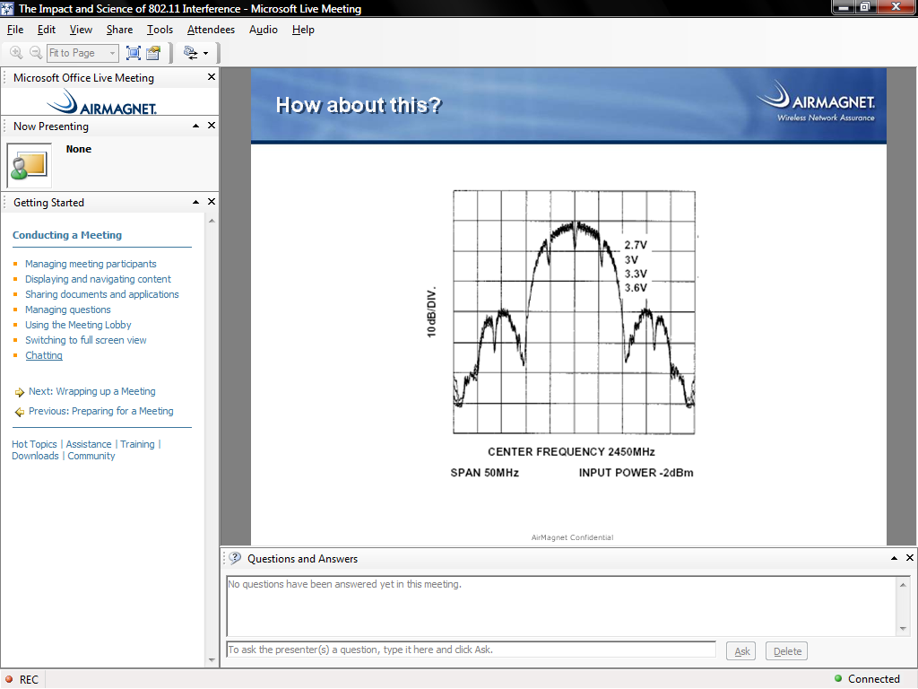
A Spread Spectrum Signal

Slide 17
Using Spread Spectrum
In the United States of America the FCC – Federal Communication Commission limits the specific implementations of spread spectrum technology that may be used in wireless transmissions as do the regulatory bodies in most countries
For the US these are specified in the Code of Federal Regulations Volume 47, Part 15

Slide 18
DSSS
DSSS is much more widely used than FHSS
DSSS uses a bandwidth of 22 MHz per channel in 802.11 standards based systems
In DSSS the transmitter sends each bit on all channels

Slide 19
DSSS
This means DSSS provides redundancy because each individual bit is actually transmitted on more than one narrowband channel
More specifically the carrier is modulated by a digital code, with the code rate being larger than the information bit rate

Slide 20
DSSS
The code bits represent the redundant bit pattern that is applied to each information bit to be transmitted
This bit pattern is called the chip or chipping code
With this redundancy, there is less possibility of data loss

Slide 21
DSSS
The longer the chip, the better the ability of the receiver to recover the original data
The direct sequence starts with a carrier signal being modulated with a code sequence
The number of chips determines how much spreading occurs

Slide 22
DSSS
The number of chips per bit and the speed of the coding, in other words the chips per second, determines the data rate
In a DSSS system a defined set of channels is used
The 802.11b channels will be used to illustrate this
In 802.11b each channel is 22 MHz wide

Slide 23
DSSS
Channel 1 operates from 2.401 GHz to 2.423 GHz, which is 11 MHz on each side of 2.412 GHz
One problem with this approach is that using two systems in the same physical space on the same or a nearby channel will result in interference and lower throughput of each system

Slide 24
DSSS
To prevent this in a 802.11b system the equipment should be deployed in the same physical space only if channels at least five channels apart are used
This is because the center frequencies are 5 MHz apart and the channels are 22 MHz wide

Slide 25
DSSS
This means in a 802.11b system only channels 1, 6, and 11 can be used in the same space

Slide 26
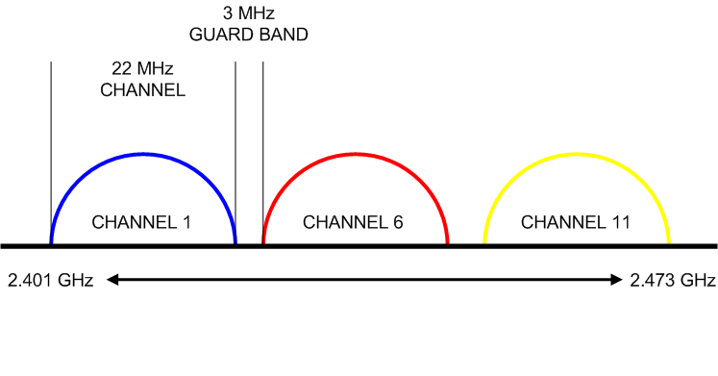
DSSS

Slide 27
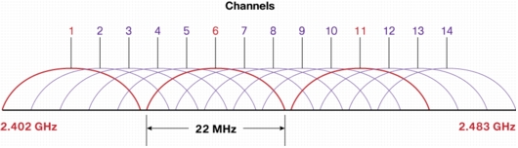
DSSS

Slide 28
DSSS
Using these three channels, 33 Mbps can be achieved in a single physical space
DSSS is a line of sight technology

Slide 29
Coding
Coding allows more data to be carried over the wireless media that just modulating the signal would allow
The coding method we will examine here is OFDM as used on wireless LANS

Slide 30
OFDM
Orthogonal Frequency Division Multiplexing uses multiple carriers to transmit information using the total available bandwidth
As such it is not actually a modulation technique, but a signal spreading method
Each carrier is orthogonal or independent of those adjacent to it

Slide 31
OFDM
By saying it is orthogonal this means that the frequency of a sub carrier coincides with the nulls of the other sub carriers
In other words when one signal is at its peak, its neighbor is at the bottom
With OFDM, guard bands are not needed between frequencies, but only between groups of frequencies

Slide 32
OFDM
OFDM is able to resist interference as any interference would only affect a small portion of the signal
Systems using this method transmit data in bursts
Each burst consists of a cyclic prefix followed by data

Slide 33
OFDM
OFDM does this by chopping a larger frequency channel into a number of smaller subchannels
These subchannels are then used in parallel to achieve higher throughput
In other words, a single transmission is broken up into parts so that each part is then placed on one of these subchannels that have been created

Slide 34
OFDM
If any one of the subchannels is blocked, the receiver can recreate the missing piece using the information it did receive
This works since noise typically is not spread over all subchannels, but only appears on one at a time
This is the same thing as the older technique of dividing a single channel up into subchannels

Slide 35
OFDM
The difference being the older technique required that some of the bandwidth be set aside for guard bands on each side of each channel used to send data
This wasted bandwidth
The main problem that OFDM is designed to overcome is distortion from multipath
More specifically this is ISI – Inter Symbol Interference

Slide 36
OFDM
In ISI the echoes of one signal are seen as interference by a later signal
OFDM overcomes this problem by the use of a Guard Interval period at the beginning of a signal or symbol
The Guard Interval is used to account for that part of the symbol that is damaged by the ISI
What follows the Guard Interval is the data

Slide 37
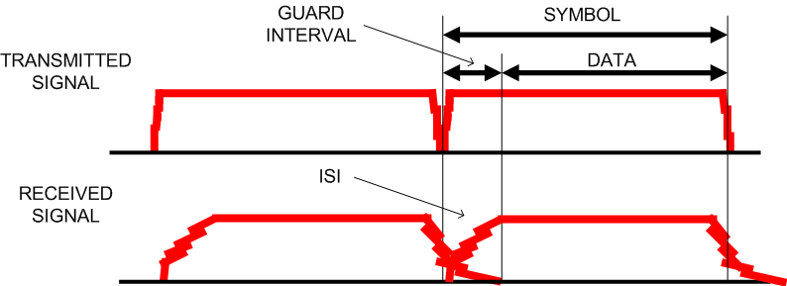
OFDM

Slide 38
OFDM
Here is a diagram of what these subcarriers look like from a webinar from March 2012 presented by Douglas Morais

Slide 39
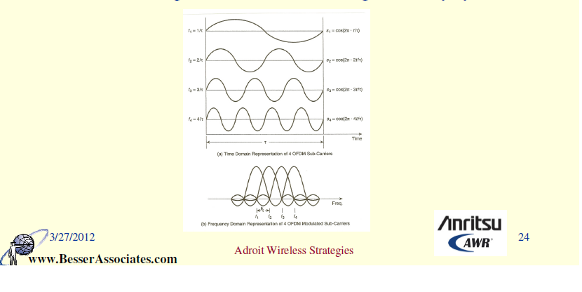
OFDM

Slide 40
Guard Interval
A nice white paper from Fluke Networks titled Guide to Deploying 802.11n Wireless LANs written by David Coleman of AirSpy Networks says this about the guard interval as well
Data is modulated onto the carrier signal in sequences of bits called symbols
In multipath conditions, symbols travel distinct paths, and therefore some symbols arrive later

Slide 41
Guard Interval
Because of the different paths, a symbol of data may arrive at a receiver before an earlier symbol has been completely received
This multipath behavior is called InterSymbol Interference (ISI) which culminates in the data corruption described earlier

Slide 42
Guard Interval
The time differential between multiple paths of the same signal is known as the delay spread. Intersymbol interference is the result of symbol corruption due to a low delay spread tolerance
Normal delay spread is 50–100 nanoseconds, and a maximum delay spread is about 200 nanoseconds
802.11 radios utilize a buffer for the delay spread called the guard interval (GI)

Slide 43
Guard Interval
The guard interval is a period of time between symbols that accommodates for the late arrival of symbols over long paths
Typically, the guard interval should be two to four times the length of the delay spread
Legacy 802.11a/g radios use an 800-nanosecond guard interval between OFDM symbols
802.11n radios have the optional capability of using a 400-nanosecond guard interval

Slide 44
Guard Interval
A shorter guard interval can increase data rates by about 10 percent
When the shorter 400-nanosecond guard interval is used with an 802.11n radio, throughput will increase, however, the odds of data corruption due to intersymbol interference increases
The optional 400-nanosecond guard interval should be used in only when good RF conditions exist

Slide 45
OFDM
OFDM is a non line of sight method
This is a distinct advantage over FHSS and DSSS
The modulation used with OFDM depends on the signal’s data rate

Slide 46
Multiplexing
There are other ways to make maximum use of a limited amount of spectrum
These methods may use only a single frequency, but as discussed next, they make the maximum use of that frequency by multiplexing signals onto it using a timing technique
Of course these methods could be combined

Slide 47
Multiplexing
Multiplexing options include
TDMA - Time Division Multiple Access
FDMA - Frequency Division Multiple Access
CDMA - Code Division Multiple Access

Slide 48
TDMA
With TDMA each user is assigned the frequency for an amount of time on a fixed, rotating basis
In wireless systems TDM – Time Division Multiplexing usually implies use of a polling mechanism to ensure all stations have an equal chance to send or receive data

Slide 49
TDMA
A TDM system provides a time slot of a fixed or variable length to each station on its list of active stations

Slide 50
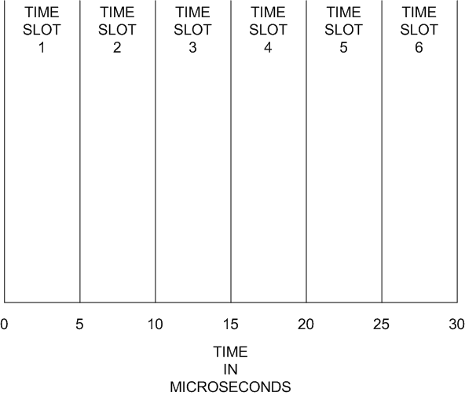
TDMA

Slide 51
TDMA
Advantages of TDMA include
More efficient use of the bandwidth
Ability to send data and voice on the same frequency
One disadvantage is that the frequency remains idle if the user has no data to transmit during the assigned time slot

Slide 52
TDMA
Some systems are designed to sense the level of use and adjust the time slots accordingly
These systems are also half duplex, as the channel can only send or receive, not both, during each cycle

Slide 53
FDMA
FDMA divides the frequency range into several small frequencies
One of main drawbacks of this method is interference or crosstalk if frequencies are closely grouped
To prevent this, guard bands must be set aside to isolate one channel from another
This of course wastes some part of the available bandwidth

Slide 54
FDMA
Some spectrum allocations do not have enough space to allow use of FDMA

Slide 55
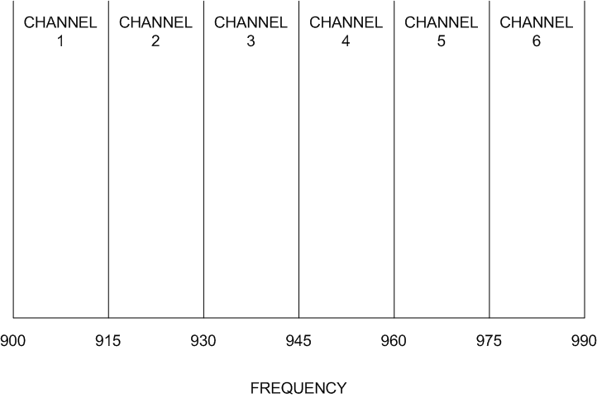
FDMA

Slide 56
FDMA
Commonly when this is implemented in wireless systems a channel is dedicated to one specific user
To provide full duplex transmission in FDMA systems one frequency is used for the upstream connection and another one for the downstream

Slide 57
CDMA
CDMA uses spread spectrum technology to spread the transmission over a larger range of frequencies, usually the entire spectrum all the time
Advantages of CDMA include
The ability to carry up to three times as much data as TDMA
It is difficult to eavesdrop on

Slide 58
CDMA
This system uses unique digital codes to differentiate transmissions

Slide 59
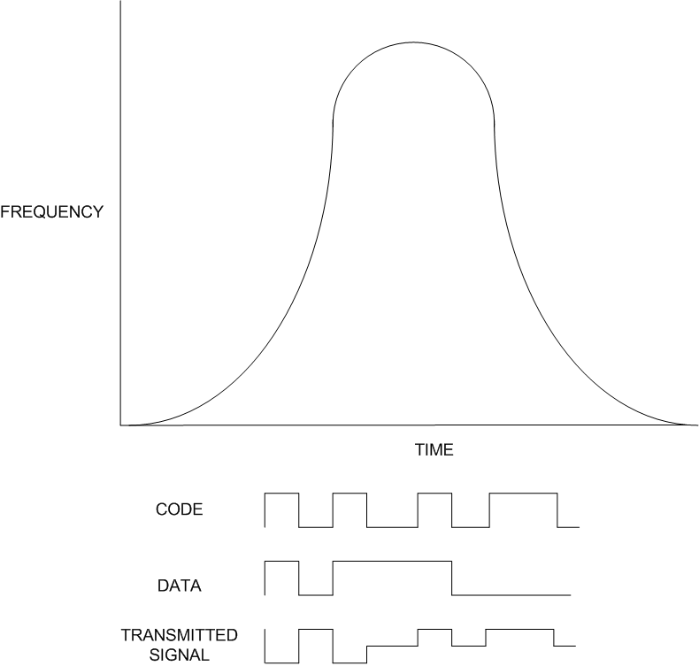
CDMA

Slide 60
CDMA
The digital codes are added to individual transmissions
When the signal is received, the codes are removed
TDMA and FDMA are common in fixed wireless communications system
CDMA is widely used in mobile wireless systems, such as cellular phones

Slide 61
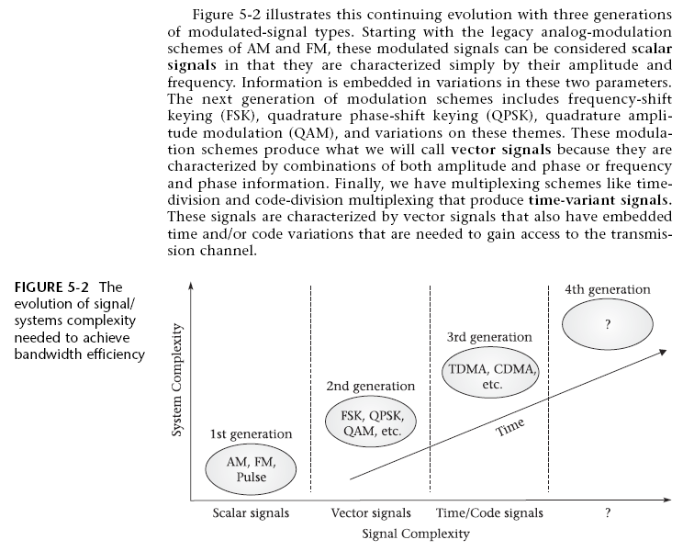
Development of Signals

