Slide 1
Testing Wireless Media
Last Update 2008.03.03
1.0.0

Slide 2
Objectives
Learn how to test wireless media

Slide 3
Introduction
You cannot directly test wireless media using a single test unit with an autotest button as you can with wired media
So the title for this presentation of Testing Wireless Media is somewhat misleading
Instead what you can do is look for potential problems both before deployment, as well as periodically after a wireless link is installed

Slide 4
Sources of Problems
The wireless environment is hard to visualize and control
There are many sources for the problems seen in wireless networks
They are all due to two reasons for the most part
The unbounded nature of a wireless network which makes it subject to interference in all its forms and manifestations

Slide 5
Sources of Problems
The technology itself produces several problems such as
Hidden Node
Near/Far
Low throughout
Fragmentation
For now we will look at interference as the details on the technology related problems are covered in another course

Slide 6
Interference
Sources of interference include, depending on the frequency
Amateur operations at least in the 2.4 GHz band
Lights that use 2.4 GHz signals to excite the gas in the tube
Satellite radio services that use 2.4 and 2.3 GHz

Slide 7
Interference
Cellular phone sites
They do not use the unlicensed frequencies for service, but they do use them for backhaul
Medical devices
Elevator motors
Television station transmission from remote vehicles back to the studio
Bluetooth headsets and similar devices
Especially when there are a large number of these, such as in a call center

Slide 8
Interference
Wireless networks see the following types of interference
Narrowband
All band
Adjacent channel
Co-channel
Multipath

Slide 9
Narrowband Interference
Narrowband interference is basically another signal at a single or narrow range of frequencies
As such it blocks out part of the spread spectrum signal
An advantage to spread spectrum technology is its ability to work around limited narrowband interference

Slide 10
Narrowband Interference
To get rid of the narrowband interference
Shield it
Turn it off
Change channels on the wireless network equipment

Slide 11
All Band Interference
All band interference is from one end of the band to the other
A microwave oven is an example of this type of interference
About the only solution to all band interference other than getting rid of the source is to change bands, such as from 802.11b/g to 802.11a

Slide 12
Adjacent Channel Interference
Adjacent channel interference is produced by co-locating access points where the channels overlap somewhat or completely
A spectrum analyzer is required to detect this problem
To prevent this
Do not use channels that overlap

Slide 13
Adjacent Channel Interference
Move the access points far enough apart that the cells do not overlap or turn the power down to achieve the same effect

Slide 14
Co-channel Interference
With co-channel interference there is a direct overlap of the channels
An example might be two different organizations using the same channels where one is on floor 1 and the other on floor 2 or in an adjacent office
To detect this a wireless network analyzer is required

Slide 15
Co-channel Interference
To prevent this
Do not use channels that overlap
Move the access points far enough apart that the cells do not overlap or turn the power down to achieve the same effect
Change the orientation of the antennas, with one horizontal and the other vertical

Slide 16
Harmonics
Interference can appear from odd locations, such as the result of harmonics and intermodulation products
Harmonics are exact multiples of a fundamental frequency, starting with two times the fundamental frequency

Slide 17
Harmonics
For example, a common source of interference for 2.4 GHz mounted on the same tower as paging equipment that operates in the 800 MHz range is a third harmonic from the paging transmitter
For a fundamental frequency of 800 MHz the second harmonic is 1600 MHz and the third is 2400 MHz

Slide 18
Harmonics
This third harmonic appears as interference in the unlicensed 2.4 GHz range
As the power of the harmonic goes up, the strength of the signal goes down
The ones most likely to create problems are the low order harmonics as the filtering in the receiver may not be able to keep these out

Slide 19
Harmonics
Harmonics are generated by almost all amplifiers
When a harmonic is produced by a transmitter it is normally the result of insufficient transmitter filtering

Slide 20
Intermodulation Products
At a site with multiple transmitters the harmonics from two different ones can combine to form an intermodulation product
For example if the second harmonic from one transmitter combines with the third harmonic from another transmitter, a fifth order intermodulation product is produced

Slide 21
Intermodulation Products
This new frequency can be the result of either adding or subtracting the two harmonics
The intermodulation can occur at the transmitter itself, in the receivers, or even be the result of poor connections on a tower

Slide 22
Harmonics and Intermodulation
Harmonics and intermodulation products are the result of nonlinear process
In a radio it is best if the amplifier amplifies without distortion, the mixer produces a perfect signal, and the radio receives perfectly
This does not happen
Everything is nonlinear

Slide 23
Harmonics and Intermodulation
The output does not follow the input perfectly
In other words, distortion is created
Prevention or harmonics and intermodulation products is done with good radio design, filtering, and sound construction practices

Slide 24
Passive Intermodulation
The most difficult type of intermodulation to find is that caused by passive sources
This occurs when two or more frequencies mix together in devices such as
Antennas
Loose joints
Joints of dissimilar metals
Micro gaps between metal surfaces

Slide 25
Multipath Interference
Another type of interference is multipath
When a radio frequency wave leaves an antenna it encounters objects off which it is reflected, this creates multiple wave fronts, one for each reflection point
Some of these waves go off in space, but others reach the receiving antenna along with the original wave front

Slide 26
Multipath Interference
Since the reflected waves cover the distance from the transmitter to the receiver over a different time interval than the original wave there is a delay between when the original wave front arrives and the reflected waves arrive
The time between the arrival of the original wave and the last reflected wave is the delay spread

Slide 27
Multipath Interference
The value for delay spread will vary
For an 802.11b or g network the delay spread is
< 50 nanoseconds for a typical home
100 ns for office environments
200 to 300 ns for a manufacturing floor

Slide 28
Multipath Interference
Multipath causes several problems
Decreased signal amplitude or downfade
Corruption
Nulling
Increased signal amplitude or upfade
With decreased signal amplitude the reflected waves are added to the original wave

Slide 29
Multipath Interference
If the reflected waves are out of phase with the original wave, then a decrease in amplitude is seen
If a reflected signal is even more out of phase, then the reduction may be so great that the received signal cannot be read at all or only partially due to corruption
This is seen in a low signal to noise ratio

Slide 30
Multipath Interference
In nulling the phase of the reflected signal entirely cancels the original signal
When a reflected signal is in phase with the original signal then the total signal may be larger in amplitude
This causes a higher signal strength than would normally be expected at the antenna, but still lower than the transmitted signal strength

Slide 31
Detecting Multipath Interference
Multipath cannot be measured directly
Only its effects can be seen and from these multipath deduced
For example, if a link budget calculation is performed but the signal as measured is less, then multipath can be a reason
Holes, areas of no signal, detected when doing a site survey may be caused by multipath

Slide 32
Water
On the physical problem side, one of the most common problems for wireless equipment mounted outside is water infiltration
Water is always bad for a wireless connection
In general there is no way to remove all the water from a part, so just replace it

Slide 33
Water
This type of problem typically occurs in connections, where the water works through the waterproofing
One way to check for water is to measure the VSWR
This type of test is done with a device designed for this purpose
The Anritsu Site Master line of products is commonly used for this

Slide 34
Water
As Anritsu says
Covering the 625 MHz to 2500 MHz frequency band, the Site Master S251C site management tool is designed to accurately locate and identify cable and antenna system faults and conduct isolation and gain measurements
This model is ideally suited for users working in cellular, PCS/GSM and ISM applications

Slide 35
Water
Measurement capability includes return loss, VSWR, cable loss and distance-to-Fault (DTF) analysis

Slide 36
Spectrum Analyzer
The main tool for testing a wireless network is a spectrum analyzer
This device shows the energy over time at a point within the spectrum
It looks like this

Slide 37
Spectrum Analyzer

Slide 38
Spectrum Analyzer
As a hardware based spectrum analyzer costs from $3,000 to $40,000 this is not a tool everyone will have
A lower cost version is a device from MetaGeek
This is a receiver in the form of a USB device along with a program to receive and display the information

Slide 39
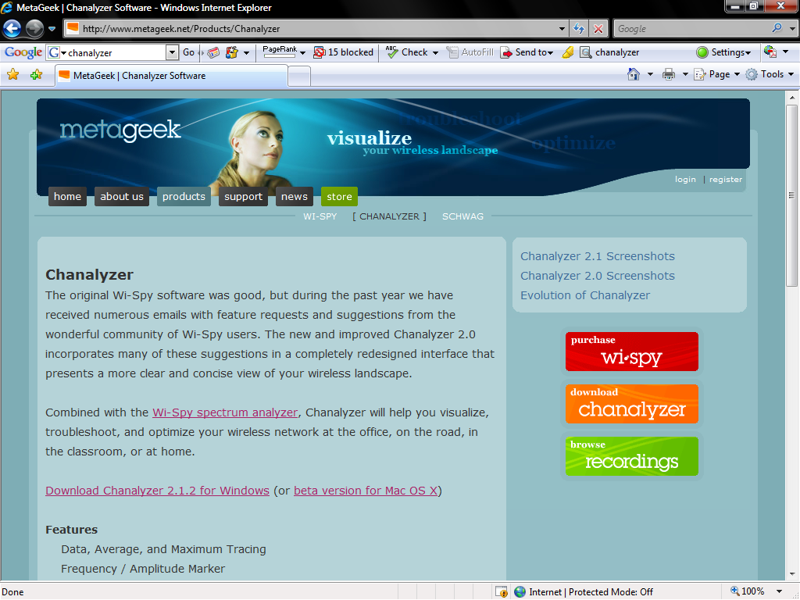
Spectrum Analyzer

Slide 40
Spectrum Analyzer

Slide 41
Spectrum Analyzer

Slide 42
Using a Spectrum Analyzer
For a hardware based spectrum analyzer there are four main controls for a spectrum analyzer
Frequency Selection
The frequency selector control is used to find the center of the range of frequencies of interest
Span Control
The span control then adjusts this range to set the area to examine
In other words, the size of the window

Slide 43
Using a Spectrum Analyzer
Attenuation or Reference Level
This control sets the sensitivity level for the on screen display
So that the entire signal will be displayed on the screen, the signal may have to be reduced or attenuated
This is also called setting the reference level or resolution bandwidth
Improper use of this control can make a nearby signal appear to intrude on another signal

Slide 44
Using a Spectrum Analyzer
This setting takes all the power within a given bandspace and averages it together as it sweeps across the screen
The wider this setting is the fewer bumps you see on the screen
The trace will smooth out as you increase this setting because it is averaging power within a wider space of spectrum
This has the added effect of making a "loud" carrier appear to cover a wider space than it actually does

Slide 45
Using a Spectrum Analyzer
This can lead to the erroneous belief that a carrier is bleeding over into the part of the band of interest
Narrowing the resolution bandwidth will show a more accurate representation of the actual power in a given bandspace, but is slower to scan on most analyzers and produces a very sporadic display
If you are looking for narrowband or adjacent channel interference into the band, then a narrow resolution bandwidth will be required
To measure the signal of your own carrier, then a wider resolution bandwidth will be required

Slide 46
Using a Spectrum Analyzer
Peak Hold
For signals that move around, such as FHSS and DSSS, a control is required to capture each small part of the total signal and hold that part while the rest of the signal appears over time

Slide 47
Common Waveforms
Let’s look at some common signal patterns
First we will look at some FM radio station signals
After those we will look at the type of signals more commonly seen in wireless data networks
The most basic type of signal is one that operates with high peak power at a single frequency

Slide 48
Common Waveforms
FM radio is an example of this
The following are some FM radio signals. These range from 88 MHz to 108 MHz
The center frequency is 98 MHz
For these measurements the span was set to 2 MHz and the reference level to -30 dBm
Here is a trace of the FM radio band

Slide 49
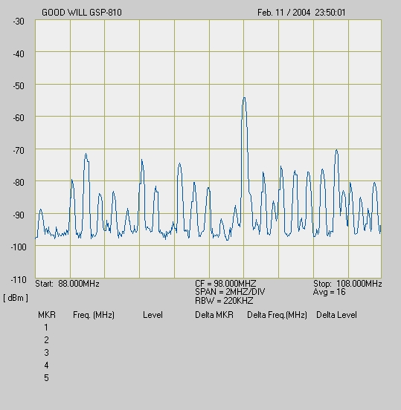
Common Waveforms

Slide 50
Using a Spectrum Analyzer
This view is similar to a group photograph
By zooming out you can see everyone in the group
Like this

Slide 51
Using a Spectrum Analyzer

Slide 52
Common Waveforms
By reducing the span to 200 KHz the individual FM stations begin to show up more clearly
In this example the center is 96.3 MHz
Off to the right a station shows up at 96.7 at lower power and local high power station at 97.1
To the left is a low power station at 95.9 MHz

Slide 53
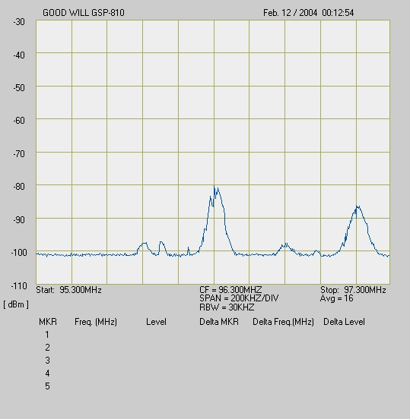
Common Waveforms

Slide 54
Using a Spectrum Analyzer
By reducing the span it is similar to zooming in to just show part of the group
Like this

Slide 55
Using a Spectrum Analyzer

Slide 56
Using a Spectrum Analyzer
Reducing the span to 50 KHz only one station at 96.3 MHz shows up

Slide 57
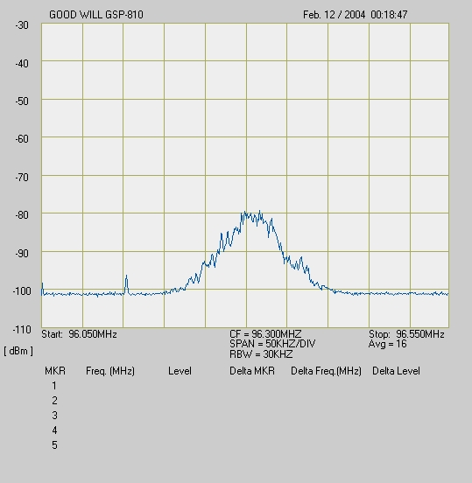
Common Waveforms

Slide 58
Common Waveforms
The next type of signal, DSSS - Direct Spread Spectrum, is characterized by a low level signal that is spread over a wide range
As such it looks very much like transient noise

Slide 59
Common Waveforms
To actually see this type of signal on the spectrum analyzer the peak hold function of the spectrum analyzer must be activated
This function keeps each signal on the screen as long as the peak hold function is activated
By doing this a pattern of the signal begins to appear

Slide 60
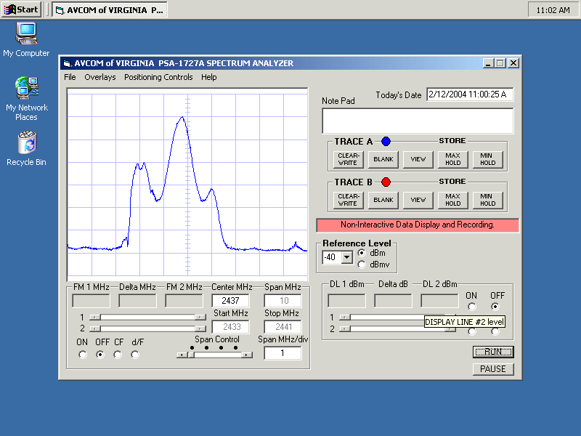
Common Waveforms

Slide 61
Common Waveforms
Being able to recognize the pattern on the screen is the difficult part of spectrum analysis
For example in the 5 GHz band radar signals can be a problem
As Alvarion explains there are six types of radar signals commonly seen
For example

Slide 62
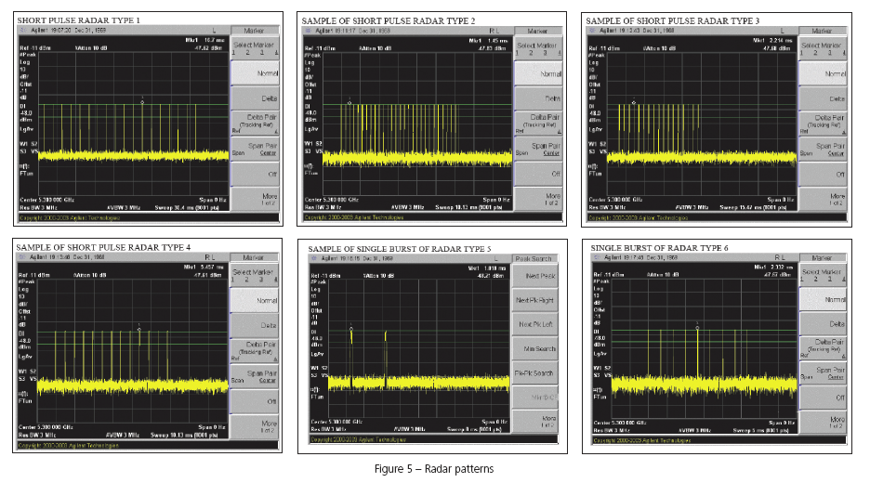
5 GHz Radar Patterns

Slide 63
Lab
Use a spectrum analyzer to plot sources of interference in the classroom

