Slide 1
Testing Copper Media Last Update 2012.01.10 1.7.0

Slide 2
Objectives
Learn how to test copper media

Slide 3
Important Parameters
There are three basic parameters that need to be tested when checking copper media such as UTP cable
These are
Signal Loss
Crosstalk
Wire Mapping

Slide 4
Signal Loss
There are two types of signal loss
Attenuation
The loss due to the length of the cable of a certain construction
Insertion
The loss due to devices connected to the cable such as connectors

Slide 5
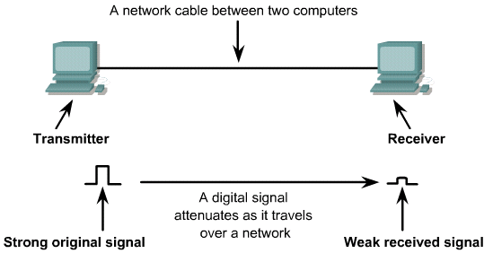
Signal Loss

Slide 6
Crosstalk
Crosstalk is the leakage of the signal from one wire onto another wire
This most often occurs at the ends of the cable where connectors are attached
At that point the signal being sent out is at its strongest, while the signal being received is at its weakest
The usual cause is improper installation of the connectors

Slide 7
Sources of Crosstalk

Slide 8
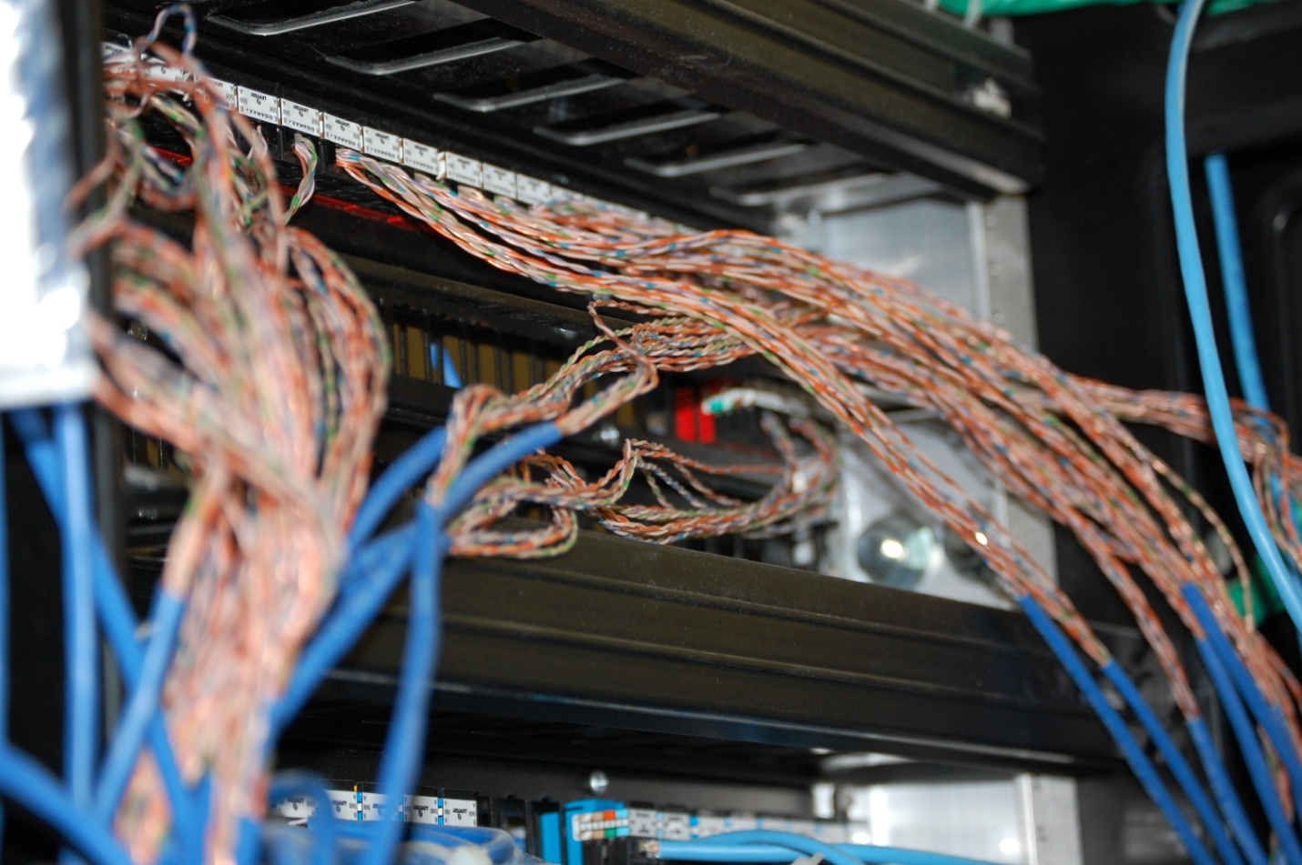
Sources of Crosstalk

Slide 9
Types of Crosstalk
There are two major types of crosstalk that are measured
NEXT
Near end
FEXT
Far end

Slide 10
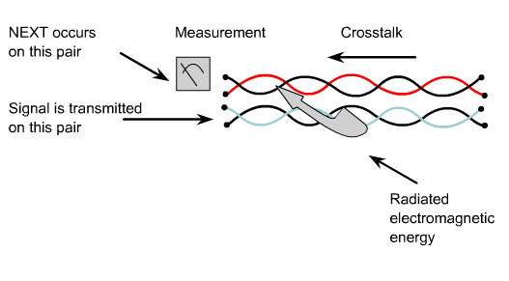
NEXT

Slide 11
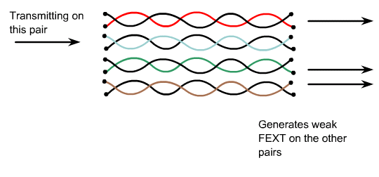
FEXT

Slide 12
Wire Map
The wire map test is to be certain the correct pins are connected to each other

Slide 13
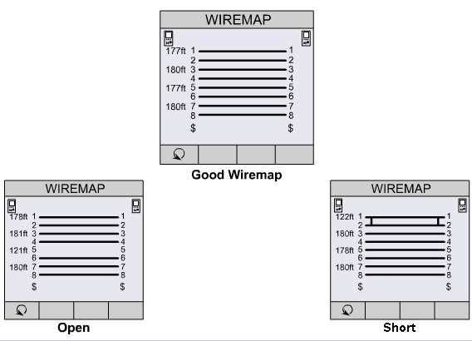
Wire Maps

Slide 14
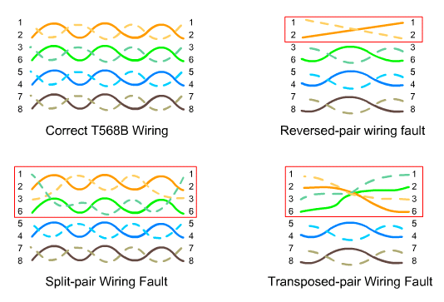
Wire Maps

Slide 15
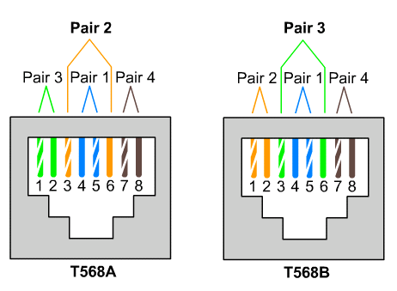
Wire Maps

Slide 16
Cable Testing
The last thing to do is to test every cable
This is what says a cable is rated to some category as discussed above
The device that does this testing is a cable tester
Such as

Slide 17
Multifunction Cable Tester

Slide 18
Multifunction Cable Tester
This device can test any kind of cable with the proper modules
Such as
Coax
UTP
Fiber Optic

Slide 19
Multifunction Cable Tester
There are two parts to these testers
It does not matter which part is at which end of the connection
The results are read on the tester
The other part, the injector, provides a means to turn the information back to the tester

Slide 20
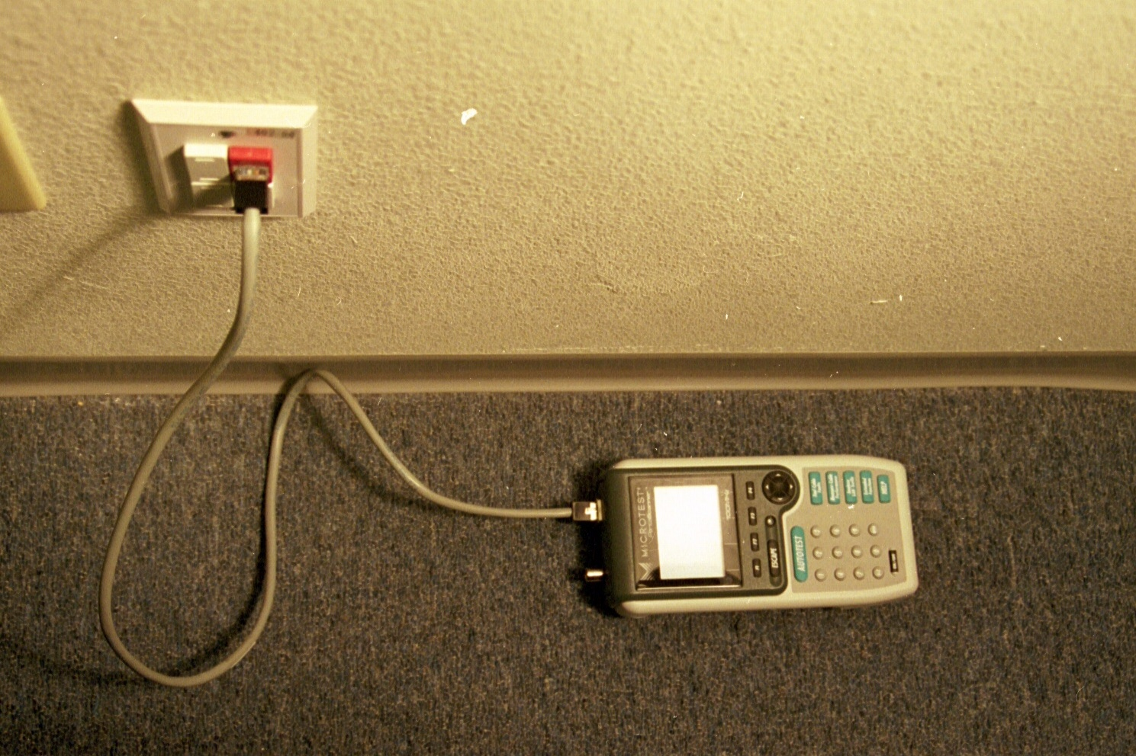
Tester

Slide 21
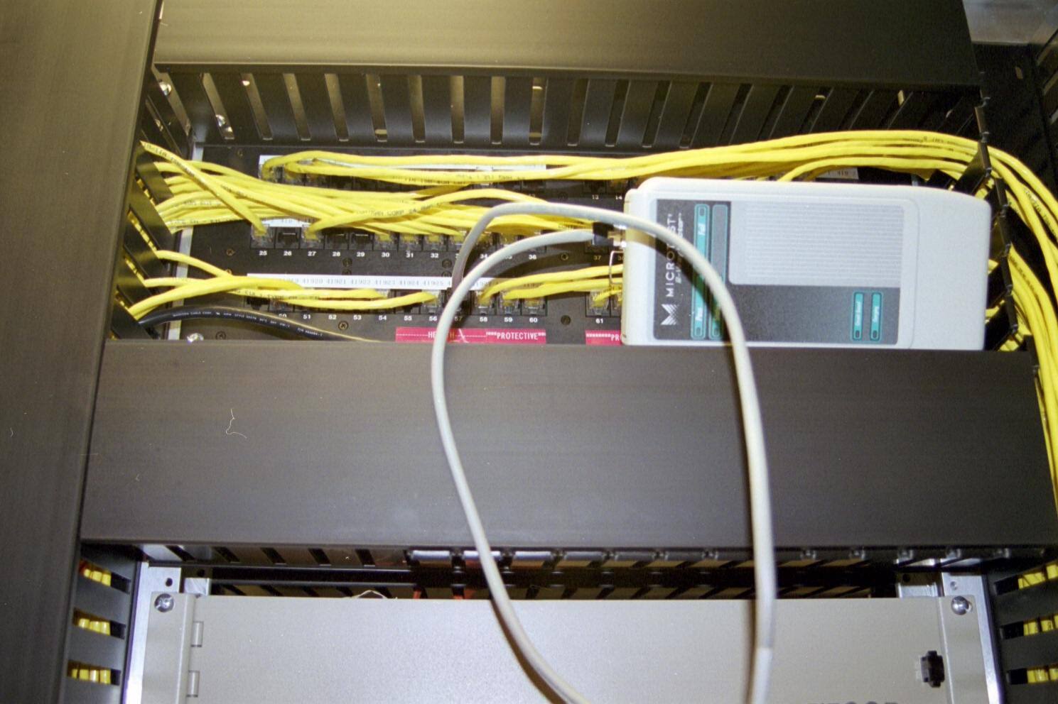
Injector

Slide 22
Multifunction Cable Tester
The common type of cable tested is UTP cable
Each cable must pass a series of tests at a specified level
The nice thing about these cable testers is their ease of use
Notice the button labeled Autotest

Slide 23
Common Problems
The most common problems with cables come from
NEXT
FEXT
In other words crosstalk
Crosstalk measures signal coupling from one wire pair to another within a twisted-pair cabling link

Slide 24
Common Problems
This kind of coupling is undesirable because it creates a noise disturbance in the wire pair
The effect of crosstalk is similar to a noisy transmission line
A receiver may not be able to distinguish the signal sent by the transmitter at the other end of the link from the noise induced by crosstalk

Slide 25
Common Problems
In data communications, crosstalk is a critical performance parameter

Slide 26
NEXT
NEXT measures the crosstalk signal that appears at the same end of the line from the test signal

Slide 27
FEXT
FEXT measures crosstalk at the other end

Slide 28
NEXT
NEXT measures the crosstalk induced by signal A to B in pair 2 that returns to the receiver side and competes with signal B to A arriving at the same receiver as pair 2
Meanwhile, ELFEXT measures the crosstalk induced in wire pair 4 that travels the length of the cable in the direction of the transmitted signal and competes with the clarity of signal 4 arriving at receiver 4

Slide 29
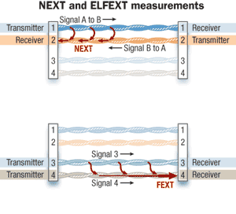
NEXT and ELEXT

Slide 30
Testing Requirements
Each category of cabling has a set of parameters that it must meet in order to be certified
Every part that carries the signal must conform to the relevant parameters
You cannot mix categories
If you do, then even if the cabling is rated Cat 6, but the patch panel is Cat 5, then the cabling installation is Cat 5

Slide 31
Testing Requirements
The testing parameters are shown next
The nice part is you need not worry about these as the cable tester takes care of this

Slide 32
Testing Requirements
Test Value | Cat 5 | Cat 5E | Cat 6
Frequency Range | 1-100 MHz | 1-100 MHz | 1-250 MHz
Attenuation | 22.0 dB | 22.0 dB | 19.8 dB
NEXT | 32.3 dB | 35.3 dB | 44.3 dB
PSNEXT | Not Used | 32.3 dB | 42.3 dB
ACR | 10.3 dB | 13.3 dB | 24.5 dB
PSACR | Not Used | 10.3 dB | 22.5 dB
ELFFEXT | Not Used | 23.8 dB | 27.8 dB
PSELFEXT | Not Used | 20.8 dB | 24.8 dB
Return Loss | 16.0 dB | 20.1 dB | 20.1 dB
Delay Skew | 45 ns | 45 ns | 45 ns

Slide 33
Testing Requirements
Test Value | Cat 6 | Cat 6A | Cat 7
Frequency Range | 1-250 MHz | 1-500 MHz | 1-250 MHz
Attenuation | 19.8 dB | ----- | 20.8 dB
NEXT | 44.3 dB | 27.9 dB | 62.1 dB
PSNEXT | 42.3 dB | ----- | 59.1 dB
ACR | 24.5 dB | ----- | -----
PSACR | 22.5 dB | ----- | -----
ELFFEXT | 27.8 dB | 9.3 dB | -----
PSELFEXT | 24.8 dB | 20.8 dB | 24.8 dB
Return Loss | 20.1 dB | 8.0 dB | 14.1 dB
Delay Skew | 45 ns | ----- | 20 ns

Slide 34
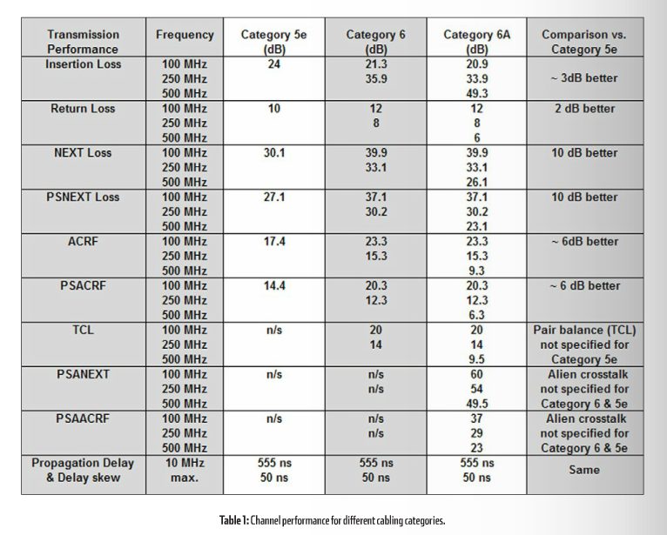
Testing Requirements

Slide 35
Testing Requirements
Nice set of numbers
So what do all of these mean
The cabletesting.com website says the following about each one

Slide 36
Testing Requirements
Attenuation or Insertion Loss
What Is It
Electrical signals lose some of their energy as they travel along the cable from one end to the other
Insertion loss measures the amount of energy that is lost
The insertion loss measurement quantifies the effect of the resistance the cabling link offers to the transmission of the electrical signals
Results Interpretation
The attenuation in a cable is largely dependent upon the gauge of wire used in constructing the pairs, with larger wires being better
Also, stranded cabling will have 20-50% more attenuation than solid copper conductors
Troubleshooting
Excessive length is the most common reason for failing attenuation
It can also be caused by poorly terminated connectors or plugs
Your clue to this cause is to compare the attenuation on the four pairs
If only one or two pairs have high attenuation, this suggests an installation issue
Temperature also affects attenuation in some cables
Temperature increases exacerbate the problem

Slide 37
Testing Requirements
NEXT
What Is It
When a current flows through a wire, an electromagnetic field is created which can interfere with signals on adjacent wires
Each pair is twisted because this allows opposing fields in the wire pair to cancel each other
The tighter the twist, the more effective the cancellation
Maintaining this twist ratio is the single most important factor for a successful installation
If wires are not tightly twisted, the result is Near End Crosstalk
Results Interpretation
Since NEXT is a measure of difference in signal strength between a disturbing pair and a disturbed pair, a larger number - less crosstalk - is more desirable than a smaller number- more crosstalk
If the NEXT curve crosses the pass/fail line at any point, then the link does not meet the stated requirement.
Since NEXT characteristics are unique to each end of the link, six NEXT results should be obtained at each end
Troubleshooting
In many cases, excessive crosstalk is due to poorly twisted terminations at connection points
All connections should be twisted to within 13 mm of the point of termination

Slide 38
Testing Requirements
PSNEXT
What Is It
PSNEXT - Power Sum NEXT is a calculation, not a measurement
PSNEXT is derived from the summation of the individual NEXT effects on each pair by the other three pairs
PSNEXT is important measurements for qualifying cabling intended to support 4 pair transmission schemes such as Gigabit Ethernet
Results Interpretation
Since PSNEXT is a measure of difference in signal strength between disturbing pairs and a disturbed pair, a larger number - less crosstalk - is more desirable than a smaller number -more crosstalk
If you look at the PSNEXT on a 50 meter segment of twisted pair cabling, it has a characteristic "roller coaster" shape
That is, it varies up and down significantly, while generally increasing in magnitude
This is because twisted pair coupling becomes less effective for higher frequencies
Typically, PSNEXT results are around 3 dB lower than the worst-case NEXT result at each end of the link
Troubleshooting
Since PSNEXT is a calculation based on NEXT measurements, troubleshooting for PSNEXT failures reduces to troubleshooting for NEXT problems
Once you have isolated and repaired the NEXT problem, PSNEXT will automatically improve

Slide 39
Testing Requirements
ACR
What Is It
ACR - Attenuation to Crosstalk Ratio is the difference between NEXT and the attenuation for the pair in the link under test
Due to the effects of attenuation, signals are at their weakest at the receiver end of the link
But this is also where NEXT is the strongest
Signals that survive attenuation must not get lost due to the effects of NEXT
During signal transmission over twisted pair cable, both attenuation and crosstalk are active simultaneously
The combined effect of these two parameters is a very good indicator of the real transmission quality of the link
Results Interpretation
ACR is an important figure of merit for twisted pair links
It provides a measure of how much 'headroom' is available, or how much stronger the signal is than the background noise
Thus, the greater the ACR, the better
Troubleshooting
ACR is derived from NEXT and attenuation data
Any steps taken to improve either NEXT or attenuation performance will improve ACR performance
This usually means troubleshooting for NEXT, because the only way to significantly improve attenuation is to shorten the length of the cable

Slide 40
Testing Requirements
PSACR - Power Sum Attenuation to Crosstalk Ratio
What Is It
Power Sum Attenuation to Crosstalk Ratio is actually a calculation, not a measurement made by the cable tester
PSACR is derived from an algebraic summation of the individual ACR effects
There are four PSACR results at each end of the link per link tested
Results Interpretation
Since PSACR is a measure of signal to noise ratio, a larger number - more signal and less noise - is more desirable than a smaller number - more noise and less signal
Typically PSACR results are around 3 dB lower than the worst-case ACR result at each end of the link
Troubleshooting
Since PSACR is a calculation based on ACR measurements, troubleshooting for PSACR failures is really troubleshooting for ACR problems
Troubleshooting for ACR becomes troubleshooting for NEXT and attenuation
So concentrate on NEXT and attenuation as is often the case in cable troubleshooting
Once you have isolated and repaired the ACR problem, the PSACR will automatically improve

Slide 41
Testing Requirements
ELFFEXT
What Is It
ELFEXT is a calculated result, rather than a measurement
It is derived by subtracting the attenuation of the disturbing pair from the Far End Crosstalk this pair induces in an adjacent pair
This normalizes the results for length
Results Interpretation
Compare the results of measurements made from both ends of the link to the appropriate limits
ELFEXT that is too high is indicative of either excessive attenuation, higher than expected FEXT, or both
Troubleshooting
The same factors that contribute to NEXT problems contribute to FEXT problems
Troubleshooting for ELFEXT means troubleshooting NEXT and attenuation problems, just as you would for ACR problems

Slide 42
Testing Requirements
PSELFFEXT
What Is It
PSELFEXT - Power Sum ELFEXT is actually a calculation, not a measurement
PSELEXT is derived from an algebraic summation of the individual ELFEXT effects on each pair by the other three pairs
Results Interpretation
Typically PSELFEXT results are around 3 dB lower than the worst-case ELFEXT result at each end of the link
Troubleshooting
The same factors that contribute to NEXT problems contribute to PSELFEXT problems
Troubleshooting for PSELFEXT means troubleshooting NEXT and attenuation problems, just as you would for ACR problems

Slide 43
Testing Requirements
Return Loss
What Is It
Return Loss is a measure of all reflections that are caused by the impedance mismatches at all locations along the link and is expressed in decibels
Return Loss is of particular concern in the implementation of Gigabit Ethernet
The value of impedances at the ends of the link must be equal to the characteristic impedance of the link
Frequently, this impedance is imbedded in the interface of equipment to be connected to the LAN
Results Interpretation
All standards define the formulae to calculate the allowable return loss for each cabling link model over the frequency range
A field test instrument may report a passing return loss test result in one of two ways
The worst case return loss margin
The worst case return loss value
Troubleshooting
Installation practices are more important on Category 5e and 6 than they were for Category 5
Additional unnecessary untwist or unjacketing in terminations can add several dB of return loss in some cases

Slide 44
Testing Requirements
Delay Skew
What Is It
Delay Skew is the difference between the propagation delay on the fastest and slowest pairs in a UTP cable
Some cable construction employ different types of insulation materials on different pairs
This effect contributes to unique twist ratios per pair and to skew
Skew is important because several high-speed networking technologies, notably Gigabit Ethernet, use all four pairs in the cable
If the delay on one or more pairs is significantly different from any other, then signals sent at the same time from one end of the cable may arrive at significantly different times at the receiver
A large skew will make it impossible to recombine the original signal
Results Interpretation
Well-constructed and properly installed cabling should have a skew less than 50 nanoseconds
Lower skew is better
Anything under 25 ns is excellent, skew between 45 and 50 nanoseconds is marginally acceptable
Troubleshooting
If one pair is much higher or lower in delay than the others, very high skew may result
If one pair exhibits uncharacteristically high or low delay, re-examine the installation
If the skew is high, it will still work in low speed environments

Slide 45
What Does This Mean
In general the only thing that needs to be done while testing cables is to hookup the cable tester, then press the autotest button
The unit then tells you if the cable passed or failed
It really does not matter why the cable failed if it did
The unit will tell you if you wish to know

Slide 46
What To Do
When a test fails what do you do
Unless you did a really bad job of pulling the cable through the walls and ceiling the most likely problem is a bad connection
So reterminate the cable
Then test again

Slide 47
Testing Patch Cables
Until recently there was no way to test patch cables, but Annex J to TIA/EIA-568-B.2-1 specified a method
With the publication of this amendment, people started testing patch cables
One industry publications has reported that their tests on Cat5E and Cat6 patch cables show a failure rate for them on these tests from 70 to 80 percent

Slide 48
Testing Patch Cables
This tells us one of three things
The test is faulty
There are a bunch of systems out there that are not working properly
It really does not matter how good or bad a patch cable is
I expect to hear more research on this subject in the future, so pay attention to the trade press

Slide 49
Testing Patch Cables
Sure enough in the January 2012 issue of Cabling Installation and Maintenance magazine there was an article on this problem of certifying patch cables
It argues that only expensive and tested by the manufacturer patch cables should be used
It also mentions an adaptor from Fluke that can now allow patch cable testing

Slide 50
Testing Patch Cables
There will be more to come on this issue I am sure

Slide 51
Communication While Testing
It is common that in a building where cabling is being installed there will be no telephones
So, to communicate from one end of the cable to the other
A radio or cell phone is often used

Slide 52
Toner
A toner is not used to test cabling
It only is used to trace wiring
At one end a device is attached to the wiring
This device sends an electrical signal down the wires
The other part of the toner set is used at the far end to find the remote end of the wires

Slide 53
Toner
This is accomplished by moving the remote end device past the wires at the remote end until a tone is heard from the remote end device

Slide 54
Toner

