Slide 1
Terminating Wireless Media
Last Update 2012.04.23
1.3.0

Slide 2
Objectives
Learn how wireless media is terminated

Slide 3
Terminating Wireless Media
Terminating wireless media is much simpler than terminating either UTP or fiber optic cable
Wired or guided media consists of a cable onto which an end must be placed
This cable carries the signal
The end or connector allows the signal to enter and exit the media

Slide 4
Terminating Wireless Media
For wireless or unguided media the signal is flying around in the air
Termination of wireless media requires that this signal be captured by a device that will convert it into an electrical or optical signal that is then placed onto one of the guided media

Slide 5
Terminating Wireless Media
The devices used to launch then recapture the wireless media form the termination points for the wireless media
This is either a radio with an antenna or a photodiode

Slide 6
Basic Radio Frequency Parts
When the wireless media is made up of radio frequency waves these are the parts that form the termination
Antenna
Radio
Made up of
Amplifier
Filter
Mixer
Source

Slide 7
Basic Radio Frequency Parts
These five parts are then put together to do one of two basic functions
Transmit
Receive
The name of the resulting device is a radio

Slide 8
A Radio
The radio may also go by many other names based on marketing considerations or its specific role in the wireless network
A radio is used to send and receive a signal that flows through the air as a series of electromagnetic waves
Radios can take on many different forms, as such it is not always easy to identify them

Slide 9
The Transmitter
When transmitting or receiving the goal is to produce a perfect sine wave, of the exact size required, at only one frequency
A block diagram of the basic parts looks like this
For a transmitter

Slide 10
Transmitter Block Diagram

Slide 11
The Receiver
A block diagram of the basic parts looks like this
For a receiver

Slide 12
Receiver Block Diagram

Slide 13
The Basic Parts
The main job of the manufacturers of these basic parts is to attempt to make them
Smaller
Lighter
More energy efficient
Lower in cost
Now on to some details on each of these parts

Slide 14
What is an Antenna
Every radio frequency wireless system must have an antenna
You may not see it
You may not recognize it, if you do see it
But it must be there somewhere

Slide 15
What is an Antenna
The antenna does only one thing, it converts electrical signals coming from a conductor into airborne waves or it converts airborne waves into electrical signals to be sent down a conductor
Just as the RJ-45 connector is the termination point for a wired UTP media so is the antenna for wireless radio wave media

Slide 16
How an Antenna Works
Being a resonant device it operates efficiently over a narrow frequency band
The real way an antenna does its work is somewhat complex
But for this level of discussion lets say it this way

Slide 17
How an Antenna Works
An antenna begins to radiate energy, in the form of radio frequency waves, whenever the length of the antenna becomes close to the wavelength of the signal
When an alternating electric current flows through a conductor, electric and magnetic fields are created around the conductor

Slide 18
How an Antenna Works
If the length of the conductor is very short compared to a wavelength, the electric and magnetic fields will generally fade out within one or two wavelengths
But as the conductor is lengthened, the intensity of the fields around it grow bigger
As such, an ever increasing amount of energy escapes into space

Slide 19
Antenna Radiation Pattern
When selecting an antenna the width of the area to be covered and the distance of each link must be considered
These considerations will then determine the type of antenna to use based on each antenna’s signal pattern
Every antenna has a pattern to the signal
This pattern applies to both sending and receiving

Slide 20
Antenna Radiation Pattern
By convention the radiation line used to draw this pattern is drawn wherever the power radiating out drops to one half the power at the antenna surface
For example, for a dipole antenna

Slide 21
Antenna Radiation Pattern

Slide 22
Antenna Radiation Pattern
As opposed to a directional antenna

Slide 23
Antenna Radiation Pattern

Slide 24
Antenna Radiation Pattern
Note in the diagram above that the radiation pattern does not have an even outline
In that there is a large main lobe, which is desired, and one or more side lobes, which are undesirable
These side lobes are also called the minor lobes

Slide 25
Antenna Radiation Pattern
Antennas also have a front to back ratio that is measured in dBs
The forward gain is the peak gain on the main lobe of the antenna
The rear gain is measured as either the gain at exactly 180 degrees from the main lobe, or from 90 degrees to 270 degrees from the main lobe

Slide 26
Antenna Radiation Pattern
Using the wider sector is the better way to measure this
These back lobes are also undesirable
A front to back ratio of 10-15 dB is considered fair to poor, 15-20 dB is good, 20-30 dB is very good, and above 30 dB is excellent

Slide 27
Antenna Radiation Pattern
The regions in between the main and minor lobes are areas of weak signals called nulls

Slide 28
Antenna Radiation Pattern
Main or Major Front Lobe
Null
Side or Minor Lobe
Back Lobe

Slide 29
Antenna Radiation Pattern
The pattern provided by the manufacturer can be a rectangular grid or the more popular polar coordinate system just shown
The plotting scales used range from linear to linear logarithmic to modified logarithmic
The linear logarithmic and modified logarithmic are the ones most commonly used

Slide 30
Antenna Radiation Pattern
These scales show the side and back lobes as well as the main lobe
For antennas in the frequencies of interest here these patterns are for the far field of the antenna
The far field region is the area in which wave propagation occurs
This field starts basically 10 wavelengths from the antenna

Slide 31
Antenna Radiation Pattern
The radiation pattern of an antenna is adjusted in most cases by adding reflectors and directors
The reflector adds gain to the antenna, in relation to the isotropic antenna, by redirecting the signal
The director then concentrates the beam into an even tighter pattern

Slide 32
Amplifier
Things often need to get bigger
In radio frequency systems an amplifier does this

Slide 33
What is a Filter
A filter filters signals
Such as a bunch of signals all at different frequencies coming in and just one, the desired one, going back out
In essence a filter is the door bouncer at a trendy club
Some get in and some are kept out

Slide 34
What is a Filter
Filters are used at the receive side as the antenna will pick up signals at and near the desired frequency
The filter removes the undesired ones
Governmental regulatory authorities say you may only transmit on the authorized frequency
The filter is designed to ensure this is the case

Slide 35
What is a Mixer
A mixer seeks to change the frequency of a signal while keeping everything else about the signal the same
But why would you want to do this
One reason would be that your voice creates sound in the area of 2,000 Hertz, but a cell phone operates at 900,000,000 Hertz

Slide 36
What is a Source
The source or oscillator is what generates the radio frequency
The desire is to produce a perfect sine wave at the desired frequency
Of course this never happens

Slide 37
Using a Radio in a LAN
In a local area network the typical use of a radio is to create an access point at one end of a link in order for wireless clients to access the wired network
In other words the access point is the on-ramp to the wired network
Then on the other end, a radio is used in a network interface card to connect a client computer to the access point

Slide 38
Access Point
Access points come in many forms
Here is an example from Cisco

Slide 39
Access Point

Slide 40
NIC
Wireless NICs are commonly built-in to computers these days
In this case they are just small circuit boards
An easier to see form is a wireless NIC as a PCMCIA card such as this Cisco card

Slide 41
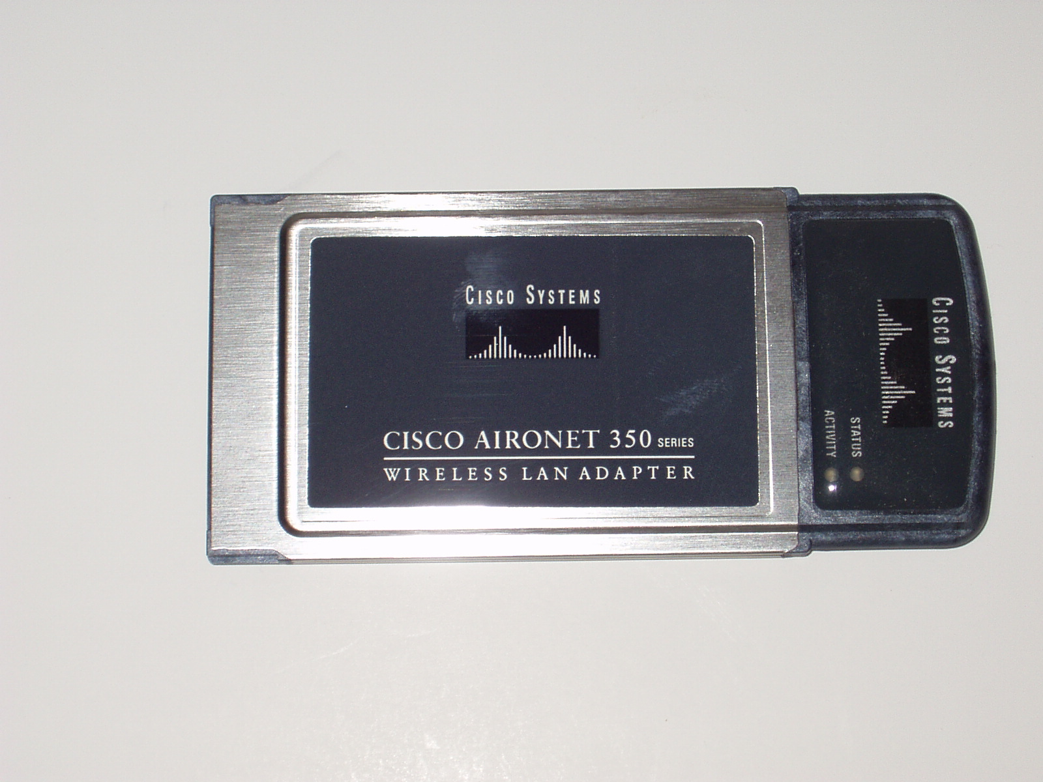
NIC

Slide 42
Using a Radio in a CAN
When used to create a link for a campus area network radios are used to create a bridge
In this use two identical radios are set to talk to each other, and only each other
For example

Slide 43
Bridge

Slide 44
Free Space Optics
FSO or Free Space Optics is a laser based system used to create a wireless link with light, instead of using a radio frequency
FSO systems operate very much like a fiber optic connection using a cable
The main difference being the attenuation in a cable is known and controllable

Slide 45
Free Space Optics
Whereas in a FSO link that uses the atmosphere as the media, the exact attenuation of the link can vary by the second and is unknowable

Slide 46
Method of Operation
To make this type of system work a device known as a laser diode is used to produce a signal in the first part of the near infrared range, which is just above visible light at 700 nanometers or nm
The most common wavelengths used are 780 nm to 900 nm and 1500 to 1600 nm

Slide 47
Method of Operation
The laser diode differs from the traditional laser in that it is simpler, smaller, and lower powered
The device on the other end that receives the signal is a photodiode
A transceiver has both devices so that the units can send and receive
For example

Slide 48
Method of Operation

Slide 49
Free Space Optics
Here is an example of such a link

Slide 50
Using FSO in a CAN

Slide 51
Lab
Setup a RF CAN
Setup a FSO CAN

