Slide 1
Terminating Fiber Optic Media
Last Update 2011.09.16
1.8.0

Slide 2
Objectives
Learn how to terminate fiber optic media

Slide 3
Handling Fiber Optic Media
Anytime you work with fiber optic cable it is important to keep everything clean
It is also important to protect yourself from injury from small pieces of fiber
These fiber pieces that are produced as a normal part of the termination process can get in your eyes or stick in your skin
They are difficult to remove

Slide 4
Work Space
The proper work space for fiber optic cable is on top of a non-reflective black surface so any loose fiber pieces can be seen
Tweezers should be used to pick up any stray pieces, which are then placed in a container made for this purpose

Slide 5
Keeping Yourself Safe
Whoever is working with the fiber should wear safety glasses
Do not rub your eyes or skin without washing your hands

Slide 6
Keeping the Media Clean
It is critical that the ends of fiber optic cable be kept clean
Dirty connections are a common cause of link failures
According to Fluke 85% of link failures are due to contaminated ends

Slide 7
Inspection
The best way to check for dirt is an inspection scope
For multimode fiber 200 times magnification is used
For single mode cable 400 time is required

Slide 8
Inspection Scope

Slide 9
Inspection Scope

Slide 10
Inspection Scope

Slide 11
Inspection Process

Slide 12
Sources of Problems
The are two main sources of problems on fiber ends
Contamination
Dirt and Dust
Finger Prints
Cleaning Method Used
Skin Oils and Cable Gels
Damage
Pitting
Scratches

Slide 13
Contamination
There are many sources of contamination that leads to dirt particles on connections
Airborne dust and dirt
Improper or insufficient cleaning of tools and materials
Debris from poor quality components
Dirt from the technicians hands
Here are some examples of common problems from Fluke and others

Slide 14
Contamination
Even touching the end of a fiber will deposit excessive oil
Gel from used to pull cable will do the same thing
Dust caps do not necessarily help as they may transfer contamination

Slide 15
Dust

Slide 16
Dirt

Slide 17
Finger Print

Slide 18
Dirt

Slide 19
Dust and Skin

Slide 20
Dust and Skin

Slide 21
Dust and Skin

Slide 22
Dry Cleaned

Slide 23
Too Much Solvent Cleaner

Slide 24
Pitting
In some cases the amount of dirt is so great that scratches, pits, and chips can be seen in the fiber ends

Slide 25
Scratches

Slide 26
Scope Resolution
In general scopes have one of three resolutions
Low – 60X
This does not show much detail, but it has a wide field of view
Medium – 200X
This will show dirt, oils, dust, and lint
High – 400X
This level will show pits and scratches as well

Slide 27
Scope Resolution
In the field the 200X is the most widely used

Slide 28
Cleaning
The solution to this problem is proper cleaning
This means the use of optical grade materials to do the cleaning
Cleaning can be done using dry or wet methods

Slide 29
Best Practice When Cleaning
As discussed below there are many suggested methods for cleaning fiber
To cut to the chase here is what Fluke says is the best way to do this regardless of whether it is a plug or jack

Slide 30
Best Practice When Cleaning
Dab the contaminated end-face with a solvent-dampened wipe or swab
The solvent dissolves and removes contaminants that have dried and firmly affixed to the end-face without producing a static charge that can attract dust from the air
It also evaporates quickly, making it preferable to isopropyl alcohol which takes much longer to disappear and can leave a staining residue in the process

Slide 31
Best Practice When Cleaning
Rub the fiber end-face perpendicularly against a dry wipe several times
Re-inspect the fiber end-face with an optical microscope to ensure that all the debris has been removed

Slide 32
Dry Cleaning
Dry cleaning is very common
However it can lead to static charges on the ends of the connectors
These charges then attract dust

Slide 33
Wet Cleaning
Although an extra step, wet cleaning is more effective
Isopropyl alcohol at 99 percent is commonly used for this purpose
While effective alcohol must be allowed time to dry, since alcohol will absorb water from the air
There are solutions designed for fiber optic cable that are a better choice

Slide 34
Cleaning Cable Ends
Let’s look at some common methods used to clean fiber optic media as provided by Fluke
Using Fluke Networks Fiber Optic Cleaning Card
Peel cover from an unused “N”– shaped cleaning zone
Apply a minimal amount of solvent from the Solvent Pen to the first corner of the “N”

Slide 35
Cleaning Cable Ends
Avoid isopropyl alcohol
Place the end-face perpendicular to the card in the first corner of the unused “N”
Swipe through the “N” shape using gentle pressure moving from wet to dry
Always check the end-face with a fiber microscope before insertion
If necessary, repeat the cleaning process from step #1 using another unused “N”
Never swipe over the same area twice

Slide 36
Cleaning Cards

Slide 37
Cleaning Cable Ends
Using Fluke Networks’ Fiber Optic Cleaning Cube
Pull out a clean wipe and lay it over the foam platen
For best results, apply a minimal amount of solvent from the Solvent Pen
A 1 cm diameter spot is sufficient
Avoid isopropyl alcohol

Slide 38
Cleaning Cable Ends
Place the end-face perpendicular to the cube in the wet spot
Swipe the end-face from the wet spot into a dry area using gentle pressure
Always check the end-face with a fiber microscope before insertion
If necessary, repeat the cleaning process on a clean portion of the wipe
Each wipe can clean up to four end-faces. Never swipe over the same area twice

Slide 39
Cleaning Cube

Slide 40
Cleaning Cable Ends
Using Fluke Networks’ Fiber Optic Swabs
Select the swab with the correct diameter to fit inside the port to be cleaned. 2.5 mm Fiber Optic Swabs fit SC, ST, and all other 2.5 mm diameter ports. 1.25 mm Fiber Optic Swabs fit LC and MU ports
Using the Fiber Optic Cleaning Cube or Card, apply some solvent from the Solvent Pen to a wipe
Avoid isopropyl alcohol

Slide 41
Cleaning Cable Ends
Touch the swab to the wet spot on the wipe for 3 seconds to draw a minimal amount of solvent
Touching the swab directly to the Solvent Pen will likely result in excess solvent
Insert the damp swab into the port and turn several times, applying gentle pressure

Slide 42
Cleaning Cable Ends
Follow the damp swab with a dry one, using the same procedure to remove any remaining solvent from the end-face and alignment sleeve
Always check the end-face with a fiber microscope before insertion
If necessary, repeat the cleaning process with fresh swabs

Slide 43
Cleaning Swabs

Slide 44
Cleaning Swabs

Slide 45
Area to Clean
It is important to clean not only the core area of the fiber end, but also the cladding area
In this photograph the core is the white dot the cladding is the dark circle

Slide 46
Area to Clean

Slide 47
Area to Clean
Failing to clean the cladding area as well as inside the connector itself will allow the debris there to migrate to the core, thus blocking the light based signal
Clean both the patch cord ends as well as the bulkhead connectors such as these

Slide 48
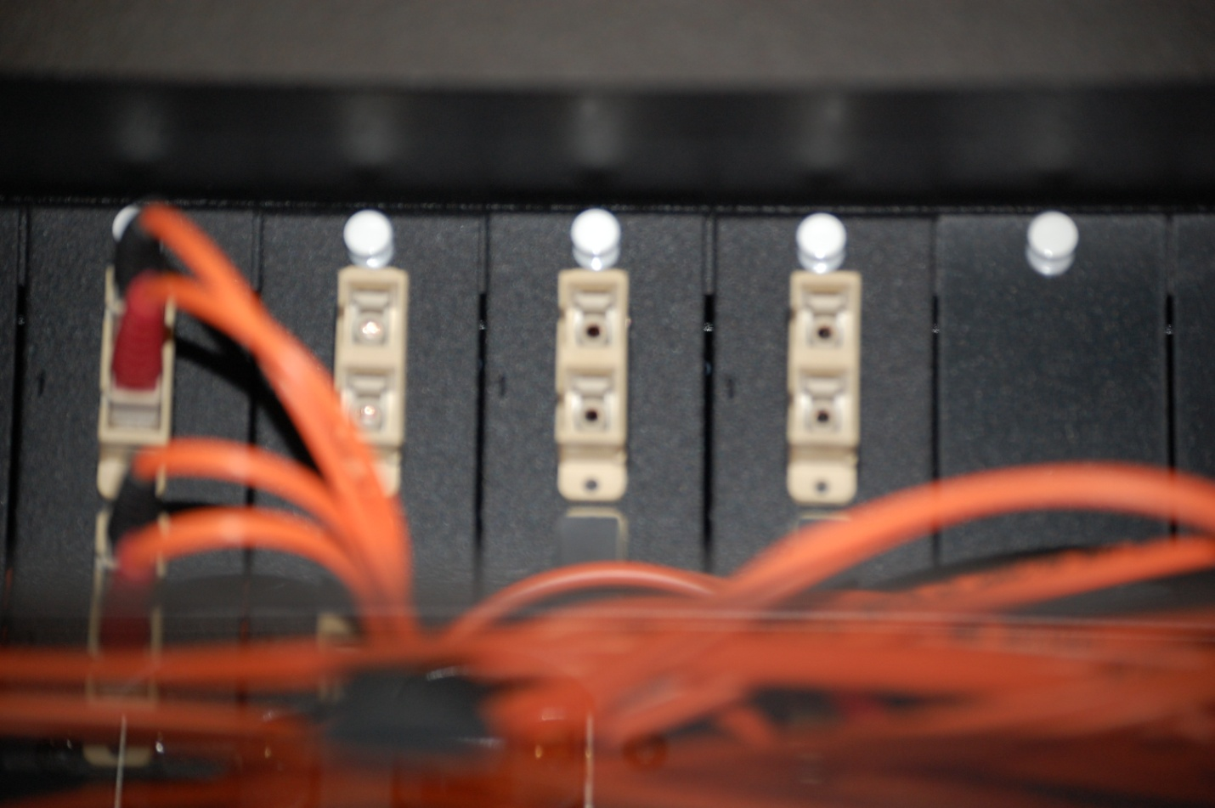
Area to Clean

Slide 49
Field Termination Methods
There are three basic termination methods that can be used in the field
The selection of which one to use is best decided by balancing the
Cost of the method
The loss the method creates
The ease of keeping the ends clean

Slide 50
Field Termination Methods
The three common field termination methods are
MPO
Factory terminated pigtails
Field termination
Lets look at each of these

Slide 51
MPO
An MPO connector is a three part system of
Cassette Connector at Originating End
Preterminated Cabling
Cassette Connector at Other End
For example

Slide 52
MPO Cassette

Slide 53
MPO Cable

Slide 54
MPO
Notice that the cassette is ready to be placed in a rack
The end facing out is ready to accept a fiber optic cable patch cord
The end facing the back is ready to accept a preterminated cable that will run from this MDF or IDF to the other end of the connection

Slide 55
MPO
Further as the photograph of the MPO cable shows these cables are preterminated
They merely need to be installed in the building
This means no termination is required in the field

Slide 56
MPO
The disadvantage to this method is
Higher cost
Need to accurately measure the length of the cable
Higher loss

Slide 57
Factory Terminated Pigtails
This method is similar to the MPO method except the back facing connection of the box mounted in the rack is non preterminated
A standard fiber optic cable is installed in the building, then the cable attached to the rack mounted patch panel using one of the methods discussed below

Slide 58
Factory Terminated Pigtails
This method has advantages and disadvantages
Cost is lower
Loss is less
Labor cost is higher
Greater installer expertise is required

Slide 59
Field Termination
When using this method everything is done in the field
Connectors are terminated at both ends
The connectors are installed in a patch panel
The cable is installed
The cable ends are attached to the connectors

Slide 60
Field Termination
This method as well as advantages and disadvantages such as
Lowest cost for parts
Lowest loss
Highest labor cost
Greatest installation expertise required

Slide 61
Attaching Connectors
There are several ways to attach connectors to fiber optic cable, such as
Polish
Oven cured epoxy
UV cured epoxy
Anaerobic epoxy
No Polish
Clamp

Slide 62
Attaching Connectors
Here is a summary from Cabling Installation and Maintenance from January 2011

Slide 63
Attaching Connectors

Slide 64
Basic Termination Steps
Regardless of the method used there are several basic steps in fiber optic cable termination
Strip the covers off the fiber
Secure the fiber to the connector
Cleave the fiber
Polish the end in some cases
Inspect the end

Slide 65
Oven Cured Epoxy
Oven cured epoxy makes the best connection
But it is the most trouble to use
This process requires mixing the resin and hardener in the correct proportions
All of it must be used before it sets up
Any that is not used, must be thrown out

Slide 66
Oven Cured Epoxy
This method is best suited for making a number of similar connections
Once the glue is applied to the connection, it is placed in an oven for around 45 minutes to set
Then the connector is put in a tray to cool

Slide 67
Oven Cured Epoxy

Slide 68
Oven Cured Epoxy

Slide 69
UV Epoxy
With the UV epoxy an ultraviolet lamp is used to cure the epoxy in about 1 minute

Slide 70
Anaerobic Epoxy
No tools are required for anaerobic epoxy
One part is applied to the fiber
The other part to the ferrule
When the two are joined the two solutions interact to form the bond
This takes about 10 seconds
The drawback to this method is a weaker joint

Slide 71
Tools
Several types of tools are used to terminate fiber optic cable
These are for
Cutting
Cleaning
Marking
Polishing

Slide 72
Tools for Cutting
Shears
For removing the strength member
Stripper
For removing the outer cover
Stripper
For removing the fiber buffer
Scribe
To cut the fiber inserted in the connector

Slide 73
Tools for Cleaning
Cleaning solution
To carry away contaminants
Lint free wipes
To remove the cleaning solution

Slide 74
Tools for Marking
Fiber marker
To mark where to remove the covers

Slide 75
Tools for Polishing
Glass plate
To support the soft pad
Soft pad
So the abrasive can properly contact the fiber
Abrasives
To grind down the end of the fiber
Puck
To hold the connector while polishing

Slide 76
Basic Procedure for Connector
The basic process for attaching a connector is
Cut the cable longer than required by a couple of inches
Slide any parts onto the cable that cannot be added later such as the strain relief boot
Strip off the outer cover
Mark the cable at the points required for the connector preparation

Slide 77
Basic Procedure for Connector
Remove the cable jacket
Cut the strength member off flush to the remaining jacket
Strip off the buffer in small sections so as to not break the fiber
Clean the fiber
Clean the connector
Dry fit the connector
Apply the glue based on the type used

Slide 78
Remove the Outer Cover

Slide 79
Remove the Outer Cover

Slide 80
Remove the Strength Member

Slide 81
Remove Buffer Around Fiber

Slide 82
Remove Buffer Around Fiber

Slide 83
Polishing
For polish type connectors the exact procedure will vary based on the specific connector used
Basically the end of the ferrule is already of the desired end face dimension
The purpose in polishing is to form the fiber end to the shape and size of the ferrule’s end face

Slide 84
Polishing
A puck is used to hold the connector with the fiber installed in the correct orientation

Slide 85
Polishing Procedure
In general the method to use to polish is
Be sure the glue is dry
Scribe the fiber at the base of the glue bead at the end of the connector
Smooth the resulting nub with a piece of 5 micron film by gently rubbing it
Place the glass plate under the soft pad
Place the 5 micron abrasive on the soft pad

Slide 86
Polishing Procedure
Place the connector in the puck
Place the puck on the film
Begin polishing using a figure 8 pattern
Make about 20 patterns
Clean the end
Change to the 0.3 micron film
Using the puck and the figure 8 pattern continue until the end is smooth

Slide 87
Polishing Procedure

Slide 88
Fiber End Face Finishes
There are several different end face finishes that can be done
PC - Physical Contact finish is the most common
Other include UPC – Ultra Physical Contact and APC – Angled Physical Contact

Slide 89
Fiber End Face Finishes
Each of these of increasing reduction of back scatter, in other words loss at the connections
For example

Slide 90
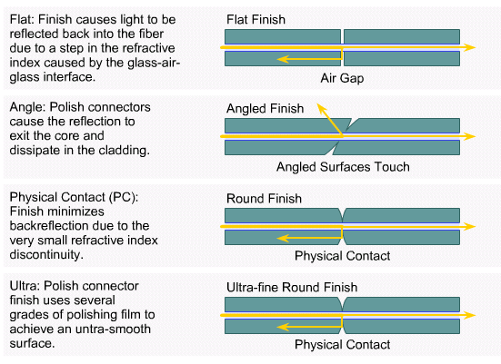
Fiber End Face Finishes

Slide 91
Scribe

Slide 92
Scribe

Slide 93
Polish Off the Pad

Slide 94
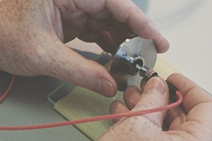
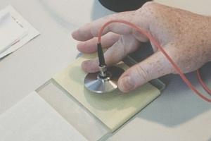
Polish On the Pad

Slide 95
Polish On the Pad

Slide 96
Polish On the Pad

Slide 97
No Polish Procedure
Corning has a commonly used no polish connector called the UniCam
Let’s let them explain how this works and the procedure used to do this

Slide 98
Clamp On Connector Operation
The patented UniCam connector incorporates a mini-pigtail housed in a connector body
There is a fiber stub bonded into the ferrule in the factory, where the end-face of the ferrule is polished to a PC, UPC, or APC finish
The other end of the fiber is cleaved and fully protected inside the connector
The field fiber is cleaved and inserted into the connector until it makes positive contact with the fiber stub

Slide 99
Clamp On Connector Operation
A simple rotating cam actuation process completes the connector with no epoxy or polishing required
After strain relieving the fiber to the connector, it is ready to be mated to another connector inside an adapter
The primary advantage of a UniCam connector, when compared to other field-installable connector methods, is the time savings

Slide 100
Clamp On Connector Operation
Because no epoxy or polishing is required in the field, a UniCam can be installed very quickly, leading to labor cost savings and the ability to increase the volume of installations
This provides installer, contractors, and end users the ability to complete installations more quickly, bringing critical systems on line, and moving on to the next revenue-generating opportunity

Slide 101
Clamp On Connector Operation
An important advantage of the UniCam connector design over other no-cure connectors is that the fiber is fully protected from the environment
The epoxy process and polishing process in the factory are carefully performed to make certain the UniCam connector will last virtually the entire life of the network

Slide 102
Clamp On Connector Operation
Another significant advantage of the UniCam connector can be attained when used for installations at the desk outlet or other areas with limited physical space
The only tools required are a stripper, a cleaver, the installation tool, and an alcohol pad

Slide 103
Clamp On Connector Procedure
The basic steps to attach a fiber optic cable to a no polish, clamp on connector are
Open the tool
Open the connector
Place the connector in the tool
Slide the strain relief boot over the fiber optic cable

Slide 104
Clamp On Connector Procedure
Strip 1.5 inches of the buffer off the fiber to expose the fiber itself
Clean the fiber
Cleave the fiber
Insert the fiber into the connector
Close the tool
Seat the clamp
Install the rest of the hardware

Slide 105
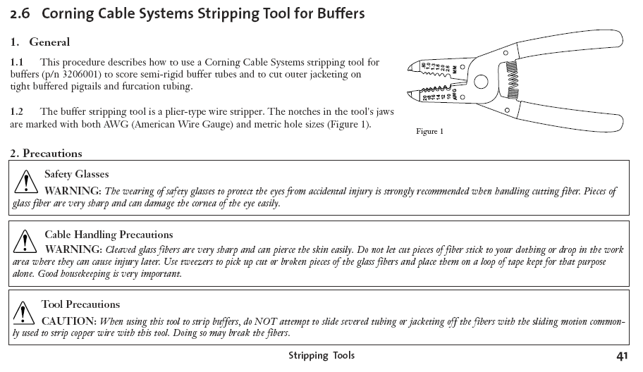
UniCam Buffer Stripping Tool

Slide 106
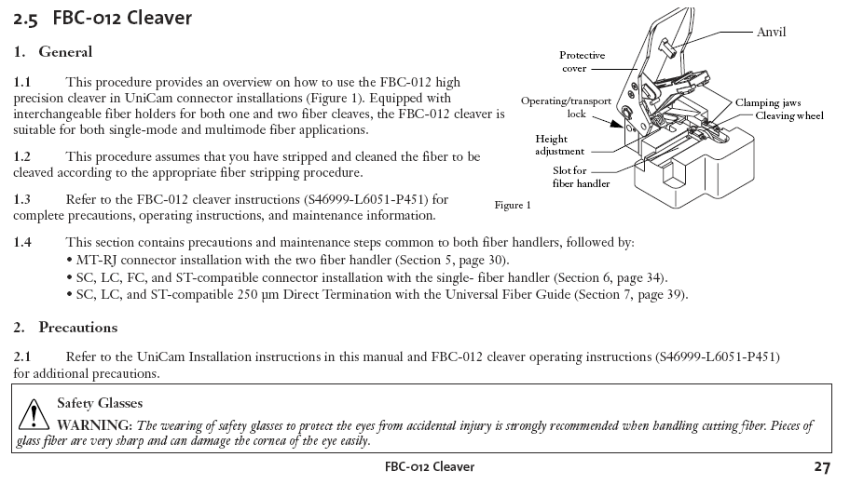
UniCam Cleaver

Slide 107
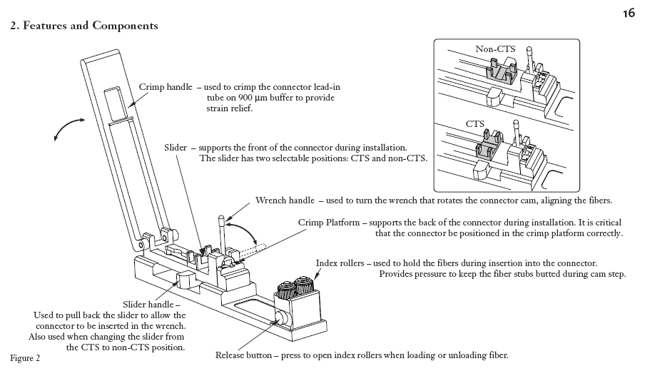
The UniCam Tool

Slide 108
Inspect the Fiber End
Using the appropriate power scope examine the fiber end using the guidelines seen in the photographs above and these examples from the Woodard and Husson book

Slide 109
Inspect the Fiber End

Slide 110
Inspect the Fiber End

Slide 111
Inspect the Fiber End

Slide 112
Inspect the Fiber End

Slide 113
Inspect the Fiber End

Slide 114
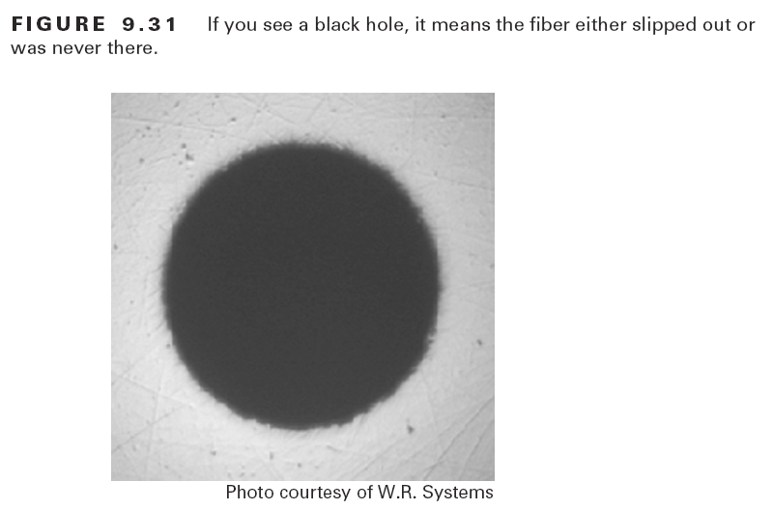
Inspect the Fiber End

Slide 115
Splicing Fiber Optic Cable
There are two ways to connect one piece of fiber optic cable to another
These are
Fusion
Mechanical
Without extensive training and expensive tools the only splicing you are likely to do is a mechanical splice

Slide 116
Fusion Splice
A fusion splice is a junction of two or more optical fibers that have been melted together
This is accomplished with a machine that performs two basic functions
Aligning of the fibers
Melting them together
Typically using an electric arc

Slide 117
Fusion Splice
A machine, called a fusion splicer is used for this
A properly made fusion splice results in a continuous length of material with minimal discontinuities at the splice

Slide 118
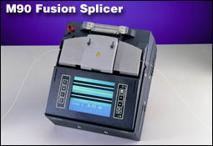
Fusion Splicer

Slide 119
Mechanical Splice
A mechanical splice is an optical junction of two or more optical fibers that are aligned and held in place by a self-contained assembly - usually the size of a large carpenter's nail
The fibers aren't permanently joined, just precisely held together so that light can pass from one to another

Slide 120
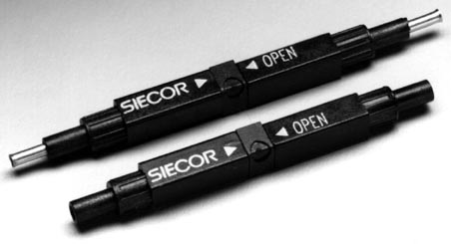
Mechanical Splice

Slide 121
Mechanical Splice

Slide 122
Which Splice to Use
Several considerations determine which splice method to use
The first is the economics
Tools for a mechanical splice cost around $1,500
The consumable of the mechanical splice is about $12 in 2011

Slide 123
Which Splice to Use
Fusion splices, on the other hand, require a large capital investment up front to purchase a fusion splicing machine
After that, the only consumable cost is in the protective device, which is generally $1 or less each

Slide 124
Which Splice to Use
Second is performance
Fusion splices typically provide lower loss and reflect less light than mechanical splices
For all intents and purposes, the splice point is transparent in a fusion splice
For most LAN applications, splice loss and reflections are minor concerns
However, splice loss must be minimized for WANs

Slide 125
Fusion Splice Procedure
Fusion splicing consists of four basic steps, regardless of how sophisticated a machine is
Prepare the fiber
Cleave the fiber
Fuse the fiber
Protect the fiber

Slide 126
Fusion Splice Procedure
Preparing the fiber is accomplished by stripping away all the protective coatings, jackets, tubes, until all that is left is the bare fiber
The main concern is cleanliness
A clean fiber is essential for the all important cleaving step
Cleaving is the cutting of the fiber

Slide 127
Fusion Splice Procedure
Cleaving the fiber properly is the key to successful splicing
It is virtually impossible to make a good fusion splice with a poor cleave
The idea here is to have a mirror-smooth, perpendicular fiber end

Slide 128
Fusion Splice Procedure
A common misconception is that the cleaver actually cuts the fiber in half
Actually, the process is the same as cutting a window pane to size, only on a much finer scale
The cleaver first nicks the fiber, and then pulls or flexes it to cause a clean break

Slide 129
Fusion Splice Procedure
A high degree of precision is required, which is why good cleavers can cost $1,000 to $4,000
Fusing comes next
It consists of two steps
Aligning
Heating
Protecting the completed splice is the final step

Slide 130
Fusion Splice Procedure
A fusion splice will typically have a tensile strength between 0.5 and 1.5 lbs
A good splice will not break during normal handling, but it must be protected from bending and tensile forces
Fusion splicing times can vary drastically depending on the end result required
Basic machines can do simple splices in 10-15 seconds

Slide 131
Fusion Splice Procedure
The most precise machines on the market can take one minute or longer per splice
Why the difference
The precise machines spend much more time prior to the splice analyzing and precisely aligning the fibers

Slide 132
Fusion Splice Procedure
The basic machines make few assumptions and splice with a quick alignment process, without the extra analysis
Fusion splicers cost anywhere from $7,000 to $12,000 in 2011
The difference depends entirely on the special features and the accuracy of the machine

Slide 133
Fusion Splice Procedure

Slide 134
Mechanical Splice Procedure
Mechanical splicing requires the same four steps as fusion splicing, with a slight modification in step three
Prepare the fiber
Cleave the fiber
Mechanically join the fiber
Using no heat
Protect the fiber

Slide 135
Mechanical Splice Procedure
The basic procedure for performing a mechanical splice is
Strip about 1 to 2 inches of the plastic coating from the fiber ends to be spliced using a stripping tool
Place the splice in the assembly tool
Clean the bare glass by pulling it through a alcohol wipe made for fiber optic cable
Cleave the fiber to the length specified for the splice device or tool

Slide 136
Mechanical Splice Procedure
This is usually 12 to 14 mm
Usually there is a gauge on the assembly tool
Insert one side of the fiber into the holder on the tool
Insert the fiber end into the splice
Push until resistance is met
The fiber should have a slight bow
Insert the other fiber into the splice
Push second fiber until it moves the first fiber

Slide 137
Mechanical Splice Procedure
Push the first fiber back in to equalize the bows
Use the assembly tool to attach the splice to the two pieces of fiber
Remove the completed splice
If called for, cover the splice with a provided protective cover

Slide 138
Mechanical Splice Procedure
Preparing the fiber is done the same way as for fusion splicing
Cleaving the fiber is done the same way as for fusion splicing, but less precision is required
There are a number of technical reasons why mechanical splices are more forgiving of poor cleaves than fusion splices

Slide 139
Mechanical Splice Procedure
The main reason is that there is an index matching gel in the center of the mechanical splice that helps couple the light from one fiber to the other fiber
A typical cleaver for mechanical splicing will cost from $200 to $1,000
The fibers are brought together and held in place by the mechanical splice
No heating of the fibers takes place

Slide 140
Mechanical Splice Procedure
The completed mechanical splice provides its own protection for the splice
Losses of 0.02 to 0.10 dB are typical for this type of connection

Slide 141
Sources
Several points are from an article from the BICSI News November/December 2007
Some procedures and photographs from Fiber Optics by Bill Woodard and Emile B. Husson
The UniCam information is from Corning

Slide 142
Lab
Review the videos under the Lab link for this course

