Slide 1
Terminating Copper Media Last Update 2012.08.01 1.6.0

Slide 2
Objectives
Learn how to attach connectors to copper cable

Slide 3
UTP Wires
Before attaching a connector to a UTP cable be certain the correct type of cable is being used
UTP cable is made of solid or stranded wires
Solid wires are used to connect work areas to the LAN room as stranded wires attenuate faster

Slide 4
UTP Wires
By solid I mean that each of the eight wires is a single piece
Stranded wire is used for patch cables, as it is easier to manage for this use only, where the cables are never very long
By stranded I mean that each of the eight wires is made up of several individual wires, but there are still only eight wires

Slide 5
Use the Correct Connector
Also use the correct type of connector
As AMP says
The conventional plug has in-line insulation displacement contacts that pierce the middle of the insulation and stranded wire when crimped
RJ45 plugs designed for solid conductors have offsetting contacts that straddle and wedge the cable’s solid conductor

Slide 6
Use the Correct Connector
If a RJ45 plug designed for stranded conductors is crimped onto solid conductors, the blade’s piercing teeth will be deflected and bent by the cable’s center conductors resulting in an intermittent connection
However, the newer tri-point plugs are designed for both stranded and solid conductors and will successfully terminate both types of conductors

Slide 7
Use the Correct Connector
Fluke also discusses this issue
They say
Using the wrong style of pin may cause intermittent connections after a period of time, though the cable usually works immediately after it is made

Slide 8
UTP Termination Contacts

Slide 9
UTP Termination Contacts

Slide 10
UTP Connectors
In a LAN both ends of a UTP cable are terminated using RJ style connectors
Specifically the RJ-45 connector

Slide 11
RJ-45 Jack

Slide 12
RJ-45 Plug

Slide 13
UTP Connection Method
Methods of connecting wires to their connectors include 110, BIX, and Krone
The 110 method is the most common
It uses the IDC – Insulation Displacement Method to attach the wires to the connector
This is done with a punch down tool or by crimping with pliers, depending on the style of connector being used

Slide 14
UTP Connection Method
This either pierces the wire with a point on the connector’s contact as in a plug or pushes the wire down into a V groove in the connector in a jack
In a jack the restriction in the groove cuts through the insulation, thus making the connection
A wire with its cover is pushed down into a groove that narrows toward the bottom

Slide 15
UTP Connection Method
As the cable goes down into this groove, the metal the groove is formed from, cuts through the cover, and makes contact with the copper wire inside

Slide 16
IDC
Opening that forms the groove
Metal that forms the groove
Cable jacket
Wire

Slide 17
IDC

Slide 18
IDC

Slide 19
UTP Wiring Schemes
Before beginning you must decide what wiring scheme to use
There are two schemes
568A
568B

Slide 20
UTP Wiring Schemes
Keep in mind that UTP cabling uses an 8-wire modular connector called the RJ-45
The trick is in making sure that you connect the right colored wire to the right pin in the RJ-45 connector
568A, 568B, 258A, and USOC are all standards which describe which wire goes on which pin

Slide 21
UTP Wiring Schemes
The first thing to remember is that the 8 wires are always thought of as 4 pairs
And no matter which cabling standard you follow, the pairs are always colored the same

Slide 22
UTP Wiring Schemes
Pair 1
Blue
Blue
Blue with White stripe
Pair 2
Orange
Orange
Orange with White stripe

Slide 23
UTP Wiring Schemes
Pair 3
Green
Green
Green with White stripe
Pair 4
Brown
Brown
Brown with White stripe

Slide 24
UTP Wiring Schemes
Pin numbers are important to this discussion as well

Slide 25
RJ-45 Jack Pin Locations
For a jack the pin locations are shown on the device
There is no standard for this so it may vary by manufacturer

Slide 26
RJ-45 Jack Pin Locations

Slide 27
RJ-45 Plug Pin Locations
For a plug when looking down at a plug from the top with the clip side down, pin 1 is on the left
Here is a great illustration of this from Wikipedia and another one from a presentation at Interop

Slide 28
RJ-45 Plug Pin Locations

Slide 29
RJ-45 Plug Pin Locations

Slide 30
RJ-45 Pin Locations

Slide 31
UTP Wiring Schemes
As you look at the diagrams below, note that
The solid color wires and the striped wires always alternate
Pin 1 is always a striped wire
Pair 1, blue, is always in the middle on pins 4 and 5
The orange and green pairs are interchanged

Slide 32
UTP 568A Wiring Scheme

Slide 33
UTP 568A Wiring Scheme
The 568A standard is supposed to be the preferred way of terminating cable
It is so because it matches the old USOC standard
However, keep reading as most do not use the 568A method
By the way it matches the method of terminating cable that Northern Telecom used for ISDN

Slide 34
UTP 568B Wiring Scheme

Slide 35
UTP 568B Wiring Scheme
Before the TIA ever met to begin creating the 568A standard for cable terminations, AT&T had a very similar standard for terminating their cable, called 258A
258A works just as well as 568A
In fact, the TIA committee decided to include AT&T's 258A standard, but they called it the 568B standard
258A and 568B are exactly the same

Slide 36
UTP 568B Wiring Scheme
This is what happens when committees try to make everyone happy

Slide 37
Wires Used

Slide 38
UTP Crossover Wiring
Here are some great illustrations of the wiring for crossover cables
First 10 and 100 Mbps
The 1000 Mbps

Slide 39
UTP Crossover Wiring Schemes

Slide 40
UTP Crossover Wiring Schemes

Slide 41
UTP Crossover Wiring Schemes

Slide 42
Why These Pin Assignments
Why are the pin locations different
First, to confuse you
But the arrangement is somewhat logical, if you know the background
Ethernet was originally designed to run over the same cabling used by the phone system - AT&T deployed this as StarLAN - so this design left pins 4 and 5 available for a phone

Slide 43
Why These Pin Assignments
If you plug an RJ-11 - 4 wire - into this, the middle two pins – 2 and 3 - of the RJ-11 would connect to the middle two pins – 4 and 5 - of the RJ-45, just perfect for a 1-line phone
If you plug an Ethernet cable into it, pins 1 and 2 will be used as one pair, and pins 3 and 6 will be used as another
So, no conflicts

Slide 44
UTP Wiring Schemes
The bottom line is, use whichever scheme you wish
It makes no difference
Just be consistent throughout the network in which one you use
By far 568B is the most widely used in the industry in the US
Although the preferred standard is 568A

Slide 45
UTP Wiring Schemes
The US government requires 568A, unless a waiver is granted
Most other countries use 568A
Again why is this, just to make it harder on you

Slide 46
Terminate All the Wires
In some cases I have found that not all of the wires are terminated
The thinking seems to be that Ethernet as originally used only used four, so just terminate those four
This is bad practice do not do this
Also I understand, although I have never used it, that some Krone connectors only use four wires

Slide 47
Attaching Wires to a Jack
Let’s see how to attach the wires to a jack
Here are some views from the L-com.com web site, these are also in their catalog, which I highly recommend

Slide 48
Attaching Wires to a Jack

Slide 49
Attaching Wires to a Jack

Slide 50
Attaching Wires to a Jack
Here is another method also from L-com
Different manufacturers use different methods, but this is a good example of a common method using pliers to clamp down a cap that holds the wires in place

Slide 51
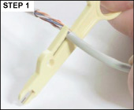
Attaching Wires to a RJ-45 Jack
Remove approximately 2” of the outer jacket from the cable
Take care not to nick the wires

Slide 52
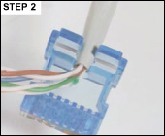
Attaching Wires to a Jack
Secure the cable jacket to the strain relief slot in cover

Slide 53
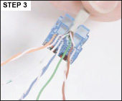
Attaching Wires to a Jack
Untwist pairs and insert into color coded slots for either T568A or T568B standard
Take care to maintain the twist to within .5” of IDC contact

Slide 54
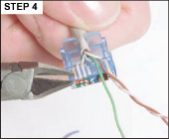
Attaching Wires to a Jack
Trim excess wires flush with the cover edge

Slide 55
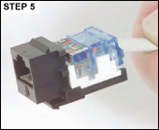
Attaching Wires to a Jack
Snap the prepared cover in place

Slide 56
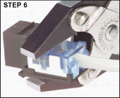
Attaching Wires to a Jack
Seat the cover with parallel action pliers

Slide 57
Attaching Wires to a Jack
The termination at the patch panel end of the connection involves stripping away some of the jacketing material and untwisting the conductors
The jacketing material should not be removed any more than necessary to complete a termination

Slide 58
Jack

Slide 59
Jack

Slide 60
Patch Panel Termination
As stated in the 568 standard, the pairs in a Category 5 cable should never be untwisted more than 1/2 inch from the point of termination
Any further untwisting of the pairs will increase crosstalk and susceptibility to EMI/RFI

Slide 61
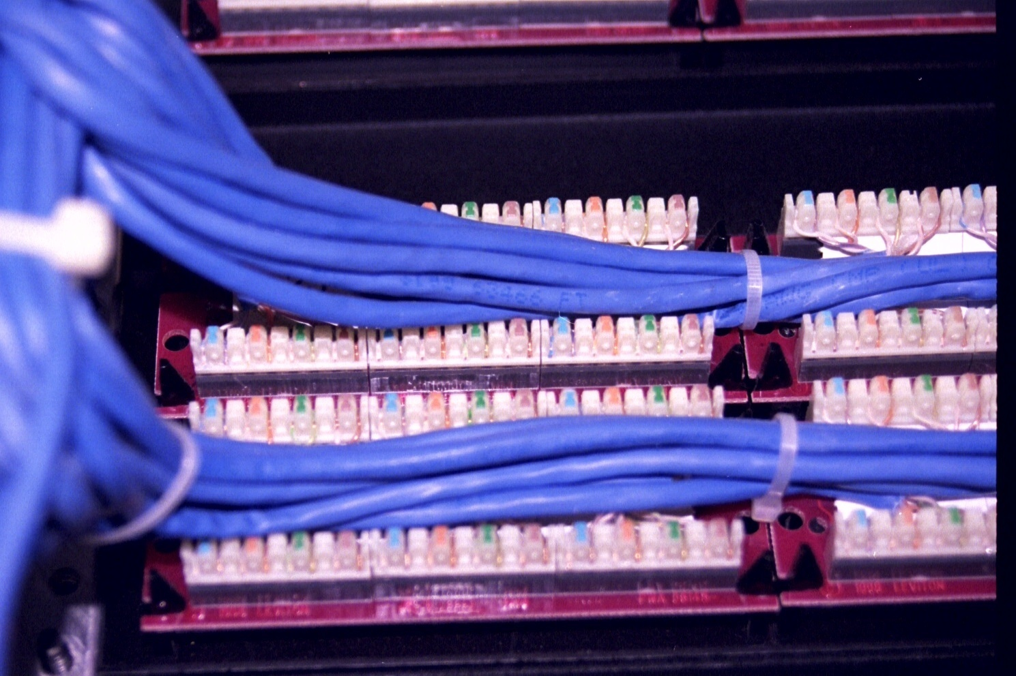
Patch Panel Termination

Slide 62
Patch Panel Termination
The wire order for a patch panel is usually indicated on it
Typically the wires go for each color solid and then the white strip for the color
For example

Slide 63
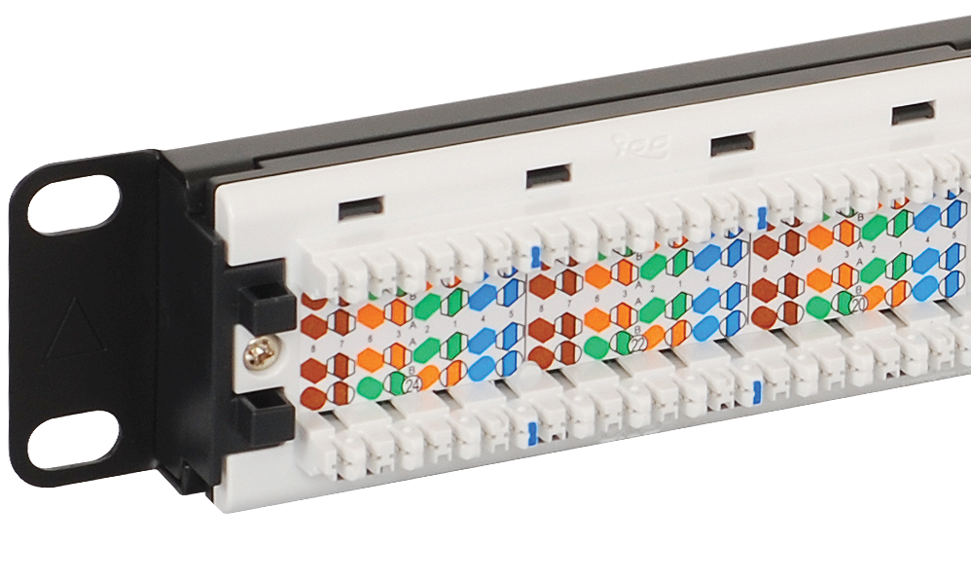
Patch Panel Termination

Slide 64
Punch Down Tool
A tool is used to push the cable down into the groove so as to allow the groove to cut through the cover and make contact with the wire inside
This tool is called a Punch Down tool

Slide 65
Punch Down Tool

Slide 66
Terminating in the Work Space
The next step is to terminate the cable in each work space area
There are two main ways to attach the jack used to terminate the cable in the work area
Flush Mount
Surface Mount

Slide 67
Flush Mount Termination
The procedures shown above are the same ones used in the work area for a flush mount
The only difference is the jack is clipped to a wall plate

Slide 68
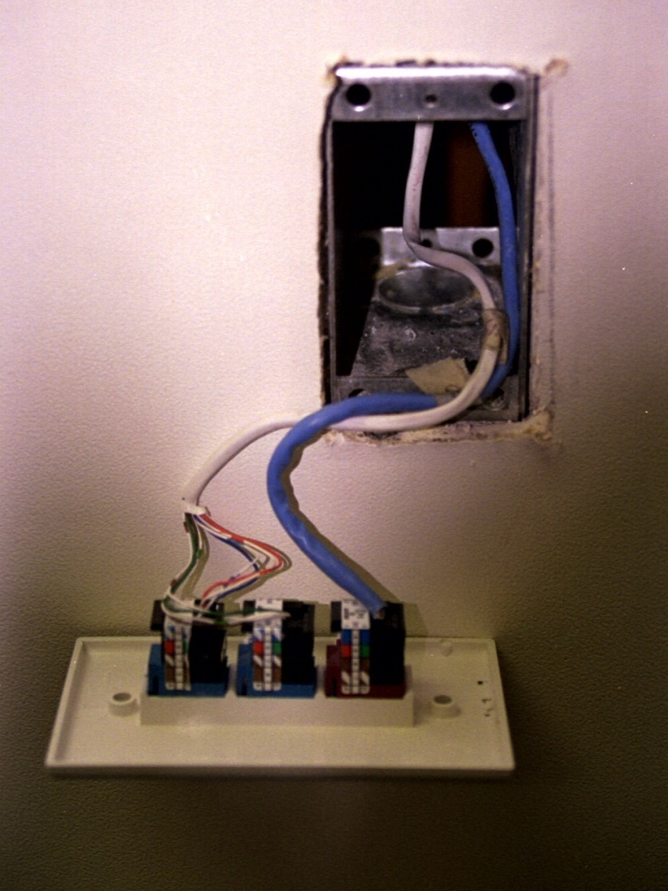
Wall Plate in Office

Slide 69
Surface Mount Termination
The second main way to place the termination point in a work space is by using a box that mounts directly to the wall
This avoids the problem of cutting a exact size hole in the wall
In some cases this takes too long
In other cases the wall is not suitable for this type of cutting

Slide 70
Surface Mount Box

Slide 71
Surface Mount Wiring
All of the following is also from the L-com site at www.l-com.com
Different manufacturers use different methods, but this is a good example of a common method where a punch down tool is used instead of pliers
In this case for a surface mount box, but the technique is the same for a flush mount box or a patch panel connection

Slide 72
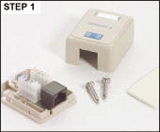
Surface Mount Wiring
Remove the cover and attach the jack base assembly using the supplied screws or double stick tape

Slide 73
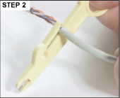
Surface Mount Wiring
Remove approximately 3” of the outer jacket from the cable
Take care not to nick the wires

Slide 74
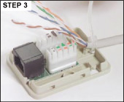
Surface Mount Wiring
Secure the cable with a cable tie to the desired entry point

Slide 75
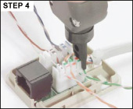
Surface Mount Wiring
Insert the pairs to the color coded slots taking care to maintain the twist to within .5” of IDC contact
Punch down using a 110 style tool

Slide 76
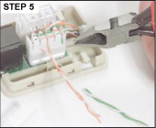
Surface Mount Wiring
Trim excess wire if your 110 tool doesn’t cut it off
Snap on the retainer caps

Slide 77
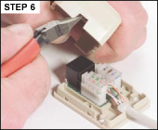
Surface Mount Wiring
Notch the cover to match the cable entry and snap it in place

Slide 78
Wiring a RJ-45 Plug
An installer terminated RJ-45 plug is not part of the structured cabling standard
As the BICSI manual says
Field-constructed patch cords are not recommended for category 5e and higher systems, and they may not be allowed for systems above category 5e

Slide 79
Wiring a RJ-45 Plug
There may be circumstances in which field-constructed category 5e patch cords are requested (e.g., repair of an existing patch cord because a spare is not available and the circuit must be restored)
If this is the case, the repaired cord should be replaced with a factory certified cord as soon as possible
ANSI/TIA/EIA-568-B.1 states that patch cords should not be field terminated

Slide 80
Wiring a RJ-45 Plug
The reason for this is you cannot do this as good as a machine
You will not be able to get the outer cover up under the locking section of the plug
This will let the wires pull out too easily
Often you will have trouble getting all of the wires all the way into the end of the plug

Slide 81
Wiring a RJ-45 Plug
Then one or more of them will make an intermittent connection
Even if the connector works initially, it will fail over time as you unplug then plug it back in over and over

Slide 82
Wiring a RJ-45 Plug
Further that left over wire you are using is solid wire, where plugs are designed for stranded wire
Solid wire when flexed will begin to crack and eventually fail

Slide 83
Wiring a RJ-45 Plug
All in all this is a bad idea
Just buy patch cables instead of making them
The only time you must attach a plug to a UTP cable is for an outside wireless connection

Slide 84
EZ-Plug
For this purpose or if you feel you must do this, then use an EZ-Plug

Slide 85
EZ-Plug

Slide 86
EZ-Plug
As you can see this plug has holes in the end
You untwist as much cable as you want
After putting the wires in the proper order, pull them through the connector until they are tight against the inside of the connector
The crimper sets the IDC connections as well as cutting off the excess

Slide 87
EZ-Plug
Here are the instructions

Slide 88
EZ-Plug Instructions

Slide 89
EZ-Plug Instructions

Slide 90
EZ-Plug Instructions

Slide 91
EZ-Plug Instructions

Slide 92
EZ-Plug Instructions

Slide 93
EZ-Plug Instructions

Slide 94
EZ-Plug Instructions

Slide 95
EZ-Plug Instructions

Slide 96
EZ-Plug Instructions

Slide 97
EZ-Plug Instructions

Slide 98
Crimping
As the EZ-Plug instructions show a crimping tool is how a plug is attached to the wires in the UTP cable
This is true regardless of whether the connector is a standard style or an EZ-Plug

Slide 99
Crimping Tool

Slide 100
Crimping

Slide 101
Crimping

Slide 102
Screw Terminal RJ-45 Jack
I have seen screw terminal RJ-45 jacks such as were once used for Category 3 cable
These are not suitable for data cabling
The connections are not reliable
They require too much untwisting of the wires

Slide 103
Screw Terminal RJ-45 Jack

Slide 104
Selecting Patch Cables
In an article for the January 2012 issue of Cabling Installation and Maintenance magazine Andy Work and Tom McAllister present further detailed reasons for only buying high quality patch cables and never building your own
You should read the entire article
Here is part of what they say

Slide 105
Selecting Patch Cables
Much has been written about the availability and abundance of substandard patch cords
Recently the Communications Cable and Connectivity published findings that indicated extremely high failure rates in patch cords from sources other than the major national brands
Substandard patch cords not only fail to perform; they can even damage physical hardware

Slide 106
Selecting Patch Cables
The first indicator of a substandard patch cord is price
If you are paying less than $4 for a 3-foot Category 6 patch cord, then odds are it is substandard
Quality, as well as code- and standard-compliance, has a price tag

Slide 107
Selecting Patch Cables
A high-priced patch cord does not mean it is standards based and will pass the performance requirements; however, price is the first indicator to help guide your decision
The RJ-45 modular plug is a highly engineered connector
The housing is molded from a fire-resistant plastic that meets the UL 94-V.O standard
A simple test you can conduct is to put a lighter to the clip on the connector

Slide 108
Selecting Patch Cables
If it catches fire and does not self-extinguish, you have found a substandard connector that violates code requirements
The cord could contain V.2 material, which is less expensive
The pins should be made from phosphor bronze, a hardened alloy that allows the plug to be rated a minimum life cycle of 750 insertions

Slide 109
Selecting Patch Cables
Other conductive metals being used are too soft and cannot withstand the insertion cycles that are required
The last step in manufacturing the contact is to apply a minimum of 50 p. of 24-karat gold (23.999 pure)
Today gold costs approximately $1,700 per troy ounce

Slide 110
Selecting Patch Cables
Seventy percent of the cost of a Category 5e or Category 6 modular plug is in the gold
The number-one area in which substandard manufacturers are skimping is the gold plating
Substandard plugs can have a multitude of gold-related issues, one being a lower grade of gold, such as 14-k gold

Slide 111
Selecting Patch Cables
There are two different types of marks, issued by either Intertek (ETL) or UL
The two types are safety and performance
Usually when an item has passed the safety standard it is said to be "safety listed“
When an item has passed a standards-based performance test it is called "verified"

Slide 112
Selecting Patch Cables
With patch cords, you are not just dealing with components that need to be both listed and verified; the entire assembly should be listed and verified
To determine if your product has these markings, inspect the cable legend to see if there is a UL "E" number printed on the jacket
If there is, go to UL's Online Certification Directory and run the E number to verify the manufacturer's authorization and standing

Slide 113
Selecting Patch Cables
If you cannot find the E number in the Online Certification Directory, odds are you have found a fraudulent use of UL's mark
ETL has a similar guide on its website
If you find the ETL mark printed on the jacket, check to see if the manufacturer's name and control number are also on the jacket
That name is required on the ETL website, so you can check the manufacturer's authorization

Slide 114
Selecting Patch Cables
There are several reasons a patch cord with all the proper components will not pass a test
It can be as simple as too much untwisting of pairs, not seating the cable to the very end of the connector, or using the improper crimp tool
Often, patch cords that use molded boots will have a higher failure rate than assembled patch cords

Slide 115
Selecting Patch Cables
If your patch cord does not have strain relief, there is a high likelihood that it was not the only thing forgotten when your patch cord was made
Here is a checklist for you to use when buying patch cords
How much does it cost
Who am I buying it from
Is it a molded or assembled connector
Does the plug burn

Slide 116
Selecting Patch Cables
What is the fitment like
How easily does it plug and unplug
Does it have an E number or a manufacturer's name for verification
Is there strain relief
Do the pins look good
Does the manufacturer perform 100-percent patch-cord testing, not just channel testing which is less demanding

Slide 117
Connectors for Shielded Cable
For shielded cables both jacks and plugs designed for shielded cable must be used to terminate this type of cable

Slide 118
Shielded Jack

Slide 119
Shielded Plug

Slide 120
Terminating Shielded Cable
As shown next terminating shielded cable requires not only the wires be securely connected, but also the shielding

Slide 121
Terminating Shielded Jack

Slide 122
Terminating Shielded Jack

Slide 123
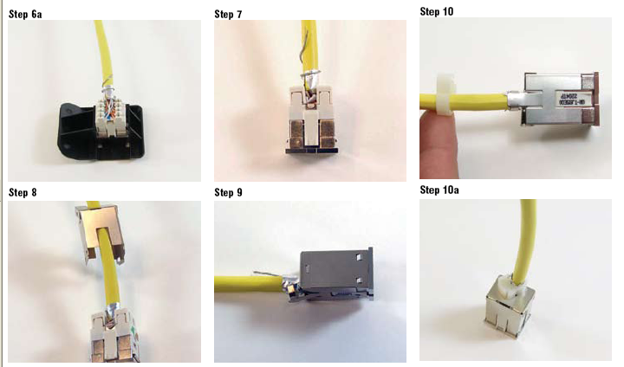
Terminating Shielded Jack

Slide 124
Terminating Shielded Plug

Slide 125
Installing Shielded Cable
In order for the shielding in the cable to be effective its integrity must be maintained
Breaks in the shield will mitigate this, such as allowing excessive bending of the cable that allows breaks in the shield
In addition, all components must be properly grounded
As an article in Cabling & Maintenance states

Slide 126
Installing Shielded Cable
The shield must be kept intact over the entire length of the cable, and must fully surround the cable and connecting hardware
If the shield is, for example, formed into a pigtail over the last inch of the cable, it will reduce the protection against EMI and alien crosstalk
In addition, avoid splitting the shield at sharp bends in the cable

Slide 127
Installing Shielded Cable
The shield is typically a ribbon of aluminum foil that is wrapped around the cable
If the cable is bent at too sharp of a radius, the shield may separate, thereby reducing the effectiveness of the shield and its ability to protect against alien crosstalk
The shield must be grounded on both ends of the link
It is often said that a shield is 90% effective when it is grounded at one end of the link

Slide 128
Installing Shielded Cable
Such a shield continues to protect the wire pairs against many external high-frequency disturbances, but an open-ended shield may allow resonances at certain frequencies
A resonance creates the chance that the signals couple into the data wire pairs, creating a significant alien crosstalk disturbance at those individual frequencies

Slide 129
Installing Shielded Cable
Field certification may record very low margins for alien crosstalk at those frequencies
Because the shield should be terminated to ground at both ends, it is critical that the ground potential at both ends is approximately the same to avoid any ground-loop currents

Slide 130
Installing Shielded Cable
The TIA-607 standard on grounding and bonding allows a maximum difference in ground potential of 1 Vrms (Volt root mean square) between the two ends

Slide 131
Installing Shielded Cable
This rule requires that the telecommunications system is grounded throughout in compliance with the TIA-607 standard and that the electrical system in the building is correctly grounded and fully complies with rules spelled out in the National Electrical Code and other codes enforced by local jurisdictions

Slide 132
Installing Shielded Cable
In the field, you can verify that the ground potential meets the difference requirement before you connect the other end
Connect the shield at one end, then measure the alternating-current voltage between the shield and the ground connection at the other end using a digital voltmeter that covers a bandwidth of 100 kHz or better

Slide 133
Grounding Shielded Cable
The article goes on to discuss the end to ensure proper grounding of this type of cable
TIA and ISO standards provide one additional step for the grounding of screened and shielded cabling systems

Slide 134
Grounding Shielded Cable
Specifically, clause 4.6 of ANSI/TIA-568-B.1 and clause 11.3 of ISO/IEC 11801:2002 state that the cable shield shall be bonded to the TGB in the telecommunications room, and that grounding at the work area may be accomplished through the equipment power connection

Slide 135
Grounding Shielded Cable
This procedure is intended to support the optimum configuration of one ground connection to minimize the appearance of ground loops, but recognizes that multiple ground connections may be present along the cabling

Slide 136
Grounding Shielded Cable
When the grounding and bonding recommendations specified in ANSI-J-STD-607-A-2002 were developed, consideration was given to the possibility that grounding at the work area through the equipment cord may occur; therefore, there is no need to specifically avoid grounding the screened/ shielded system at the user’s PC or device
The difference between a ground connection and a screen/shield connection is notable and important

Slide 137
Grounding Shielded Cable
A ground connection bonds the screened/shielded cabling system to the TGB or TMGB, while a screen/shield connection maintains electrical continuation of the cable screen/shield through the screened/shielded telecommunications connectors along the full length of cabling

Slide 138
Grounding Shielded Cable
Part of the function of the screen or shield is to provide a low-impedance ground path for noise currents that are induced on the shielded material

Slide 139
Grounding Shielded Cable
Compliance to the TIA and ISO specifications for the parameters of cable and connection hardware transfer impedance and coupling attenuation ensures the maintenance of a low-impedance path through all screened/shielded connection points in the cabling system

Slide 140
Grounding Shielded Cable
For optimum alien crosstalk and noise immunity performance, shield continuity should be maintained throughout the end-to-end cabling system
UTP patch cords in screened/shielded cabling systems should be avoided
Building end users should perform a validation to ensure that screened and shielded cabling systems are properly grounded to the TGB or TMGB

Slide 141
Grounding Shielded Cable
Here’s a recommended inspection plan
Visually inspect to verify that all equipment racks/cabinets/metallic pathways are bonded to the TGB or TGMB using a 6-AWG conductor
Visually inspect to verify that all screened/shielded patch panels are bonded to the TGB or TMGB using a 6-AWG conductor

Slide 142
Grounding Shielded Cable
Perform a DC resistance test to ensure that each panel and rack/cabinet grounding connection exhibits a DC resistance measurement of <1 Ω between the bonding point of the panel/rack and the TGB or TMGB. (Note: Some local/ regional standards specify a maximum DC resistance of <5 Ω at this location)
Document the visual inspection, DC test results, and all other applicable copper/fiber test results

Slide 143
Grounding Shielded Cable
As the excerpts from this article discuss it is important to properly ground shielded cabling systems
Siemons, a cabling manufacturer, says this about the specific procedure to follow

Slide 144
Grounding Shielded Cable
While electrical services, telecommunications equipment, and all other low voltage systems are required to be bonded to ground per national and local electrical codes and industry standards for safety reasons; the specific need to ground screened and shielded network cabling systems is only a matter of performance

Slide 145
Grounding Shielded Cable
A properly bonded and grounded cabling system carries noise currents induced by electromagnetic interference (EMI) in the environment to ground along the screen or foil shield, thereby protecting the data-carrying conductors from external noise

Slide 146
Grounding Shielded Cable
The screen or foil shield also minimizes cabling emissions
It is these functions that afford screened and shielded systems their superior immunity to alien crosstalk and other sources of conducted or radiated electromagnetic interference

Slide 147
Grounding Shielded Cable
The general recommended grounding sequence is as follows
The outlet self-grounds to the patch panel
Then the panel is grounded to the equipment rack or adjacent metallic pathways
The basic sequence is reflected in the diagram below

Slide 148
Grounding Shielded Cable
More specifically
F/UTP cable screen or the S/FTP shield is terminated by the outlet
Outlet makes contact with patch panel's grounding strip as outlets are snapped into place
Panel is grounded to equipment rack or adjacent metal pathways via 6 AWG wire attached to panel ground lug
6 AWG ground wire connects rack to the TGB

Slide 149
Grounding Shielded Cable

Slide 150
Grounding Shielded Cable

Slide 151
Grounding Shielded Cable
Panduit explains it this way for the patch panel end
Bond all the shielding (foil and/or braid) of the data cable to the shielded jack module, which provides 360° shielding termination
Snap the jack module into an all-metal patch panel to create a bond between the module and the unpainted tabs on the patch panel

Slide 152
Grounding Shielded Cable

Slide 153
Grounding Shielded Cable
Attach the patch panel to the rack using thread-forming bonding screws; the thread on the screws removes paint from the thread holes on the rack, and the serrations on the head of the screws remove paint from the patch panel, creating a high-performance electrical bond between the patch panel and the rack

Slide 154
Grounding Shielded Cable
So long as electrical continuity exists throughout the rack, the last step is to bond the rack to the main busbar or MCBN located under the data center’s raised floor
To ensure long-term integrity of the system, always use compression connectors (not mechanical) so the connection does not loosen with vibration

Slide 155
Grounding Shielded Cable

Slide 156
Grounding Shielded Cable
Panduit goes onto to say concerning the workstation end
During installation, a frequently asked question is whether the installer should ground one or both ends of a shielded cable channel
Generally, the cable shield is bonded to the grounded equipment chassis or rack at each access or patch location

Slide 157
Grounding Shielded Cable
In other words, if the IT equipment is grounded, then any shielded cables used to connect equipment to patch panels, or to other equipment, must be grounded
A typical shielded structured cabling channel runs from a switch to the workstation and comprises two patch cord links and the shielded horizontal link

Slide 158
Grounding Shielded Cable
One end of the channel starts in the data center where the switch, patch panel, and shielded patch cord linking them must be properly bonded to the rack
The rack is tied to the telecommunications grounding system, which in turn is bonded to the AC power system
The other end of the channel terminates outside the data center at the workstation outlet

Slide 159
Grounding Shielded Cable

Slide 160
Grounding Shielded Cable
An issue to consider is whether a shielded cabling link at this outlet location can be properly bonded to a grounding system without inducing a ground loop
A cable shield that is terminated at the workstation may be bonded to the AC ground via connections within the workstation itself, but the outlet AC ground must be at the same potential as the telecommunications grounding system

Slide 161
Grounding Shielded Cable
Therefore, to reduce the magnitude of such ground currents, all serving AC power systems must be bonded together to the same grounding electrode system
A building can have only one grounding electrode system, as required by the National Electrical Code

Slide 162
Grounding Shielded Cable
This approach will reduce any ground voltage differences that may exist either between differing AC power system grounds or between the AC power system ground and the telecommunications ground

Slide 163
Grounding Shielded Cable
An alternative industry practice is to use UTP patch cords between the outlet and the workstation, effectively grounding only one end of the shielded cable channel in the data center and leaving the cable link at the workstation area ungrounded

Slide 164
Grounding Shielded Cable
The advantage of this option is that the risk of establishing a substantial ground loop current is greatly reduced
This option, however, lowers the level of protection against external noise, such as alien crosstalk, EMI, and RFI, across that link in the channel, thus lowering system performance

Slide 165
Grounding Shielded Cable
It commonly is used only when it is not possible to eliminate voltage differences between ground potentials
To facilitate inspection of the grounding system, install connectors, busbars, and conductors in such a way to allow visual verification of the bond

Slide 166
Grounding Shielded Cable
There should be a logical flow as you follow the grounding busbar
If a potential difference exists between these two points, a ground loop will form and current may flow within the loop

Slide 167
Grounding Shielded Cable

Slide 168
Grounding Shielded Cable
A method for testing whether a ground loop potential exists at a workstation is to use a true RMS multimeter to measure the potential difference between the power outlet ground and the shielded module on the workstation outlet

Slide 169
Grounding Shielded Cable
Position one multimeter probe on the face of the shielded module on the workstation and the other in the grounding prong of the electrical outlet, and check the voltage reading on the meter

Slide 170
Grounding Shielded Cable
If the meter reads less than 1 volt of potential (as described in ANSI J-STD-607-A Annex D) between the module and the power outlet, the endpoint device is expected to operate properly during steady-state conditions
If the meter reads 1 volt or more, a ground loop problem exists that may cause data errors or equipment damage

Slide 171
Grounding Shielded Cable

Slide 172
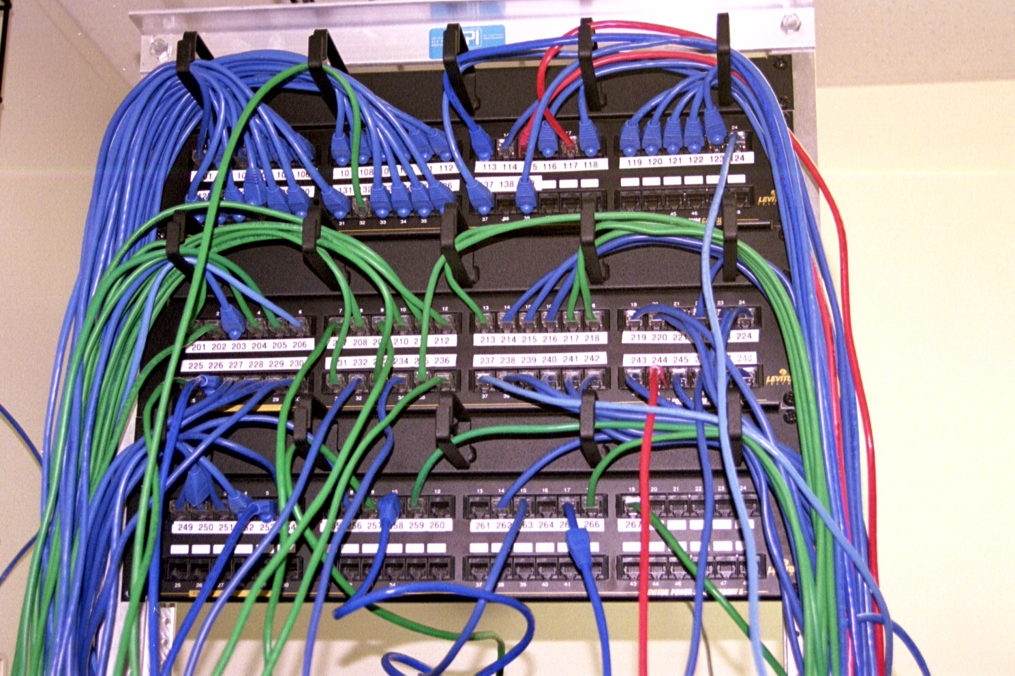
Patch Panel

Slide 173
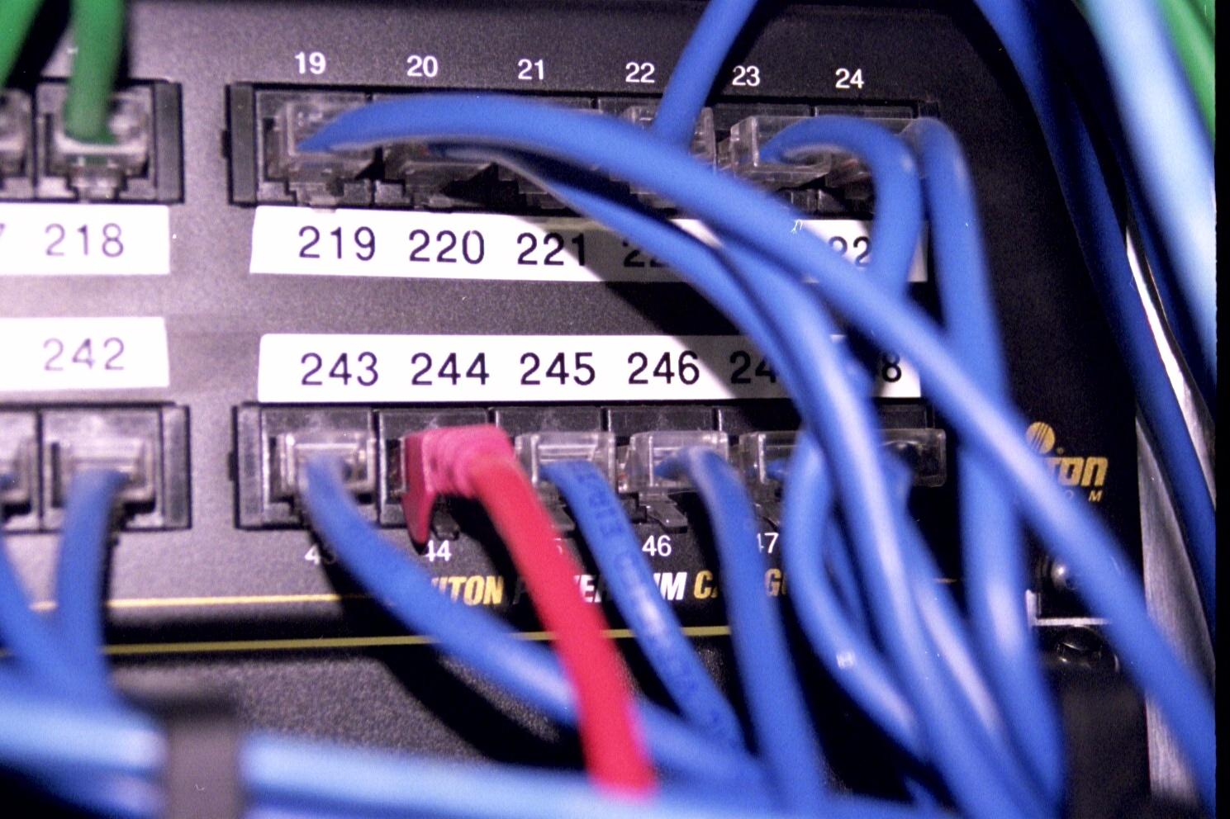
Patch Panel

Slide 174
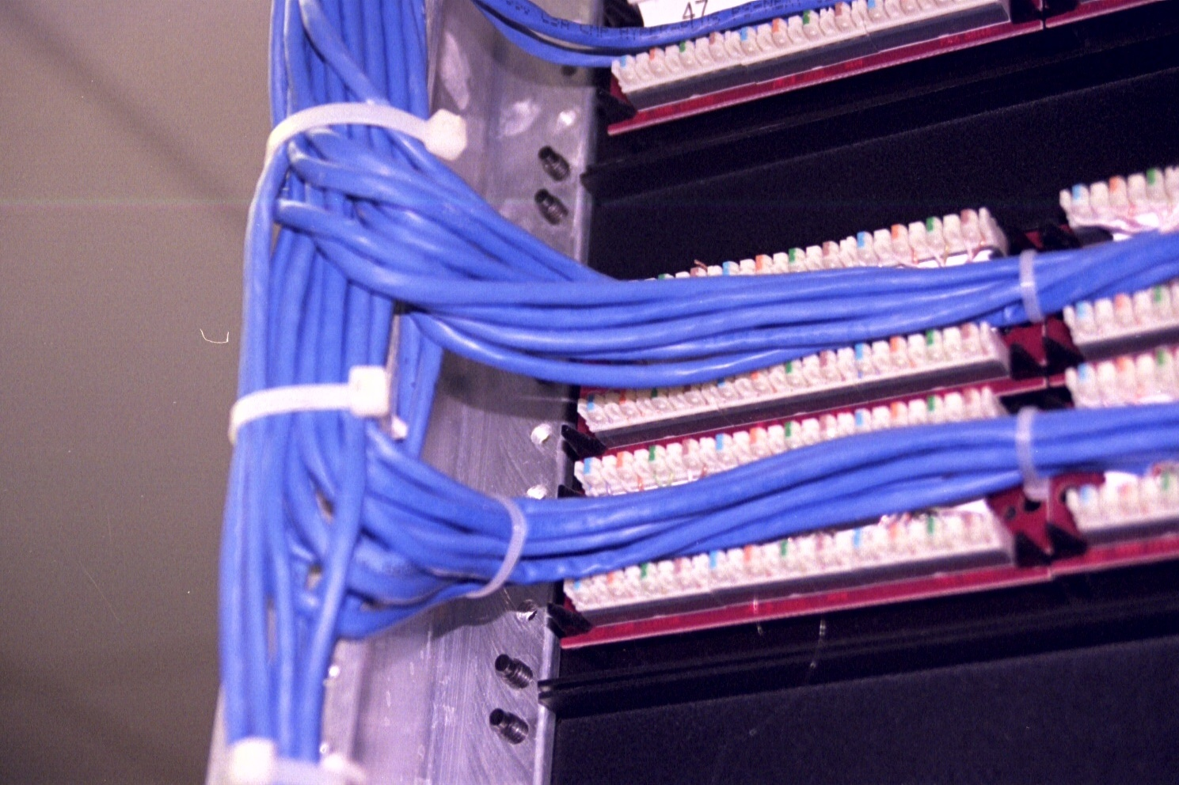
Terminated in the Patch Panel

Slide 175
Terminated in the Patch Panel

Slide 176
Standard Patch Panel

Slide 177
Angled Patch Panel

Slide 178
Smart Patch Panel
Some vendors are producing patch panels with network management capabilities
These smart patch panels and their required cables can
Map the network's physical connections
Trace circuits so as to perform basic connectivity tests
Monitor these connections for unauthorized changes

Slide 179
Smart Patch Panels
Here are some examples of these

Slide 180
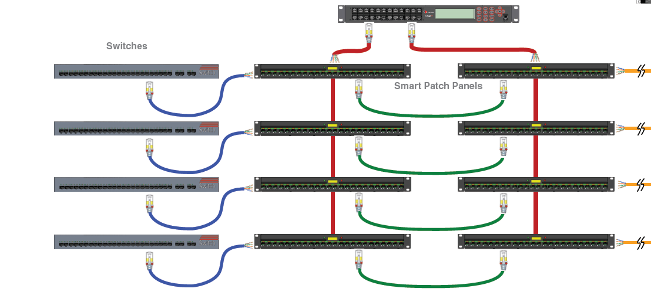
Smart Patch Panels

Slide 181
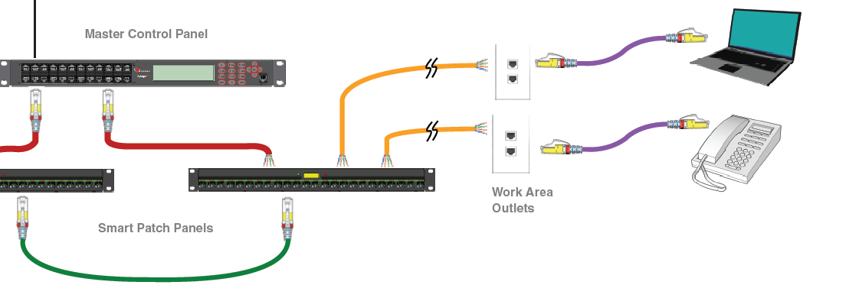
Smart Patch Panels

Slide 182
Smart Patch Panels

Slide 183
Transceiver
On occasion a cable has been terminated with one type of connector and the device only has another type of connector
To solve this problem in an Ethernet network a transceiver is used
For example

Slide 184
Transceiver
AUI
AUI
BNC
RJ-45
RJ-45
BNC

