Slide 1
Structured Cabling
The Standards
Last Update 2012.07.31
1.20.0

Slide 2
Objectives
Learn how to properly install LAN cabling

Slide 3
Before We Begin
This is a complex topic
What is discussed here is merely an introduction
That is why you should hire someone that does this for a living to do this type of work for you
This is not a useful expenditure of your time as a manager

Slide 4
Before We Begin
However, as you will have to check up on who you select, and as you may occasionally have to install a few cables, here are some things to understand and keep in mind
If you need to know more, check the end of this presentation for places to look

Slide 5
What is LAN Cabling
First, let’s look at a sample medium size LAN to first see all of the parts required to build such a thing
Keep in mind that there are many ways to do this type of job, in terms of the exact parts and methods used, this is just one example
Then we will concentrate on just the cabling

Slide 6
In the Work Area
PC
  So some work can be done
NIC
  To connect the PC to the LAN
Patch Cable
  Attaches the NIC to the wall plate jack
Box
  Holds everything to the hole in the wall

Slide 7
In the Work Area
Sheet Metal Screws
  Attaches the box to the metal wall stud
Jack
  What the cable is plugged into
Wall Plate and Mounting Screws
  Covers the hole in the wall
Label
  Placed on the wall plate so you can find the other end

Slide 8
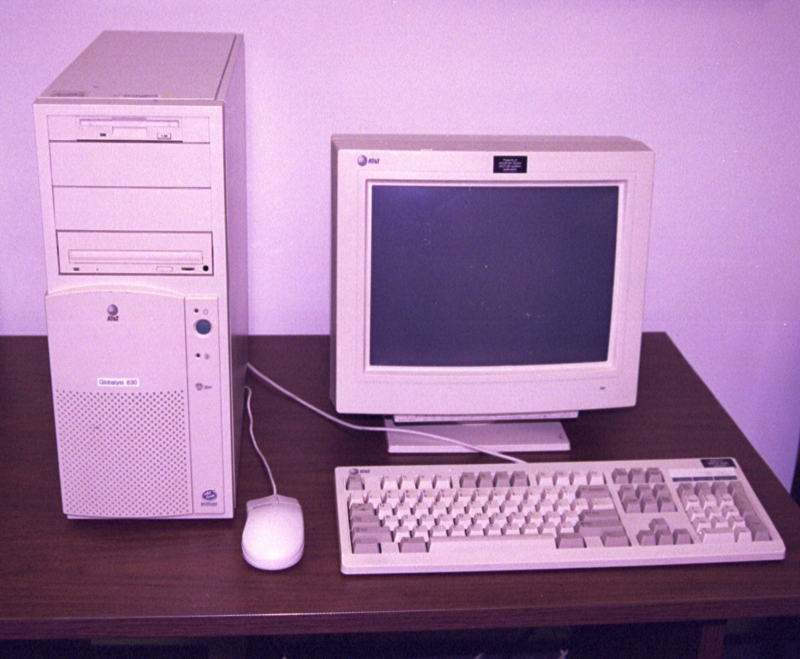
PC

Slide 9
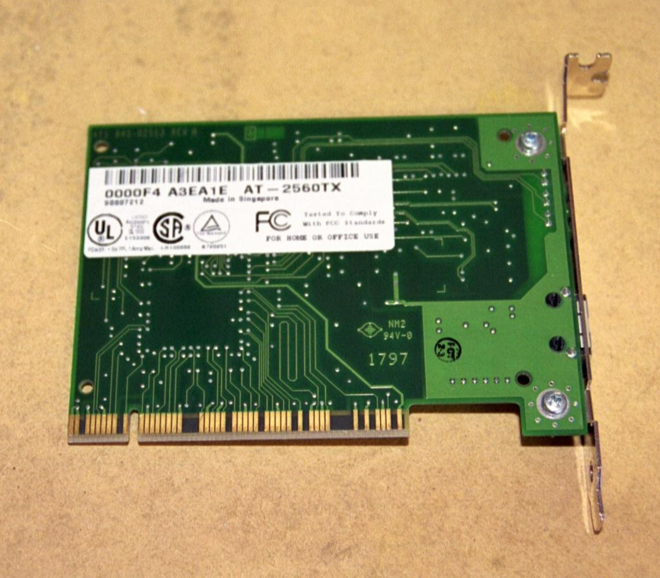
NIC

Slide 10
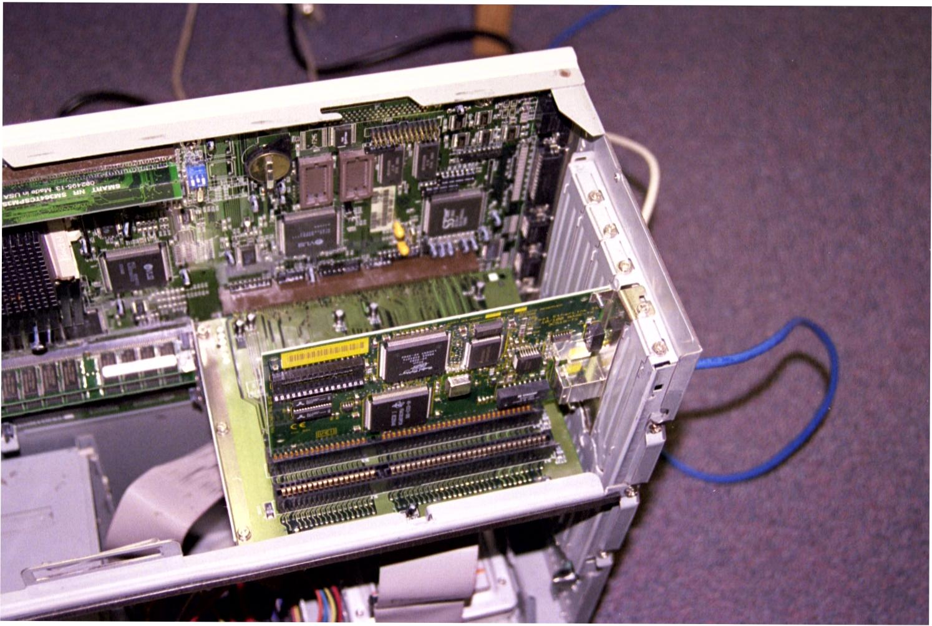
NIC in the PC

Slide 11
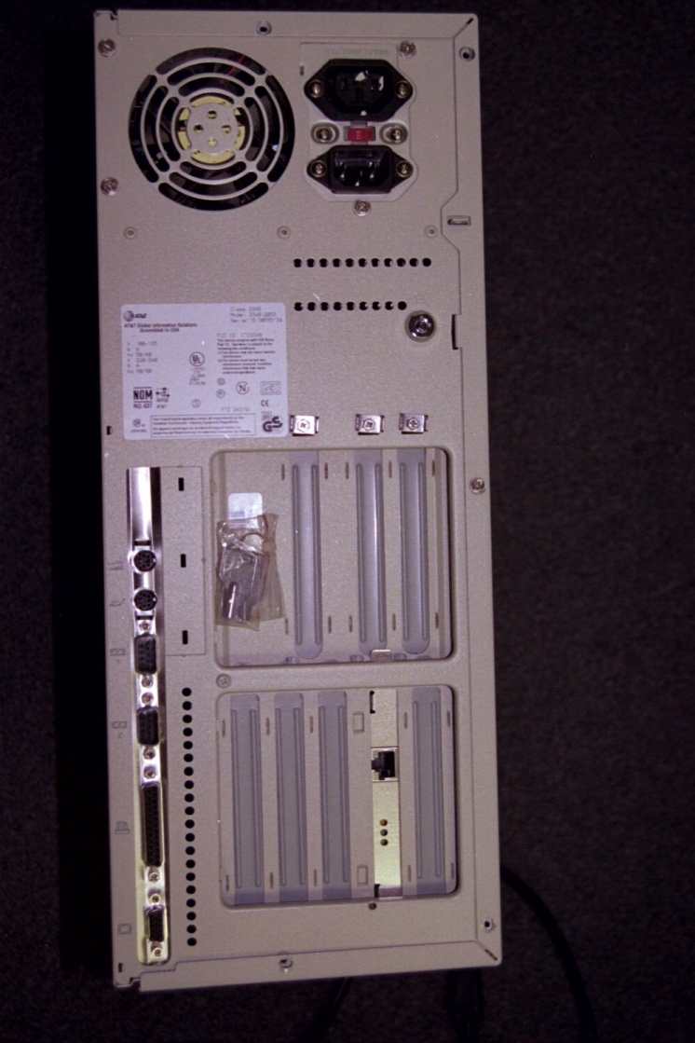
NIC in the PC

Slide 12
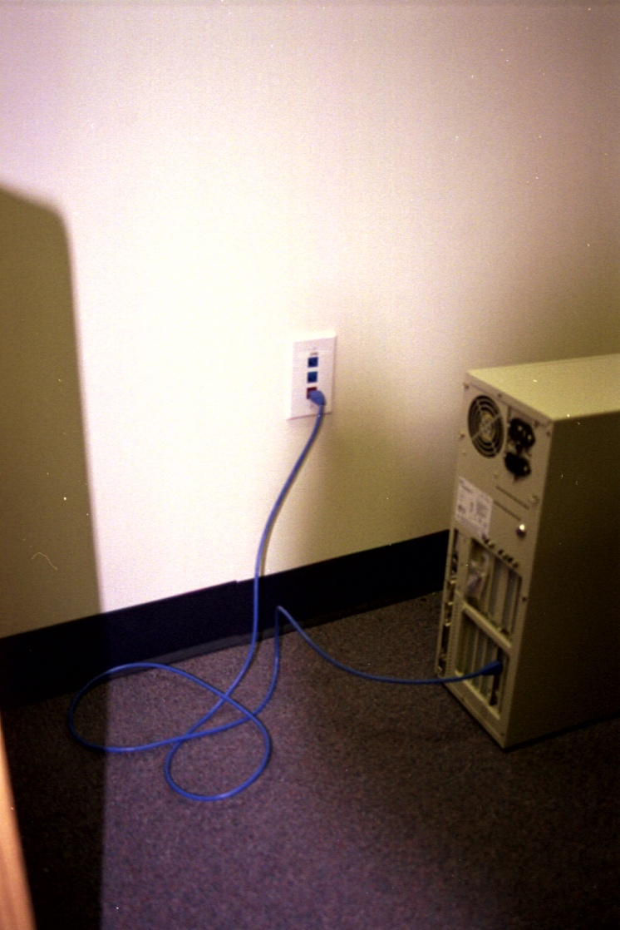
PC Plugged Into Wall Plug

Slide 13
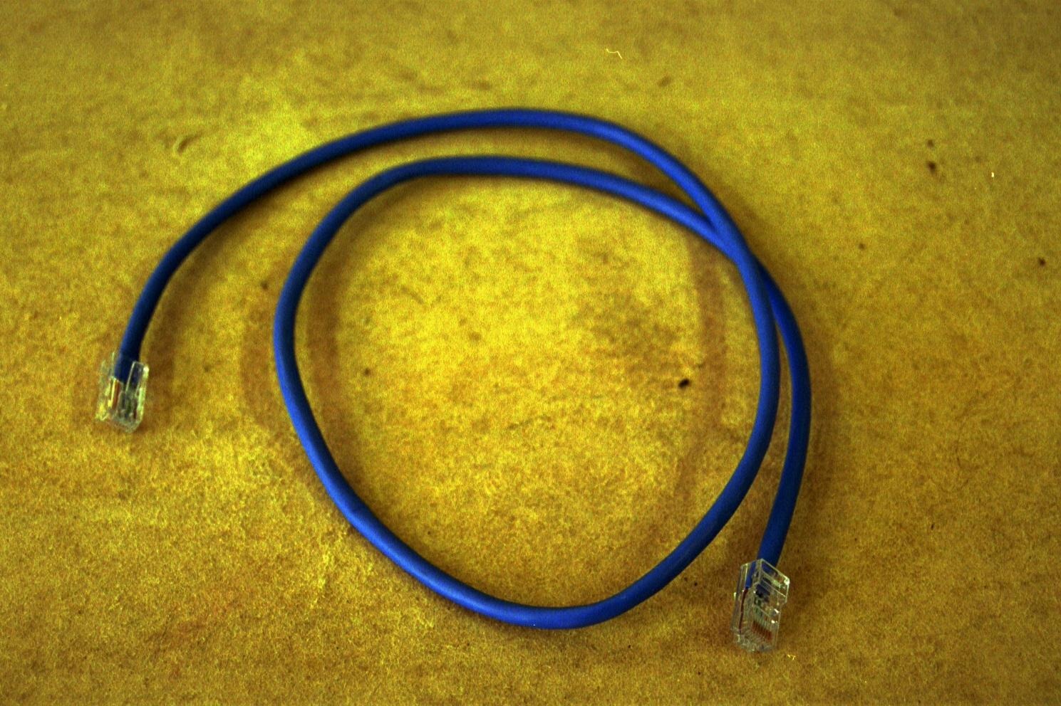
Patch Cable

Slide 14
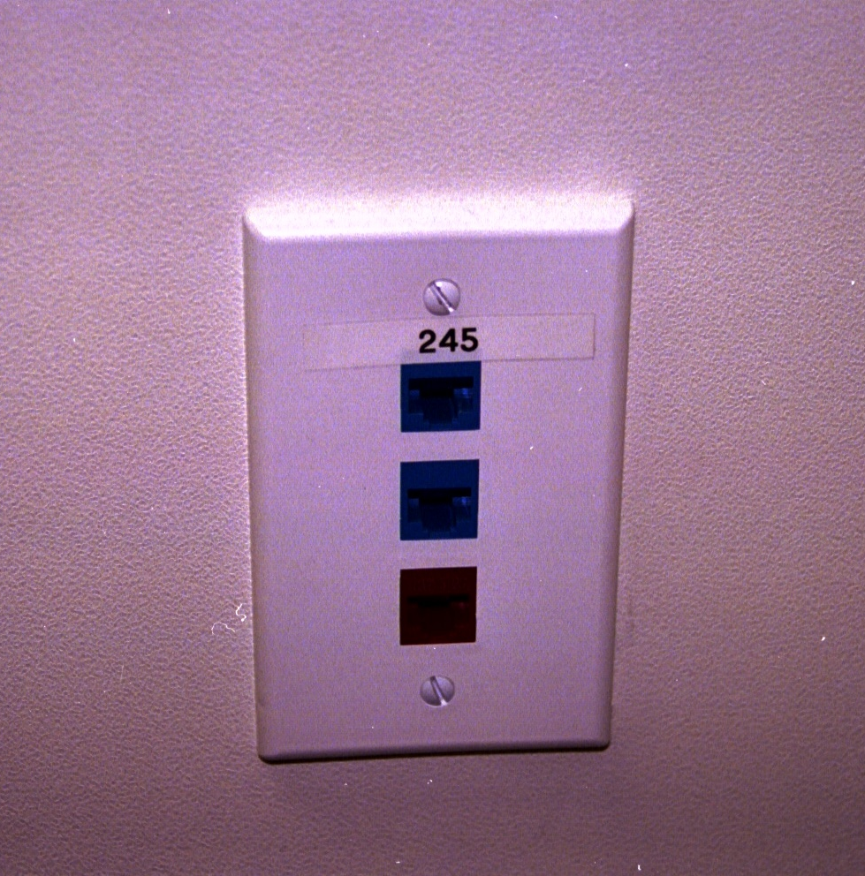
Wall Plate in Office

Slide 15
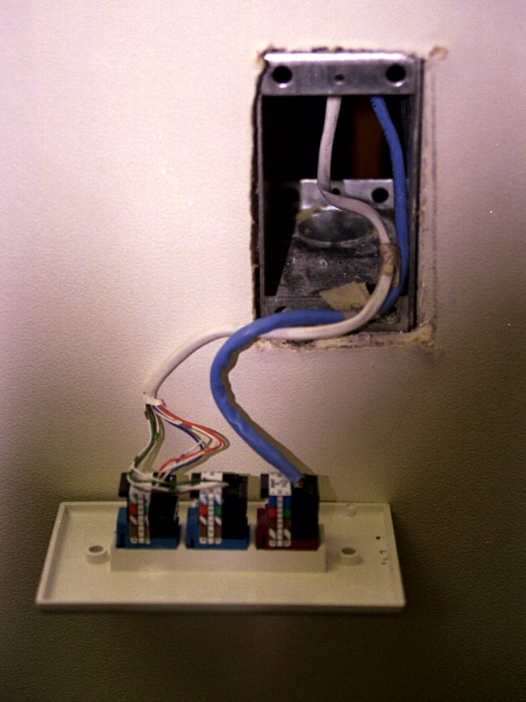
Wall Plate in Office

Slide 16
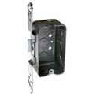
Box

Slide 17

Sheet Metal Screws

Slide 18
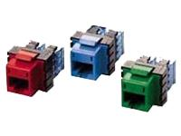
Jack

Slide 19

Wall Plate

Slide 20
Label

Slide 21
In the Walls and Ceiling
Wire
  What carries the signal from the work area to the LAN room

Slide 22
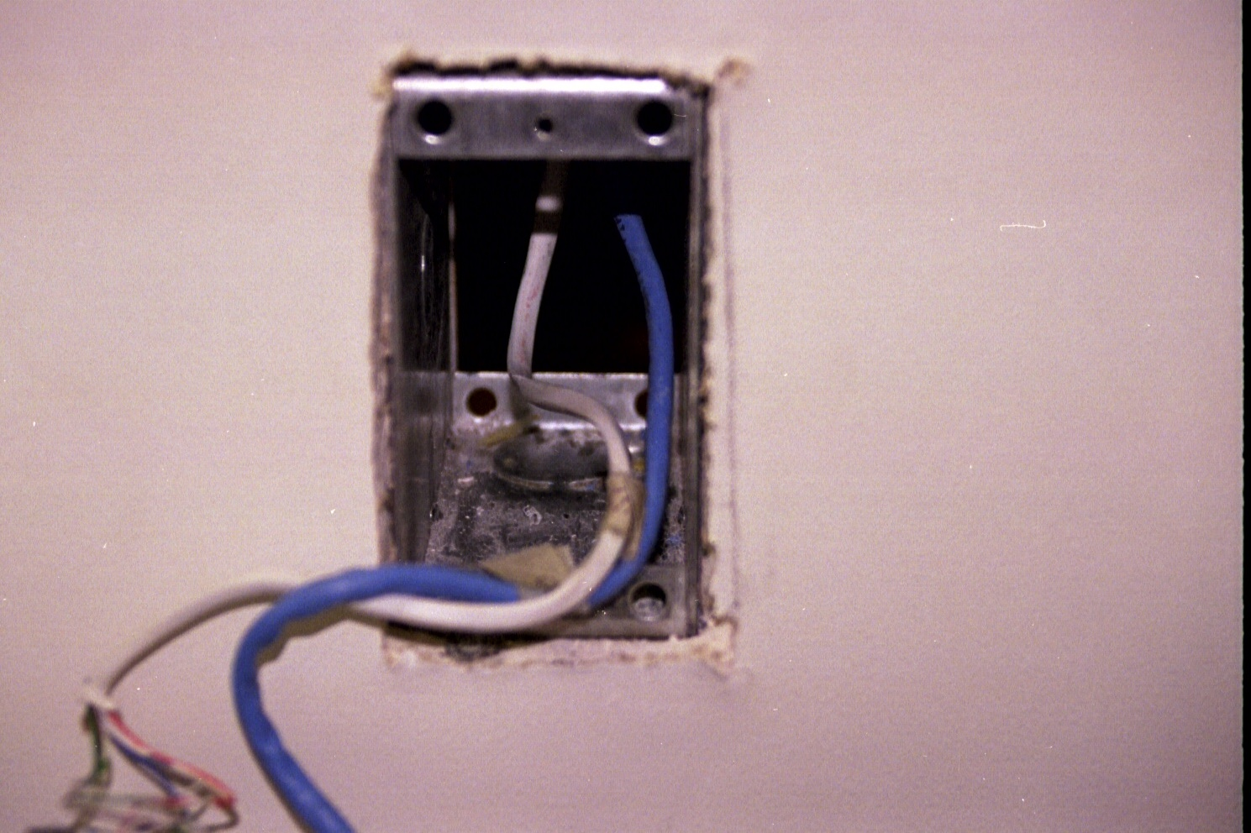
Wire Run Up Wall in Office

Slide 23
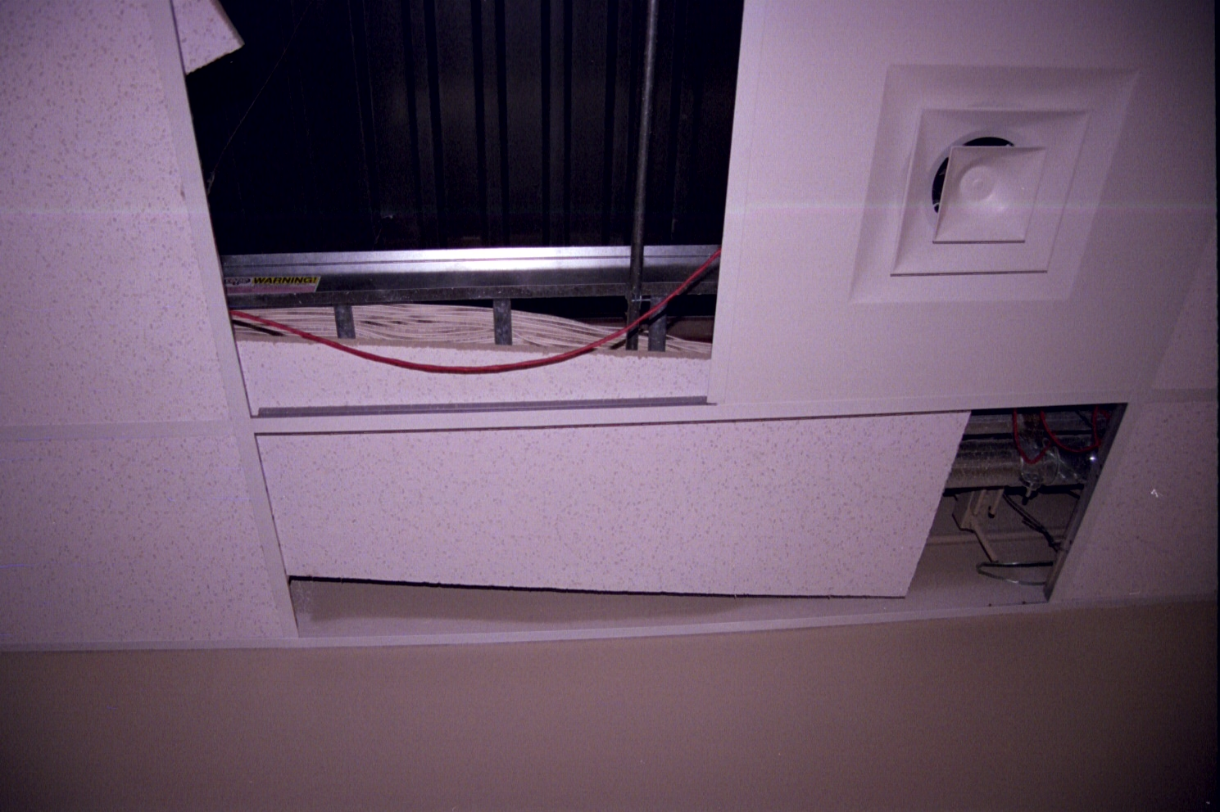
Cable Plenum Space

Slide 24
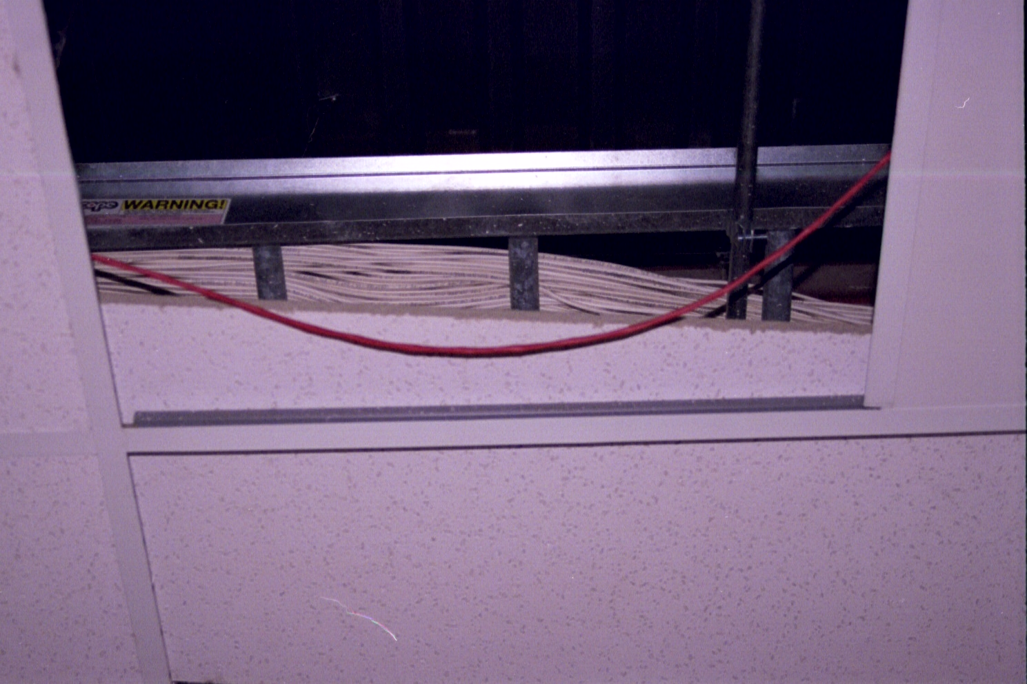
Cable Plenum Space

Slide 25
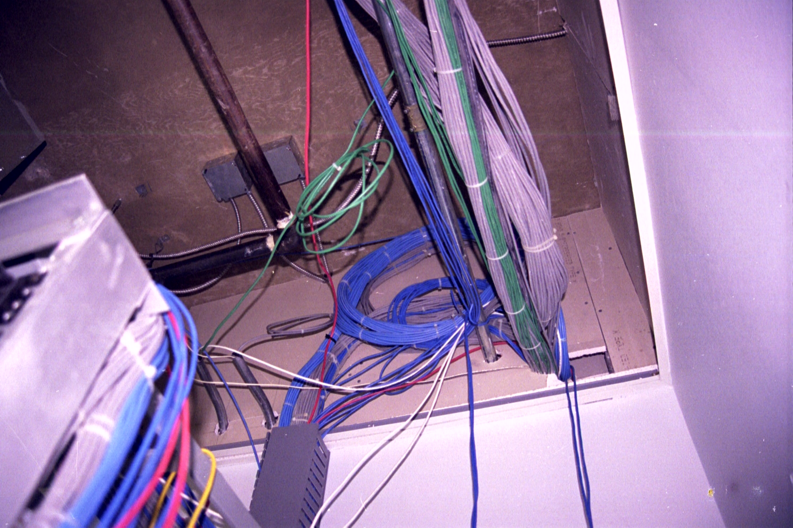
Cable Into the LAN Room

Slide 26
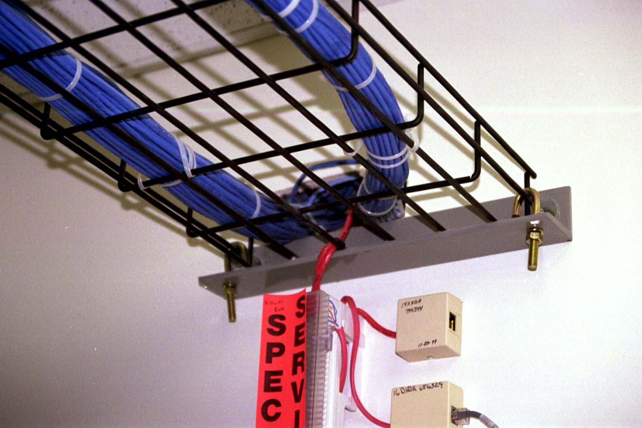
Cable Into the LAN Room

Slide 27
In the LAN Room
Relay Rack
  Holds all of the cabling stuff
Concrete Anchors
  Used to hold the bolts, which hold the rack to the floor
Concrete Anchor Bolts
  Used to attach the relay rack to the floor
Ladder Rack
  Braces the Relay Rack to the wall

Slide 28
In the LAN Room
Patch Panel
  Used to terminate the wiring in the LAN room
Jack
  What the cable is plugged into
Label
  Placed on the patch panel so you can find the other end
Switch
  Used to allow stuff to talk to each other

Slide 29
In the LAN Room
Machine Screws
  Holds the stuff to the relay rack
Patch Cable
  Attaches the patch panel to the switch

Slide 30
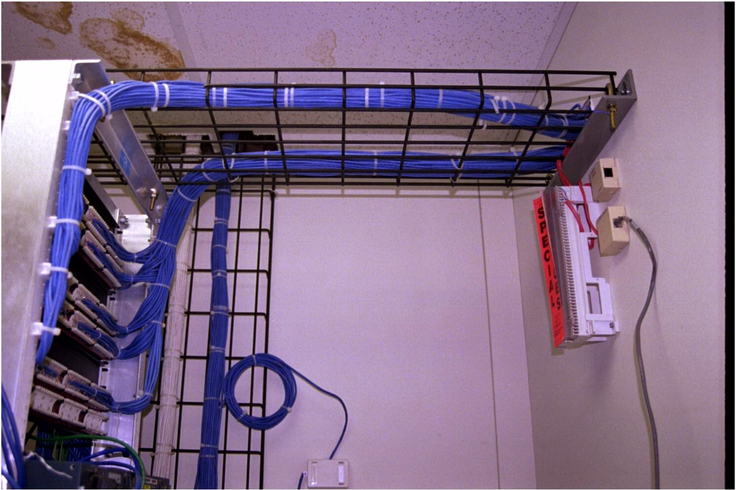
Across to the Relay Rack

Slide 31
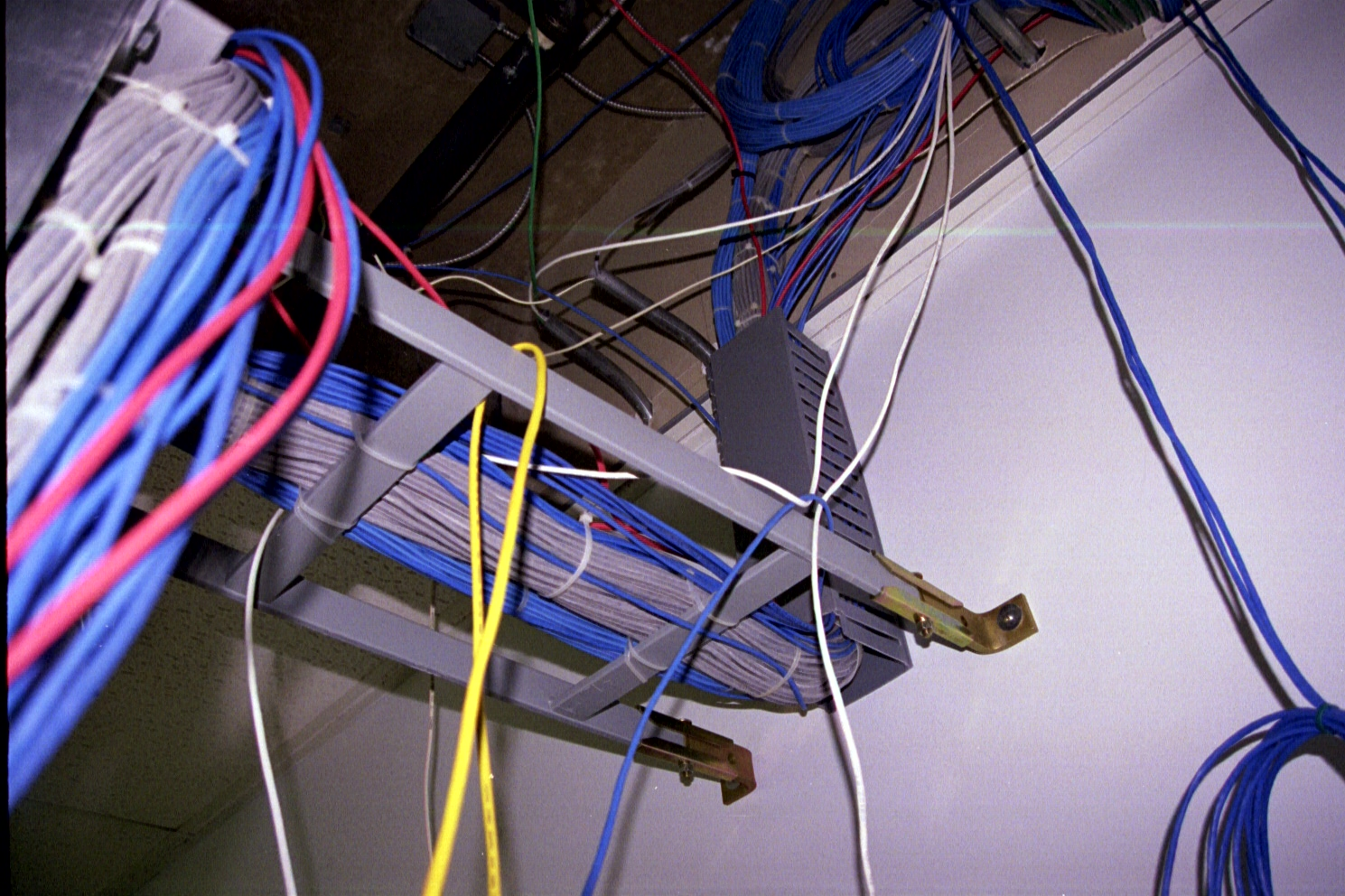
Across to the Relay Rack

Slide 32
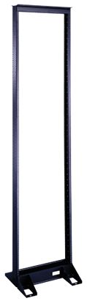
Relay Rack

Slide 33
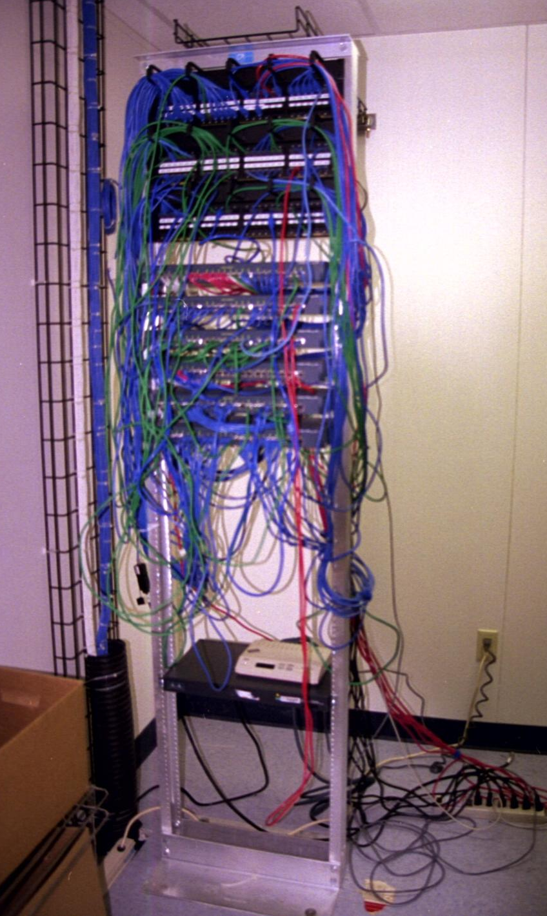
The Relay Rack

Slide 34
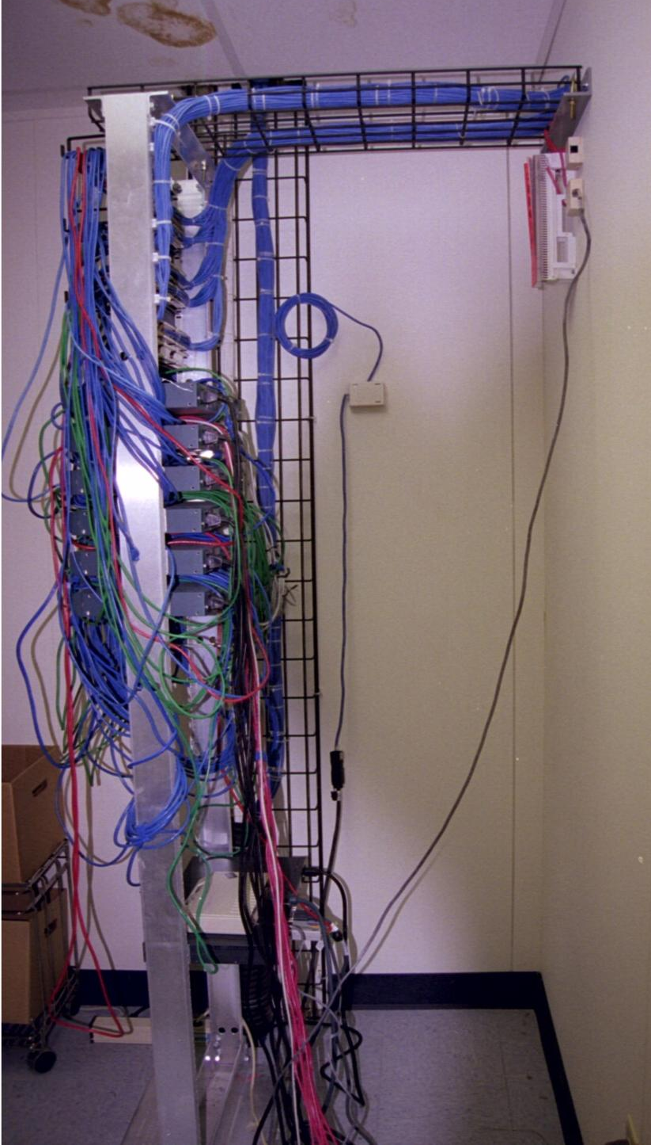
The Relay Rack

Slide 35
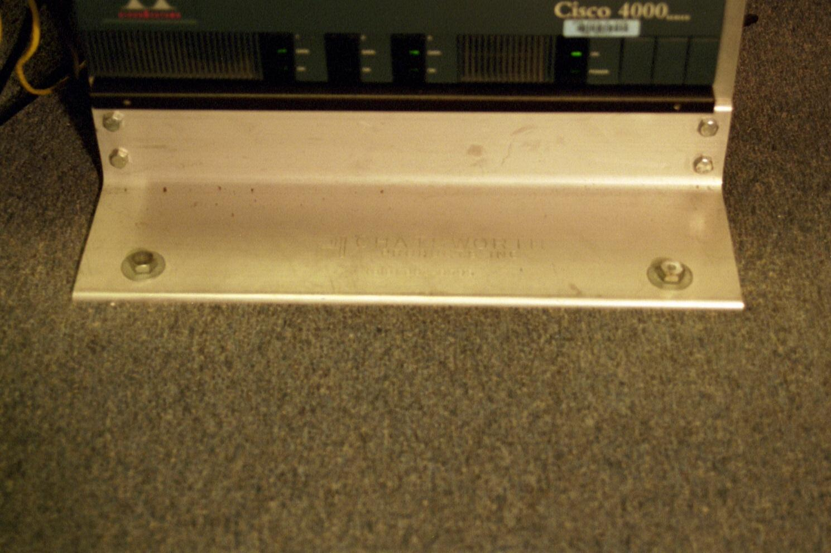
Relay Rack Bolted to the Floor

Slide 36
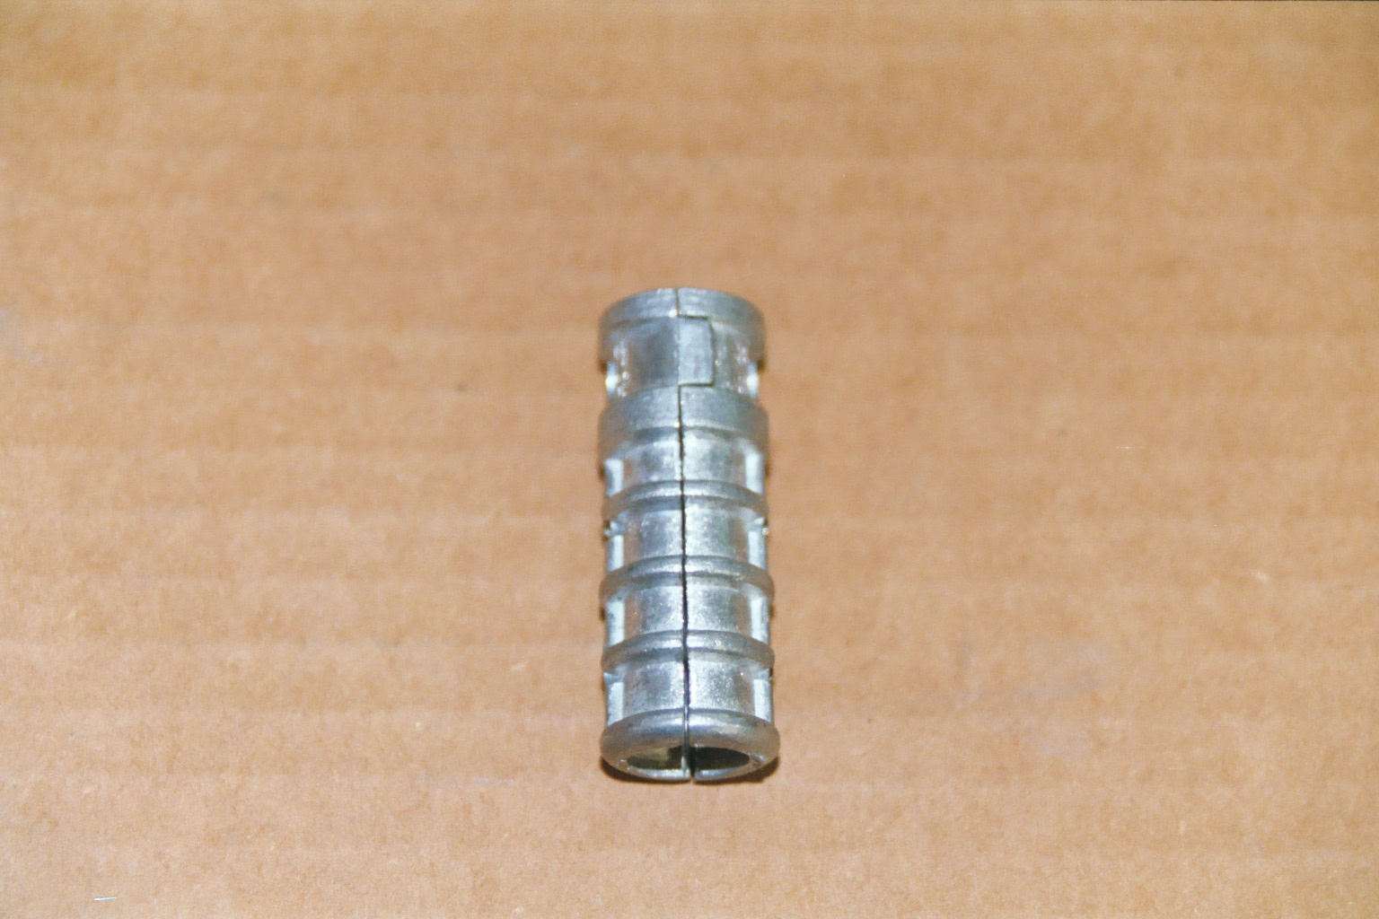
Concrete Anchor

Slide 37
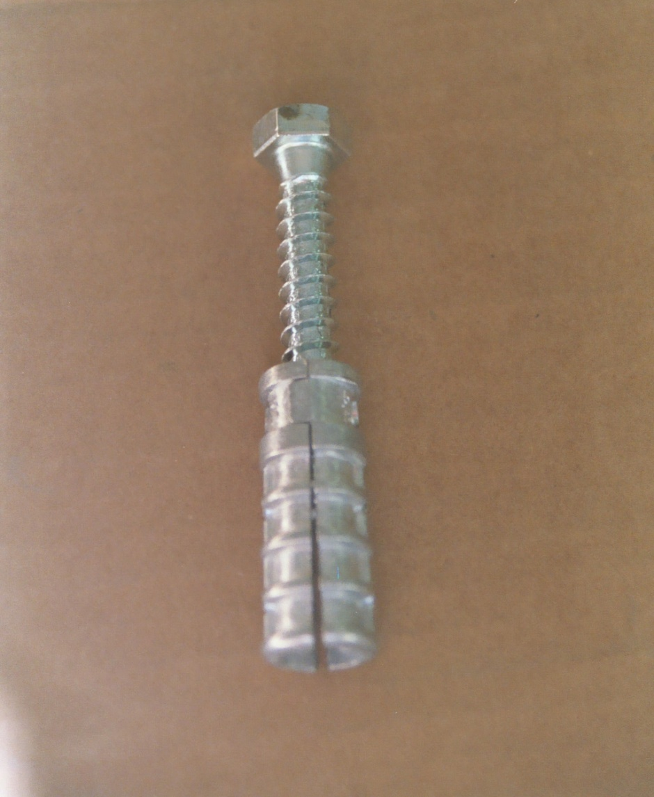
Concrete Anchor With Bolt

Slide 38
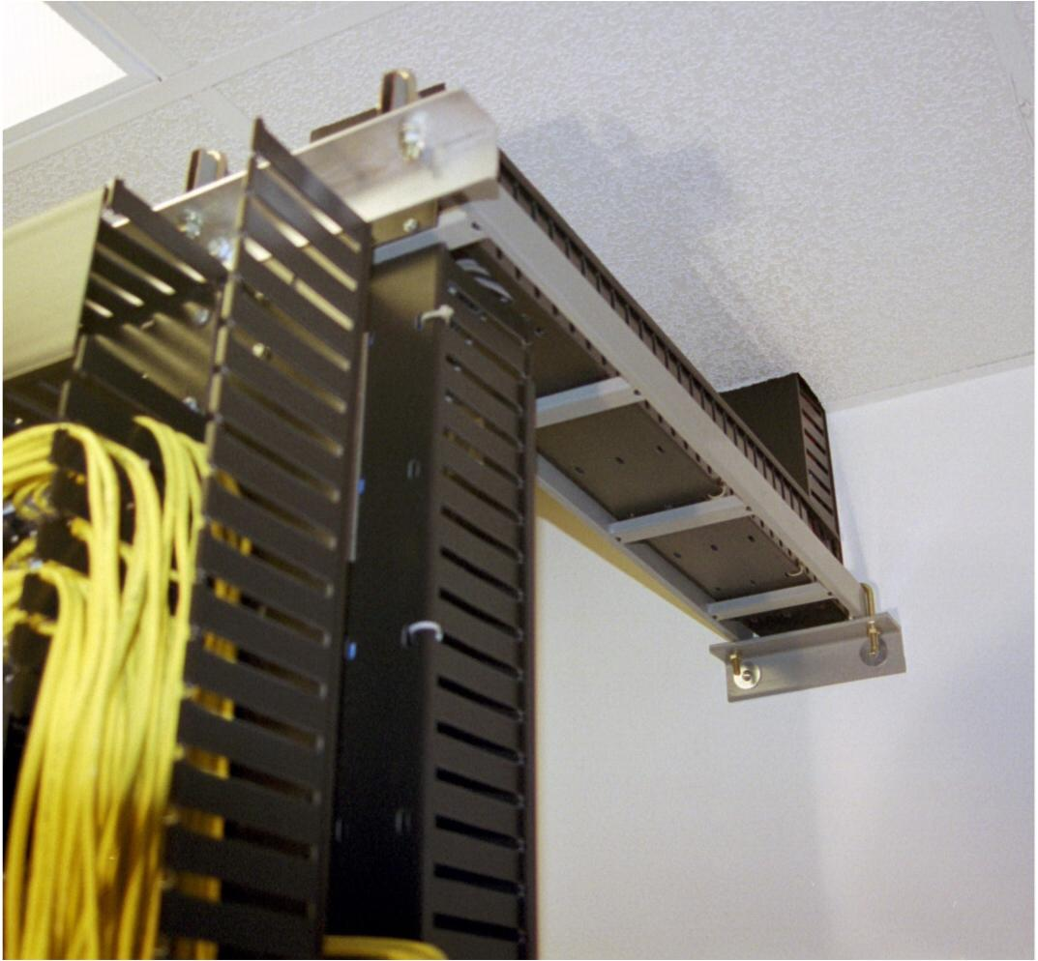
Ladder Rack

Slide 39
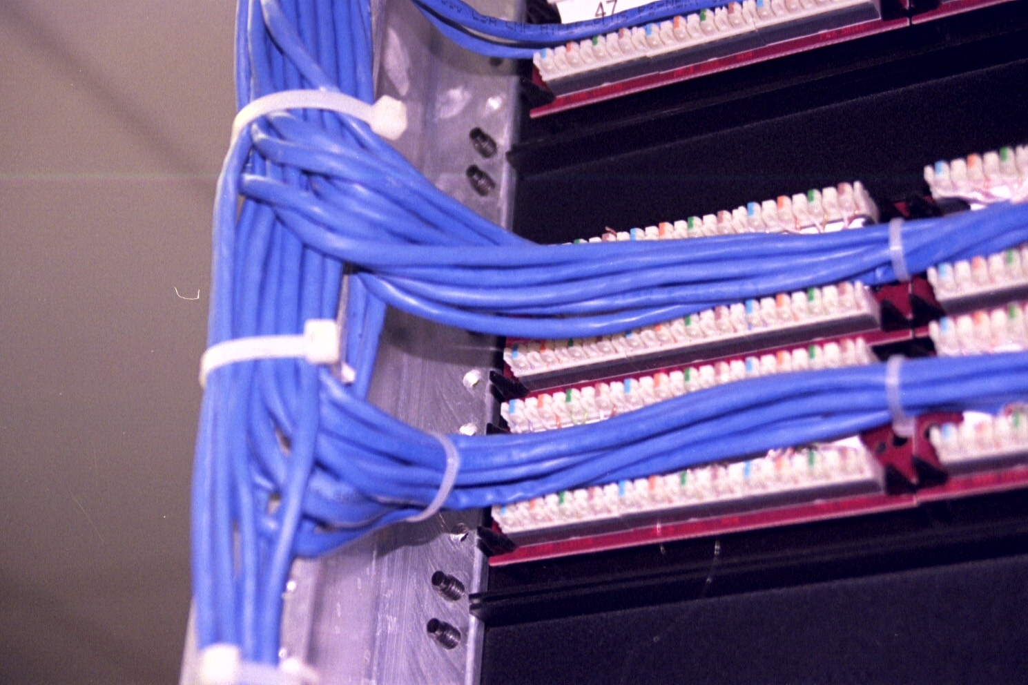
Terminated in the Patch Panel

Slide 40
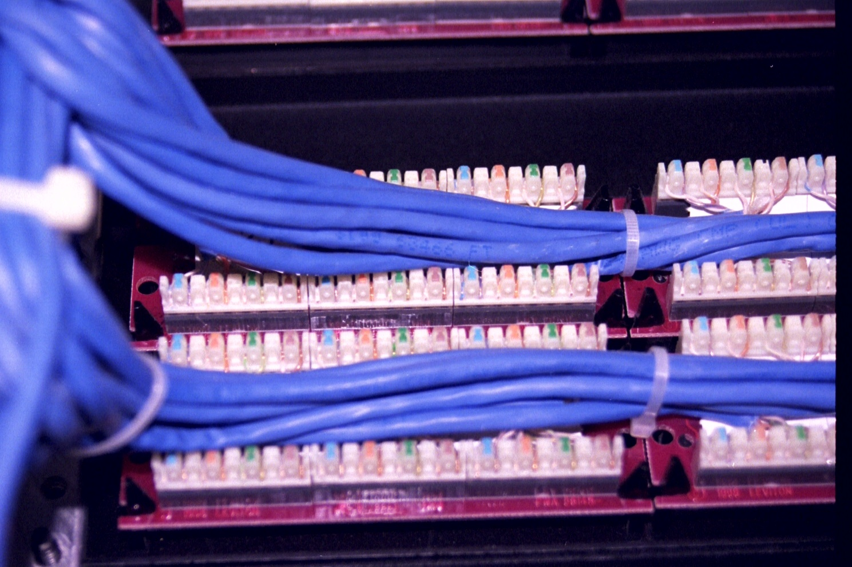
Terminated in the Patch Panel

Slide 41
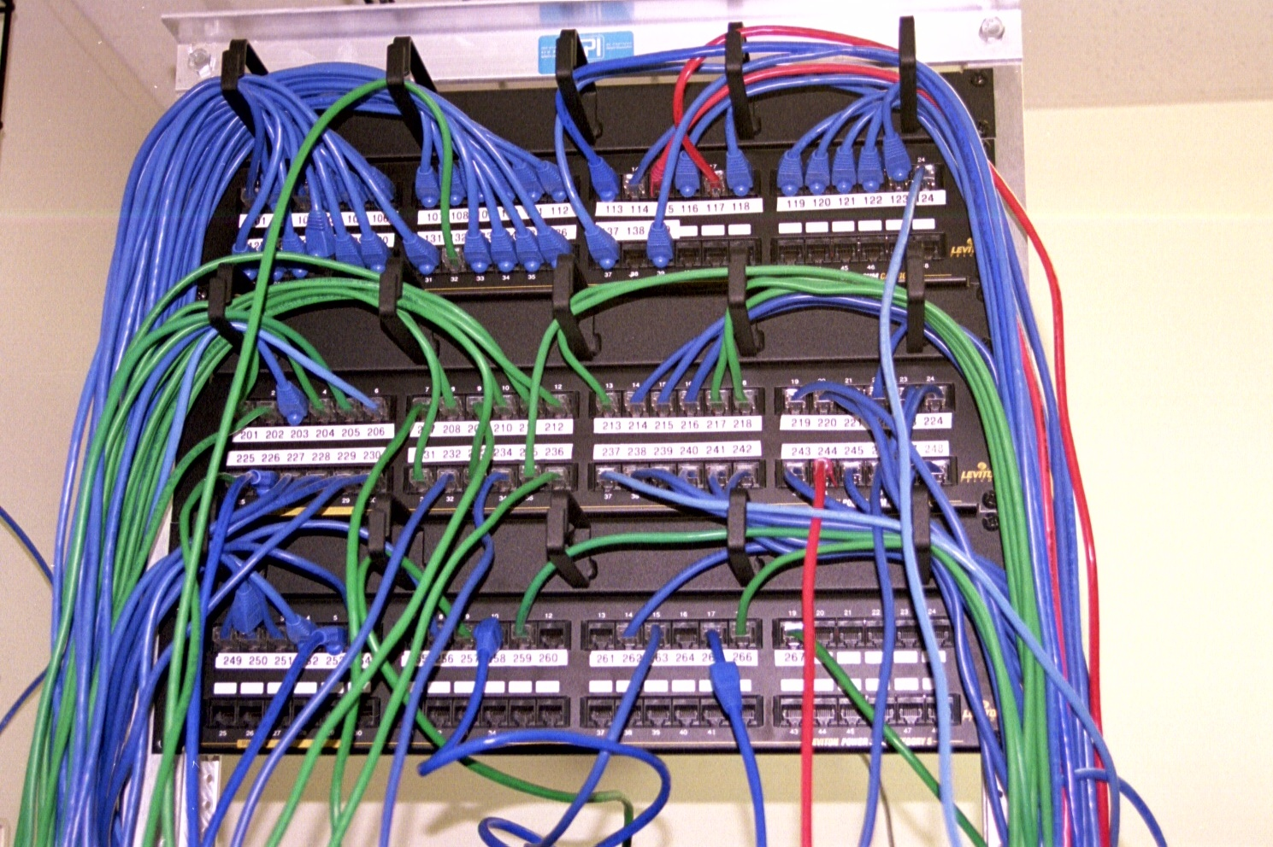
The Patch Panel

Slide 42
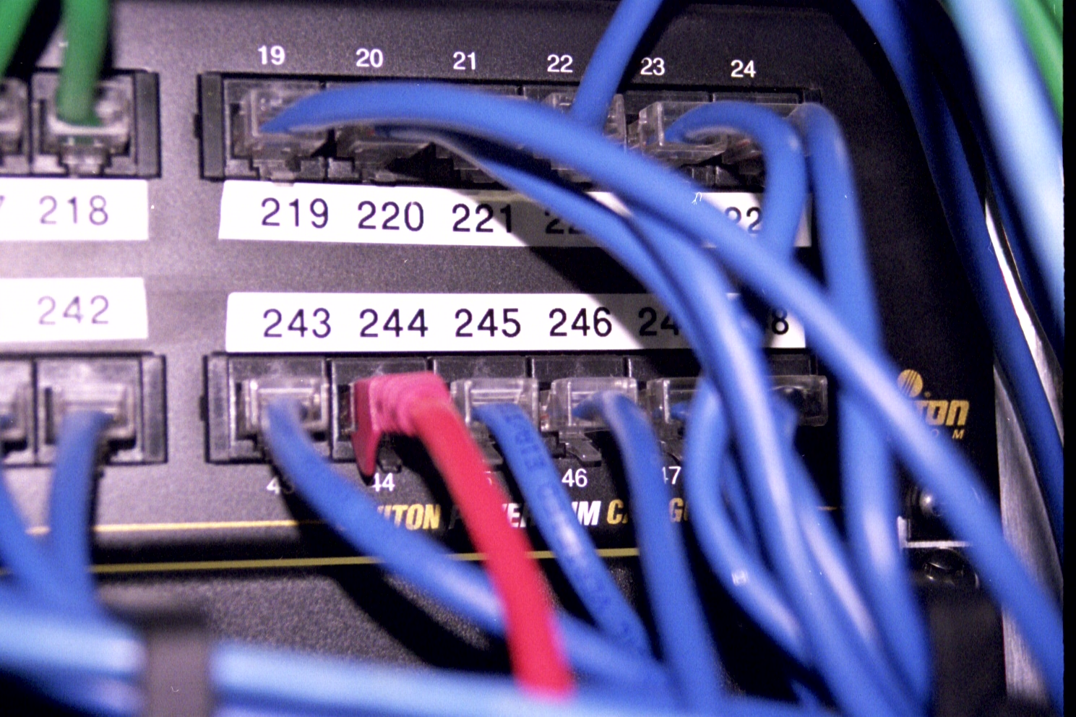
The Patch Panel

Slide 43
Jack

Slide 44
Label

Slide 45
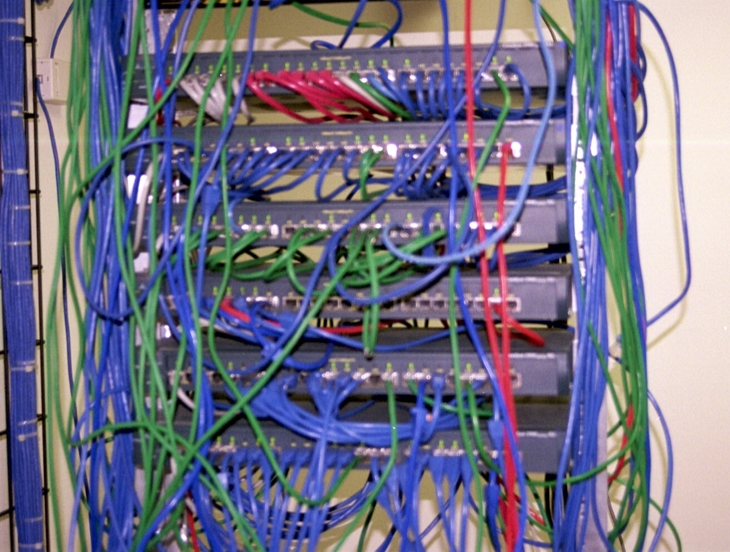
Switches in the Relay Rack

Slide 46
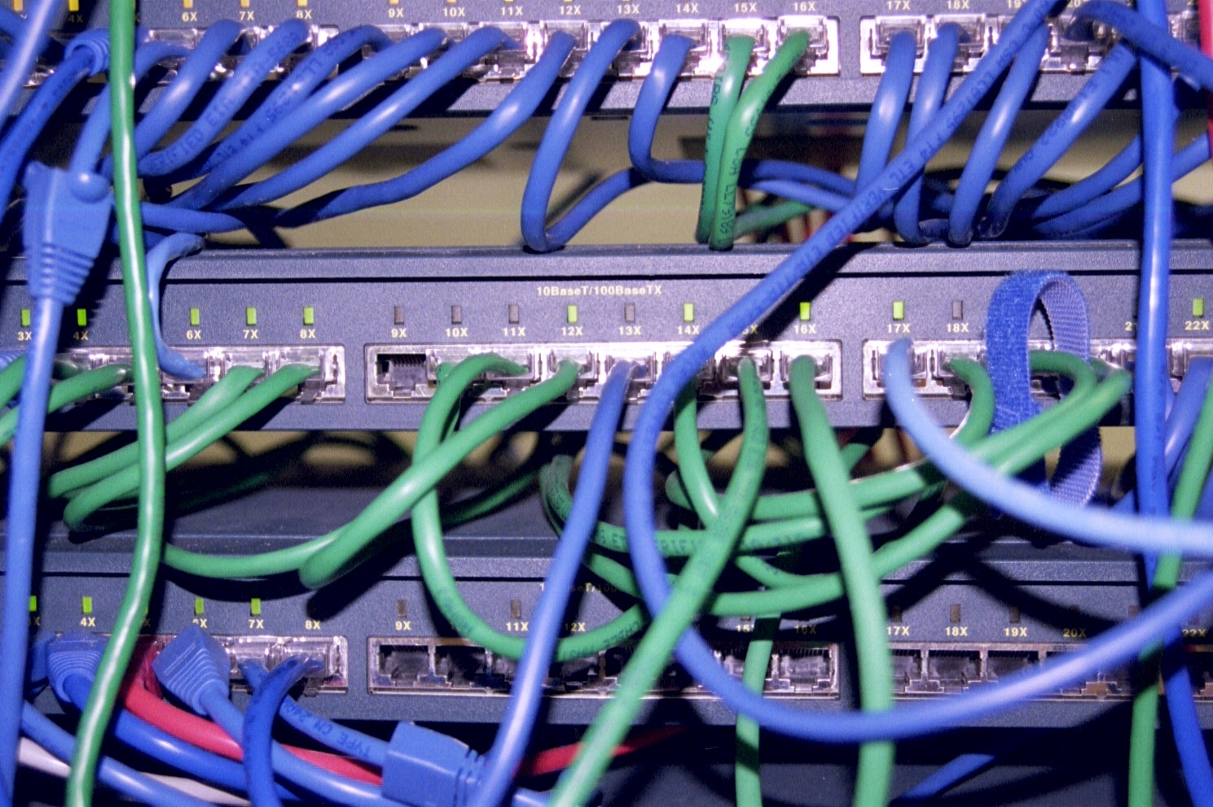
PC Port in the Switch

Slide 47
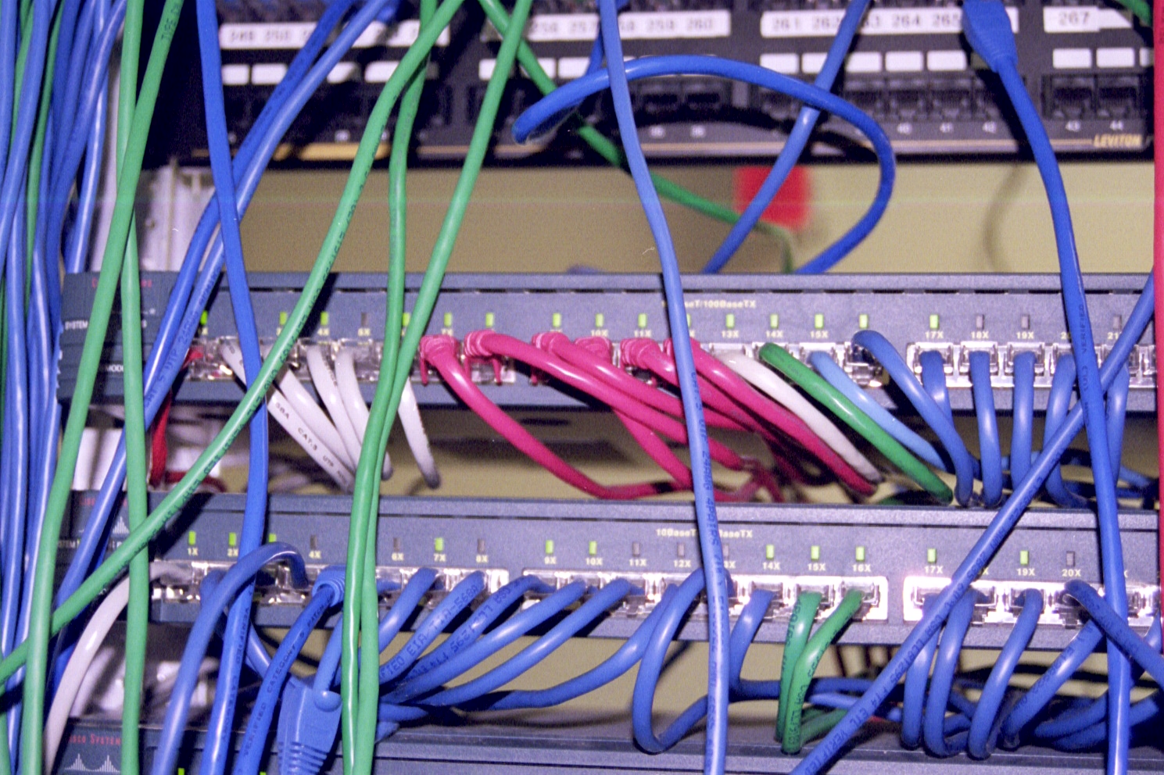
Switch Ports for LAN Equipment

Slide 48
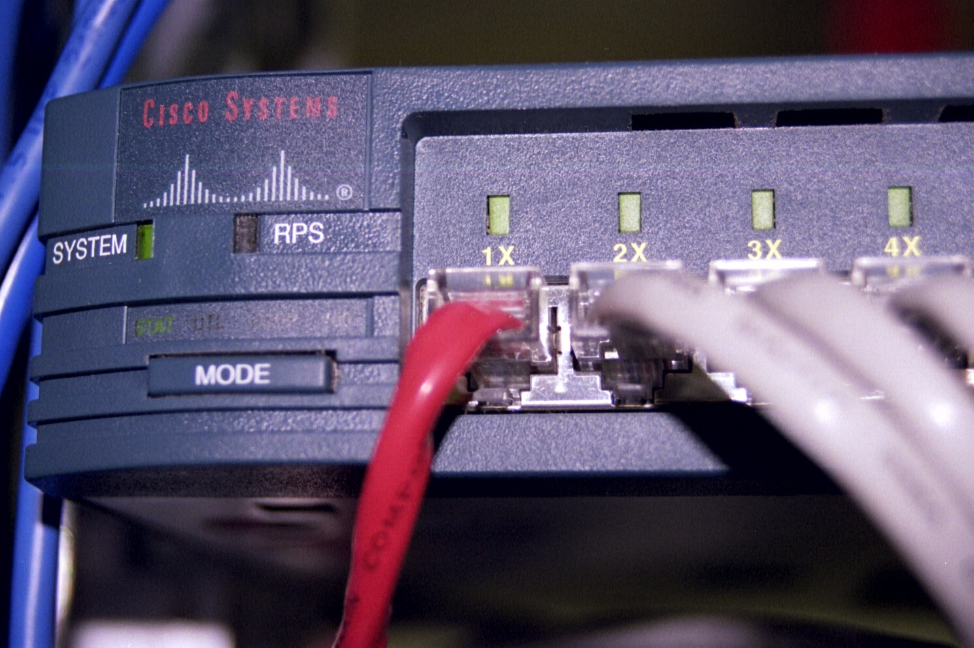
Server Port in the Switch

Slide 49
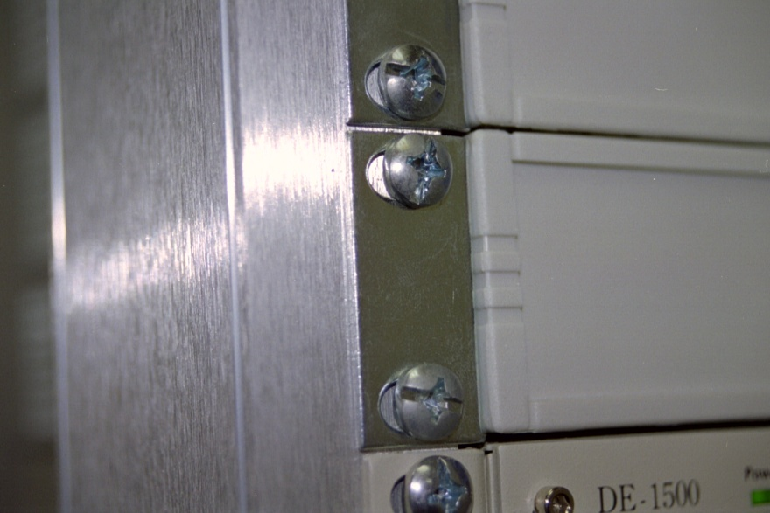
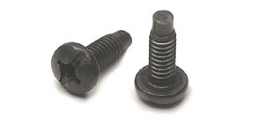

Machine Screws
or

Slide 50
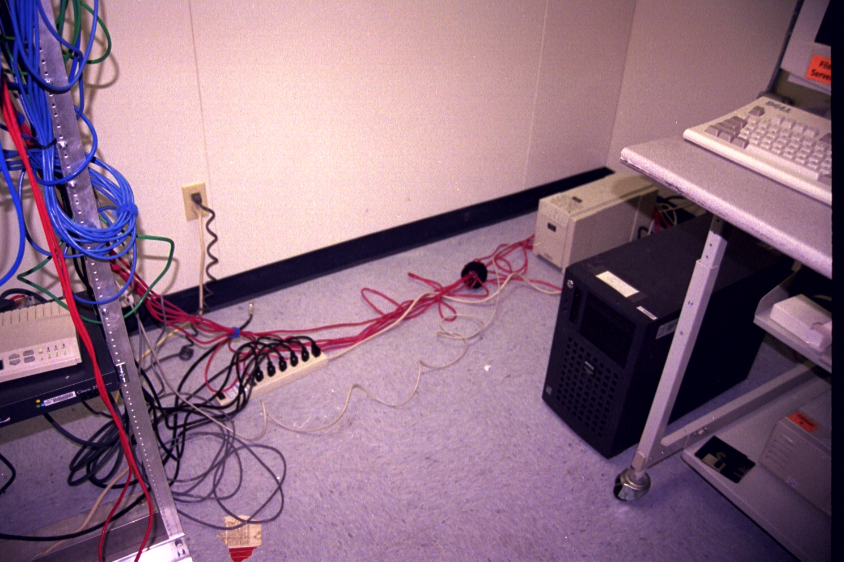
Patch Cable to Server

Slide 51
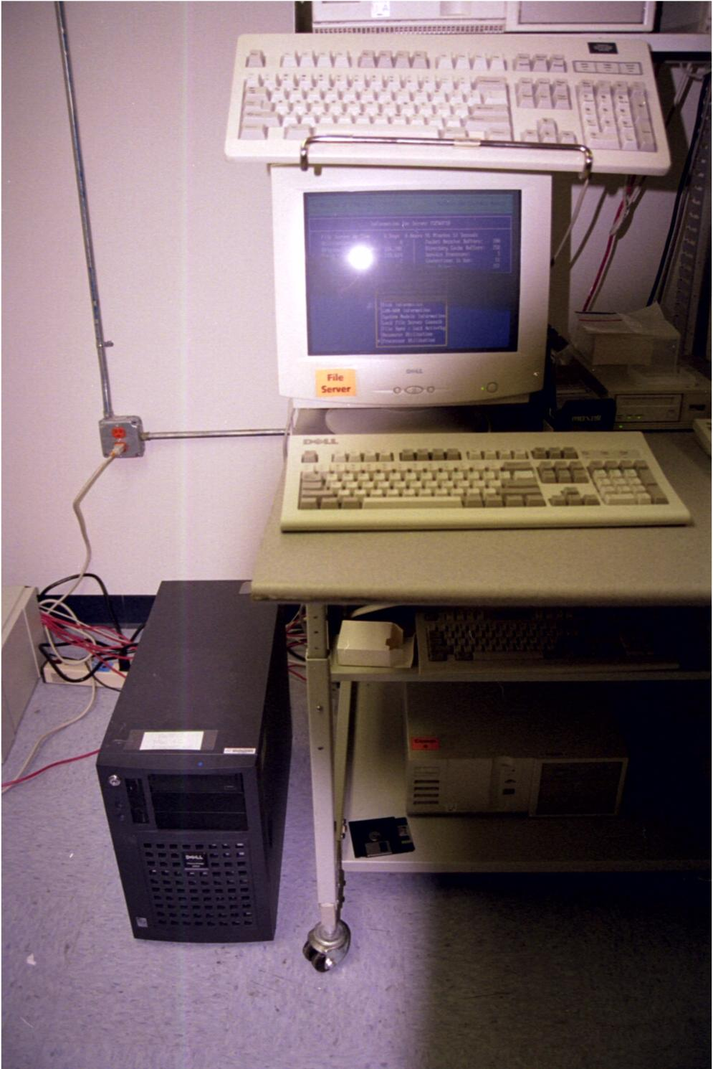
The Server

Slide 52
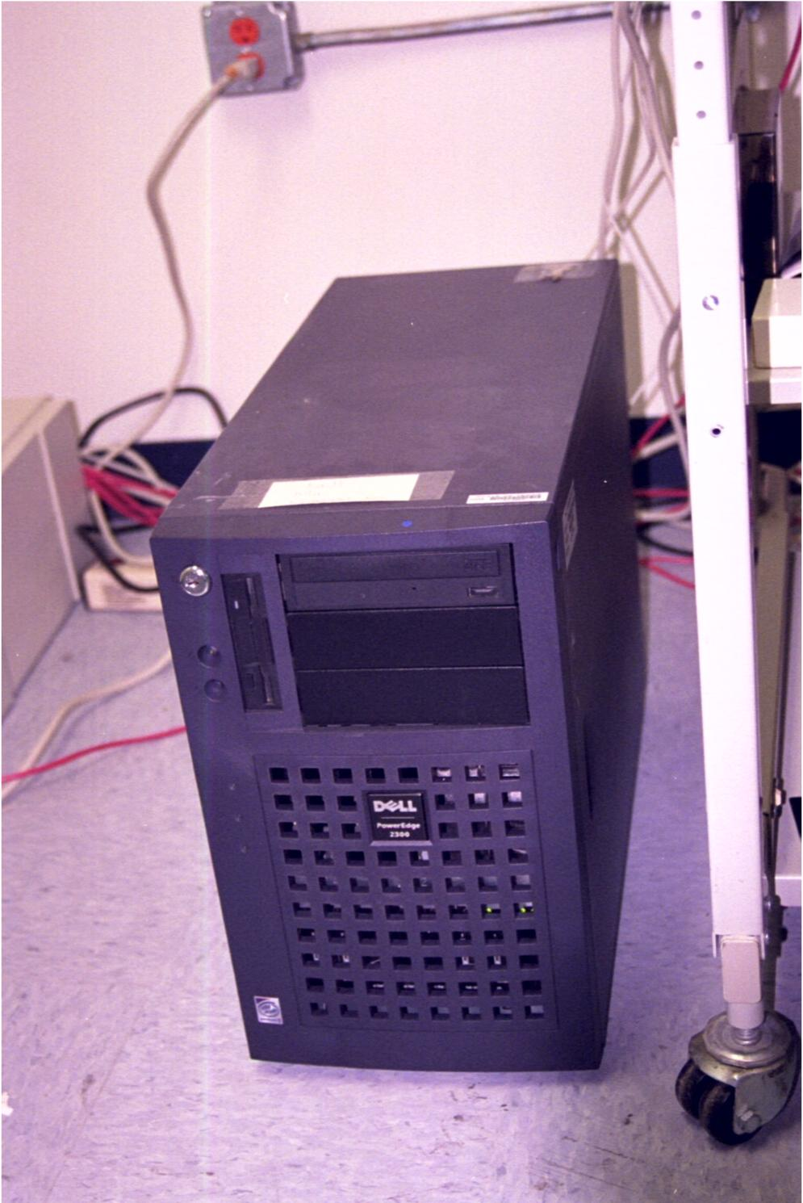
The Server

Slide 53
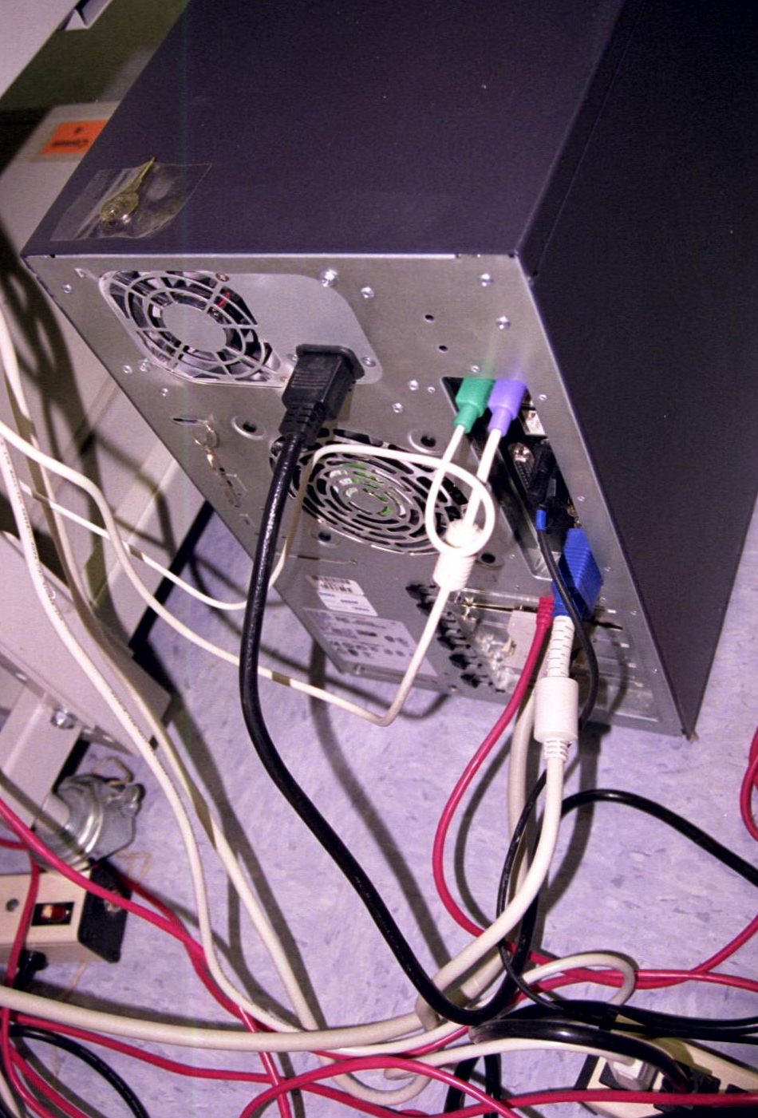
NIC in the Server

Slide 54
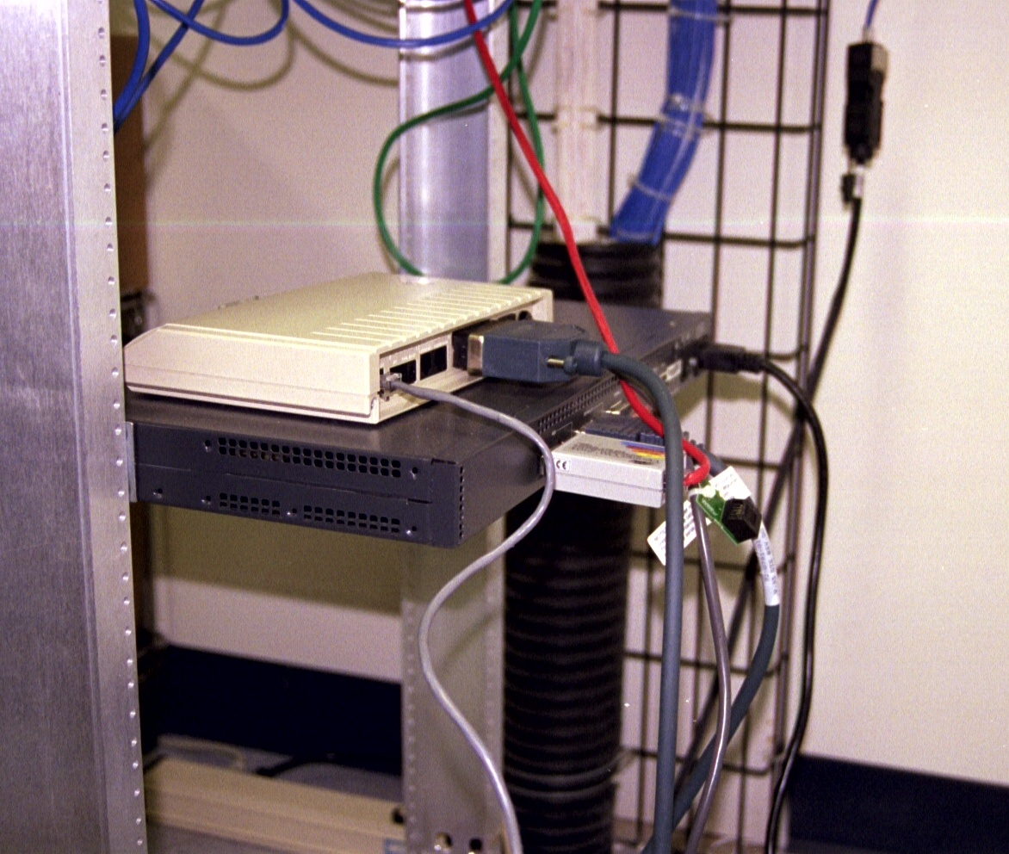
WAN Access Can Be Shared

Slide 55
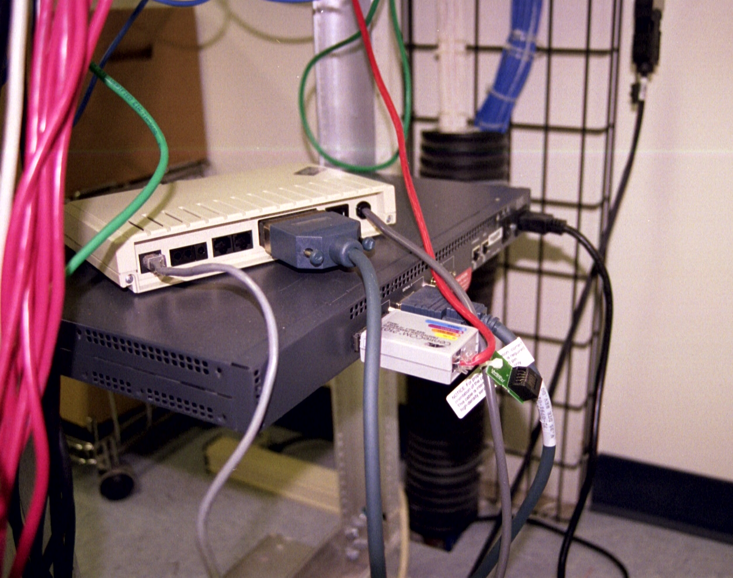
WAN Access Can Be Shared

Slide 56
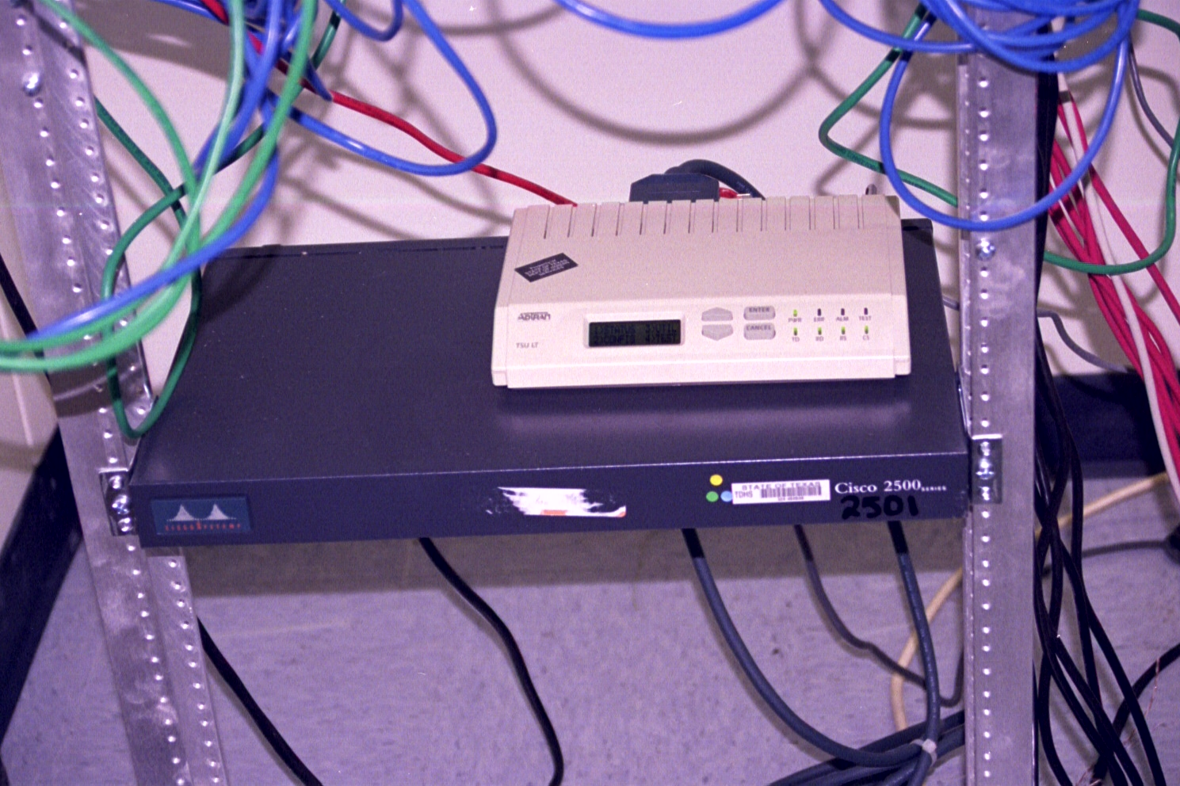
WAN Access Can Be Shared

Slide 57
Structured Cabling
The proper way to do LAN cabling is to follow the recognized standards that have been agreed on
Standards work when they are adopted by both the cable manufacturers and by the device manufacturers

Slide 58
Structured Cabling
Then if an end-user also follows these same standards, any application, cable, connector, or electronic device built for compliance will work in any system built with such parts
This is called Structured Cabling
The standards that direct this are those produced by the Telecommunications Industry Association or TIA

Slide 59
Structured Cabling
As some of these standards were co-developed with the Electronics Industry Alliance or EIA and are recognized by the American National Standards Institute or ANSI, these standards are then often called the EIA/TIA or even the ANSI/EIA/TIA standards
As to what you call these, suit yourself, most people say and write TIA

Slide 60
What is ANSI
As the ANSI web site says
  ANSI is a private, non-profit organization (501(c)3) that administers and coordinates the U.S. voluntary standardization and conformity assessment system.

Slide 61
What is the EIA
As the EIA web site says
  The Alliance is a partnership of electronic and high-tech associations and companies whose mission is promoting the market development and competitiveness of the U.S. high-tech industry …more than 2,300 member companies whose products and services range from the smallest electronic components to the most complex systems …

Slide 62
What is the TIA
As the TIA web site says
  The Telecommunications Industry Association (TIA) is the leading non-profit trade association in the communications and information technology industry …standards development …. TIA provides a market-focused forum for its 1,100 member companies that manufacture or supply the products and services used in global communications.

Slide 63
What is the Relationship
So what is the relationship in terms of structured cabling for all of these organizations
  TIA develops the standards
  EIA recognizes the standards as valid since TIA is one of the organizations that belong to the umbrella EIA
  The standards are then recognized by ANSI as the American coordinating body

Slide 64
What Structured Cabling Is Not
Keep in mind that cables do not have to be installed according to the standards in order to work
Many cable installations use a mixture of parts that meet no standard or the parts are installed in a haphazard method
Many of these installations work for years

Slide 65
What Structured Cabling Is Not
However these installations are difficult to troubleshoot and repair and these installations fail when placed under a load

Slide 66
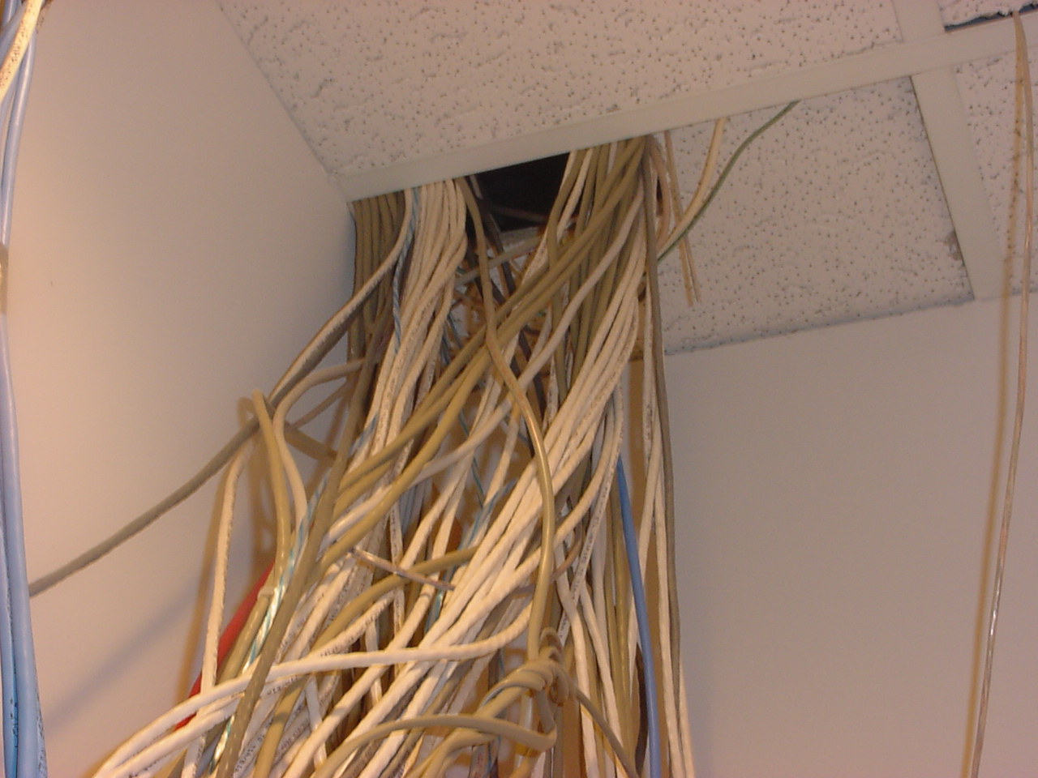
This is Not Structured Cabling

Slide 67
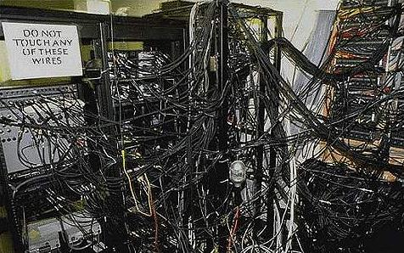
Nor Is This

Slide 68
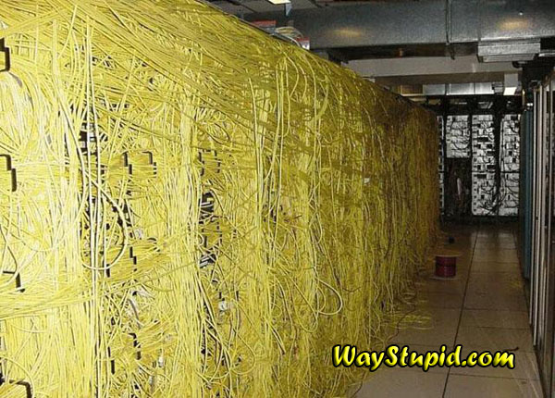
Nor This

Slide 69
The Standards
So if those pictures do not show structured cabling, what does it look like, how do you create such a thing
By following the standards
What standards are we talking about

Slide 70
The Former Standards
TIA-568-A.5
  Commercial Building Telecommunications Cabling Standard
Up until Spring of 2002 this was the main standard

Slide 71
The Former Standards
After the A version came
  TIA-568-B.1
    Commercial Building Telecommunications Cabling Standard – Generic Requirements
  TIA/-568-B.2
    Commercial Building Telecommunications Cabling Standard – Connecting Hardware and Components
  TIA-568-B.3
    Commercial Building Telecommunications Cabling Standard – Optical Fiber Cabling

Slide 72
The Current Standard
After B comes C
It arrived in March 2009
It is now in four parts
  TIA-568-C.0
    Generic Telecommunications Cabling for Customer Premises
  TIA-568-C.1
    Commercial Building Telecommunications Cabling Standard

Slide 73
The Current Standard
  TIA-568-C.2
    Balanced Twisted-Pair Telecommunications Cabling and Components Standard
  TIA-568-C.3
    Optical Fiber Cabling Components Standard

Slide 74
The Standards
In addition the following standards are used as well
TIA-569-A
  Commercial Building Standard for Telecommunications Pathways and Spaceways
TIA-606-B
  Administration Standard for the Telecommunications Infrastructure of Commercial Buildings

Slide 75
The Standards
TIA-607-B and NECA/BICSI-607-2011
  Generic Telecommunications Bonding and Grounding for Customer Premises
TIA-758
  Customer Owned Outside Plant
TIA-942 and BICSI-002
  Data Centers

Slide 76
Standards Revision
Each of these standards is under more or less constant examination by various TIA TR-42 committees
When circumstances in the industry call for a revision or just an amendment these committees produce these
Regardless of any changes each standard must be revised or just reissued once every five years as required by ANSI

Slide 77
Standards Revision
It is not unusual to see a set of amendments issued over the intervening years to correct or add small additions to the various standards
If something that was not discussed at all in the standard arises, the a TSB – Telecommunications Services Bulletin is issued to add that

Slide 78
Standards Revision
Here is what the TIA says about these two types of changes made to a standard in between major revisions
  A TSB is a Telecommunications Services Bulletin
  It is purely informational: we might look at a subject, collect information and share it with the industry
  There is no normative information, - no "shall" statements
  TSBs are often stepping stones in the standards process as we start to explore topics that might become part of a standard

Slide 79
Standards Revision
  In fact, a TSB can be referenced by a standard
  An addendum is an official addition to a publish standard
  Anything in the addendum has the same enforcement as a full, published standard
  The contents can be normative or informative depending on the content and how the engineering committee positions the material as an addendum

Slide 80
Standards Revision
These then must be considered in addition to the standard itself
Here is the process the committees follow to do this

Slide 81
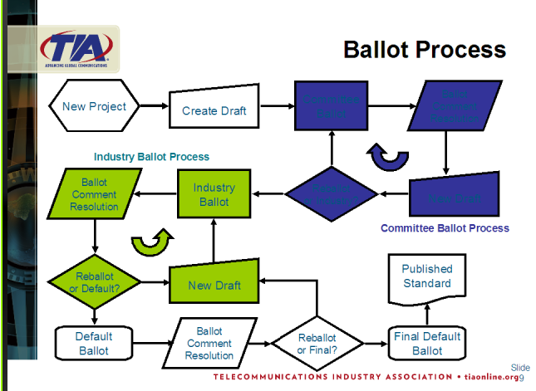
Standards Revision

Slide 82
Acquiring the Standards
These standards can be ordered through the TIA
Right now the easiest way is to go to tiaonline.org

Slide 83
The Standards
Besides the standards produced by TIA at least two other sets of standards must be adhered to
  The NEC - U.S National Electric Code Chapter 8 Communications Systems
  All local codes and standards related to building construction

Slide 84
Relationship of the Standards
Here is a nice graphic from the Siemens web site that shows how the standards relate to each other

Slide 85
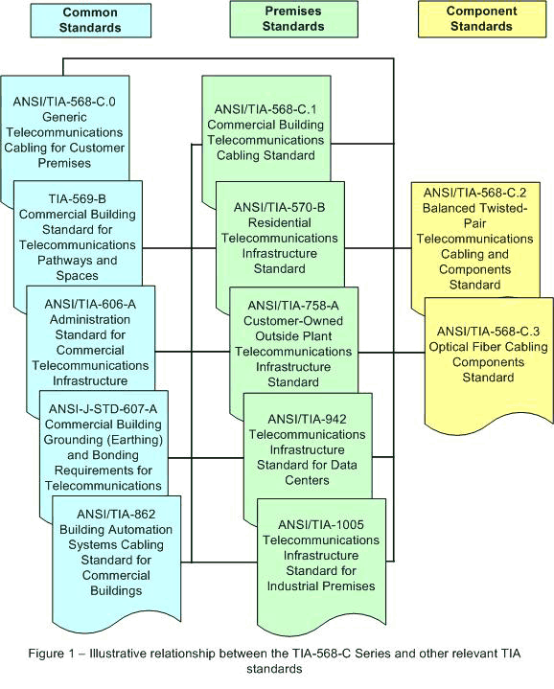
Relationship of the Standards

Slide 86
Specifics on These Standards
Let’s go over each of these in more detail

Slide 87
TIA-568-A
The main standard was
  TIA-568-A.5
    Commercial Building Telecommunications Cabling Standard
This is from 1995
As stated before it was replaced in early 2002
The replacement was TIA-568-B

Slide 88
TIA-568-B
As stated this standard is actually three standards
  TIA-568-B.1
    General requirements
  TIA-568-B.2
    Copper cabling specifics
  TIA-568-B.3
    Fiber optic cabling specifics

Slide 89
TIA-568-B
The major changes included
  Category 5 is no longer recognized, Category 5E must be used at a minimum
  Performance specifications are included for Category 5E
  50 micron fiber optic cable is included in addition to the more common 62.5
  Smaller connectors for fiber optic cable are recognized

Slide 90
TSBs
In between the EIA/TIA-568-A standard and the 568-B standard things changed
To address these changes TSBs –Telecommunications Service Bulletins were issued
These disappeared with the publication of 568-B
But people will still refer to these as well for a while

Slide 91
TSBs
Commonly referred to TSBs
  TSB67
    Testing guidelines
  TSB75
    Open Office cabling
  TSB95
    Higher speed testing guidelines

Slide 92
Addendums
In addition to the TSBs, 568-A itself was amended
These too disappeared with the publication of 568-B
568-A addendums include
  A-1 through A-5

Slide 93
TIA-568-B.1 Addendums
As might be expected 568-B was also being amended

Slide 94
TIA-568C
The current standard as of March 2009 is TIA-568C
This standard is in four parts
  568-C.0
  568-C.1
  568-C.2
  568-C.3

Slide 95
TIA-568-C.0
Generic Cabling
  This section includes all of the basic requirements that apply regardless of the type of cable used
  Such as laying the cabling out in a star topology

Slide 96
TIA-568-C.1
This section applies to office oriented cabling systems
This is the most common type of installation
It outlines the allowances and exceptions to the basic 568-C.0 that apply in the office environment

Slide 97
TIA-568-C.2
The copper cable specific requirements are in this section

Slide 98
TIA-568-C.3
The fiber optic cable specific requirements are in this section

Slide 99
Development of 568 Standard
Here is a nice summary of the development of this standard over time
It is from a presentation at a BICSI conference in November 2011

Slide 100
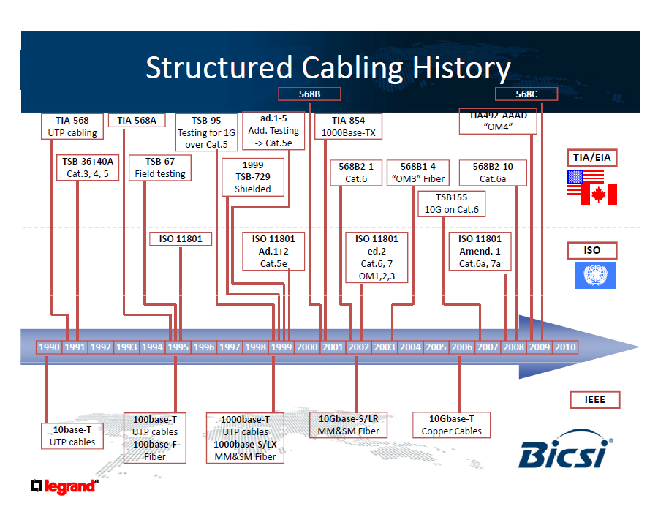
Development of 568 Standard

Slide 101
TIA-569-B
The TIA-569-B relates to Commercial Building Standard for Telecommunications Pathways and Spaceways
This standard provides guidelines for rooms, areas, and pathways through which telecommunications equipment and media are installed

Slide 102
Star Topology
The standards call for a structured cabling system to use a star topology
That is all cables from a floor or area in a building must be run back to one central point for administration
Each telecommunications closet must be star-wired back to the equipment room for the building

Slide 103
Star Topology
In a campus environment each building is star-wired back to one main administration area
Within the requirement to run the cables in a star pattern, there are two ways to do this
One is to run all of the horizontal cables back to one point, such as the LAN room

Slide 104
Star Topology
Another way to do this, especially in a large building, is to use a zone distribution system
In this method horizontal backbone cables run from the LAN room to consolidation points
A distribution device of some sort is at each distribution point
This backbone can be copper or fiber

Slide 105
Star Topology
Then from each zone consolidation point, copper cables are run to the work area
Zone consolidation points can be in the ceiling
Such as

Slide 106
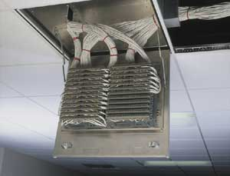
Zone Cabinet

Slide 107
TIA-569-B
The 569 standard also states what names to use for each area typically seen in a network
Some of these areas are distinct and some are actually the same room in smaller buildings

Slide 108
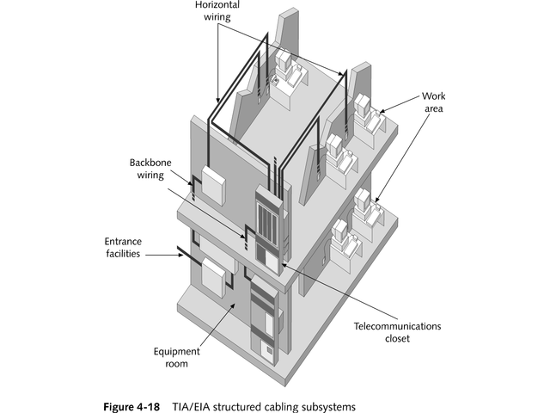
TIA-569-B

Slide 109
TIA-569-B
It also details some of the considerations to be addressed when designing and constructing a building that will include a telecommunications system such as doors, ceilings, electrical, lighting, and so on
According to this standard, a structured cabling system consists of six subsystems
They are

Slide 110
Entrance Facility
The entrance facility is the point where outside cables and associated hardware are brought into the building
The entrance facilities may be used for public network services, private network customer services or both
The demarcation point between carrier and customer and building wide over voltage protection devices are here

Slide 111
Entrance Facility
Everything coming into the building from an outside entity or a campus area connection should enter and be terminated here
The standard calls for dedicated room for this function alone if the building contains 20,000 or more useable square feet

Slide 112
Entrance Facility
If the building has more than 70,000 useable square feet, then this room should be dedicated, locked, and have plywood on at least two of the walls

Slide 113
Equipment Room
The equipment room is a centralized space for telecommunications equipment that serves users in the building
This space is for the WAN and telephone equipment
It may be part of the entrance facility in some cases or it may be part of the telecommunications closet

Slide 114
Telecommunications Room
The telecommunications room is where the horizontal distribution cables are terminated
Backbone cables are also terminated in the telecommunications room
There should be one telecommunications room on each floor of a building
These should be stacked on top of each other

Slide 115
Telecommunications Room
The three rooms just mentioned here are often the same room in a small building

Slide 116
Telecommunications Enclosure
A telecommunications enclosure is another telecommunications room on the same floor as the main telecommunications room
It just is not the main room
This is commonly seen in zoned cabling layouts as discussed later

Slide 117
Backbone Cabling
The backbone cabling provides interconnections between telecommunications closets, equipment rooms, and entrance facilities
This cabling consists of the backbone cables, main and intermediate cross-connects, mechanical terminations, and patch cords

Slide 118
Backbone Cabling
Backbones may connect closets within a building or between buildings
A backbone cable can be routed horizontally or vertically

Slide 119
Horizontal Cabling
The horizontal cabling consists of the physical media used to connect each work area outlet to a telecommunications closet
Various types of cable can be used for horizontal distribution
Each type has its own performance limitations, size, cost, and ease-of-use

Slide 120
Work Area Components
The work area components extend the telecommunications connector end of the horizontal cabling system to the station equipment
These cables must be flexible
For example, if the conductor is copper, then stranded cable is used

Slide 121
Parts Not Included
All adapters, transceivers, or media filters used to adapt the equipment to the structured cabling system must be external to the telecommunications outlet and are outside the scope of the standards

Slide 122
TIA-606-B
EIA/TIA-606-B
  Administration Standard for the Telecommunications Infrastructure of Commercial Buildings
This standard covers labeling, color-coding, and documenting an installed cabling system
It was released in June 2012

Slide 123
Administration Classes
This standard also establishes classes of administration to address the different needs of small, medium, large, and very large telecommunications infrastructure systems
There are four classes of administration defined

Slide 124
Administration Classes
  Class 1 is for a network with 100 or fewer users and a single telecommunications room
  Class 2 has hundreds of users and several rooms all in a single building
  Class 3 is the same as Class 2, but spread out among several buildings and several floors
  Class 4 systems cover a widely geographically distributed network

Slide 125
TIA-606-B Labeling
Labeling is an important part of the 606 standard
It identifies the following hardware as requiring labeling
  User area outlets
  Patch panels
  Horizontal cabling
  Backbone cables
  Backbone termination points

Slide 126
TIA-606-B Labeling
  Rooms
  Busbars
All labels should be resistant to deterioration from the environment, whatever that is
The labels should not be hand lettered
The layout of each type of label is specified as well

Slide 127
TIA-606-B Labeling
The standard calls for a uniform labeling format that shows the type, location, and purpose of the cable or the endpoint
Although shown below as single characters, these can be as many as are required
Two methods are recognized in 606-B
These are the original 606-A method shown next as well as a new method

Slide 128
TIA-606-B Labeling
User Area Outlets
  FS-AN
    F - a numeric for the floor of the building
    S – an alpha for the room
    A – an alpha for the patch panel
    N – a numeric or the port on the patch panel
Patch panel
  AN
    A – a alpha for the patch panel
    N – a numeric for the port on the patch panel

Slide 129
TIA-606-B Labeling
Horizontal Cables, within 300 mm of the each end
  FS-AN
    F - a numeric for the floor of the building
    S – an alpha for the room
    A – an alpha for the patch panel
    N – a numeric or the port on the patch panel

Slide 130
TIA-606-B Labeling
Backbone Cable
  FS1/FS2-N
    FS1 – this is the identifier for the room at one end of the cable
    FS2 - this the identifier for the room at the other end
    N – is the number assigned to the backbone cable itself

Slide 131
TIA-606-B Labeling
Backbone Termination Points, when buildings are interconnected
  FS1/FS2-N.D
    FS1 – this is the identifier for the room at one end of the cable
    FS2 - this the identifier for the room at the other end
    N – is the number assigned to the backbone cable itself
    D – for identification of a specific cable pair or fiber in the bundle

Slide 132
TIA-606-B Labeling
Rooms
  Each room shall be identified inside the room
    FS
      F - a numeric for the floor of the building
      S – an alpha for the room

Slide 133
TIA-606-B Labeling
Grounding Busbars
  If a busbar is used as a common grounding point, then it must be marked
    FS-TGB
      FS – for the room
      The letters TGB follow the FS identifier, which stands for Telecommunications Grounding Busbar

Slide 134
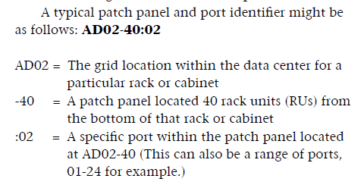
TIA-606-B Labeling
The new method in 606-B looks like this

Slide 135

TIA-606-B Cable Labeling

Slide 136
TIA-606-B Color Coding
The recommended, but not required, colors are
  Orange
    Demarc Point
  Green
    Network connections on the customer side of the demarc point
  Purple
    Termination of cables originating from common equipment

Slide 137
TIA-606-B Color Coding
  White
    First level backbone media
    MDF to IDF or Equipment Room
  Gray
    Second level backbone media
    IDF to Equipment Room
  Blue
    End user connection points
  Brown
    Inter-building backbone media

Slide 138
TIA-606-B Color Coding
  Yellow
    Auxiliary circuits, such as alarms
  Red
    Termination of key telephone systems
It is estimated that only about 50 percent of the installations have labeling and color coding that conforms to the standard
Confusion, slough, and unawareness are likely the reasons for this

Slide 139
TIA-607-B
This prescribes practices for installing grounding systems to ensure a reliable ground reference level for all telecommunications equipment subsequently installed

Slide 140
NECA/BICSI-607-2011
This standard also deals with grounding and bonding

Slide 141
TIA-1005
This standard is specific to cable installed in industrial settings

Slide 142
TIA-1179
This standard from August 2010 addresses cabling in healthcare facilities
The main differences from the more generic standards are
  Call for two diverse pathways from the entrance facility to the equipment room
  Larger equipment and telecommunications rooms

Slide 143
TIA-1179
  Enclosed pathways to help with infection control
  Detailed work area cabling suggestions
  Suggested cabling categories and types

Slide 144
TIA-942
On how to setup data centers

Slide 145
BICSI-002
Also on how to setup data centers

Slide 146
TIA-758
On customer owned outside plant cabling

Slide 147
NEC
There are other standards that must be considered when installing cabling systems
The main one of these is
  The NEC - U.S National Electric Code Chapter 8
    Article 800 – Communications Circuits
    Article 770 – Optical Fiber Cable and Raceways
    The other chapters of the NEC do not apply unless they are referenced in Chapter 8

Slide 148
NEC
The NEC is published by the National Fire Protection Association
It is revised on a three year schedule
The latest version is the 2011 one with 2014 being the next update
It is expected to appear in late 2013

Slide 149
NEC
This defines five levels of cable for use with LAN cabling and telecommunications
  Plenum Use
  Riser
  General Purpose
  Residential Use
  Under-carpet cable

Slide 150
NEC
The NEC in Articles 770.2, 800.2, and 830.2 also discuss the requirement to remove old cable
Here are some tables from an article in Cabling Installation and Maintenance magazine December 2011 that show where the different types of cables may be used

Slide 151

NEC

Slide 152
NEC

Slide 153
NEC
Here is a table from the January 2012 issue of Cabling Installation and Maintenance that shows what cable types are covered by what part of the NEC

Slide 154

NEC

Slide 155
NEC
The NEC also has a section on computer rooms and data centers that is specific to those spaces
It is Article 645
Here is a summary table that shows what it covers from the February 2012 issue of Cabling and Installation magazine

Slide 156

NEC

Slide 157
Local Codes
In addition, pay attention to any local codes
Usually these local codes will refer back to the NEC

Slide 158
Other Standards
BICSI is the organization that certifies cable system designers and installers
They use all of these standards just discussed as well as some of their own
These are in their manuals, which may be purchased at www.bicsi.org

Slide 159
Standards from Other Places
Other countries have their own standards that may or may not be the same as the ones discussed here that apply to the United States

Slide 160
Standards from Other Places
For example consult these sources for other standards
  Canadian Standards Association
  European Committee for Eletrotechnical Standardization
  Japanese Industrial Standards Committee

Slide 161

Standards from Other Places

Slide 162
The Standards
For a very comprehensive look at a listing of these various standards download the sample RFQ document that was provided by the BICSI on their web site

Slide 163
So What
So what happens if I do not use these standards
Well, in a lightly loaded network not much
It will probably chug along just fine
In a heavily used network the network will become slower and slower due to errors and retransmissions

Slide 164
So What
The TIA standards do not have the force of law
However, the NEC and its reliance on the UL listing for these cables does have the force of law
There are civil, limited criminal, and tort based remedies you my be subjected to for failure to adhere to these standards and codes

Slide 165
So What
Cabling Installation and Maintenance magazine presented a webinar on this in February 2012
As one of the presenters stated

Slide 166

So What

Slide 167
So What
Another presenter pointed out the increasing number of cables imported to the US that neither meet the performance requirements specified by the TIA nor the safety standards required by the NEC and by reference the Underwriters Laboratory
Here is what they had to say on this

Slide 168

So What

Slide 169

So What

Slide 170
So What
Here is an example of the type of safety related problem being found
The cable tested was said to meet the UL standards for flame and smoke production
But as these photographs show it did not

Slide 171

So What

Slide 172
So What
The so what is if you install that cabling and the building burns you could be subject to civil and criminal penalties in addition to being liable for damages
Performance problems are seen when the cable is not constructed as called for
For example, this photograph shows cable that is made of aluminum wire with only a thin coating of copper over it

Slide 173

So What

Slide 174
So What
How do you know you are using the proper cable
For the performance requirements about all you can do is to use cabling produced by a well known manufacturer
Also be wary of a price that is too good to be true
For safety requirements the UL labeling is what to check for

Slide 175
So What
Unfortunately this involves more than just looking for UL somewhere as counterfeiting is becoming harder and harder to uncover even with cabling
The UL suggests these steps to be sure it is UL listed

Slide 176

So What

Slide 177

So What

Slide 178
So What
New box labels are now required that include holographic images that can be verified with a credit card sized authenticator available from the UL

Slide 179

So What

Slide 180

So What

Slide 181

So What

Slide 182

So What

Slide 183

So What

Slide 184

So What

Slide 185
So What
So be sure you get what you expect

