Slide 1
How to Use a Fluke DTX Cable Tester Last Update 2013.08.04 2.1.0

Slide 2
Objectives
Learn how to use a Fluke DTX cable tester

Slide 3
What is a Fluke DTX Test Unit
The Fluke DTX test unit is used to ensure copper and fiber optic cable and connections have been installed to the category or test level required for an installation

Slide 4
Uses
This tester can be used to test
Copper Cable
UTP
Coaxial
Fiber Optic Cable
Singlemode
Multimode

Slide 5
Tests That Can Be Done
A cable test regardless of the type of cable requires a test device on each end
For copper cable using this unit that is
DTX CableAnalyzer
DTX SmartRemote

Slide 6
Tests That Can Be Done
For fiber optic cable using this unit that is
DTX CableAnalyzer with the Fiber Module attached
DTX SmartRemote with the Fiber Module attached
or
DTX CableAnalyzer with the Fiber Module attached
SimpliFiber light source

Slide 7
DTX CableAnalyzer
Here is what the CableAnalyzer looks like

Slide 8
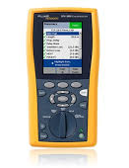
DTX CableAnalyzer

Slide 9
Test Unit Setup
Regardless of the cable being tested the device must first be configured
This involves
Telling the units what type of cable they will be testing
Setting the reference level
The procedure for both copper and fiber optic cable will be discussed, beginning with copper UTP cable

Slide 10
Setup for Copper Testing
Connect the two units to each other as shown here

Slide 11
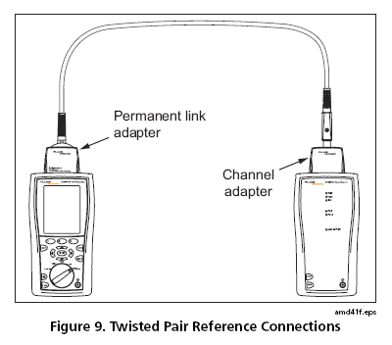
Setup for Copper Testing

Slide 12
Setup for Copper Testing
To setup the CableAnalyzer to test UTP cable to a category’s requirements do the following
Turn the unit’s selector to
Setup
On the screen select
Twisted Pair
Test Limit
Whatever test limit you are testing

Slide 13
Setup for Copper Testing
Cable Type
UTP
Whatever cable type you are testing
Outlet Configuration
Whatever outlet configuration you are testing

Slide 14
Set the Reference Level
Before testing copper cable the reference level should be set between the two CableAnalyzer and the SmartRemote
This sets a zero point to test from
First connect the two units to each other as shown below
Turn on both units
Turn the rotary switch to Special Functions

Slide 15
Set the Reference Level
Select Set Reference
Press Enter
Press Test

Slide 16
Running the Test
Attach adapters appropriate for the job to the tester and the smart remote
Turn the rotary switch to AutoTest and turn on the smart remote
Connect to the installed cabling, as shown below depending on whether this is a permanent link or a channel

Slide 17
Running the Test
Press Test
To stop the test at any time, press Exit
The tester shows the AutoTest Summary screen when the test is complete
To view results for a specific parameter, use the Up and Down Arrow buttons to highlight the parameter, and then press Enter

Slide 18
Running the Test
If the AutoTest failed, press F1 Fault Info for possible causes of the failure

Slide 19
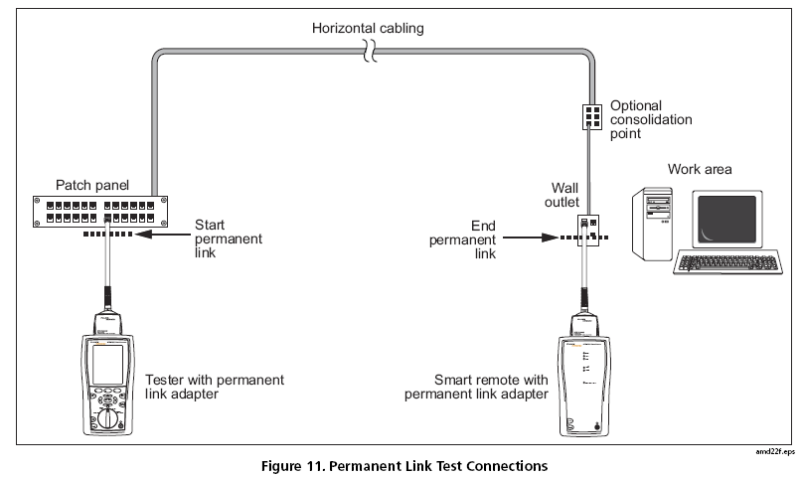
Permanent Link

Slide 20
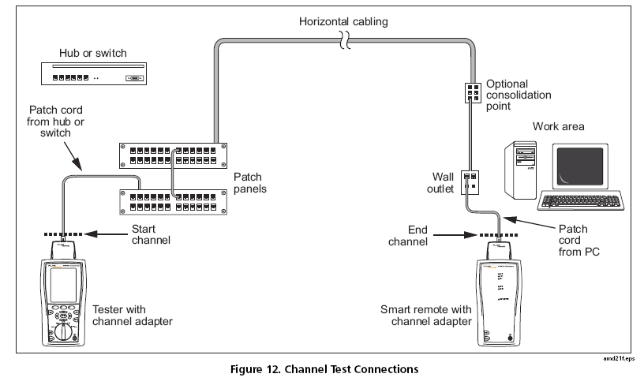
Channel

Slide 21
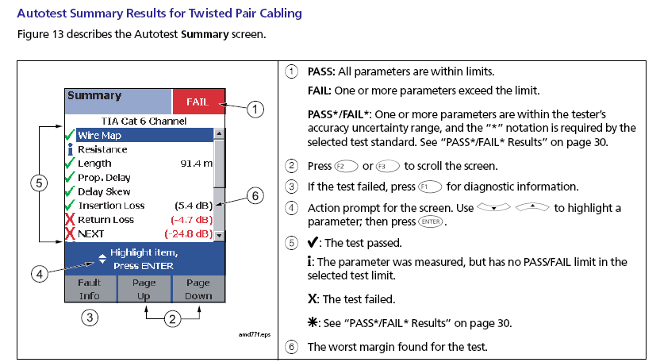
UTP Test Results

Slide 22
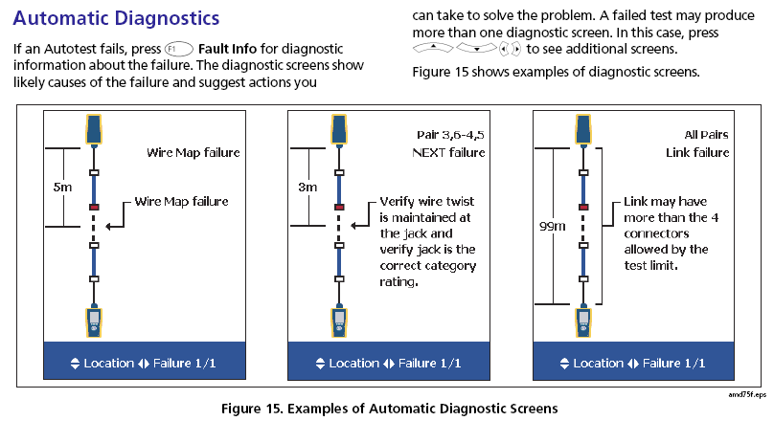
Failed UTP Test Results

Slide 23
Testing Fiber Optic Cable
To test fiber optic cable a module is added to the CableAnalyzer and the SmartRemote
These two units when used together constitute an OLTS – Optical Loss Test Set
or
The unit at the remote end can be a SimpliFiber light source

Slide 24
Fiber Module
The fiber module is used to allow the DTX to test fiber optic cable
This is attached to the back of the main and remote units

Slide 25
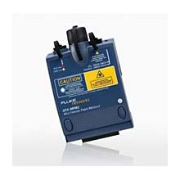
Fiber Module

Slide 26
SimpliFiber
In place of the fiber optic cable module attached to the SmartRemote of the DTX system a SimpliFiber end unit can be used
It looks like this

Slide 27
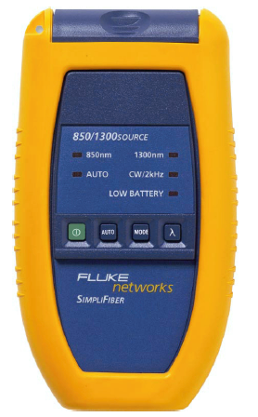
SimpliFiber

Slide 28
Fiber Testing
The fiber test example presented here is the test used for multimode cable as it is commonly used as a backbone cable inside of a building
This is a simple insertion loss test
The purpose of this test is to determine if any damage occurred during installation or termination

Slide 29
Fiber Testing
For example, the cable itself may have micro or macro bends that will cause excessive loss
A connector may not have been properly installed
The cable end faces may be too dirty

Slide 30
Steps in Fiber Testing
To perform a fiber optic multimode cable test
Compute the allowable loss
Setup the display unit
Setup the remote light source unit
Clean the connections
Set the reference level
Perform the test

Slide 31
Compute the Allowable Loss
In most cases the expected loss must be calculated based on the number of connectors, splices, and length of the installed cable, then compared to the actual loss for a pass or fail of the link
The DTX CableAnalyzer will do this for you

Slide 32
Compute the Allowable Loss
Even though it is calculated for us with these units let’s compute the expected loss just to see how it is done

Slide 33
Compute the Allowable Loss
In this example, which is typical for a multimode fiber backbone cable we have
Length of cable
150 feet
At 0.001067 dB of loss per foot
Connectors
One at each end using no polish connectors
At 0.75 dB of loss per no polish connector

Slide 34
Compute Allowable Loss
For this example of 150 feet of cable with a connector at each end
(0.001067 X 150) + 0.75 + 0.75
1.66 dB of loss in a perfect installation
Of course this number will vary depending on the characteristics of the actual installation in the field
These values for connector loss are also way to high

Slide 35
Compute Allowable Loss
As most connectors these days have a typical loss of .1 dB and a maximum loss of .5 dB this allowable loss is going to be way high
Still .75 is considered to be the standard loss number used for these types of calculations
It provides an extra margin as well

Slide 36
Compute Allowable Loss
If you wish to take the belt and suspenders approach you may add the commonly used fudge factor of 3 dB to the computed number to be sure the connection will still work as things deteriorate over time from slight damage and dirty connections
This would make the number to enter 4.66 in this example

Slide 37
Compute Allowable Loss
Shown next are tables where the basic numbers are computed for common distances in feet for the two multimode test wavelengths
In our case the cable length is 150 feet
The value in the table for 100 feet is 1.6067
The value for 200 feet is 1.7134

Slide 38
Compute Allowable Loss
So the table value for 150 feet is 1.66

Slide 39
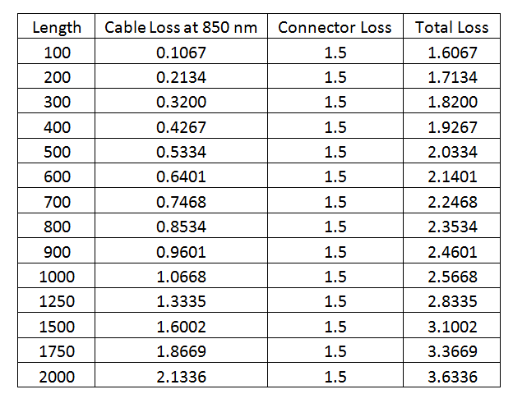
Compute Allowable Loss

Slide 40
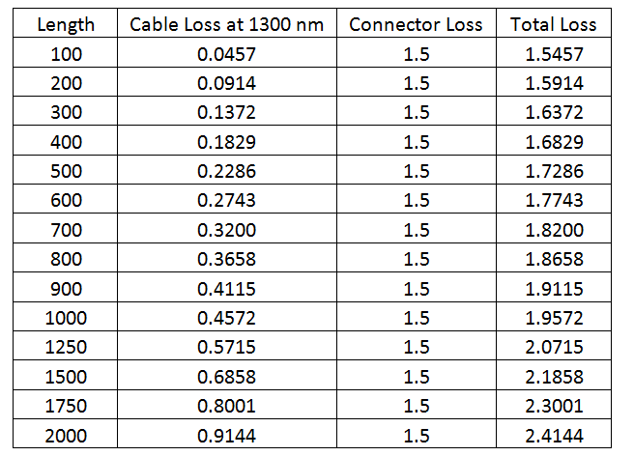
Compute Allowable Loss

Slide 41
Setting the Fiber Test Settings
The next step is to setup the test units to do the type of test we want to do

Slide 42
Setting the Fiber Test Settings
Turn on both units
On the CableAnalyzer turn the unit’s selector to
Setup

Slide 43
Setting the Fiber Test Settings
On the screen select
Fiber Loss
Test Limit
Select or setup the test limit for the link to be tested
Fiber Type
Select the type of fiber being tested
Multimode 62.5 in this example

Slide 44
Setting the Fiber Test Settings
Remote End Setup
Smart Remote for the DTX SmartRemote
or
Far End Source for the SimpliFiber unit
Bi-Directional
No

Slide 45
Cleaning Fiber Before Testing
Fiber connectors need to be clean before testing
To clean use 98% pure isopropyl alcohol or fiber cleaning fluid and optical grade wipes and swabs

Slide 46
Cleaning Fiber Before Testing
To clean a connector in a patch panel
Place a drop of cleaning solution on a fiber wipe
Firmly touch the tip of a fiber optic cable cleaning swab to the damp spot to transfer the cleaning solution to the swab
Insert the swab firmly against the end face inside the connector
Pushing against the connector end face twist the swab round about 3 times

Slide 47
Cleaning Fiber Before Testing
Repeat this with a dry swab to remove any excess cleaning fluid

Slide 48
Cleaning Fiber Before Testing
To clean a connector on a cable
Place a drop of cleaning solution on a fiber wipe
Wipe the tip of the connector to the damp spot
Wipe the tip with a dry fiber wipe to remove any excess cleaning fluid

Slide 49
Set the Reference Level
An accurate reference level must be set before any measurements are made in order for the CableAnalyzer to determine if the link passes or fails
It determines this by using the setup information to extract and use stored values for the characteristics selected during setup
Let’s set the reference level

Slide 50
Set the Reference Level
Turn off both the DTX CableAnalyzer units
Setting the reference level requires two equal length patch cables with a connector at each end
One should be marked as cable 1 and the other as cable 2

Slide 51
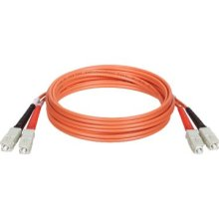
Set the Reference Level

Slide 52
Set the Reference Level
Connect the black connector on either end of the patch cord labeled 1 to the input port on the CableAnalyzer
Leave the red end of this end of the cable loose

Slide 53
Set the Reference Level
Connect the red connector at the other end of the patch cable labeled 1 to the output port of the remote unit
Leave the black connector of this end of the connector loose

Slide 54
Set the Reference Level
Connect the red connector on either end of the patch cord labeled 2 to the output port on the CableAnalyzer
Leave the black end of this end of the cable loose

Slide 55
Set the Reference Level
Connect the black connector at the other end of the patch cable labeled 2 to the input port of the remote unit
Leave the red connector of this end of the connector loose

Slide 56
Set the Reference Level
If this is all done correctly the units will chirp

Slide 57
Set the Reference Level
On the CableAnalyzer turn the unit’s selector to
Special Functions
On the screen select
Set Reference
The Set Reference screen is displayed

Slide 58
Set the Reference Level
This screen shows a reference diagram
Verify that the diagram matches your setup
Press Test
After the test
Press F2

Slide 59
Set the Reference Level
Once the reference is set do not unplug the cable from either output port
Otherwise the reference will need to be reset

Slide 60
Test the Link
Remove the inputs on each end
For cable 2 which is attached to the CableAnalyzer hook the black connector of the end of the cable where the red connector is already attached to the unit to the input port

Slide 61
Test the Link
For cable 1 which is attached to the remote unit hook the black connector of the end of the cable where the red connector is already attached to the unit to the input port

Slide 62
Test the Link
Connect cable 1 to cable 2 by using a dual sided connector to attach the remaining connectors this way
Cable 1 red to one end of the cable to be tested red connector
Cable 1 black to one end of the cable to be tested black connector

Slide 63
Test the Link
For cable 2 which is attached to the CableAnalyzer hook the black connector of the end of the cable where the red connector is already attached to the unit to the input port

Slide 64
Test the Link
Connect cable 1 to cable 2 by using a dual sided connector to attach the remaining connectors this way
Cable 2 red to one end of the cable to be tested black connector
Cable 2 black to one end of the cable to be tested red connector

Slide 65
Test the Link
The unit should chirp

Slide 66
Using Mandrels
There is a lot of back and forth about the need to use mandrels when testing fiber optic cable
As the cost of these is so small and the attachment of them to the patch cables is so easy, I fail to see why so much discussion revolves around this topic
Here is some of that discussion

Slide 67
Using Mandrels
The reason the instructions call for this is if an LED light source is used at the far end of the link, then a mandrel should be used
The mandrel acts as a mode filter to remove the unwanted high order modes from the light source
This occurs as the less accurate LED overfills the fiber

Slide 68
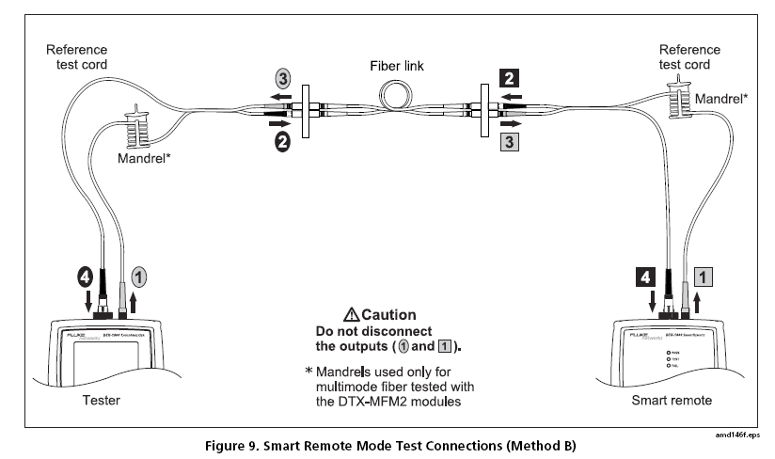
Using Mandrels

Slide 69
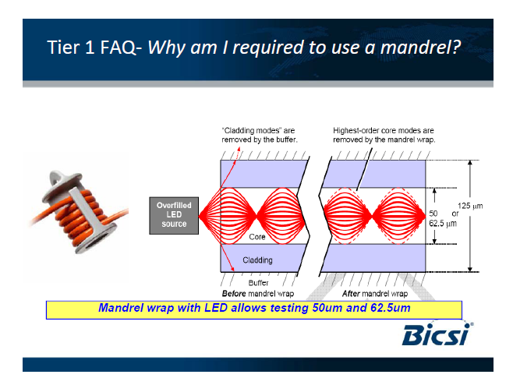
Using Mandrels

Slide 70
Using Mandrels
Mandrel wrapping is a technique used to create a defined mode power distribution
If the launch optical fiber is fully filled ahead of the mandrel wrap, the higher order modes will be stripped off, leaving only the lower order modes
This is required for the meter attached to the other end to properly measure the light received

Slide 71
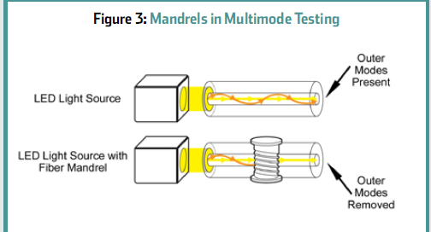
Using Mandrels

Slide 72
Wrapping Mandrels
A patch cord is wrapped around the mandrel as show next

Slide 73
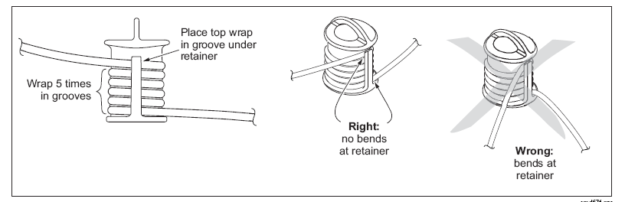
Wrapping Mandrels

Slide 74
Using Mandrels
Many argue against using these as they say in practice the large limits that are acceptable for these tests are sufficient that a mandrel need not be used
An article in a 2009 issue of BICSI News explained this very clearly
It says

Slide 75
Using Mandrels
The use of a mandrel, a smooth rod, is one additional practice specified by TIA standards to achieve the most accurate loss measurements during calibration and testing
A multimode launch cord is wrapped five times - nonoverlapping around the mandrel before calibration

Slide 76
Using Mandrels
Consistency can be improved by taping the cord around the mandrel and then taping the entire assembly to the source to reduce undesirable movement of the launch cord in relation to the source
The diameter of the mandrel is determined by the launch cord core size and construction, as shown in Table 3

Slide 77
Using Mandrels
The purpose of the mandrel in multimode testing is to remove the modes, or pathways, of light near the outer edge of the core, as shown in Figure 3
Without a mandrel, these outer modes of light will make it through the short launch cord to the meter during calibration and ultimately be included in the reference measurement

Slide 78
Using Mandrels
When the link test is performed, the normal bends and connections of an installed link will cause these outer modes to be lost, and using a mandrel gives a more realistic measurement by removing these outer modes before calibration
Most technicians do not use mandrels—in fact, many have never seen one

Slide 79
Using Mandrels
However, acceptable test results are typically still achieved since the acceptance values specified in the standards are relatively lax as noted previously
If unexpected high loss is encountered in an installed link, using a mandrel may resolve that high loss

Slide 80
Warm Up
Let the test and remote unit warm up for five minutes before testing a link

Slide 81
Measure the Loss
To measure the loss
Turn the selector to Auto Test
Press Test
Read the result
The unit will report a pass or a fail

Slide 82
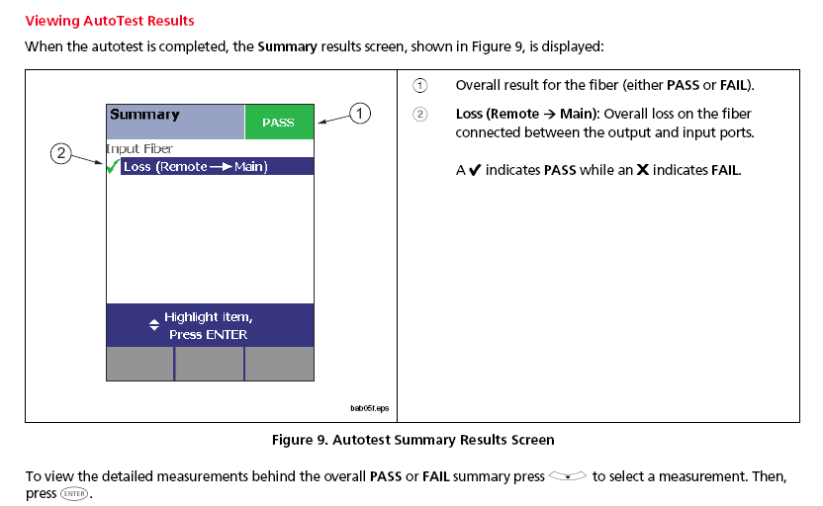
Viewing Test Results

Slide 83
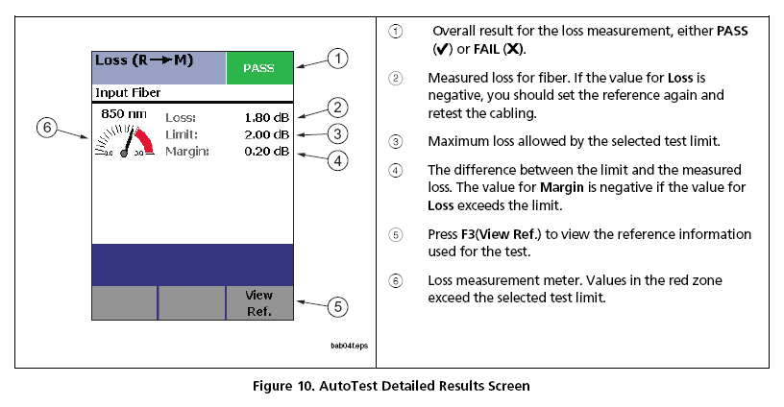
Viewing Test Results

Slide 84
Visual Fault Locator
The CableAnalyzer includes a visual fault locator
This function is used to check fiber continuity, as well as to find faults
To use this function
Connect the fiber to the VFL port
Press the VFL button next to the connector
Look for a red light from the fiber

Slide 85
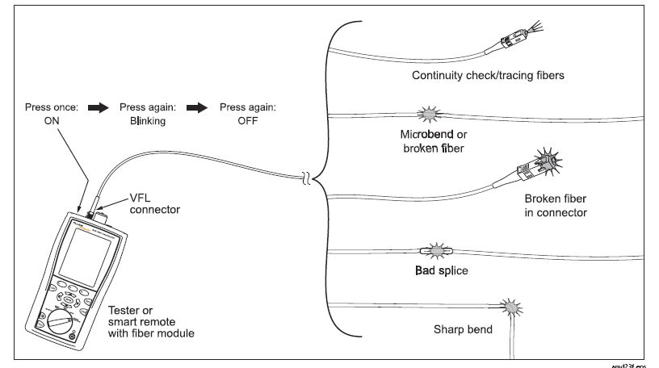
Visual Fault Locator

