Slide 1
Fiber Optic Cable Installation Indoors
Last Update 2012.02.15
1.3.0

Slide 2
Objectives
Learn how to install fiber optic media indoors

Slide 3
Installation Indoors
Fiber optic cable is run for the most part just like any other data cable
As discussed in the structured cabling presentation the same precautions concerning bend radius, exerting force by pulling, and so on must be observed
Single-mode cable is very bend sensitive
The only difference is in the conduit used to protect this type of cable

Slide 4
Bending
Bending the cable can produce micro or macro bends
Either of these will cause loss or complete blockage of the signal

Slide 5
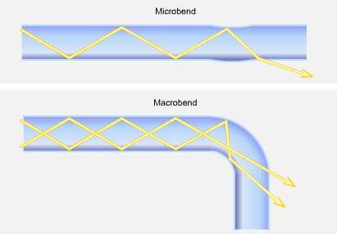
Bending

Slide 6
Bending
As Kam Patel said in an article from BICSI News in November 2008
The microbend is a small, microscopic bend that may be caused by the cabling process itself, mechanical stress due to water in the cable during repeated freeze and thaw cycles, packaging or installation
External forces are also a source of microbends

Slide 7
Bending
An external force deforms the cabled jacket surrounding the fiber but causes only a small bend in the fiber
A microbend typically changes the path that propagating modes take, resulting in loss from increased attenuation as low-order modes become coupled with high-order modes that are naturally lossy

Slide 8
Bending
A macrobend is a larger cable bend that can be seen with the unaided eye and is often reversible
As the macrobend occurs, the radius can become too small and allow light to escape the core and enter the cladding
The result is insertion loss at best, and in worst cases, the signal is decreased or completely lost

Slide 9
Bending
Cable is installed inside of an innerduct to both protect from crushing as well as prevent an excess bend radius
Besides innerduct armored cable can be used for this same purpose

Slide 10
Installation Precautions
In addition to these common guidelines for fiber optic cable installation Eric Pearson in the February issue of Cabling Installation and Maintenance magazine adds these suggestions on the selection and installation of fiber optic cable

Slide 11
Installation Precautions
Pearson adds these precautions
Avoid moisture
Avoid heat sources
In both cases this will cause increased attenuation
This may be why the light loss seen in a test is higher than expected
If moisture cannot be avoided then cable designed for it must be used

Slide 12
Installation Precautions
When installing fiber optic cable in risers measures should be take to prevent the fibers sliding down inside the cable cover
This can be support or more likely service loops
In his view a 10 to 12 foot service loop should also be added to each end of a horizontal cable run

Slide 13
Installation Indoors
This is seen in the pictures shown next, which show multi-mode fiber optic cable being used to connect floors together in a building as in a backbone arrangement

Slide 14
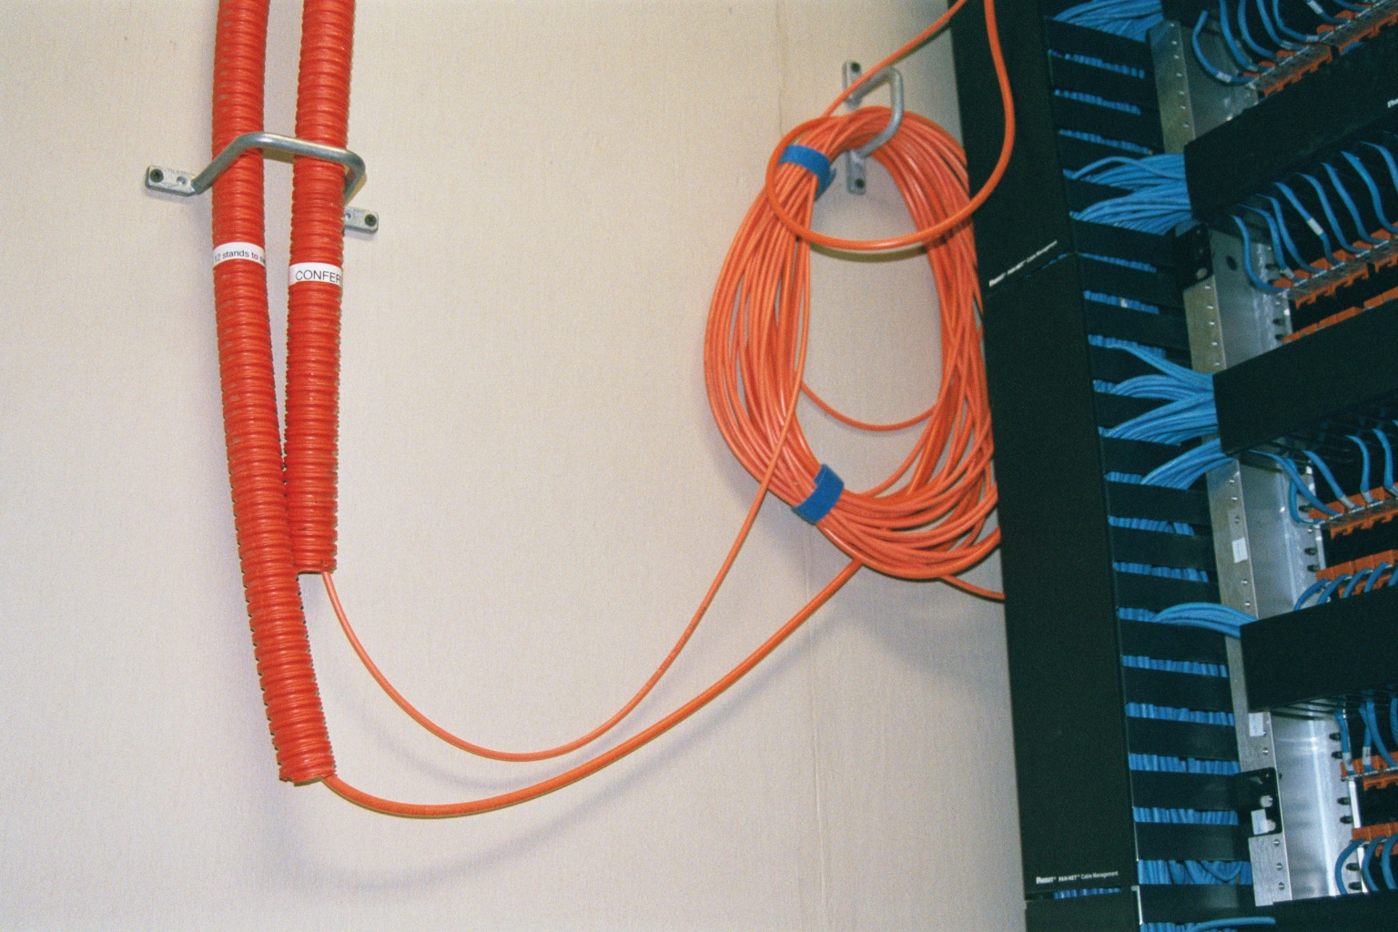
Installation Indoors

Slide 15
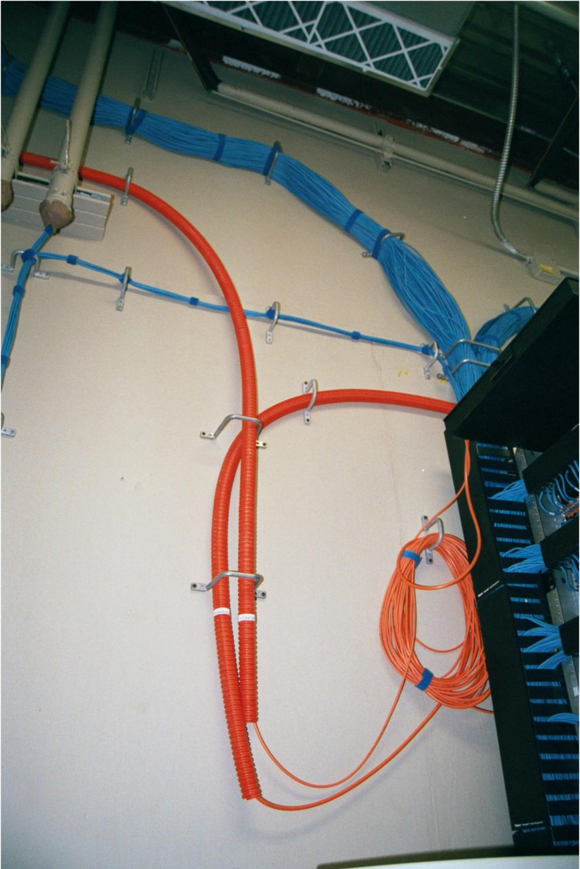
Installation Indoors

Slide 16
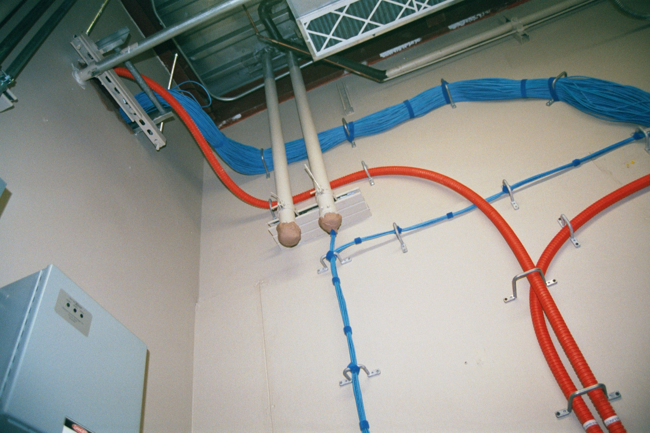
Installation Indoors

Slide 17
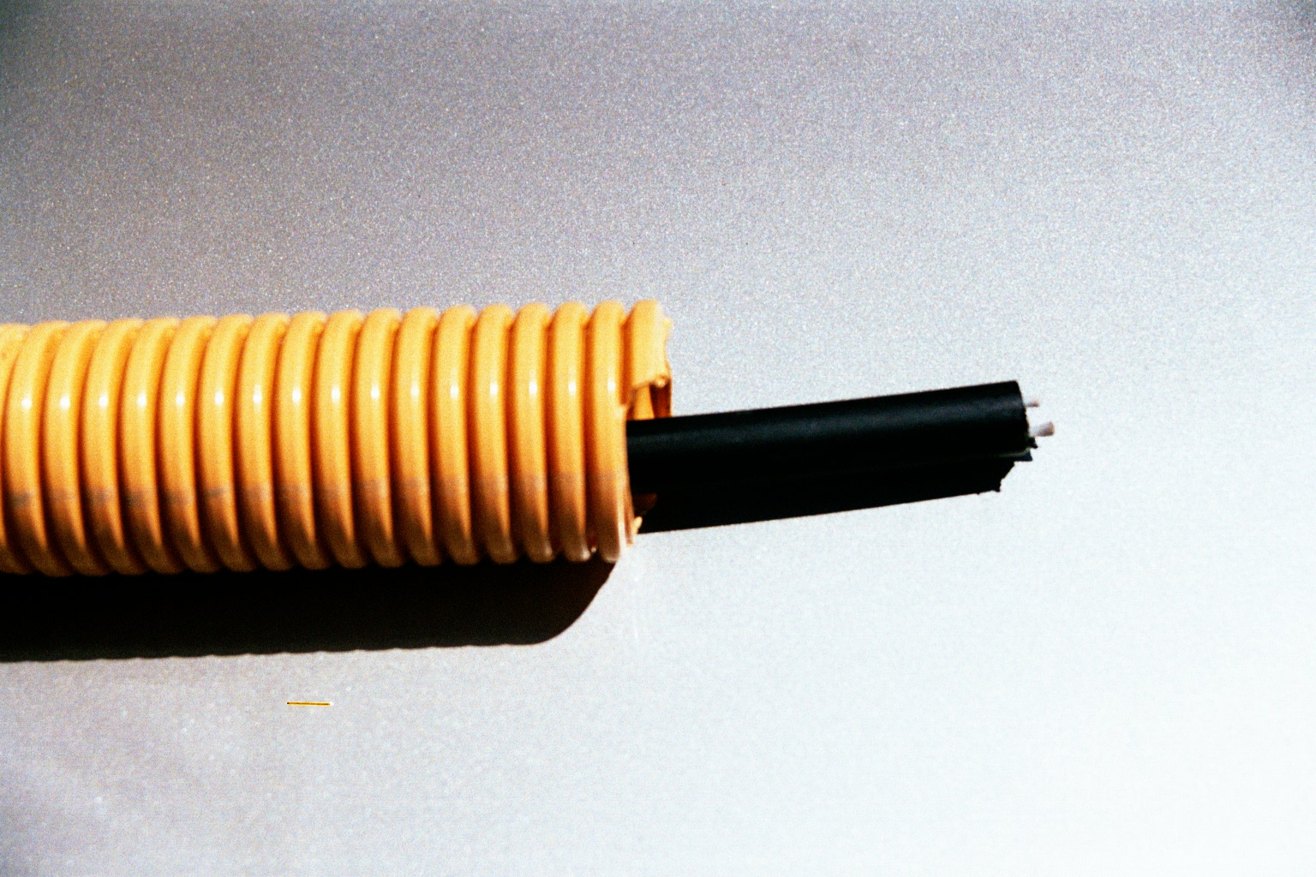
Installation Indoors

Slide 18
Installation Indoors
All of this is multi-mode fiber as is seen by the orange color of the fiber optic cable itself in the first picture above, not necessarily in the color of the protective conduit
This cable is terminated in a fiber patch panel
The connectors are the ones at the top being covered by yellow caps

Slide 19
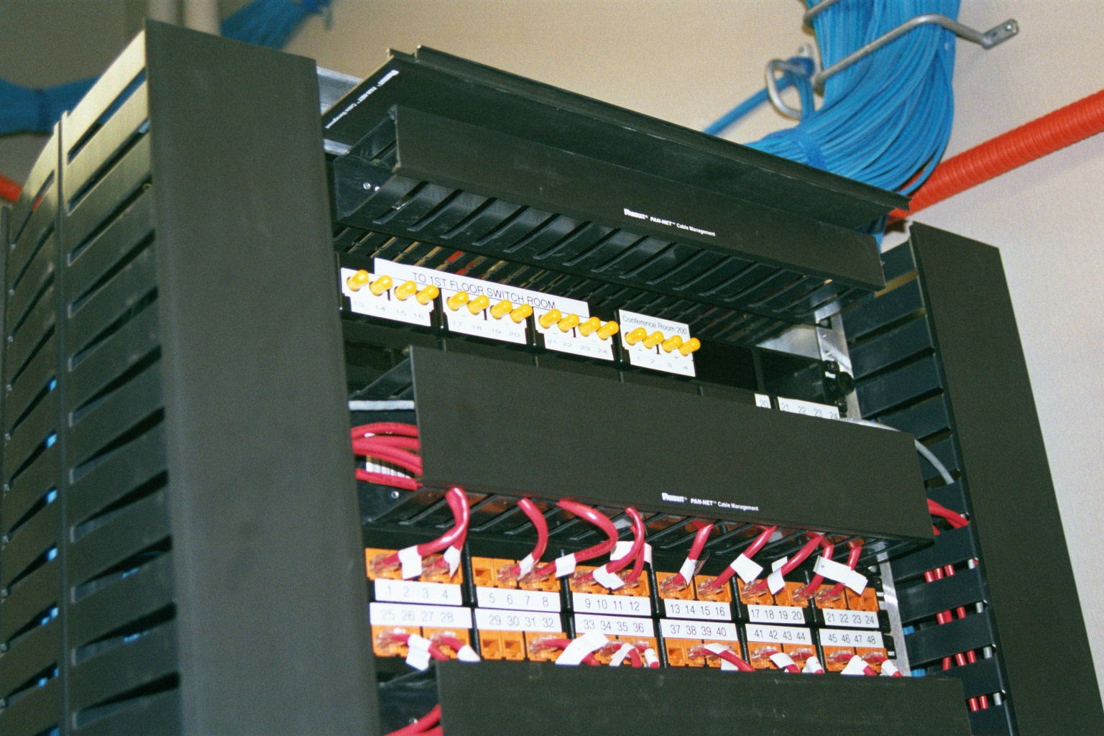
Installation Indoors

Slide 20
For More Information
Cabling: The Complete Guide to Network Wiring
David Groth and Jim McBee
ISBN 0782126456
The Cabling Handbook - 2nd Edition
John R. Vacca
ISBN 0130883174

Slide 21
For More Information
Fiber Optic Technicians Handbook
Jim Hayes
ISBN 076681825X
Understanding Optical Communications
Harry Dutton
ISBN 0130201413
Understanding Fiber Optics
Jeff Hecht
ISBN 0139561455

