Slide 1
Fiber Optic Media Last Update 2014.08.09 1.18.0

Slide 2
Objectives
Learn about the different types of fiber optic media

Slide 3
Sending Data
Data can be sent over the media by
Varying - modulating - an electrical signal as it passes over a copper wire
Varying - modulating - the power of light as it is sent over a glass optical fiber
Varying – modulating - the radio waves sent through space, which is commonly referred to as a wireless communications system

Slide 4
What is Fiber Optic Cable
Fiber optics is a medium for carrying information from point to point using light as the transmission media
This is different from the more common copper cables that use electrical energy to carry the information

Slide 5
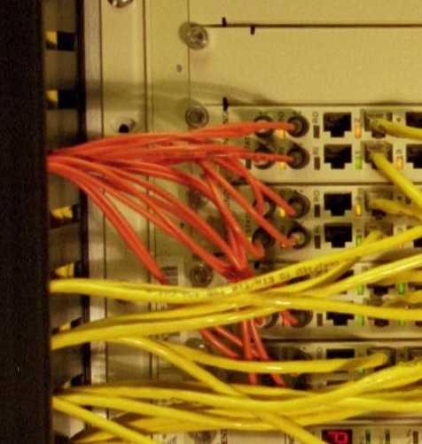
Fiber Optic Interface

Slide 6
Reasons to Use
There are four main reasons to use fiber instead of copper cables
The long distances a fiber cable can run without loss of signal
Resistance to interference
Better security
The carrying capacity of the fiber cable compared to a copper cable

Slide 7
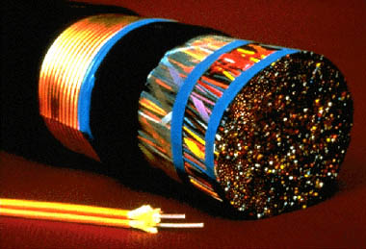
Fiber Compared to Copper

Slide 8
Construction
Optical fiber for telecommunications consists of three components
They are the core, the cladding, and the coating

Slide 9
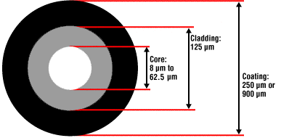
Construction

Slide 10
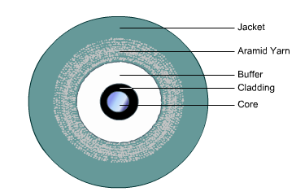
Construction

Slide 11
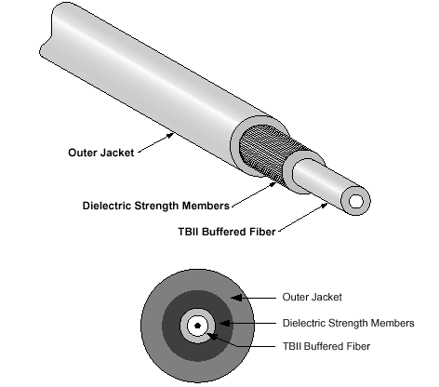
Construction

Slide 12
Construction
The core is the central region of an optical fiber through which light is transmitted
Glass is the common media for the core

Slide 13
Construction
The cladding is manufactured together with the core as a single piece of silica glass with slightly different compositions, and they cannot be easily separated from one another
The glass does not have a hole in the core, but is completely solid throughout

Slide 14
Construction
The lower refractive index of the cladding acts like a mirror reflecting the signal back into the core as it travels
The third section of an optical fiber is the outer protective coating called the buffer
This coating is typically made of plastic
It provides physical and environmental protection for the fiber

Slide 15
Construction
The outer components of fiber optic cable differ depending on the purpose and application of the cable
Fiber optic cable that is used in telecommunications is typically made of glass
Plastic is used in some very limited cases
This plastic or POF – Polymer Optical Fiber is limited in bandwidth and distance

Slide 16
Construction
Specifically around 100 Mbps and up to 50 meters
The core size of plastic fiber is also quite a bit larger at 490, 200, and 120 nm
Generally speaking fiber requires two cables, one to transmit and one to receive
These may be bonded side by side or inside another covering cable

Slide 17
Lab
Pass around samples of different types of fiber optic cable

Slide 18
Types of Fiber Optic Cable
In terms of the intended use of the cable there are two different types of fiber optic cable
Tight Buffer
For indoor use
Loose Tube
For outdoor use

Slide 19
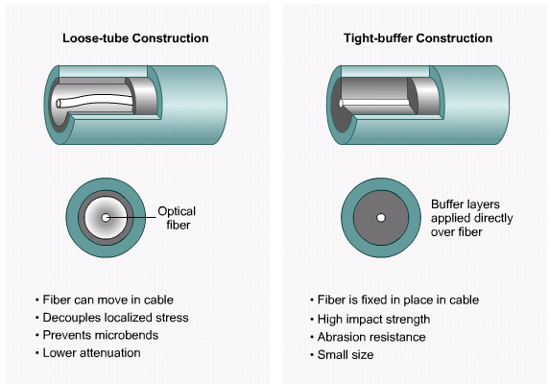
Types of Fiber Optic Cable

Slide 20
Tight Buffer Fiber Construction
As stated the construction of the outer covering of the cable depends on how it will be used
Tight buffer construction is used for indoor applications

Slide 21
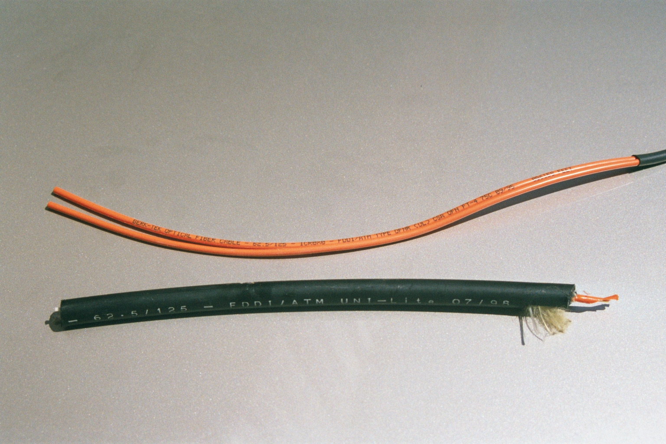
Tight Buffer Fiber

Slide 22
Loose Tube Fiber Construction
Loose tube design is used for most outdoor cables
In loose tube cable the fiber, with its covering, is contained inside of a gel, that is held inside of another cover
The gel combats the harmful effects of temperature, humidity, and mechanical loads

Slide 23
Loose Tube Fiber Construction
Moisture will ruin the ability of the core to transmit a signal
Additional strength is provided by Kevlar yarn, armor sheaths, or steel messengers

Slide 24
Loose Tube Fiber

Slide 25
Loose Tube Fiber Construction
Some loose tube cables use a dry packing instead of a gel
In the dry packing type the packing is designed to fill in any nicks in the outer coating
The following photograph shows the gel type
The shiny substance on the inside of the orange cover is the gel

Slide 26
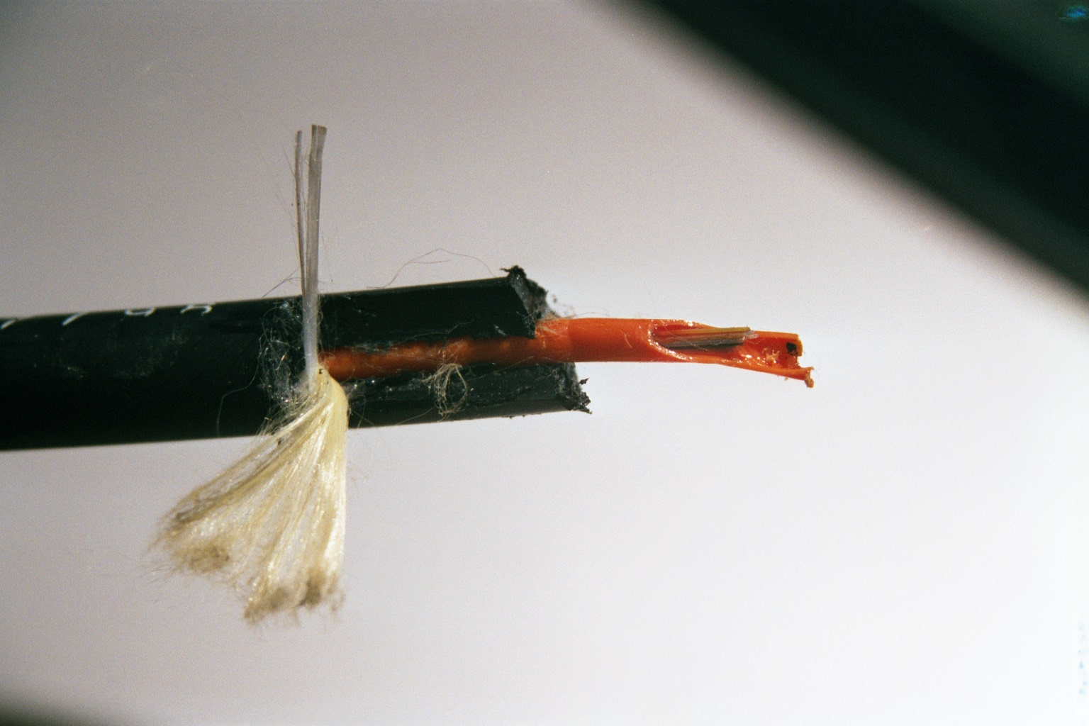
Loose Tube Fiber
Gap between fiber and covering where gel goes

Slide 27
Loose Tube Fiber Construction
The loose tube design also allows for stability in the cable when the temperature fluctuates
The buffer allows room for expansion and contraction

Slide 28
Operation
The basic method of operation of a fiber optic system starts with a device on the network that takes the electrical energy that travels the normal computer network and translates it into light pulses
A transmitting device then places these signals onto a fiber cable by flashing the light source on and off in the pattern for the signal

Slide 29
Operation
The cable carries the signal to the other end
At the far end a receiver accepts the light pulses
They are then converted back to an electrical signal for use in the computer

Slide 30
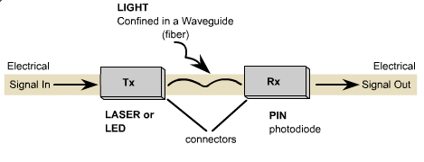
Optical Media

Slide 31
Operation
Optical fiber transmission utilizes wavelengths from above the visible light spectrum
The ITU – International Telecommunications Union has divided the mode wavelengths into bands as shown on the second chart

Slide 32
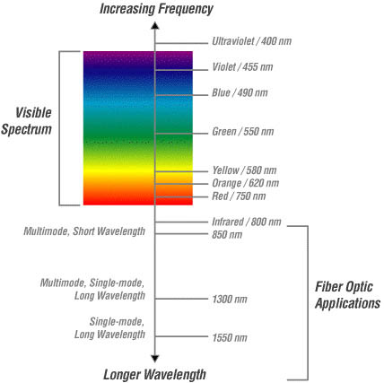
Wavelength Chart
Cisco

Slide 33
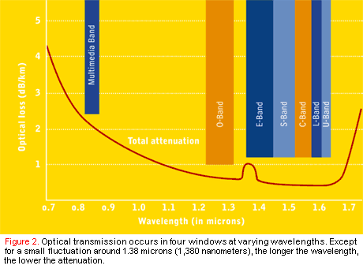
Wavelength Chart
Network Magazine
July 2001

Slide 34
Wavelengths
As defined by the ITU the bands cover
No label – 820 nm to 900 nm – for multimode cable
O - 1260 nm to 1310 nm – for singlemode cable
E – 1360 nm to 1460 nm – for singlemode cable
S – 1460 nm to 1530 nm – for singlemode cable
S+ - 1430 nm to 1480 nm - maybe
C – 1530 nm to 1565 nm – for singlemode cable
L – 1565 nm to 1625 nm – for singlemode cable
U – 1625 nm to 1675 nm – for singlemode cable
nm = nanometer

Slide 35
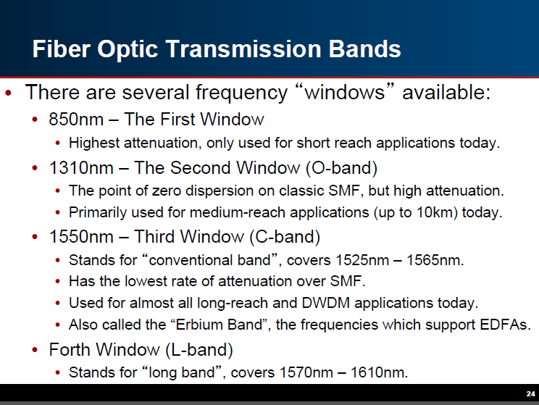
Wavelengths

Slide 36
Operation
Typical optical transmission wavelengths are 850 nm, 1300 nm, 1310 nm, and 1550 nm
Both lasers and LEDs have been used to transmit light through optical fiber
Lasers are usually used for 1310 or 1550 nanometer, single-mode applications
LEDs are used for 850 or 1300 nanometer multi-mode applications

Slide 37
VCSELs
In general at speeds at 1 Gigabit and above only lasers are used
For multimode cable VCSEL – Vertical Cavity Surface Emitting Lasers are used in place of LEDs
The reason for this is the slow signaling rate of LEDs

Slide 38
VCSELs
They have a maximum rate of 622 Mbps as this is as fast as they can be turned on and off
This move toward VCSELs has also accelerated the move toward 50 micron fiber optic cable as the VCSELs do not work well with 62.5

Slide 39
Caution
Never look into the end of a fiber which may have a laser coupled to it
Laser light is invisible and can damage the eyes
Viewing it directly does not cause pain
The iris of the eye will not close involuntarily as when viewing a bright light; consequently, serious damage to the retina of the eye is possible

Slide 40
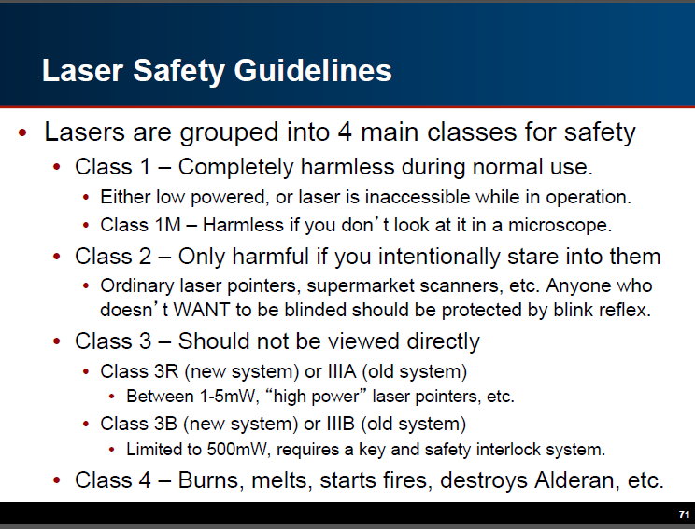
Caution

Slide 41
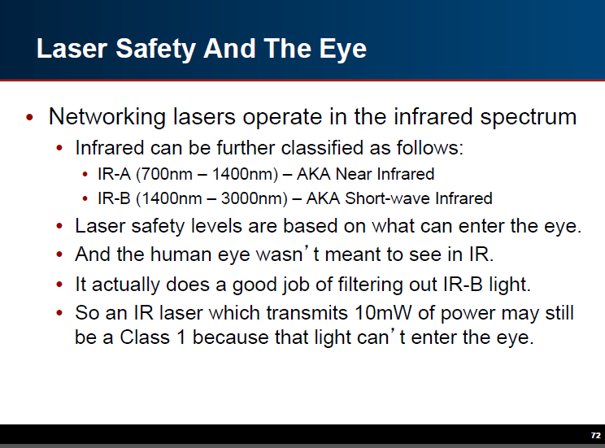
Caution

Slide 42
Caution
As the cabinets say

Slide 43
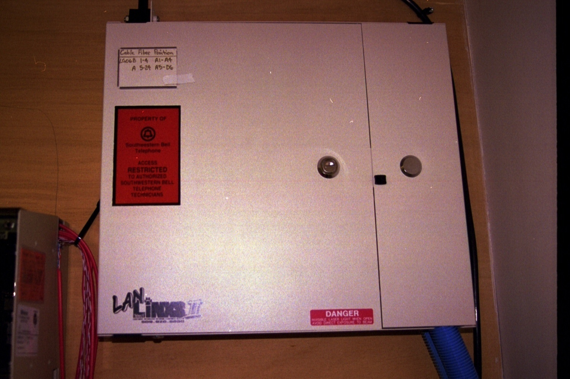
Caution

Slide 44
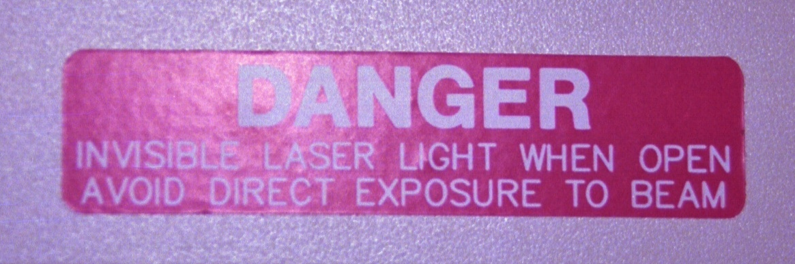
Caution

Slide 45
Operation
Once light enters a fiber optic cable, it travels in a stable state called a mode
A mode is a ray of light, not the entire light beam - just a ray of that beam, that enters the fiber at a particular angle
There can be from one to hundreds of modes depending on the type of fiber

Slide 46
Operation
Each mode carries a portion of the light from the input signal
Generally speaking, the number of modes in a fiber is a function of the relationship between core diameter, numerical aperture, and wavelength
In fiber optic cable it is desirable to have as few modes as possible

Slide 47
Operation
Opposite of how it may seem the fewer modes the better
This is because single modes are more efficient
Think of it this way

Slide 48

Beam Types
Laser
LED

Slide 49
Operation
A single mode cable is just like the device used to send the signal, a laser
The beam is sharp and focused
It can travel a long distance before the strength weakens

Slide 50
Operation
A multi-mode beam is like a cheap flashlight
The beam of light spreads out in all directions
As such, it soon plays out and things go dark just a few feet out from the end of the flashlight

Slide 51
Fiber Optic Cable Issues
A fluke white paper on troubleshooting fiber optic cable pointed out these issues that are common to all types of fiber optic cable

Slide 52
Attenuation
Attenuation in an optical fiber is caused by
Absorption
Scattering
Bending
Attenuation is the loss of optical power as light travels along the fiber
Optical input power is the power injected into the fiber from an optical source

Slide 53
Attenuation
Optical output power is the power received at the fiber end or optical detector

Slide 54
Absorption
Absorption is a major cause of signal loss in an optical fiber
Absorption is defined as the portion of attenuation resulting from the conversion of optical power into another energy form, such as heat

Slide 55
Scattering
Scattering losses are caused by the interaction of light with density fluctuations within a fiber
Density changes are produced when optical fibers are manufactured
During manufacturing, regions of higher and lower molecular density areas, relative to the average density of the fiber, are created

Slide 56
Scattering
Light traveling through the fiber interacts with the density areas as shown in the figure below
Light is then partially scattered in all directions
This is primarily Rayleigh Scattering

Slide 57
Bending
If the fiber cable were installed perfectly straight then the light that entered the cable at the suitable angles would easily reach the other end of the fiber without much degradation or loss in the cable
However there are small and large bends that affect fiber optic cable and its performance

Slide 58
Bending
As light passes through these bends a certain amount of the light gets lost the more sharp the bend in the fiber becomes
If bends are numerous or severe, enough light may be lost so that the link fails
If the fiber is bent even further then the fiber is at risk of even breaking

Slide 59
Bending
Two common types of bends in fiber are
Micro
Macro
Bending loss is classified according to the bend radius of curvature

Slide 60
Bending
Micro bends are small microscopic bends of the fiber axis that occur mainly when a fiber is cabled, and in the manufacturing process
Macro bends are bends having a large radius of curvature relative to the fiber diameter
Micro bend and macro bend losses are very important loss mechanisms

Slide 61
Bending
Fiber loss caused by micro bending can still occur even if the fiber is cabled correctly
Micro bend losses can be small discontinuities or imperfections in the fiber
Uneven coating applications and improper cabling procedures increase micro bend loss

Slide 62
Bending
External forces are also a source of micro bends
An external force deforms the cabled jacket surrounding the fiber but causes only a small bend in the fiber
Micro bends change the path that propagating modes take

Slide 63
Bending
Micro bend loss increases attenuation because low-order modes become coupled with high-order modes that naturally have more loss
Macro bend losses are observed when a fibers bend radius is larger than compared to the fiber diameter

Slide 64
Bending
Practically speaking Macro bends are generally a result of the fiber being installed where it is bent to tightly either around a corner, as it enters the splice tray, patch panel
Micro bends can be a result of simply cinching a cable tie too tightly around the fiber cable or bundle

Slide 65
Decibel to Power Table
Here is a table from Steenbergen that shows how this loss relates to dBs

Slide 66
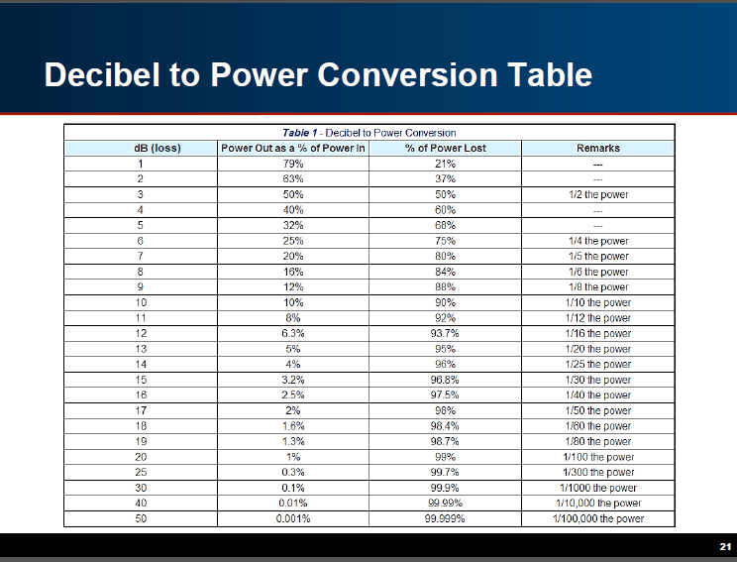
Decibel to Power Table

Slide 67
Types of Fiber Optic Cable
In terms of how they carry the light there are two types of fiber optic cable
Multi-mode
Single-mode

Slide 68
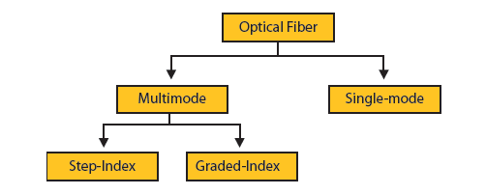
Types of Fiber Optic Cable

Slide 69
Types of Fiber Optic Cable
In general, the telecommunications industry uses core sizes from 62.5 µm - micrometer down to 8.7 micrometers
Multi-mode cable has a core diameter of 50 or 62.5 micrometers
Single mode cable has a core diameter between 8 and 10 µm

Slide 70
Types of Fiber Optic Cable
It is impossible to distinguish between multi-mode and single-mode cable by looking at it
The fibers are too small to accurately judge the size
The diameter of the cladding surrounding each of these cores is 125 µm, which is why they are labeled 62.5/125 or 8.7/125 for example

Slide 71
Types of Fiber Optic Cable
A human hair is 70 µm or .003 inches thick

Slide 72
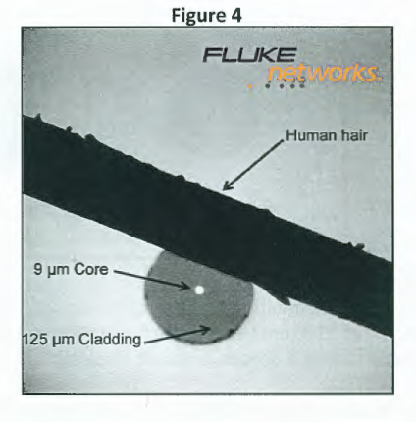
Types of Fiber Optic Cable

Slide 73
Types of Fiber Optic Cable

Slide 74
Fiber Optic Cable
Fiber optic cable began to appear in the late 1970s into the early 1980s
Early fiber had a 50 micron diameter but this was soon changed to 62.5 due to the light emitting diode being based on an LED
The 62.5 cable allowed more of this dispersed light to be captured

Slide 75
Fiber Optic Cable
As light sources moved from LEDs to VCSELs in the late 1990s there was no longer any need for this larger cable core
Current multimode cable is 50 micron

Slide 76
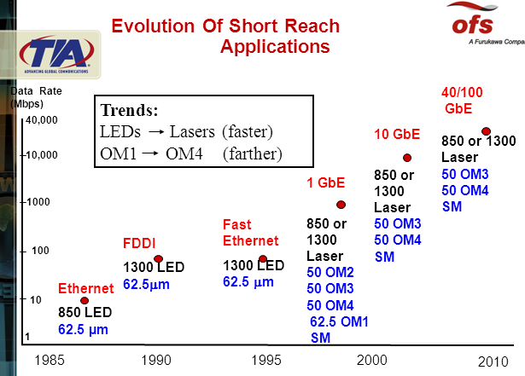
Fiber Optic Cable

Slide 77
Multi-Mode Fiber
Multi-mode fiber allows many modes, or paths, of light to propagate down the fiber optic path
Because these modes of light enter the fiber at different angles, they will arrive at the end of the fiber at different times
This characteristic is known as modal dispersion

Slide 78
Multi-Mode Fiber
Modal dispersion limits the bandwidth and distances that can be traversed using multi-mode fibers
This is expressed as MBW

Slide 79
MBW
For example 62.5 µm multimode fiber has a modal bandwidth equal to 160 MHz per km at 850 nm thus the maximum distance for Gigabit Ethernet is 220 meters
Whereas 62.5 µm multimode fiber with a modal bandwidth of 200 MHz per km at 850 nm has a maximum distance for Gigabit Ethernet of 275 meters

Slide 80
MBW
If you are not sure what the MBW is for a cable, then the conservative case of a MBW of 160 should be used
Modal bandwidth is based on the individual pulses of light which make up a digital signal traveling along the fiber that will suffer some distortion

Slide 81
MBW
This distortion is due to the energy traveling in different modes, so some of the light energy in a pulse travels along a longer path than other parts of the pulse
Graded Index fiber is used to overcome this problem
Steenbergen shows it this way

Slide 82
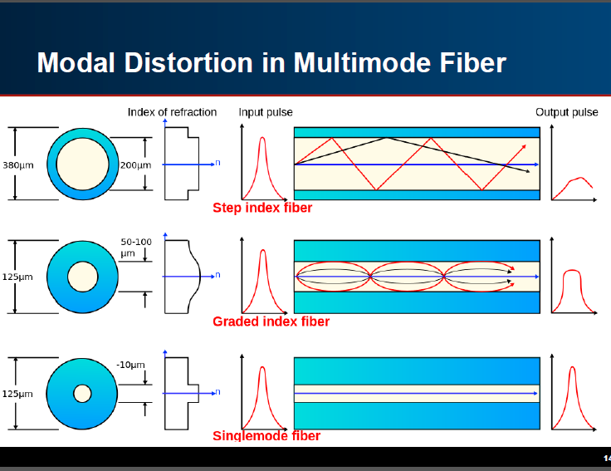
MBW

Slide 83
Multi-Mode Fiber
For this reason, multi-mode fiber is generally used for connectivity within a building such as a backbone cable
The relatively large core of a multi-mode fiber allows good coupling from inexpensive LEDs as light sources, and the use of inexpensive couplers and connectors

Slide 84
Multi-Mode Fiber
This makes multi-mode most useful for short distance, low bandwidth applications
The 62.5 version of multimode cable is typically orange in color
The OM3 laser optimized multimode cable is commonly aqua in color
It is primarily used in LANs
Laser optimized cable can carry higher speeds using laser based equipment

Slide 85
Multi-Mode Fiber
So be sure you know what size is being used for the fiber, the connectors, and the equipment
The primary advantage of multi-mode fiber over copper twisted pair cabling is that it supports longer segment lengths

Slide 86
Multi-Mode Fiber
Multi-mode fiber can support segment lengths as long as 2,000 meters for 10 and 100 Mbps Ethernet, and 550 meters for 1 Gbps Ethernet

Slide 87
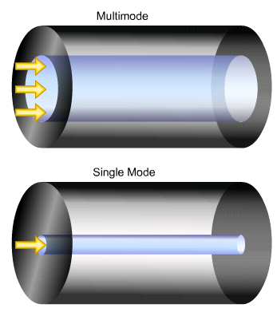
Multi-Mode Fiber

Slide 88
Types of Multi-Mode Fiber
As the textbook says
Two types of multimode fiber exist, distinguished by the index profile of their cores and how light travels in them
Step index multimode fiber has a core composed of one type of glass
Light traveling in the fiber travels in straight lines, reflecting off the core/cladding interface

Slide 89
Types of Multi-Mode Fiber
The numerical aperture is determined by the differences in the indices of refraction of the core and cladding and can be calculated by Snell’s law
Because each mode or angle of light travels a different path link, a pulse of light is dispersed while traveling through the fiber, limiting the bandwidth of step index fiber

Slide 90
Types of Multi-Mode Fiber
In graded index multimode fiber, the core is composed of many different layers of glass, chosen with indices of refraction to produce an index profile approximating a parabola
Because the light travels faster in lower index of refraction glass, the light will travel faster as it approaches the outside of the core
Likewise, the light traveling closest to the core center will travel the slowest

Slide 91
Types of Multi-Mode Fiber
A properly constructed index profile will compensate for the different path lengths of each mode, increasing the bandwidth capacity of the fiber by as much as one hundred times that of step index fiber
Step index fiber is used where large core size and efficient coupling of source power is more important than low loss and high bandwidth
It is commonly used in short, low-speed data links with LED sources

Slide 92
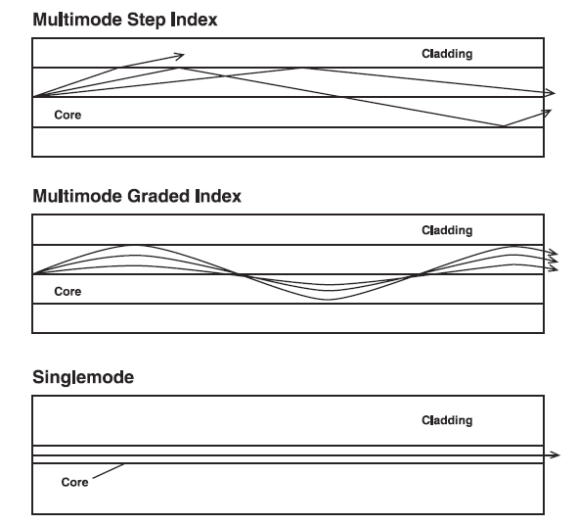
Types of Multi-Mode Fiber

Slide 93
Types of Multi-Mode Fiber
In the fiber optic cable industry multimode cable is also referred to using an OM nomenclature as in optical mode
This table from a webinar shows the different types of multimode cable from OM1 to OM4

Slide 94
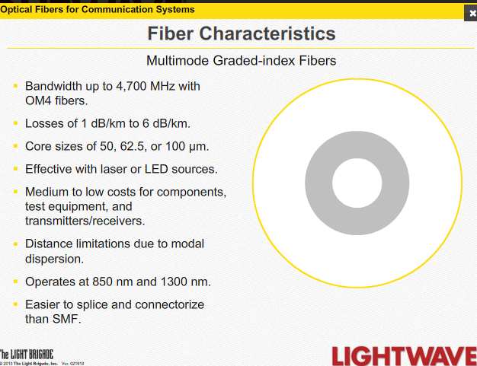
Types of Multi-Mode Fiber

Slide 95
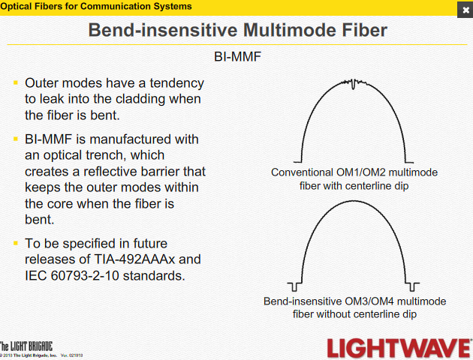
Types of Multi-Mode Fiber

Slide 96
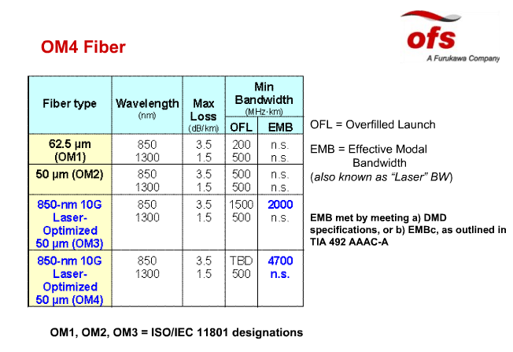
OM Types

Slide 97
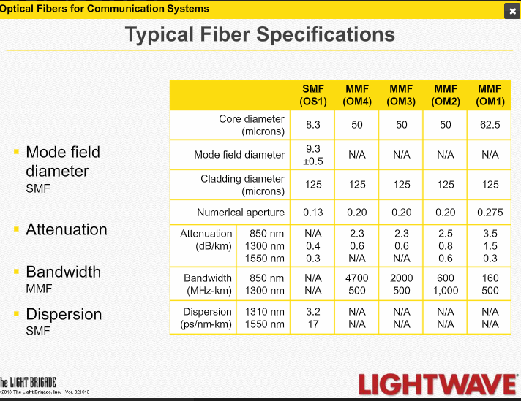
OM Types

Slide 98
OM Types
OM1 and OM2 have been the only types commonly used with OM2 being by far the most common in building backbones
OM1 is basically obsolete
There is a shift to OM3 as it is laser optimized and therefore able to achieve higher data rates such as 10G

Slide 99
OM Types
OM4 is for longer distances at 10G speeds as well as for short-range, high-speed backbones
As the shift is made from 62.5 to 50 the OM type purchased is also shifting from OM2 to OM3

Slide 100
Single-Mode Fiber
Single-mode fiber has a core diameter that is so small, usually from 8 to 10 microns, that only a single mode of light is propagated
The exact size does not matter as long as it is in this range
This eliminates the main limitation to bandwidth, modal dispersion

Slide 101
Single-Mode Fiber
Therefore, single-mode is capable of delivering considerably higher performance and over much larger distances, which is why it generally is used within environments that are more geographically dispersed

Slide 102
Single-Mode Fiber
However, the small core of a single-mode fiber makes coupling light into the fiber more difficult, and thus expensive lasers must be used as light sources

Slide 103
Single-Mode Fiber
Lasers produce higher bandwidth because their signaling rate is higher than an LED device
That is the laser can turn on and off or cycle at a faster rate than an LED
Therefore, more information can be placed on the channel in the same amount of time
For example

Slide 104

Signaling Rate
Device | Time Span Zero to 1 Second
LED
Laser
It is how much is put into the pipe in a span of time Which is based on how fast the device can cycle on and off

Slide 105
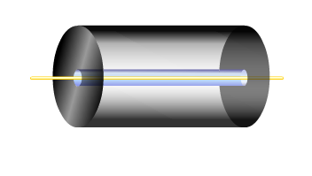
Single-Mode Fiber

Slide 106
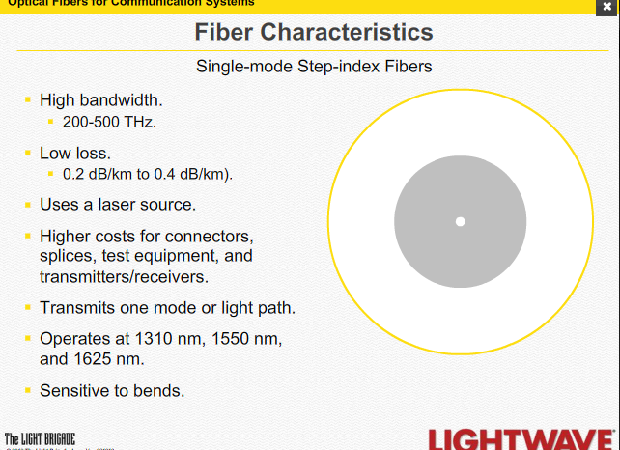
Single-Mode Fiber

Slide 107
Single-Mode Fiber
This cable is usually yellow in color
It is used primarily outside of the LAN
Single mode is also referred to using the new nomenclature
OS1
This is basic single mode cable
OS2
This is the common low water peak single mode cable

Slide 108
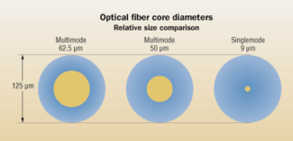
Multi-Mode v Single-Mode

Slide 109
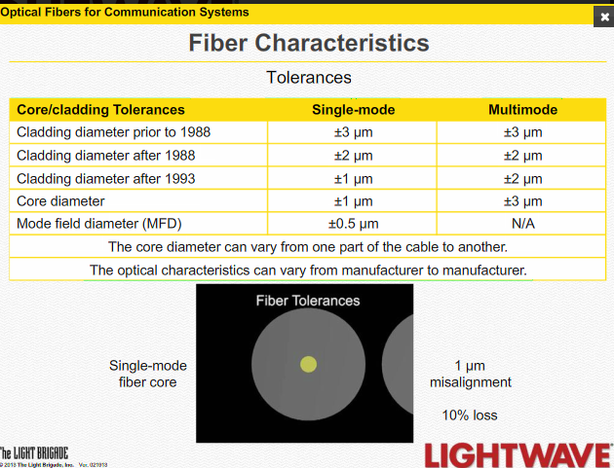
Multi-Mode v Single-Mode

Slide 110
Types of Fiber Optic Cable
In terms of where the fiber optic cable can be used there are several types
OFNP
Plenum rated
OFNR
Riser rated
OFNG
General use

Slide 111
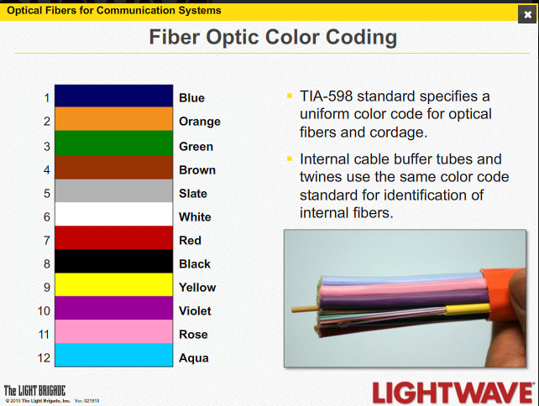
Fiber Optic Cable Color Codes

Slide 112
Fiber Optic Cable Colors
The approved colors for the outside cover of the various types of fiber optic cable is shown next on a slide from the Steenbergen presentation to NANOG 57 in 2013
Usually the short cables used inside use these color codes
A generic gray is commonly seen as well

Slide 113
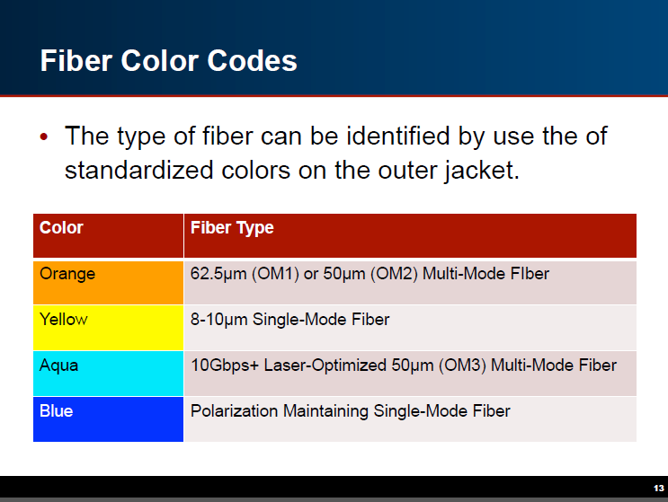
Fiber Optic Cable Colors

Slide 114
Lab
Examine different type of fiber optic cable
Answer these questions about each one
Type of cable
Manufacturer
Model number

Slide 115
Transmission Distances
Using the standard methods multimode fiber optic cable can transmit data 2,000 meters without repeaters
Using common proprietary methods longer distances are possible
Singlemode cable can easily extend 80,000 meters
There is a formula to calculate the maximum transmission distance

Slide 116
Transmission Distances
Link Length =
Available Power minus Link Loss
Divided By
Length Dependent Link Loss
Where
Available Power in dB =
Minimum Transmit Power in dBm minus Receive Sensitivity in dBm
Link Loss in dB =
Connector Loss in dB plus Fudge Factor in dB
Link Dependent Link Loss =
Maximum Attenuation in dB per km plus Splice Losses in dB per km

Slide 117
Transmission Distances
These values are available from the equipment manufacturers
Here are some common figures for various fiber standards from Fluke

Slide 118
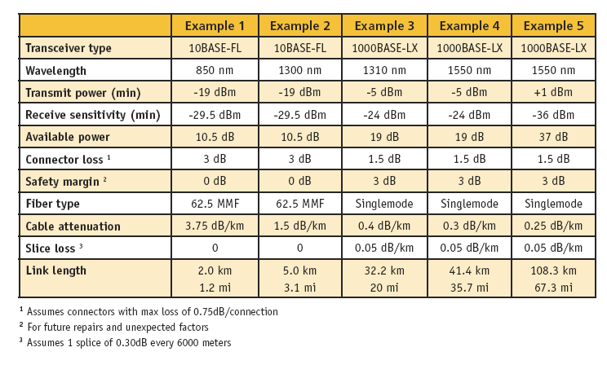
Transmission Distances

Slide 119
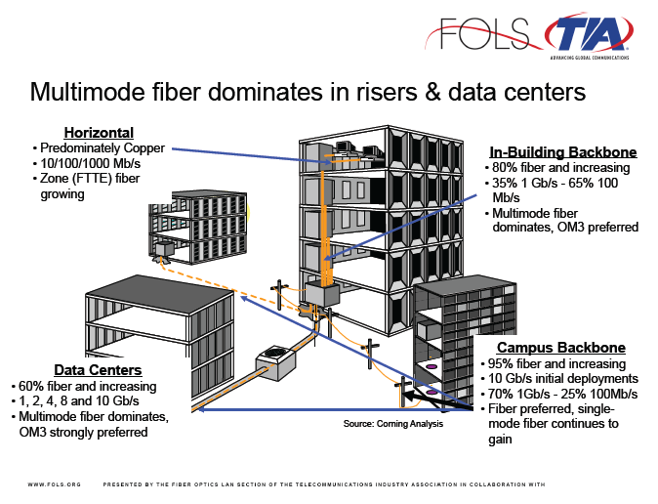
Use of Fiber

Slide 120
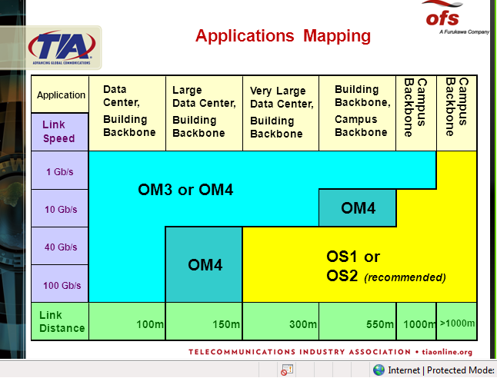
Use of Fiber

Slide 121
Use of Fiber
Fiber is widely used to interconnect long distances such as between cities and continents
Sometimes problems occur with these links
For example

Slide 122

Use of Fiber

Slide 123

Use of Fiber

Slide 124
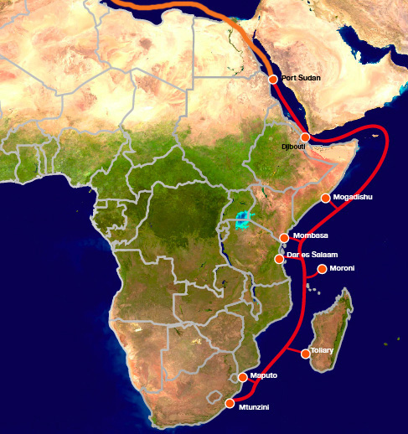
Use of Fiber

Slide 125
Use of Fiber
Notice how long the fiber has been down

Slide 126
Fiber Connectors
Several styles of connectors are used to terminate fiber optic cable
We will look at the more common ones

Slide 127
ST Connector
ST - Straight Tip is a single tip connector similar to a BNC connector
This is the older style connector
It is still very widely used
It is sometimes referred to as a stick and twist as in ST

Slide 128
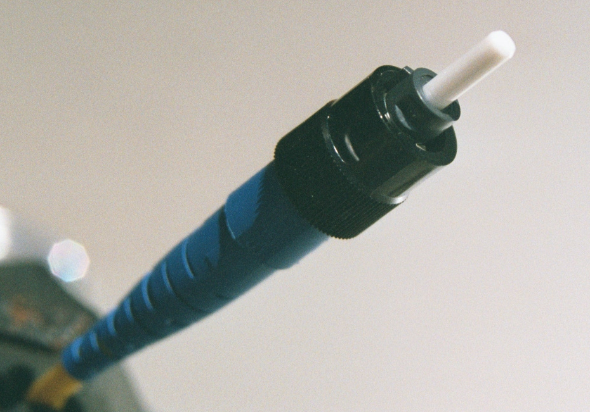
ST Connector

Slide 129
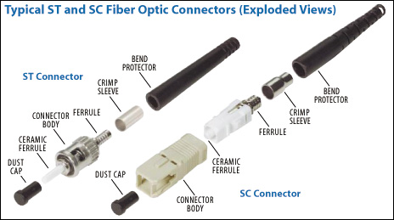
ST Connector

Slide 130
SC Connector
SC - Subscriber Connector is a push on connector
It is also called a snap and click as in SC
This connector can be round, but is more commonly square
The square style has a latch that prevents the sections from coming apart

Slide 131
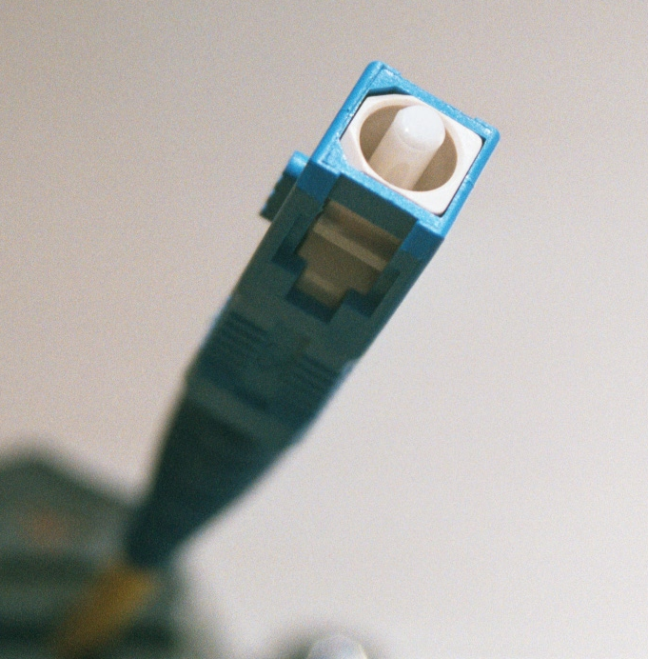
SC Connector

Slide 132
SC Connector

Slide 133
Duplex or Simplex Connectors
ST and SC connectors can come in a duplex or simplex configuration
The difference is whether both the send and receive connectors are bonded or attached to each other or not
The duplex connector makes it easier to keep the send and receive straight
In any case they are color coded

Slide 134
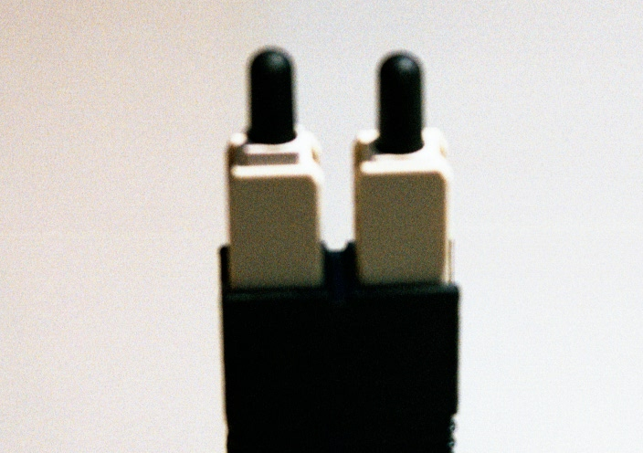
Duplex Connector

Slide 135
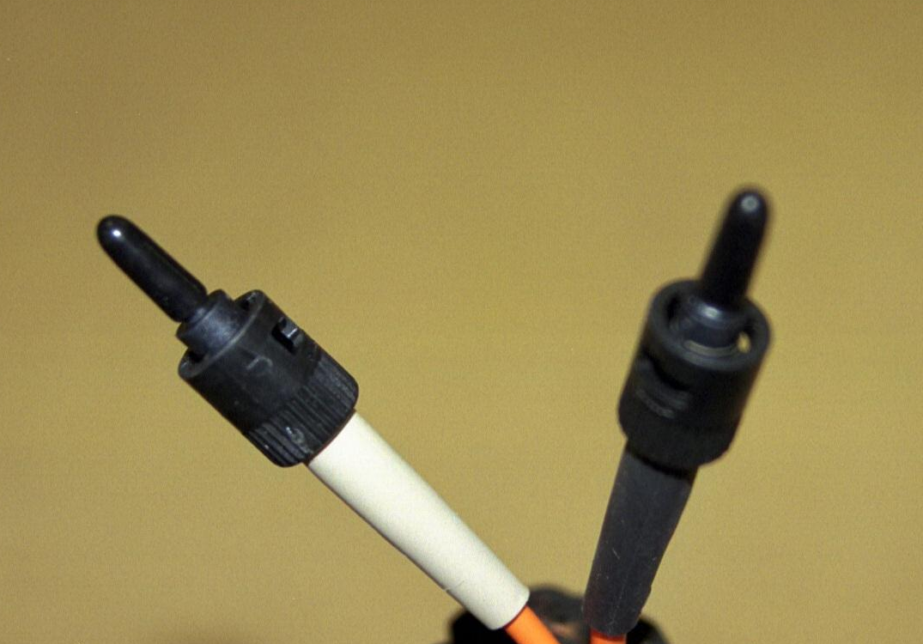
Simplex Connector

Slide 136
Small Form Factor Connector
The latest connector contains both connections inside of a single unit unlike most of the connectors discussed above
This connector puts both connections in a space of an RJ-45 connector
This allows manufacturers to pack more connectors in the same space

Slide 137
LC Connector
The most common small form factor connector is the LC
It uses the common SC style but in a smaller size
This is seen in the next slide
The connector at the top is a duplex SC
The one at the bottom is a duplex LC

Slide 138
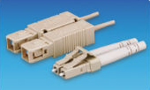
LC Connector

Slide 139
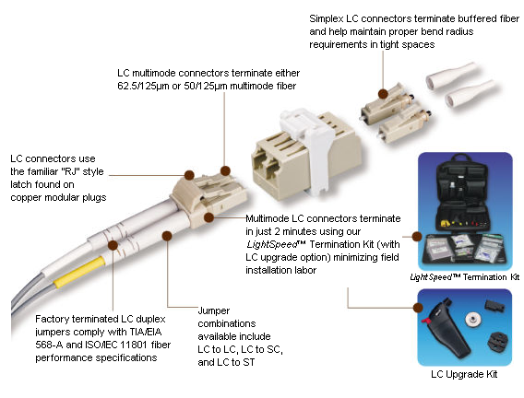
LC Connector

Slide 140
MPO Connector
As 40G and 100G is deployed a connector that has more than two strands will be needed as these speeds use several at a time to achieve the speeds
A MPO connector can do this in a small form factor
Notice the multiple stands side by side here

Slide 141
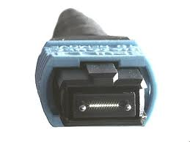
MPO Connector

Slide 142
Who Uses What
As reported in an article by 3M a survey at a trade show from November 2013 suggested this is the amount of use of each type of connector

Slide 143
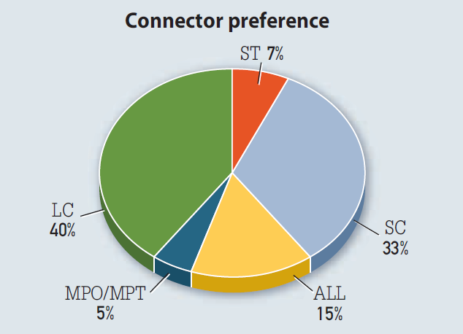
Who Uses What

Slide 144
Lab
Examined fiber optic cable connectors
Answer the following questions
Type
Simplex or duplex

Slide 145
Differential Mode Delay
Another type of connector, which is actually a combination of connectors and cable, may be required when connecting singlemode and multimode equipment to each other

Slide 146
Differential Mode Delay
When an unconditioned laser source that was designed for use with singlemode fiber cable is directly coupled to a multimode cable, an effect known as DMD - Differential Mode Delay may occur

Slide 147
Mode Conditioning Cables
DMD can degrade the modal bandwidth of the fiber-optic cable, which causes a decrease in the link span, in other words the distance between the transmitter and the receiver
Mode Conditioning Cables, which as also known as Gigabit launch cables, are used when one of these singlemode devices is used with a multimode cable

Slide 148
Mode Conditioning Cables
The function of the Mode Conditioning Cable is to provide an offset launch of the 8.3 µm singlemode core, into the 62.5 or 50 µm multimode core
Without this type of cable, multiple overlapping signals can occur when a singlemode signal is launched into the area of a multimode core

Slide 149
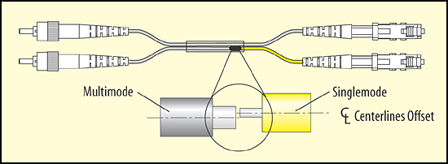
Mode Conditioning Cables

Slide 150
Equipment Modules
For the cable to be connected to the equipment, such as a switch or a router, it must have a port for the fiber optic cable
There are two ways to do this
In some equipment the port is built-in to the equipment
In other cases a module is plugged in

Slide 151
Equipment Modules
Using a module allows the same box to handle different types of cable
There are two types of modules
GBIC – Gigabit Interface Converters
SFP – Small Form Pluggable
The GBIC is the older style

Slide 152
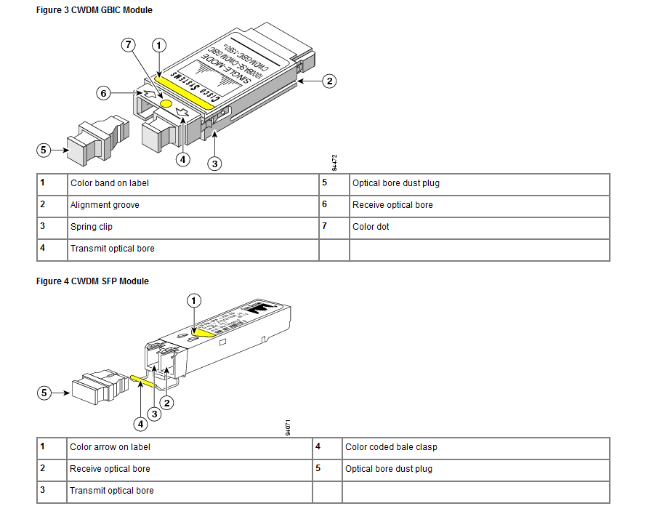
Equipment Modules

Slide 153
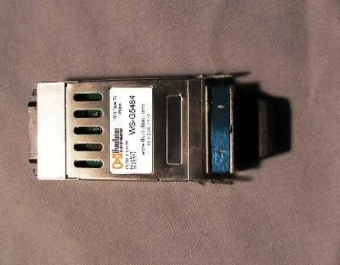
GBIC

Slide 154
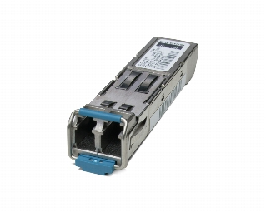

SFP

Slide 155
Media Converter
Some times to save money fiber optic cable will be run from one point to another, but the devices at the ends, such as a switch, will have copper ports, since copper based boxes are cheaper than ones with fiber interfaces
To convert the copper port to the fiber optic cable a media converter is required
Such as

Slide 156

Media Converter

Slide 157
Sources
The slides with the blue top are from a presentation to NANOG 57 in February 2013 by Richard Steenbergen

