Slide 1
Equipment Installation Last Update 2013.05.15
1.37.0

Slide 2
Objectives of This Section
Learn how to
Setup a site the proper way by conforming to generally accepted standards and regulations
Use common techniques and guidelines related to equipment installation

Slide 3
Standards
The TIA-942 standard along with the other structured cabling standards provide a guide to the setup of a data center

Slide 4
Planning Steps
Ensure the equipment received can be moved into place
Such as door widths, weight of equipment, security access
Check that any support needed, both internal and vendors, will be accessible when the work is being done
Such as 2 AM Sunday morning

Slide 5
Planning Steps
Have a rollback plan in place
In other words have a retreat path that will take you back to where you were in case the installation does not work out

Slide 6
What to Call the Places
The name used to describe where you put all of the stuff you need to run a network varies widely depending on who your talking to and the exact purpose of the particular room
It also depends on whether you are adhering strictly to the standards, as they call out specific names for specific rooms

Slide 7
What to Call the Places
In many cases all of the individual rooms the standards call for do not exist

Slide 8
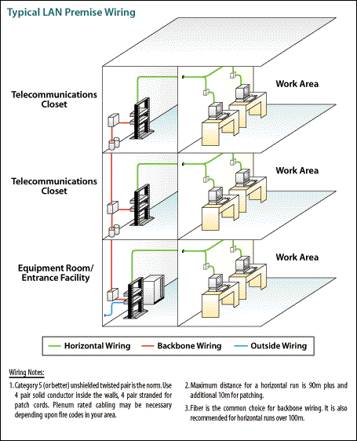
What to Call the Places

Slide 9
What to Call the Places
In practice one room does many functions
This is especially true in older buildings
Strictly speaking there are two main types of equipment rooms
Main
Intermediate

Slide 10
What to Call the Places
The main room, often called the MDF - Main Distribution Frame room by telco people, is where the bulk of the equipment resides
Another type of room, IDF - Intermediate Distribution Frame in telco talk, is where devices are placed when the distance is too far or the site is too large for everything to go in the MDF

Slide 11
What to Call the Places
Many LAN folks call the MDF the LAN or server room
They will refer to the IDFs as IDFs in most cases.

Slide 12
LAN Room Names
LAN rooms go by many names
LAN room
Server room
Equipment room
Wiring closet
Telecommunications closet
Telecommunications room
MDF - Main distribution frame
IDF -Intermediate distribution frame

Slide 13
LAN Room Names
MCC – Main cross-connect
ICC – Intermediate cross-connect

Slide 14
What Not to Do
The first thing about an equipment room is that it should be a room of some sort
Security is always important so I would never just leave equipment out in an open area as the next slide shows
Yes this is a site I provide support for
I have been over this with them several times, but they trust everybody
Yeah, right

Slide 15
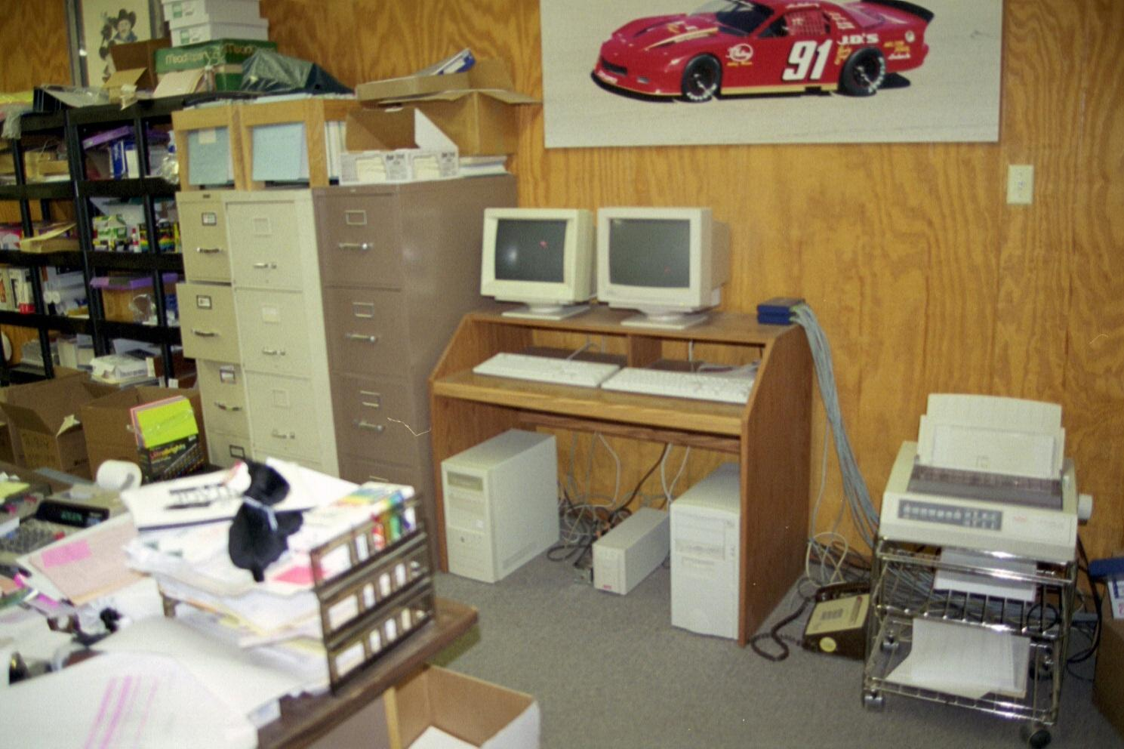
What Not to Do

Slide 16
Design Specifications
The standard calls for these specifications for the telecommunications room or closet
This room should only be used for telecommunications functions
Equipment not related to telecommunications shall not be installed, pass through or enter the telecommunications room
Multiple closets on the same floor shall be interconnected by a minimum of one 78mm conduit, or equivalent pathway

Slide 17
Design Specifications
Minimum one closet per floor to house telecommunications equipment and cable terminations and associated cross-connect cable and wire
Located near the center of the area being served.
Horizontal pathways shall terminate in the telecommunications room on the same floor as the area served

Slide 18
Design Specifications
One wall should have 20mm (0.75 in.) A-C plywood 2.4m (8 ft.) high
Lighting shall be a minimum of 500 lx (50 foot candles) at 1m (3 ft.) above finished floor (AFF)
False ceilings shall not be provided
Minimum door size 910mm (36 in.) wide and 2000mm (80 in.) high without sill, hinged to open outwards, or slide side-to-side or removable, and fitted with a lock

Slide 19
Design Specifications
Minimum of two dedicated 120V nominal non-switched duplex electrical outlet receptacles or equivalent, each on separate branch circuits
Additional convenience duplex outlets placed at 1.8m (6 ft.) intervals around perimeter, 150mm (6 in.) above floor
Access to the telecommunications grounding system as specified by ANSI-J-STD-607-A

Slide 20
Design Specifications
HVAC requirements to maintain temperature the same as adjacent office area
A positive pressure shall be maintained with a minimum of one air change per hour or per code

Slide 21
Design Specifications

Slide 22
Small Size Room
The room does not even need to be a room
It can be a locked and ventilated or air conditioned cabinet in an otherwise open area
At a small site there is no need for a separate room
These typically cost from $1,000 to $3,000

Slide 23
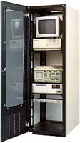
Equipment Cabinet

Slide 24
Medium Size Room
A medium size equipment room is typically about the size of an office and it may be a spare office

Slide 25
Large Size Room
A large equipment room is anything larger than a standard size office
It may just be a large room
If it gets large enough it may be more specialized as seen here

Slide 26
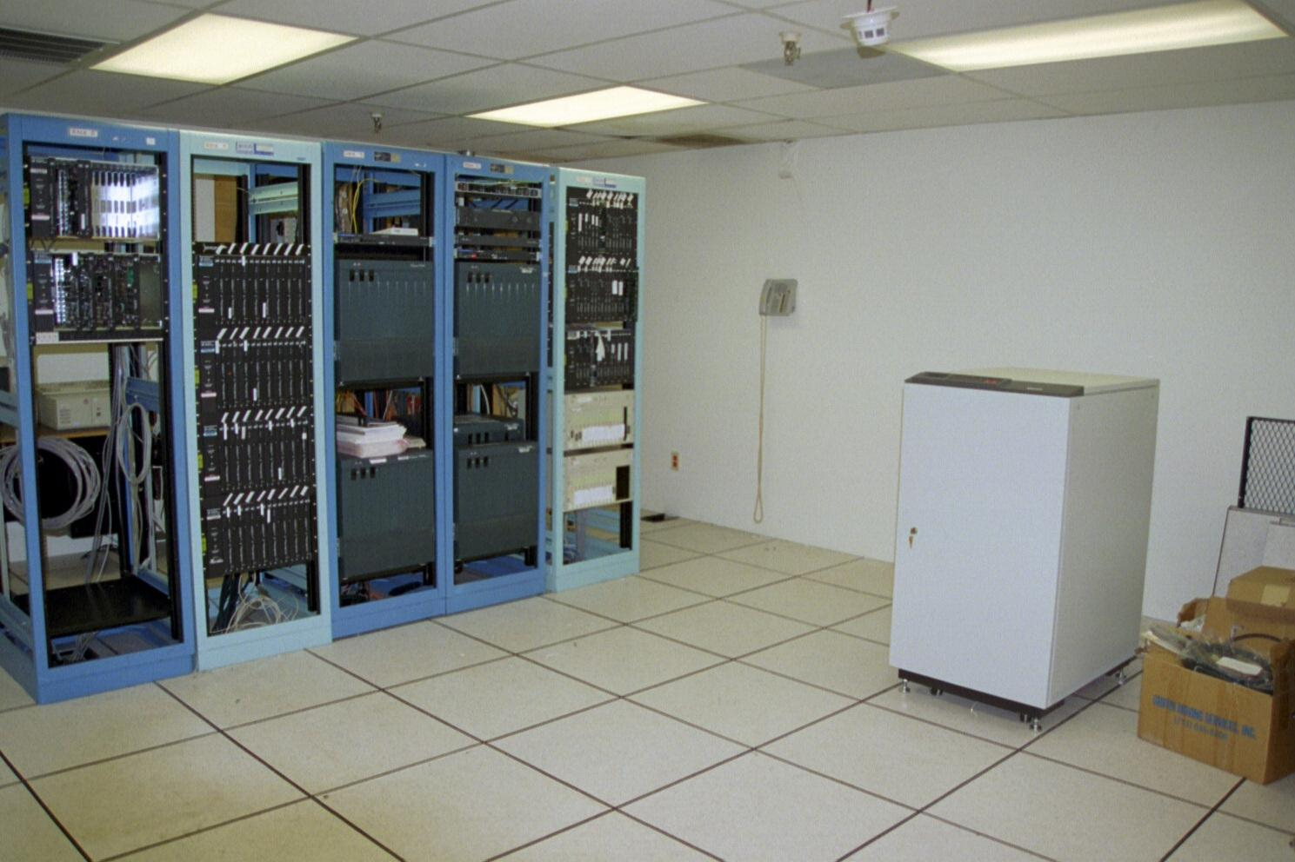
Large Room

Slide 27
Raised Floor
Often these larger rooms will have a raised floor
This type of floor is used to route cabling
There are several different types of raised floors
The best currently available uses a composite panel for the floor tile
This is a composite wood product covered in steel

Slide 28
Raised Floor
These panels are supported by stands placed directly on the concrete floor
Cost for a floor like this runs from $10 to $20 per square foot of floor area

Slide 29
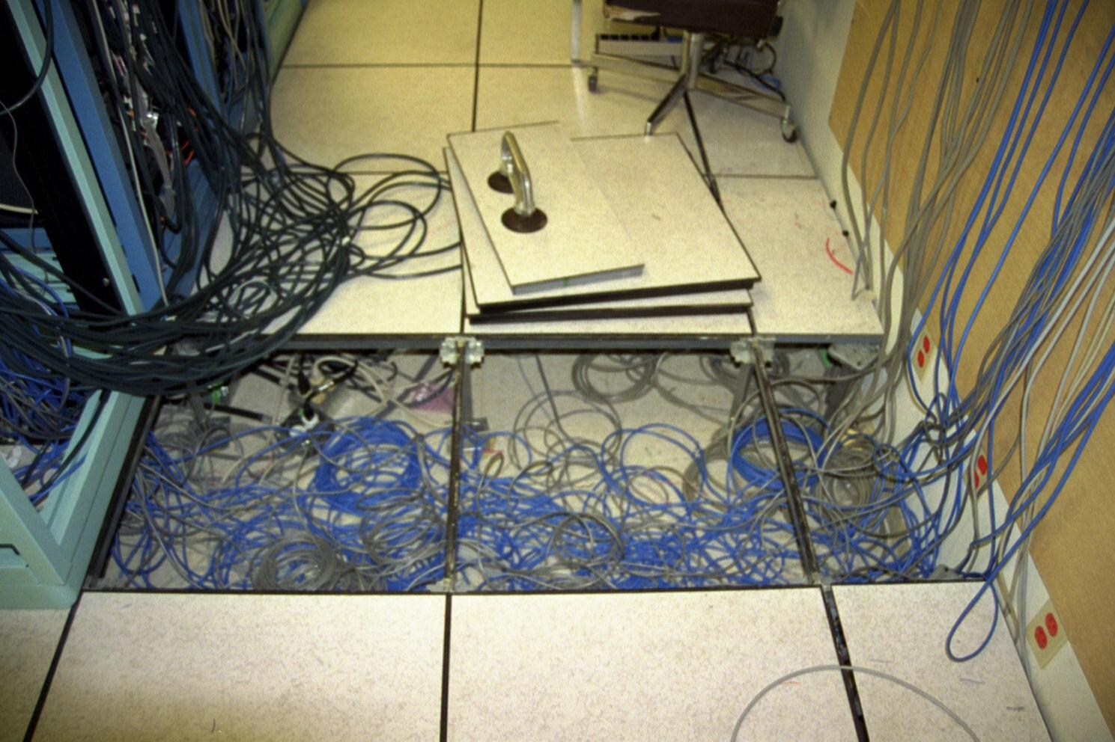
Raised Floor

Slide 30
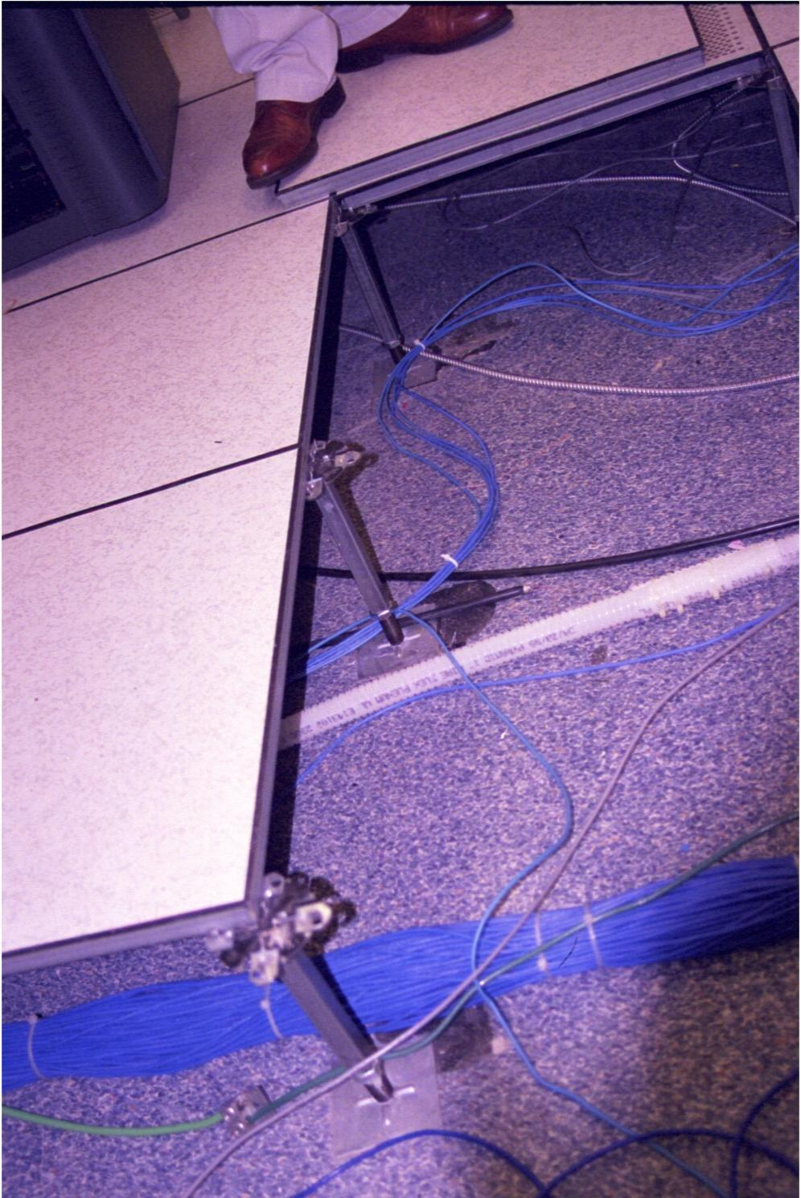
Raised Floor

Slide 31
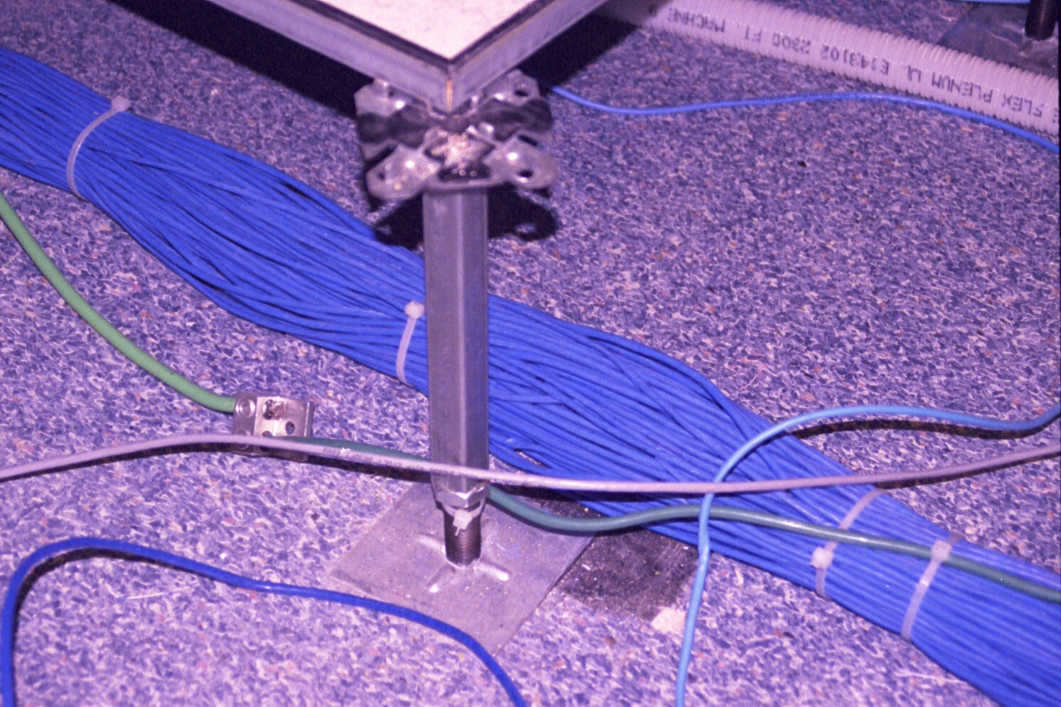
Raised Floor

Slide 32
Raised Floor Layout

Slide 33
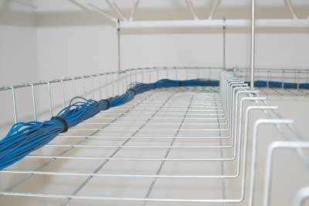
Overhead Cable Racks

Slide 34
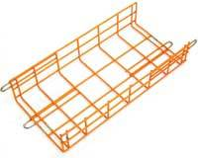
Overhead Cable Racks

Slide 35
Raised Floor v Overhead Rack
Over the last few years opinion has coalesced around the idea that power cables should go under the raised floor and the data cables overhead in basket racks

Slide 36
Sensors
Equipment rooms need to be monitored for problems that occur when no one is around
These often include sensors for
Heat
Water
Humidity
Airflow around equipment
Door open

Slide 37
Sensors
Power outage
Hydrogen alarm for battery backup

Slide 38
Sensors
Some of these also include audio, to listen for strange equipment sounds, and a camera to see who is in the room
A good example of an integrated unit doing this are the two from NetBotz
The WallBotz is a web-accessed, environment-monitoring appliance in a book-sized package

Slide 39
Sensors
As the manufacturer says
Completely self-contained, the unit continually checks the room environment, including temperature, humidity, smoke, and airflow
Alarms are sent via email and pager when a connected device's environment condition is out of range
A built-in camera records individuals accessing the server room and allows both the customer and technician to easily view the condition of equipment via an internally generated web page

Slide 40
Sensors
The RackBotz is a web-accessed, environment-monitoring appliance
As the manufacturer says
Alarms providing you with advanced warning of equipment failure are sent via email and pager when a connected devices condition is out of range
A built-in camera records individuals accessing the rack or cabinet and allows both the customer and technician to easily view the condition of equipment via an internally generated web page
These range in price from $800 to $1,000

Slide 41
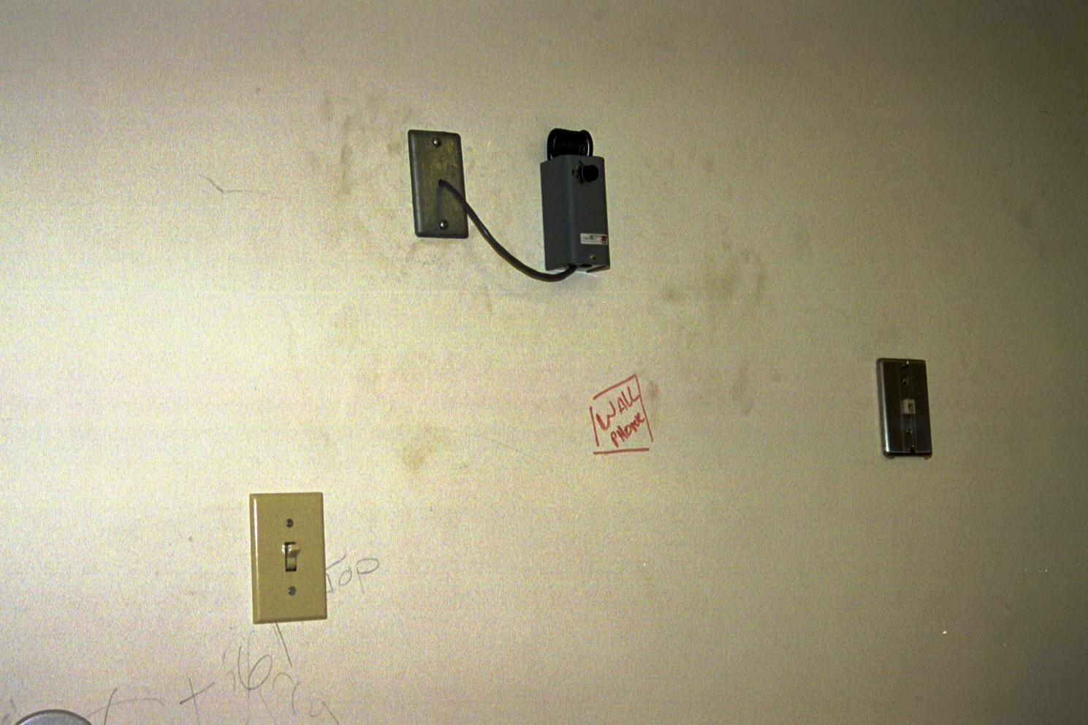
Heat Sensor

Slide 42
Heat Load
Depending on the room size and the equipment in the room a separate air conditioner may be needed
These can be in room or placed in the space above the ceiling tiles
Equipment manufacturers will have heat load figures for their equipment
If not most HVAC companies have standardized figures

Slide 43
APC Heat Load Computation
Here is what APC had to say on this
To ensure continuous operation of the equipment in the wiring closet 7 x 24 x 365, cooling and airflow issues must be identified and addressed
Power dissipation in the wiring closet should be calculated to decide on a cost effective method to solve the problem

Slide 44
APC Heat Load Computation
The most important thing to note here is that many network switches have a high power draw; however this does not mean that all the power is dissipated as heat inside the wiring closet
For example a layer 2/3 switch may draw 1800W of power but it may be dissipating only 300-500W in the closet

Slide 45
Heat Load Computation
The rest of power is supplied over the network to the various devices like wireless access points, IP phones, security cameras scattered and is dissipated throughout the office area

Slide 46
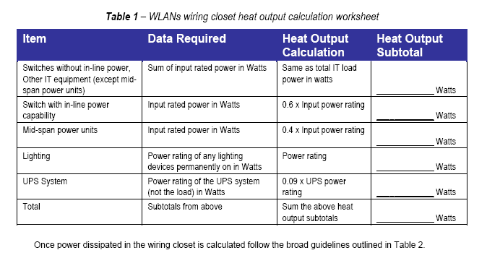
APC Heat Load Table 1

Slide 47
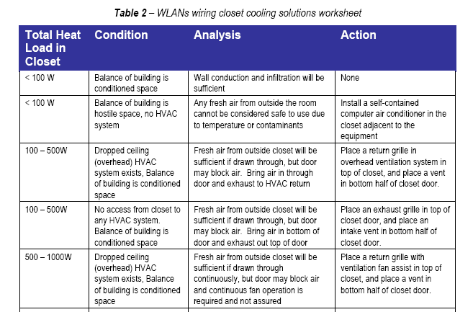
APC Heat Load Table 2 - Part

Slide 48
APC Heat Load Table 2 - Part

Slide 49
Heat Load Guidelines
APC has some guidelines for determining how to cool equipment closets in White Paper #68 from 2007
The next few slides are from this white paper
According to APC the typical recommended operating temperatures from IT equipment vendors are between 70°F (21°C) and 75°F (24°C)

Slide 50
Heat Load Guidelines
In addition, The American Society of Heating, Refrigeration, and Air Conditioning Engineers (ASHRAE) TC 9.9 publishes both recommended and allowable operating temperatures for IT equipment

Slide 51
Heat Load Guidelines

Slide 52
Heat Load Guidelines
The goal should always be to maintain temperatures no higher than 77°F (25°C)
However, if doing so is not possible, maintaining below the maximum allowable temperature of 90°F (32°C) can be a suitable solution for less critical closets
Any temperature above 90°F (32°C) should be avoided to reduce risk of equipment failure

Slide 53
Heat Load Guidelines
Also, 90°F (32°C) is the maximum temperature organizations such as the Occupational Safety and Health Administration (OSHA) and International Organization for Standardization (ISO) deem permissible for light work loads
More careful consideration must be given to closet environments where a UPS is deployed

Slide 54
Heat Load Guidelines
Increases in temperature have a much more pronounced effect on battery longevity than other types of IT equipment
A user can expect a typical UPS battery operating at 104°F (40°C) to only last 1.5 years or less as compared to the usual 3 – 5 years at normal operating conditions
An operating temperature below 77°F (25°C) should be a requirement

Slide 55
Heat Load Guidelines
Heat can leave a small confined space like an office or closet in four different ways
Conduction
Heat can flow through the walls of the space
Ventilation
Heat can flow into cooler air via a vent or grille, without an air moving device
Heat can flow into cooler air via a vent or grille that has an air moving device

Slide 56
Heat Load Guidelines
Building Cooling
Heat can be removed by a building’s comfort cooling system
Dedicated Cooling
Heat can be removed by a dedicated air conditioner

Slide 58
Conduction
When using conduction heat can flow through the walls of the space
If a closet is effectively sealed, then the only way for the heat to leave is by conduction through the walls
For this to work, the air in the closet must heat up to the point where it is hotter than the temperature that is on the other side of the closet walls

Slide 59
Conduction
Practically, this means that the closet will always be hotter than the other ambient air within the building, and the degree of temperature rise will be greater as the power level of the IT equipment increases
The size of the room, as well as the material the walls and so forth are made of affect this

Slide 60
Conduction
One common occurrence that impacts conductive cooling performance is a rise in the building ambient air temperature, due to weekend cooling setbacks
When this happens, the closet temperature will rise in step

Slide 61
Conduction
Another limitation of this method of cooling is that if one of the closet walls is an outside wall of the building, the closet temperature will be subject to the outdoor wall temperature, which is effected by both the ambient outdoor temperature and the heating due to sun exposure

Slide 62
When to Use Conduction
Use conduction as a sole means of cooling for critical closets when the power load within the closet is less than 400 watts with consideration given to other factors as mentioned above that will impact cooling performance
For non-critical closets, conduction should only be used when the load in the closet is less than 1000 W

Slide 63
Ventilated Closet
Closets can be cooled by venting them to the ambient building air
The venting can be passive using appropriately placed holes or vents, or it may be fan-assisted
The basic principle is to ensure that the closet air temperature does not rise substantially above the building ambient air temperature

Slide 64
Vented Closet

Slide 65
When to Use Ventilation
For power levels below 700 watts, passive ventilation is effective for critical closets
For power levels of between 700 watts and 2000 watts, fan-assisted ventilation is appropriate for critical closets
Support of even higher power levels can be achieved if higher capacity or multiple fan assist units are used

Slide 66
When to Use Ventilation
Likewise, for non-critical closets, passive ventilation is effective for up to 1750 watts, and fan-assisted ventilation is effective from 1750 watts to 4500 watts

Slide 67
Using Building Cooling
This is generally a bad idea
Building cooling systems cycle on and off
A thermostat placed somewhere in the zone, but not in the closet is the usual control mechanism
For a small space like a closet with IT devices, this means that the temperature will decrease when the cooling system is on, and increase when it is off

Slide 68
Using Building Cooling
This results in significant swings in temperature that actually stress IT equipment more than sustained higher temperature conditions
Furthermore, best practice for comfort cooling systems involves turning up the temperature set points on week nights and weekends to help conserve electricity
Some are actually shut off completely

Slide 69
Using Building Cooling
If a wiring closet is part of a larger zone, the average temperature of the wiring closet will increase by the amount the temperature set point is increased
By simply adding ductwork, one is forced to choose between wasting electricity on nights and weekends and making the temperature swings in the wiring closet even worse

Slide 70
Using Building Cooling
In order to use a building comfort cooling system to cool a wiring closet, the wiring closet in question would have to be made into a dedicated zone with its own properly sized supply and return ducts, terminal units, and controls
This is not practical

Slide 71
Dedicated Cooling
The most effective way to gain control of closet temperatures is by installing dedicated closet air conditioning equipment
In general, when the power level in a closet exceeds approximately 2000 W for critical closets or 4500 W non-critical closets, dedicated air conditioning equipment is recommended

Slide 72
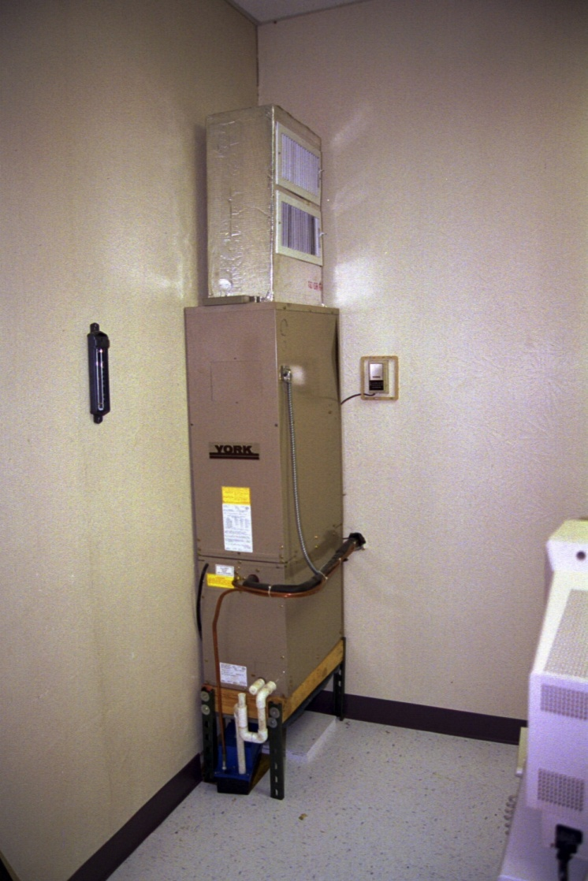
In Room AC Unit

Slide 73
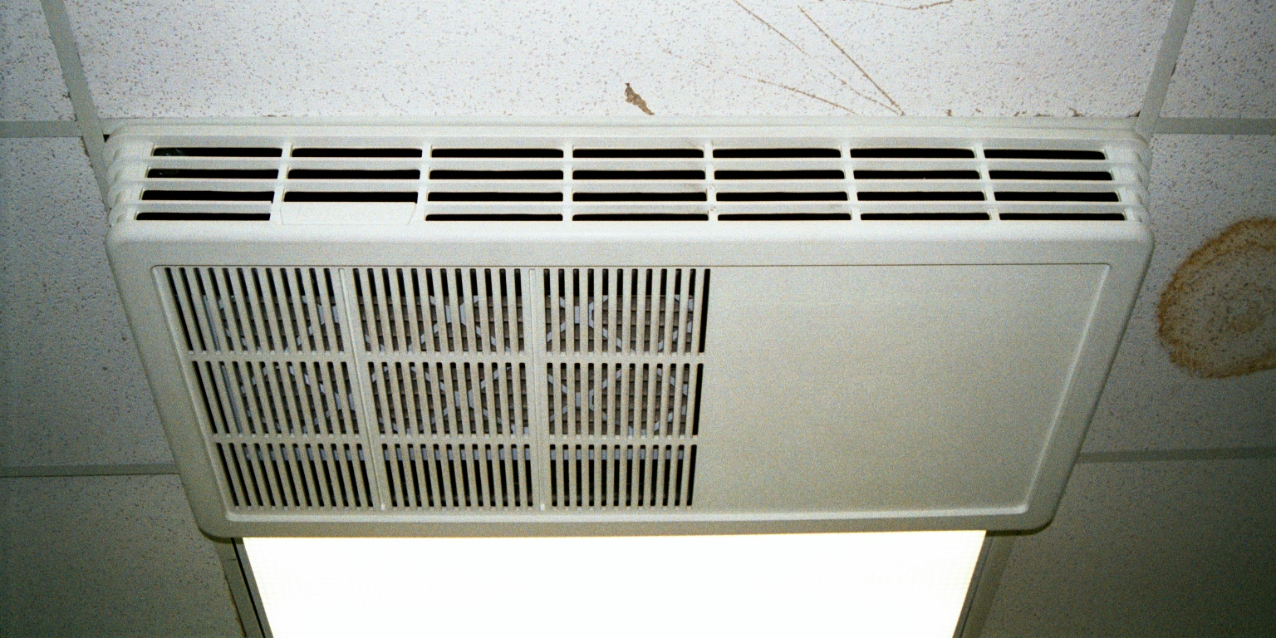
Ceiling AC Unit

Slide 74
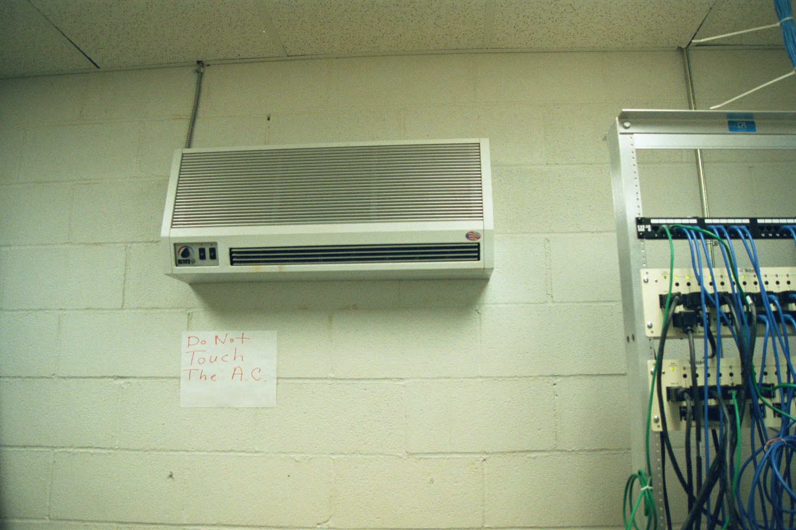
Wall Mount AC Unit

Slide 75
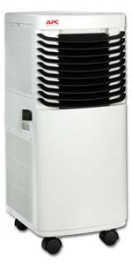
Portable AC Unit

Slide 76
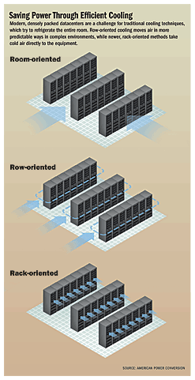
Air Flow Options

Slide 77
Air Flow Options

Slide 78
UPS Impact on Cooling
When a UPS is installed, the IT equipment will continue to create heat during a power outage
Therefore the cooling system must continue to operate
If the backup time is less than 10 minutes, the thermal mass of the air and wall surfaces within the closet will keep the temperature within reasonable limits

Slide 79
UPS Impact on Cooling
However, if the UPS is designed to provide runtime in excess of 10 minutes the cooling system must continue to operate during this period

Slide 80
Liquid Cooling
As data centers switch from standalone servers in separate cases to chassis with blade servers heat will become even more of a problem
Some think liquid cooling of the servers is the answer
If so, this will introduce a whole new level of complication to the data center

Slide 81
Water Protection
Water always rises
However, it may arrive at the site from any number of directions
For example, read what happened to these poor folks

Slide 82
Water Protection
TESSCO’s Disaster Recovery Continues
On Saturday night our entire central voice, data, and e-commerce technology center was destroyed!
Let me recap what happened, last Saturday evening, October 12 2002, a malfunctioning public water system resulted in a 6-inch main driving water with tremendous force directly toward the outside wall of TESSCO’s Global Logistics Center in Hunt Valley

Slide 83
Water Protection
The “water cannon” blew a three-foot square hole through the wall, immediately into our network operating center, destroying the equipment and functionality of our central voice, data, and Internet systems

Slide 84
The Water Cannon At Work

Slide 85
The Result

Slide 86
More Results

Slide 87
Other Causes
Other causes of water in an equipment room include
Windows blown out by a storm
Roof leaks
Fire suppression sprinkler system leaks
Firefighting efforts on floors above you can cause water to end up in your area

Slide 88
Water Protection
So what do you do
There is no good answer
Some ideas that have been tried include
For rising water
Floor drains
Sump pumps
Wet/Dry vacuums

Slide 89
Water Protection
For falling water
Rolled-up plastic tarps on rollers suspended from the ceiling, with a good solid handle dangling down on a rope
Also
Consider putting data centers not on the ground floor or the basement,
Mount equipment 18” off the floor

Slide 90
Fire Protection
Computer equipment does not like being sprayed with water
A better solution for fire protection is a system designed to suppress fire without unduly damaging the equipment
If local codes allow, be sure the sprinkler heads in the equipment room are disabled

Slide 91
Fire Protection
Fire suppression systems are not cheap
From design through installation the cost will be around $30,000 in year 2000 dollars
Such a system also requires space for the extinguisher storage bottles

Slide 92
Fire Protection
A common system uses a pressurized gas called FM200
Chemically known as heptafluoropropane
It is also known as HFC-27ea
It is a replacement for the ozone depleting Halon 1301 used extensively before 1994

Slide 93
Fire Protection

Slide 94
Fire Protection

Slide 95
Fire Protection

Slide 96
Fire Protection

Slide 97
Computer Hardware Storage
Once you have a room setup, where do you put all of this stuff
Let’s look at some options
But first, don’t do it this way

Slide 98
How Not To Do This

Slide 99
Relay Rack
The easiest way to keep things straight is to place the equipment and devices in a rack
The most common type is called a Relay Rack
In the picture in a few slides the extra length on the patch cables is hidden inside the cable management system on the left side of the Relay Rack

Slide 100
Relay Rack
The cables can be seen on the right side where the cable management cover has been removed
This unit is about seven feet tall and two feet wide
It is attached to the concrete floor with bolts and braced to the wall
Equipment is attached to the rack with machine screws

Slide 101
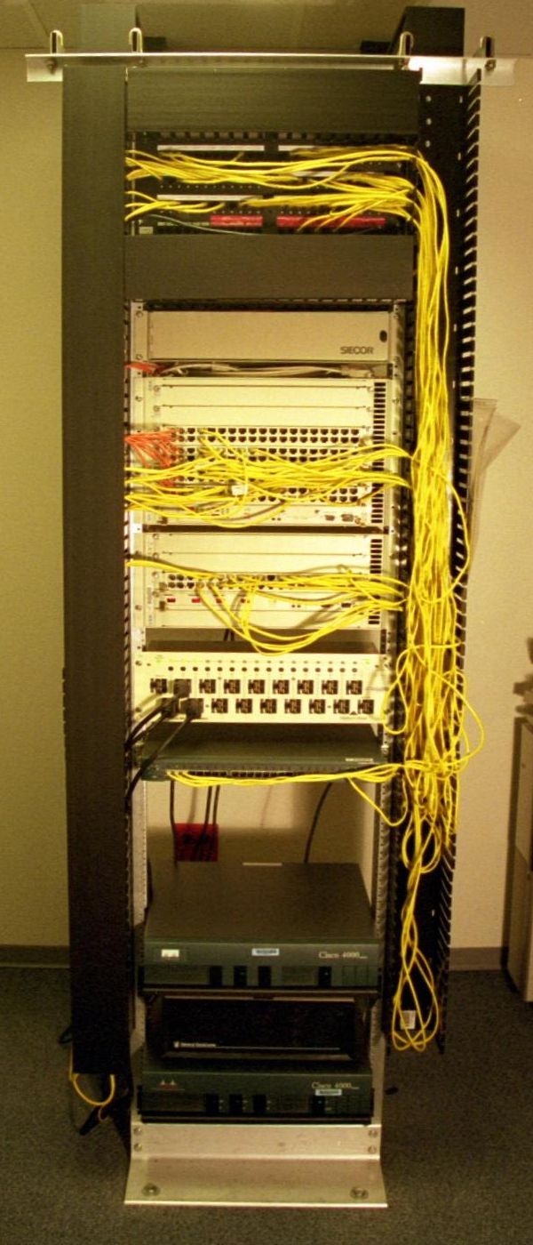
Relay Rack

Slide 102
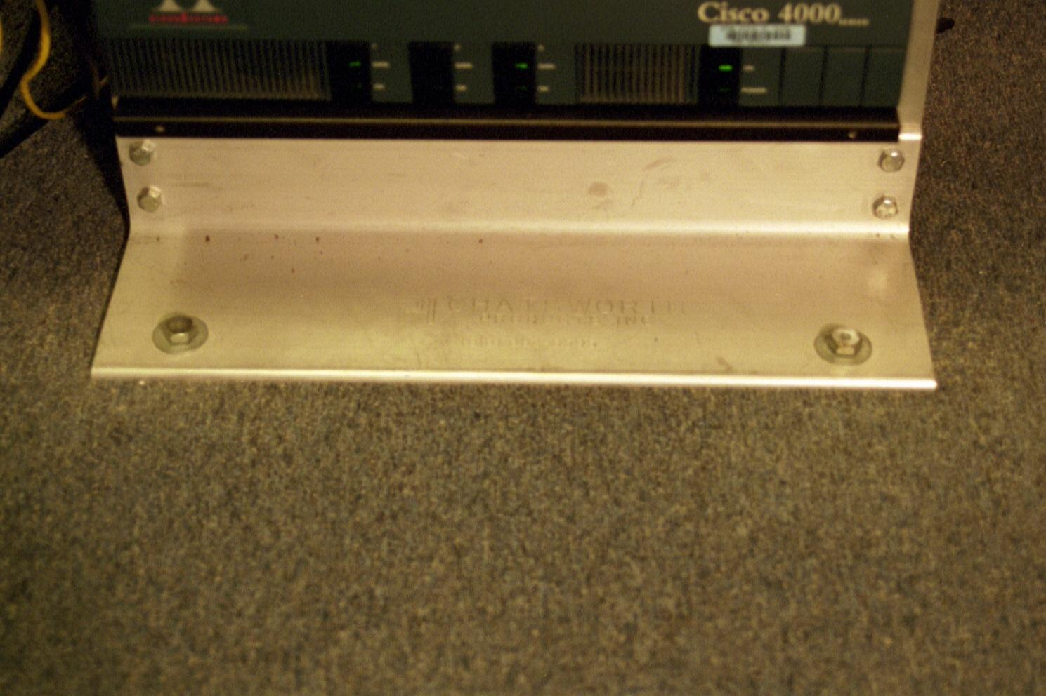
Relay Rack

Slide 103
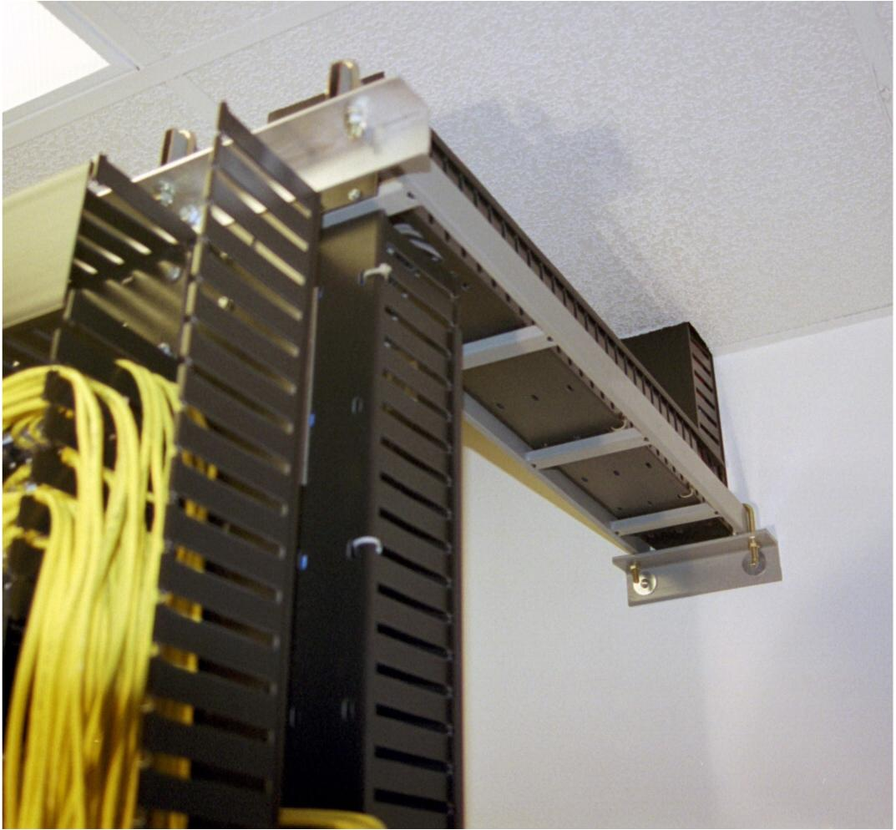
Relay Rack

Slide 104
Relay Rack
Be sure the Relay Rack itself is grounded to a suitable building ground
In addition to the rack the joints between all the various parts of the structure, such as the supporting ladder racks, must be connected to each other with short ground straps
This is especially true for painted components

Slide 105
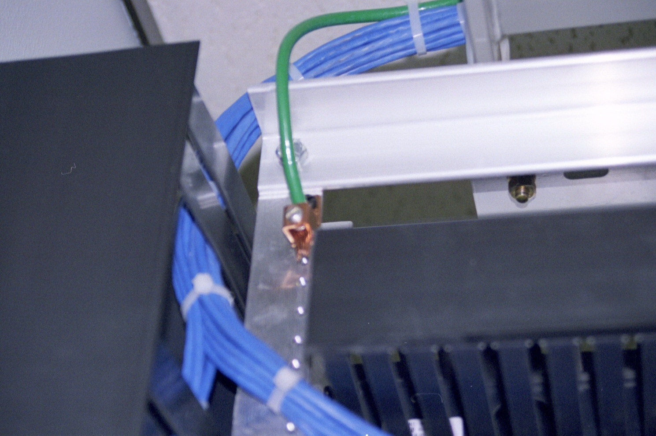
Grounding Racks

Slide 106
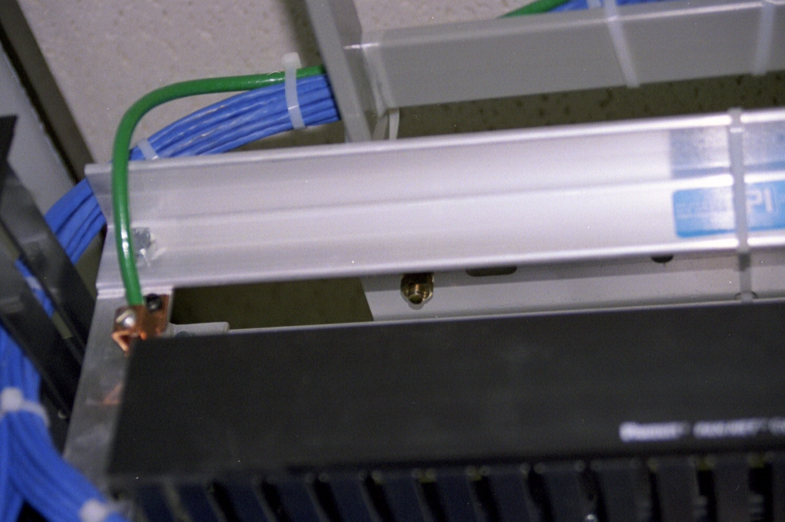
Grounding Racks

Slide 107
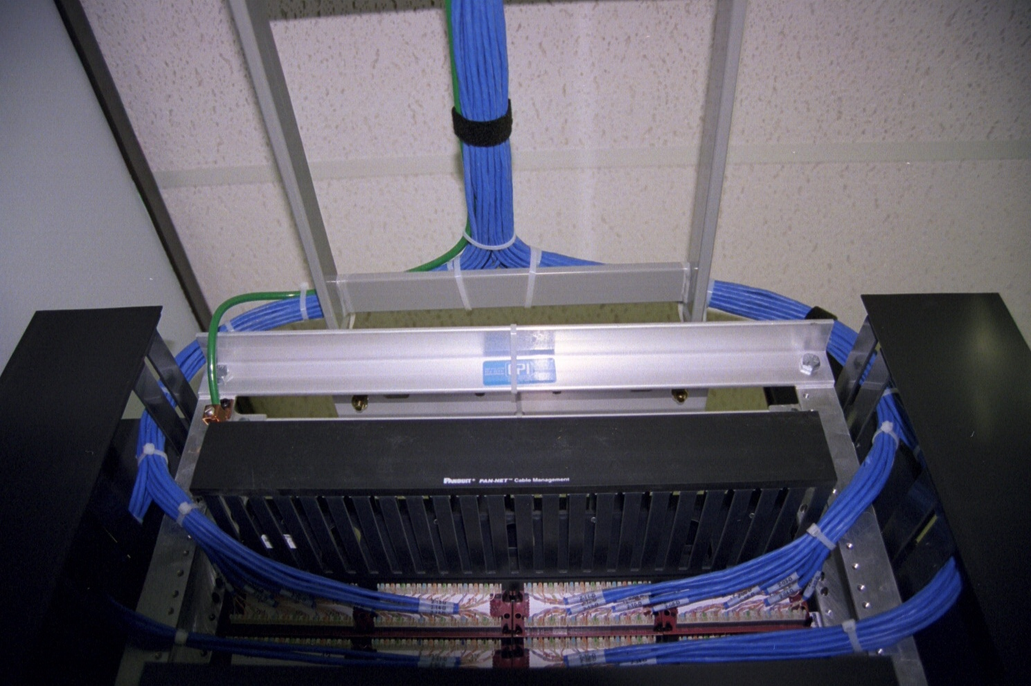
Grounding Racks

Slide 108
Grounding Racks

Slide 109
Grounding Racks

Slide 110
Grounding Racks

Slide 111
Grounding
The standards call for a two-hole compression lug for the attachment to the ground bar
The wire used should have a green color to indicate its use as a grounding connection
In general a #6 AWG wire will suffice for these types of short runs

Slide 112
Grounding
Although not yet a requirement it is expected that the standard will eventually call for a jumper connection from all devices to the rack, instead of relying on the AC power cord ground wire
Other changes are expected as well

Slide 113
Relay Rack
Things are mounted to a relay rack using Pan Head Machine Screws
Of course any head style will work
The size is either a 10-32 or a 12-24 depending on the rack
This refers to the diameter and thread pitch
They are ½” to ¾” long

Slide 114
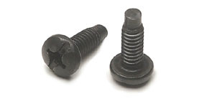
Relay Rack

Slide 115
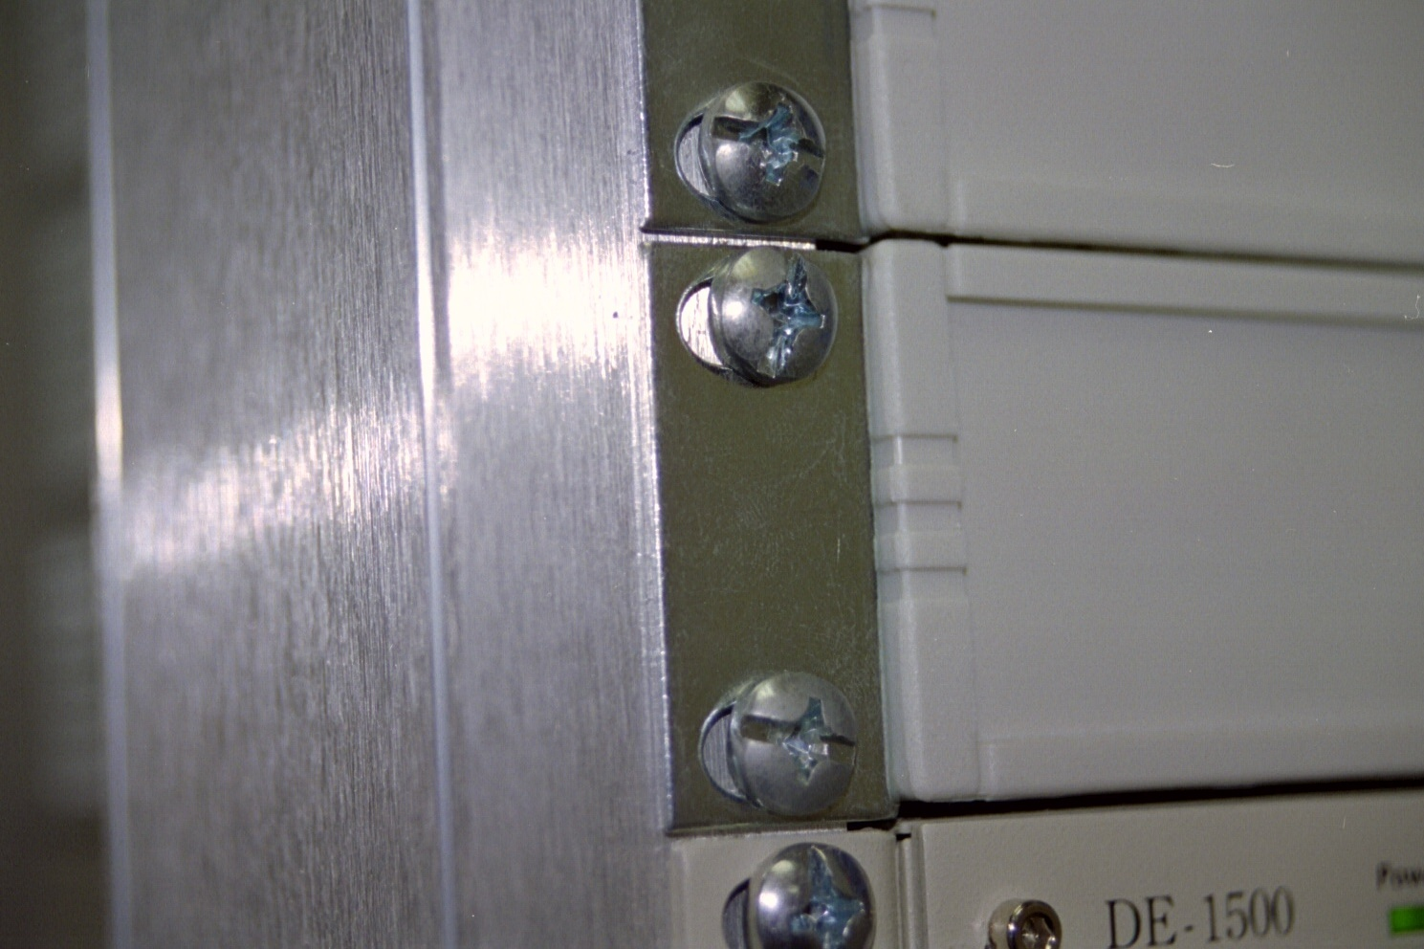
Relay Rack

Slide 116
Relay Rack
Width of the rack is usually 19 inches
Some racks are 23 inches wide, especially those used with high price WAN equipment
Check the size of the equipment before having the rack installed

Slide 117
Relay Rack
It is a good idea to document the layout of the boards in the hubs and other configuration information
A copy of the manuals, especially the quick setup manual, should be stored here also
These can be stored on the Relay Rack itself

Slide 118
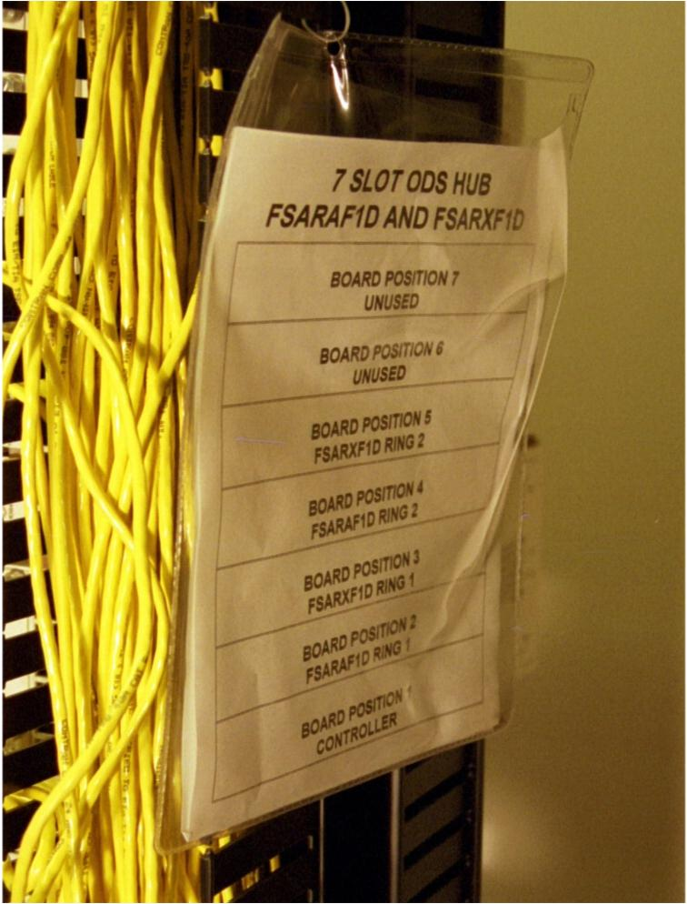
Relay Rack

Slide 119
Relay Rack – Wall Mount
Relay racks need not be seven feet tall and bolted to the floor
They can be any size
If they are shorter than seven feet, then they are usually bolted to a wall and swing out for access

Slide 120
Relay Rack – Wall Mount

Slide 121
Equipment Rack
Instead of bolting something to the floor a free standing rack such as shown next may be used instead
It makes no difference, suit yourself
A rack like this costs from $2,000 to $4,000

Slide 122
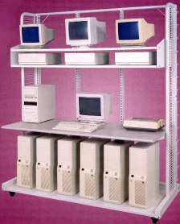
Equipment Rack

Slide 123
Command Center
If you want to look really slick, spend money on a command center
Sitting at one of these you will think you know what you are doing, even if you don’t

Slide 124
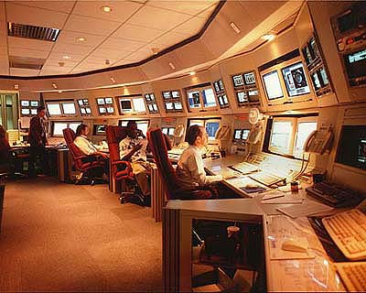
Command Center

Slide 125
Equipment Cabinet
As mentioned above a room is not even needed if all of the equipment can be put into a single enclosed and ventilated enclosure
Equipment cabinets are also useful when installed in a large room with a raised floor
For example

Slide 126
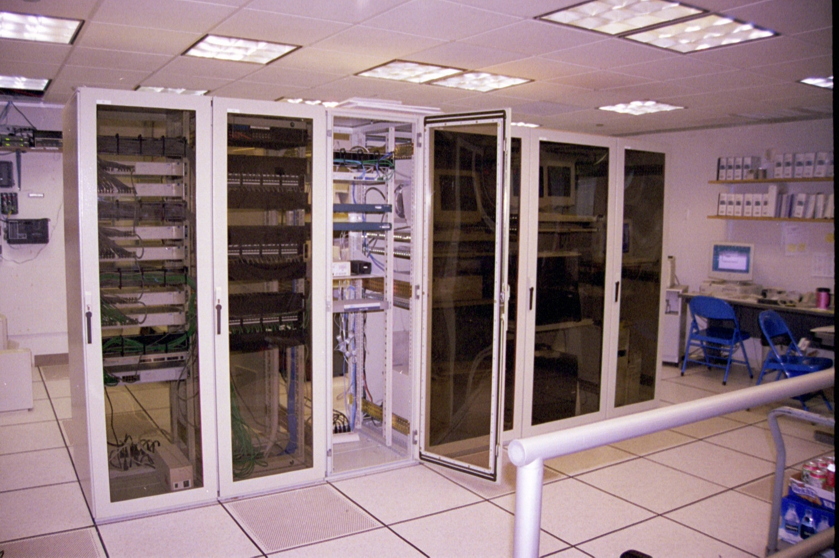
Equipment Cabinets

Slide 127
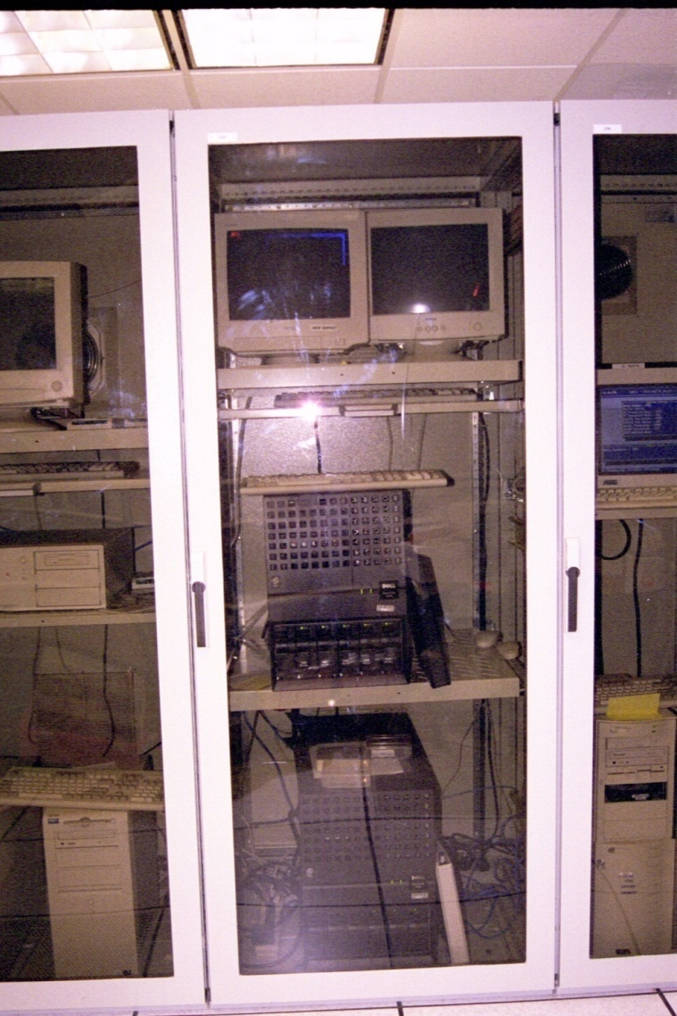
Equipment Cabinet Front

Slide 128
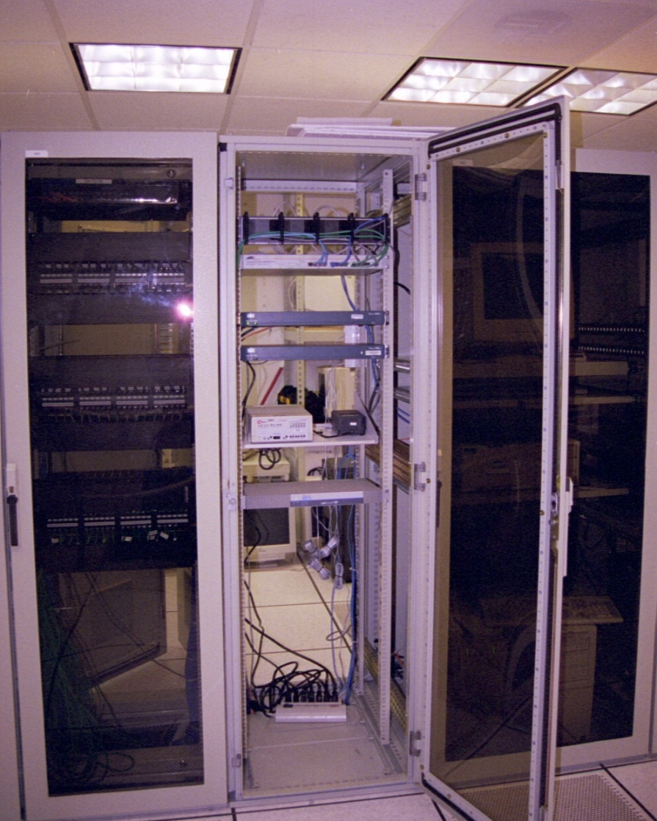
Equipment Cabinet Front

Slide 129
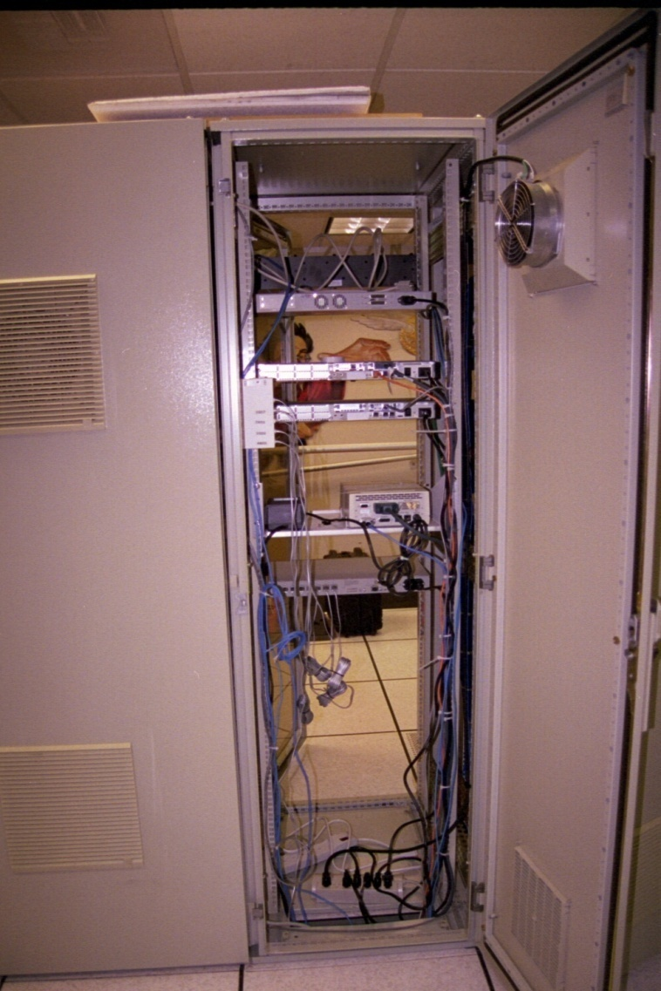
Equipment Cabinet Back

Slide 130
Equipment Cabinet
Be sure that the equipment will fit in the space available
Also account for the heat load that will go in the cabinet
Most equipment cabinets are rated to handle 3,000 to 5,000 BTUs

Slide 131
Equipment Cabinet
The manufacturers of the stuff you are putting in the cabinet can supply BTU figures
If the heat load is too high, additional fans must be installed in the cabinet
Place the cabinet so that there is easy access to all doors, front, back or side
3 feet is good, if space is available

Slide 132
The U
Things that mount in a relay rack or equipment cabinet are measured in rack units
One unit or 1U is 1.75”
So if the vendor says something is 7Us you know it will take up 12.25 inches of space
Standard size racks and cabinets hold 42 to 45Us of equipment

Slide 133
Mounting Equipment
When equipment is mounted in a rack, put the heaviest stuff at the bottom, especially in a relay rack
The heaviest equipment is usually the UPS
Put the monitor where it can be seen
Put the keyboard where it can be used

Slide 134
Bread Rack
All of the above is pretty expensive
Almost as good and much cheaper is a bread rack
Such as

Slide 135
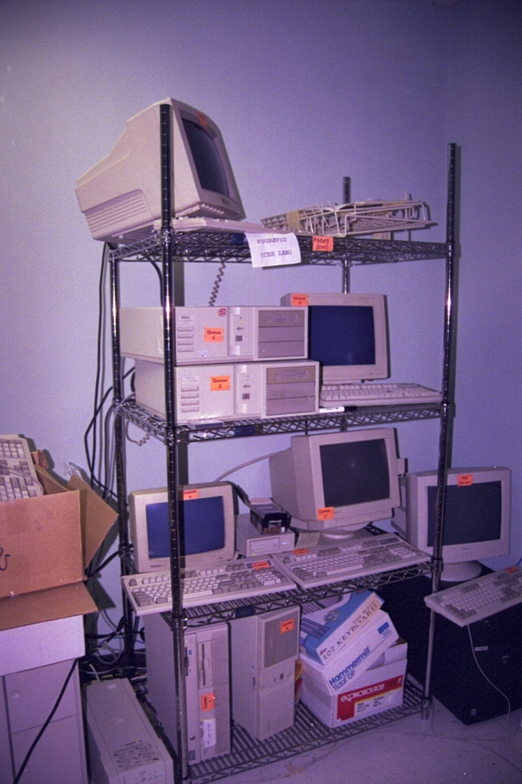
Bread Rack

Slide 136
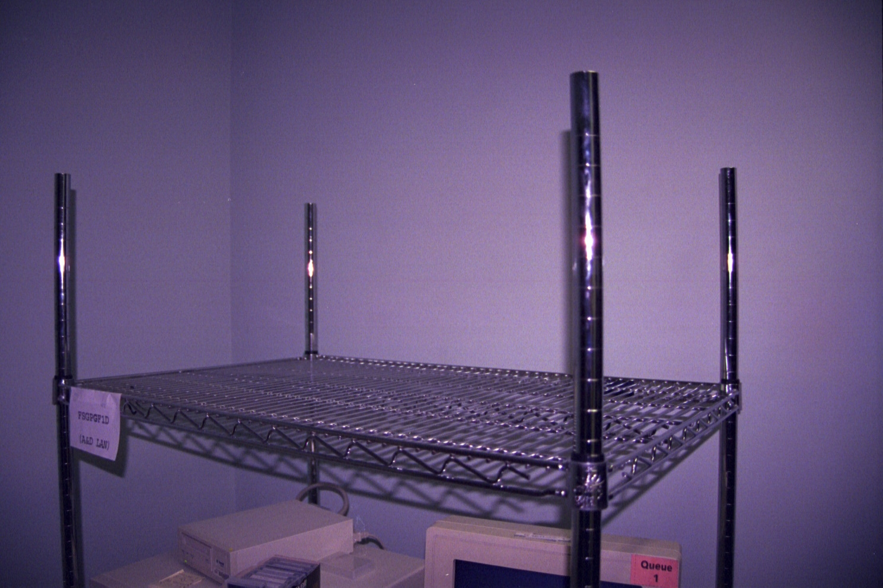
Bread Rack

Slide 137
Crash Cart
If you really need to, you can put it all on wheels
This works especially well in test centers and for large diagnostic setups

Slide 138
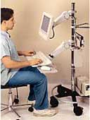
Crash Cart

Slide 139
A Bunch of Tables
A less costly solution is to just put a bunch of tables in the room and stack everything on the them

Slide 140
A Bunch of Tables

Slide 141
The Wall
If there are only a couple of pieces of equipment, such as makes up this very small LAN, mount all of it to a wall

Slide 142
The Wall

Slide 143
The Floor
Finally if all else fails or you want to take a chance of water damage, crud, and people kicking the equipment, just put it on the floor
Although I do not recommend this idea

Slide 144
The Floor

Slide 145
KVM
To reduce the amount of equipment that has to be put in the rack or on the table a KVM – Keyboard, Video, Monitor – switch can be used
With such a thing a single keyboard, a single monitor, and a single mouse can be used to control from 2 to 200 computers
These look like this

Slide 146
KVM

Slide 147
KVM

Slide 148
Headless Server
A server can also be managed remotely without a keyboard, monitor, or mouse being attached to it at all
This is done using Telnet or some other remote management program
This is called a headless server

Slide 149
Electrical Power
Has anyone ever heard of any problems with the power supply anywhere in the country
Can anyone think of any reason to monitor, filter, or provide temporary power to computer equipment

Slide 150
West Coast

Slide 151
East Coast

Slide 152
Electrical Power Management
There are several aspects to providing electrical power to the equipment room
These range from the proper installation of the power, to monitoring the quality of the power, and to what to do if the power goes off
Each of these will be discussed

Slide 153
Power Supply
The first thing to do is be certain proper quality power is supplied to the WAN room
This is done when the room is first setup
The proper way to supply standard 120-volt power to a network device is through a dedicated, isolated, and grounded circuit
This means each circuit goes from its own breaker in the breaker panel to a single duplex outlet

Slide 154
Power Supply
The only loads on this circuit are the ones attached to that outlet or to a power strip attached to that outlet
This prevents the problem of people plugging strip heaters into the same circuit, which then trip the breaker, resulting in the power going off

Slide 155
Power Supply
This also prevents voltage variations from other equipment on the circuit going on, going off, or drawing various levels of power as it operates, such as a copy machine
Each circuit should also have an isolated ground which is one that is attached directly from the outlet to the circuit breaker panel

Slide 156
Power Supply
For regular outlets the ground is via the conduit the cable is carried in or shared by other outlets through a common wire
The ground for these regular circuits may not be at the circuit breaker box, but to the building structure near the outlet

Slide 157
Power Supply
This helps to be certain that quality power is delivered to each device
This type of circuit is designated by an orange outlet with a small green triangle

Slide 158
Isolated Grounded Outlet

Slide 159
NEMA L Series and Others
In many cases the electrical outlet will not use the common household type connector as shown above
Instead it will be something along these lines

Slide 160
Electrical Connectors

Slide 161
NEMA L Series and Others
These are discussed below in more detail

Slide 162
Power Conditioning
Next is circuit protection and conditioning
This is done with surge protectors and circuit conditioners
The surge protector can be installed at the breaker box for the entire building, as part of a power strip, or built into the UPS
Circuit conditioning is usually part of the UPS in small to medium sized rooms

Slide 163
Power Monitoring
The second thing to do is to monitor the power being supplied to the site
This is done using a power monitoring device such as those offered by PowerTronics at www.powertronics.com or Fluke at www.fluke.com

Slide 164
Temporary Power
The last thing is to provide for temporary power if the main power fails
This can be done in three ways, each providing a step up in running time and cost

Slide 165
Planning for Power Loss
There are four basic steps to planning for a power loss
Determine the worst case scenario
Are you concerned about a sag, spike, lightening, or other short term outage
Or are you concerned about an extended outage due to failure of the power grid
Decide what systems must be kept running and for how long
As always compute if it is simply less expensive to suffer the downtime, than to correct it

Slide 166
Planning for Power Loss
In some cases, such as a hospital, it does not matter what the cost is
Count the kilowatts needed
The number of these depends on the size of the organization and the equipment used
There are some guidelines below
Decide whether to buy or rent
Compute the costs for all alternatives
Decide whether you want to hire or train someone to manage such a system

Slide 167
Size the Power Supply
Regardless of the method used to provide the backup power be sure to size it according to the loads that will be placed on it
Depending on the size and cost of the site it may be best to have a power audit done by an electrical engineer or a company like APC - American Power Conversion, that makes UPSs

Slide 168
Size the Power Supply
It will evaluate exactly what you have, what you need, and what needs to be done to get the site up to the required level for a few hundred to a few thousand dollars
For a basic estimate of the proper size UPS, which is the minimum power backup system everyone should have, a calculation of the VA - volt-amperes must be done

Slide 169
Size the Power Supply
The problem is for older equipment power ratings are in watts and UPS ratings are in volt-amperes
Both of these measure power, but they are not the same thing
For the older equipment a power factor correction must be applied

Slide 170
Size the Power Supply
You must make sure that the total VA used by your computer equipment is less than the VA available from the backup power system
Alternatively, you must make sure that the wattage used by your equipment is less than the wattage available from the backup power system

Slide 171
Size the Power Supply
Only when all of your equipment has power factor correction can you indiscriminately mix the VA and watts in making comparisons
To convert a VA rating to a watt rating, multiply the VA by the power factor of the backup power supply

Slide 172
Size the Power Supply
To go the other way, watts to VA, divide the wattage rating of the backup power system by its power factor
For computers made before the year 2000, a safe value to assume for the power factor is 2/3

Slide 173
Size the Power Supply
If all you have is recently manufactured computers and peripherals, you need not worry about these details
Nearly all servers made since early in the year 2000 have built-in power factor correction, which means that the number of watts the equipment consumes equals the number of volt-amperes it consumes

Slide 174
Size the Power Supply
Total up all the equipment you want to protect, and select a UPS that will handle it
The basic rule of thumb to use is
If you do not know the VA loading, take the Watt rating of your equipment at 120 volts AC and multiply by 2.5 to figure a very safe VA rating

Slide 175
UPS
A UPS is an Uninterruptible Power Supply
In essence it is a collection of batteries that provides running time for critical components if the main power goes off
Most UPSs provide from 10 minutes to two hours of running time
Once the battery runs down there is no more power

Slide 176
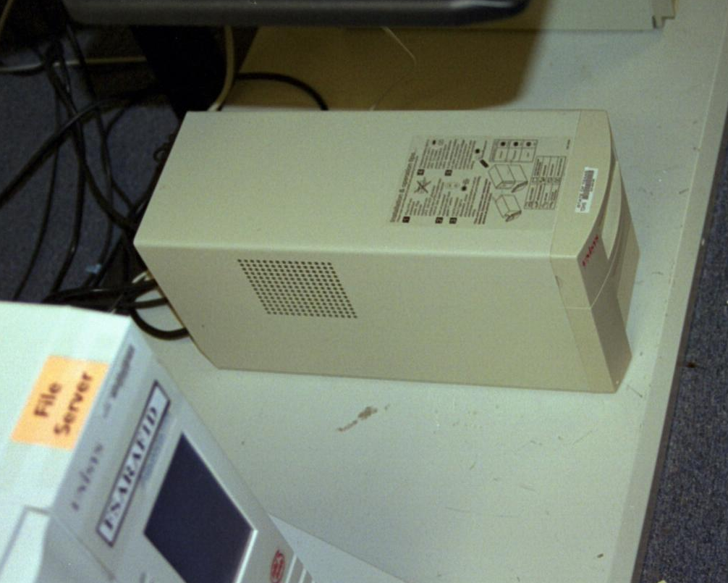
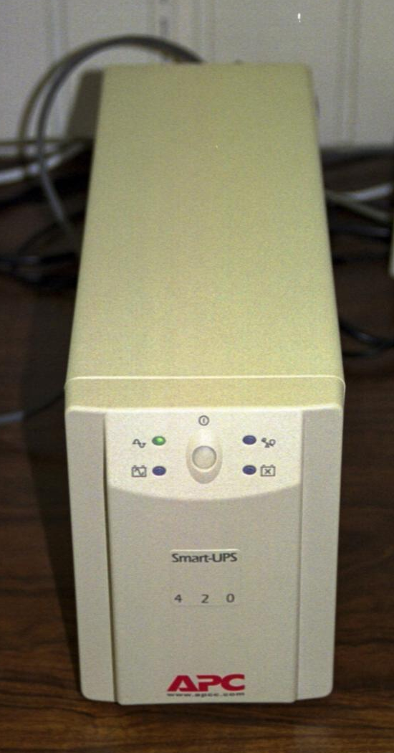
Small UPS
A small UPS suitable for a few devices

Slide 177
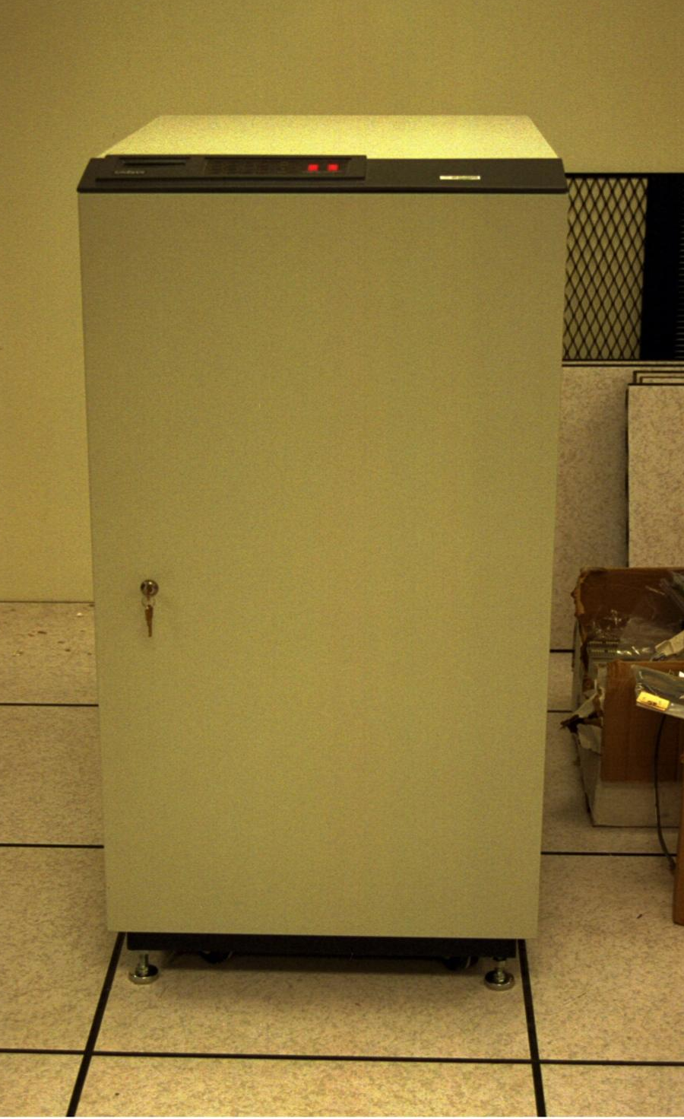
Medium UPS

Slide 178
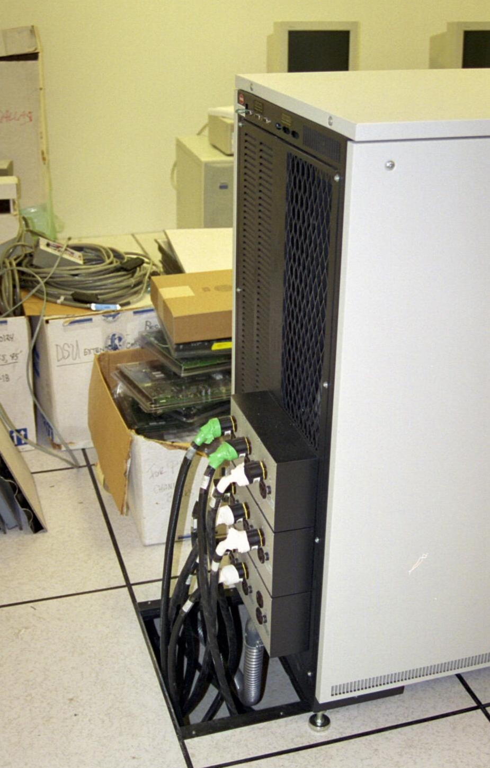
Medium UPS

Slide 179
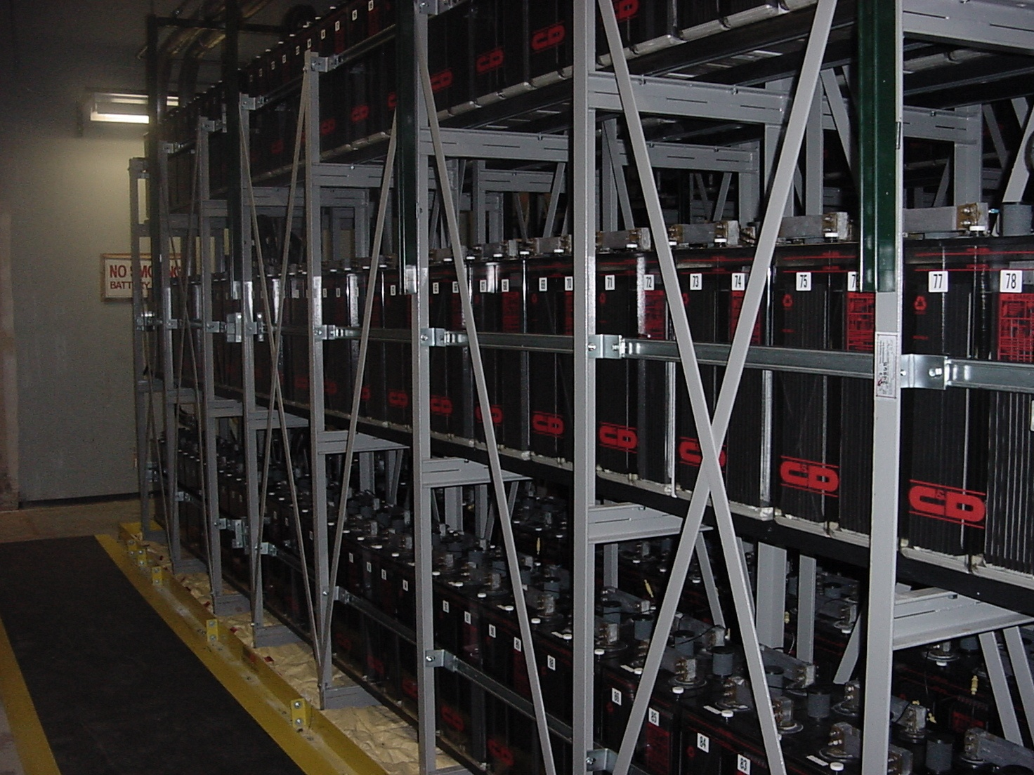
Large UPS

Slide 180
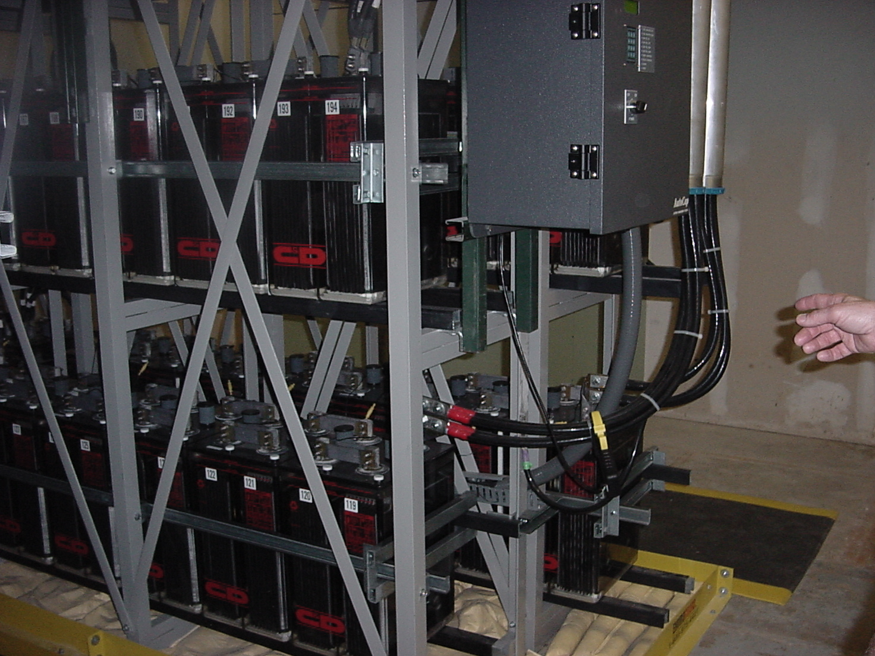
Large UPS

Slide 181
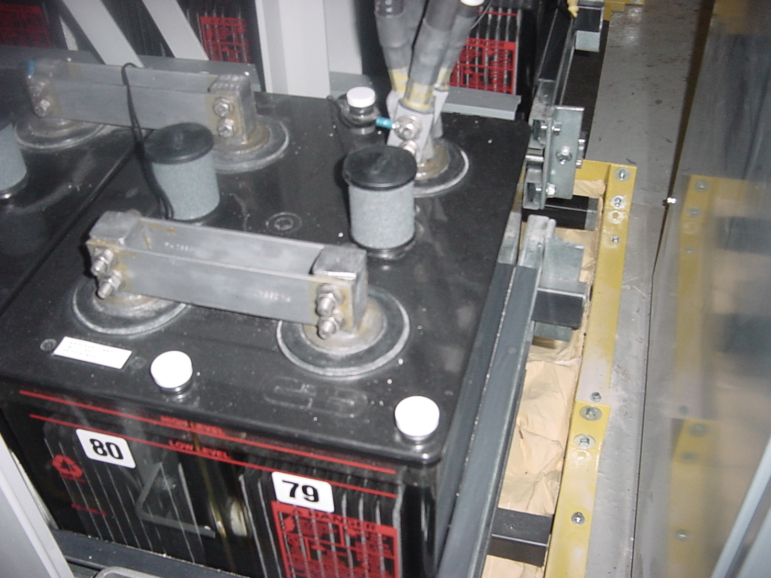
Large UPS

Slide 182
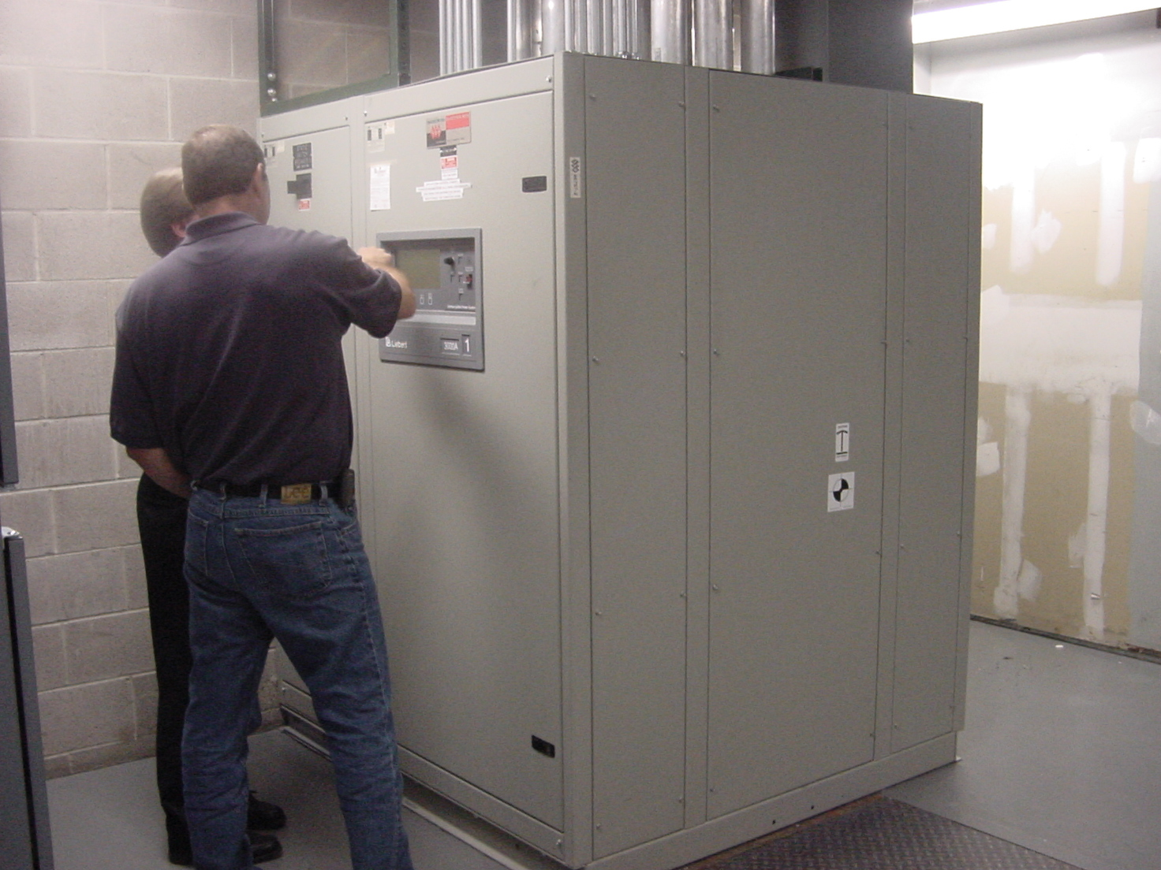
Large UPS

Slide 183
Large UPS
Each of the batteries in this array weighs 450 pounds
It takes 345 for this facility, which is a large telecom business

Slide 184
What Size UPS
A rule used for determining whether you need a small, medium, or large UPS is to add up the kVA for the equipment to be protected, then add 25%
The better way is to talk to an expert, especially when a medium to large one is needed

Slide 185
Types of UPSs
There are three basic kinds of UPS
The standby UPS is the simplest and the cheapest
It only switches to battery power if there is an incident; as such the switchover may be too slow to prevent loss of data

Slide 186
Types of UPSs
Line-interactive systems will actively fix sags and spikes in line voltage with power conditioning transformers; they'll only switch to battery power when the source reaches a certain threshold voltage

Slide 187
Types of UPSs
The advantage of the line-interactive UPS is that the batteries are not constantly being used and therefore not constantly being drained; so they should be at full power when an incident does arise
The last type of UPS is the online UPS
These are the best sources of power protection since they constantly convert power

Slide 188
Types of UPSs
They receive AC power from the utility source, convert it into battery DC, and then back in to AC in a constant 120V stream
When power fluctuations occur from the outside line, they never make it to equipment since all power is regulated internally in the UPS

Slide 189
Types of UPSs
Because of this, the power that goes to the equipment is always cleaned - that is, there is no noise, because of the "double-conversion" process within the UPS
There is no transfer time between utility source and battery

Slide 190
Types of UPSs
Online UPS' eliminate most noise and provide the steadiest voltage of the three different types and can usually protect against the most massive of spikes and surges compared to the others

Slide 191
Batteries
Regardless of the size or type of UPS the batteries will eventually have to be replaced
This can be on a schedule or when the periodic tests you should also be doing show the need

Slide 192
UPS Connectors
As the size of the UPS goes up the connectors used changes from the standard household plug
This is to ensure a solid connector
Prevent unplugging by accident
And ensuring proper grounding
An example of a common connector used is the NEMA L series

Slide 193
UPS Connectors

Slide 194
UPS Connectors

Slide 195
UPS Connectors
To use these the wall outlet will have to be wired with the correct plug
The equipment that will connect to the UPS will also have to have the correct plug

Slide 196
Automatic Shutdown
Keep in mind that even with a UPS when the batteries run down, there is no more power
The servers stop running
This is very bad on most servers
If the power loss occurs while everyone is at work, no problem, just go down the servers using the approved method

Slide 197
Automatic Shutdown
What if the power goes off at 2 in the morning during a driving thunderstorm
The point being that a battery backup without a program running on the server that talks to the UPS is pointless
Who is going to go into work at two in the morning during a severe thunderstorm to turn off the server

Slide 198
Automatic Shutdown
An automatic shutdown program will do this for you
This will help to save the data on the server

Slide 199
Generator
If the site must continue in operation after the expected running time of a UPS, the next step up is a generator powered by a gasoline or diesel engine
The size depends on the load
A very small site might get by with one this size, which you can store in a closet

Slide 200
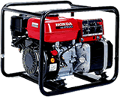
Small Generator

Slide 201
Large Generator
In most cases a site that needs to be kept running regardless of power loss is quite a large site
As such it will need a bigger generator
Like these

Slide 202
Generator

Slide 203
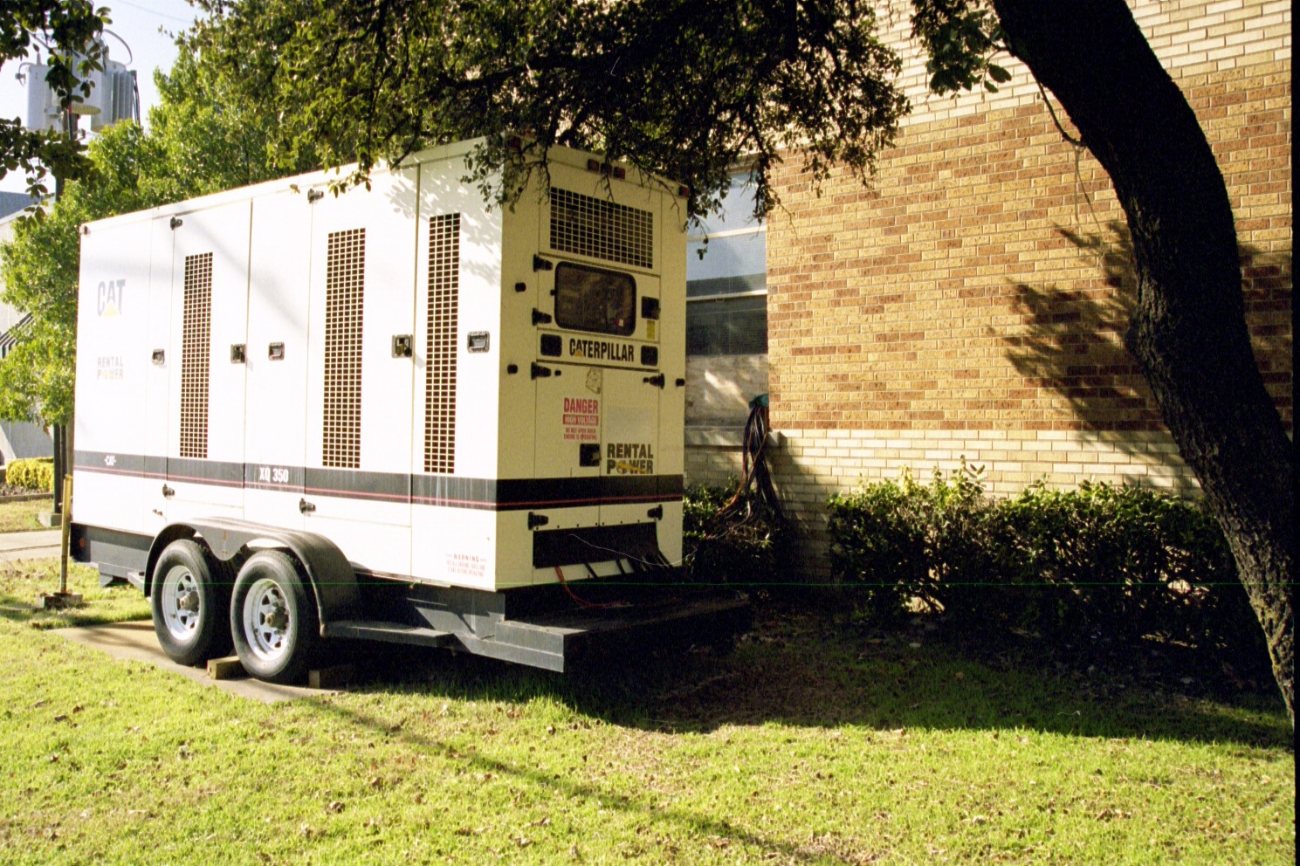
Generator

Slide 204
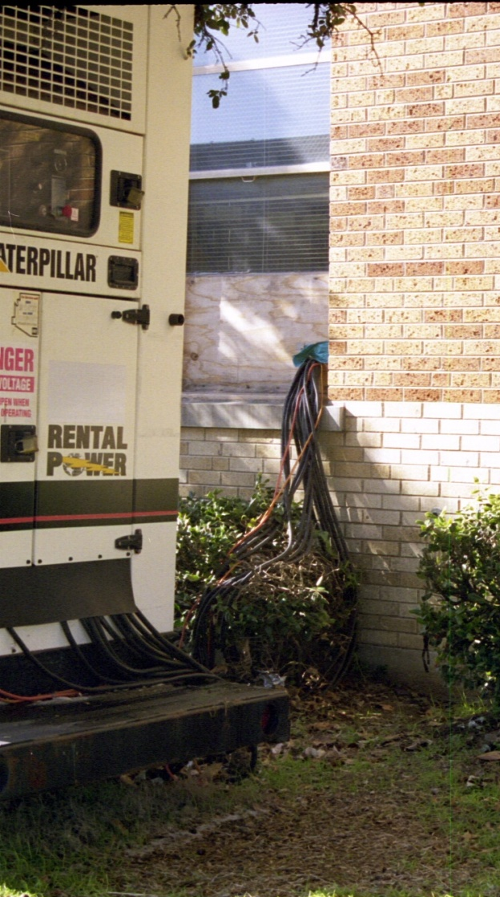
Generator

Slide 205
Generator
Size of Organization | 25 Person Office | 200 Room Hotel | 500 Person Office
Generator Capacity | 75 kW | 400 kW | 2,000 kW
Engine Type | Natural Gas/Diesel | Diesel | Diesel
Engine Size | 125 hp | 600 hp | 1,500 hp
Fuel for 48 hours | 100 gallons | 400 gallons | 1,320 gallons
Purchase Cost | 20,000 | 100,000 | 600,000
Rental Cost | 2,000 | 5,000 | 25,000

Slide 206
Multiple Power Grids
The final level is to attach the site to two entirely different power grids if the electrical power provider can do this
This way if the main power grid fails, the electrical service will be switched to the second grid

Slide 207
Fuel Cell
Instead of all of this some organizations are starting to use fuel cells instead
For example as the web site of one of the companies selling these products says

Slide 208
Fuel Cell
High availability, high 9s, premium power, computer grade, or uninterruptible electricity, no matter what term you use, there is only one on site power plant with guaranteed availability beginning at six 9s, 99.9999% uptime

Slide 209
Fuel Cell
Matching high availability electricity with high availability computers allows web hosting centers, collocation centers, ISPs, ASPs, corporate data centers, and industrial process facilities to substantially increase uptime, thereby raising revenues and decreasing losses

Slide 210
Fuel Cell
The clean and green Sure Power System is the primary power source for the critical load
The utility grid becomes a backup power source
The System is 100 to 1,000 times less likely to fail than static UPS, batteries, and standby diesel generators used today

Slide 211
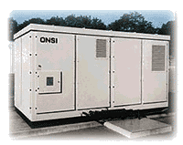
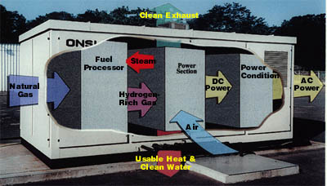
Fuel Cell

Slide 212
Fuel Cell
An interesting idea
Check http://www.hi-availability.com/ for more information on this approach

Slide 213
Dual Power Supplies
In some cases it is wise to run two independent power systems that duplicates all or part of what was just discussed
For example

Slide 214
Dual Power Supplies

Slide 215
Routing Power and Data Cables
Power and data cables must be separated from each other to prevent EMI in the data cable
There is no standard for this
Common practice says to do it this way

Slide 216
Routing Power and Data Cables
Power Level | In Spaces | In Pathways
Less than 3 kva | 2 inches | 2 inches
3 to 6 kva | 10 feet | 5 feet
More than 6 kva | 20 feet | 10 feet

Slide 217
PoE
PoE – Power over Ethernet was created to provide power to devices over the existing UTP cable
This includes many types of devices such as wireless access points and IP telephones
The standard for this is 802.3af
This standard was approved on 12 June 2003

Slide 218
PoE
There are two elements to a PoE system
PSE – Power Source Equipment
PD – Powered Device
PSEs are devices such as switches with ports designed to deliver power
The PD could be any device that uses a RJ-45 connector to talk to the network

Slide 219
PoE
That is any device that requires 15.4 watts or less of power
The voltage at the PSE is 48 volts
The standard has five power classifications
0 – 15.4 watts
1 – 4 watts
2 – 7 watts
3 – 15.4 watts
4 – Not used yet

Slide 220
PoE
Either of two sets of wires can be used to deliver the power
The first method, Alternative A, uses the data pins of 1, 2, 3, and 6
This is sometimes called phantom power

Slide 221
PoE
The second method, Alternative B, uses the normally unused pins – 4, 5, 7, and 8
The power can be delivered by the switch or a device inserted into the line to provide power
Endpoint switches can use either alternative
Midspan inserted devices can only use Alternative B

Slide 222
PoE

Slide 223
PoE

Slide 224
PoE

Slide 225
PoE
In the case where the end point uses a 1000Base connection that requires all eight wires for the data the electrical power is delivered or floated along with the data
1000base devices can only be powered from the end point, never by a midspan device

Slide 226
PoE
The standard includes protection to prevent other devices such as printers from being damaged by connection to a PSE port
The PSE only sends electrical power down the cable if the device at the other end asks for it

Slide 227
PoE
The 802.3af standard uses a DC detection technique to determine whether a powered device is attached and to which power classification the device belongs
A DC voltage is applied between the transmit and receive pairs
Then either the received current or voltage is measured

Slide 228
PoE
To deliver power to a port a PSE will expect to see a 25K Ohm resistance between the pairs for the device to be considered a valid powered device
If the PSE does not detect a valid 25KOhm resistor, power is not applied to the port

Slide 229
PoE
Once a powered device has been detected, the PSE may perform powered device classification
This is done by the PSE applying a DC voltage and current to the port

Slide 230
PoE
If the PD supports optional power classification it will apply a load to the line to indicate to the PSE the classification the device requires by attenuating the DC voltage
The PSE then determines the powered device’s power classification using the Volt-Amp slope returned by the powered device’s signature

Slide 231
PoE
If the powered device does not support classification, the powered device is assigned to Class 0
Each PSE must maintain a power budget
This is the maximum amount of power the PSE is rated to deliver
If the number of devices asking for power exceeds this budget, then one or more devices will not be provided with power

Slide 232
PoE
Keep this in mind when troubleshooting device failures
The standard also includes methods for determining that a power capable PD has been disconnected and a non-power capable device has been plugged in
Basically when the link status goes down, power is disconnected

Slide 233
PoE
A potential problem with powering all network connected devices is the wiring closet power requirements that result
With a large number of PDs the electrical service to the wiring closet may grow from a 15 amp circuit to a 50 amp circuit
Office buildings do not have that type of power to the wiring closets

Slide 234
PoE
For example, if 240 devices require power, such as VoIP telephones, 3,695 watts of power would have to be delivered to the end point devices
In addition the typical switch requires 1,000 to 2,000W
This yields 5,000 to 6,000W of power
A 110 volt 15 amp circuit can provide 1,650W

Slide 235
PoE
To upgrade this circuit the cabling will have to be replaced
Even that has a limit when dealing with 110 volt circuits
The maximum 30 amp circuit can deliver 3,300W per circuit
In addition to the electrical power requirements, the heat load will increase

Slide 236
PoE
IDFs, for example, may become too warm without supplemental air conditioning

Slide 237
PoE+
Even worse for heat loading is the revision to PoE that the IEEE is working on
POE+ or 802.3at is expected to deliver up to 30W per port
At this power level there are questions as to the ability of standard copper cables to handle this heat load
In addition, this will require even more power to the LAN room

Slide 238
PoE+
The IEEE, TIA, and ISO are looking into this heat problem
A TSB from TIA is expected
Right now the thinking is a maximum heat rise of 10 degrees C will be allowed, up to an absolute of 50 degrees C

Slide 239
New Versions of PoE
Some new versions of PoE are being discussed according to a webinar by Microsemi

Slide 240
New Versions of PoE

Slide 241
New Versions of PoE

Slide 242
New Versions of PoE

Slide 243
New Versions of PoE

Slide 244
New Versions of PoE

Slide 245
New Versions of PoE

Slide 246
New Versions of PoE

Slide 247
New Versions of PoE

Slide 248
Floor Covering
Generally speaking for the average LAN room I do not think it makes much difference what is on the floor from concrete to carpet
And since I never wear shoes while working and sometimes take off my socks as well I am partial to carpet everywhere

Slide 249
Floor Covering
But technically speaking this is a poor choice, even the very short pile office type carpeting, as any carpet will build up static electricity
I have yet to zap anything in the office environment, although I have ruined a couple of things at home
So let’s go over what you should do

Slide 250
Floor Covering
Don’t do what I do as carpet, socks, and cool dry air are not a good combination
ESD is the concern
This is electrostatic discharge
ESD occurs when one material has an excess of electrons and another device has too few

Slide 251
Floor Covering
When the two get near each other, nature seeks to achieve a balance
This balancing act is the spark from the ESD

Slide 252
Floor Covering
Methods to use to reduce this risk include
Tile
Linoleum
Metallic Tiles
Antistatic Mats
Table Mats

Slide 253
Floor Covering
Tile means just normal floor tile
It is less likely to build up static than carpet
The same is true of linoleum
More fancy are metallic tiles which are grounded to the power supply for the room
If you do not want to change the existing floor covering, antistatic mats can be grounded through a screw on a wall socket

Slide 254
Floor Covering
Table mats do the same thing
The only difference being you stand on the antistatic mat, whereas the equipment stands on the table mat
If you don’t want to do any of these, you can always use a wrist strap or ankle strap

Slide 255
Physical Security
How physically secure the site should be depends on the level of risk and the tolerance to loss that can be tolerated
Security must take into account access to the site in all four dimensions
The door
The floor
The walls
The ceiling

Slide 256
Physical Security
In some cases as was seen before there is no security
All equipment is just placed on a table or desk out in the open
This is poor practice because anyone, disgruntled employee or upset customer, can easily get to this equipment

Slide 257
What’s Wrong Here
The following picture is from the Cisco Networking Academy website
This is the program that trains future network administrators
What’s wrong with this picture

Slide 258
What’s Wrong Here

Slide 259
The Door
The first thing to do is to secure the door
A latch should be put on the door to control access so as to restrict access to certain individuals and certain times of the day, such as a card reader as shown next
The reader is the small gray device to the left of the door
These systems cost from $1,000 to $2,000 in year 2000 prices in most cases

Slide 260
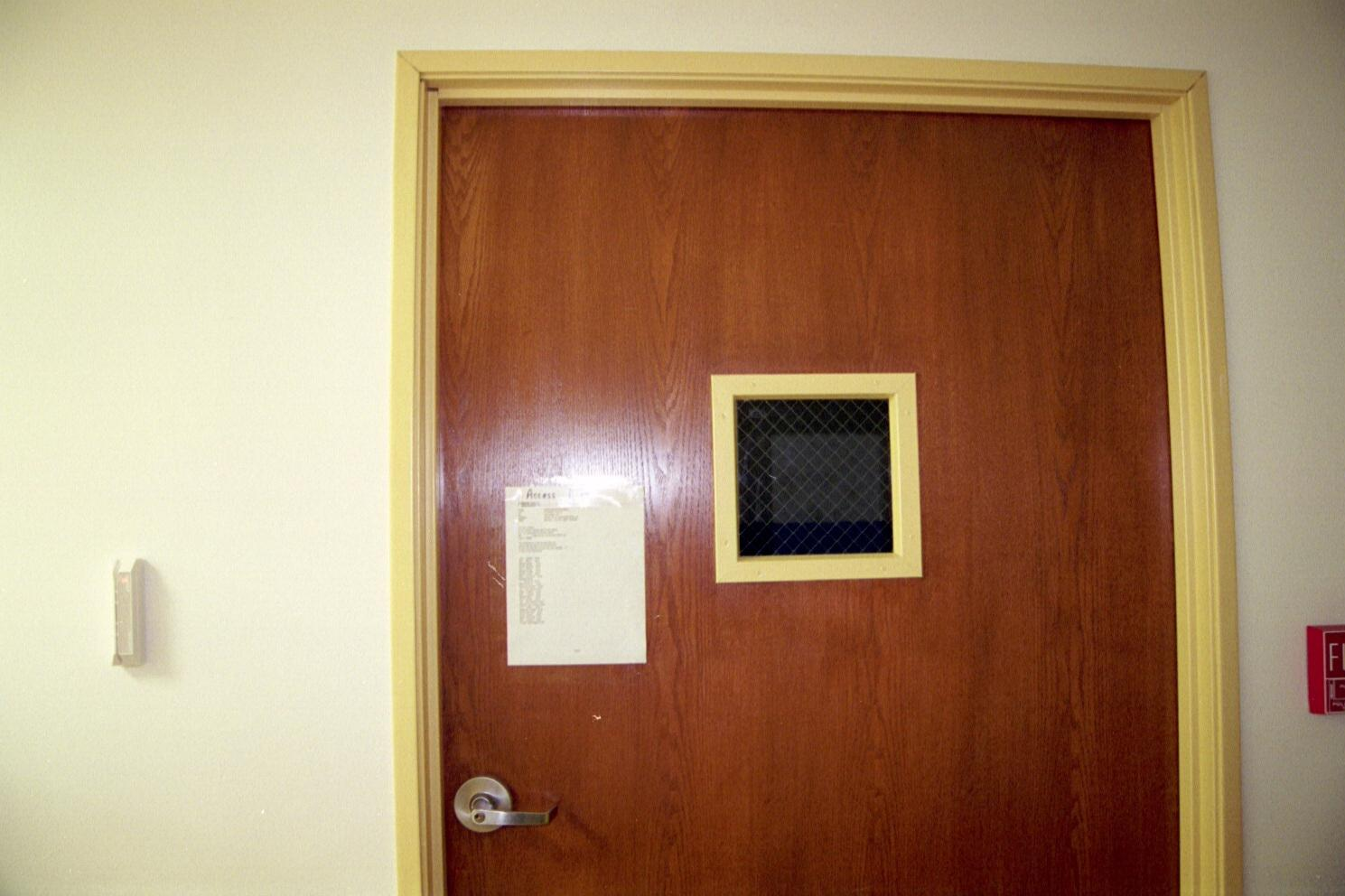
The Door

Slide 261
The Door
A combination lock system could also be used
If so, issue a different combination to each user, and issue new combinations periodically and whenever a combination is compromised
Have a procedure in place that revokes user access when a user leaves the company

Slide 262
The Door
Use a lock that has a shield so that only the user entering the combination can see the keypad
Configure the lock to record an event log of users entering the locked area
You can also use a door camera to further document the user and any guests who enter with the user

Slide 263
The Door
Use a metal or solid core wood door that's substantial enough to resist being forced open by shoulder impact
Reinforce the doorframe and strike plate to further resist shock loads and prying
Locate hinges so that intruders can't remove hinge pins from outside the door, or use nonremovable hinge pins

Slide 264
The Door
Use long screws to attach hinges and strike plates to the surrounding wall structure
Also use one-way screws that cannot be removed
Weld the nuts onto any bolts that extend through the surface of steel doors
For fire doors and secondary exits equip the door with an alarm unit and heavy-duty lock

Slide 265
Floor/Wall/Ceiling
What the floor, walls, and ceiling are made of is also very important
For example, a few years ago I was moving into a new building
For reasons I still do not understand we were moving in before the building was finished
When I went to open the door to my office, I found it locked and no key

Slide 266
Floor/Wall/Ceiling
As I was complaining about this an electrician walked by
He said no problem I'll open it for you
So he set his ladder down, picked up a short piece of electrical conduit, climbed the ladder, and opened the door by raising the ceiling tile up and reaching over the wall to push down on the door handle
It took him about one minute to do this

Slide 267
Floor/Wall/Ceiling
As you can see a false ceiling is no security at all
Besides opening doors, someone can just crawl over the top of the wall and drop into the room

Slide 268
Floor/Wall/Ceiling
Typical office walls are no barrier either
Have you ever had to repair a hole in the wall caused by children playing
Even better, have you ever made a hole in the wall to hang a picture
Wallboard can be penetrated in just a few minutes

Slide 269
Ventilation System
Secure any vents that lead into the data center
This could be inside the building or a roof vent
Inspect these areas periodically to be sure no one is slowly working on them

Slide 270
Signs
Signs and wall maps that say here is where all of the really expensive equipment is located are a poor idea as well

Slide 271
Location in the Building
If possible keep the data center away from areas where it will share a wall with an unused space or exterior wall
People have been known to just back a vehicle through an outside wall
Windows are always a bad idea
Try also to avoid high traffic areas
You want a stranger to be noticed

Slide 272
Cabling Security
Security for the cabling system may be a consideration as well
Cables can be tapped physically or by sensing the EMI they put off
Conduit may be run throughout the building to help prevent this
However, this is quite expensive

Slide 273
Electrical Power Security
If local codes allow, secure the electrical panels that feed the area
Some will turn the power off hoping the security system will be disabled as well
Of course if the security system has a battery backup, test it

Slide 274
Surveillance
Keep an eye on things with cameras feeding to a video recorder
Use obvious ones and hidden ones
Consider combining door switches, motion detectors, sound-discrimination sensors, photocell beams, proximity switches, IR sensors, and cabinet-door switches into a comprehensive detection system

Slide 275
Surveillance
Carefully control information about the details and location of any surveillance devices that you install

Slide 276
Remote Access
Logging into equipment from home in the middle of the night is a lot more convenient than driving into work
However, what is convenient for you is also convenient for everyone else

Slide 277
External Monitoring
You should be using a program to monitor server responsiveness and report offline servers, stopped services, and so on
However, this is probably a device in the data center
So, set up a secondary monitoring node outside the server room

Slide 278
External Monitoring
This unit will sound the alarm if an intruder disables the network connection or shuts down the primary unit to prevent notification pages from getting out of the server room

Slide 279
Inventory and ID Tags
Keep an inventory of all computer equipment that someone could remove
Such as servers, disk drives, and monitors
Attach asset tags or other markings to these devices
Compare actual equipment with asset records annually

Slide 280
Security
I am not talking about keeping professional spies out, just the use of common sense based on the amount of loss that can be tolerated

Slide 281
Earthquake Zones
In earthquake prone areas equipment must be installed according to the Uniform Building Code requirements for seismic anchorage or the more stringent NEBS – Network Equipment Building System requirement in GR-63-CORE

Slide 282
Markets Other Than the US
If you do work in other markets be familiar with
Canada – CSA standards
European Union – CENELEC and EN standards
Australia/New Zealand – AS/NZ standards
Everywhere Else – ISO/IEC standards
Many countries publish additional national standards

Slide 283
For More Information
Build the Best Data Center Facility for Your Business
Douglas Alger
ISBN 1578051826
Network Cabling
Chris Clark
ISBN 0072132337

Slide 284
For More Information
Cabling: The Complete Guide to Network Wiring
David Groth and Jim McBee
ISBN 0782126456
The Cabling Handbook - 2nd Edition
John R. Vacca
ISBN 0130883174

Slide 285
For More Information
The Telecommunications Industry Association
http://www.tiaonline.org/index.cfm

Slide 286
For More Information
Sean Donelan, a frequent contributor to the NANOG newsgroup suggests these sources for questions on electrical grounding in particular, electrical and other cabling installation in general

Slide 287
For More Information
He wrote in a message from April 2002
While working at a previous employer, I had the privilege of hiring Ralph Morrison to look at grounding in our facility
I spent some time with Mr. Morrison talking about different methods used in large installations
It was a great learning experience
If you don't know Mr. Morrison, check out a few of his books on the subject

Slide 288
For More Information
Specific sources he said to look at include
BICSI, Telecommunications Cabling Installation Manual
NFPA 70, National Electrical Code
IEEE Std 1100, IEEE Recommended Practice for Powering and Grounding Sensitive Electronic Equipment
IEEE Std 142, IEEE Recommended Practice for Grounding of Industrial and commercial Power systems

Slide 289
For More Information
Mil HDBK 419, Grounding, Bonding, and Shielding for Electronic Equipment and Facilities

Slide 290
For More Information
And these
Federal Information Processing Standards Publication 94, Guideline on Electrical Power for ADP Installations (A bit out of date, but explains where some of the weirder stories come from)
TIA/EIA-568-A, Commercial Building Telecommunications Cabling Standard

Slide 291
For More Information
TIA/EIA-569-A, Commercial Building Standard for Telecommunications Pathways and Spaces
And a few more
TIA/EIA-570-A, Residential and Light Commercial Telecommunication Wiring Standard
TIA/EIA-607, Commercial Building Grounding/Bonding Requirements for Telecommunications

Slide 292
For More Information
TIA/EIA-758, Customer-Owned Outside Plant Telecommunications Cabling Standard
IS0/IEC 11801, Generic Cabling for Customer Premises

