Slide 1
Detecting Errors Last Update 2009.03.04 1.0.0

Slide 2
Objectives
Learn how to detect errors in networks

Slide 3
Error Detection
Error detection is the responsibility of the data link layer
Error correction is done at the transport layer
Therefore this discussion will be limited to the detection of errors

Slide 4
Sources of Errors
Errors can occur for several reasons
Lost frames
Corrupted frames
Malformed frames

Slide 5
Lost Frame
A lost frame is just what it says
The originating NIC sent a frame out, but it was never received at the other end
Unfortunately the data link layer will never know this
It is the data link or physical layer that lost the frame, but the transport layer is the one that must notice this and initiate corrective action

Slide 6
Lost Frame
Why might a frame be lost
This is usually due to a physical layer problem such as bad wiring or a bad NIC
The only way to see this at the data link layer is to use a network analyzer to capture the conversation frame by frame
The network analyzer will also record the types of errors seen on the network

Slide 7
Lost Frame
For example

Slide 8
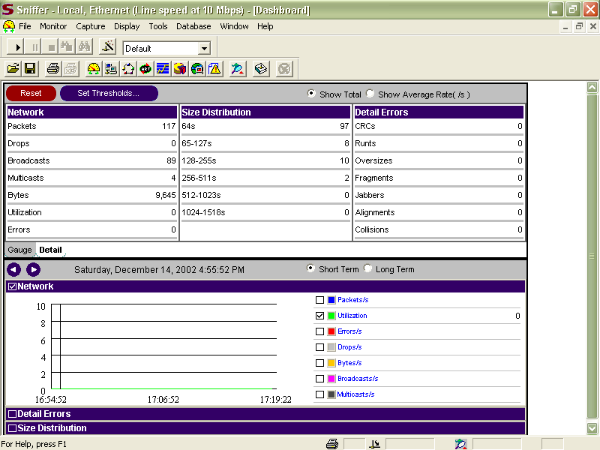
Network Analyzer Error Display

Slide 9
Corrupted Frames
A frame may be received, but is discarded because it was damaged in transit
This is the reason for the trailer or FCS – Frame Check Sequence part of the frame
There are two common FCS methods
Checksum
CRC

Slide 10
Checksum
The checksum is the most basic of the two methods
It counts the number of 1s in the frame just created except for the FCS itself
It stores the result as a binary number inside the FCS
The NIC at the other end does the same thing

Slide 11
Checksum
If the numbers match, the entire frame is assumed to be valid
The data is extracted and passed up to the network layer
If not, the frame is discarded
The problem with a checksum is enough errors can occur in a frame that the 1s still add up

Slide 12
Checksum
For if eight 1s are inadvertently switched to 0s, while eight 0s are changed to 1s the checksum still matches

Slide 13
CRC
A CRC – Cyclical Redundancy Check works differently
It looks at the contents of the header and data sections as a single binary number
A calculation is performed on this number
The result is stored in the FCS
The receiving NIC does the same thing

Slide 14
CRC
If the numbers match, the frame is considered to be valid
If not, it is thrown out

Slide 15
Malformed Frame
A malformed frame is one that is too large or too small
These giants and runts are detected as errors merely by their nonstandard sizes
The NIC throws these out

Slide 16
Lab
Do lab from eCollege

