Slide 1
Copper Media Last Update 2013.07.06 1.11.0

Slide 2
Objectives
Learn about the different types of wired copper media

Slide 3
Sending Data
Data can be sent over the media by
Varying - modulating - an electrical signal as it passes over a copper wire
Varying – modulating - the power of light as it is sent over a glass optical fiber
Varying – modulating - the radio waves sent through space, which is commonly referred to as wireless communications

Slide 4
Types of Copper Cabling
When electricity is used to generate the signal a copper cable is used to carry the signal
The major types of copper cable used in networks are
Coaxial
Unshielded Twisted Pair
Shielded Twisted Pair

Slide 5
Lab
As each cable type is discussed pass around samples of each one

Slide 6
Coax Cable
The oldest type of copper cable used in networks is coax or coaxial cable
These days this type of cable is only used in data centers to connect to high speed data lines such as a DS3, in data centers to interconnect devices, and for older video surveillance cameras

Slide 7
Coax Cable
This type of cable accounts for about 1.6 percent of the installed copper cable
A coax cable has four parts
Core
Insulation
Shielding
Cover or Sheath
One type has a single conductor and the other two conductors

Slide 8
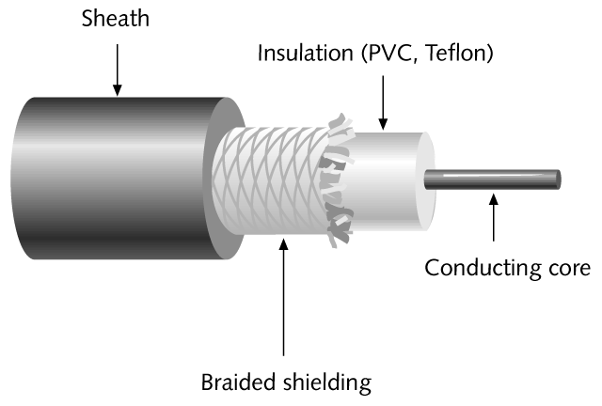
Coax Cable

Slide 9
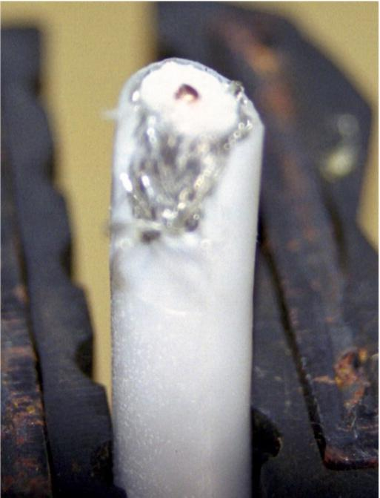
Coax Cable

Slide 10
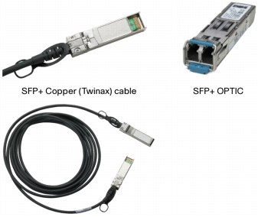
Twinax Cable

Slide 11
Coax Connectors
The connectors used with single conductor coax cables are the BNC style connectors
As in

Slide 12
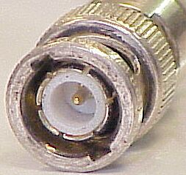
BNC Connector

Slide 13
Coax Cable
When coax cable was used in a 10Base2 LAN it was called
Thinnet
Cheapnet
This form of coax is RG-58 A/U or RG-58 U
It is rated at 50 ohm impedance
The maximum speed is 10 Mbps

Slide 14
Coax Cable
185 meters is the maximum distance for this type of cable
When installing coax in a LAN, both ends must be terminated using a BNC terminator
One end only must be grounded
In the LAN, coax cable is outmoded
If you find it, get rid of it now

Slide 15
Coax Cable for Data Lines
Unless this cable is being used in a WAN circuit
DS3 circuits still use coax cables
When used to connect DS3 equipment for a WAN the type of coax is
RG-59/U
With 75 ohm of impedance

Slide 16
Coax Cable for Data Lines
When used for a WAN circuit the use of 75 ohm single conductor coax is governed by the TIA-942-1: Data Center Coaxial Cabling Specifications and Application Distances addendum

Slide 17
Twinax for Interconnection
Twinax cable is used to interconnect devices in a data center in a rack
For example

Slide 18
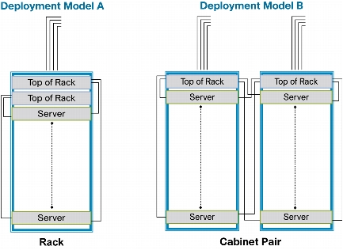
Twinax for Interconnection
Twinax

Slide 19
UTP
The next type of copper cable seen in LANs and by far the most widely used is UTP – Unshielded Twisted Pair cable
UTP accounts for 92.5 percent of copper cabling
This cable uses 8 insulated color coded copper wires
These 8 wires are in 4 pairs of 2 wires each

Slide 20
UTP
Each of the pairs of wires is twisted
Then all pairs are twisted together
The twists vary among the pairs
There are 2 to 12 twists per foot
No shielding is used in this type of cable
These twists are used to resist interference

Slide 21
The Nature of UTP Cable
UTP cable is designed to be a balanced system
As an article in Cabling Installation & Maintenance magazine says
Electrical signals can propagate in either common mode or differential mode
Common mode describes a signal scheme between two conductors in which the voltage propagates in phase and is referenced to ground

Slide 22
The Nature of UTP Cable
Examples of common mode transmission include DC circuits, building power, cable TV, heating/ventilation/air-conditioning (HVAC) circuits, and security devices
Electromagnetic noise induced from disturbers, such as motors, transformers, fluorescent lights, and radio-frequency (RF) sources, also propagates in common mode

Slide 23
The Nature of UTP Cable
Virtually every signal and disturber type in the building environment propagates in common mode, with one notable exception- twisted-pair cabling, which is optimized for balanced, or differential mode, transmission
Differential mode also called balanced transmission refers to two signals that have equal magnitudes, but are 180° out of phase, and that propagate over two conductors of a twisted pair

Slide 24
The Nature of UTP Cable
In a balanced circuit, two signals are referenced to each other rather than one signal being referenced to ground
There is no ground connection in a balanced circuit and, as a result, these types of circuits are inherently immune to interference from most common mode noise disturbers
In theory, common mode noise couples equally onto each conductor of a perfectly balanced twisted-pair

Slide 25
The Nature of UTP Cable
Differential mode transceivers detect the difference in peak-to-peak magnitude between the two signals on a twisted pair by performing a subtraction operation
In a perfectly balanced cabling system, the induced common mode signal would appear as two equal voltages that are simply subtracted out by the transceiver, thereby resulting in perfect noise immunity

Slide 26
The Nature of UTP Cable
In the real world, however, twisted-pair cables are not perfectly balanced, and their limitations must be understood by application developers and system specifiers

Slide 27
Interference in UTP Cable
The two most common types of interference are EMI and RFI
EMI is due to the cable crossing through the electromagnetic field of some device, such as an electric motor
RFI occurs when the frequency range on a network falls within the frequency range of a signal from outside the network

Slide 28
Interference in UTP Cable
More specifically the same article also states
Noise can be coupled onto twisted-pair cabling in any or all of three ways
Differential noise: Noise induced from an adjacent twisted-pair or balanced cable
Environmental noise: Noise induced by an external electromagnetic field
Ground loop noise: Noise induced by a difference in potential between conductor ends

Slide 29
Interference in UTP Cable
Different applications have varying sensitivity to interference from these three noise sources, depending upon their capabilities
For example, the 10GBase-T application is commonly recognized to be extremely sensitive to alien crosstalk (differential mode cable-to-cable coupling) because its digital signal processing (DSP) capability electronically cancels internal pair-to-pair crosstalk within each channel

Slide 30
Interference in UTP Cable
Unlike pair-to-pair crosstalk, alien crosstalk cannot be cancelled by DSP
Conversely, because the magnitude of alien crosstalk is very small compared to pair-to-pair crosstalk, the presence of alien crosstalk minimally impacts the performance of other applications, such as 100Base-T and 1000Base-T, that employ partial or no crosstalk-cancelling algorithms

Slide 31
Why Are Cables Twisted
As an article in the January 2009 issue of Cabling Business explained
Balanced signal transmission means that each of the two conductors carries a different version of the same signal, identical in every way except that they are 180 degrees out of phase
Information is conveyed by the differential amplitude of the signal, which may vary from zero to some predetermined maximum value

Slide 32
Why Are Cables Twisted
If a pair of these conductors were run past a source of interference, such as fluorescent lighting, a motor or an AC power line, one of the conductors, the nearer one, would acquire more unwanted current than the other, resulting in a less than ideal and perhaps unacceptable signal to noise ratio
At the receiver end, the signal would be degraded and even unreadable

Slide 33
Why Are Cables Twisted
By twisting the members of each pair, it was found that harmful interference could be substantially reduced
This is because first one conductor, then the other, is closer to the source of noise so that each gets an equal dose
And since the balanced signal is differential, the noise is cancelled at the receiver

Slide 34
Why Are Cables Twisted
It must be emphasized that while balanced signal transmission by itself is not totally effective in an electrically noisy environment, it is absolutely necessary for the twisting to work
One problem remained
If two active twisted pairs were run in close proximity for any appreciable distance, there could be unwanted mutual interference

Slide 35
Why Are Cables Twisted
This is because as both pairs twisted, a member of one pair, white/blue, for example, would always be closer to a member of the other pair, white/orange
Likewise blue and white would always be closer since both pairs twisted at the same rate
Differential noise cancellation would not take place

Slide 36
Why Are Cables Twisted
A simple remedy, again borrowed from earlier telephone work, has been implemented
The rate of twist (usually measured in turns per meter) could vary for different pairs within the same cable
This scheme is widely used today

Slide 37
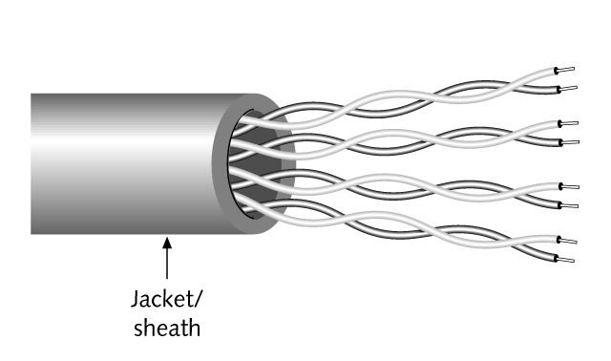
UTP

Slide 38
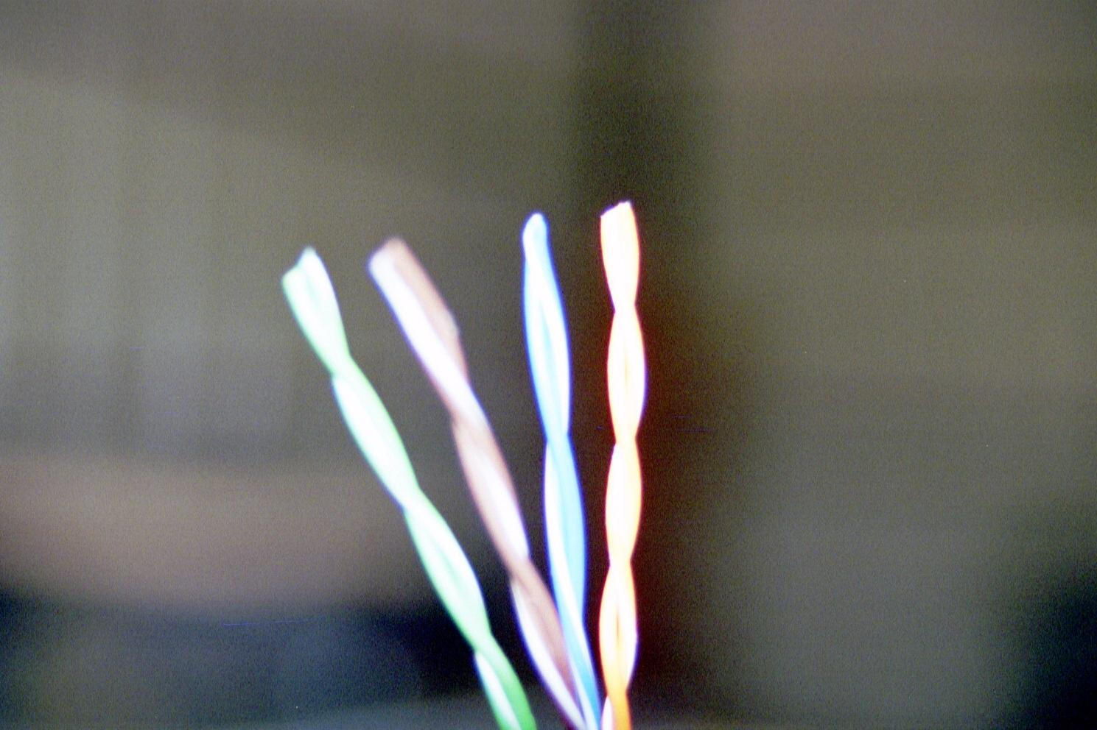
UTP

Slide 39

UTP

Slide 40
UTP
UTP cable is graded by the TIA/EIA-568C standard
Grading is based on the
Thickness of the wire
The quality of the cover
The twists per foot

Slide 41
UTP
Solid wires are used to connect work areas to the LAN room as stranded wires attenuate faster
Stranded cable is used for patch cables, as it is easier to manage for this use only

Slide 42
Categories of Cabling
Here is a table from the Ethernet Alliance from February 2012 that lists the various cabling categories that have existed

Slide 43
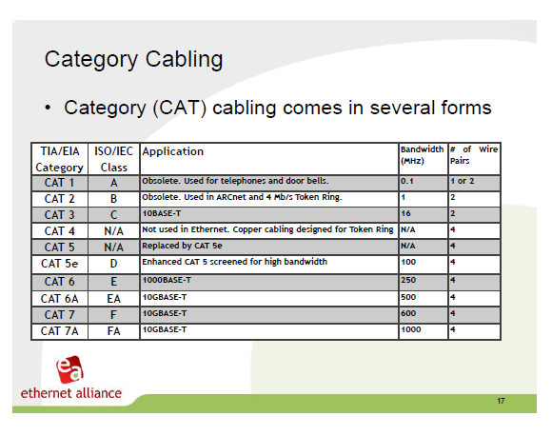
Categories

Slide 44
Category 1
This was used for old voice systems
It is no longer used

Slide 45
Category 2
This was used for ISDN, ArcNET, Token Ring. and AppleTalk networks
It is no longer used

Slide 46
Category 3
This is for voice circuits
Some people have used it in the past for low speed 4 Mbps Token Ring and 10 Mbps Ethernet

Slide 47
Category 4
This was designed for the higher speed, 16 Mbps, version of Token Ring
As Category 5 soon arrived I do not think anyone ever used Category 4

Slide 48
Category 5
This category works fine for the data rates of 10 and 100 Mbps

Slide 49
Category 5E
This category was designed for 1000 Mbps Ethernet networks over copper cable

Slide 50
Category 6
This category was approved as of June 2002
It specifies requirements for 100 ohm balanced twisted-pair cables, connecting hardware, patch cords, channels and permanent links, and provides test procedures for laboratory and field performance verification over the frequency range of 1 to 250 MHz

Slide 51
Category 6
Because Category 6 supports PSCAR - positive power sum attenuation to crosstalk margins up to 200 MHz, this new cabling system offers double the bandwidth of Category 5e cabling and vastly improved signal-to-noise margins

Slide 52
Category 6
The Category 6 standard includes cable and connecting hardware balance recommendations for improved electromagnetic compatibility performance
At the higher frequencies used in Cat 6 cable it is more likely that the signal on one cable will bleed through to a nearby cabling within the same jacket

Slide 53
Category 6
This has lead to different designs for Cat 6 cable within the common jacket
Normally this will be an internally divided jacket using a separator called a spline
This spline serves to separate the cable pairs from each other
For example

Slide 54

Category 6

Slide 55
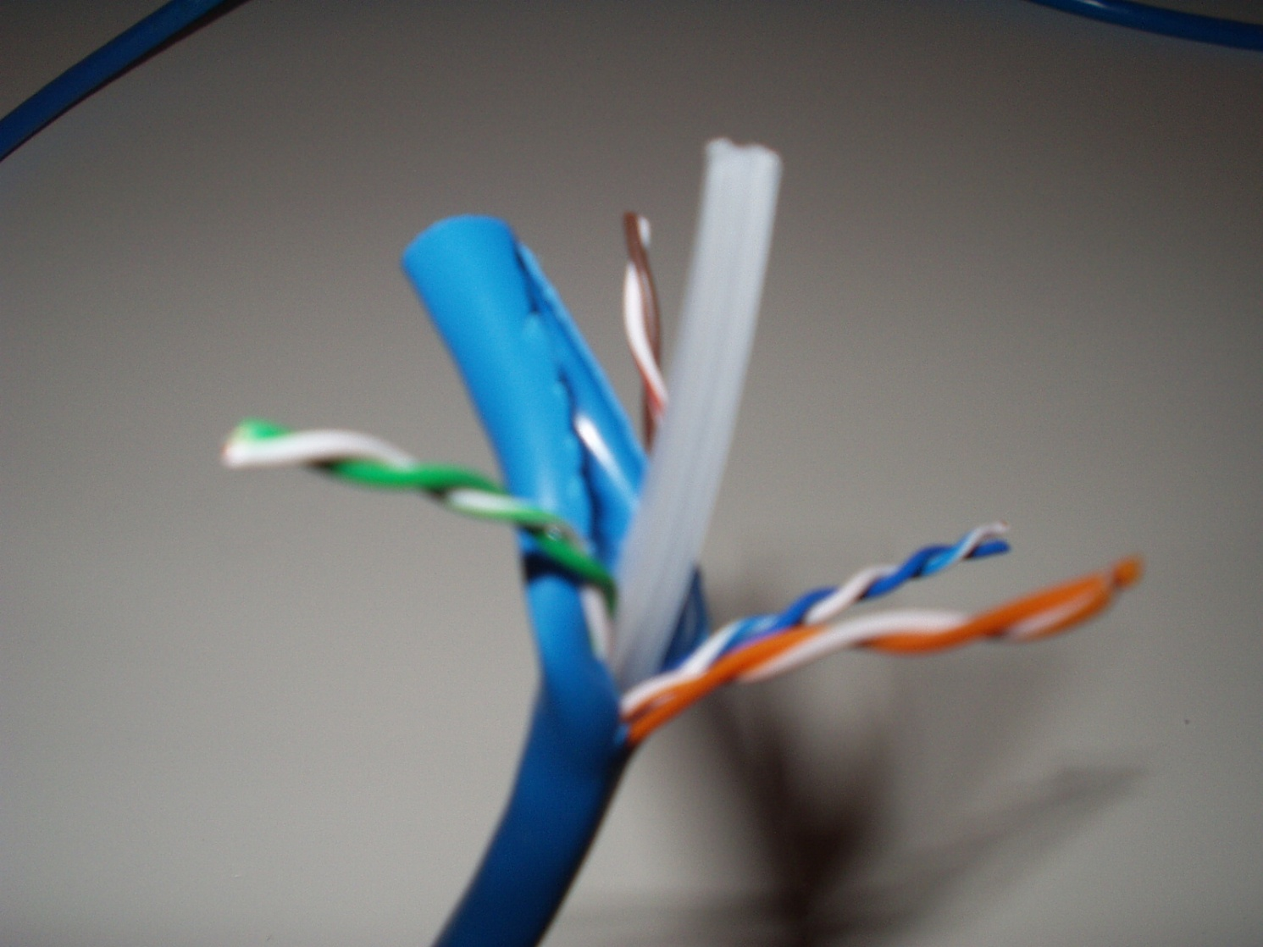
Category 6

Slide 56
Category 6
Some cables are doing away with the spline
Different designs and better twisting methods are used in this case
The connectors for Cat 6 also require additional isolation between conductors to prevent crosstalk

Slide 57
Category 6 Augmented
Category 6A or Augmented Category 6 cable is designed to work with 10G copper networks
I am of the view that at this speed fiber should be used
But some prefer the robustness of copper, such as in crowded data center cabinets
They believe fiber is too easily damaged there

Slide 58
Category 6 Augmented
This cable differs from Category 6 cable in the use of a better separator between the wire pairs inside the cable and in the use of a filler inside the cable to prevent alien crosstalk
This makes the cable noticeably larger than Cat 6 cable
The wires are also more tightly twisted

Slide 59
Category 6 Augmented
As Cabling Installation and Maintenance magazine said
Alien crosstalk and insertion loss are the primary parameters to consider for 10GBase-T operation
Alien crosstalk is specified as power sum alien near end crosstalk (PSANEXT), power sum alien equal level far end crosstalk (PSAELFEXT), and power sum far-end crosstalk (PSAFEXT)

Slide 60
Category 6 Augmented
The 10GBase-T signal-to-noise ratio (SNR) is primarily based on the ratio of the signal (insertion loss) to the alien crosstalk noise appearing at the receiver
They go on to say
Additional cabling guidelines for 10GBase-T deployment on balanced copper cabling are provided in Annex 55B, to be published with the 10GBase-T standard

Slide 61
Category 6 Augmented
This annex includes procedures to mitigate alien crosstalk should the link segment specifications not be met
ANSI/TIA/EIA-TSB-155, “The Additional Cabling Guidelines for 4-Pair 100 Ω Category 6 Cabling for 10GBase-T applications,” also provides procedures for alien crosstalk mitigation
Alien crosstalk noise levels are dependent on the number and proximity of adjacent cables and connectors

Slide 62
Category 6 Augmented
Fluke has this to say concerning alien crosstalk
10GBASE‑T signaling requires cabling bandwidth up to 500 MHz, which is much higher than the 100 MHz bandwidth required for 1000BASE-T
Because of these very high frequencies, one significant new disturbance must be added to the cabling test parameters

Slide 63
Category 6 Augmented
This new set of test parameters is called Alien Crosstalk
Crosstalk measures signal coupling from one wire-pair to another within a twisted-pair cabling link
This kind of coupling is undesirable since it creates a noise disturbance in a wire pair
The effect of crosstalk is very similar to a noisy transmission line

Slide 64
Category 6 Augmented
A receiver may not be able to distinguish the signal sent by the transmitter at the other end of the link from the noise induced by crosstalk
In data communications, crosstalk is a critical performance parameter
The amount of crosstalk increases with the frequency of the transmitted signal while the higher frequency signals are subject to greater attenuation

Slide 65
Category 6 Augmented
It is reduced as the distance between adjacent cables and connectors increases
Possible field-mitigation strategies include
Selective deployment of 10GBase-T utilizing non-adjacent patch panel positions (adjacency should also be checked at the rear of the patch panel)

Slide 66
Category 6 Augmented
Reduce the alien crosstalk coupling in the first 5 to 20 meters of the horizontal cabling by separating the equipment cords and patch cords and unbundling the horizontal cabling (A significant portion of the ANEXT coupling occurs in the first 20 meters)
Choose equipment cords sufficiently specified to mitigate the alien crosstalk coupling, such as Category 6 ScTP and Augmented Category 6
Reconfigure the cross-connect as an interconnect
Replace connectors with Augmented Category 6

Slide 67
Category 6 Augmented
Another method to mitigate alien crosstalk is to reduce the power
As they say
The 10GBase-T standard includes transmit power backoff (PBO) provisioning to adjust the transmit power levels based on the power level at the receiver

Slide 68
Category 6 Augmented
Power backoff reduces the amount of alien crosstalk coupled between link segments while maintaining the required power level at the receiver

Slide 69
Category 6 Augmented Cable
Cat 6A cable itself is different in construction from previous cables
The Cat 6A cable is about 0.30 inches in diameter as compared to the usual 0.25 inches for Cat 6 and 0.20 inches for Cat 5E
The conductors are also larger at 23 AWG minimum in size

Slide 70
Category 6 Augmented Cable
Inside the cable has more twists as well as more airspace between cables
All of this is to reduce loss and prevent alien crosstalk
As the power levels seen in PoE go up, this type of construction will also help keep the cable cool
All of this is detailed in addendum 10 to the 568-B.2 standard

Slide 71
Category 7
Category 7, sometimes called Class F cable, is a category and then again it is not
This standard was developed in Europe for use mainly on the factory floor
To date it is not widely used in the US
With the increase in speeds to 1,000 Mbps and 10,000 Mbps Ethernet networks interest in running these speeds over copper has grown in the US

Slide 72
Category 7
Cat 7 is formally referred to as international standard ISO/IEC 11801-2002
This cabling handles up to 600 MHz of bandwidth
Cat 7 cabling is fully shielded
Each pair is shielded with a foil screen, and the cable itself has an overall shield

Slide 73
Category 7
Some versions also add in a braid screen between the cable sheath and the shielded pairs
This is all to prevent crosstalk and noise from the outside
Twisting is not enough at these speeds
To some extent we have cycled back around to IBM Type 1 style cable, but with eight wires instead of four

Slide 74
Category 7
RJ and non-RJ style connectors can be used
Of course one could just jump to fiber to the desktop instead

Slide 75
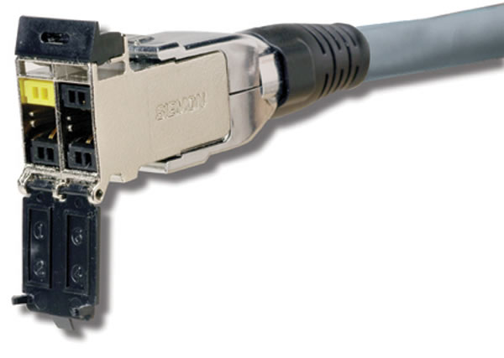
Category 7 Connector

Slide 76
Category 7A
There is also a higher speed version of Class F called Class FA or Category 7A
It to is not used in the US

Slide 77
Category 8
The next step in UTP cabling will be Category 8
It is being designed for use in data centers to carry 40 Gbps
The TIA is developing this category
As such the TIA will skip from Category 6 to Category 8

Slide 78
10G Over Copper
There is a desire to run 10G over copper
Several categories can do this for varying distances
The options are

Slide 79
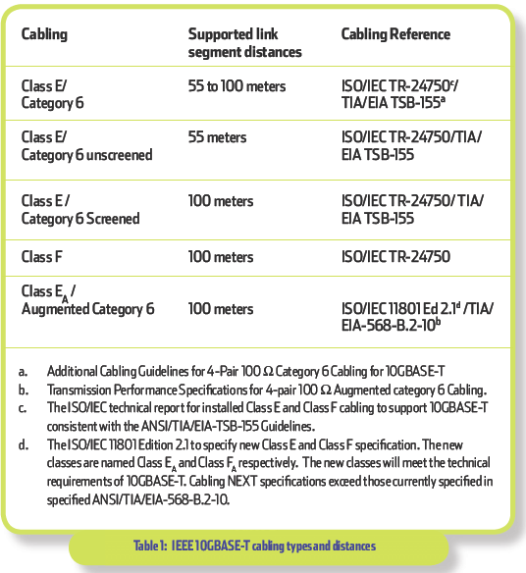
10G Over Copper

Slide 80
Category v Class
In the US cable types are specified as categories
In other parts of the world the ISO classes are more commonly used
The correspondence is
Category 5e – Class D
Category 6 – Class E
Category 6A – Class E_{A}
Category 7 – Class F

Slide 81
Meeting a Category
For a cable installation to meet one of these categories every single, solitary part that touches the cable used must meet the category requirements
This means all of them

Slide 82
UTP Wires
As stated earlier solid wires are used to connect work areas to the LAN room as stranded wires attenuate faster
By solid I mean that each of the eight wires is a single piece
Stranded wire is used for patch cables, as it is easier to manage for this use only, where the cables are never very long

Slide 83
UTP Wires
By stranded I mean that each of the eight wires is made up of several individual wires, but there are still only eight wires

Slide 84
Use the Correct Connector
AMP says
The conventional plug has in-line insulation displacement contacts that pierce the middle of the insulation and stranded wire when crimped
RJ45 plugs designed for solid conductors have offsetting contacts that straddle and wedge the cable’s solid conductor

Slide 85
Use the Correct Connector
If a RJ45 plug designed for stranded conductors is crimped onto solid conductors, the blade’s piercing teeth will be deflected and bent by the cable’s center conductors resulting in an intermittent connection
However, the newer tri-point plugs are designed for both stranded and solid conductors and will successfully terminate both types of conductors

Slide 86
Color of Cable
It makes no difference what color the cable is that runs through the walls and ceiling

Slide 87
Plenum Cables
Besides the categories, cables are also rated based on their flammability, heat resistance, and how much visible smoke – in the case of plenum rated cable – they generate when exposed to a flame
Plenum cable may be used in the plenum space and as riser cable

Slide 88
Plenum Cables
The plenum is the space between the structural ceiling in a building and any false ceiling that may exist, or any other space that holds breathable air
This space is used for air ducts and to carry return air to the HVAC system

Slide 89
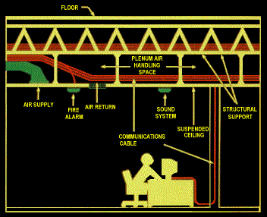
Plenum Space

Slide 90
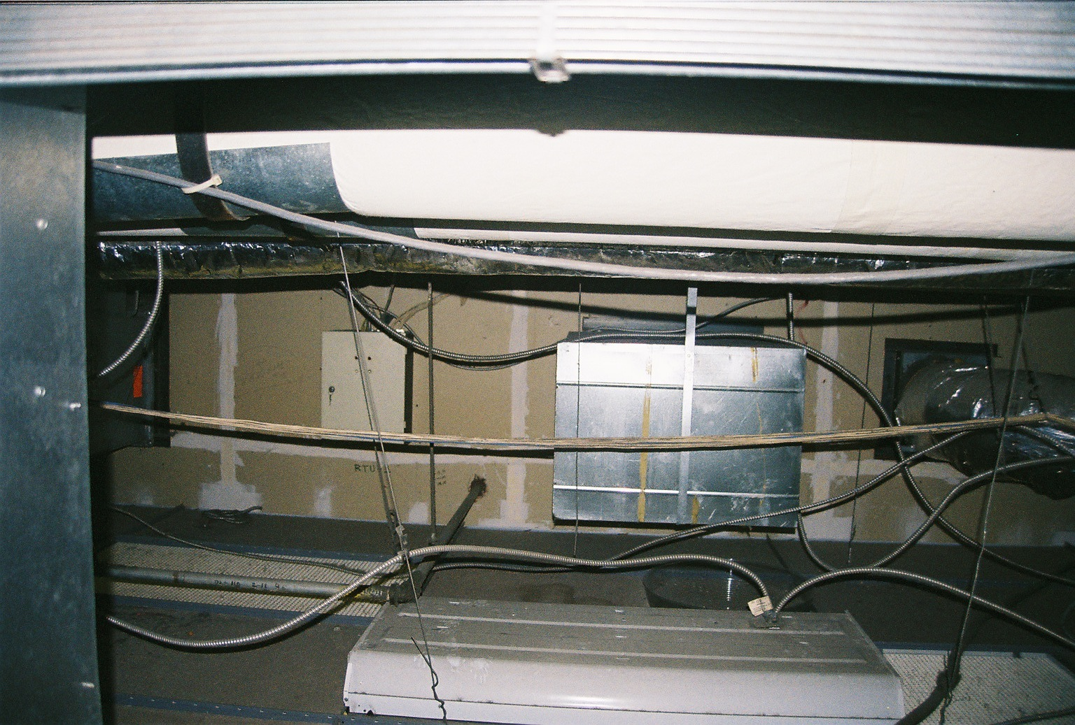
Plenum Space
Structural Ceiling
False Ceiling
Top of Light Fixture

Slide 91
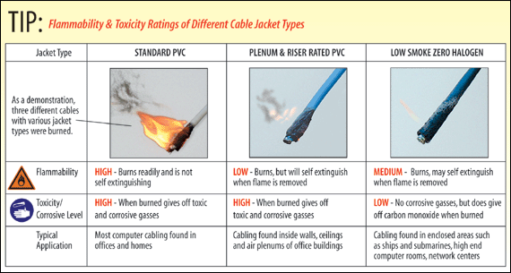
Plenum Cables

Slide 92
Plenum Cables
What makes plenum cable plenum cable is the material used in its construction
Plenum cable uses FEP insulation around each wire and modified PVC in the outside cover

Slide 93
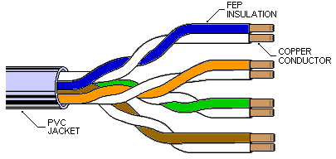
Plenum Cables

Slide 94
LCC Cables
There is a new type of plenum cable called LC or LCC for Limited Combustible cable
This has better fire performance than standard plenum cable
This cable is not required
You may use it if you wish

Slide 95
Cable Coverings
Here is a summary graphic showing the different types of cable coverings from a Belden webinar from July 2013

Slide 96
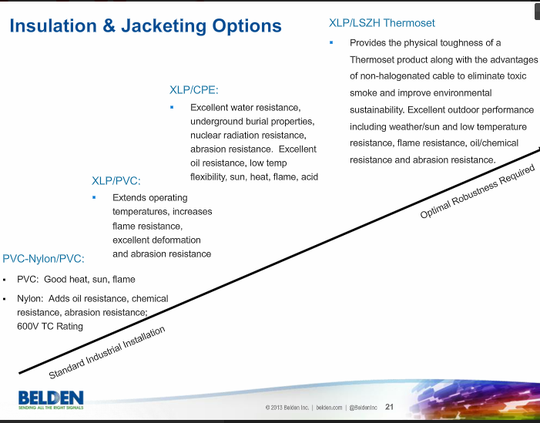
Cable Coverings

Slide 97
Lab
Pass out short pieces of cable
Reading the codes on the cable answer these questions
Type of cable
Category of cable
Wire size
Manufacturer
Model number

Slide 98
Reading Cables
The only way to know what type of cable you have is to read the codes on the side of the cable
In most cases the information you need is printed on the cable
If not, hopefully at least the manufacturer's name and the model number of the cable are

Slide 99
Reading Cables
If this is the case, then you must look up the information on the manufacturer’s website or in a catalog
Let’s look at a typical cable

Slide 100
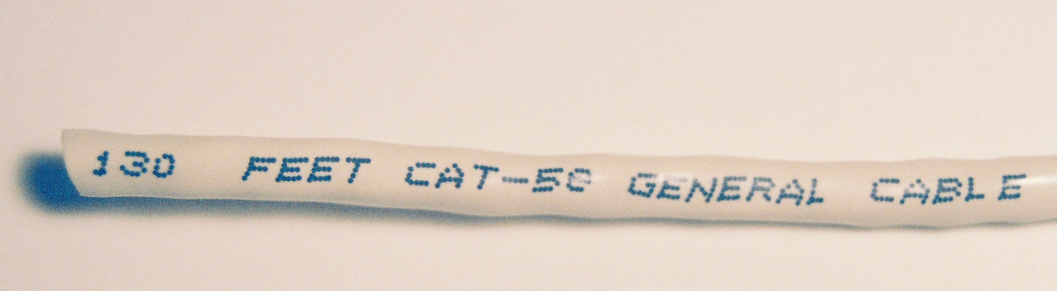
Reading Cables

Slide 101
Reading Cables
In this case we are at the 130 foot mark of a 500 foot roll of Category 5E cable

Slide 102
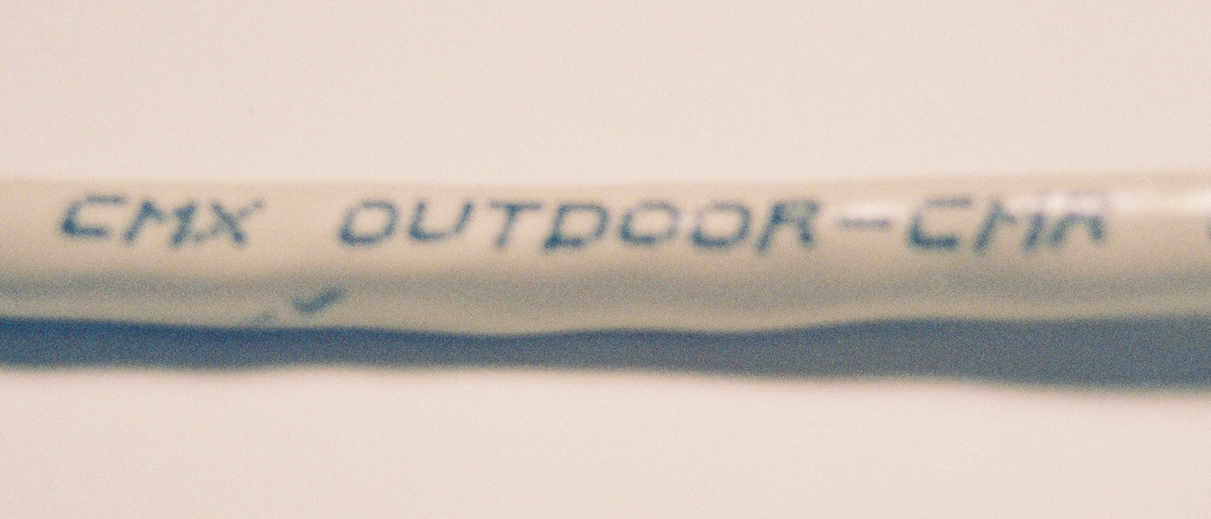
Reading Cables

Slide 103
Reading Cables
This is outdoor rated type CMR cable

Slide 104
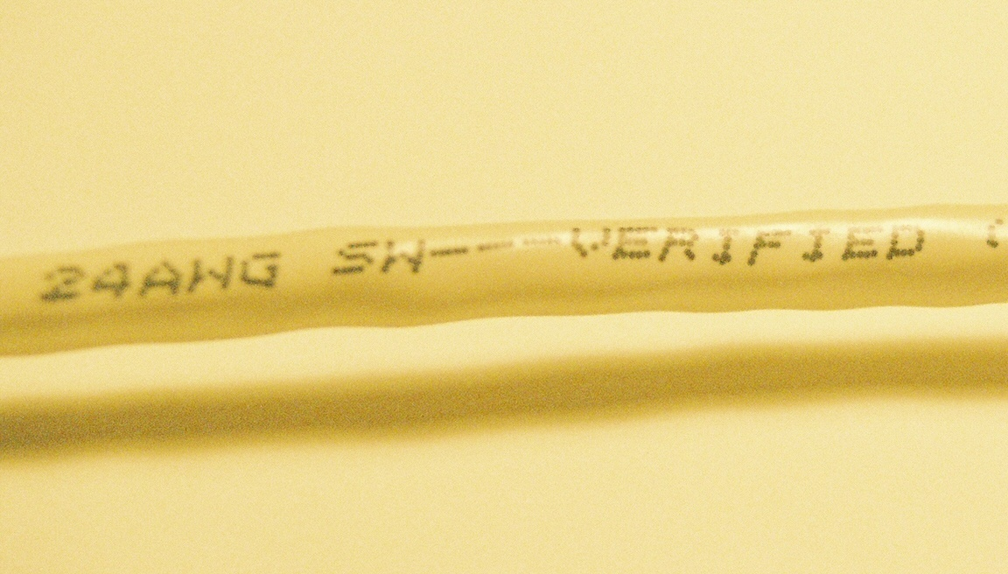
Reading Cables

Slide 105
Reading Cables
This one also says it is 24 gauge wire inside

Slide 106
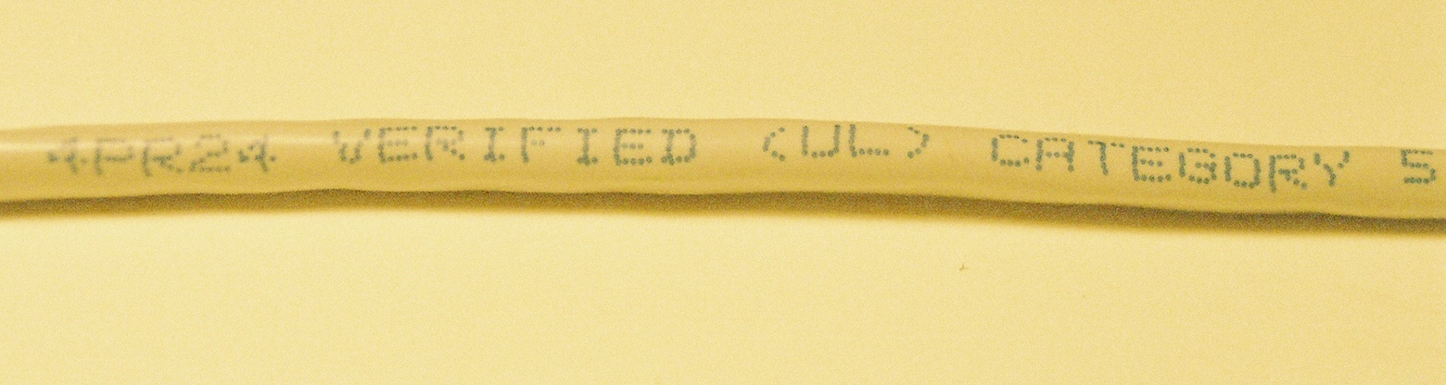
Reading Cables

Slide 107
Reading Cables
This one is 4 pair 24 gauge inside and is Category 5 rated

Slide 108
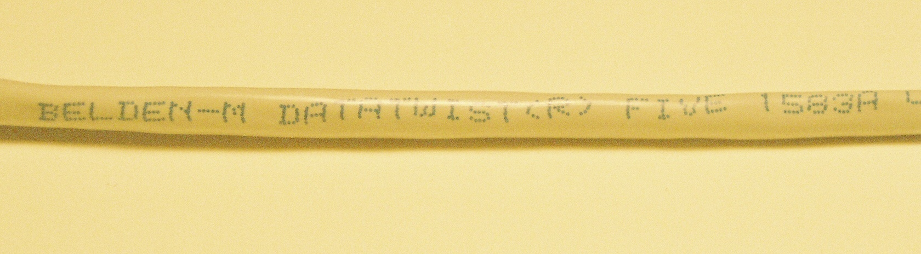
Reading Cables

Slide 109
Reading Cables
If the cable does not tell you what you need to know, then the manufacturer’s website or catalog may
This cable is Belden Datatwist 5, part number 1583A

Slide 110
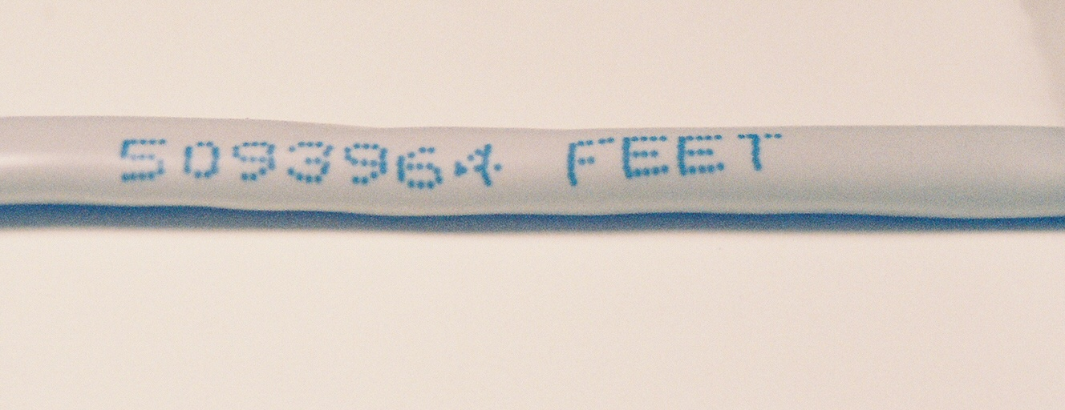
Reading Cables

Slide 111
Reading Cables
Sometimes the foot marks on the cable are based on the manufacturer’s output
In this case you have to notice that the beginning of the roll is at the 5093964 foot mark, and track it from there

Slide 112
Reading the Cable Codes
The cable type codes are
CM
CMR
CMP

Slide 113
Reading the Cable Codes
CM is general use cable
This can be used in areas other than plenum space and risers
CMR is riser rated cable
This is used in cables that connect floors
CMP is plenum rated cable
This cable can be used in ducts and plenum spaces
CMP cable can also be used in raceways

Slide 114
UTP Connectors
In a LAN both ends of a UTP cable are terminated using RJ style connectors
The RJ-45 is used for LANs
The wires are attached using the IDC – Insulation Displacement Connector method

Slide 115
UTP Connectors
This is done with a punch down tool or by crimping with pliers, depending on the style of connector being used
This pushes the wire down into a V groove in the connector
The restriction in the connector cuts through the insulation, thus making the connection

Slide 116
RJ Connectors
The RJ style of connector comes from the USOC, Universal Service Order Code
These codes were developed in the 1970's by AT&T to identify tariffed services and equipment
They were later adopted in part by the FCC in Part 68, Subpart F, Section 68.502 of the Code of Federal Regulations

Slide 117
RJ Connectors
USOC codes, as applied to telephone and data jacks are
RJ - denotes a registered jack
C – indicates a flush or surface mount jack
W – indicates a wall mount jack
X – means a complex multi-line or series type jack

Slide 118
RJ Connectors
Each jack has a specific application
Single line phones, accessories, answering machines, and modems use the RJ11
Two line phones, accessories and answering machines use the RJ 14
RJ22 is the designation for the smaller jack that is used on handsets
Three line phones and accessories use the RJ25

Slide 119
RJ Connectors
Burglar and fire alarms circuits use the RJ31 and RJ38
Single line fixed loss loop data installations use the RJ41
Data circuits use the RJ45
Four wire data circuits use the RJ48C/RJ48X/RJ48S
Four line phones and accessories use the RJ61

Slide 120
RJ Connectors
One to twenty five single or multiple line circuits bridged to the network or customer equipment use the TJ21

Slide 121
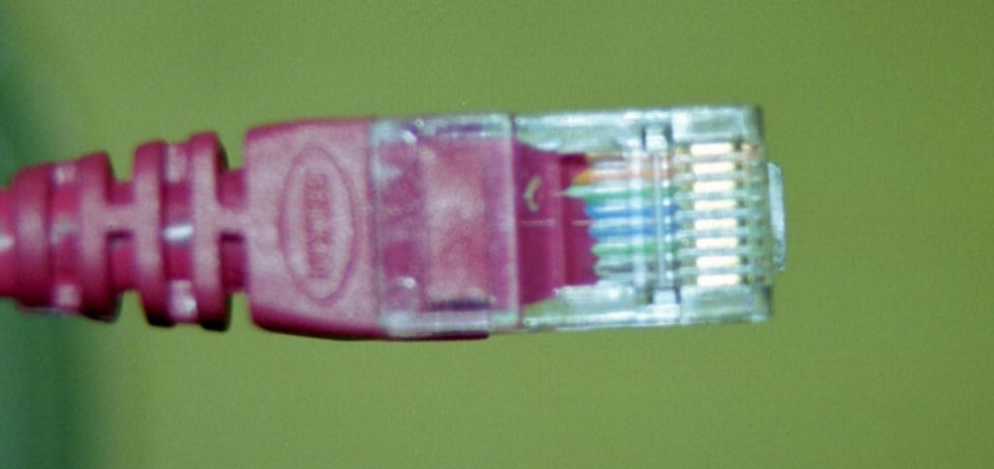
RJ-45 Connector

Slide 122
RJ Connectors
In the original lower speed days the connectors did not need to be considered as they were effectively invisible to the signal
As speeds have increased changes have been made

Slide 123
RJ Connectors
These include introducing a twist inside the connector, and in some cases including a circuit board with capacitors inside the connector

Slide 124
Shielded Cable
With the development of 10G Ethernet there is interest in running these links over copper cabling among some
As UTP cable will not handle these speeds, there is renewed interest in shielded cable
Other than in Europe there has been little use of shielded cable
This may or may not change

Slide 125
Shielded Cable
TIA has published a Telecommunications Systems Bulletin that addresses the use of copper cabling for 10G
TSB-155 discusses both performance within the cable and outside the cable

Slide 126
Shielded Cable
Regardless the various types of shielded cable need to be discussed
The original form of shielded cable is IBM Type 1 STP cable as used in old Token Ring LANs
Currently there are several types of shielded cable that may see use in the future

Slide 127
Shielded Cable
STP cable is used in 2.2 percent of installations
These are using the new nomenclature
STP
S/UTP
S/STP
And compared to UTP

Slide 128
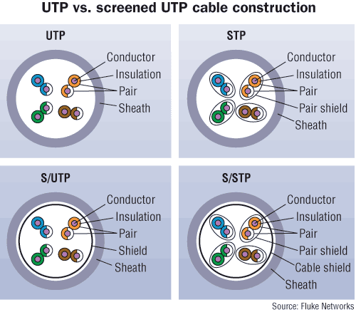
Shielded Cable

Slide 129
STP
This is original type of shielded cable used in Token Ring networks

Slide 130
S/UTP
S/UTP is also called F/UTP
It used to be called ScTP
This cable is made of 4 pair 100 ohm UTP inside
This is surrounded by a foil or braided shield around all pairs
This metal shield is meant to minimize outside interference

Slide 131
S/UTP
A drain or bond wire is also included in many types of this cable
In some cases foil is placed around each pair of wires as well

Slide 132
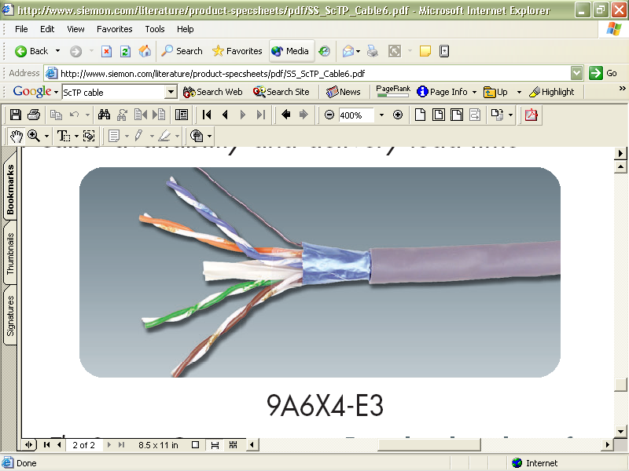
S/UTP

Slide 133
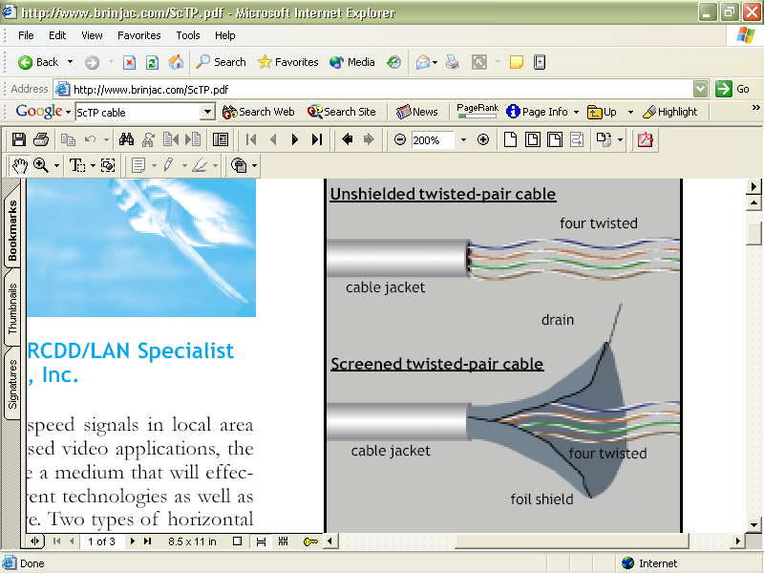
S/UTP

Slide 134
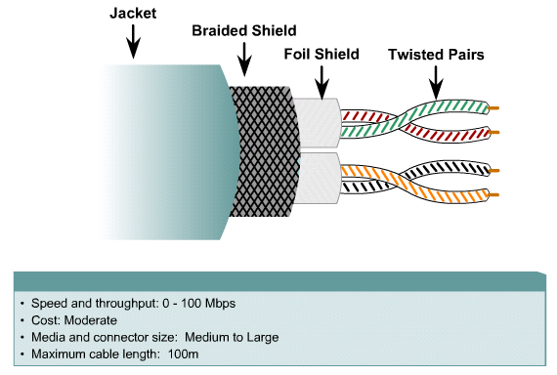
S/UTP

Slide 135
S/STP
In this form there is a foil shield around each wire pair
Another shield is around this set of foil shielded wires
Finally a braided screen woven of thin wire is placed outside the foil shield

Slide 136
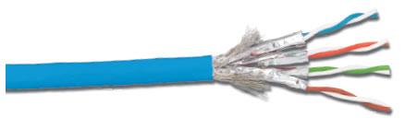
S/STP

