Slide 1
What is a Network
Last Update 2012.02.22
1.2.0

Slide 2
Why Have a Network
The only reason to have a network is to share stuff
If you have nothing to share, there is no point in setting up a network unless you are a nerd who just loves to look at flashing lights and listen to the humming of fans

Slide 3
What Might You Share
Things that are commonly shared include
  Files
  Printers
  Internet Access

Slide 4
Types of Networks
Assuming that there is something that needs to be shared, the next question is what form should the network take
The least expensive way to create a network is to create a …

Slide 5

SneakerNet
You copy the information to a USB drive, put on your sneakers, and walk it down the hall
Although useful and inexpensive, we are interested in other kinds of networks

Slide 6
Network Types
A common way of thinking about types of networks is in terms of their size
Using this concept there are then four types
  LAN – Local Area Network
  CAN – Campus Area Network
  MAN – Metropolitan Area Network
  WAN – Wide Area Network

Slide 7
Network Types
To show the relative size of a LAN, CAN, MAN, and WAN we will use some images and maps from the University of North Texas

Slide 8
LAN
The LAN covers a small area
This is usually just a single building or a few floors in a single building
The LAN contains devices such as workstations, servers, and printers
It is used to share these things

Slide 9
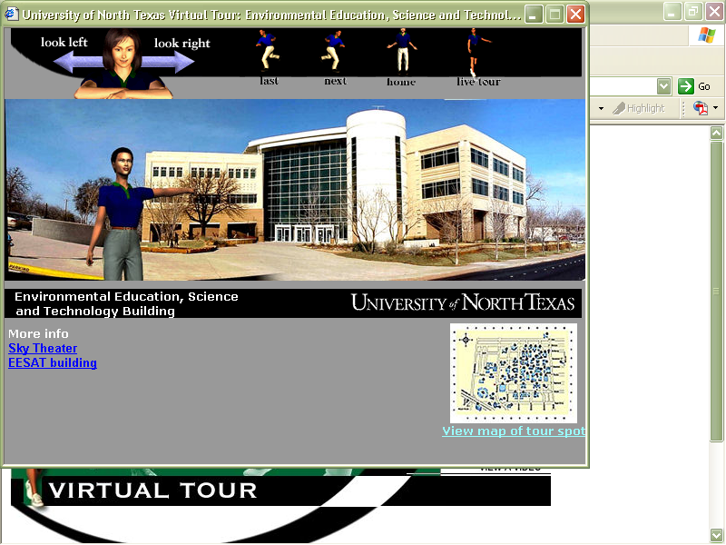
LAN
This is the Environmental Education, Science, and Technology Building as shown in the virtual tour of the campus
A single LAN could cover this entire building

Slide 10
CAN
A CAN typically connects LANs that are located in distinct buildings that are near to each other
By near I mean you can walk to each building and back without much trouble
A CAN may also connect LANs on several floors in a tall building

Slide 11
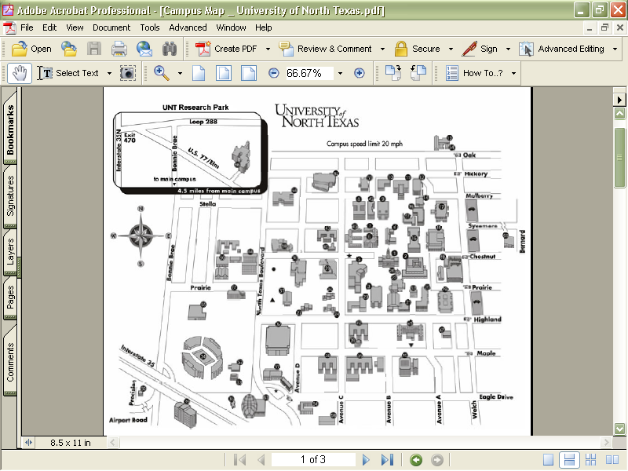
CAN
This distance is 1.3 kilometers or .8 miles
This distance is 1.8 kilometers or 1.1 miles

Slide 12
MAN
A MAN is more like a WAN than a LAN
You cannot easily walk there
But you can drive there and back in a short while
A MAN will normally use the same technologies as a WAN
UNT has a research site a few miles from the main campus

Slide 13
MAN

Slide 14
WAN
A WAN covers a very large area or connects sites together that are far apart
You could drive there in a car, but it would be hard to do so and return in the same day

Slide 15
WAN
For example, as a news release from the University of North Texas says
  “Dr. Timothy Montler, UNT professor of linguistics, has been working for over two decades to preserve the languages of Pacific Northwest Native American tribes”
  “In the past ten years, Montler has focused on the language of the Klallam in Washington state”

Slide 16
WAN
As seen next, Dr. Montler could not drive to Washington, do some work, and drive back in one day

Slide 17
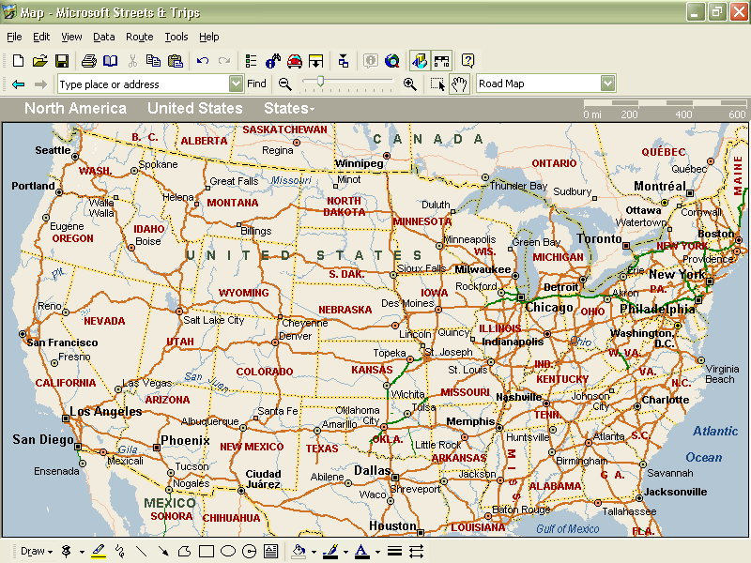
WAN
Washington
This distance is
2500 kilometers or 1500 miles
Texas

Slide 18
PAN
The PAN – Personal Area Network is a concept sometimes used to describe a small network surrounding a single workstation
This is based on the IEEE 802.15 standard to be
Bluetooth, a wireless technology, is commonly used to create this type of network

Slide 19
SAN
A SAN – Storage Area Network is a specialized subnetwork that is an offshoot of the LAN
This network only stores data

Slide 20
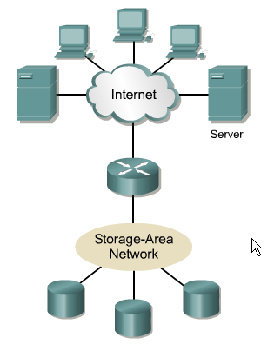
Storage-Area Networks

Slide 21
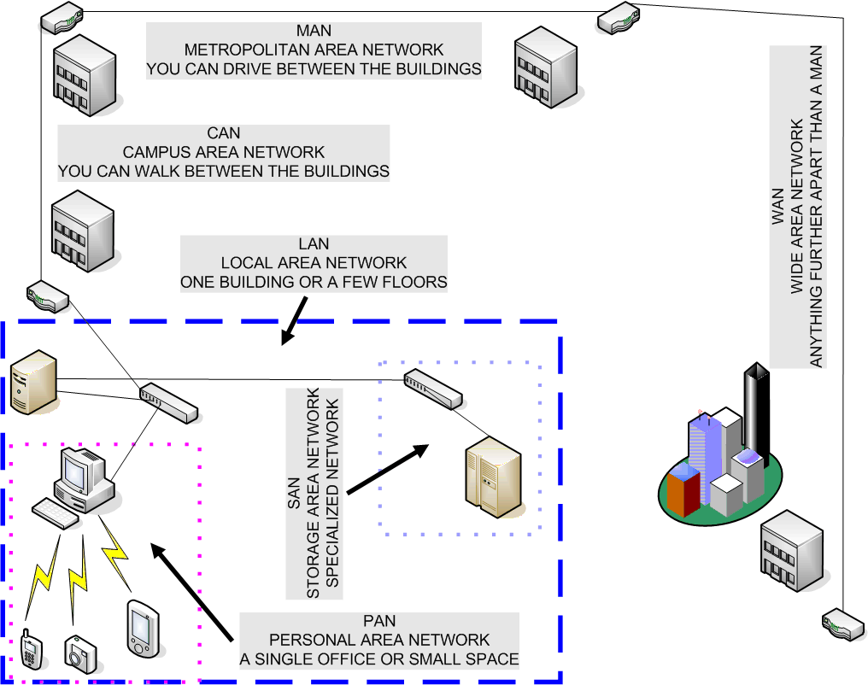
Summary of Network Types

Slide 22
Organization Size
Books and articles in the trade press would make you think that every organization in the country is huge
That each one of these has a highly complex network with layer after layer of equipment
In reality most organizations are fairly small

Slide 23
Network Size
The network needed by most organizations is therefore also fairly small
Keep in mind that a single broadcast domain can work just fine with several hundred active users depending on the nature of the network traffic

Slide 24
Organization Size
Let’s see how many firms and the dependent establishments there are at various sizes
Here is data from 2008 from the Census Bureau

Slide 25
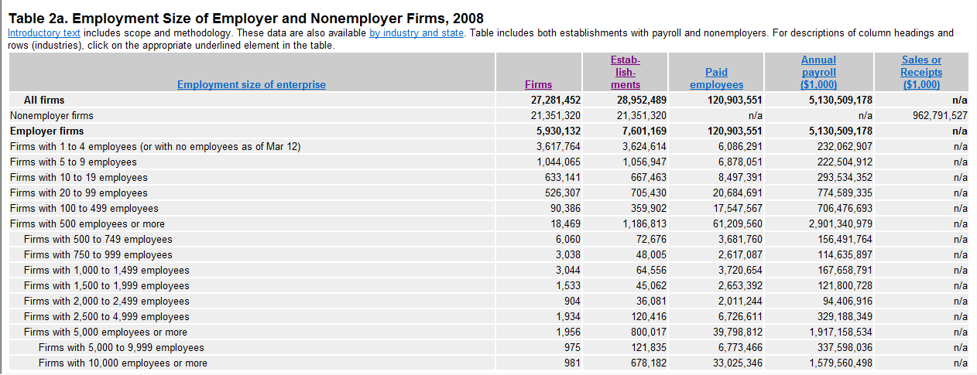
Organization Size

Slide 26
Organization Size
As the chart shows there are a total of 27,281,452 firms with 120,903,551 employees
However, over 78 percent or 21,351,320 of these firms have no employees
All 121 million employees work for just 6 million firms
How big are these firms

Slide 27
Organization Size
Well 5,821,277 or 98 percent of these 6 million firms have 99 employees or less
Clearly the overwhelming number of firms are at best classified as small firms
Another 90,386 or 1 ½ percent are considered to be medium size firms

Slide 28
Organization Size
This leaves just 18,469 or ½ of a percent out of 6 million firms that can be considered to be large or enterprise size organizations

Slide 29
Organization Size

Slide 30
SOHO
Let’s look first at the very small firms
Those with 1 to 19 employees
As this table shows there are 5,821,277 of those
Again that is 98 percent of all firms
Clearly none of these need more than a single local area network consisting of a single switch, a server or NAS box, and a printer

Slide 31
SMB
Small and Medium sized businesses are defined as those with 500 or fewer employees
No doubt an organization with up to 500 staff in a single location could also work well with a single or at worst a handful of local area networks, a set of switches, a server, maybe separate storage, and a number of printers

Slide 32
SMB
This too is not a very complicated setup

Slide 33
Large
This leaves just 18,469 organizations with 500 or more employees out of over 6 million total firms

Slide 34
Do Not Over Complicate
What is the point to this discussion
To point out to you to not over complicate this
A basic, simple, single layer network design will work for over 98 percent of all firms

Slide 35
What is a Network
But regardless of this a network of any size is basically connecting Point A to Point B

