Slide 1
Example of a WAN Last Update 2009.06.29 1.0.0

Slide 2
A WAN
A WAN can be created with wires or by using a wireless connection
Typically these are wired connections where a data line is leased from a service provider such as AT&T
These service providers will offer several different types of connections to connect the Point A to Point B

Slide 3
Data Lines
For example here is what AT&T is offering now

Slide 4
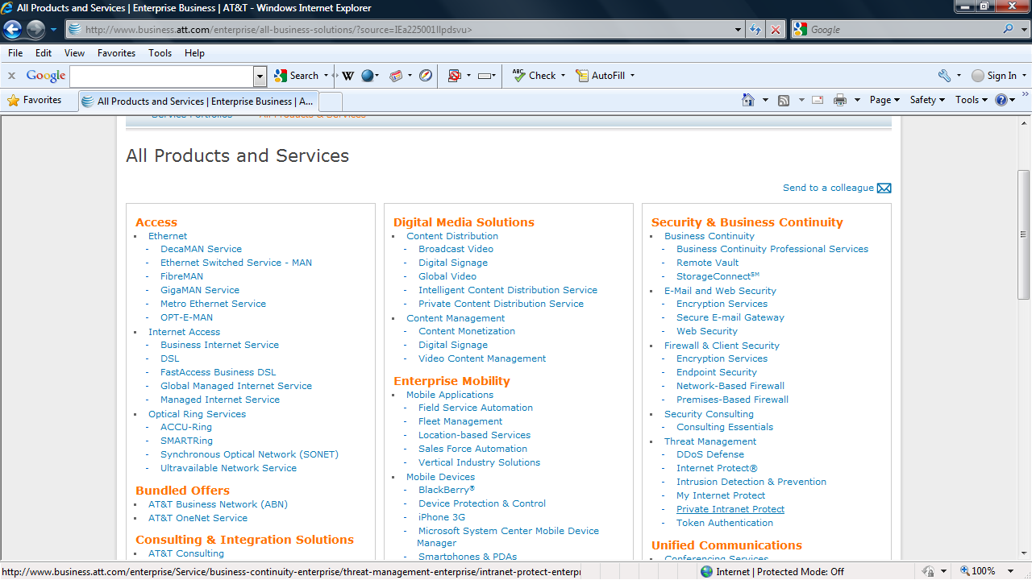
Data Lines

Slide 5
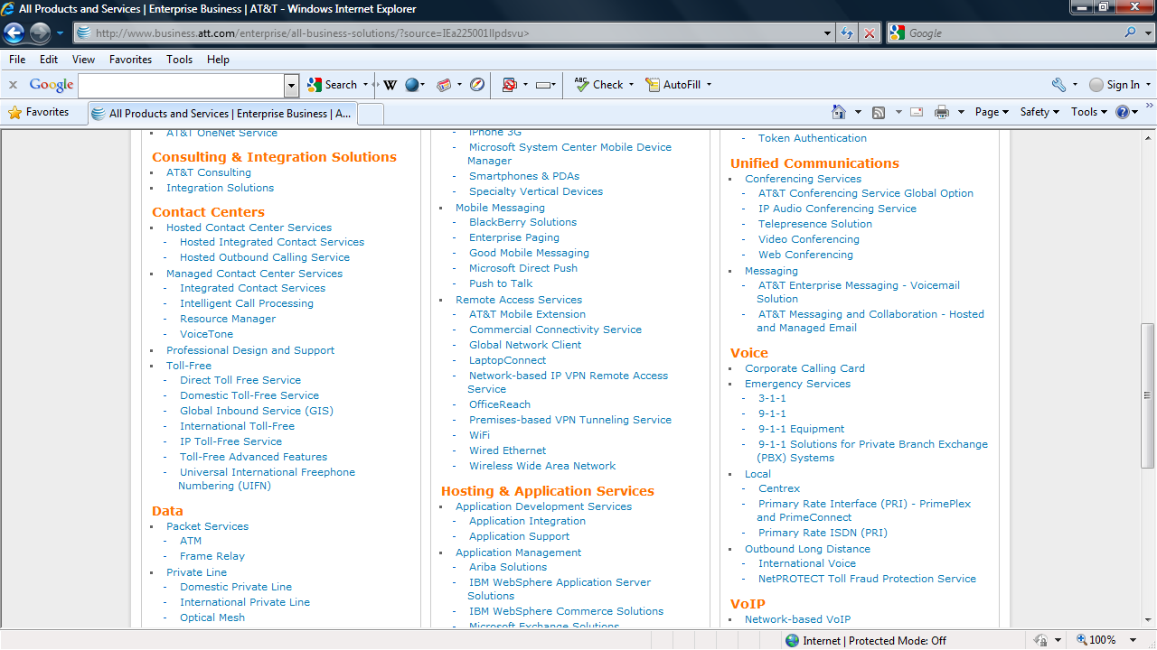
Data Lines

Slide 6
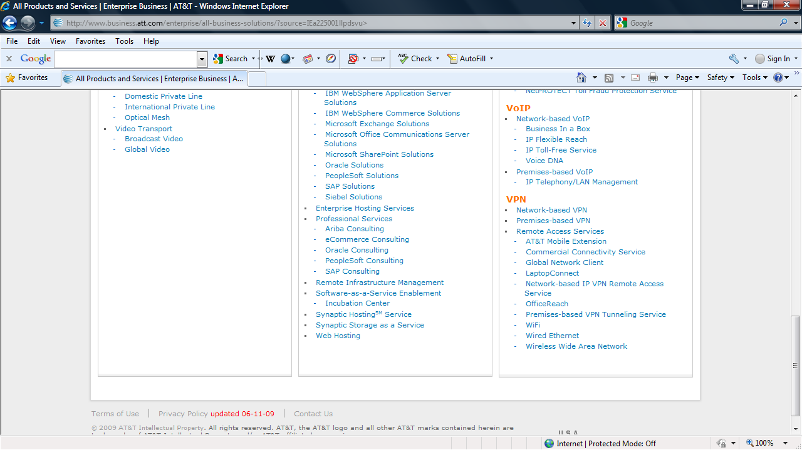
Data Lines

Slide 7
A Common WAN
Currently a typical large organization will connect each of its site to each other through a MPLS network
Here is what AT&T says about there MPLS offerings

Slide 8
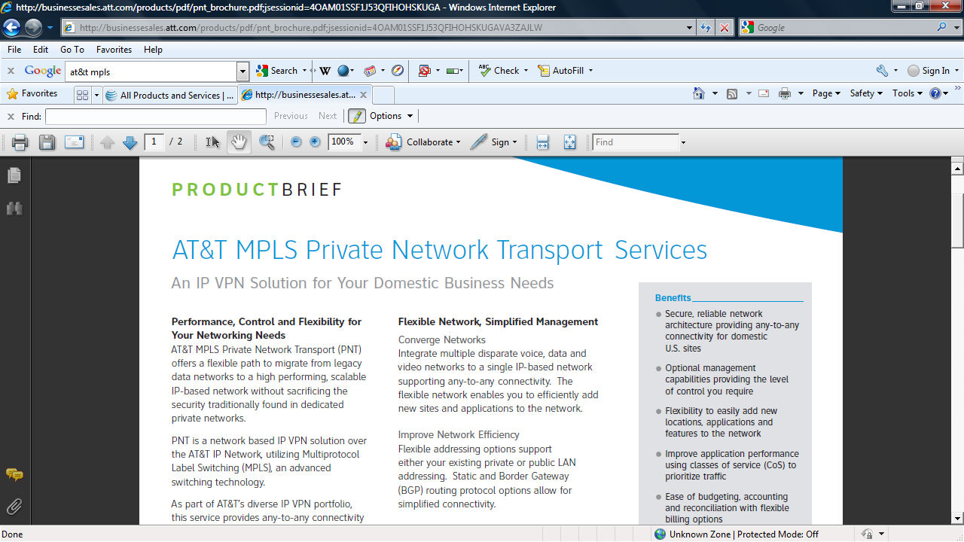
MPLS

Slide 9
Satellite
A satellite based network is a good example of a wireless WAN
And a good example of a wireless WAN is the network access from a ship at sea
As it is very difficult to connect a wire to a ship at sea so data lines to ships are always wireless
Here is an example of a wireless WAN connection to a cruise ship

Slide 10
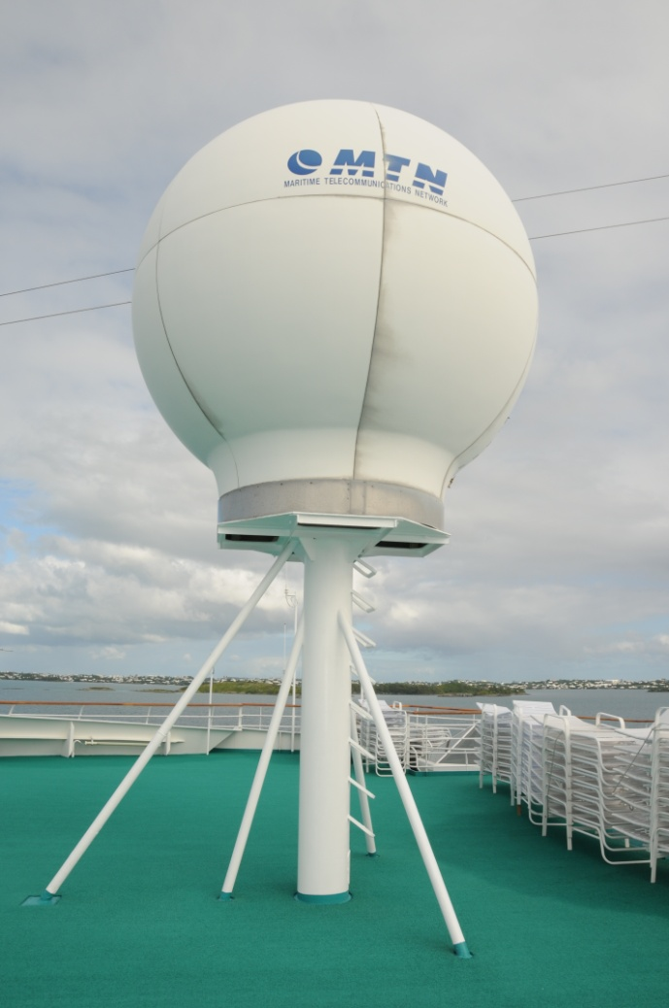
Antenna on the Ship

Slide 11
Satellite Locations
The satellites we are interested in are those in geostationary orbits
The GEO satellites

Slide 12
Satellite Locations

Slide 13
Satellite Locations
The transponders on satellites can be tuned to provide general coverage to a large area, a hemisphere, a zone, or spot coverage to a small area
In this example we will assume the ship will tune into the global beam of one of three satellites
These three satellites can provide coverage for the entire globe

Slide 14
Satellite Locations
These are
Intelsat 903 (AOR)
Intelsat 906 (IOR)
NSS-5 (POR)
Graphic by Intelsat

Slide 15
Global C Band Satellites

Slide 16
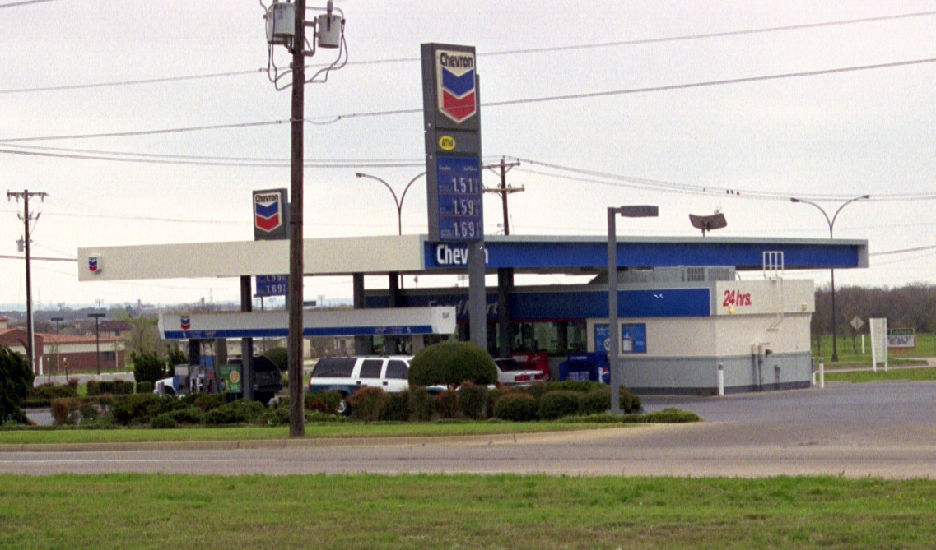
Satellite Links on Shore
Antenna

