Slide 1
Transport Layer
Last Update 2011.09.05
1.1.0

Slide 2
Moving to the Transport Layer
To ensure the correct protocol is used at the transport layer a Protocol Number is used

Slide 3
Context for Protocol Numbers
Layer | Protocol
Application | FTP/SMTP and many others
 | Port
Transport | UDP/TCP
 | Protocol Number
Internet | IP
Network Interface | Ethernet handles these functions
Hardware | Ethernet handles these functions

Slide 4
Finding Protocol Numbers
To find out what a Protocol Number is used for return to the IANA web site and go to the list of protocol numbers as seen in the following screenshots

Slide 5
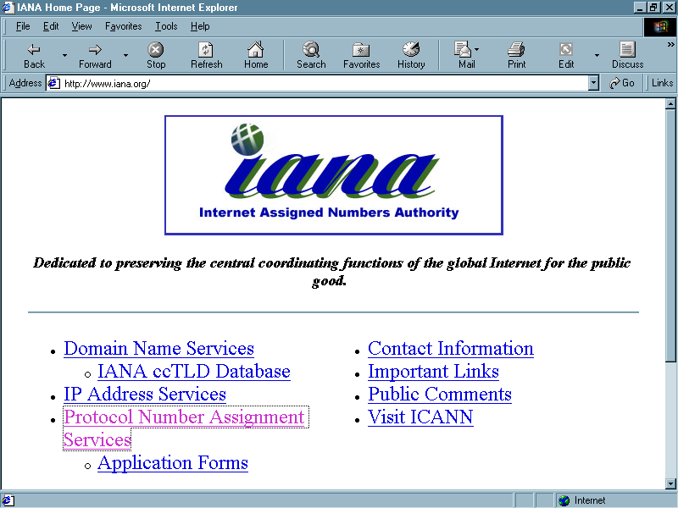
Finding Protocol Numbers

Slide 6
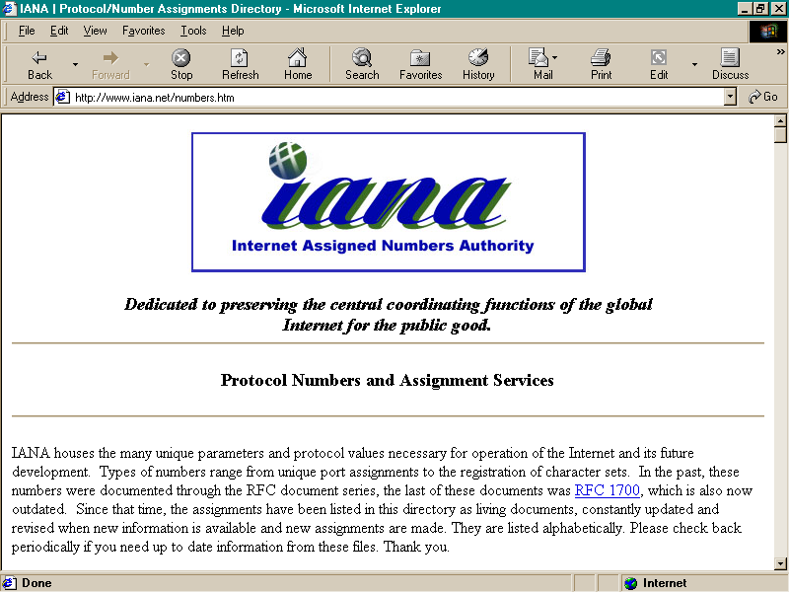
Finding Protocol Numbers

Slide 7
Finding Protocol Numbers
Click on the P on the following page, then scroll down in the P section to Protocol Numbers heading, then click on it

Slide 8
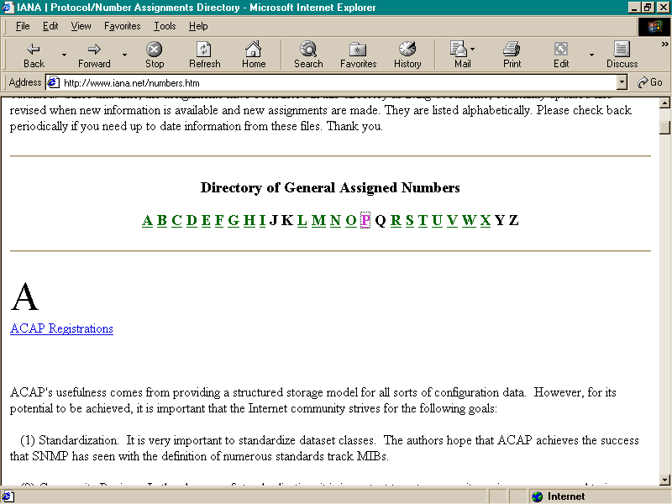
Finding Protocol Numbers

Slide 9
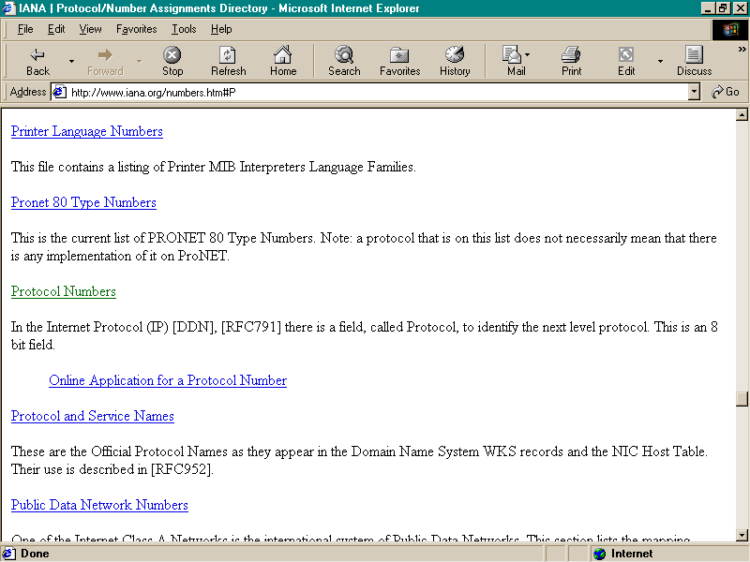
Finding Protocol Numbers

Slide 10
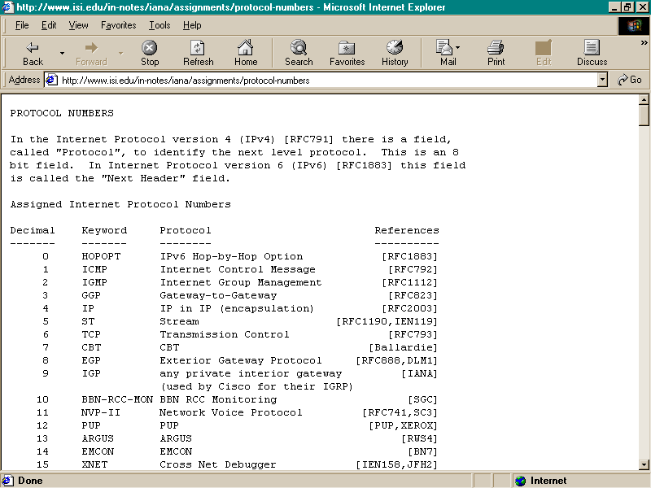
Finding Protocol Numbers

Slide 11
Finding Protocol Numbers
As the list at IANA shows there are less than 200 of these

Slide 12
Protocols at the Transport Layer
There are two main protocols used at the transport layer
UDP – User Datagram Protocol
TCP – Transmission Control Protocol

Slide 13
The Context for UDP
Layer | Protocol
Application | FTP/SMTP and many others
 | Port
Transport | UDP/TCP
 | Protocol Number
Internet | IP
Network Interface | Ethernet handles these functions
Hardware | Ethernet handles these functions

Slide 14
What is UDP
At the layer below UDP, the network layer, IP lives
IP uses the destination IP address to identify a host
IP makes no further distinction about the host
IP does not care what happens to the data once it reaches the correct host

Slide 15
What is UDP
UDP does
It is used to identify the application or service the data needs to go to

Slide 16
Operation
UDP is
Connectionless
Unreliable
Best Effort
As such messages can
Fail to arrive at all
Be duplicated
Arrive out of order
Arrive too fast to be processed

Slide 17
Operation
In other words, UDP is like your father
Mom goes out and tells dad to watch the kids
But what does he do
When she gets home she asks where Junior is
What does he say

Slide 18
Operation
I don’t know, he’s around here somewhere

Slide 19
Operation
But UDP is fast and efficient
Use it when speed is important
It relies on upper layer protocols to be responsible for everything else
That is the application program that uses UDP
The application programmer makes the decision as to whether to use UDP or TCP

Slide 20
Operation
Protocols that use UDP include
NFS on ports 1021 and 1022
SNMP on ports 161 and 162
DNS on port 53
TFTP on port 69

Slide 21
UDP Datagram Header
UDP SOURCE PORT
UDP DESTINATION PORT
UDP MESSAGE LENGTH
UDP CHECKSUM

Slide 22
UDP Datagram Header
UDP SOURCE PORT
UDP DESTINATION PORT
UDP MESSAGE LENGTH
UDP CHECKSUM

Slide 23
UDP Datagram Header
UDP Source Port
1 byte
This is optional, if not used, set to zero
Port number of the port the datagram is from

Slide 24
UDP Datagram Header
UDP SOURCE PORT
UDP DESTINATION PORT
UDP MESSAGE LENGTH
UDP CHECKSUM

Slide 25
UDP Datagram Header
UDP Destination Port
1 byte
Port number of the port the datagram is meant for

Slide 26
UDP Datagram Header
UDP SOURCE PORT
UDP DESTINATION PORT
UDP MESSAGE LENGTH
UDP CHECKSUM

Slide 27
UDP Datagram Header
UDP Message Length
1 byte
Length of the datagram in octets including the header and data

Slide 28
UDP Datagram Header
UDP SOURCE PORT
UDP DESTINATION PORT
UDP MESSAGE LENGTH
UDP CHECKSUM

Slide 29
UDP Datagram Header
UDP Checksum
1 byte
To ensure datagram integrity
Optional and rarely used

Slide 30
UDP Datagram Header
Data
The important stuff

Slide 31
More on Operation
When UDP receives a datagram it checks to see if the destination port in the datagram matches one of the ports currently in use
If not, UDP sends a port unreachable message back to the sender and throws out the datagram
If the destination port is active, UDP places the data in that port’s queue

Slide 32
Common Uses
UDP is commonly used when speed is important
SNMP traps
TCP would slow them down too much
Traps do not require ACKs
When it doesn’t get there on time, you can’t add it back in later
Streaming video or voice

Slide 33
Common Uses
Single packet transmissions
When lost packets do not matter

Slide 34
TCP
TCP is the second and most important of the Transport layer protocols in the TCP/IP protocol stack
In fact TCP/IP was originally called just TCP
It is only second in importance to its cousin IP as in TCP/IP

Slide 35
The Context for TCP
Layer | Protocol
Application | FTP/SMTP and many others
 | Port
Transport | UDP/TCP
 | Protocol Number
Internet | IP
Network Interface | Ethernet handles these functions
Hardware | Ethernet handles these functions

Slide 36
What is TCP
TCP – Transmission Control Protocol carries most packets handled by TCP/IP – 90% by many estimates
It is a general purpose delivery protocol
It provides reliable stream delivery of these packets
It makes few assumptions about the underlying network

Slide 37
Why Does TCP Exist
As such it operates well in a LAN, CAN, MAN, or WAN
Application programs usually need to send large volumes of information from one host to another

Slide 38
Why Does TCP Exist
To ensure the information gets there, which in most cases the application wants to know if it did, without TCP the application programmer would have to build error detection and recovery into each program
This is not efficient

Slide 39
Why Does TCP Exist
It is better for the protocols stack to do this
With UDP the packets can be
Lost
Destroyed
Damaged
Delayed
Delivered out of order
Duplicated

Slide 40
Characteristics of TCP
Unlike UDP, TCP is designed to deal with these problems
In other words, TCP is like your Mom
She cares about you, she worries about you, she checks to see that you got where you were going

Slide 41
Characteristics of TCP

Slide 42
TCP Segment
When talking TCP the thing formed up and sent is called a segment
As always the thing is in two parts
Unlike UDP there are quite a few fields in the TCP header
Let’s look at each of these
HEADER | DATA

Slide 43
TCP Segment Header
SOURCE PORT
DESTINATION PORT
SEQUENCE NUMBER
ACKNOWLEDGEMENT NUMBER
HLEN or DATA OFFSET
RESERVED
CODE BITS
WINDOW
CHECKSUM
URGENT POINTER
OPTIONS

Slide 44
TCP Segment Header
SOURCE PORT
DESTINATION PORT
SEQUENCE NUMBER
ACKNOWLEDGEMENT NUMBER
HLEN or DATA OFFSET
RESERVED
CODE BITS
WINDOW
CHECKSUM
URGENT POINTER
OPTIONS

Slide 45
TCP Segment Header
Source Port
Application program it came from
TCP port number of the sending endpoint

Slide 46
TCP Segment Header
SOURCE PORT
DESTINATION PORT
SEQUENCE NUMBER
ACKNOWLEDGEMENT NUMBER
HLEN or DATA OFFSET
RESERVED
CODE BITS
WINDOW
CHECKSUM
URGENT POINTER
OPTIONS

Slide 47
TCP Segment Header
Destination Port
Application program it is going to
TCP port number of the destination endpoint

Slide 48
TCP Segment Header
SOURCE PORT
DESTINATION PORT
SEQUENCE NUMBER
ACKNOWLEDGEMENT NUMBER
HLEN or DATA OFFSET
RESERVED
CODE BITS
WINDOW
CHECKSUM
URGENT POINTER
OPTIONS

Slide 49
TCP Segment Header
Sequence Number
Sequence number of the first byte of data in the segment
Position in the sender’s bit stream of the data in the segment
Allows destination to re-sequence data if it arrives out of order

Slide 50
TCP Segment Header
For example, if the sequence number for a segment is 2453, that's the sequence number of the first byte in the segment
Let's say I send 1000 bytes, because the other side said that's what its maximum segment size is
The other side sends an ACK
The ACK number is 3453

Slide 51
TCP Segment Header
The ACK number indicates that the recipient received up through byte number 3452 and is expecting 3453 next

Slide 52
TCP Segment Header
SOURCE PORT
DESTINATION PORT
SEQUENCE NUMBER
ACKNOWLEDGEMENT NUMBER
HLEN or DATA OFFSET
RESERVED
CODE BITS
WINDOW
CHECKSUM
URGENT POINTER
OPTIONS

Slide 53
TCP Segment Header
Acknowledgement Number
The number of the byte that the source expects to receive next
Because the acknowledgement number refers to the stream flowing in the opposite direction of the segment
The sequence number refers to the steam flowing in the same direction as the segment

Slide 54
TCP Segment Header
SOURCE PORT
DESTINATION PORT
SEQUENCE NUMBER
ACKNOWLEDGEMENT NUMBER
HLEN or DATA OFFSET
RESERVED
CODE BITS
WINDOW
CHECKSUM
URGENT POINTER
OPTIONS

Slide 55
TCP Segment Header
HLEN or Data Offset
Length of the header in 32 bit multiples
Used with OPTIONS field

Slide 56
TCP Segment Header
SOURCE PORT
DESTINATION PORT
SEQUENCE NUMBER
ACKNOWLEDGEMENT NUMBER
HLEN or DATA OFFSET
RESERVED
CODE BITS
WINDOW
CHECKSUM
URGENT POINTER
OPTIONS

Slide 57
TCP Segment Header
Reserved
Not used

Slide 58
TCP Segment Header
SOURCE PORT
DESTINATION PORT
SEQUENCE NUMBER
ACKNOWLEDGEMENT NUMBER
HLEN or DATA OFFSET
RESERVED
CODE BITS
WINDOW
CHECKSUM
URGENT POINTER
OPTIONS

Slide 59
TCP Segment Header
Code Bits
Tells everybody the purpose of the segment
Bit From Left | Meaning If bit set to 1
URG | Urgent
ACK | Acknowledgement
PSH | Push
RST | Reset
SYN | Synchronize
FIN | Finished

Slide 60
TCP Segment Header
SOURCE PORT
DESTINATION PORT
SEQUENCE NUMBER
ACKNOWLEDGEMENT NUMBER
HLEN or DATA OFFSET
RESERVED
CODE BITS
WINDOW
CHECKSUM
URGENT POINTER
OPTIONS

Slide 61
TCP Segment Header
Window
How much to send
The size of the buffer that is available
In bytes

Slide 62
TCP Segment Header
SOURCE PORT
DESTINATION PORT
SEQUENCE NUMBER
ACKNOWLEDGEMENT NUMBER
HLEN or DATA OFFSET
RESERVED
CODE BITS
WINDOW
CHECKSUM
URGENT POINTER
OPTIONS

Slide 63
TCP Segment Header
Checksum
Error checking for the header and the data
TCP also uses a pseudo-header like UDP
Keep in mind that at this layer we are only concerned with end-to-end transport
Errors in transit are detected by the Data Link layer
The checksum there is what is checked to see if there was an error in transmission

Slide 64
TCP Segment Header
If there was such an error the receiving router would throw out the packet
If the TCP checksum detects an error, that will indicate a bug in the software of the local station

Slide 65
TCP Segment Header
SOURCE PORT
DESTINATION PORT
SEQUENCE NUMBER
ACKNOWLEDGEMENT NUMBER
HLEN or DATA OFFSET
RESERVED
CODE BITS
WINDOW
CHECKSUM
URGENT POINTER
OPTIONS

Slide 66
TCP Segment Header
Urgent Pointer
To allow the bit stream to be interrupted for data that must be acted on immediately, such as for out of band management within the actual bit stream

Slide 67
TCP Segment Header
SOURCE PORT
DESTINATION PORT
SEQUENCE NUMBER
ACKNOWLEDGEMENT NUMBER
HLEN or DATA OFFSET
RESERVED
CODE BITS
WINDOW
CHECKSUM
URGENT POINTER
OPTIONS

Slide 68
TCP Segment Header
Options
Several uses including
Negotiate between the sender and receiver as to the MSS – Maximum Segment Size they agree to handle
Finding the optimal segment size is still problematic
Each device in between must be able to handle that segment size or it spends time breaking up the segments into smaller pieces

Slide 69
TCP Segment Header
The best size is the largest size that can be handled without having to break up the segment
The window-scale option is intended to address the issue of the maximum window size in the face of paths that exhibit high-delay
This option allows the window size advertisement to be right-shifted by the amount specified
Without this option, the maximum window size that can be advertised is 65,535 bytes, which is the maximum value obtainable in a 16-bit field

Slide 70
TCP Segment Header
The limit of TCP transfer speed is effectively one window size in transit between the sender and the receiver
For high-speed, long-delay networks, this performance limitation is a significant factor, because it limits the transfer rate to at most 65,535 bytes per round-trip interval, regardless of available network capacity
Use of the window-scale option allows the TCP sender to effectively adapt to high bandwidth, high delay network paths, by allowing more data to be held in flight

Slide 71
TCP Segment Header
The maximum window size with this option is 2 ³⁰ bytes
This option is negotiated at the start of the TCP connection, and can be sent in a packet only with the SYN flag

Slide 72
TCP Segment
Padding
As needed to bring the segment up to the minimum size
Data
The reason for all of this
The important stuff

Slide 73
Establishing a Connection
TCP uses a procedure called a three way handshake to create a connection which
Guarantees both sides are ready to transfer data
Allows both sides to agree on the initial sequence numbers
Both sides state the maximum segment size it can handle

Slide 74
TCP Handshake Process
Sender | Flow | Receiver
SYN sent
 |  | SYN received
 |  | SYN and ACK sent back
SYN and ACK received
ACK sent
 |  | ACK received

Slide 75
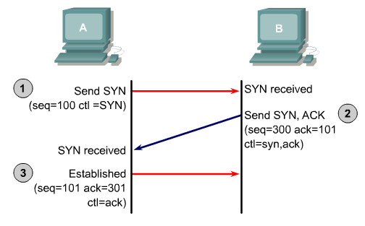
TCP Handshake

Slide 76
TCP Handshake Process
Let’s look at a packet trace of the TCP handshake sequence
The first screen shows the data this frame contains, in this case the SYN sequence
The second frame shows the response, the SYN-ACK
The third frame shows the response to this the ACK
Each frame is shown over three slides

Slide 77
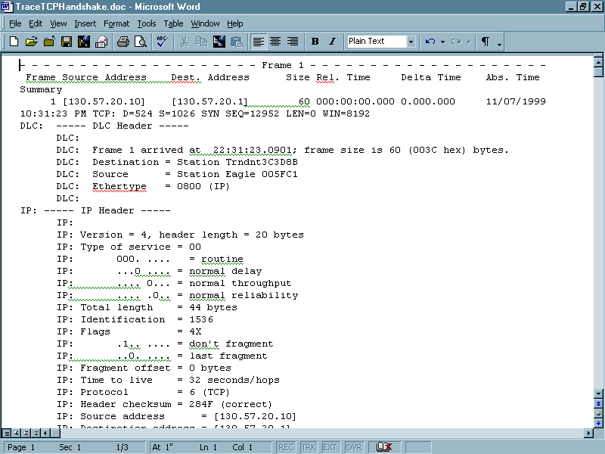
Handshake - SYN

Slide 78
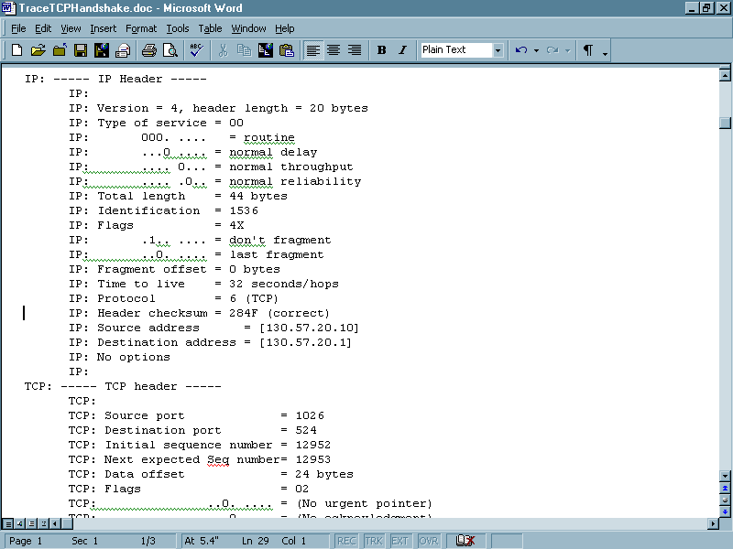
Handshake - SYN

Slide 79
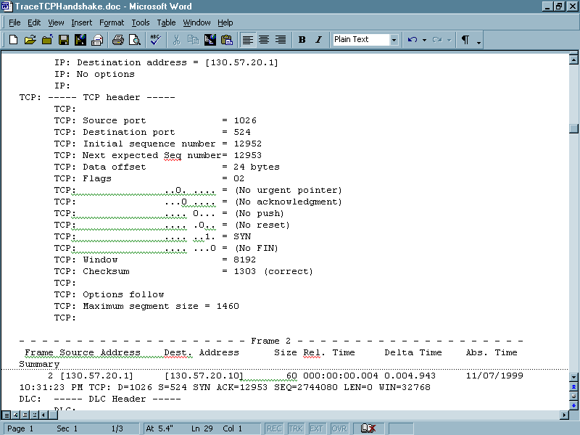
Handshake - SYN

Slide 80
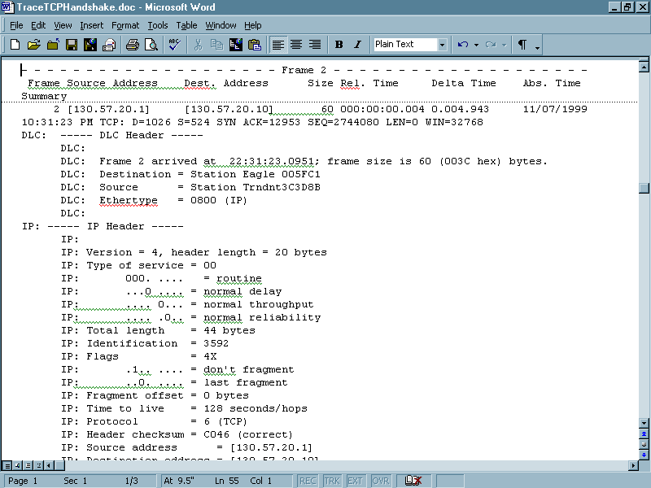
Handshake – SYN-ACK

Slide 81
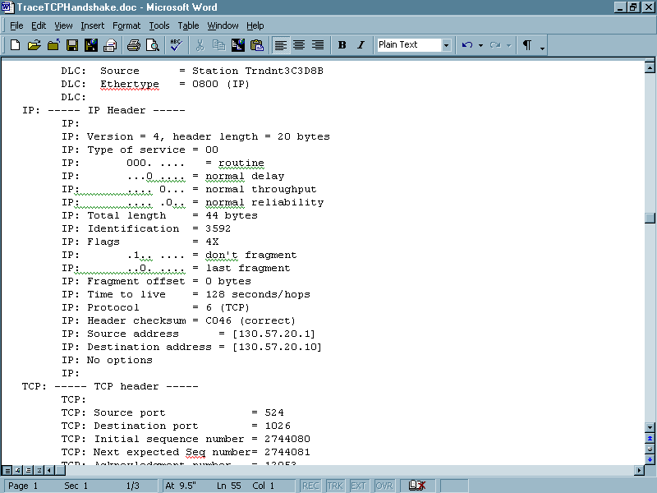
Handshake – SYN-ACK

Slide 82
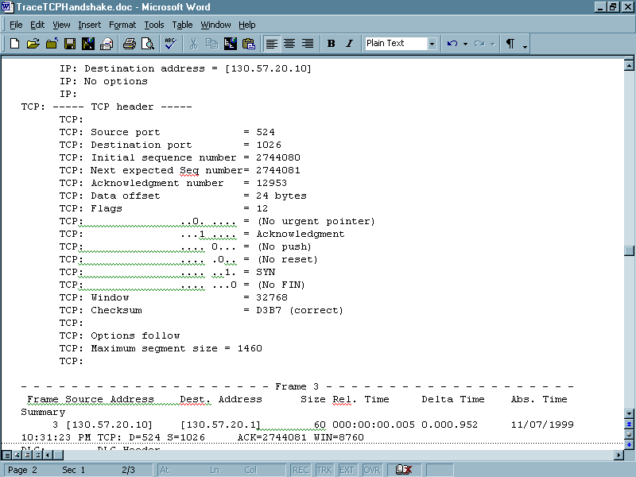
Handshake – SYN-ACK

Slide 83
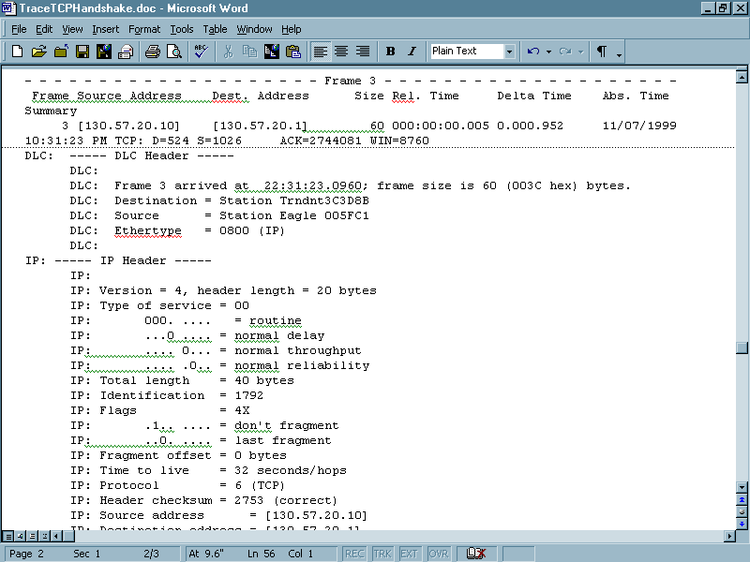
Handshake – ACK

Slide 84
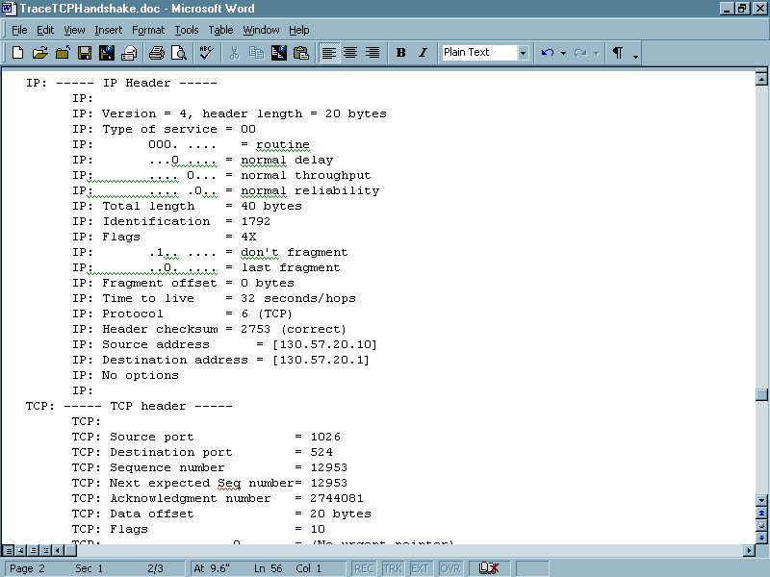
Handshake – ACK

Slide 85
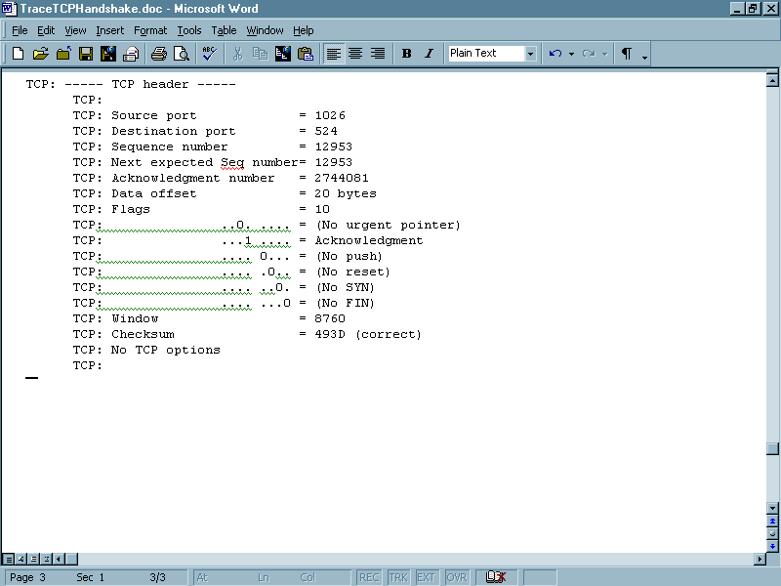
Handshake – ACK

Slide 86
Problems with the Handshake
What problems occur with this process
Hackers use it in creating denial of service attacks
For example, look at this news report from April 2002
MSNBC.com briefly bumped off line
The headline said
News site unavailable for nearly 2 hours after ‘SYN’ attack

Slide 87
Problems with the Handshake
April 25 - MSNBC.com was bumped off line for nearly two hours early Thursday. The Web news site experienced a “SYN” attack at 7:30 a.m. ET that caused its content to be unavailable to users, according to MSNBC.com’s technical production staff.
Service was restored about 9:20 a.m. ET. MSNBC.com staff members at the Redmond, Wash.-based Web site were continuing to investigate the attack Thursday.

Slide 88
Problems with the Handshake
A “SYN” attack is a basic type of denial-of-service attack, but one that’s still pesky to combat.
Each time a computer attempts to connect to a Web server, a so-called “three-way handshake” is initiated. First, a “SYN” (synchronization) packet is sent by the computer to the Web server. The server will respond with an “ACK” (acknowledgement) packet to indicate it’s ready to talk.

Slide 89
Problems with the Handshake
And for the purposes of redundancy, the original computer sends a second “ACK” packet back to the server, to ensure the connection has been made — a so-called “three-way handshake.”
But in a “SYN” flood attack, the original address of the first “SYN” packet is altered, or spoofed, usually as a non-existent address.

Slide 90
Problems with the Handshake
The Web server doesn’t know that, and so it tries to send an “ACK” packet to a computer that it can’t find. Imagine asking your desktop computer to find a file on a floppy drive when no floppy is inserted. In the case of a “SYN” flood, a duped Web server will try to respond to a fake IP for about three minutes each time.
Multiply that effect by thousands of millions of requests, and a Web server can become unreachable.

Slide 91
Problems with the Handshake
There are only a finite number of connections any Web server can accept, or put on a waiting list. “SYN floods effectively fill up that waiting list and make the server unreachable.
Eventually, Web administrators manage to shut off responses to the spoofed “SYN” traffic, but this can be challenging, as the faked originating address can literally point to anywhere.

Slide 92
Initial Sequence Numbers
The initial sequence number is agreed on during the handshake used to establish communication
A random number is selected to start the sequence
A problem has always existed with this method relating to the lack of randomness in the selection of the initial sequence number

Slide 93
Initial Sequence Numbers
This was described first in 1985
Due to the difficulty of implementing the proposed fixes, not much has been done

Slide 94
Maximum Segment Size
The segment size is added as a TCP option to the TCP header in a SYN packet
The two sides do not need to agree as to the segment size to be used, they just state to each other what they can do
But they usually do agree
A typical size is 1,460 bytes

Slide 95
Maximum Segment Size
This size when the 20 byte TCP header is added along with the 20 byte IP header yields the typical Ethernet frame of 1,500 bytes

Slide 96
Reliability in TCP
We said TCP is reliable in that we can be assured things get from one place to other
This is totally opposite from UDP
TCP provide reliable service through positive acknowledgement with retransmission
To do this the recipient sends an acknowledgement for each message received

Slide 97
Reliability in TCP
The sender keeps a list of each packet sent and waits for each to be acknowledged before sending the next
The sender starts a timer when it sends, so it knows if it needs to resend
Let’s look at this sequence of events

Slide 98
Reliability in TCP
Sender | Flow | Receiver
Send Packet 1
 |  | Receive Packet 1
 |  | Send ACK 1
Receive ACK 1
Send Packet 2
 |  | Receive Packet 2
 |  | Send ACK 2
Receive ACK 2

Slide 99
Data Flow From End to End
Once the session has been established by using the handshake sequence, both sides sequence their bytes that they send and both sides ACK the other side's bytes
Remember it's a stream-oriented protocol
Each side has a stream of bytes it needs to send

Slide 100
Data Flow From End to End
When a sender sends data, the sequence number that it puts in the packet is the sequence number of the first byte in the packet
The packet has a certain number of bytes in it, that is, a length
The sequence number in the next packet from this sender to be (seq + length) -1

Slide 101
Data Flow From End to End
The sender will keep sending as long as it has not gotten to the end of its send window
Then it must stop and wait for an ACK from the other side
The sender's send window is based on the recipient's receive window
The recipient states the size of its receive window in every packet

Slide 102
Data Flow From End to End
It is an indication of how much memory the recipient has for receiving bytes and how much is used up at this point in time
The recipient ACKs every byte, but not explicitly
The recipient sends a packet with the ACK bit set and the ACK number set to the next byte that the recipient expects to receive

Slide 103
Data Flow From End to End
By stating the next byte it expects to receive, the recipient acknowledges receiving the bytes before this

Slide 104
Retransmission
Because TCP sends data in variable length segments and because retransmitted segments can include more data than the original, acknowledgements cannot easily refer to datagrams or segments
Instead it refers to a position in the stream using the stream sequence numbers

Slide 105
Retransmission
The receiver collects data bytes from arriving segments and reconstructs an exact copy of the data stream being sent
TCP acknowledgements then refer to the sequence number of the next byte expected by the received

Slide 106
Timeout and Retransmission
If the acknowledgement is not received the packet must be retransmitted
Retransmission is assumed to be needed if a set amount of time goes by without an acknowledgement
To do this TCP uses an adaptive retransmission algorithm
It monitors the performance of the connection and deduces a reasonable timeout

Slide 107
Timeout and Retransmission
TCP uses the round trip sample time for this
Accurate measurement of round trip samples is done by using Karns’ Algorithm and Backoff Timer
Karns says to use only unambiguous acknowledgements for computing round trip samples
Karns is further adjusted by the Backoff Timer

Slide 108
Timeout and Retransmission
It says for each failure in transmission increase the timeout
This is also adjusted for high variance in delay by having the formula account for high degree of variance in delay as well

Slide 109
Retransmission in TCP
Sender | Flow | Receiver
Send Packet 1 and Start Timer
 |  | Packet should arrive and ACK should be sent
ACK would normally arrive by now
So Timer Expires
Resend Packet 1 and Start Timer
 |  | Receive Packet 1 and send ACK1
Receive ACK 1 and Cancel Timer

Slide 110
Sliding Window
Waiting for an acknowledgement for each packet is not very efficient
To improve efficiency a sliding window or burst mode was developed
The sliding window acknowledgement method allows multiple packets to be sent without waiting for an acknowledgement for the first to arrive
Let’s see what this looks like

Slide 111
Sliding Window
Packets sent and acknowledged |  | Current Window Packets sent at one time |  | Packets waiting to be sent
1 | 2 | 3 | 4 | 5 | 6 | 7 | 8
Packets sent and acknowledged |  | Current Window Packets sent at one time |  | Packets waiting to be sent

Slide 112
Sliding Window
The window slides one group to the right

Slide 113
Sliding Window
Packets sent and acknowledged |  |  |  | Current Window Packets sent at one time |  | Packets waiting to be sent
1 | 2 | 3 | 4 | 5 | 6 | 7 | 8
Packets sent and acknowledged |  |  |  | Current Window Packets sent at one time |  | Packets waiting to be sent

Slide 114
Sliding Window
In the sliding window method all packets fall into one of three sets
Those to the left of the window that have been sent, received, and acknowledged
Those in the window that are being sent
Those to the right of the window not yet sent
The lowest number, the one at the left edge of the window, is the first packet that has yet to be acknowledged

Slide 115
Sliding Window
When sending a packet a station includes in the TCP header the current size of its receive window
This means that the sender can send that many bytes without stopping and waiting for an ACK

Slide 116
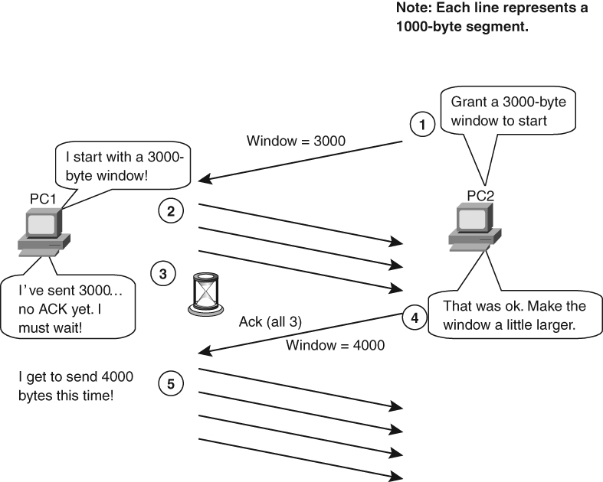
Sliding Window

Slide 117
Flow Control
To enhance efficiency further and to prevent overloading a host each acknowledgement of the number of bytes received also contains a window advertisement that specifies how many bytes the receiver is prepared to accept at that point in time
Typical values are 8,192 and 24,000 bytes
In most cases 8,192 is used

Slide 118
Flow Control
Some servers will advertise a window of 24,000 bytes
In response to an increased window size advertisement the sender speeds up or increases the size of the window
Each time an acknowledgement message is received, the window size is doubled

Slide 119
Flow Control
In response to a decreased window size advertisement the sender slows down or decreases the size of the window
If packet loss occurs, the sender cuts the window size back to half
In case of a total connection collapse, the sender resumes the connection with a small window size

Slide 120
Flow Control
Thus the stream is throttled just as a car on the freeway is
During rush hour, it must slow
During the middle of the day, it can speed up
Such is required in the uncertain world of the Internet, since from second to second one cannot tell what is going where or how

Slide 121
Response to Congestion
Since the endpoints cannot account for the congestion that may be encountered outside of their areas of control such as router problems
They assume that the packets have been lost or damaged and just resend them
Which leads to more and more congestion

Slide 122
Response to Congestion
TCP then needs to respond to the ICMP source quench packets that routers send out when congestion occurs
They do this through
Multiplicative Decrease
This says upon loss of a segment reduce the congestion window by half
and
For those segments that remain in the window, backoff the retransmission timer exponentially

Slide 123
Response to Congestion
Slow Start
This is used to prevent oscillation back and forth
It says start with a single segment then increase the window one segment each time an acknowledgment is received
Congestion Avoidance
Once the congestion windows reaches one-half of its original size before congestion, TCP then increases the congestion window by 1 only if all segments in the window have been acknowledged

Slide 124
Silly Window Syndrome
But too much speed adjustment can produce oscillation in the window size called silly window syndrome
A solution for the problem that occurs when the sending and receiving applications operate at greatly different speeds

Slide 125
Silly Window Syndrome
This resulted in each acknowledgement advertising a small window and each segment carrying a small amount of data
This is solved by the Nagle algorithm

Slide 126
Silly Window Syndrome
On the receiving side
Before sending an updated window advertisement after advertising a zero window, wait for space to become available that is either at least 50% of the buffer size or equal to the maximum segment size
On the sending side
Do not send data until there is sufficient data to fill a maximum sized segment
If still waiting to send when an acknowledgement arrives, send anyway
Ignore pushes during this time

Slide 127
Summary of Congestion Control
Below is a nice summary of this process from a Network World newsletter by Steve Taylor and Jim Metzler from July 2005
Last time, we discussed the fact that TCP has a flow control mechanism for each connection
The mechanism is based on a field in the segment header called the "Advertised Window“
The Advertised Window specifies how many additional bytes of data the receiver can accept

Slide 128
Summary of Congestion Control
The goal of congestion control is to ensure that the sending device does not transmit more data than the network can accommodate
To achieve this goal, the TCP congestion control mechanisms are based on a parameter referred to as the "Congestion Window“

Slide 129
Summary of Congestion Control
Determining the optimum value for the Congestion Window is somewhat tricky, particularly because network congestion changes over time
In order to ensure smooth end-to-end performance, TCP defines a parameter that is referred to as "Max Window“
It is helpful to think of Max Window as being an upper limit on the number of bytes that the sender could transmit at any point in time

Slide 130
Summary of Congestion Control
In order to ensure that the sending device does not send more data than the network and the receiving device can accommodate, Max Window is defined to be the lesser of Advertised Window and Congestion Window
However, data is continually being transmitted from the sending device to the receiving device and acknowledged by the receiving device

Slide 131
Summary of Congestion Control
To account for this, TCP defines a parameter called Effective Window
Effective Window is equal to Max Window minus the number of bytes that have been sent, but not acknowledged
The next newsletter will describe some techniques that are used to compute the Congestion Window

Slide 132
Summary of Congestion Control
Last time, we discussed how TCP combines a flow control parameter (Advertised Window) and a congestion control parameter (Congestion Window) to determine how many bytes the sending device can transmit (Effective Window)
We also mentioned that determining the optimum value for the Congestion Window is somewhat tricky because network congestion changes over time

Slide 133
Summary of Congestion Control
TCP has multiple mechanisms to determine Congestion Window and today, we'll describe one of those called Additive Increase/Multiplicative Decrease (AI/MD)
AI/MD is typically used when the sending device is operating close to the available capacity of the network

Slide 134
Summary of Congestion Control
The basic assumption made by AI/MD is that if the sender does not receive an acknowledgement of a sent packet, the packet was dropped by the network due to congestion
Hence, when faced with a timeout, AI/MD assumes there is network congestion and cuts Congestion Window in half
Subsequent timeouts result in additional halving of Congestion Window, which leads to the phrase "Multiplicative Decrease"

Slide 135
Summary of Congestion Control
While AI/MD decreases Congestion Window rapidly, it increases Congestion Window slowly
Every time that the source is successful in sending a Congestion Window's worth of packets, it adds the equivalent of one packet to Congestion Window
Analysis of TCP throughput demonstrates that this slow increase and rapid decrease in Congestion Window results in throughput that resembles a saw tooth

Slide 136
Summary of Congestion Control
This analysis also demonstrates that network throughput can be significantly impacted by packet loss
Future newsletters will examine some of the techniques that are used to overcome the performance limitations of TCP

Slide 137
Closing a Connection
Both parts of a full duplex connection must be closed so the process has two parts
To close a connection the sending side waits for the acknowledgement of the last byte
Then

Slide 138
Closing a Connection
Sender | Message Directions | Receiver
FIN sent
 |  | FIN received
 |  | ACK sent
ACK received |  | FIN sent
FIN received
ACK sent
 |  | ACK received

Slide 139
Connection Reset
To stop a connection without the normal closing procedure just described a connection can be reset
In this case
RST is sent
Other side immediately kills the connection
Informs the application program that the connection has been killed

Slide 140
Forcing Data Delivery
If something must be moved to the front of the line, a push is used to force delivery without waiting for the buffer to fill

