Slide 1
The Organizations That Create the Standards Last Update 2009.09.12 1.0.0

Slide 2
Objective
Learn about the organizations that create the future you will live in

Slide 3
Form of Standards
Some standards are de jure and the rest are de facto
De jure standards such as those governing frequency usage in wireless networks are created by regulatory agencies at various levels of government under the authority of legislation
For example, frequency coordination for civilian usage is delegated to the FCC

Slide 4
Form of Standards
Other standards, such as the 802.3 standard, are de facto standards that are standards solely because the community of developers and users agree to conform to these

Slide 5
Standards are Created By
These de facto standards come from several sources
The two main ones we will talk about here are those created by the IETF and the IEEE
In general hardware standards govern what goes on at layers 1 and 2
Software standards govern layers 3 to 7

Slide 6
Standards are Created By
Software standards are developed by the IETF
Hardware standards are developed by the IEEE
Let’s discuss these organizations

Slide 7
Development of the Internet
But first a history lesson
The Internet is filled with a series of problems
Most of these arise from the scale the Internet has assumed
The nerds who first setup the system made a series of poor decisions

Slide 8
Development of the Internet
All of these were based on the assumption that the size of the network would always be small
This was a poor assumption
For example
In the beginning all configuration information was in a set of files at each location
Addresses were divided into classes based on the size of the organization

Slide 9
Development of the Internet
By the 1980s it was clear that none of this would work any longer

Slide 10
Precursor Steps
How did we get where we are today
Let’s see
In the beginning of interconnections among computers – the late 1960s – most organizations bought all of their equipment from a single company
These were large, expensive, proprietary systems that only talked to each other and no one else

Slide 11
Precursor Steps
All of the equipment was plugged into a central controller that held all of the intelligence
The protocols used were only understood by the vendor’s equipment

Slide 12
Precursor Steps
As computers became more central to national defense the defense agencies saw the need for them to all talk to each other without excessive overhead from translations through gateways
The agency that drove this effort was DARPA – Defense Advanced Research Projects Agency of the Department of Defense of the United States

Slide 13
Precursor Steps
How did we get from the world as described from the 1960s to now
The first recorded description of the social interactions that could be enabled through networking was a series of memos written by J.C.R. Licklider of MIT in August 1962 discussing his "Galactic Network" concept

Slide 14
Precursor Steps
He envisioned a globally interconnected set of computers through which everyone could quickly access data and programs from any site
The significance of this is that Licklider was the first head of the computer research program at DARPA

Slide 15
Precursor Steps
While at DARPA he convinced his successors at DARPA, Ivan Sutherland, Bob Taylor, and Lawrence G. Roberts, of the importance of this networking concept
Also Leonard Kleinrock at MIT published the first paper on packet switching theory in July 1961 and the first book on the subject in 1964

Slide 16
Precursor Steps
Kleinrock convinced Roberts of the theoretical feasibility of communications using packets rather than circuits
To explore this, in 1965 working with Thomas Merrill, Roberts connected a computer in Massachusetts to California with a low speed dial-up telephone line creating the first WAN

Slide 17
ARPANET
This is significant since it worked so well the Internet as a whole was based on much of the work done there
As Vint Cerf has said the original design of this internetwork was to be a network that would be interconnected in an arbitrary mesh as opportunity and need dictated

Slide 18
ARPANET
This was consistent with the mission then conceived for the technology
Which was to
Interconnect differing systems
Provide support for military command and control under peaceful and conflict conditions
In late 1966 Roberts went to DARPA to develop this computer network concept and put together his plan for the ARPANET in 1967

Slide 19
ARPANET
In August 1968, after Roberts and the DARPA funded community had refined the overall structure and specifications for the ARPANET, an RFQ was released by DARPA for the development of one of the key components, the packet switches called IMP - Interface Message Processors – in other words routers

Slide 20
ARPANET
The RFQ was won in December 1968 by a group headed by Frank Heart at BBN - Bolt Beranek and Newman based in Massachusetts
All this came together in September 1969 when BBN installed the first IMP at UCLA and the first host computer was connected
The second network at Stanford was installed on 1 October

Slide 21
ARPANET
The first packet was sent out over the internetwork on 29 October 1969
As the letter G of LOGIN was typed the entire internetwork crashed
Oh well, it wasn’t a very big internetwork
At this time the ARPANET was not very large or formal as seen from this drawing provided by one of the pioneers in this field, Bob Braden

Slide 22
ARPANET
This is from a presentation he provided to the Internet History mailing list

Slide 23
ARPANET

Slide 24
ARPANET
The first cross country link was setup in 1970 by AT&T between UCLA and BBN at 56 Kbps
In October 1972 a successful demonstration of the ARPANET at the International Computer Communication Conference was conducted
This was the first demonstration of this new network technology to the public

Slide 25
ARPANET
It was also in 1972 that the initial application that would help to drive interest in this network was introduced, electronic mail
To prevent a single point of failure in the system each site was required to connect to at least two other sites and the software driving the network was designed to adapt automatically to loss of a site by rerouting

Slide 26
ARPANET
Eventually ARPANET was split into two parts – ARPANET and MILNET
ARPANET was then transferred to DCA – Defense Communications Agency in 1975 to become part of DDN – Defense Data Network
It was finally retired from service in July 1990

Slide 27
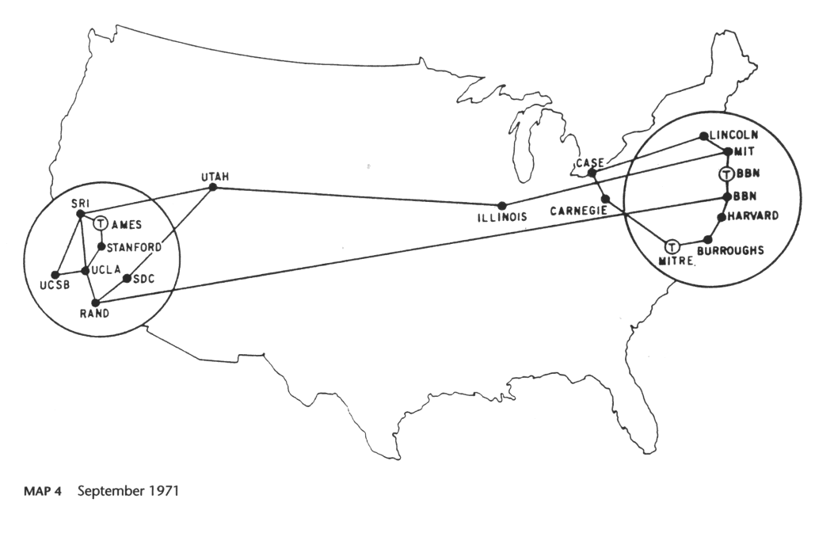
ARPANET - 1971

Slide 28
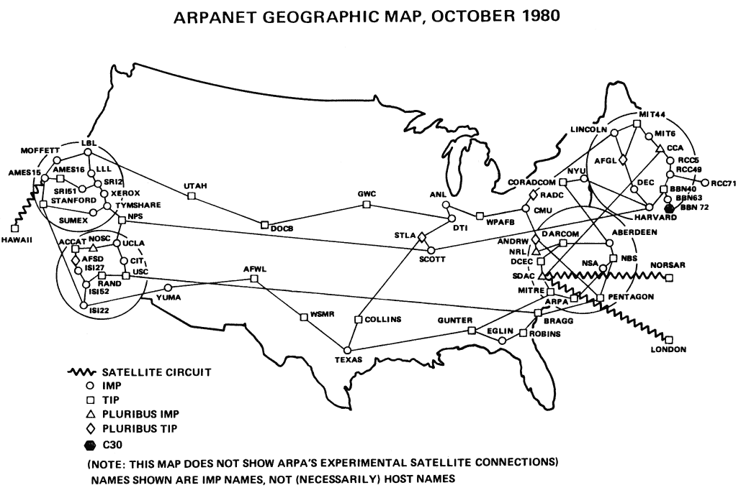
ARPANET - 1980

Slide 29
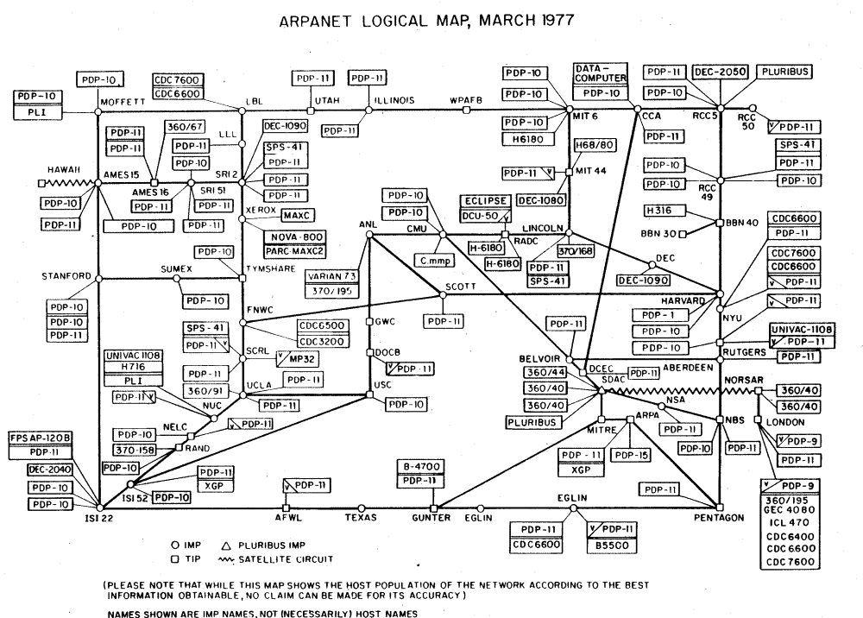
ARPANET - Bits n Pieces

Slide 30
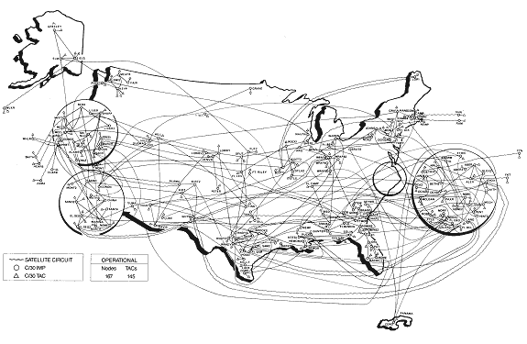
MILNET – US - 1984

Slide 31
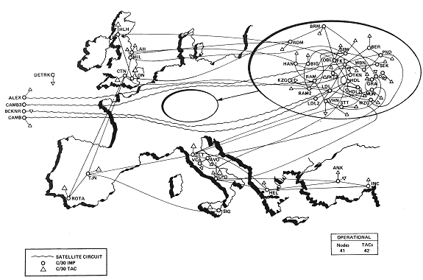
MILNET – Europe - 1984

Slide 32
Growth Begins
Success breed success
As universities made successful use of the internetworking concept others began to take an interest in it
NSF – National Science Foundation began to expand it to all computer scientists through CSNET – Computer Science Network
Later this was done through NSFNET

Slide 33
NSFNET
Which connected the NFS supercomputer centers to each other and ARPANET
The main interest in this network is that as it grew larger and larger the ARPANET got smaller and smaller
Until eventually NSFNET formed the Internet backbone

Slide 34
NSFNET
Again this was a series of 56K circuits connecting major supercomputer and research centers
Soon after the original backbone was in place in 1987 it was deemed to be too slow
Sound familiar
In 1988 a new backbone went into operation

Slide 35
NSFNET
It was faster and connected more and more sites
Sound familiar
These were network circuits over a wide area connected together using packet routers
Each router also had an Ethernet interface to the local network
In 1989 speed was again increased

Slide 36
NSFNET
This time to DS1 size – 1.544 Mbps
Redundancy was also introduced
NFSNET was retired from service in April 1995

Slide 37
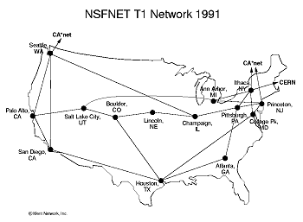
NSFNET - 1991

Slide 38
ANSNET
By 1991 things were getting out of hand
Private companies were beginning to connect to the network
Commercial as opposed to purely scientific research was traversing the network
Of course once again this called for more capacity and more sites to be connected

Slide 39
ANSNET
To meet these challenges the backbone was privatized and commercialized
Organizations wishing to connect needed to pay for access
This was done through ANS – Advanced Networks and Services
This new network was owned by ANS
It operated at DS3 speed – 45 Mbps

Slide 40
vBNS
In 1995 speed was again too slow
So a new network called vBNS – Very High Speed backbone was installed by MCI
This backbone operated at OC3 speed – 155 Mbps

Slide 41
Current Form of the Backbone
Since 1995 increasing commercialization of the Internet and decreasing governmental funding has lead to a series of Internet backbones
Commercial companies have created large privately owned backbones

Slide 42
Current Form of the Backbone
All of these are connected together through private peering arrangements, at public exchange points, or at the traditional MAE locations
For example, companies like MCI have done this work

Slide 43
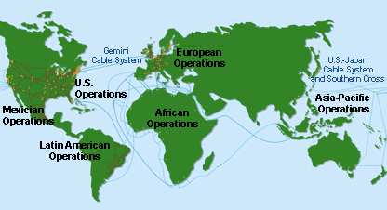
MCI - Overall

Slide 44
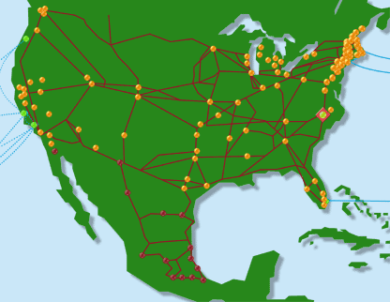
MCI - North America

Slide 45
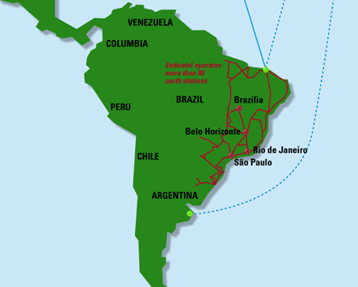
MCI - South America

Slide 46
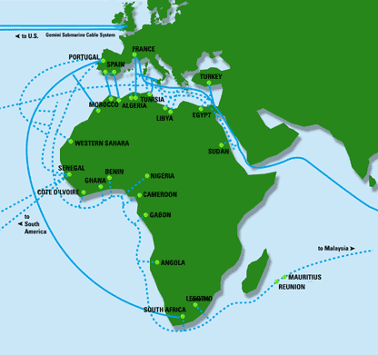
MCI - Africa

Slide 47
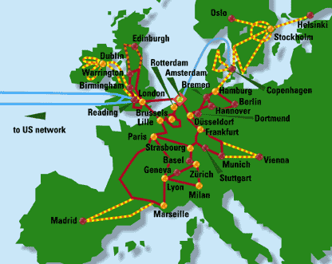
MCI - Europe

Slide 48
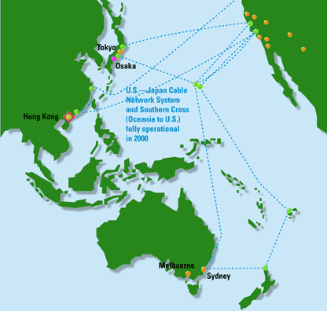
MCI - Asia

Slide 49
Current Form of the Internet
The result is an internetwork or a network or networks
This is what the Internet is, just a network of networks
This is formed by large providers creating networks that span huge distances, often worldwide
These backbone networks then connect to each other to form the Internet

Slide 50
Current Form of the Internet
Then within these backbones is a series of smaller and smaller ISPs that provide access to the Internet
These ISPs are the onramp to the Internet highway

Slide 51
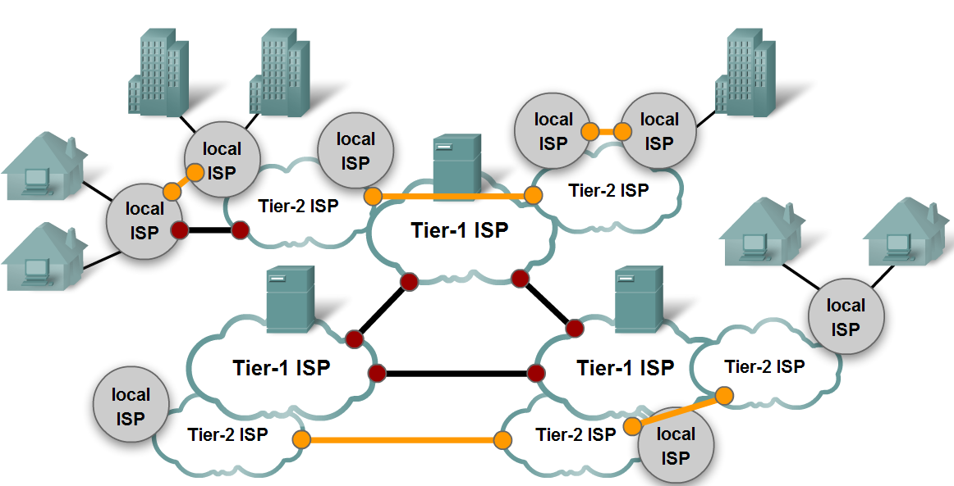
Current Form of the Internet

Slide 52
Who Controls the Internet
The next question to consider is who controls all of this
Who sets the rules
Who has the recipe to the secret sauce
For most of this it is the Internet Society and its associated bodies

Slide 53
Who Controls the Internet
The Internet Society
IAB
IRSG |  | IESG
IRTF |  | Areas
 |  | IETF
Research Groups |  | Working Groups

Slide 54
The Internet Society
The Internet Society or ISOC was formed in 1992 so that the Internet would not be entirely US-centric
The Internet Society was created to include the IAB and any other organizations from other countries that wished to participate

Slide 55
IAB
If ISOC provides the coordinating function, who actually controls the Internet and TCP/IP
For the most part today it is the IAB – Internet Architecture Board
Most of the real work is done by the subparts of the IAB including the following as the IAB serves in a coordinating role for these groups that do the day to day work

Slide 56
IAB Groups
IRTF - Internet Research Task Force
IRSG – Internet Research Steering Group
IESG – Internet Engineering Steering Group
IETF – Internet Engineering Task Force
Most of the real work is done by the IETF and its working groups

Slide 57
IRTF
This is the research arm of the organization to some extent
In practice much of this work is done by the IETF
IRTF is organized into Research Groups
The groups are setup for long term research projects

Slide 58
IRSG
This is the governing body of the research side of the Internet Society
Its job is to approve and pass up the work of the IRTF

Slide 59
IESG
The IESG is responsible for technical management of IETF activities and the Internet standards process
However, the IESG doesn't do much direct leadership, such as the kind you will find in many other standards organizations

Slide 60
IESG
The IESG ratifies or corrects the output from the IETF's Working Groups, gets WGs started and finished, and makes sure that non-WG drafts that are about to become RFCs are correct

Slide 61
IETF
Finally we are down to where the real work goes on
The IETF is divided into working groups
Each group concentrates on a particular problem or need
This is the organization that drives the Internet and TCP/IP development

Slide 62
IETF
As the Tao of IETF says
The Internet Engineering Task Force is a loosely self-organized group of people who make technical and other contributions to the engineering and evolution of the Internet and its technologies
It is the principal body engaged in the development of new Internet standard specifications

Slide 63
IETF
An IETF meeting is not a conference, although there are technical presentations
The IETF is not a traditional standards organization, although many specifications are produced that become standards
The IETF is made up of volunteers who meet three times a year to fulfill the IETF mission

Slide 64
IETF
There is no membership in the IETF
Anyone may register for and attend any meeting
The closest thing there is to being an IETF member is being on the IETF or working group mailing lists
This is where the best information about current IETF activities and focus can be found

Slide 65
IETF Working Groups
There are many IETF working groups
Last time I checked there were over a hundred
The interests of the groups cover a wide area as you might expect

Slide 66
Other Important Organizations
Outside of the ISOC umbrella, but just as important are three other organizations
The three control various aspects of TCP/IP
ICANN
IANA
Regional Internet Registries

Slide 67
ICANN
ARIN says the following about ICANN
In July 1997, the President directed the Department of Commerce to privatize DNS management to increase competition and facilitate international participation
In September 1998, the Internet Corporation for Assigned Names and Numbers (ICANN) was formed to take over IANA's responsibilities and to operate without government funding

Slide 68
ICANN
Among its duties, ICANN distributes IP addresses to the RIRs, of which there are three:
ARIN serving North and South America, the Caribbean, and sub-Saharan Africa
RIPE NCC (Réseaux IP Européens Network Coordination Centre) serving Europe, the Middle East, and parts of Africa
APNIC (Asia Pacific Network Information Centre) serving the Asia Pacific region

Slide 69
IANA
As ARIN says about IANA
An early pioneer of the global network, Dr. Jon Postel, took it upon himself to begin maintaining a list of host names and addresses, and a list of ARPANET research documents, or Requests for Comments (RFCs)

Slide 70
IANA
Dr. Postel's efforts led to the formation of the Internet Assigned Numbers Authority (IANA), which, under U.S. Government contract, had global responsibility for Internet Protocol (IP) address space allocation, protocol parameter assignment, and Domain Name System (DNS) management

Slide 71
ARIN
As ARIN says about itself
It is a non-profit organization established for the purpose of administration and registration of Internet Protocol (IP) numbers for the following geographical areas
North America,
South America,
the Caribbean and
sub-Saharan Africa

Slide 72
ARIN
ARIN is one of three Regional Internet Registries worldwide which collectively provide IP registration services to all regions around the globe
The others are
RIPE NCC - Europe, Middle East, parts of Africa
APNIC - Asia Pacific

Slide 73
ARIN
Among ARIN's tasks are the management of IP numbers, autonomous system numbers, and IN-ADDR.ARPA or IP6.INT inverse mapping, as well as database maintenance, verification of reassignment information, and maintaining a routing registry where network operators can submit, maintain, and retrieve router configuration information

Slide 74
ARIN
ARIN officially opened for operation on December 22, 1997 through the authorization of the NSF and the transfer by the IANA of authority of IP number administration from Network Solutions , the InterNIC, to ARIN

Slide 75
Protocols Used in Internetworks
Today’s internetworks rely solely on TCP/IP for the protocols used to define transfers
This was not always the case
Let’s see how we got to where we are

Slide 76
NCP
As computers were added to the ARPANET work proceeded on completing a functionally complete Host-to-Host protocol and other network software
In December 1970 the NWG - Network Working Group finished the initial ARPANET Host-to-Host protocol, called NCP - Network Control Protocol

Slide 77
NCP
As the ARPANET sites completed implementing NCP during the period 1971-1972, the network users finally could begin to develop applications
However, NCP did not have the ability to address networks and hosts further downstream than a destination IMP on the ARPANET and thus some change to NCP would also be required

Slide 78
NCP
NCP relied on ARPANET to provide end-to-end reliability
If any packets were lost, the protocol and presumably any applications it supported would come to a grinding halt
NCP had no end-end host error control, since the ARPANET was to be the only network and it would be so reliable that no error control would be required

Slide 79
NCP
But as we have seen more and more networks were being connected into an internetwork

Slide 80
TCP Comes on the Scene
Robert Kahn who had done some of the basic work in the field decided to develop a new version of the protocol which could meet the needs of an open architecture network environment
This protocol would eventually be called the TCP/IP - Transmission Control Protocol/Internet Protocol

Slide 81
TCP Comes on the Scene
While NCP tended to act like a device driver, the new protocol would be more like a communications protocol

Slide 82
Requirements Set for TCP/IP
Four ground rules were critical to Kahn's early thinking
Each network would have to stand on its own, no internal changes would be required to a network
Communications would be on a best effort basis
If a packet didn't make it to the final destination, it would be retransmitted from the source

Slide 83
Requirements Set for TCP/IP
Black boxes would be used to connect the networks
There would be no information retained by the black boxes about the individual packets passing through them
Thereby keeping them simple and avoiding complicated recovery routines
There would be no global control at the operations level

Slide 84
Requirements Set for TCP/IP
Other requirements included
Algorithms to prevent lost packets from permanently disabling communications and enabling them to be successfully retransmitted from the source
The need for global addressing
Techniques for host to host flow control
Interfacing with the various operating systems

Slide 85
Development of TCP/IP
In the spring of 1973 Kahn asked Vint Cerf to work with him on the detailed design of the protocol
Cerf had been intimately involved in the original NCP design and development and already had the knowledge about interfacing to existing operating systems

Slide 86
Development of TCP/IP
So armed with Kahn's architectural approach to the communications side and with Cerf's NCP experience, they teamed up to spell out the details of what became TCP/IP

Slide 87
Development of TCP/IP
The first written version of the resulting approach was distributed at a special meeting of the INWG - International Network Working Group which had been set up at a conference at Sussex University in September 1973

Slide 88
Development of TCP/IP
Some basic approaches emerged from this collaboration between Kahn and Cerf
Communication between two processes would logically consist of a very long stream of bytes - called octets
The position of any octet in the stream would be used to identify it.
Flow control would be done by using sliding windows and acknowledgments

Slide 89
Development of TCP/IP
The destination could select when to acknowledge and each ack returned would be cumulative for all packets received to that point
Although Ethernet was under development at Xerox PARC at that time, the proliferation of LANs were not envisioned at the time, much less PCs and workstations

Slide 90
Development of TCP/IP
The original model was national level networks like ARPANET of which only a relatively small number were expected to exist
A 32 bit IP address was used of which the first 8 bits signified the network and the remaining 24 bits designated a host on that network
This assumption, that 256 networks would be sufficient for the foreseeable future, was clearly in need of reconsideration when LANs began to appear in the late 1970s

Slide 91
Development of TCP/IP
The original Cerf and Kahn paper on the Internet described one protocol, called TCP, which provided all the transport and forwarding services in the Internet
However, the initial effort to implement TCP resulted in a version that only allowed for virtual circuits

Slide 92
Development of TCP/IP
This model worked fine for file transfer and remote login applications, but some of the early work on advanced network applications, in particular packet voice in the 1970s, made clear that in some cases packet losses should not be corrected by TCP, but should be left to the application to deal with

Slide 93
Development of TCP/IP
This led to a reorganization in 1978 of the original TCP into two protocols, the simple IP which provided only for addressing and forwarding of individual packets, and the separate TCP, which was concerned with service features such as flow control and recovery from lost packets

Slide 94
Development of TCP/IP
For those applications that did not want the services of TCP, an alternative called UDP - User Datagram Protocol was added in order to provide direct access to the basic service of IP
Much of the widespread use of TCP/IP has come from three things besides its excellent design

Slide 95
Deployment of TCP/IP
TCP/IP was adopted as a defense standard in 1982
As such all defense related networks were required to use it as the only protocol standard
Many of the original internetworks were funded with defense related funds

Slide 96
Deployment of TCP/IP
TCP/IP was widely distributed at low cost to university computer science departments
Much of this was done by AT&T through UNIX
ARPANET moved in mass from NCP to TCP/IP in 1983

Slide 97
What is the IEEE
They say about themselves
A non-profit organization, IEEE is the world's leading professional association for the advancement of technology
The IEEE name was originally an acronym for the Institute of Electrical and Electronics Engineers, Inc
Today, the organization's scope of interest has expanded into so many related fields, that it is simply referred to by the letters I-E-E-E

Slide 98
IEEE
About their role in standards development they say
The IEEE is a leading developer of international standards that underpin many of today's telecommunications, information technology and power generation products and services

Slide 99
IEEE
Often the central source for standardization in a broad range of emerging technologies, the IEEE Standards Association has a portfolio of some 900 active standards and more than 400 standards in development. This includes the prominent IEEE 802® standards for wireless networking

Slide 100
IEEE
Most of the work we are interested in is done by the various 802 committees

