Slide 1
The Relationship of the Protocol Stack to the Operating System
Last Update 2009.06.29
1.4.0

Slide 2
DOS v Windows
What is an operating system
It is the way the hardware talks to the human
Some things are built into the OS
Some things are not
Things built-in include
Keyboard driver
Mouse driver

Slide 3
DOS v Windows
Things not built-in include
Network services
You see deep underneath Windows is the original Microsoft operating system called DOS – Disk Operating System
As such it does not understand network related commands

Slide 4
In the Old Days
In the old days you purchased a protocol stack
It was not included with the OS
It was not part of the OS
Each one was slightly different
Commonly one vendor’s version would not talk to another vendor’s version

Slide 5
In the Old Days
For example, to talk to the WAN where I worked at that time I had to use a version of TCP/IP called “LAN Workplace for DOS” from Novell
To talk to some Token Ring hubs I had to use a version of TCP/IP called Chameleon from another company
Each time I needed to talk to one or the other, I had to reboot

Slide 6
In the Old Days
This is why we love standards
Standardization came along with Version 2 of the TCP/IP protocol stack for PCs
The following is an example of how this was once done

Slide 7
Load the OS
C:\>

Slide 8
Issue a TCP/IP Command
C:\>ping 127.0.0.1
Bad command or file name
C:\>
Note that nothing happens
The OS does not know what to do
The request for network services falls into the bit bucket

Slide 9
DOS by Itself

Slide 10
Surround DOS with a Redirector

Slide 11
Surround DOS with a Redirector
The redirector software surrounds DOS
Any command issued to DOS is intercepted
Those for DOS alone are passed onto DOS
Those for network services are redirected to a device driver that can deal with such a command

Slide 12
Load the Redirector
C:\>lsl
NetWare Link Support Layer v2.12 (940922)
(C) Copyright 1990-1994 Novell, Inc. All Rights Reserved.
BUFFERS 4 4096
MEMPOOL 4096
The configuration file used was “C:\NET.CFG”.
Max Boards 4, Max Stacks 6
Buffers 4, Buffer size 4176, Memory pool 4096 bytes.

Slide 13
Issue a TCP/IP Command
C:\>ping 127.0.0.1
Bad command or file name
C:\>
Why does nothing happen now
The redirector is loaded
But there is nothing to pass the command to, yet

Slide 14
Load the NIC driver
C:\>ne2000
Novell NE2000 Ethernet MLID v1.54 (931123)
(C) Copyright 1990-1993 Novell, Inc. All Rights Reserved.
Int 5, Port 300 Node Address 8029648B55 L
Max Frame 1514 bytes Line Speed 10 Mbps
Board 1, Frame ETHERNET_802.2, LSL mode
Board 2, Frame ETHERNET_802.3, LSL mode
Board 3, Frame ETHERNET_II, LSL mode

Slide 15
Issue a TCP/IP Command
C:\>ping 127.0.0.1
Bad command or file name
C:\>
Why does nothing happen now
The redirector is loaded
The NIC driver is loaded
But there is still nothing to pass the command to, yet

Slide 16
Load TCPIP.EXE
C:\>tcpip
Novell TCP/IP Transport v5.0 (9600301)
(C) Copyright 1990-1995 Novell, Inc. All Rights Reserved.
Network Name: IP_NET Bind: NE2000
IP Address: 10.0.0.3 Board Number: 3
Subnet Mask: 255.0.0.0 Board Instance: 1
Default Router: 10.0.0.1 FRAME: Ethernet_II

Slide 17
Issue a TCP/IP Command
C:\>ping 127.0.0.1
Bad command or file name
C:\>
Everything is there
Why doesn’t it work
I forgot
Now you have to go out and buy ping
But DOS is ready

Slide 18
TCP/IP with Windows
TCP/IP is not built into the base OS, but added in
For example

Slide 19
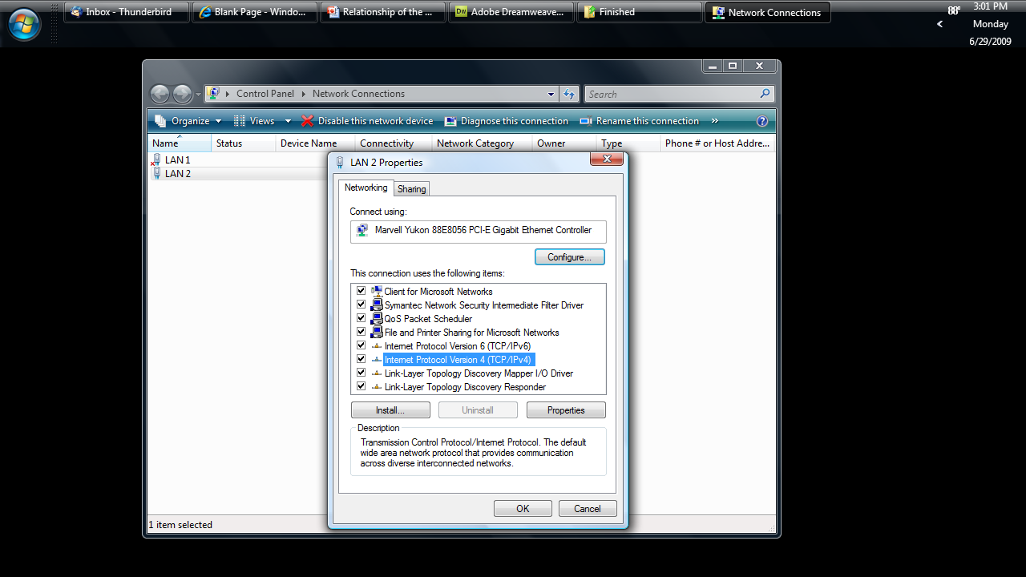
TCP/IP in Windows

Slide 20
TCP/IP with Windows
However at last ping is built in to the stack that’s loaded
C:\>ping 127.0.0.1
Pinging 127.0.0.1 with 32 bytes of data:
Reply from 127.0.0.1: bytes=32 time<10ms TTL=32
Reply from 127.0.0.1: bytes=32 time<10ms TTL=32
Reply from 127.0.0.1: bytes=32 time<10ms TTL=32
Reply from 127.0.0.1: bytes=32 time<10ms TTL=32
Ping statistics for 127.0.0.1:
Packets: Sent = 4, Received = 4, Lost = 0 (0% loss),
Approximate round trip times in milli-seconds:
Minimum = 0ms, Maximum = 0ms, Average = 0ms
C:\>

