Slide 1
Physical Layer Last Update 2009.07.12 1.1.0

Slide 2
The Physical Layer
At the bottom of both the OSI and TCP/IP models is the physical layer
This layer is all hardware based
Over the years the hardware used at the physical layer has progressed from just cables to hubs to switches
Let’s look at this development

Slide 3
Cable Based Network
The original LANs were created by connecting devices together using a single long cable
For example

Slide 4
10Base5
10Base5 was the original LAN connection method
It was also called Thicknet due to the size of the coax cable it used

Slide 5
10Base5 Architecture Example

Slide 6
10Base2
10Base5 was replaced by a similar connection method that used smaller coax cable
With 10Base2 sections of coax cable were strung together using BNC T Connectors to which the NICs were directly attached
Each end of this long piece of cable was terminated to prevent signal reflections

Slide 7
10Base2
One end was grounded for electrical safety
10Base2 was also called Thinnet or Cheapnet

Slide 8
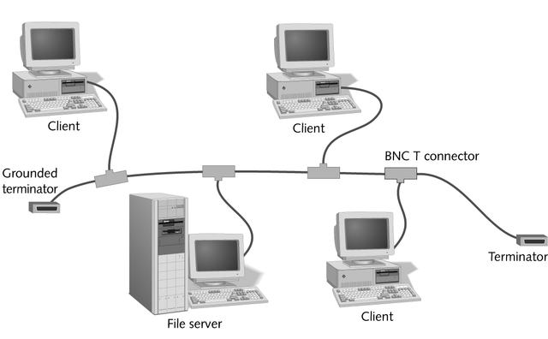
10Base2 Network

Slide 9
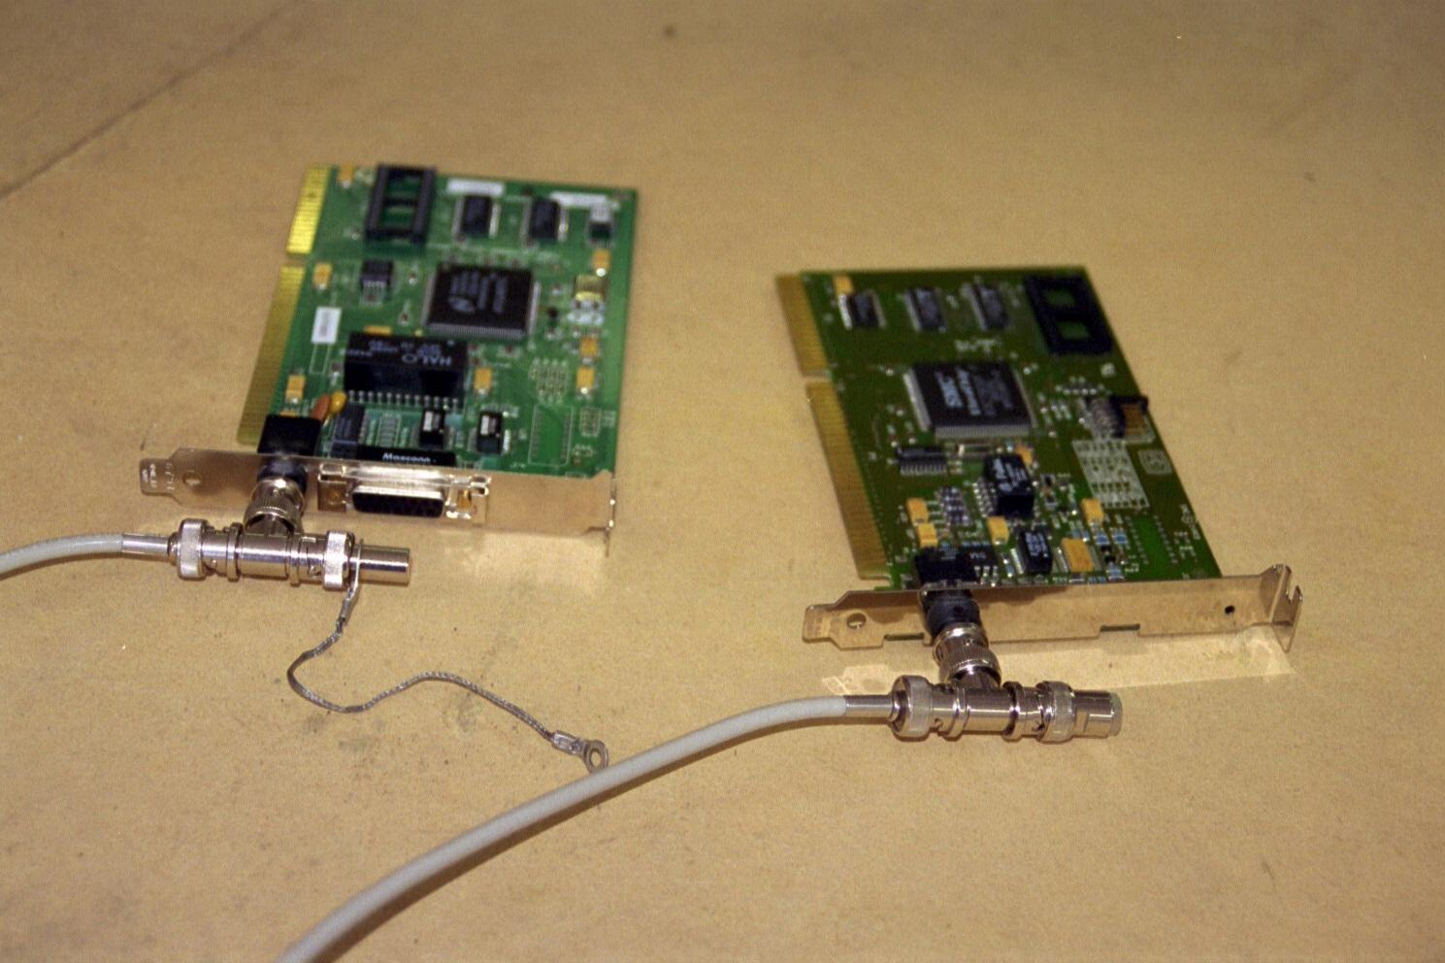
10Base2 Parts

Slide 10
10Base2 Connection

Slide 11
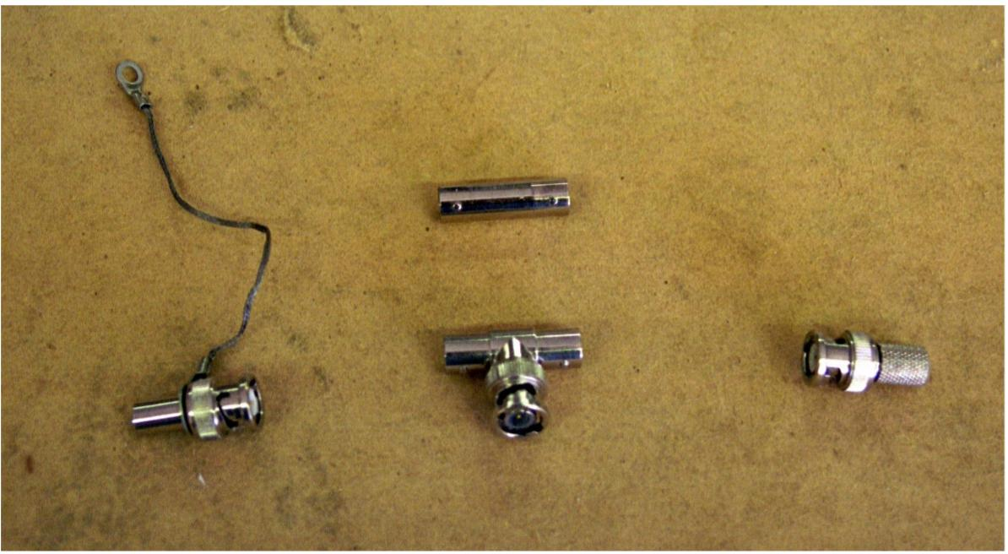
10Base2 Connectors

Slide 12
10Base2 with Ground Wire

Slide 13
10BaseT
As connecting wires together to form one long cable did not scale well a new layout using a central hub and wiring in a star pattern was developed
In its original form it was called 10BaseT

Slide 14
10BaseT

Slide 15
Hubs Appear
As this is the current form of the network let’s look at it more closely
In its first form this central connection point was called a hub
A hub in nerd talk is a multiport repeater
In that anything that appears at a port is sent to all of the other ports whether they need to see it or not

Slide 16
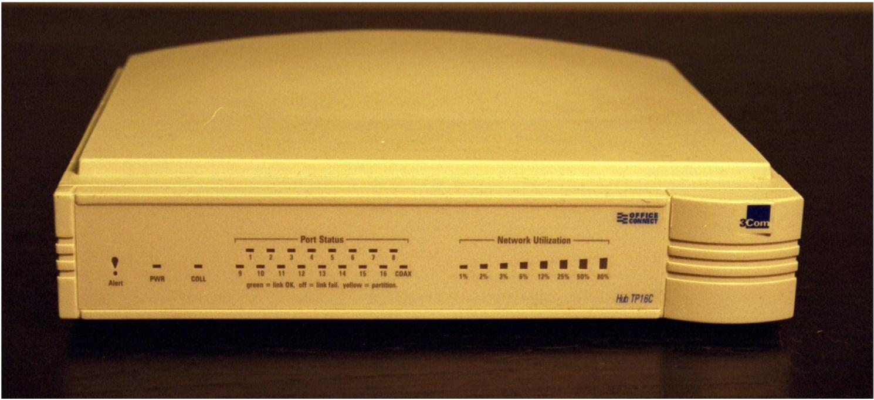
Basic Hub - Front

Slide 17
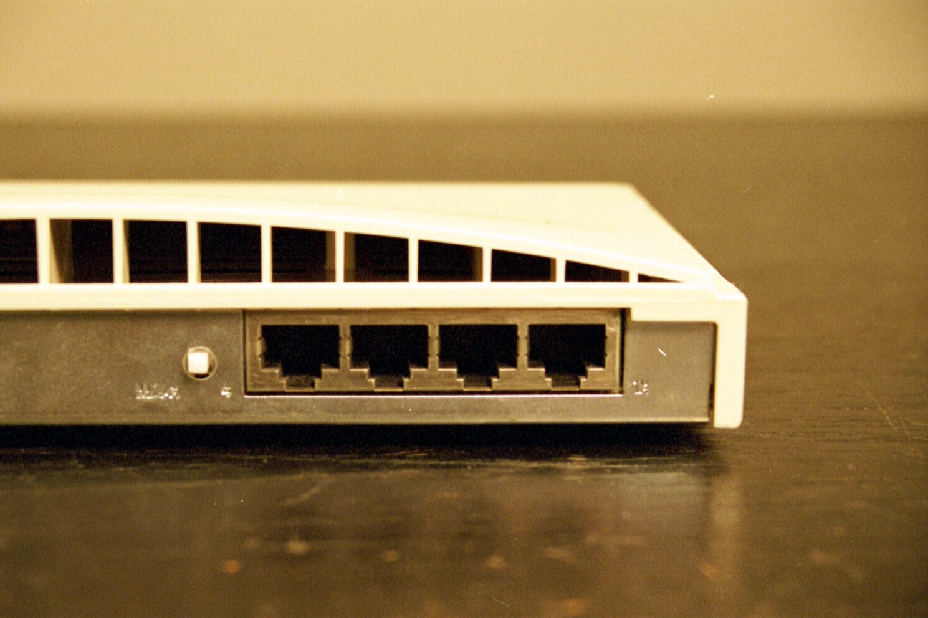
Basic Hub – Back

Slide 18
Characteristics of Hubs
A hub is a layer 1 device, as such it is not very intelligent
It only deals with bits – 1s and 0s
The hub forwards bits from one port to all the other ports
The ports are used to connect devices used on the network
A hub usually has from 2 to 96 ports

Slide 19
RJ-45 Port
RJ-45 Port

Slide 20
Linking Hubs
Hubs can be hooked together in order to increase the number of ports available to the network
There are two ways to do this
Uplink
Stack
These methods are not mutually exclusive

Slide 21
Uplink
When hubs are uplinked, each hub is still a distinct entity
To create an uplink connection between hubs a port from one hub is connected to a port on another hub
One of the ports must be an uplink port
This can be a port that is dedicated to this use

Slide 22
Uplink
Or a normal port can be converted to this by flipping a switch or through a software setting

Slide 23
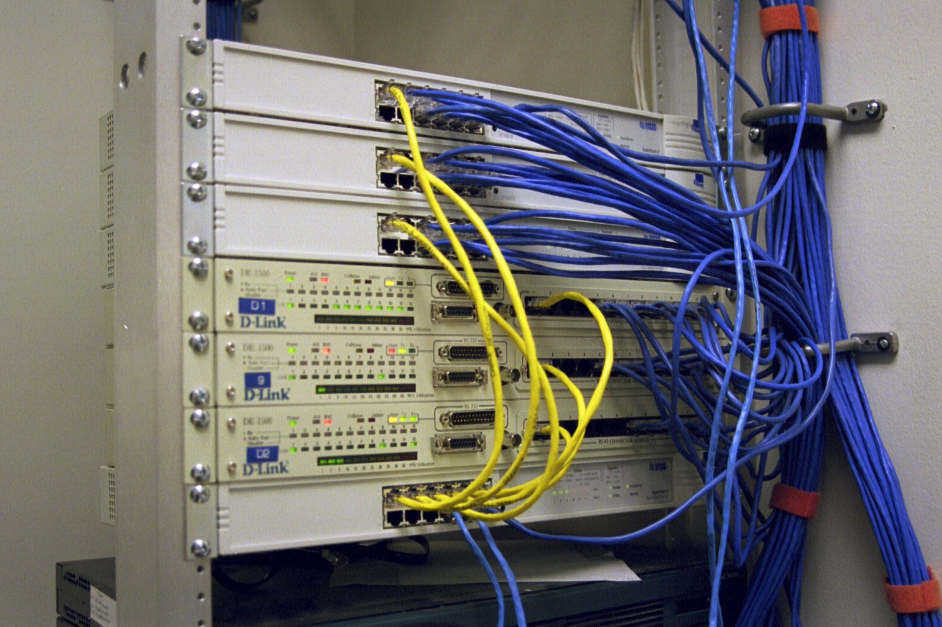
Uplink
The yellow cables are the uplink cables in this example

Slide 24
Uplink

Slide 25
Uplink
Each hub is different, for this one a switch called the MIDI switch is used to tell the hub whether a normal device like a PC is plugged into the port or if it is another hub
This allows you to use normal patch cables instead of crossover cables to uplink the hubs
If there is no MIDI switch, just use a crossover cable

Slide 26
Stacking
When hubs are stacked they become one hub for purposes of management
One logical hub
Usually stacking requires a special proprietary cable
There is a limit to the number of hubs that may be stacked
Normally all must be the same type

Slide 27
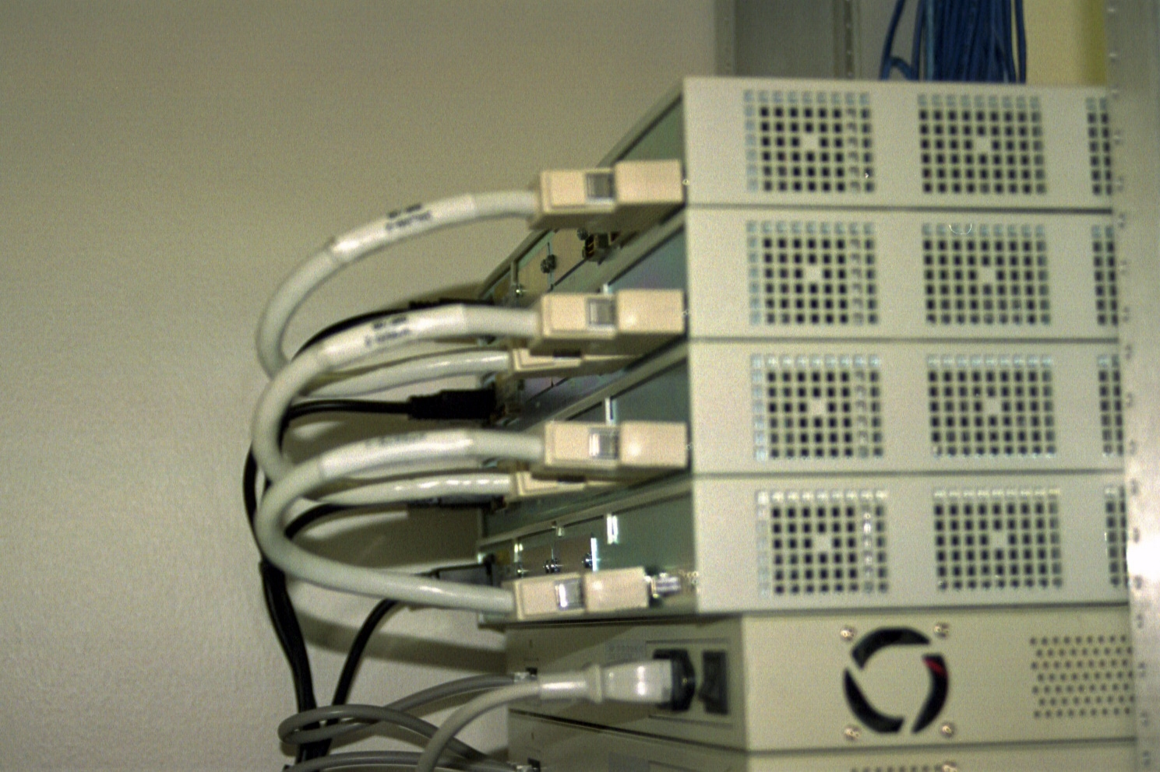
Stacking
Stacking Cables

Slide 28
Stacking

Slide 29
Stacking
In this case starting from the bottom unit attach the UP port on the bottom unit to the DOWN port on the unit just above
Continue on like this for each unit
Up to eight units can be stacked

Slide 30
Speeds
Hubs operate at
10 Mbps
100 Mbps
All ports in a hub must operate at the same speed

Slide 31
Ethernet Hub – Front

Slide 32
Ethernet Hub – Back

Slide 33
Management
A hub can be unmanaged or managed
An unmanaged hub provides no information to the network manager except for whatever may be indicated by lights
Such as
The power is on
A basic connection has been made
Instantaneous utilization of the network

Slide 34
Management
A managed hub provides more information to the network manager through a software program provided by the maker of the hub
Things that are reported include
Port is enabled or disabled
Speed of port
Errors on the port

Slide 35
Management
Management also allows configuration through the software either on site or remotely

Slide 36
Collision Domain
All stations that share a media, such as all stations attached to a hub, are said to be in the same collision domain
This means that they must cooperate in sending messages over the media
Too many stations attempting to use the same media slows or stops the network

Slide 37
Broadcast Domain
Another domain of importance in a local area network is the broadcast domain
In a local area network some messages need to be sent to all devices attached to a network
A broadcast message is used for this purpose
All stations on the shared media pick it up

Slide 38
Broadcast Domain
Only the station it is intended for will process the message, but all will still receive it

Slide 39
What is a Bridge
In the old days, before switches bridges were used to segment LANs
A bridge was used to isolate traffic and thereby collisions by placing a server and most of the workstations needing access to that server all on the same side of the bridge

Slide 40
How a Bridge Operates
Devices on this side of the bridge | List of devices by MAC address | Bridge | List of devices by MAC address | Devices on this side of the bridge

Slide 41
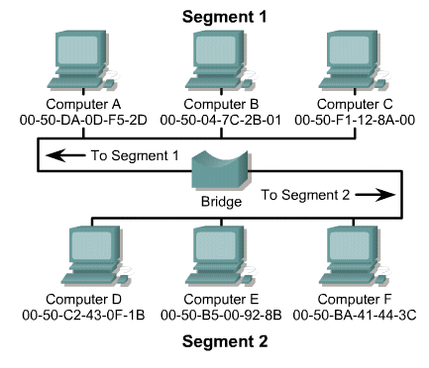
How a Bridge Operates

Slide 42
How a Bridge Operates
An Ethernet bridge connects two or more segments and operates by inspecting all packets on the network for their address
The bridge can receive all packets since it operates in promiscuous mode
This device operates at the MAC sublayer of the Data Link layer

Slide 43
How a Bridge Operates
As each packet is examined by the bridge, the source address is recorded and entered into a table of addresses
This process of observing and recording addresses is referred to as learning
This type of bridging is known as transparent bridging, since the devices that are communicating over the network are not aware of the bridge's existence

Slide 44
How a Bridge Operates
All packets are addressed to the destination address, not the bridge
When the bridge receives a packet, it will look up the destination address in its table
If a match is found, the packet will be discarded since the destination was on the same segment as the source, there is no need to forward the packet to another network

Slide 45
How a Bridge Operates
In essence, the packet has been filtered
If the destination address is not found in the table, the packet will be forwarded to all segments to which the bridge is attached
The process of forwarding to all active ports is referred to as flooding

Slide 46
How a Bridge Operates
When the destination station sends a response to the packet that was just flooded the bridge will then learn the address and the device's location
It will not have to flood the same address twice, since the location will be added to the address table

Slide 47
How a Bridge Operates
Typically, forwarding an unknown packet is a rare occurrence, and the learning process is very brief
Otherwise, the act of flooding packets out of all ports would have a negative effect on surrounding networks
An exception is broadcast packets, which must be sent to all devices
Therefore, broadcast packets will always be flooded onto all active ports

Slide 48
Uses of Bridges
Today, except for wireless and campus area networks, bridges are not used anymore
The bridge of today is called a switch

Slide 49
What is a Switch
Hubs have been replaced by switches
Basically a switch is a multiport bridge
A basic switch is a layer two device

Slide 50
Uplinking and Stacking
Just like hubs switches can be uplinked and stacked

Slide 51
Operation
Switches typically operate at 10, 100, or 1000 Mbps
Each port can be set to its own speed independent of the other ports

Slide 52
Front of Switch

Slide 53
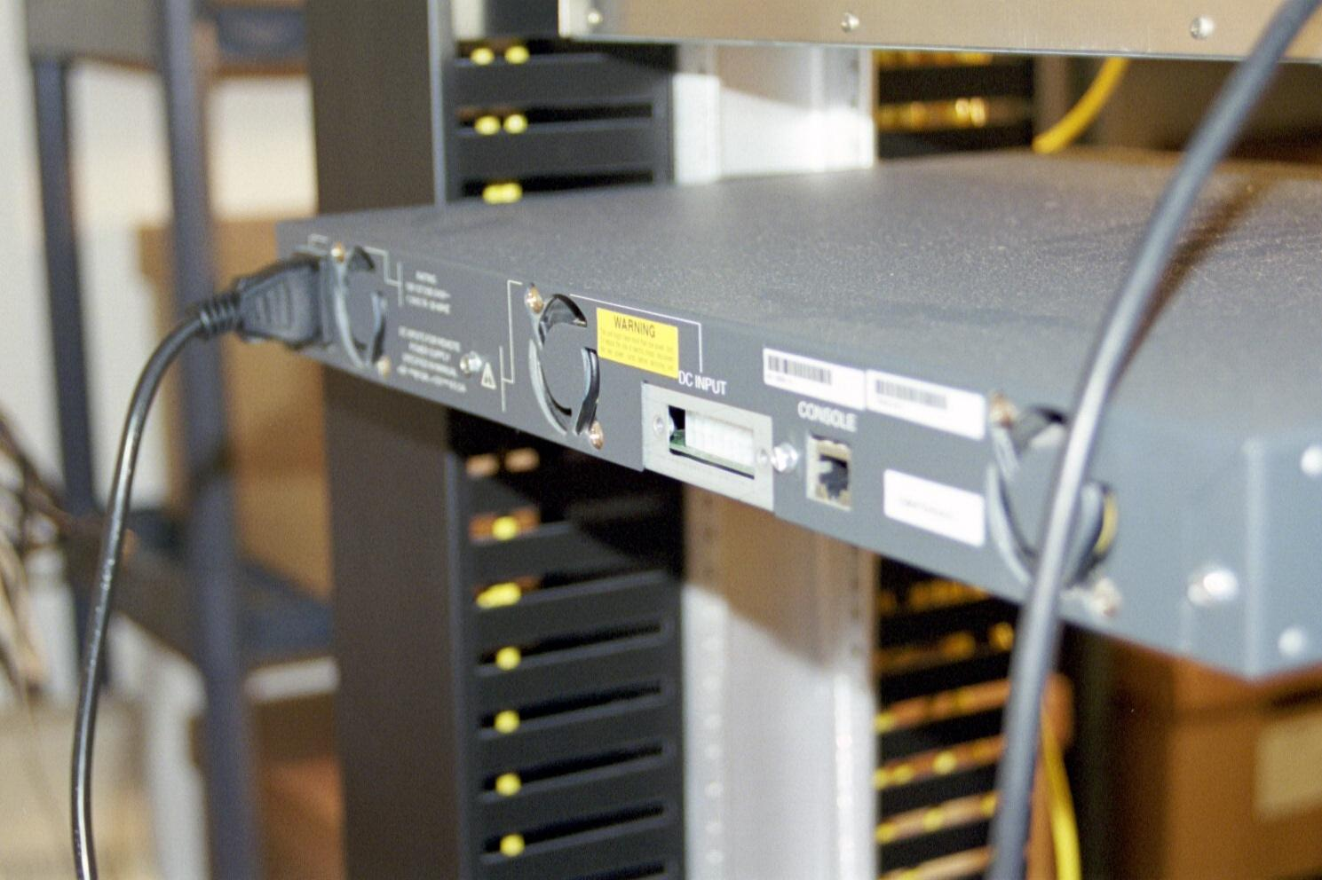
Back of Switch

Slide 54
Larger Switch
The switch just shown is a fixed configuration
There is no way to increase the number of ports without buying another switch
Another larger style of switch uses blades that are inserted into a chassis
Up to the capacity of the chassis, ports can be added by just inserting more blades

Slide 55
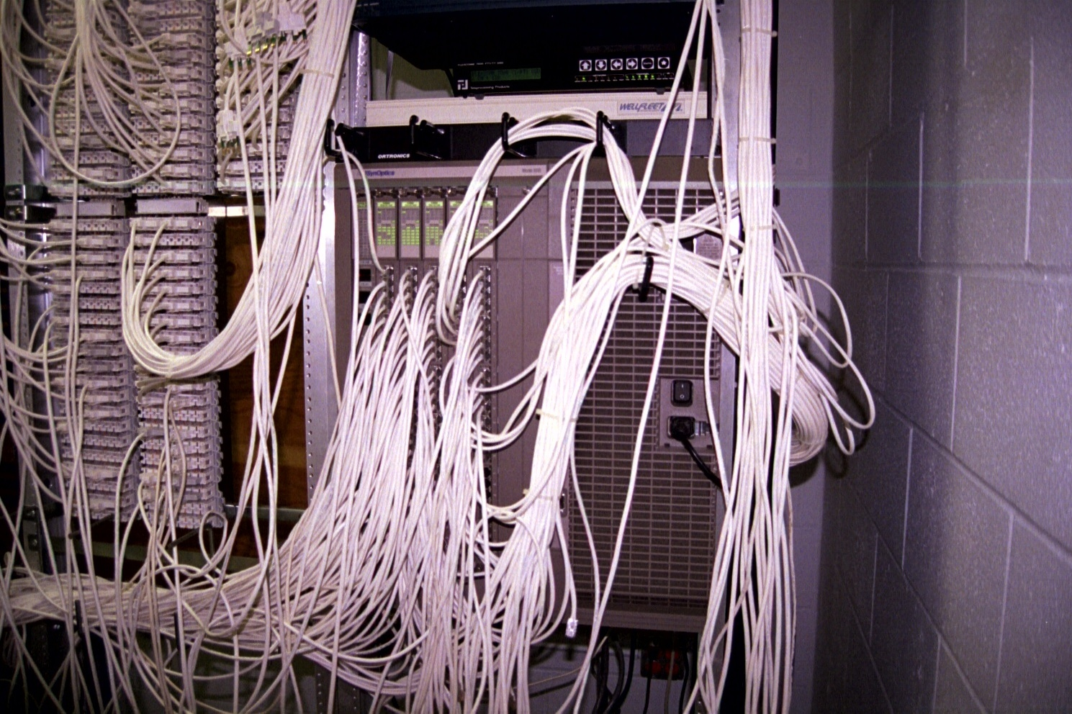
Larger Switch

Slide 56
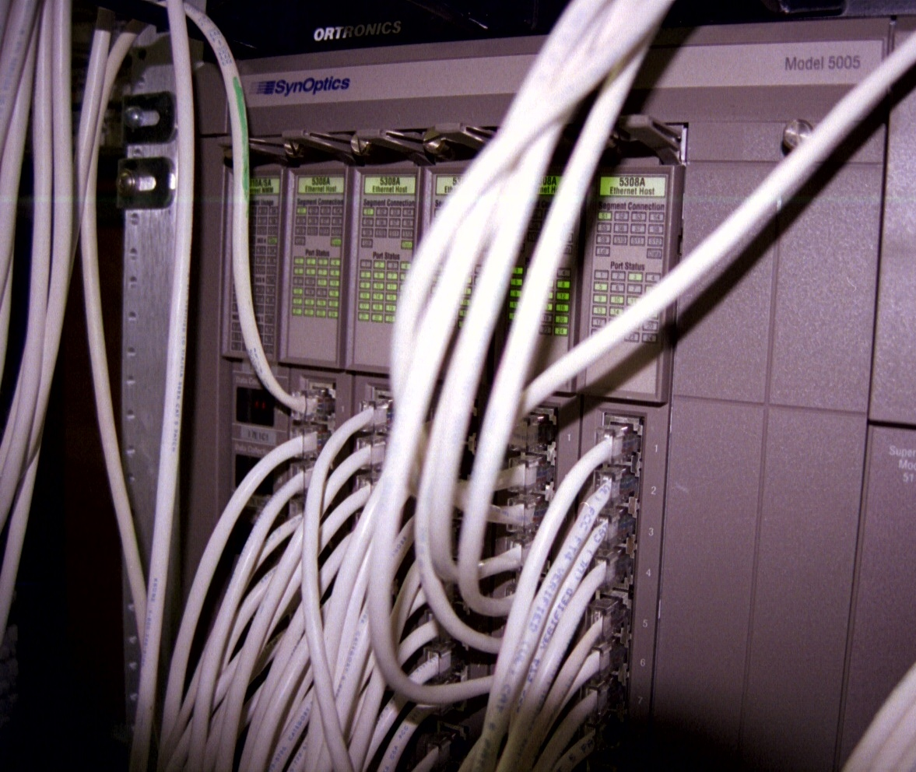
Larger Switch

Slide 57
Management
A switch can be unmanaged or managed
An unmanaged switch provides no information to the network administrator except for whatever lights it might have
These lights may provide an indication of a link to the wire plugged in
In general if the link light on the switch and on the NIC that is attached to that port are both on, then the wiring is probably ok at a basic level at least

Slide 58
Management
Other lights may give an indication of the instantaneous utilization of the network bandwidth
A managed switch will do the above plus collect data on network statistics
What is collected and reported depends on the switch
A program will be provided by the manufacturer of the hub to read and display this information

Slide 59
Management
Common things that can be done with these programs include configure ports, watch utilization, and check for errors
This information is normally collected using SNMP or RMON

Slide 60
Media
Also at the physical layer are the cables used to connect the switch to the end devices
These cables were once coax cables
Now they are UTP copper cables or fiber optic cables
Let’s look at these more closely

Slide 61
Coax Cable
The oldest type of copper cable used in networks is coax or coaxial cable
These days this type of cable is only used in WANs
The only use in WANs is as short run cables to connect high speed data lines, such as a DS3

Slide 62
Coax Cable
A coax cable has four parts
Core
Insulation
Shielding
Cover or Sheath

Slide 63
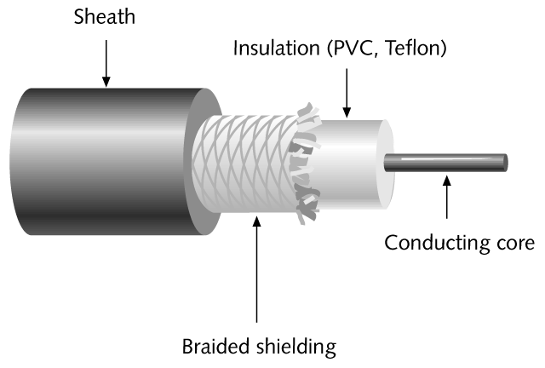
Coax Cable

Slide 64
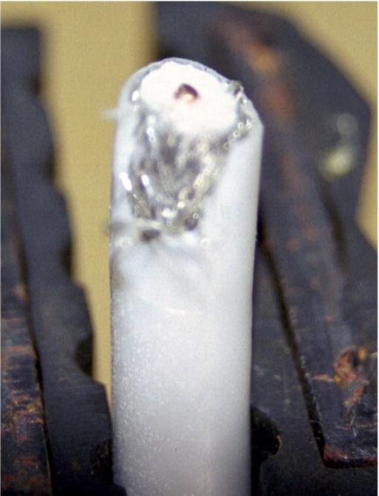
Coax Cable

Slide 65
Coax Connectors
The connectors used with coax cable are the BNC style connectors
As in

Slide 66
BNC Connector

Slide 67
Coax Cable
In the LAN, coax cable is outmoded
If you find it, get rid of it now

Slide 68
UTP
The next type of copper cable seen in LANs and by far the most widely used is UTP – Unshielded Twisted Pair cable
This cable uses 8 insulated color coded copper wires
These 8 wires are in 4 pairs of 2 wires each
Each of the pairs of wires is twisted

Slide 69
UTP
Then all pairs are twisted together
The twists vary among the pairs
There are 2 to 12 twists per foot
No shielding is used in this type of cable
These twists are used to resist interference

Slide 70
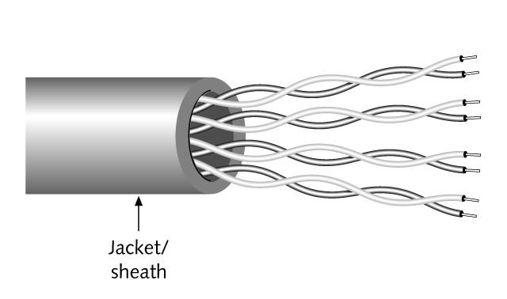
UTP

Slide 71
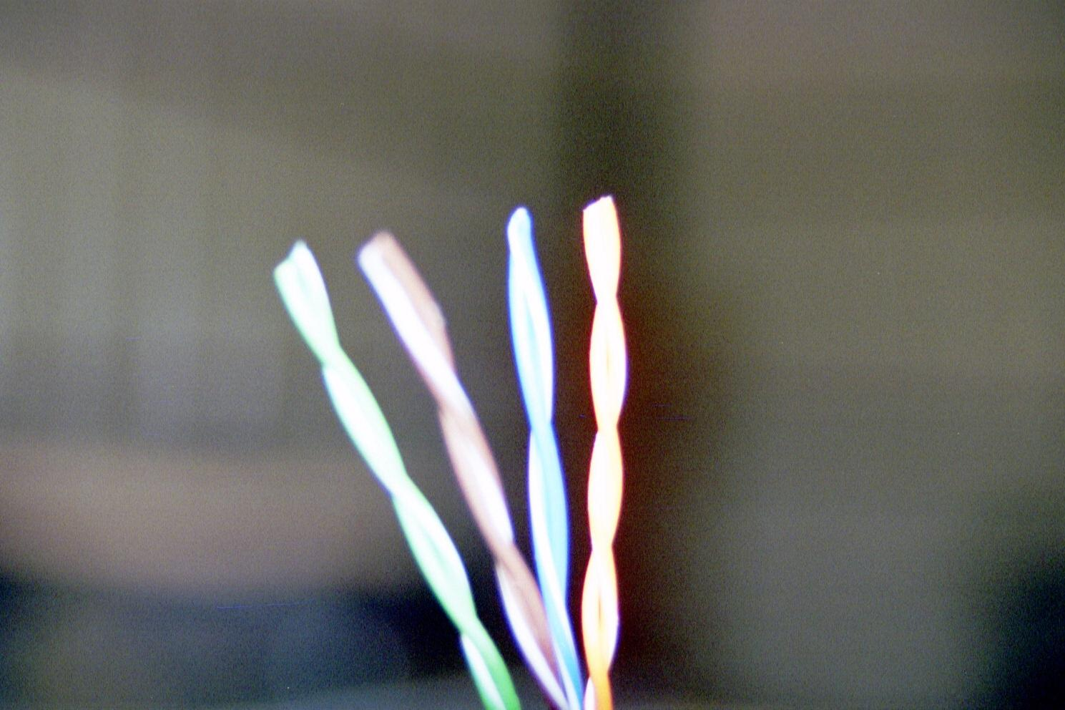
UTP

Slide 72
UTP

Slide 73
UTP
Solid wires are used to connect work areas to the LAN room as stranded wires attenuate faster
Stranded cable is used for patch cables, as it is easier to manage for this use only

Slide 74
UTP Categories
Category | Use | Year
3 | Voice | 1991
5 | Ethernet 100Base | 1994
5E | Ethernet 1000Base | 1999
6 | Ethernet 1000Base | 2002
6 Augmented | Ethernet 10000Base | 2006
7 | Ethernet | Sort of a Standard in Europe

Slide 75
UTP Connectors
In a LAN both ends of a UTP cable are terminated using RJ style connectors
The RJ-45 is used for LANs
The wires are attached using the IDC – Insulation Displacement Connector method

Slide 76
UTP Connectors
This is done with a punch down tool or by crimping with pliers, depending on the style of connector being used
This pushes the wire down into a V groove in the connector
The restriction in the connector cuts through the insulation, thus making the connection

Slide 77
Fiber Optic Cable
Sometimes fiber optic cable is used in LANs
It is always used in larger networks
Fiber optics is a medium for carrying information from point to point using light as the transmission media
This is different from the more common copper cables that use electrical energy to carry the information

Slide 78
Reasons to Use
There are four main reasons to use fiber instead of copper cables
The long distances a fiber cable can run without loss of signal
Resistance to interference
Better security
The carrying capacity of the fiber cable compared to a copper cable

Slide 79
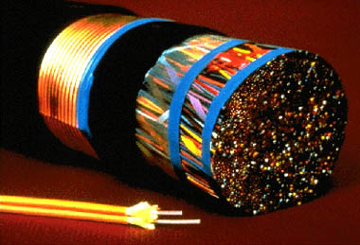
Fiber Compared to Copper

Slide 80
Construction
Optical fiber for telecommunications consists of three components
They are the core, the cladding, and the coating

Slide 81
Construction

Slide 82
Construction
The core is the central region of an optical fiber through which light is transmitted
Glass is the common media for the core

Slide 83
Construction
The cladding is manufactured together with the core as a single piece of silica glass with slightly different compositions, and they cannot be easily separated from one another
The glass does not have a hole in the core, but is completely solid throughout

Slide 84
Construction
The lower refractive index of the cladding acts like a mirror reflecting the signal back into the core as it travels
The third section of an optical fiber is the outer protective coating called the buffer
This coating is typically made of plastic
It provides physical and environmental protection for the fiber

Slide 85
Construction
The outer components of fiber optic cable differ depending on the purpose and application of the cable
Fiber optic cable that is used in telecommunications is typically made of glass
Plastic is used in some very limited cases
This plastic or POF – Polymer Optical Fiber is limited in bandwidth and distance

Slide 86
Operation
The basic method of operation of a fiber optic system starts with a device on the network that takes the electrical energy that travels the normal computer network and translates it into light pulses
A transmitting device then places these signals onto a fiber cable by flashing the light source on and off in the pattern for the signal

Slide 87
Operation
The cable carries the signal to the other end
At the far end a receiver accepts the light pulses
They are then converted back to an electrical signal for use in the computer

Slide 88
Optical Media

Slide 89
NIC
Attached to the other end of the cable is a NIC or Network Interface Card
Every device connected to a network must have one of these in one form or the other

Slide 90
Form of a NIC
In most cases these days the NIC is built in to the motherboard
In some cases the NIC is a separate card that is plugged into the computer’s bus
For most laptops the NIC is also part of the motherboard
If not it uses a PCMCIA Card

Slide 91
Form of a NIC
Some are starting to forget the NIC altogether and use the USB port instead, usually only for home or single PC connections

Slide 92
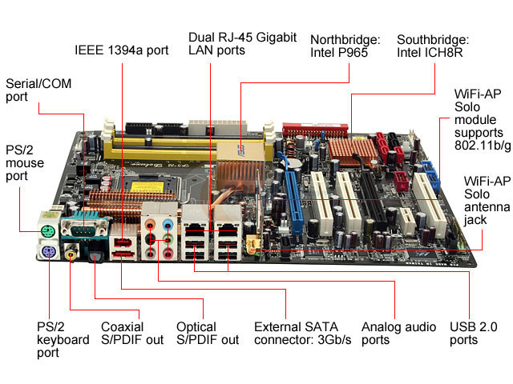
Motherboard NIC

Slide 93
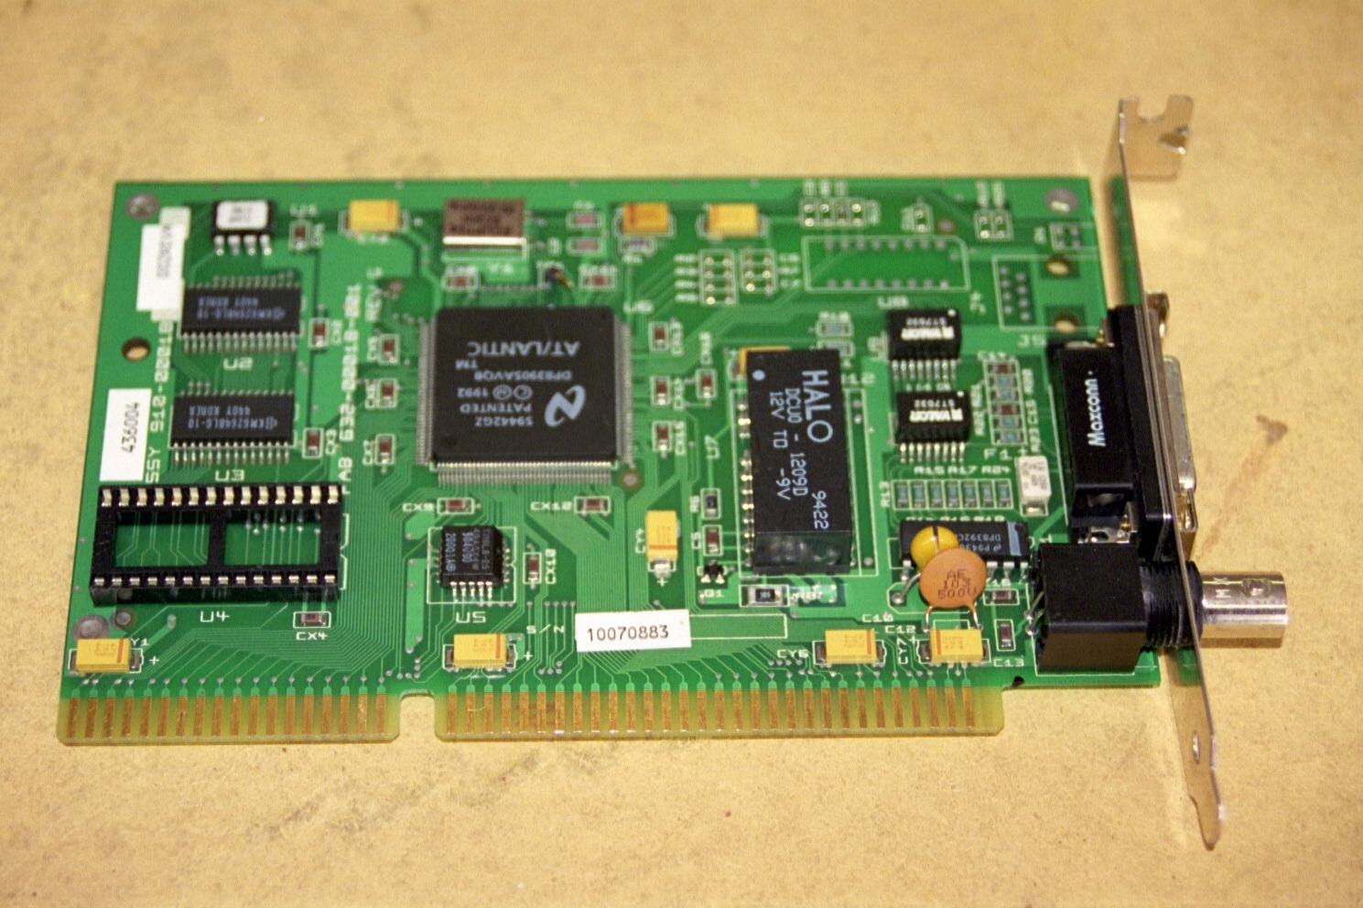
Internal NIC

Slide 94
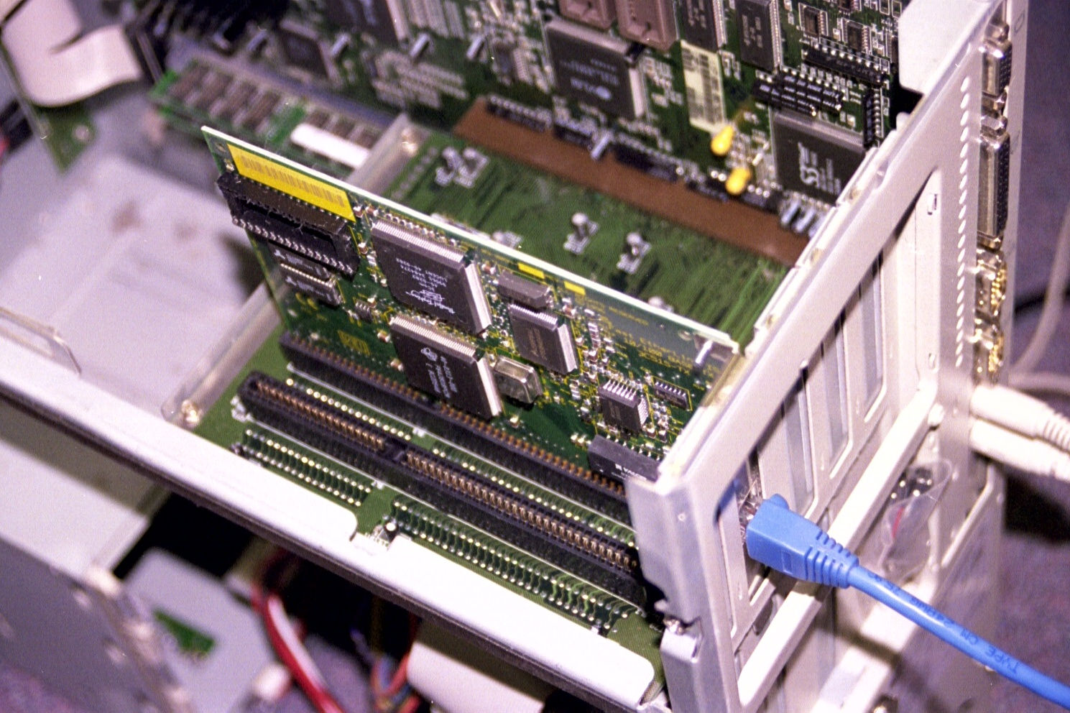
Internal NIC

Slide 95
Laptop NIC

Slide 96
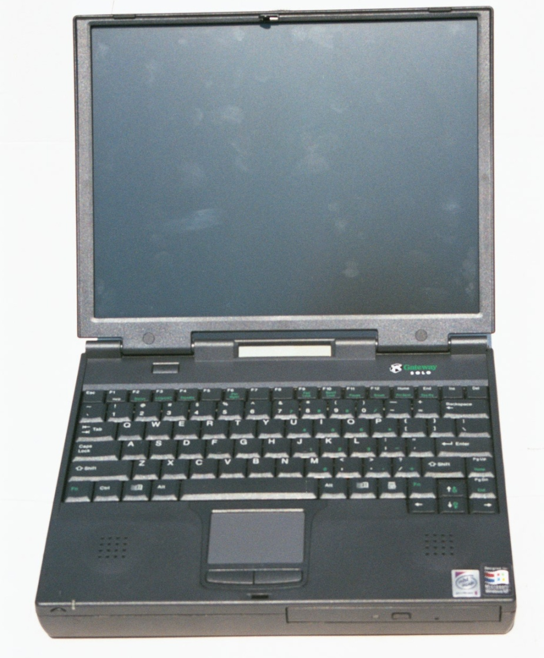
PC Card NIC

Slide 97
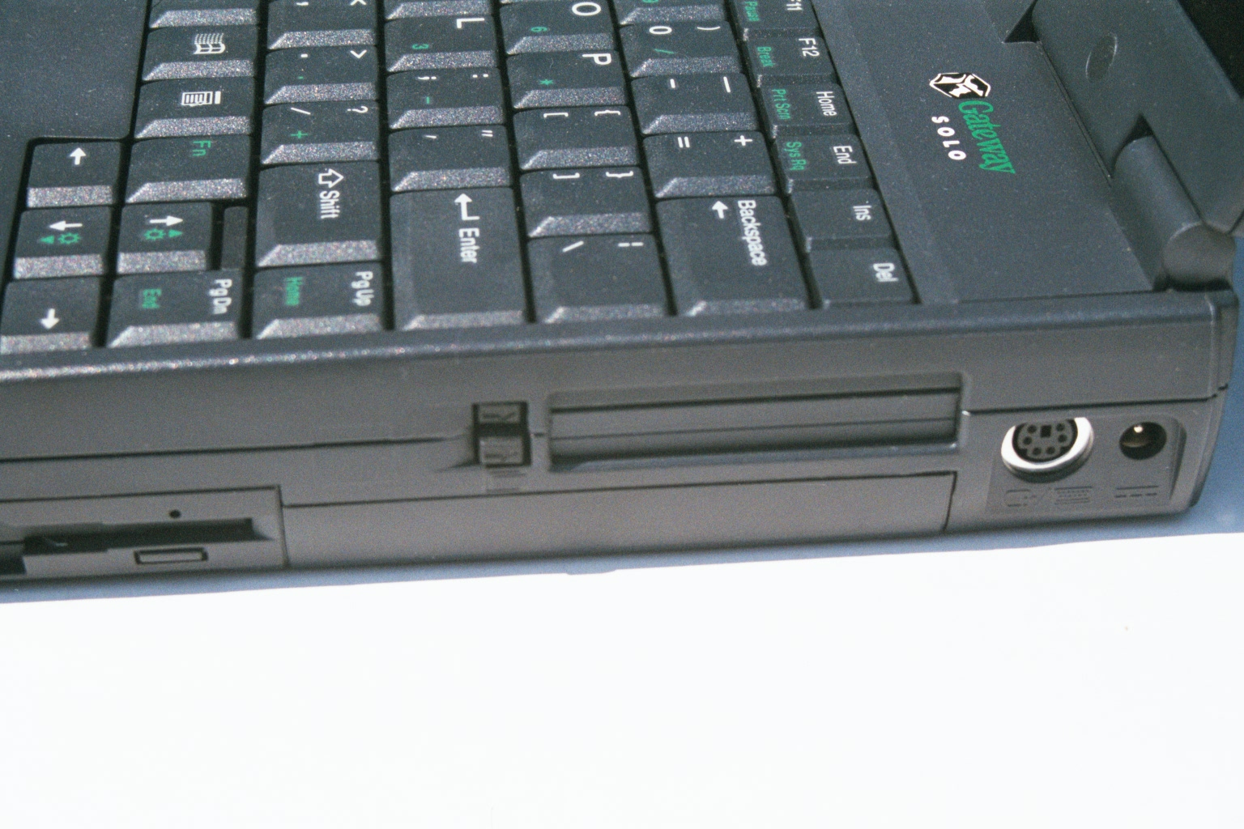
PC Card NIC

Slide 98
PC Card NIC

Slide 99
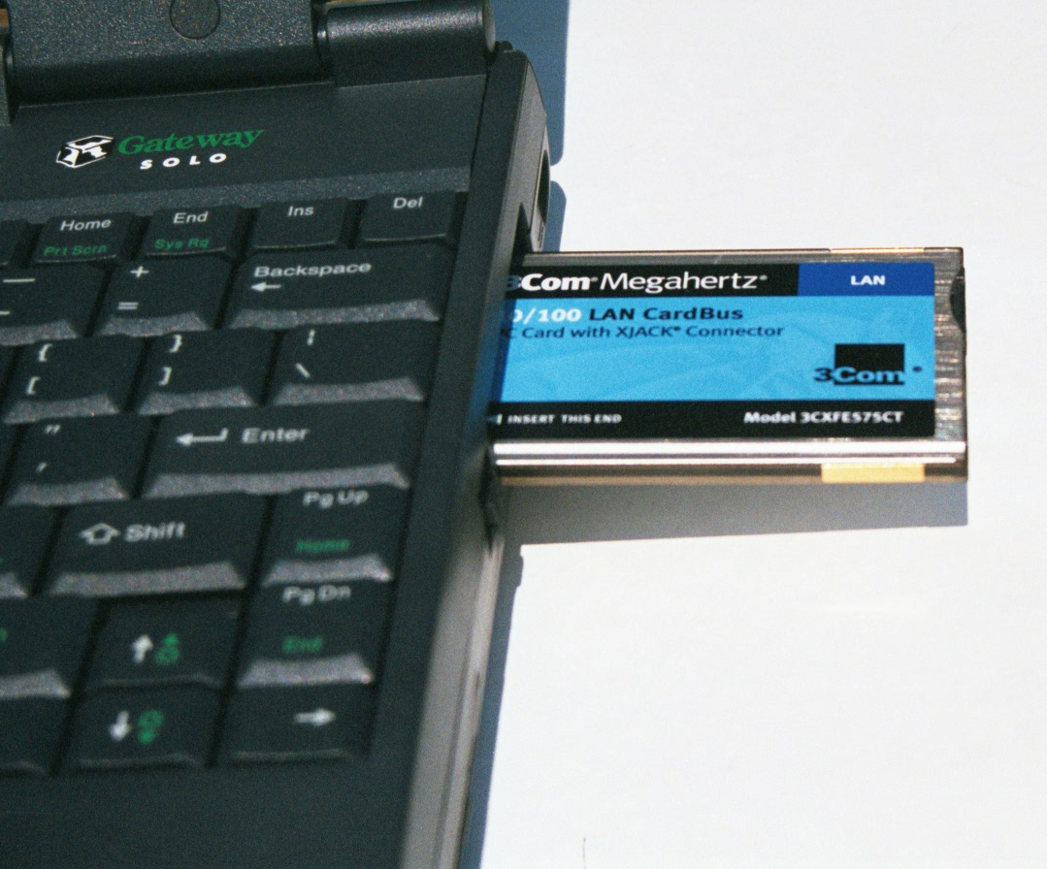
PC Card NIC

Slide 100
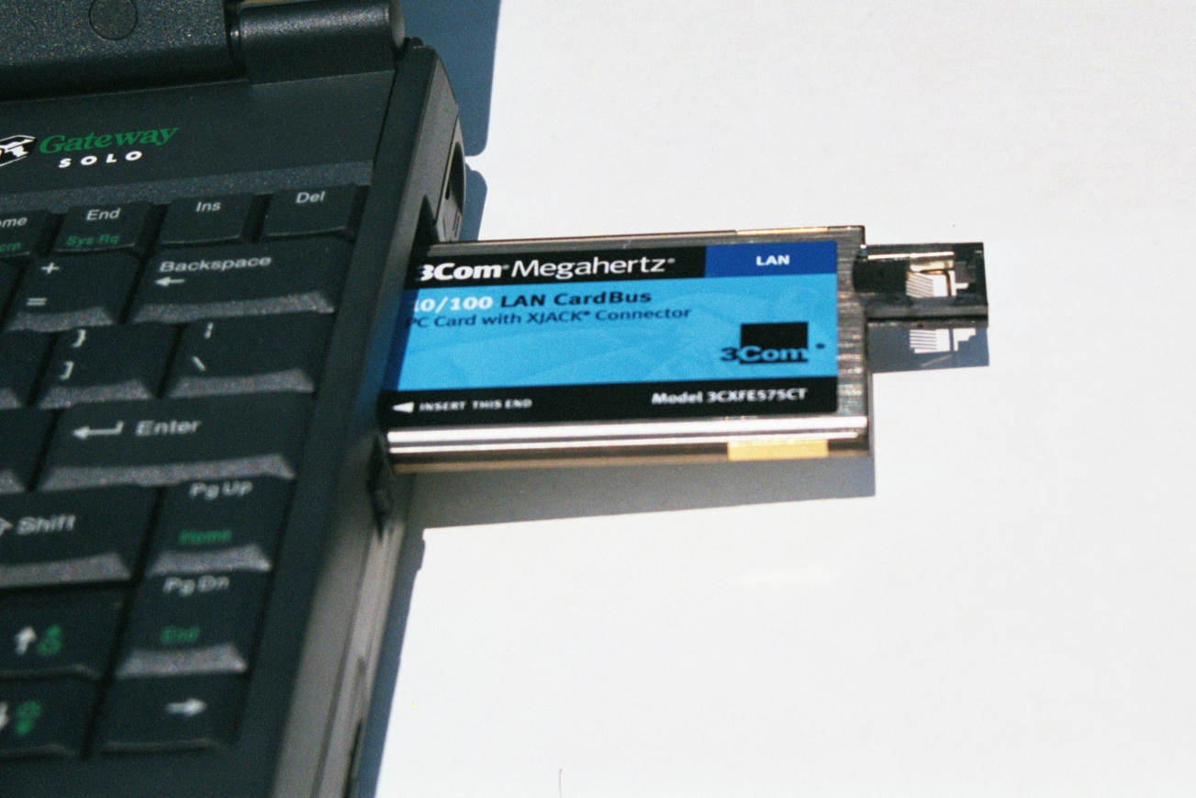
PC Card NIC

Slide 101
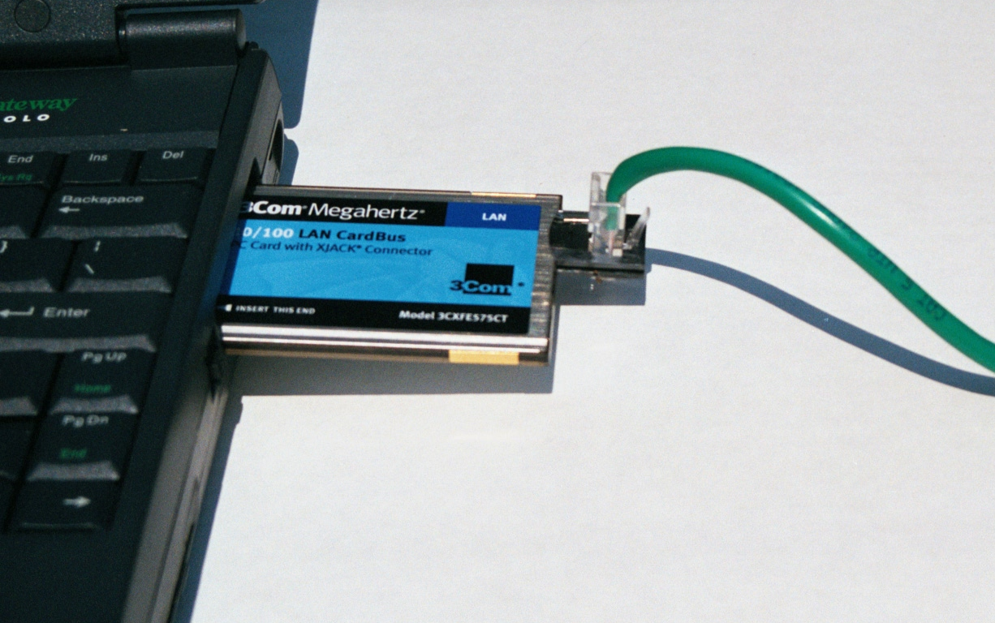
PC Card NIC

Slide 102
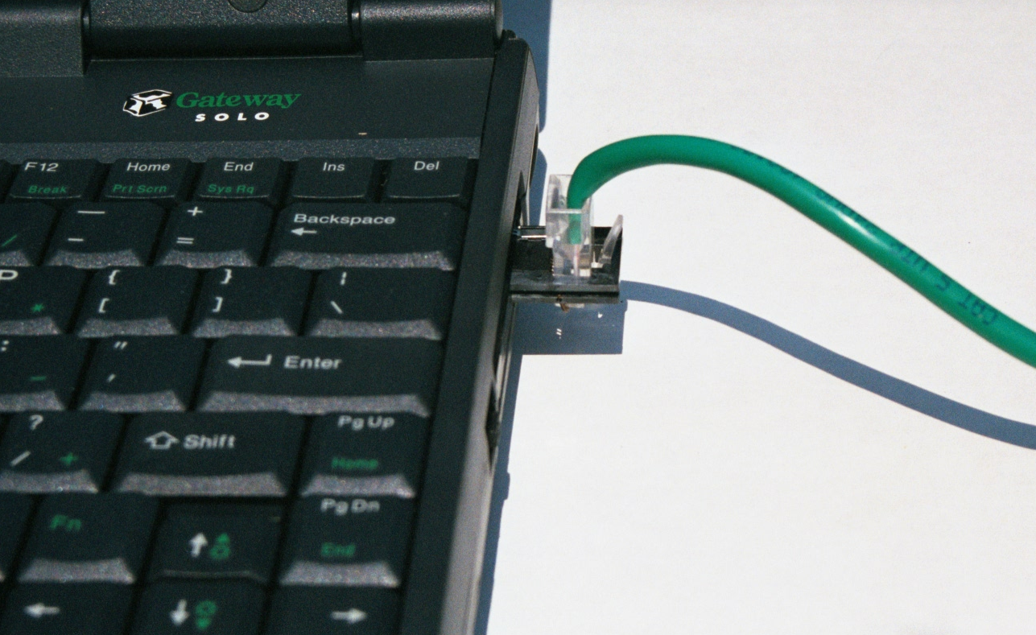
PC Card NIC

Slide 103
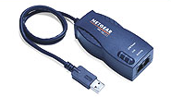
USB Port NIC

Slide 104
NIC Lights
NICs commonly have two lights on them
Link
Activity
The link light indicates a connection of one sort or the other exists between the NIC and the device at the other end of the line, such as a hub or a switch

Slide 105
NIC Lights
The link light is not an absolute indicator, as all wires may not be making a proper connection
The activity light blinks as data is passed from the NIC and the device on the other end

Slide 106
NIC Lights
Link Light
Activity Light
Speed Light

Slide 107
NIC Lights
There may also be a speed indication light, such as is shown on the NIC above
In this case it lights when the speed is 100 Mbps
It is off when the speed is 10 Mbps

Slide 108
Other NIC Related Aspects
When buying a NIC there are several considerations that may or may not be important depending on the usage of the device and the load on the network
Performance improvements include
Bus Mastering
This allows the NIC to control the bus without bothering the CPU

Slide 109
Other NIC Related Aspects
RAM Buffering
This provides a place to store packets while they await processing
So they are not dropped and have to be resent

Slide 110
Other NIC Related Aspects
Wake on LAN or WoL
This capability allows a management program to turn on a computer that has been turned off, but is still plugged into a wall outlet and the LAN
This allows management tasks to be performed while the computer is not being used, such as software installations, upgrades, backups, and virus scans
The NIC and the PC must both support this

Slide 111
Other NIC Related Aspects
It works by having the NIC continuously monitor the network connection
When a wakeup packet arrives it alerts the motherboard, that then powers up the system

Slide 112
Other NIC Related Aspects
PXE – Preboot Execution Environment
PXE allows management software to load and execute before the operating system boot loader takes control of the CPU
When using PXE the NIC can be a boot device just like the hard drive
This works by the PXE on the NIC contacting a server

Slide 113
Other NIC Related Aspects
The server sends a boot image back to the workstation that the workstation uses to configure and boot the workstation

Slide 114
Other NIC Related Aspects
Multiple Ports
This is a special kind of NIC that has two or more ports built into a single card
This is for load balancing or aggregation

Slide 115
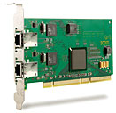
Other NIC Related Aspects

