Slide 1
The OSI and TCP/IP Models
Last Update 2009.06.29
1.0.0

Slide 2
What is the OSI Model
The OSI – Open System Interconnection model is mentioned constantly
It is used to classify and clarify the function of the hardware and software used in all types of computer networks
But even more important

Slide 3
Why Are We Discussing This
All the books and articles mention it
Vendors use it in their sales pitches
It makes the process of understanding how data flows in a network easier to understand
Everyone else had to learn it, so you do to

Slide 4
Background
The OSI model was developed in 1984 to
List the general functions that must be performed by a protocol stack or individual protocol
Break the complexity into manageable sublayers
Standardize interfaces to enable ease of interoperability
Ease troubleshooting by limiting what needs to be examined

Slide 5
OSI Model Layers
This model and others along the same lines use the concept of layers
Each layer is a definable function required for the whole to operate
Each layer handles one function
Each layer operates by itself, but requires all of the other layers to carry out the entire function

Slide 6
OSI Model Layers
A layer on the receiving end receives exactly what was sent by the same layer on the sending end

Slide 7
OSI Model Layers
Layer 7 - Application
Layer 6 - Presentation
Layer 5 - Session
Layer 4 - Transport
Layer 3 - Network
Layer 2 - Data Link
Layer 1 - Physical

Slide 8
Application Layer
Provides services to applications

Slide 9
Presentation Layer
Formats and converts data

Slide 10
Session Layer
Manages the communications session
For example, one physical wire; yet two data flows on this single wire

Slide 11
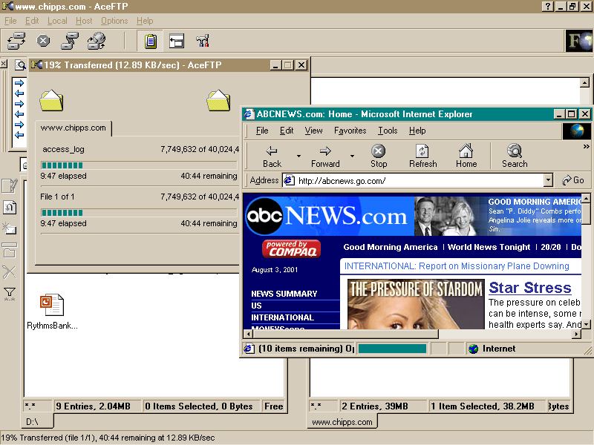
Session Layer

Slide 12
Session Layer
In this case a file is being downloaded using ftp and a web page is being loaded using http

Slide 13
Transport Layer
Manages flow across the network

Slide 14
Network Layer
Manages addressing

Slide 15
Data Link Layer
Provides reliable transmission over the physical media

Slide 16
Physical Layer
Puts the bits on the media

Slide 17
OSI Layers

Slide 18
OSI Layers

Slide 19
OSI Layers

Slide 20
OSI Layers

Slide 21
OSI Layers

Slide 22
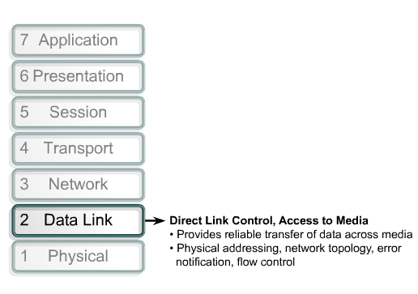
OSI Layers
Provides connectivity and path selection between two host
Provides Logical address
No error correction, best effort delivery.

Slide 23
OSI Layers

Slide 24
How Do You Remember This
Away
Pizza
Sausage
Throw
Not
Do
Please

Slide 25
Data Link Layer Subdivision
The Data Link layer can be subdivided into two sublayers
LLC – Logical Link Control
MAC – Media Access Control
This was done by the IEEE 802 committees to further isolate the functions that must be performed at the Data Link layer

Slide 26
Data Link Layer Subdivision
LLC Sublayer
This layer is defined by a single IEEE protocol called 802.2 or LLC – Logical Link Control
This layer isolates the upper layers from the details of the lower layers

Slide 27
Data Link Layer Subdivision
MAC Sublayer
This layer describes how the media is to be accessed and used by devices connected on the same segment
These are the network access methods, such as
Ethernet – 802.3
Token Ring – 802.5
This is also where the physical or MAC address assigned to each NIC is defined

Slide 28
Data Link to Network Layer
Above the LLC sublayer is the 802.1 High Level Interface

Slide 29
Data Flow
An important aspect addressed by the OSI model is how data flows in a network
As seen below, data flows
Down the stack
Across the media
Up the stack
It does not matter if it starts on the left or right side

Slide 30
Peer-to-Peer Communication

Slide 31
TCP/IP Model

Slide 32
Process of Encapsulation

Slide 33
Process of Encapsulation
As data flows in a network up and down using the layers as defined by the OSI model a process called encapsulation occurs
In this process control information is added or removed
It is added as the data moves into the top of the model and proceeds downward to the bottom

Slide 34
Process of Encapsulation
At the receiving end this control information is removed as the data proceeds up the layers of the OSI model to pop out the top
This control information is called a header
Each header is divided into fields
The fields carry the information needed to provide the control

Slide 35
Process of Encapsulation
Let’s look at a sample header to illustrate this
This header is shown in the format displayed by a network analyzer
A network analyzer is a common tool used to look at the layers for troubleshooting and optimization of networks

Slide 36
Process of Encapsulation
In this first screenshot the frame to be examined is shown in the context of all of the other frames traveling over the network
Some of these other frames are related to the one we will look at in detail, others are carrying on other conversations over the same network

Slide 37
Process of Encapsulation

Slide 38
Process of Encapsulation
First the layers used in this conversation are collapsed so that we can see each layer involved

Slide 39
Process of Encapsulation

Slide 40
Process of Encapsulation
In this example we see four layers listed, DLC, IP, TCP, HTTP
Actually as the network analyzer displays it we see one layer and three protocols, but these three protocols exist at the distinct layers as we are discussing here

Slide 41
Process of Encapsulation
These are
DLC – Data Link
IP – Network
TCP – Transport
HTTP – Session/Presentation/Application

Slide 42
Process of Encapsulation
Notice that only four of the seven layers are shown
The physical layer is not shown as there is no frame structure to decode at that level
A network analyzer only deals with a structured data flow
The top three layers of the OSI model are shown as one layer

Slide 43
Process of Encapsulation
This is common as most real protocol stacks, such as TCP/IP, as opposed to the model as represented by the OSI model collapse the top three OSI layers into one

Slide 44
Process of Encapsulation
Now let’s look at the fields in one of the layers
In this case the network layer and the IP protocol

Slide 45
Process of Encapsulation

Slide 46
Process of Encapsulation
As you can see there are several fields in the IP header at the network layer
Let’s just detail two of these
These two are the source and destination addresses
The source address is
64.236.24.20
The destination address is
192.168.1.3

Slide 47
Process of Encapsulation
The data being carried by this frame came from 64.236.24.20, which is www.cnn.com
The data was sent to the computer using IP address 192.168.1.3, which is the local computer where this PowerPoint presentation is being created

Slide 48
Process of Encapsulation
So what is the point to all of this complication
It is to send the important stuff, the data, from one place to another
In the example detailed above, the data was a web page sent from CNN to me, because I asked for it

Slide 49
Process of Encapsulation
The fields in these headers that are added at each layer of the OSI model are what is used by all of the devices on all of the networks between CNN and me to deliver the information I asked for
The last part of this process of encapsulation is the error checking that must be done

Slide 50
Process of Encapsulation
As the Data Link layer is the one that is concerned with getting the data from one point to another in its journey from Point A to Point B, this is the layer where the trailer is attached
As might be deduced from the name, the trailer goes at the end of the frame
HEADER | DATA | TRAILER

Slide 51
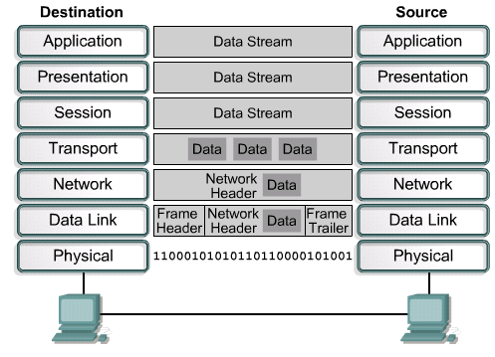
Encapsulation

Slide 52
What To Call This Stuff
As data flows down the stack the name given to it changes
The general name used is PDU – Protocol Data Unit
The exact name changes with each layer
Application/Presentation/Session Layer
User information converted to data or some say a message

Slide 53
What To Call This Stuff
Transport Layer
Data or message converted to segments if TCP is used
Otherwise, in order to confuse us, when UDP is used it is called a datagram
Network Layer
Segments converted to datagrams
Then if the datagrams are fragmented, which they usually are, they are called packets

Slide 54
What To Call This Stuff
Data Link Layer
Datagrams or packets converted to frames
Physical Layer
Frames are converted to bits
Most of these terms are used interchangeably
There is very little consistency in their use

Slide 55
What To Call This Stuff
But in general
A frame is an information unit whose source and destination are data link entities
A datagram or packet is an information unit whose source and destination are network layer entities
But if you want to go to the source to see for yourself read RFC 1122 and its successor RFC 1349

Slide 56
What To Call This Stuff
As RFC 1122 says
Segment
A segment is the unit of end-to-end transmission in the TCP protocol
A segment consists of a TCP header followed by application data
A segment is transmitted by encapsulation inside an IP datagram

Slide 57
Encapsulation
Message
In this description of the lower-layer protocols, a message is the unit of transmission in a transport layer protocol
In particular, a TCP segment is a message
A message consists of a transport protocol header followed by application protocol data
To be transmitted end-to-end through the Internet, a message must be encapsulated inside a datagram

Slide 58
Encapsulation
IP Datagram
An IP datagram is the unit of end-to-end transmission in the IP protocol
An IP datagram consists of an IP header followed by transport layer data, i.e., of an IP header followed by a message
In the description of the internet layer (Section 3), the unqualified term "datagram" should be understood to refer to an IP datagram

Slide 59
Encapsulation
Packet
A packet is the unit of data passed across the interface between the internet layer and the link layer
It includes an IP header and data
A packet may be a complete IP datagram or a fragment of an IP datagram
Frame
A frame is the unit of transmission in a link layer protocol, and consists of a link-layer header followed by a packet.

Slide 60
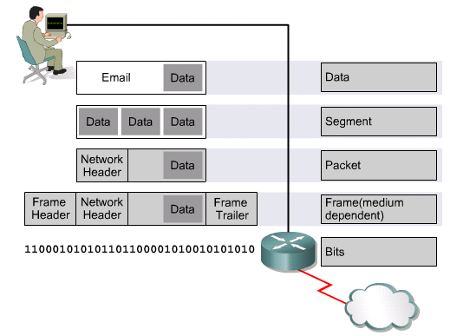
Names for Data at Each Layer

