Slide 1
Network Addressing Last Update 2011.03.21 1.2.0

Slide 2
Objectives of This Section
Learn how network addressing is done

Slide 3
Network Layer Address
A network layer address provides the globally accepted method used to identify an entity at the network layer
Network addresses usually exist within a hierarchical address space and sometimes are called virtual or logical addresses since they are temporary addresses
When TCP/IP is the routed protocol being used these addresses are IP addresses

Slide 4
IP Addresses
An IP address has two functions
First, indicate where in the internetwork a computer is located
In other words, in what particular network in this internetwork is an individual host located
Second, identify a device or more accurately an interface on a device on that network
For example

Slide 5
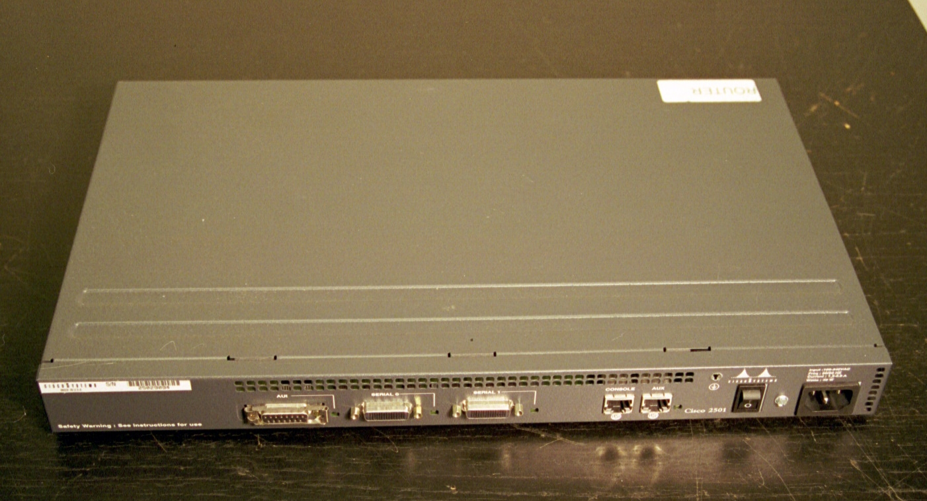
Entry Points

Slide 6
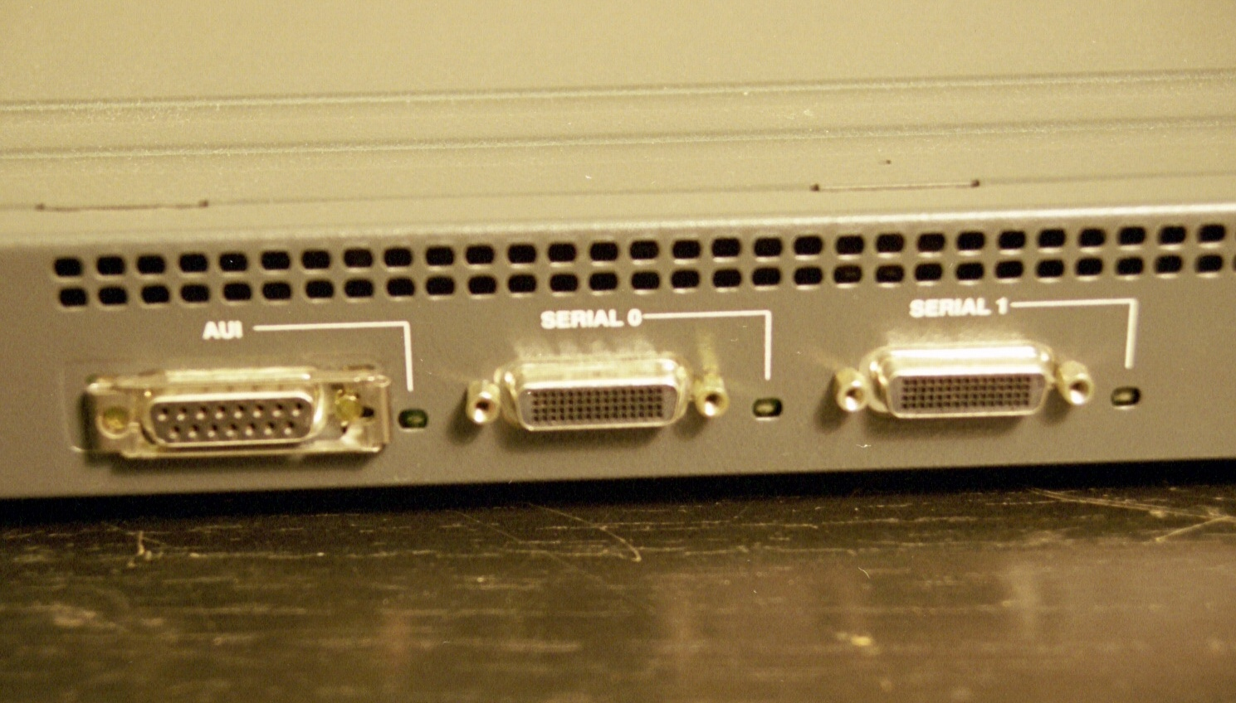
Entry Points

Slide 7
Entry Points
In the example above there is one device, the router, but three interfaces
And therefore it requires three IP addresses
Indeed it requires three distinct network addresses as well
One interface – AUI – points to an inside or LAN connection

Slide 8
Entry Points
The other two – Serial 0 and 1 – point to outside or WAN connections in this case
What do these network addresses look like

Slide 9
Form of an IP Address
In the TCP/IP scheme a single 32 bit address is assigned to each host or more properly each interface or entry point to the internetwork
This address is in two parts
Network
Host
NETWORK | HOST

Slide 10
Network v Host
For any device to separate the network portion of the IP address from the host portion another piece of information is required
This is the subnet mask
The subnet mask is used to identify to the layer 3 devices what part of the address is the network and what part is the end point or host

Slide 11
Network v Host
The layer 3 device is only concerned with delivering the packet to the final network
So each layer 3 device applies the subnet mask to the entire destination address of the packet

Slide 12
Network v Host
Where the subnet mask, when converted to binary, stops, when viewed from left to right, the layer 3 device knows the part of the IP destination address that represents the network and what part the host
The layer 3 device then determines if one of its directly attached networks has that network address
If it does, then the packet has arrived

Slide 13
Network v Host
If it does not, then the layer 3 device sends the packet on to another layer 3 device
For example, assume the following
IP address 168.35.2.23 with a subnet mask of 255.255.255.0
Where does the network part of the 168.35.2.23 address stop and the host part begin

Slide 14
Network v Host
To determine this convert the subnet mask to binary
In this case 255.255.255.0 converts to 11111111.11111111.11111111.00000000
Without even converting the IP address to binary we can see that the first three octets in this example belong to the network part of the IP address of 168.35.2.23

Slide 15
Network v Host
So the network in this example is 168.35.2
The final step is for the layer 3 device to deliver the data in this packet to the device on the LAN that is named 23, in this example
As we have seen this is done by the layer 3 device using the ARP protocol to ask who on the 168.35.2 network is named 23

Slide 16
Network v Host
23 answers back to the layer 3 device with its MAC address
The layer 3 device then takes the data out of the packet, turns it into a frame, and using the MAC address sends it out onto the LAN for final delivery to 23 using the MAC address of 23 for delivery

Slide 17
Notation
The notation of the address refers to how IP addresses are written
These addresses are 32 bits or 4 octets long
The 32 bits are divided into four groups of eight bits each
Each part of the address is separated by a dot

Slide 18
Notation
Being in binary this means there are 2 to the 32nd possible addresses

Slide 19
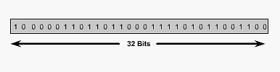
IP Addressing Format

Slide 20
Notation
That is 4,294,967,295 possible addresses
An IP address looks like this
In decimal
145.10.34.3
In binary
10010001.00001010. 00100010.00000011

Slide 21
Progression of Addressing
Next we will discuss each of the methods that have been and are now being used to handle addressing in TCP/IP internetworks
In the very beginning back in January of 1980 an address was just an address
The first part was the network and the last part was the host
Soon this gave way to the same form for the address but divided by classes

Slide 22
Progression of Addressing
As will be seen classful addressing soon proved to be much too limiting
Let’s now go through each of the kludges that have been applied to IP addressing from the beginning to the present to deal with these limitations

Slide 23
Progression of Addressing
The methods in order include
RFC 760 Form
Classful Addressing
Fixed Length Subnetting
CIDR
Private Address Space
NAT
At present a combination is used
CIDR with NAT and Private Address Space

Slide 24
First Form of an IP Address
Where did IP addresses come from
Long ago and far away - I say this since they were invented in California which is certainly far away from Texas, at least in a cultural sense - the first form of an IP address was developed in January 1980
An IP address in its original form looked like this
network.host.host.host

Slide 25
First Form of an IP Address
Just an address that indicates a network and a host on that network
As RFC 760 says
Addresses are fixed length of four octets (32 bits)
An address begins with a one octet network number, followed by a three octet local address
This three octet field is called the "rest" field

Slide 26
First Form of an IP Address
Source Address: 32 bits The source address
The first octet is the Source Network, and the following three octets are the Source Local Address
Destination Address: 32 bits The destination address
The first octet is the Destination Network, and the following three octets are the Destination Local Address

Slide 27
First Form of an IP Address
Recall that when IP addressing was first defined in January 1980 in RFC 760 an address was simple, just
network.host.host.host
Our life would be so simple if the assumption made in 1980 had been correct
The assumption was that the world as we knew it then would never change

Slide 28
First Form of an IP Address
The world in 1980 was one of a very, very few networks; each one with many hosts
So the form of network.host.host.host worked very well
It produces 256 networks with 16,777,216 hosts each
Unfortunately that world soon ended

Slide 29
First Form of an IP Address
It was replaced by one with many networks; each one with only a few hosts

Slide 30
Classful Addressing
So in September 1981 RFC 791 introduced classful addressing
As RFC 791 says
Addresses are fixed length of four octets (32 bits)
An address begins with a network number, followed by local address (called the "rest" field)

Slide 31
Classful Addressing
There are three formats or classes of internet addresses: in class a, the high order bit is zero, the next 7 bits are the network, and the last 24 bits are the local address; in class b, the high order two bits are one-zero, the next 14 bits are the network and the last 16 bits are the local address; in class c, the high order three bits are one-one-zero, the next 21 bits are the network and the last 8 bits are the local address

Slide 32
Classful Addressing
Let’s look at classful addressing as it once existed

Slide 33
Classful Addressing
Class A
Was for large companies with many hosts
Of which there would be few
126 networks each with 16,774,216 hosts
Class B
For medium size companies
16,384 networks each with 65,535 hosts
Class C
For small companies with few hosts
Of which there would be many
2,097,152 networks each with 254 hosts

Slide 34
Classful Addressing
Class | 0 to 8 | 8 to 16 | 16 to 24 | 24 to 32
A | NETWORK | HOST
B | NETWORK |  | HOST
C | NETWORK |  |  | HOST
D | MULTICAST ADRRESSES
E | EXPERIMENTAL

Slide 35
Address Ranges
Class | First Octet Range
A | 1 – 126
B | 128 – 191
C | 192 – 223
D | 224 – 239
E | 240

Slide 36
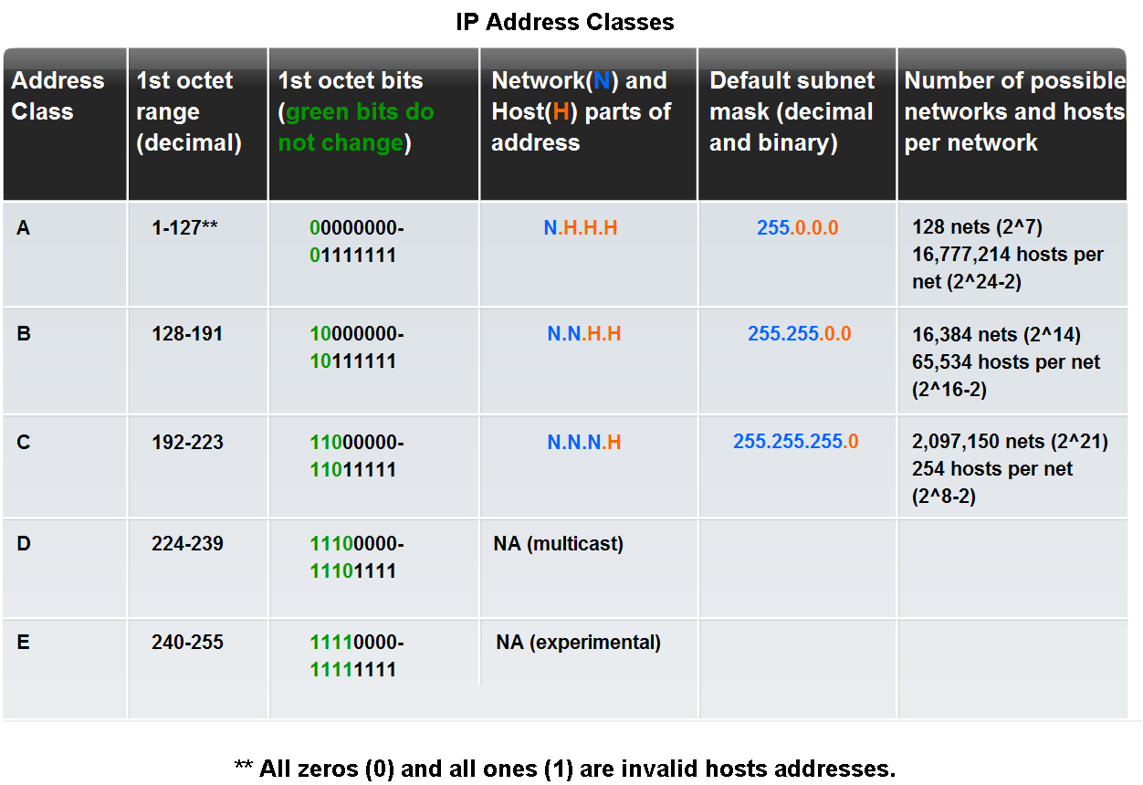
Classful Addressing

Slide 37
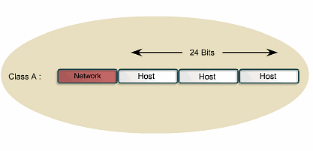
Class A Address

Slide 38
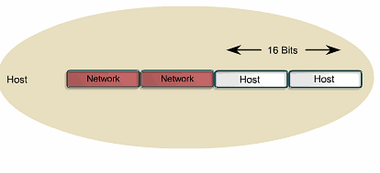
Class B Address

Slide 39
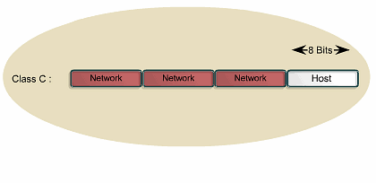
Class C Address

Slide 40
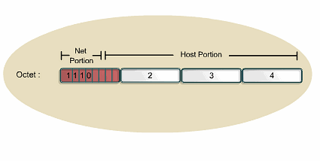
Class D Address

Slide 41
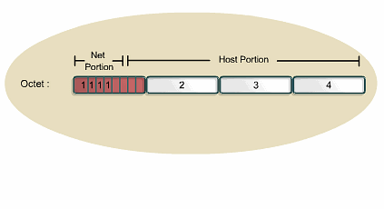
Class E Address

Slide 42
Reason For Address Classes
The reason address classes were invented was because we were running out of network addresses as 256 proved to be way too few
The invention of address classes is the first time addresses were subnetted

Slide 43
Public v Private Addresses
As more and more bits from the original host section of 24 bits were used to create new subnets to meet the demand for more network addresses as the table above shows there were fewer and fewer bits left for host addresses

Slide 44
Public v Private Addresses
Computer scientists much prefer that a every host attached to a network is directly reachable by any other host on any network in the internetwork
As classful addressing and then CIDR used more and more of the 32 available bits to create new subnets this produced a shortage of host addresses

Slide 45
Public v Private Addresses
The solution is a movement to a new version of IP
That new version is IP6
However, when this problem became apparent a temporary fix was developed that later on took hold
This has pushed the adaption of IPv6 back
What was temporary, is now permanent

Slide 46
Public v Private Addresses
This works by setting aside a portion of each former address class for use on internal networks
These are called RFC 1918 or private addresses
The idea was to use these addresses on all of the internal networks and leave the other addresses for the external links

Slide 47
Public v Private Addresses
By doing this the address shortage was solved, at least for a while
So now most organizations use the private addresses inside there own locations, then only use public addresses when talking to the outside world
Let’s see what these private addresses look like

Slide 48
Public v Private Addresses
10.0.0.0 - 10.255.255.255/8
172.16.0.0 - 172.31.255.255/12
192.168.0.0 - 192.168.255.255/16
As the RFC says
The first block is nothing but a single class A network number, while the second block is a set of 16 contiguous class B network numbers, and third block is a set of 256 contiguous class C network numbers

Slide 49
Public v Private Addresses
Layer 3 devices never send a packet out of their own network to an external network using the private address as the source IP address
How then does an organization talk to the outside world

Slide 50
NAT
Even if an organization uses addresses from the private address space in their internal network they must still use a public address when they communicate with the outside world
For this to work the private address must be exchanged for a public address when a packet leaves the internal network

Slide 51
NAT
This process is called Network Address Translation or NAT

Slide 52
What is NAT
NAT does not require, but typically uses, addresses from the RFC 1918 Address range called the Private Address Space
One could use a public address, even ones already used by someone else as these addresses will never been seen outside of the local network, but most people use RFC 1918 addresses

Slide 53
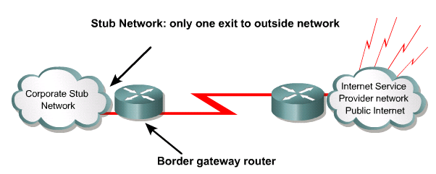
Location of NAT
A NAT-enabled device typically operates at the border of a stub network

Slide 54
How NAT Works - Outbound
INTERNET
OUTGOING PACKET AS PRESENTED TO THE INTERNET
SOURCE ADDRESS | DESTINATION ADDRESS | DATA | CRC
GLOBALLY VALID IP ADDRESS | GLOBALLY VALID IP ADDRESS | REQUEST FOR WEB PAGE | 1234
NAT BOX
OUTGOING PACKET AS PRESENTED TO THE NAT BOX
SOURCE ADDRESS | DESTINATION ADDRESS | DATA | CRC
PRIVATE IP ADDRESS | GLOBALLY VALID IP ADDRESS | REQUEST FOR WEB PAGE | 1234

Slide 55
How NAT Works - Inbound
INTERNET
INCOMING PACKET AS RECEIVED FROM THE INTERNET
SOURCE ADDRESS | DESTINATION ADDRESS | DATA | CRC
GLOBALLY VALID IP ADDRESS | GLOBALLY VALID IP ADDRESS | THE WEB PAGE | 1234
NAT BOX
INCOMING PACKET AS RECEIVED FROM THE NAT BOX
SOURCE ADDRESS | DESTINATION ADDRESS | DATA | CRC
GLOBALLY VALID IP ADDRESS | PRIVATE IP ADDRESS | THE WEB PAGE | 1234

Slide 56
How NAT Works
How is the translation made between the single global address and the many private addresses
With a table
The table in most cases is built dynamically as packets are sent from hosts inside the network to hosts on the Internet

Slide 57
How NAPT or PAT Works
What we have just seen only works for a single inside host going to different outside hosts for each request
A more general form is needed to handle multiple internal hosts and a host going to the same destination over and over
This leads us to NAPT- Network Address and Port Translation

Slide 58
How NAPT or PAT Works
It is also commonly called PAT – Port Address Translation
In this case we use NAT with port numbers
For example if four packets with inside local addresses arrive at the NAT box
Notice in the diagram that follows that packets 1 and 4 are from the same address but different source ports

Slide 59
How NAPT or PAT Works
Packets 2 and 3 are from different addresses but have the same source port
The source addresses of all four packets are translated to the same inside global address, but the packets remain unique because they each have a different source port

Slide 60
How NAPT or PAT Works
By translating ports, approximately 32,000 different inside local sockets can be translated to a single inside global address

Slide 61
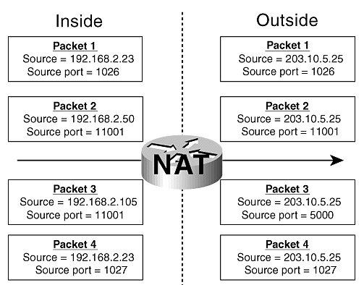
How NAPT or PAT Works
Cisco Press Diagram

Slide 62
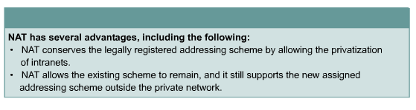
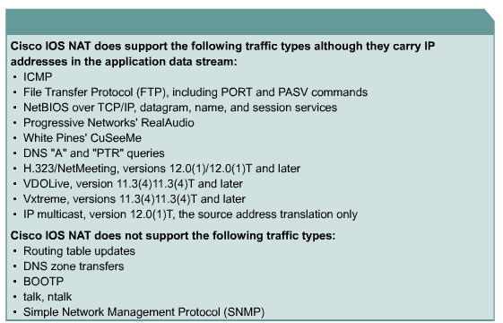
Issues With NAT

Slide 63
Assigning Addresses
Now that we have all of these IP addresses we need a way to assign them to the various devices that need them
This can be an automatic or a manual process
Automatic methods include
DHCP
Link Local

Slide 64
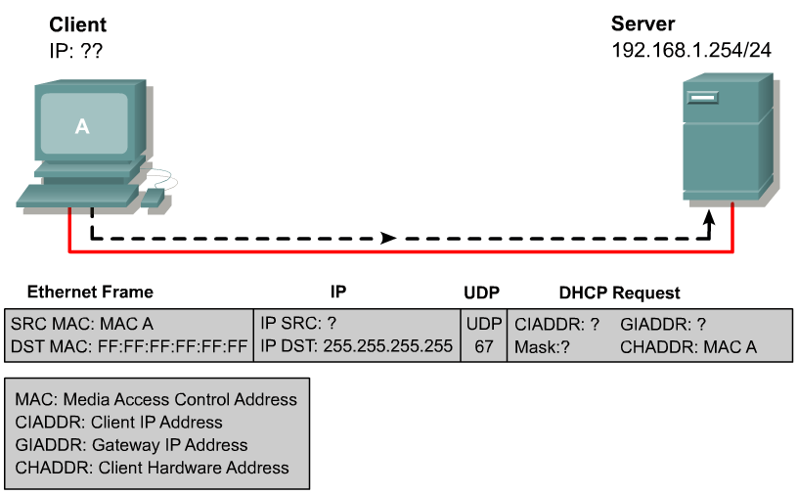
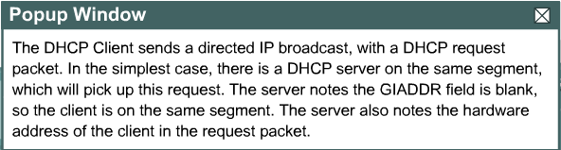
DHCP Operation
DHCP works by providing a process for a server to allocate the IP information to clients

Slide 65
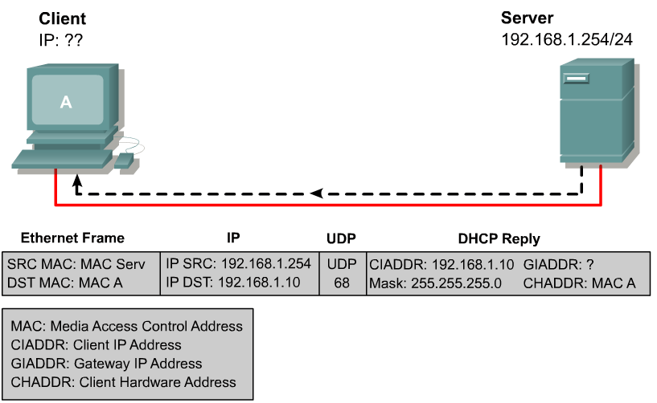
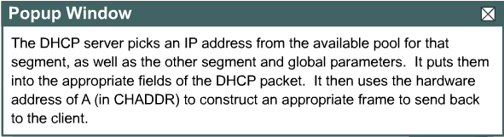
DHCP Operation
Clients lease the information from the server for an administratively defined period

Slide 66
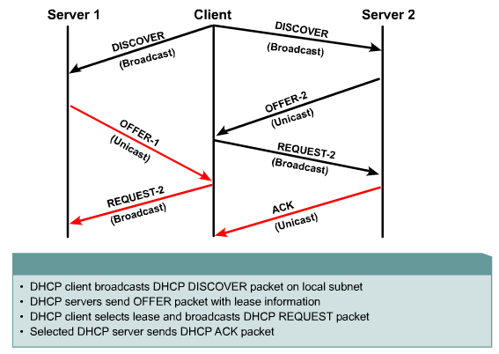
DHCP Operation

Slide 67
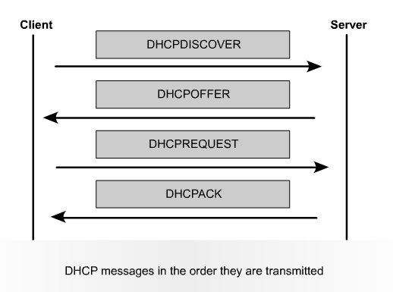
Order of DHCP Messages

Slide 68
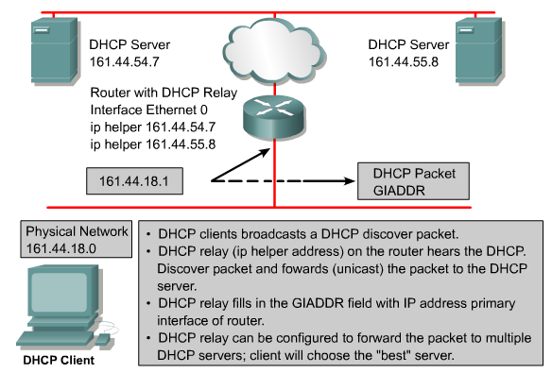
DHCP Relay

Slide 69
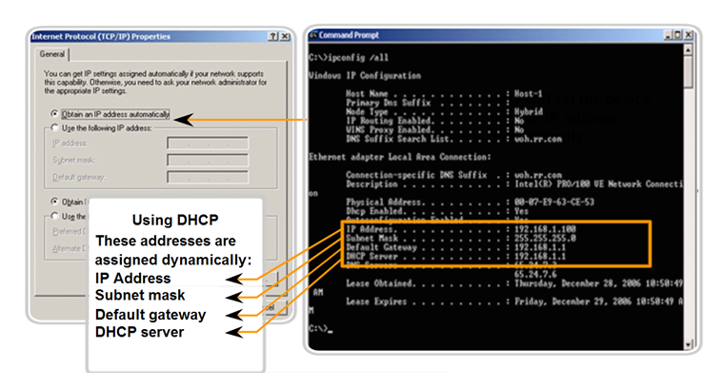
DHCP

Slide 70
Link Local Addresses
There is a special case of the private address space that exists in addition to those discussed above
The addresses were intended to allow a very small local area network to autoconfigure itself
However, no one actually uses this capability

Slide 71
Link Local Addresses
You need to learn to recognize these addresses since devices will assign themselves an address from this range when they are told to get their IP address from a DHCP server, but there is no DHCP server available
Here is the range
169.254.0.0 to 169.254.255.255
It is a /16

Slide 72
Link Local Addresses
When you run ipconfig and the address shown is from this range start looking for a DHCP related problem or a network related problem that is preventing the device from seeing the DHCP server

Slide 73
Manual Address Assignment
If you do not use a DHCP server to provide automatic IP address assignment, the you must manually enter the IP address on each device
This is easy, but tedious
Just go to each machine and enter an IP address in the appropriate location
For example

Slide 74
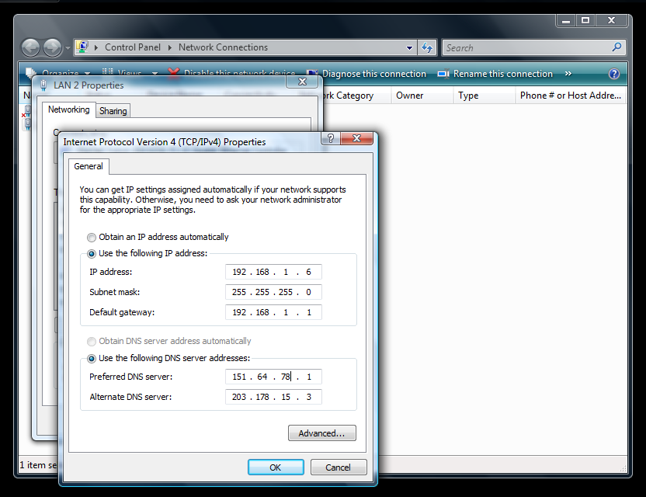
Manual Address Assignment

Slide 75
IP Address Planning
For all of the above to work the use of these various forms of dealing with IP addresses must be planned out to fit the network now, plus the network in the future
Let’s see how this is done

Slide 76
IP Address Planning
Questions to answer
Should I use IP4 or IP6
Should I use public or private addresses
How much growth will I see in the future

Slide 77
IP4 or IP6
There is no reason to use IP6 inside a network yet
Most of the initial usage will be in point to point links in the internetwork connecting larger networks for a while

Slide 78
Public or Private
In general you should use private IP addresses inside a network
You will need public addresses to connect to the outside world

Slide 79
IP Address Planning
The first step in planning IP addressing is to determine the size of the network
Consider the following
How many locations will there be
How many devices may there be
What are the requirements for each location
What subnet size for each location

Slide 80
IP Address Planning
Growth of 10 to 20 percent should be allowed for
Here is an example of a multisite plan

Slide 81
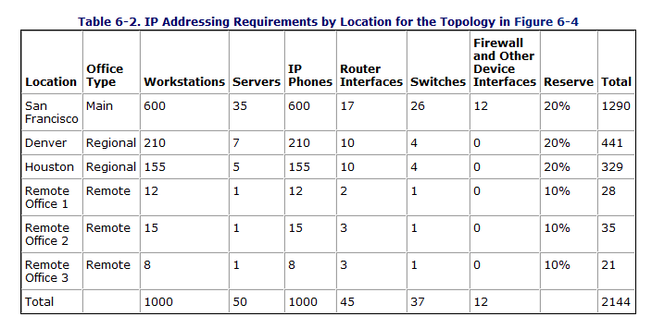
IP Address Planning

Slide 82
What Range to Use
What address range should be used
Here is a good approach as suggested on nanog.org during an exchange on bogan filters
Darden, Patrick S. wrote
…pick a network from the appropriate sized Private Networking ranges, then apply a well thought out scheme to the section of IP addresses you chose

Slide 83
What Range to Use
E.g. 10.150.x.y/16 as their network
X could be physical positioning, and Y could be purposive in nature
10.150.0.0 as basement, 10.150.1.0 as first floor, 10.150.2.0 as second floor, etc. 1-20 as switches/routers, 21-50 as servers and static workstations, 51-100 as printers, and 101--200 as DHCP scope for PCs, and 201-254 for remote login DHCP scope (vpn, dialup, etc.)

Slide 84
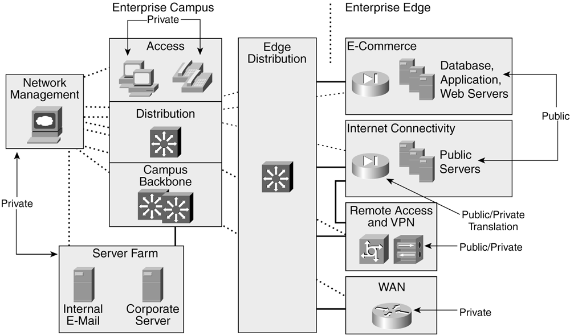
Private v Public

Slide 85
Summarization
Address summarization will be discussed in a future class
For now just know that address summarization should be designed into the network at appropriate locations

Slide 86
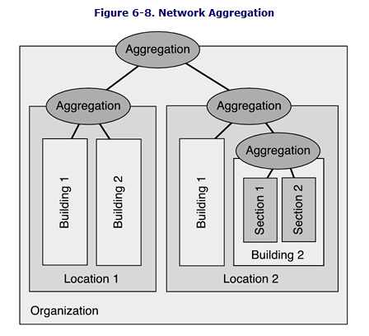
Figure 6-8

Slide 87
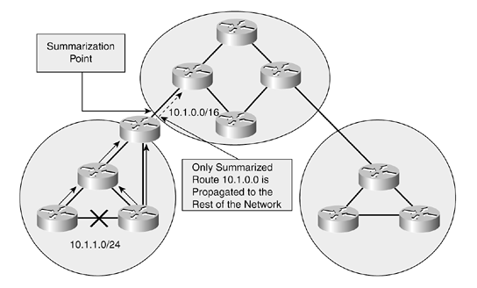
Figure 6-10

Slide 88
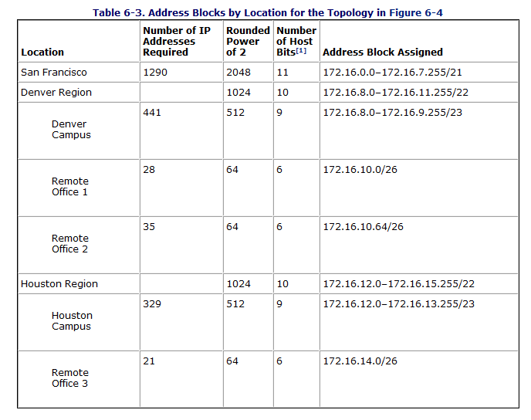
Address Block Assignment

Slide 89
Static v Dynamic Addressing
Networks of any size should use dynamic assignment via DHCP servers
However certain devices require static address such as
Network management network and devices
Servers
Printers
All modules of the Enterprise Edge

Slide 90
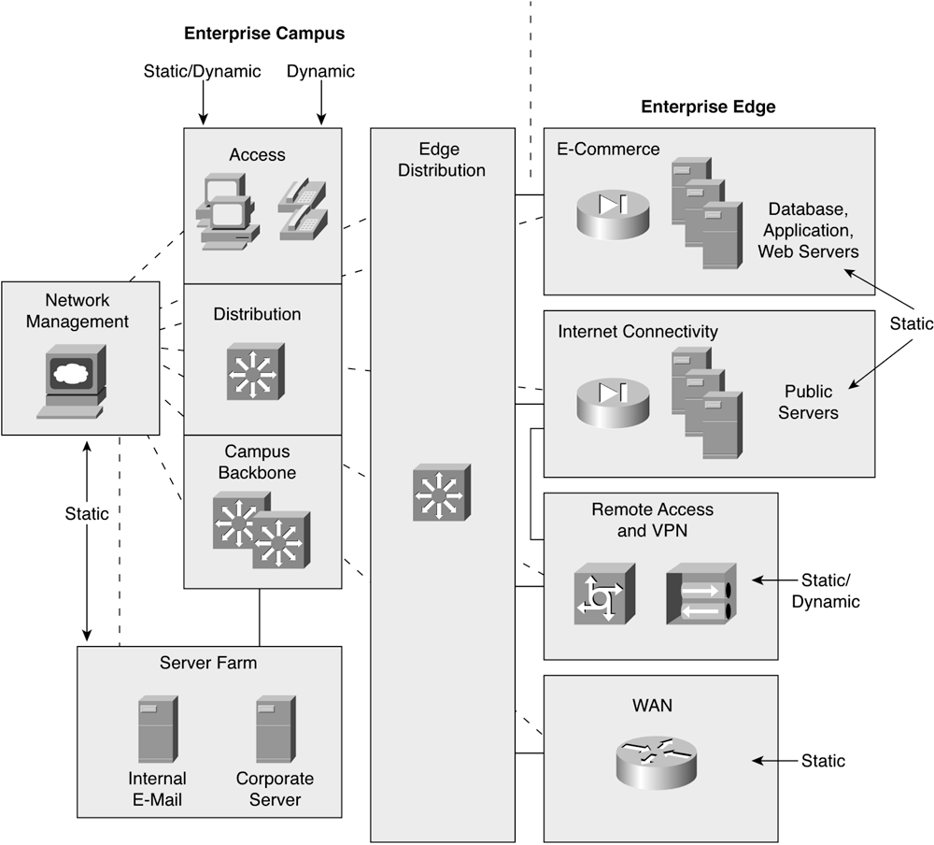
Figure 6-15

Slide 91
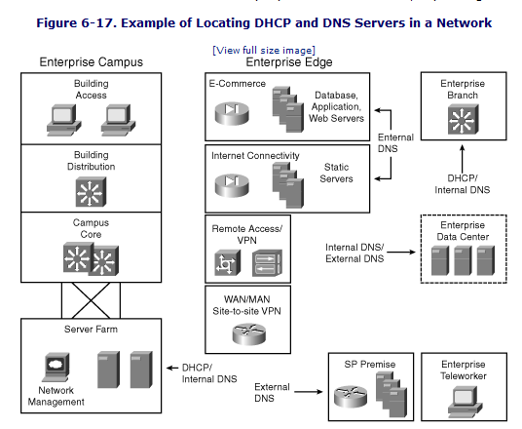
Figure 6-17

Slide 92
An Example
Let’s look at an example of a medium size organization
This network is used by First Command a financial services company
Here is their campus

Slide 93
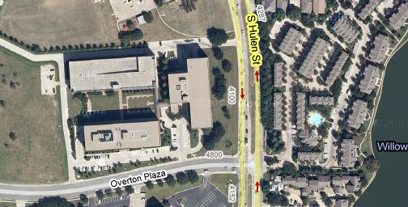
First Command
Parking Garage
Command III
Command I

Slide 94
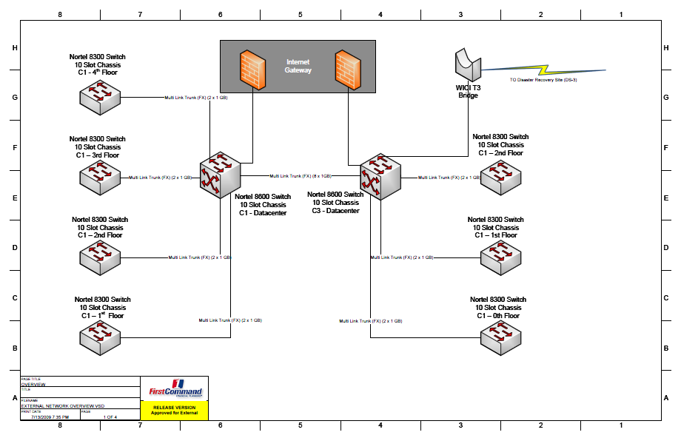
First Command

Slide 95
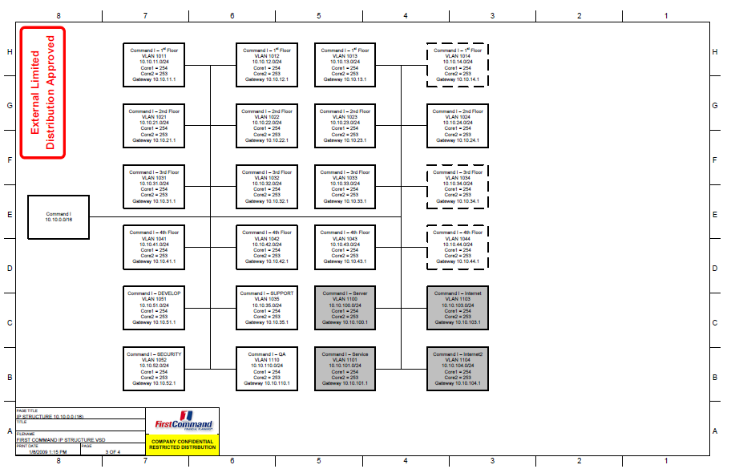
First Command

Slide 96
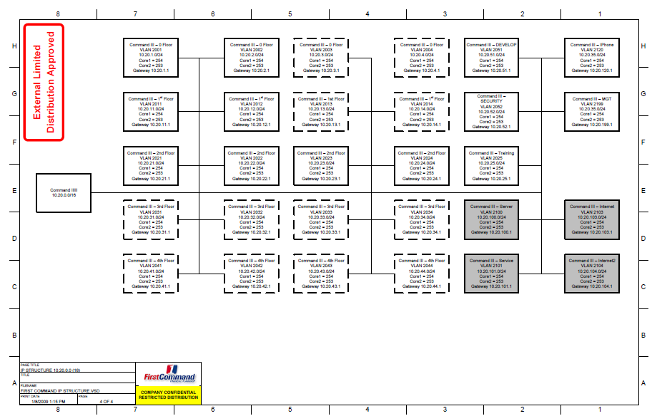
First Command

Slide 97
Where Addresses Come From
Each address must be unique
For this to occur some central authority must issue addresses
So where do IP addresses come from

Slide 98
Where Addresses Come From
The Easter Bunny
No

Slide 99
Where Addresses Come From
If the network is to be connected to a private internetwork
Then any IP address range can be used
But if the network will be connected to the Internet or someone else’s network
Then the IP addresses used must be assigned

Slide 100
Where Addresses Come From
In the beginning they came from the IANA – Internet Assigned Numbers Authority or actually Jon Postel
After his death in 1998 a new organization took over
ICANN – The Internet Corporation for Assigned Names and Numbers
But the addresses are still under the authority of IANA

Slide 101
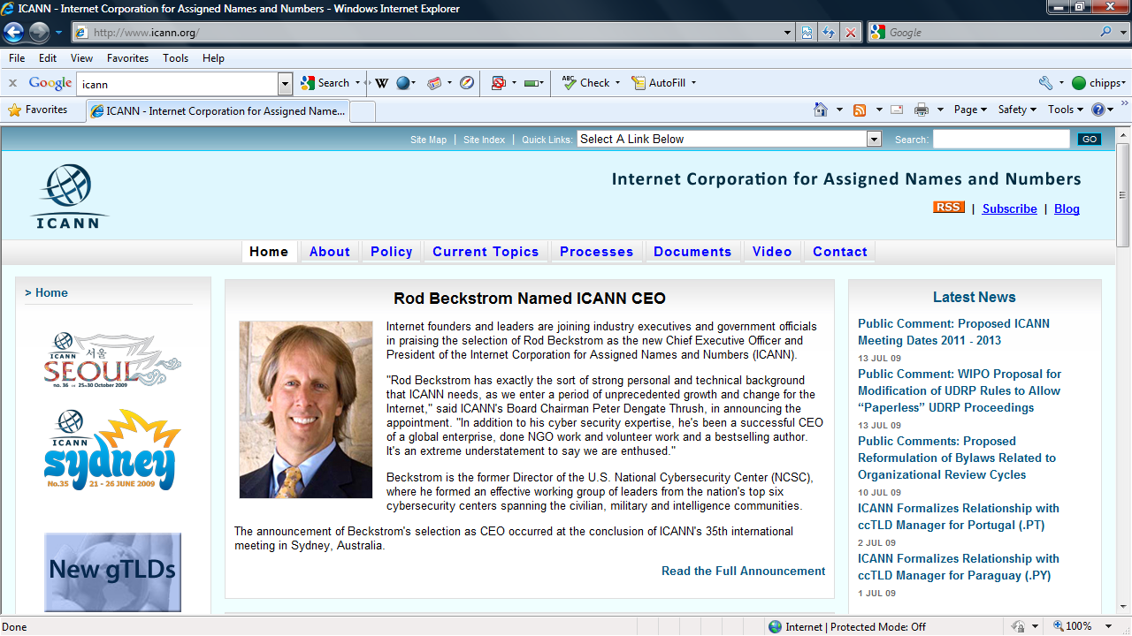
Where Addresses Come From

Slide 102
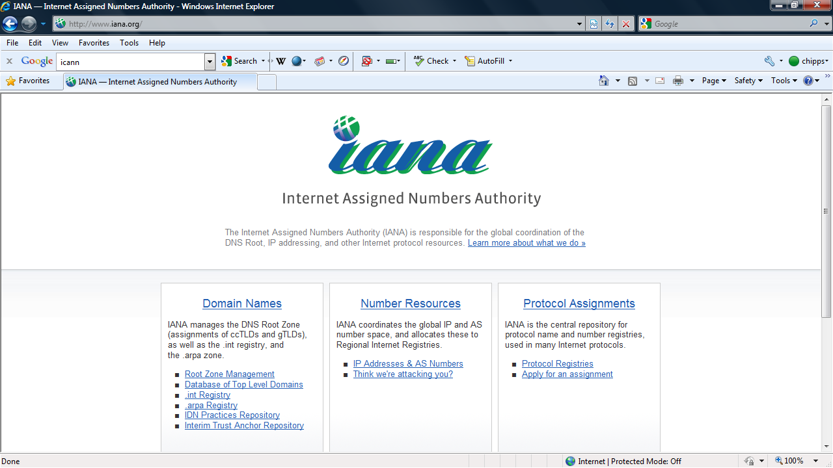
Where Addresses Come From

Slide 103
Where Addresses Come From
But ICANN and IANA have assigned the day to day responsibility for handing out addresses to a group of regional registries
For example addresses for North America come from ARIN

Slide 104
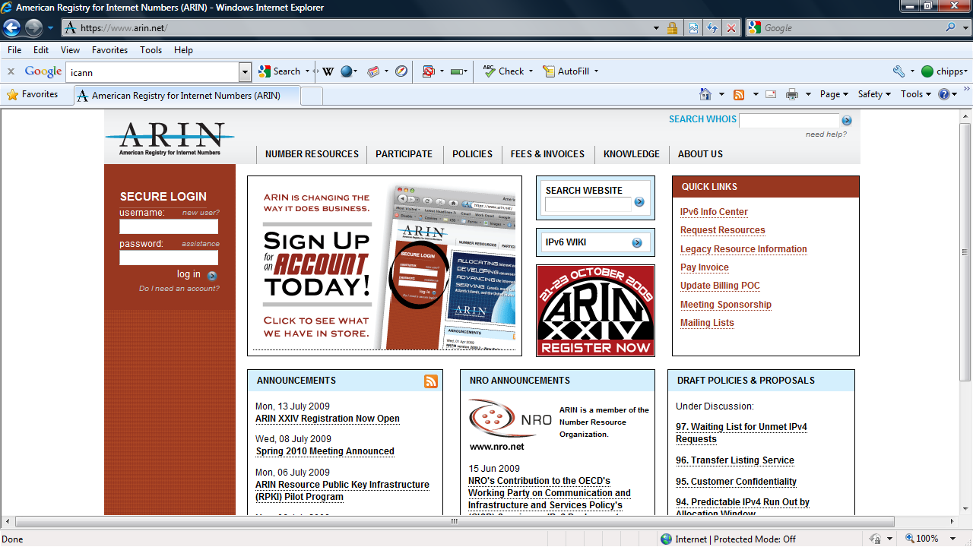
Where Addresses Come From

Slide 105
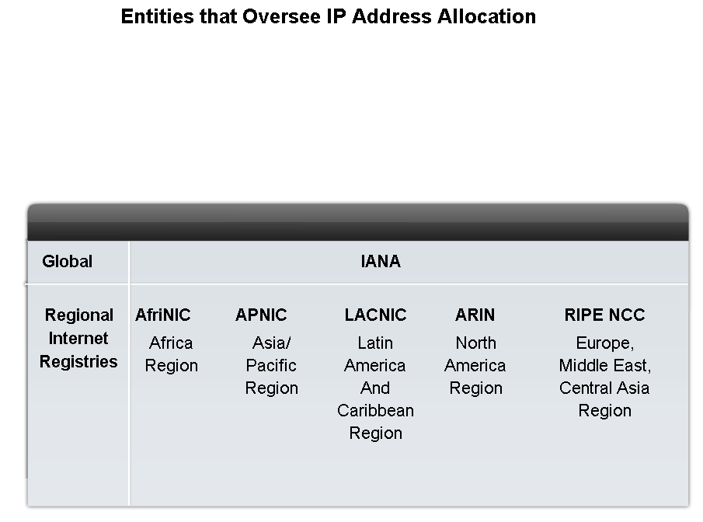
Where Addresses Come From

Slide 106
Where Addresses Come From
Below this level ISPs of various sizes hand out the addresses to each other until finally to the end user

Slide 107
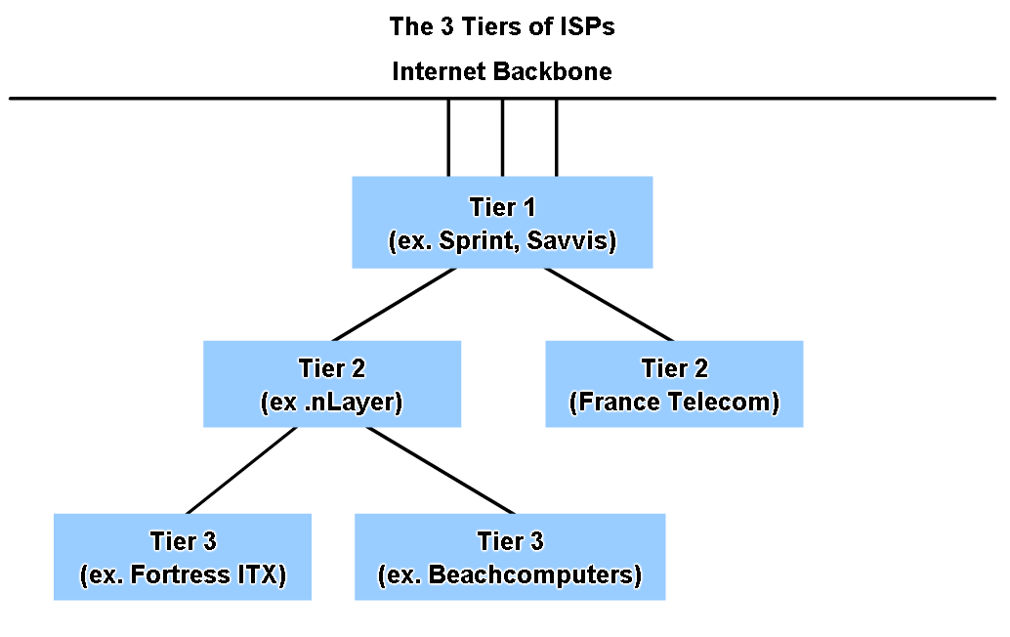
Where Addresses Come From

Slide 108
Types of Traffic
There are three types of addresses in terms of the population they serve seen in a network
Unicast
Multicast
Broadcast

Slide 109
Types of Traffic
Unicast traffic has the address of a single end point in the address field
It is the only device that reads it in
There are several special use unicast addresses
Default Route
Loopback

Slide 110
Types of Traffic
Default Route
0.0.0.0
This says to send everything that does not belong on the local network to this port so it can exit the network
Loopback
127.0.0.1
This sends the traffic back to the sender

Slide 111
Types of Traffic
Multicast traffic has the address of a multicast IP address in the address field
Only those devices tuned into that stream read it
The multicast address is used to conserve bandwidth by allowing a single packet to be read by all who tune into the transmission

Slide 112
Types of Traffic
These are the 224.0.0.0 to 239.255.255.255 addresses

Slide 113
Types of Traffic
Broadcast traffic has the broadcast address in the address field
All NICs read the frame
There are two types of broadcasts
Directed
All hosts on a specific network
Uses the highest host number
The one that is all 1s
For example
192.168.1.255
Can be forwarded if desired

Slide 114
Types of Traffic
Limited
All hosts on the local network
255.255.255.255
Not forwarded by layer 3 devices

