Slide 1
Example of a MAN
Last Update 2009.06.29
1.0.0

Slide 2
A MAN
A MAN can be created with wires or by using a wireless connection
A cellular network is a good example of a MAN
Here is another example
This is a wireless MAN used to provide high-speed Internet access to folks in rural areas

Slide 3
A MAN
Out in the country the population density is too thin for the economical deployment of DLS or similar services
Therefore satellite Internet access or a wireless MAN as shown here is a common way of connecting to the Internet
This is called a WISP – Wireless ISP

Slide 4
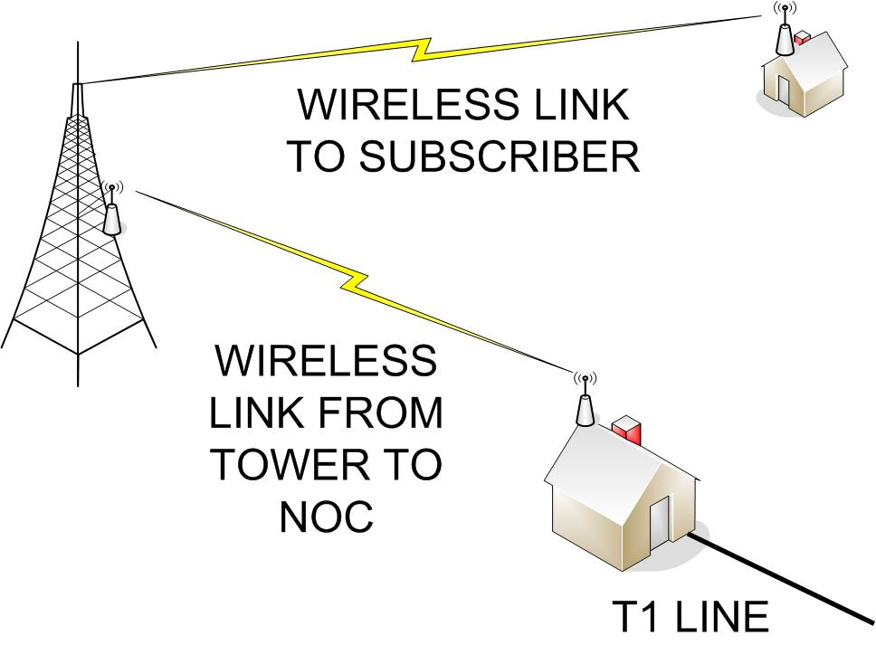
WISP Layout

Slide 5
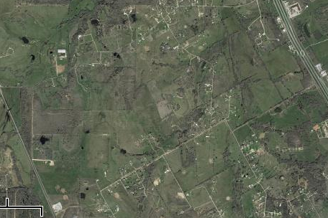
WISP Layout
BASE STATION
TOWER
INTERSTATE 35 W
1.5 MILES
CUSTOMER
LOCATION

Slide 6
WISP Base Station
The base station for the WISP consists of
  A tower
  An antenna
  A radio

Slide 7
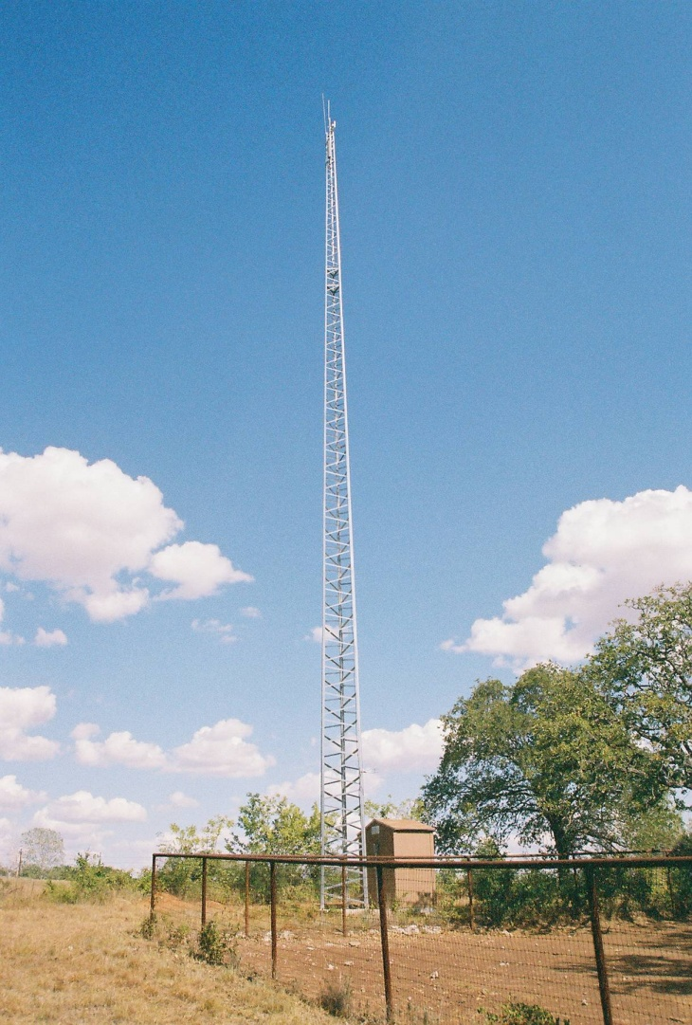
WISP Tower

Slide 8
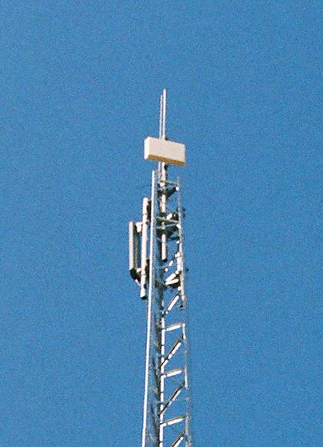
WISP Antenna

Slide 9
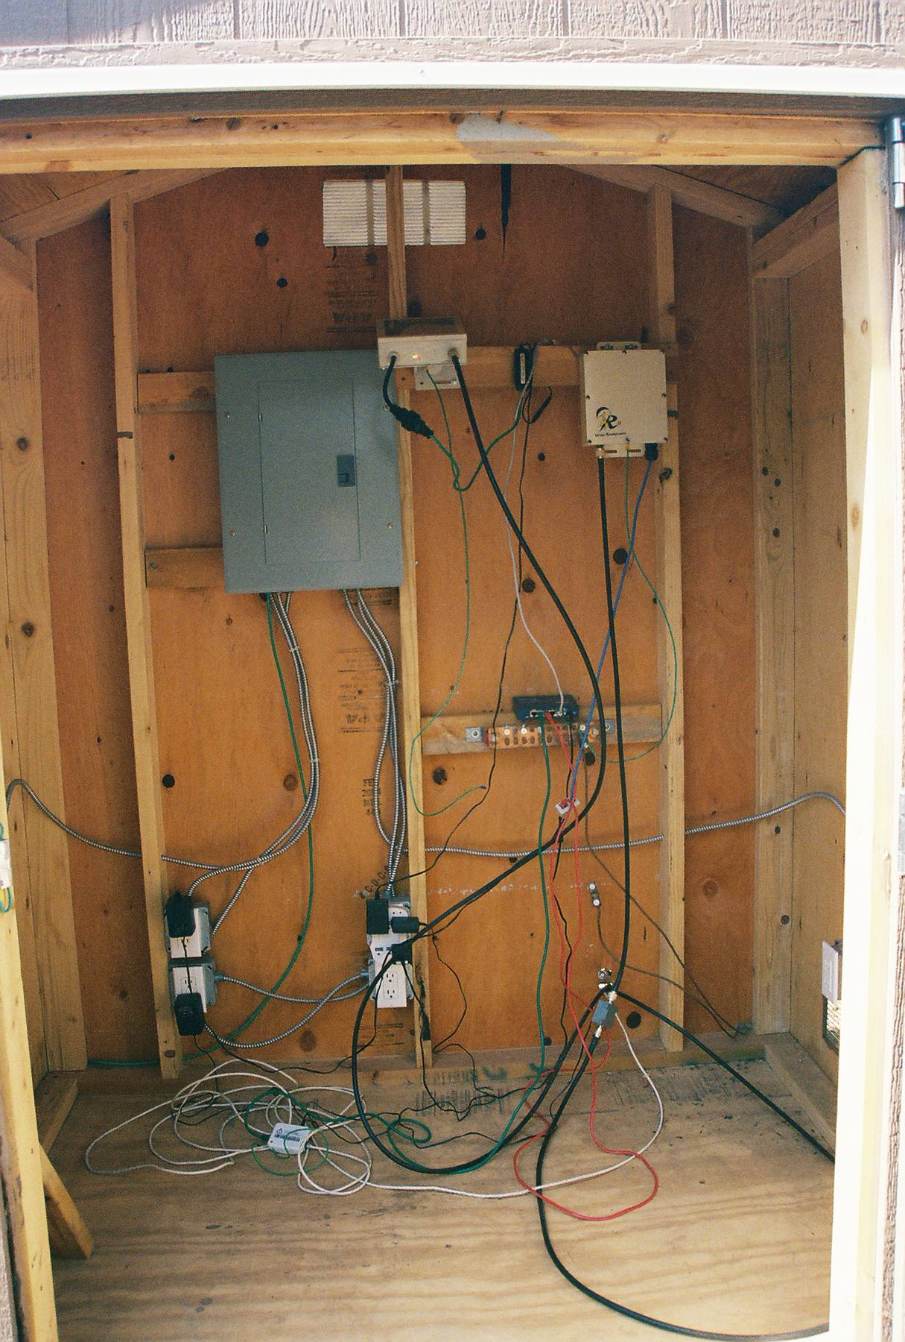
WISP Radio

Slide 10
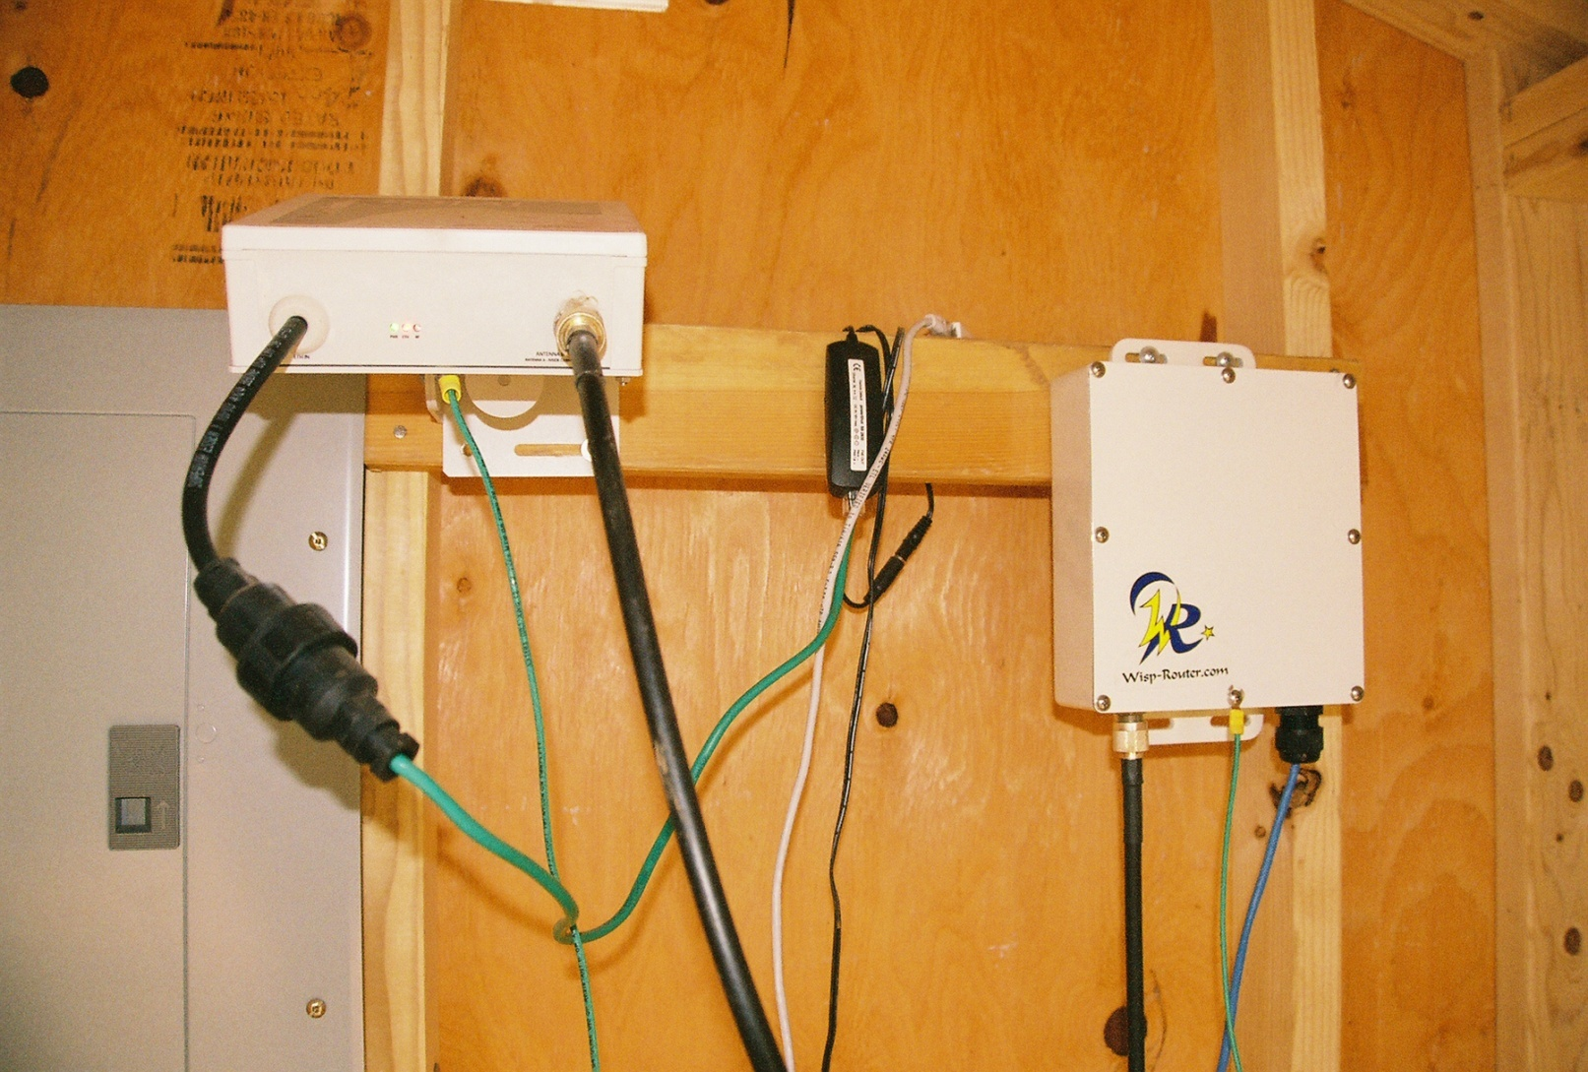
WISP Radio

Slide 11
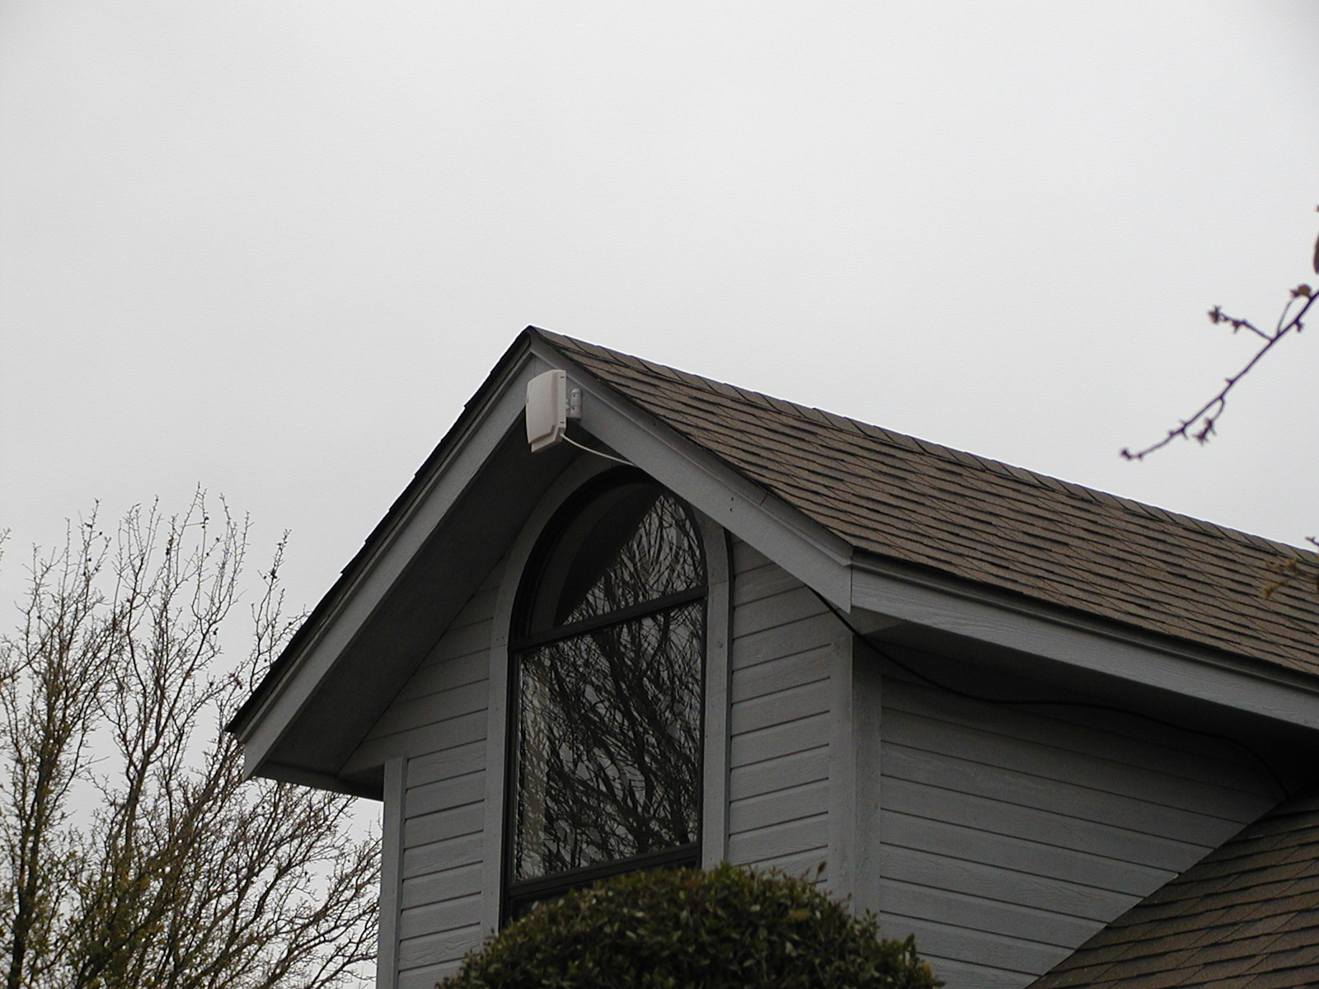
WISP Customer Site

Slide 12
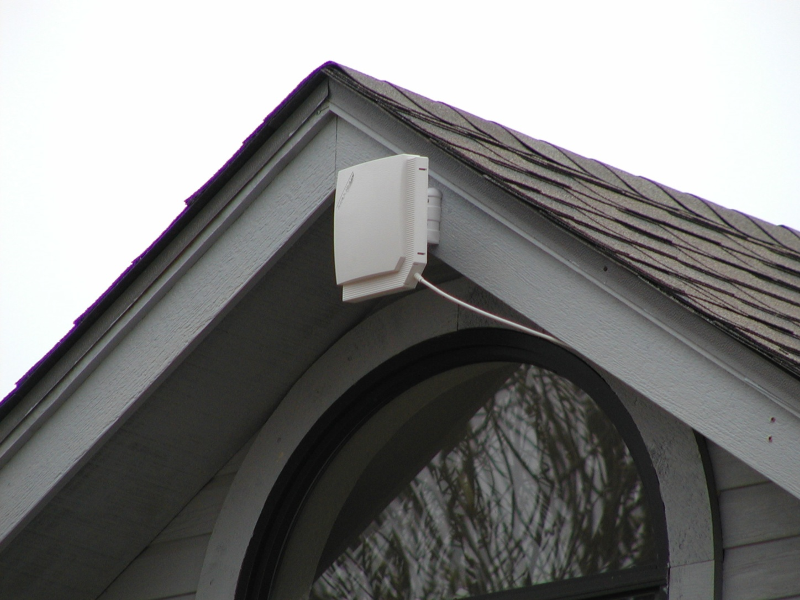
WISP Customer Site

Slide 13
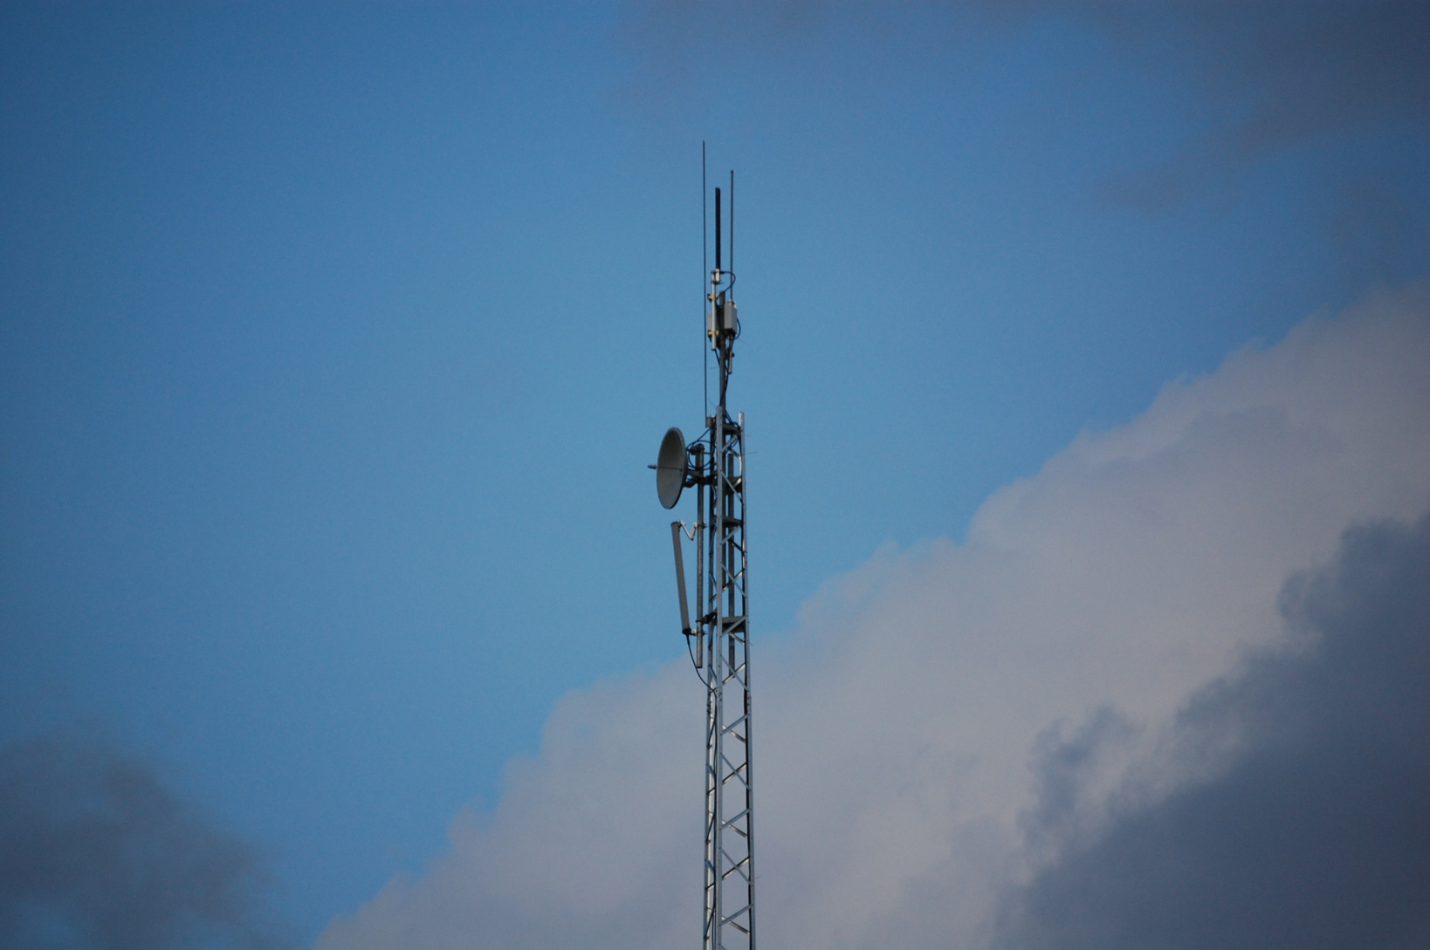
New MAN

