Slide 1
Example of a LAN
Last Update 2009.06.29
1.0.0

Slide 2
What is a LAN
A LAN – Local Area Network connects points that are near to each other
This is usually within the same building
Let’s look at a typical wired LAN
This consists of

Slide 3
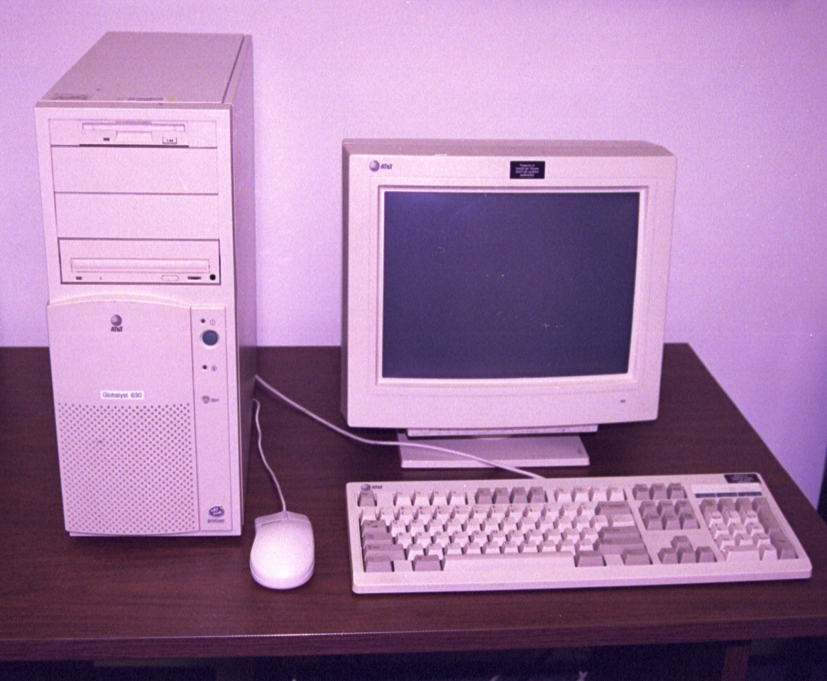
PC in Office 245

Slide 4
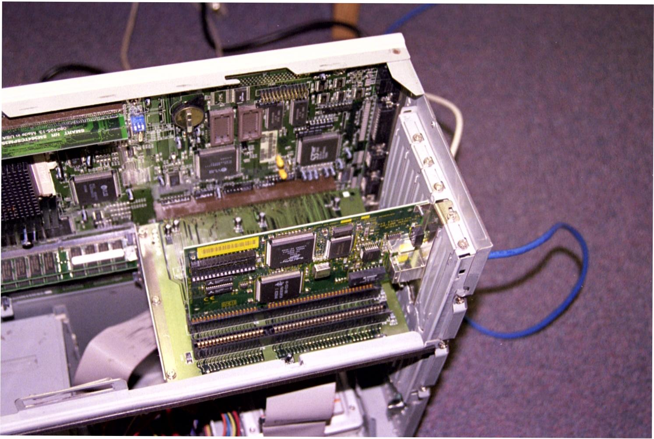
NIC in the PC

Slide 5
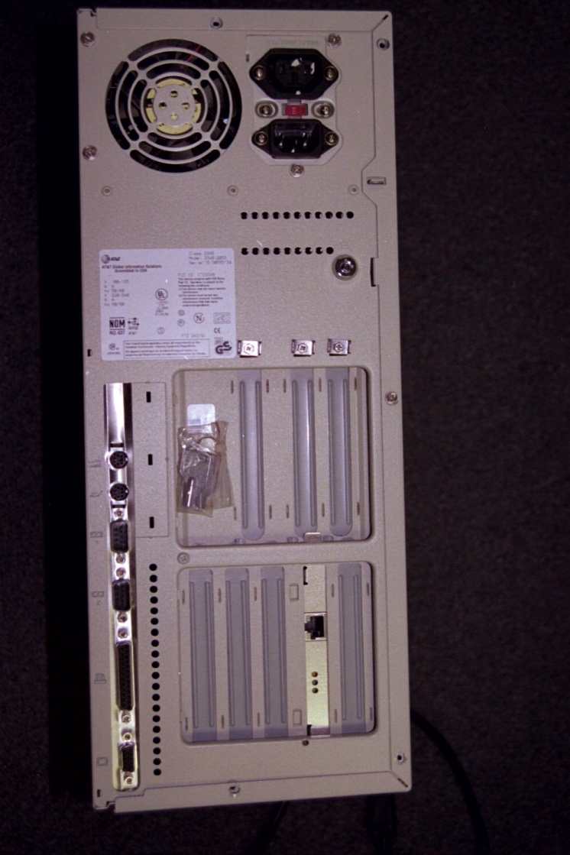
NIC in the PC

Slide 6
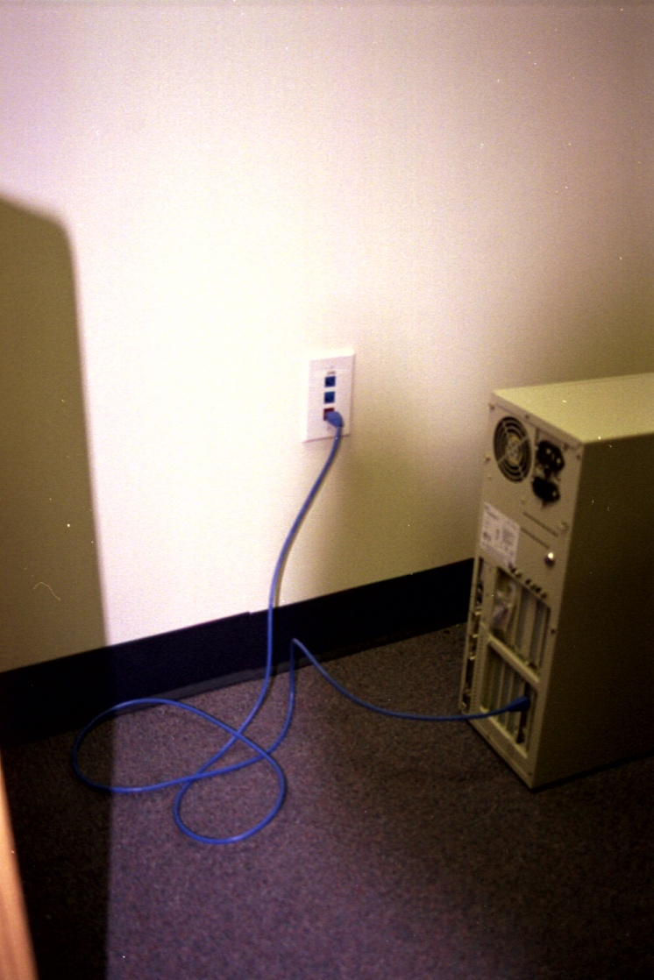
Patch Cable to Wall Plug

Slide 7
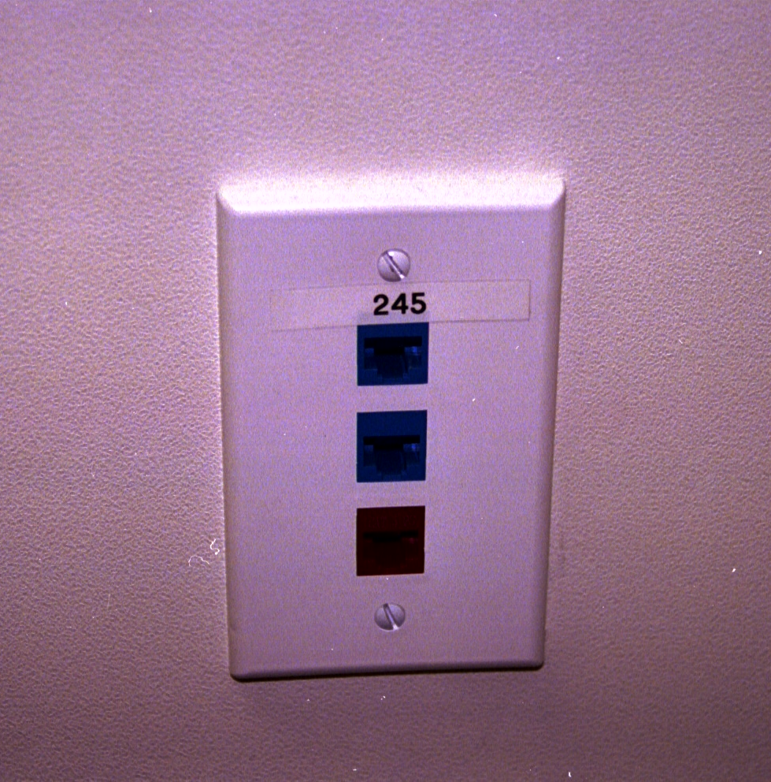
Port 245 Wall Plate in Office

Slide 8
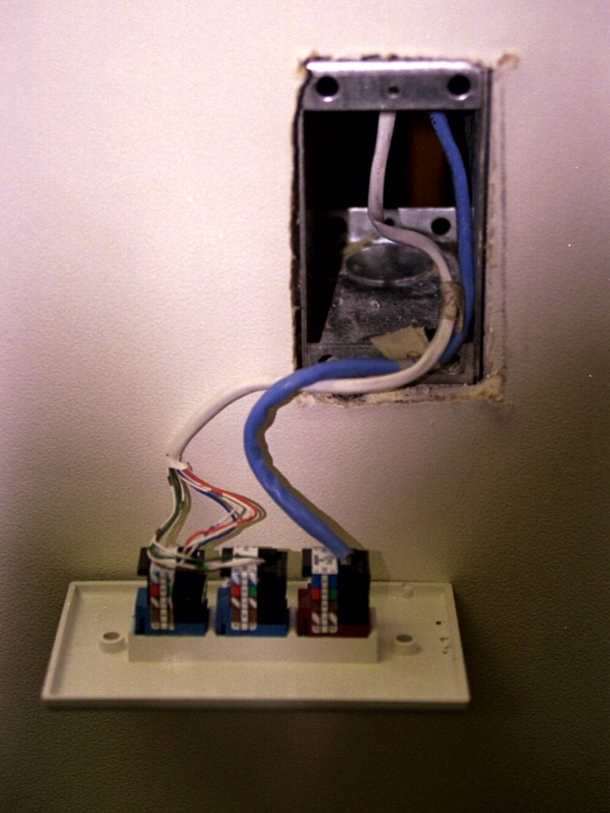
Wall Plate in Office

Slide 9
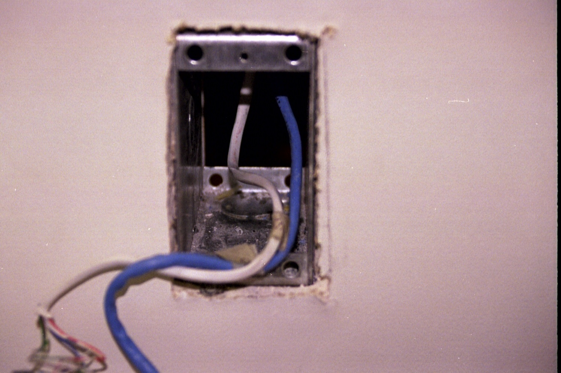
Wire Run Up Wall in Office

Slide 10
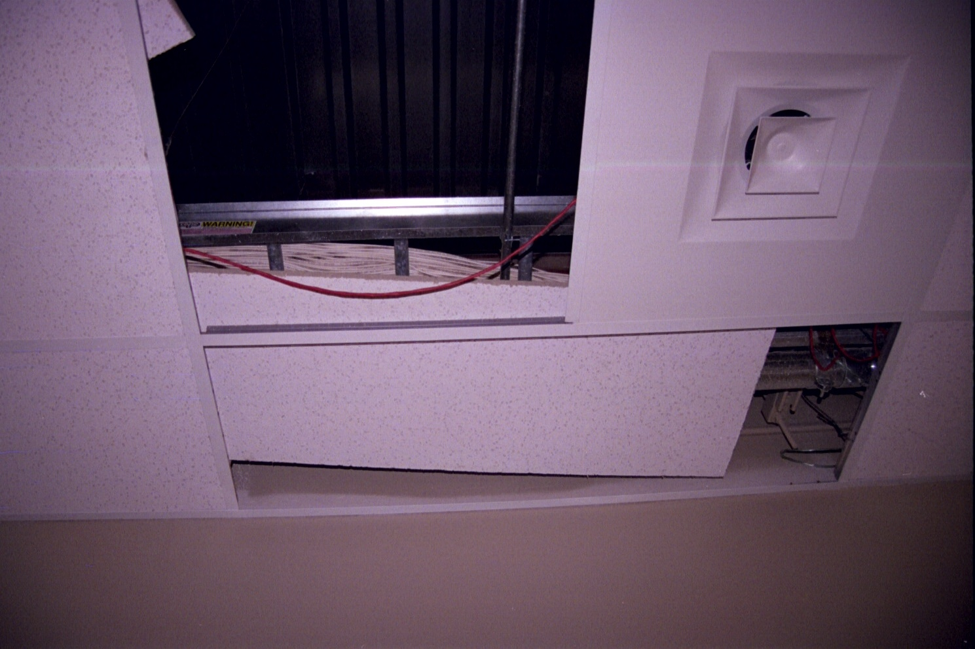
Cable Run in the Ceiling

Slide 11
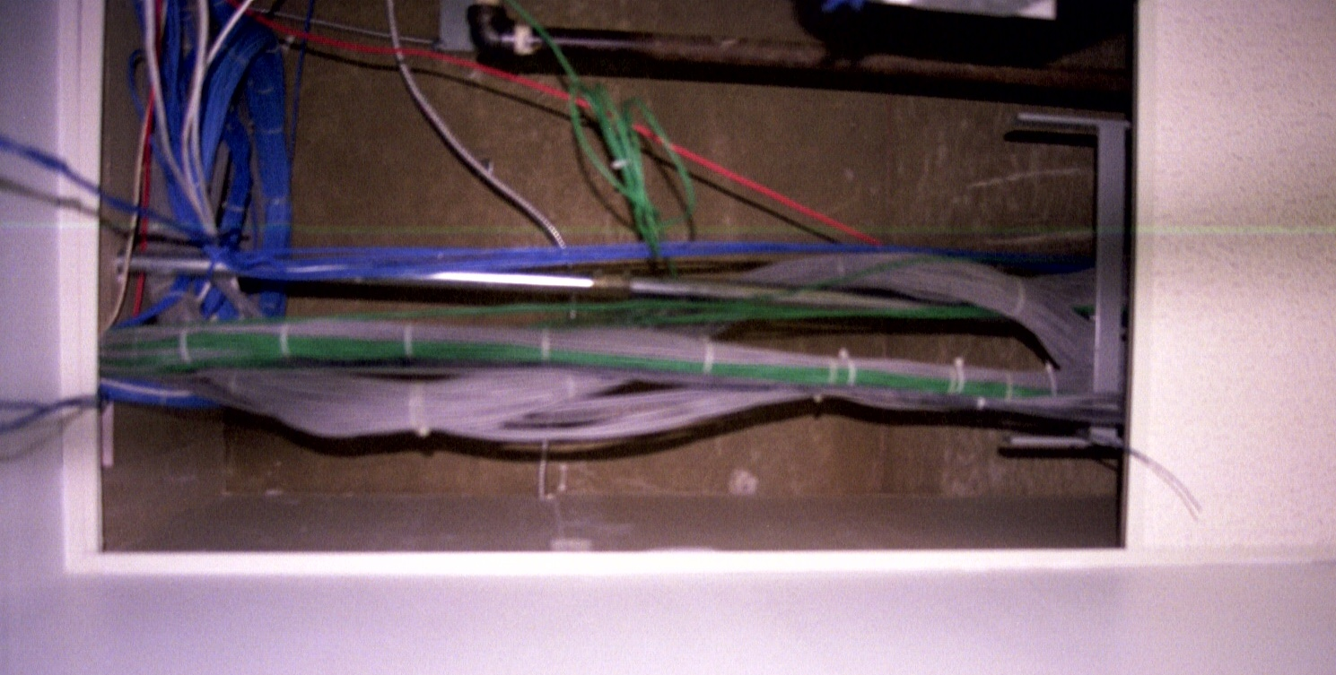
Cable Run in the Ceiling

Slide 12
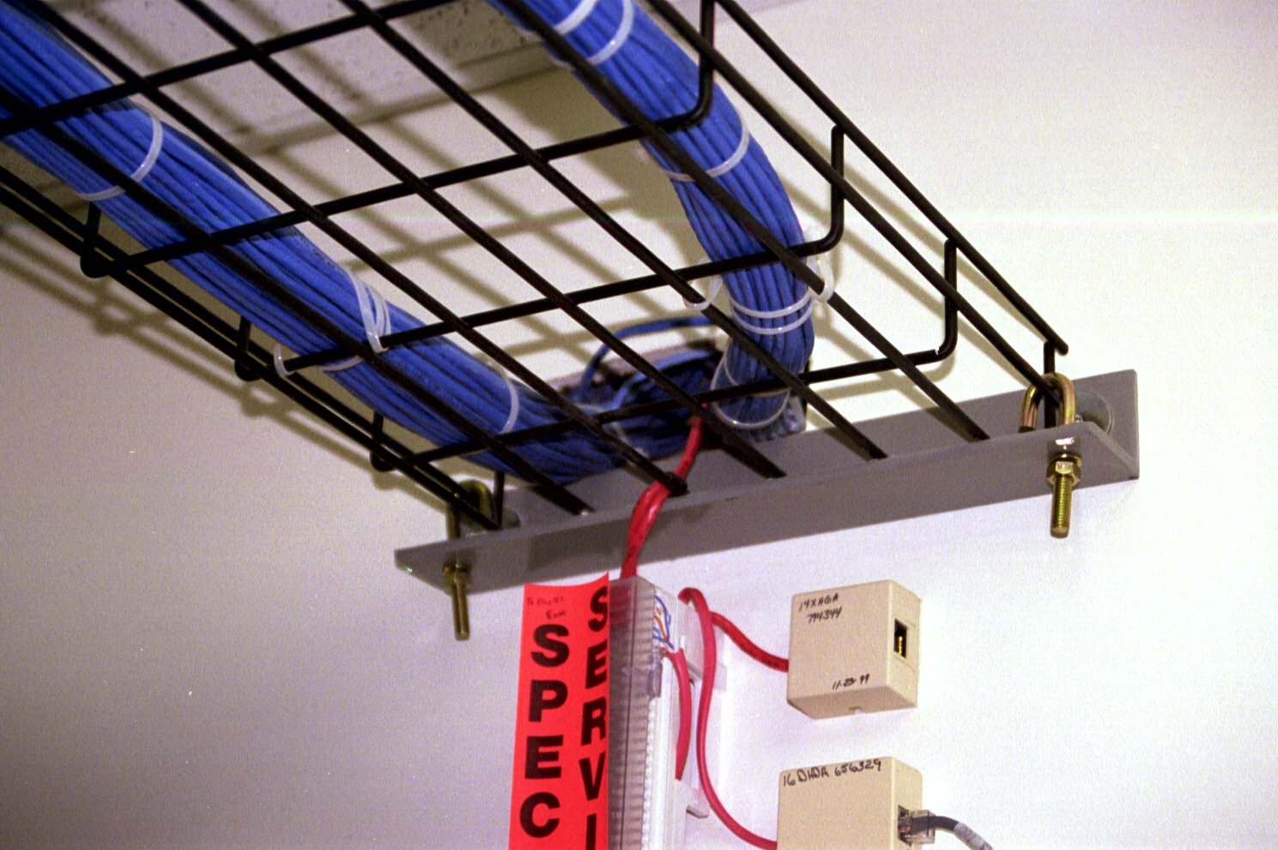
Cable Into the LAN Room

Slide 13
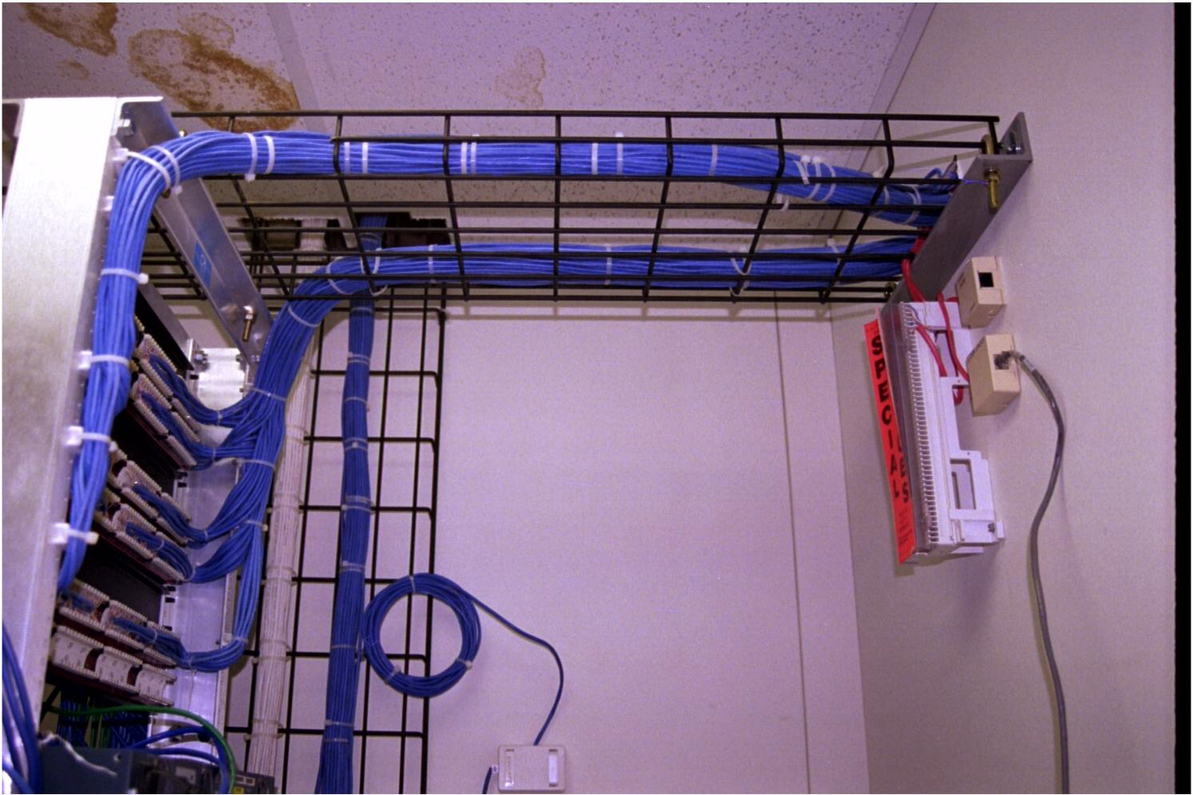
Across to the Relay Rack

Slide 14
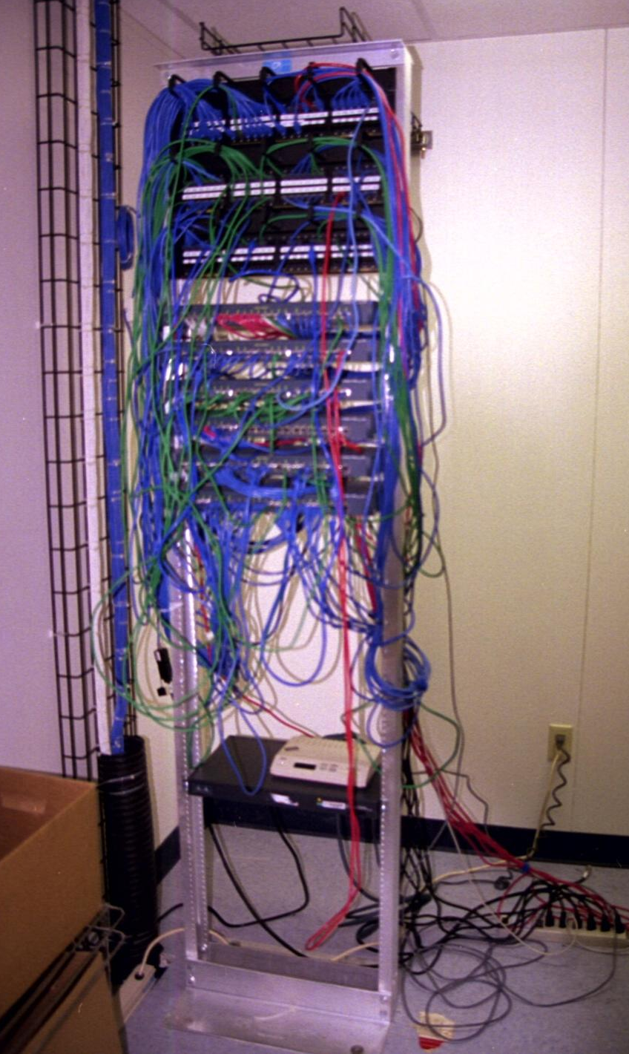
Relay Rack

Slide 15
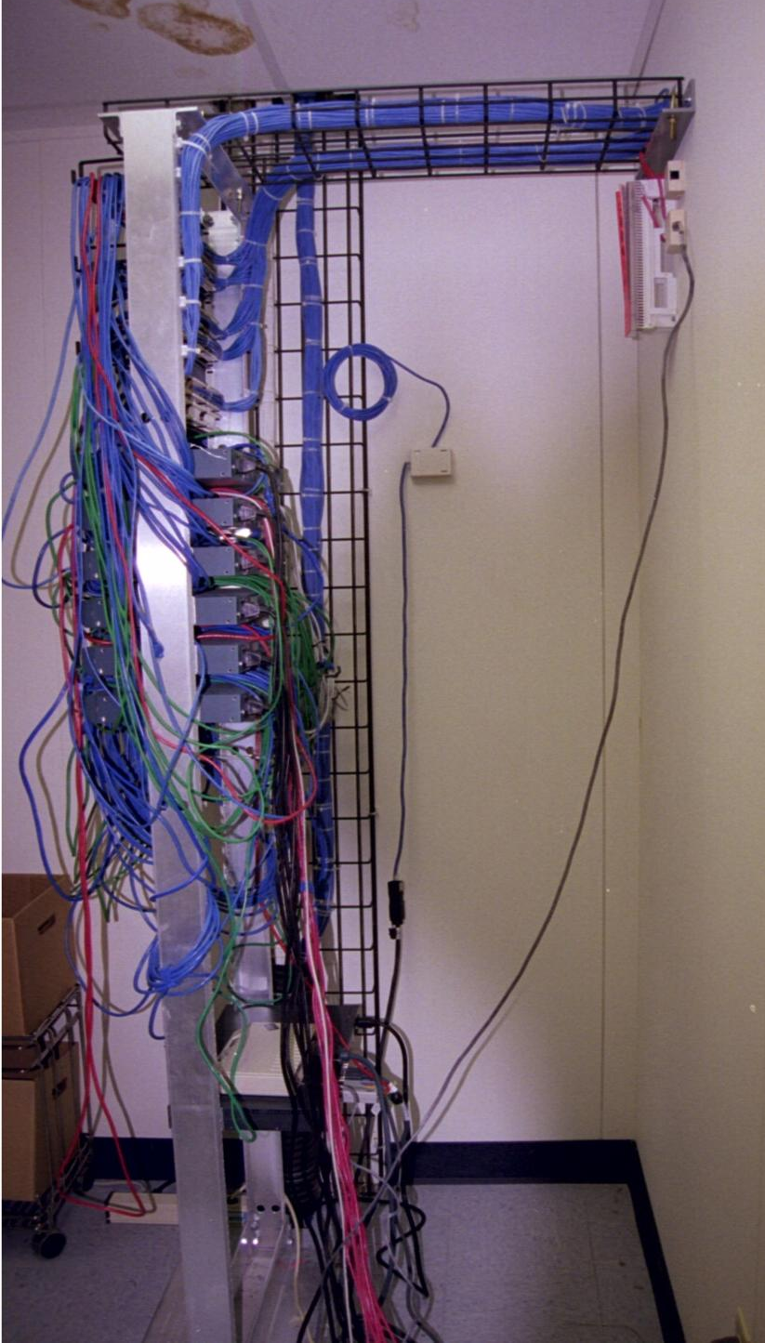
Relay Rack

Slide 16
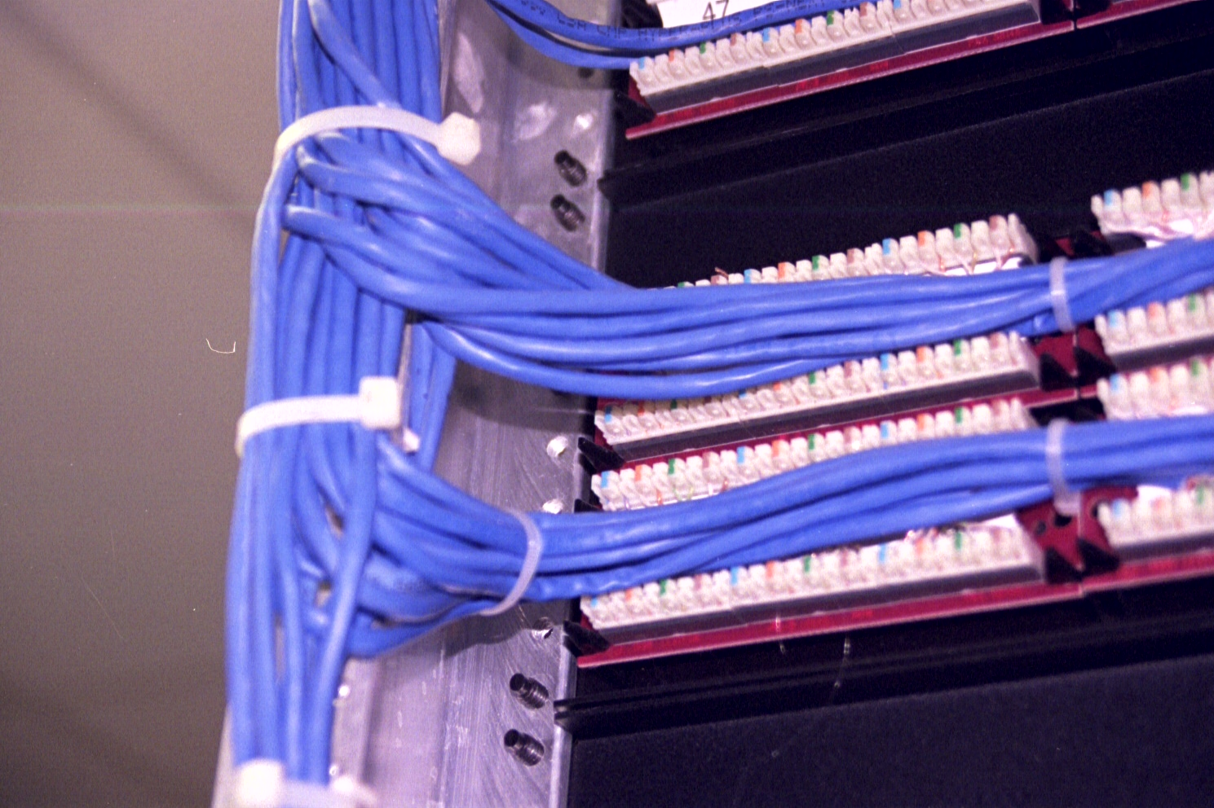
Patch Panel

Slide 17
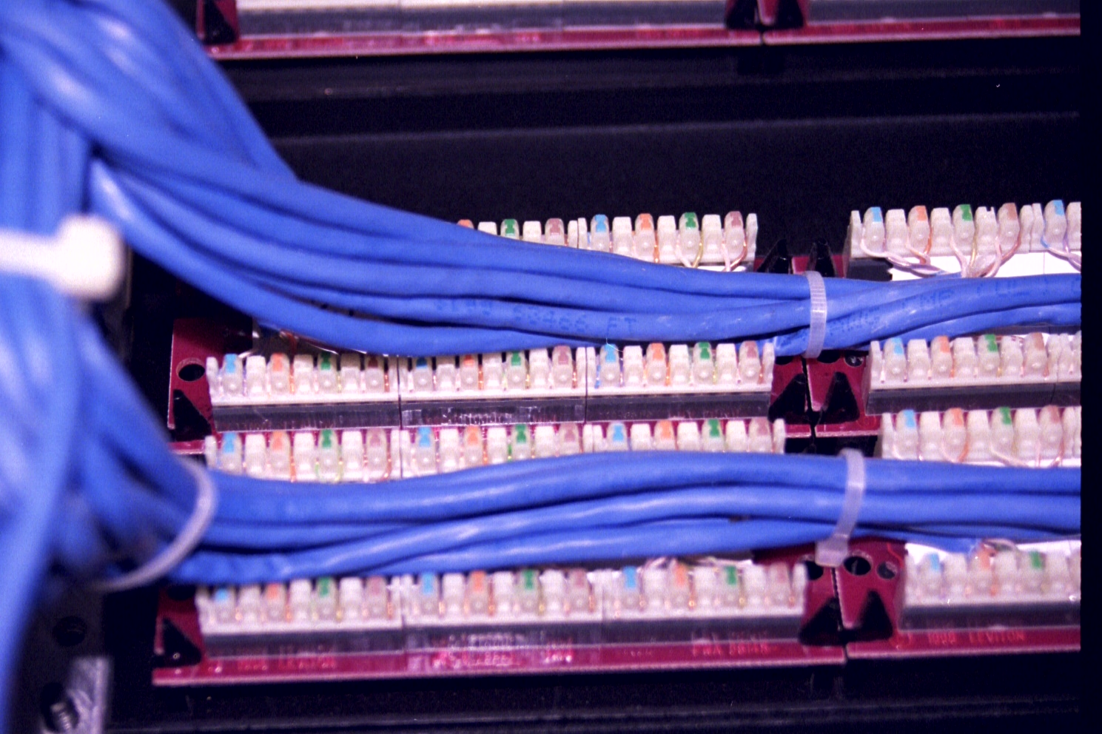
Patch Panel

Slide 18
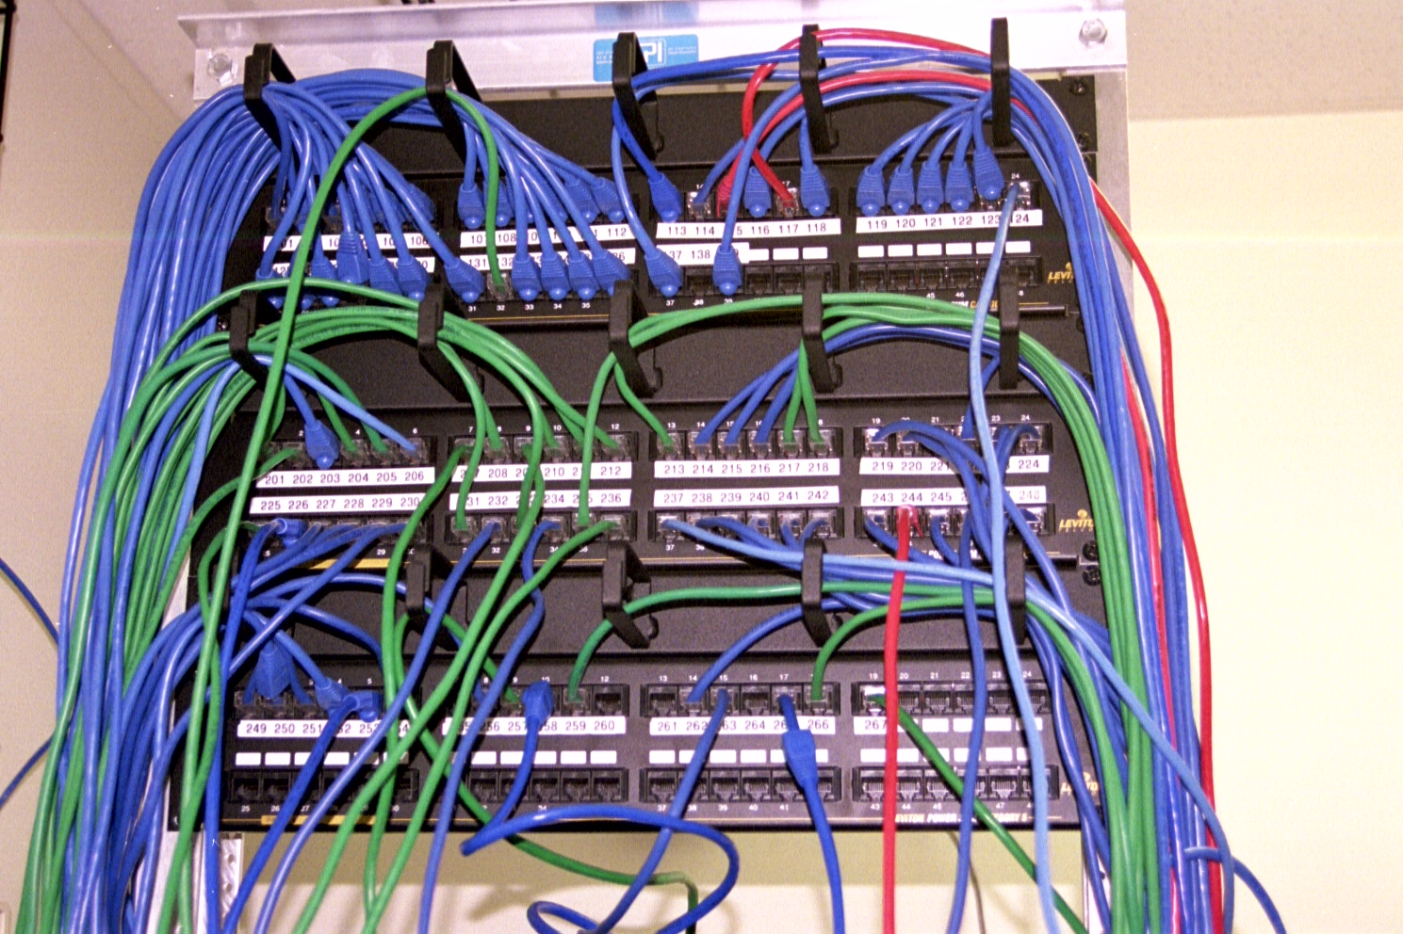
Patch Panel

Slide 19
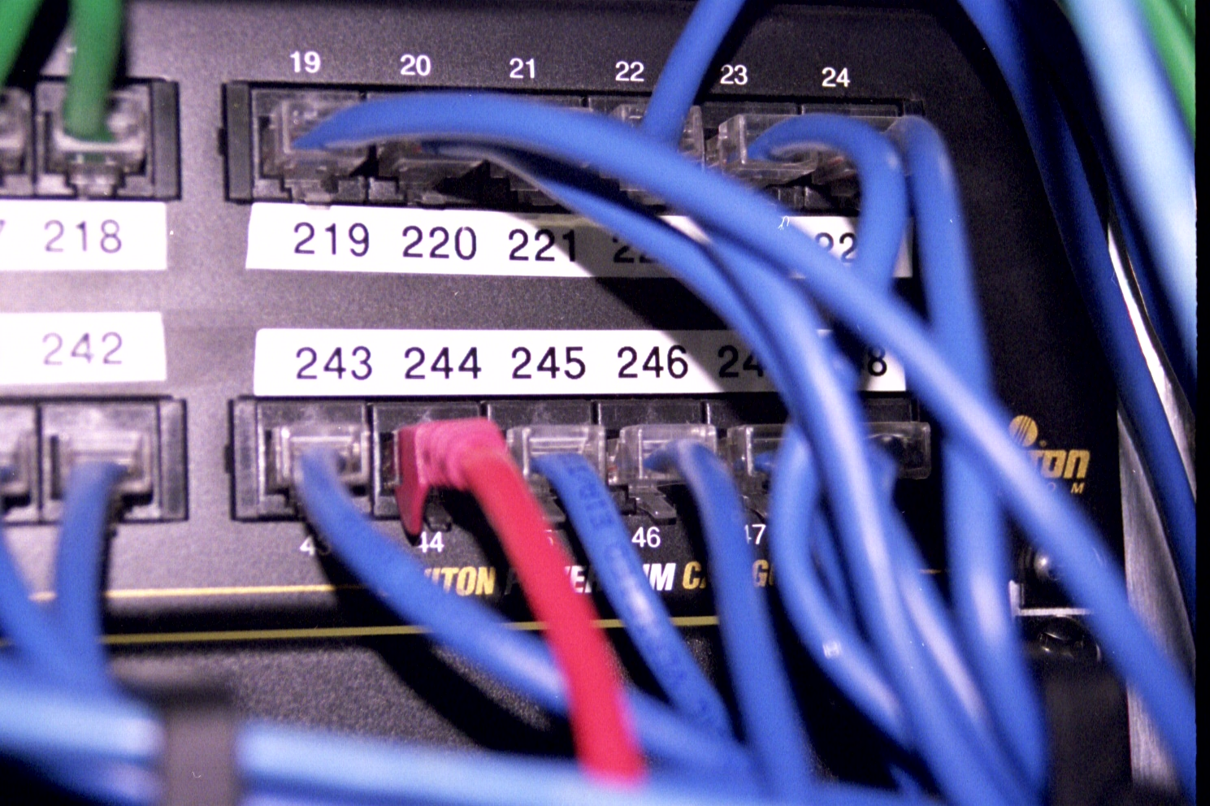
Port 245 in the Patch Panel

Slide 20
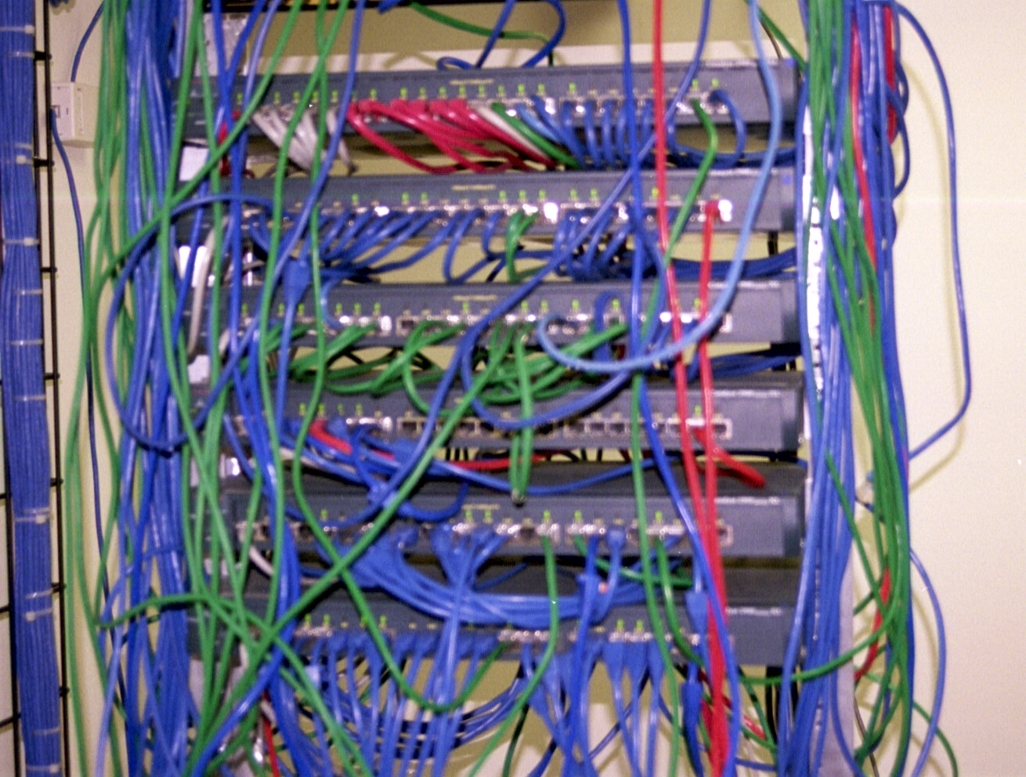
Switches in the Relay Rack

Slide 21
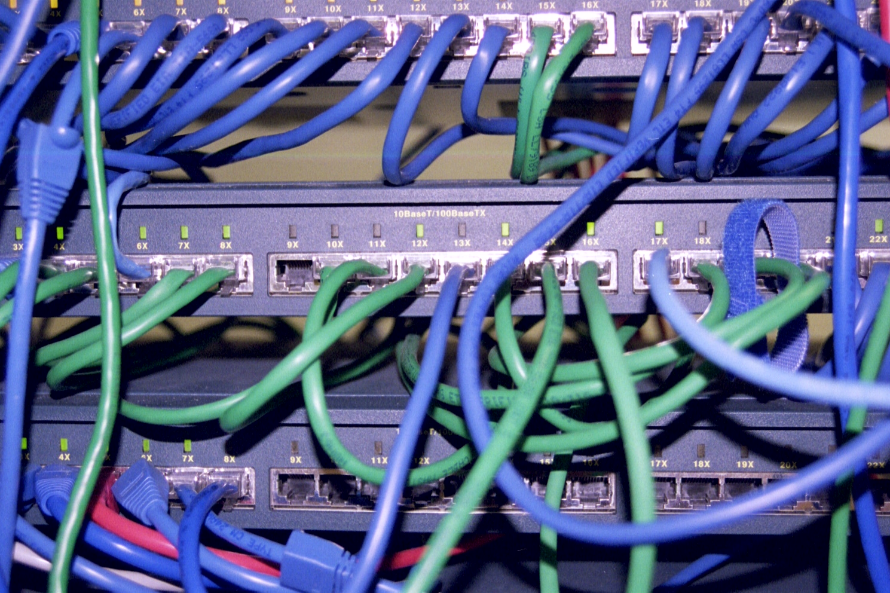
Switch Port for the PC

Slide 22
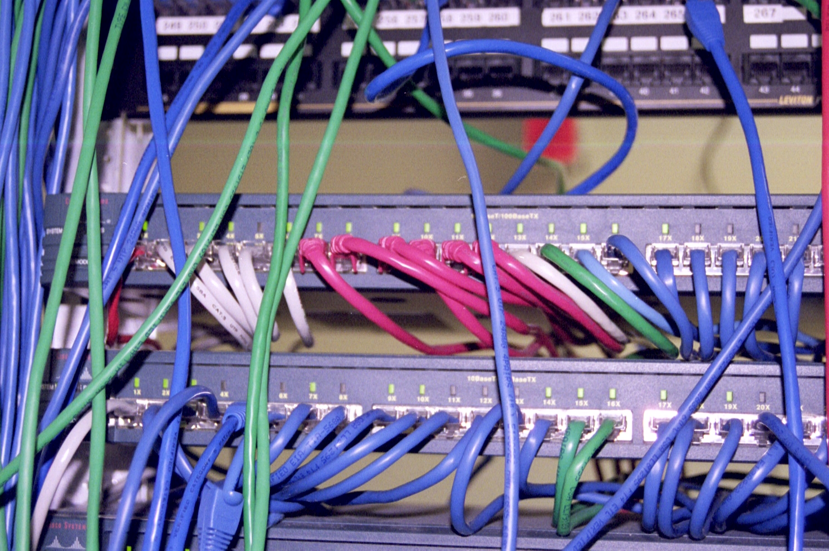
Switch Ports for LAN Equipment

Slide 23
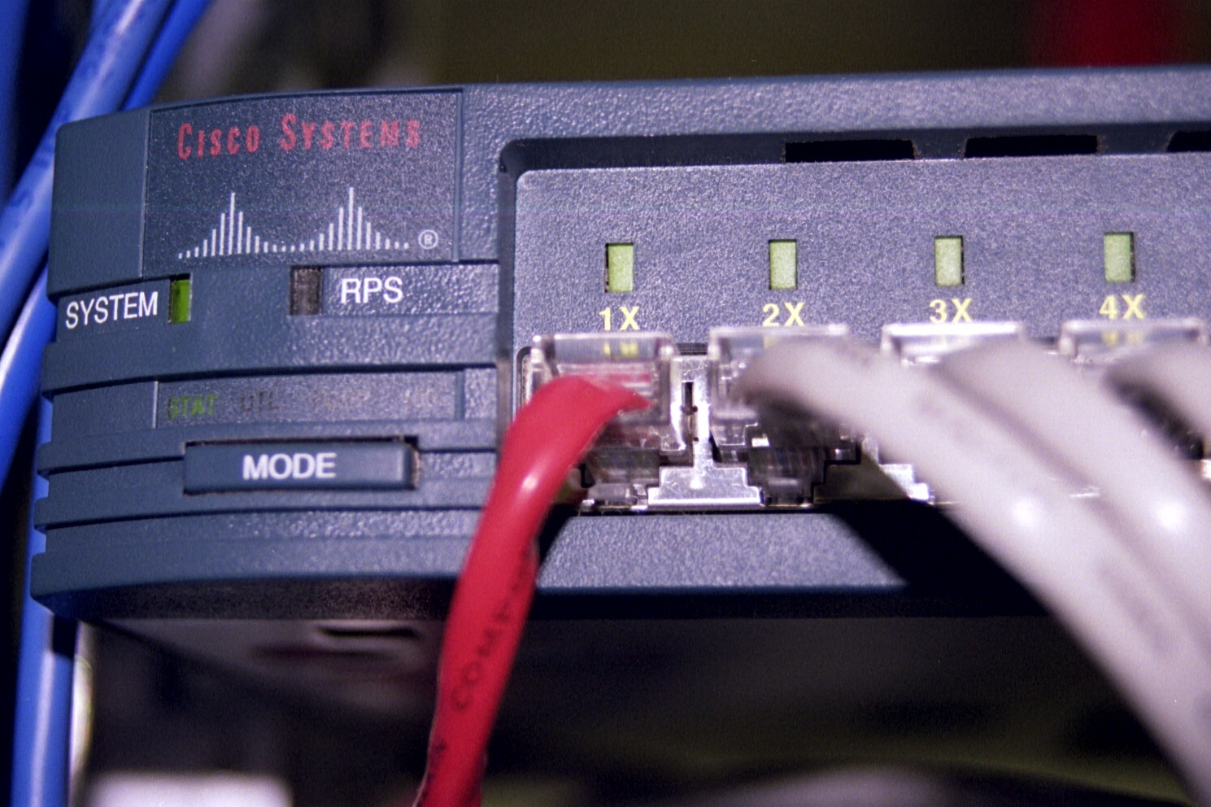
Server Port in the Switch

Slide 24
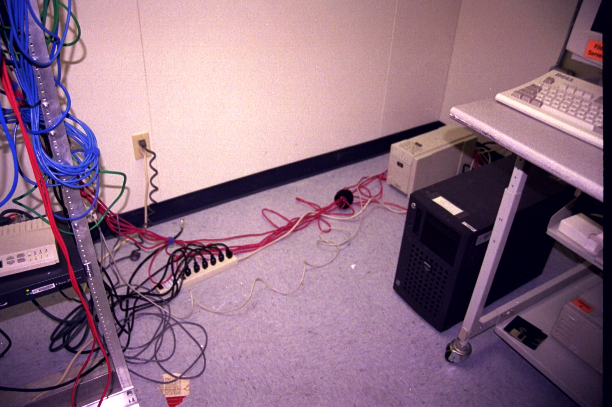
Patch Cord to Server

Slide 25
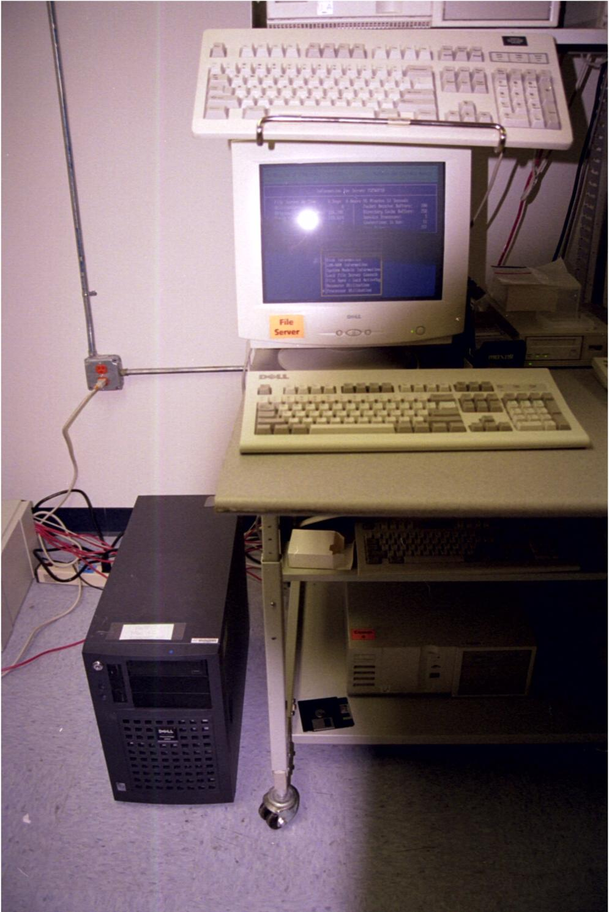
The Shared Server

Slide 26
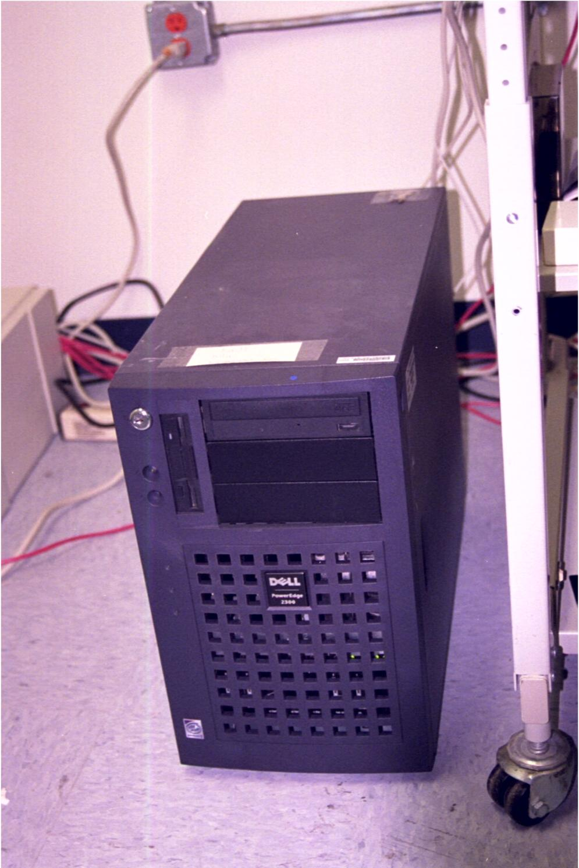
The Shared Server

Slide 27
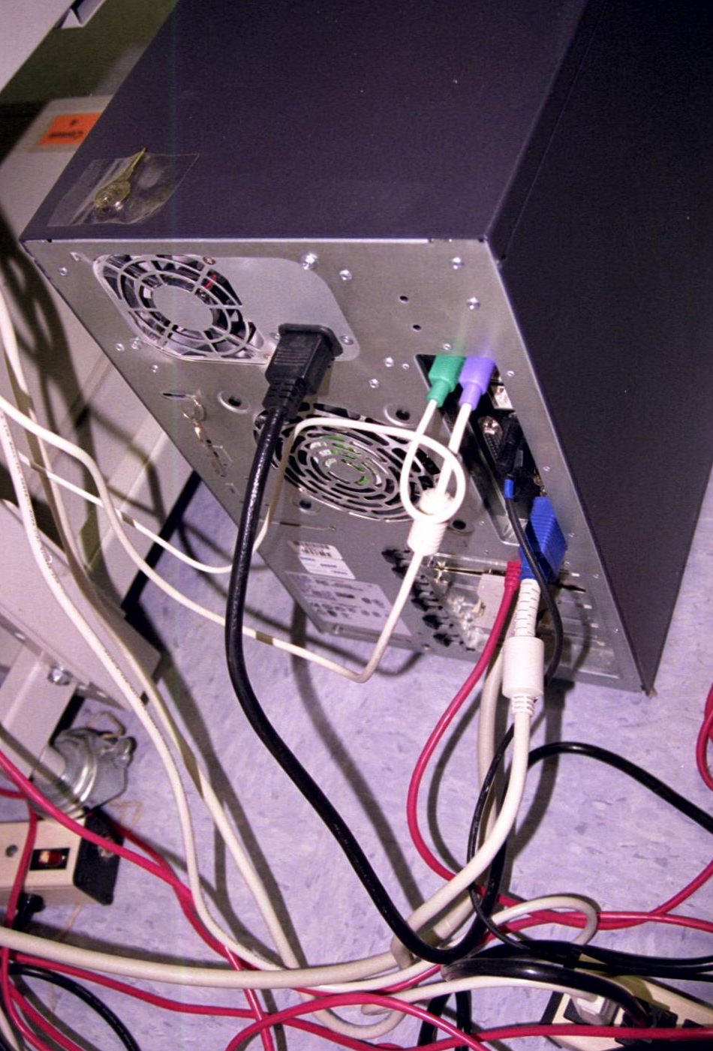
NIC in the Shared Server

Slide 28
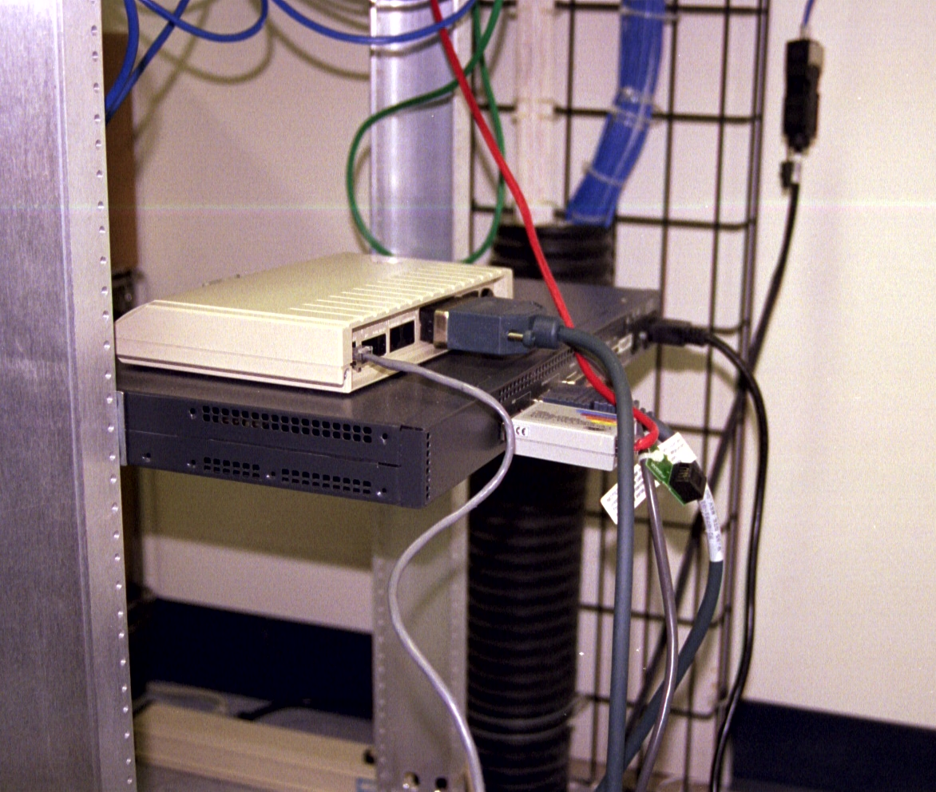
WAN Access Being Shared

Slide 29
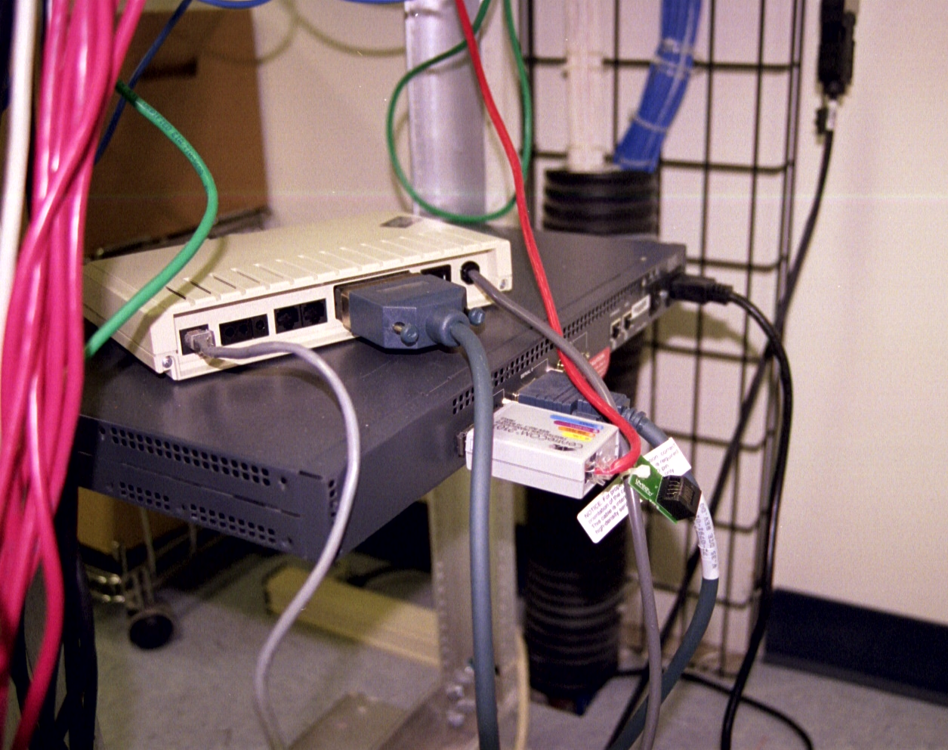
WAN Access Being Shared

Slide 30
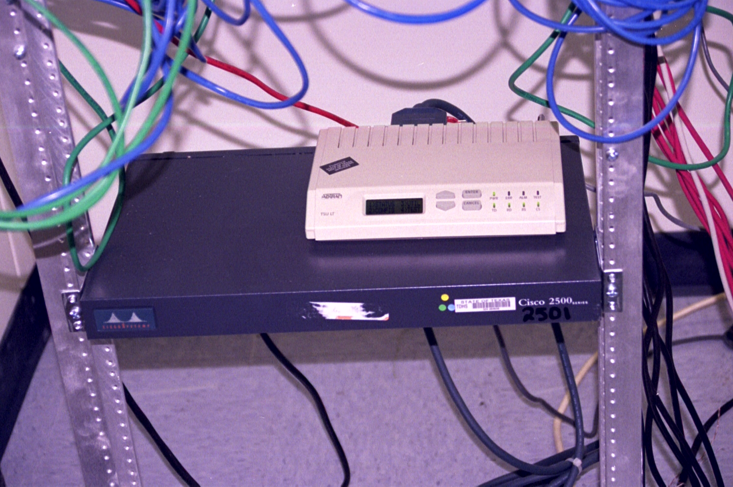
WAN Access Being Shared

