Slide 1
Host Addressing Last Update 2009.07.14 1.1.0

Slide 2
MAC Address
Each end device attached to a LAN and in fact each interface, in other words each NIC, of each end device attached to a LAN needs a name so that we and the network can tell them apart
This name is the MAC address
Media Access Control Address
These addresses are assigned by the card manufacturer as they produce the NIC

Slide 3
MAC Address
The address is made up of six hex numbers
The address is in two parts
The first part is a code for the manufacturer
The code is assigned by the IEEE
It is called an OUI – Organizationally Unique Identifier
This is the first three hex numbers
The second part is a number assigned by the manufacturer

Slide 4
MAC Address
The address is burned into the card on a chip
To see this address on a Windows computer, from the command prompt type
ipconfig /all
This shows

Slide 5
MAC Address
C:\>ipconfig /all Windows IP Configuration Host Name . . . . . . . . . . . . : home Primary Dns Suffix . . . . . . . : Node Type . . . . . . . . . . . . : Unknown IP Routing Enabled. . . . . . . . : No WINS Proxy Enabled. . . . . . . . : No Ethernet adapter Local Area Connection: Connection-specific DNS Suffix . : Description . . . . . . . . . . . : SiS 900-Based PCI Fast Ethernet Adapter Physical Address. . . . . . . . . : 00-E0-06-09-55-66 Dhcp Enabled. . . . . . . . . . . : No IP Address. . . . . . . . . . . . : 192.168.1.3 Subnet Mask . . . . . . . . . . . : 255.255.255.0 Default Gateway . . . . . . . . . : 192.168.1.1 DNS Servers . . . . . . . . . . . : 209.246.139.252 206.168.213.252

Slide 6
MAC Address
In this example the manufacturer code is
00-E0-06
The manufacturer’s tracking number is
09-55-66

Slide 7
Mapping Addresses
In an internetwork packets are routed between networks, not hosts
But once the final destination layer 3 device is reached, the packet must be converted to a frame and delivered to the host on the network for which it was originally intended

Slide 8
Mapping Addresses
How does the layer 3 device know what host on the network has the final destination IP address
It does not know, it must discover this using ARP – Address Resolution Protocol

Slide 9
ARP
Why is ARP required
Why not just use the MAC address in the IP address field
Several reasons
MAC addresses are 6 hex numbers or 48 bits long
IP addresses are 32 bits long including the network portion
The host only 48 bits of a MAC address will not fit

Slide 10
ARP
Second, it is easy to change the MAC address of a host by replacing the NIC card
Third, resolution must be done without recompiling code or maintaining a huge database
Lastly, MAC addresses, although centrally assigned at least in part, are not hierarchical
So name resolution is required

Slide 11
ARP
ARP does this by sending out a special broadcast packet that asks for the device with the IP address in question to respond back with its MAC address
All hosts on the LAN receive this packet, but only the host with that IP address responds back
Could not the layer 3 device just broadcast each frame each time

Slide 12
ARP
The destination host would be sure to hear it
But this would be very wasteful of bandwidth and host processing time
So the broadcast answer is used to make an entry in a cache table
The next time a packet arrives for a host the layer 3 device first looks in the cache table for the MAC address

Slide 13
ARP
Only if the address is not found, does it again use a broadcast
Addresses usually last 2 minutes in Windows to 10 minutes on many servers to 4 hours on some routers before being purged

Slide 14
ARP
An example
Who can I see
Who are they
Where are they

Slide 15
ARP
C:\>arp -a
Interface: 168.35.71.148 on Interface 0x2000002
Internet Address Physical Address Type
168.35.71.1 00-00-0c-31-ae-f1 dynamic
168.35.71.14 00-a0-c9-d6-19-75 dynamic

Slide 16
ARP
Who might these two be

Slide 17
ARP
C:\>ipconfig
Windows 98 IP Configuration
0 Ethernet adapter :
IP Address. . . . . . . . . : 168.35.71.148
Subnet Mask . . . . . . . . : 255.255.255.0
Default Gateway . . . . . . : 168.35.71.1

Slide 18
ARP
So, what is 168.35.71.1
The router, since it’s the gateway device
Without leaving my chair, who made the router
How do I know this

Slide 19
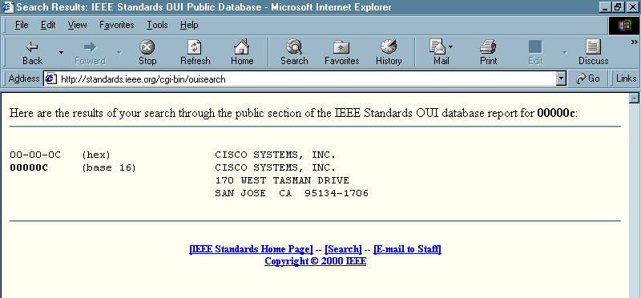
ARP

Slide 20
ARP
What’s the other host
Who made it

Slide 21
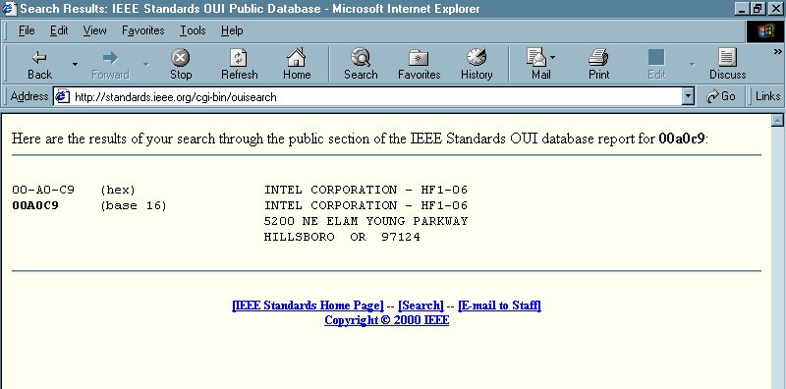
ARP

Slide 22
ARP
That did not tell us much
How about where is it

Slide 23
ARP
C:\>tracert 168.35.71.14
Tracing route to dalmis03.dhs.state.tx.us [168.35.71.14]
over a maximum of 30 hops:
1 <10 ms <10 ms <10 ms dalmis03.dhs.state.tx.us [168.35.71.14]
Trace complete.

Slide 24
ARP
It is in the same building with me
It is controlled by the State of Texas
What could this be

Slide 25
ARP
What else can ARP do
Displays and modifies the IP-to-Physical address translation tables used by address resolution protocol (ARP).
ARP -s inet_addr eth_addr [if_addr]
ARP -d inet_addr [if_addr]
ARP -a [inet_addr] [-N if_addr]
-a Displays current ARP entries by interrogating the current
protocol data. If inet_addr is specified, the IP and Physical
addresses for only the specified computer are displayed. If
more than one network interface uses ARP, entries for each ARP
table are displayed.
-g Same as -a.
inet_addr Specifies an internet address.
-N if_addr Displays the ARP entries for the network interface specified
by if_addr.
-d Deletes the host specified by inet_addr.
-s Adds the host and associates the Internet address inet_addr
with the Physical address eth_addr. The Physical address is
given as 6 hexadecimal bytes separated by hyphens. The entry
is permanent.
eth_addr Specifies a physical address.
if_addr If present, this specifies the Internet address of the
interface whose address translation table should be modified.
If not present, the first applicable interface will be used.
Example:
> arp -s 157.55.85.212 00-aa-00-62-c6-09 .... Adds a static entry.
> arp -a .... Displays the arp table.

Slide 26
ARP
In addition to the above each sender of an ARP broadcast includes its own IP to MAC address information
Receiving hosts then add this to their own ARP caches
This allows them to communicate to this host without a broadcast
How do hosts know that a frame contains an ARP broadcast

Slide 27
ARP
They can look in the type field of the frame that carries the ARP message in its data portion
If the type code is 0806, then they know the data in the frame is an ARP message

Slide 28
ARP
There are two special cases of ARP that are required
Proxy ARP
Gratuitous ARP

Slide 29
Proxy ARP
Proxy ARP
This is required when a device must respond to another device’s ARP requests, when that other device is behind it
An example of this is a remote dial-in client that receives a frame at a router
The router must ask who has this IP address, but the remote host – who may be miles away – will not hear this request since it is on the other side of a RAS box

Slide 30
Proxy ARP
In this case the RAS box answers for the remote dial in host

Slide 31
Gratuitous ARP
Gratuitous ARP
This is where a device broadcasts its own MAC and IP addresses just so other devices on the network will place the entry in their ARP cache
Servers that communicate with many different clients frequently do these to save time and bandwidth

Slide 32
Let’s Look at ARP in Operation
Type
arp –a
This is who I know about

Slide 33
ARP in Operation

Slide 34
ARP in Operation
Who are these devices
192.168.1.6 is a printer
The printer is doing a gratuitous arp
192.168.1.11 is the default gateway
This is the door that leads out of the LAN
In other words, the layer 3 device
192.168.1.255 is the LANs broadcast address
224.x.x.x these are multicast addresses on the LAN

