Slide 1
Frames Seen On Local Area Networks
Last Update 2012.04.17
1.0.0

Slide 2
Objectives
See and examine the traffic typically seen at each stage of the operation of a local area network

Slide 3
Frames Seen on Networks
The are many easily recognized frames seen traveling around local area networks
There are also some strange ones most people just ignore
In this presentation we will examine in detail both types

Slide 4
Frames Seen on Networks
After all how do you know if a network is well or sick if you do not know what it should look like when it is operating normally

Slide 5
Switch Only
In this first example we will look at the traffic seen on a network when the only device is the switch itself
In this example a Cisco 2950 switch will be used
The switch configuration is the default for the device
One PC running Windows 7 64 bit was attached to fa0/1

Slide 6
Switch Only
Then the captured frames were filtered to show only those that emanated from the switch
What do we see

Slide 7
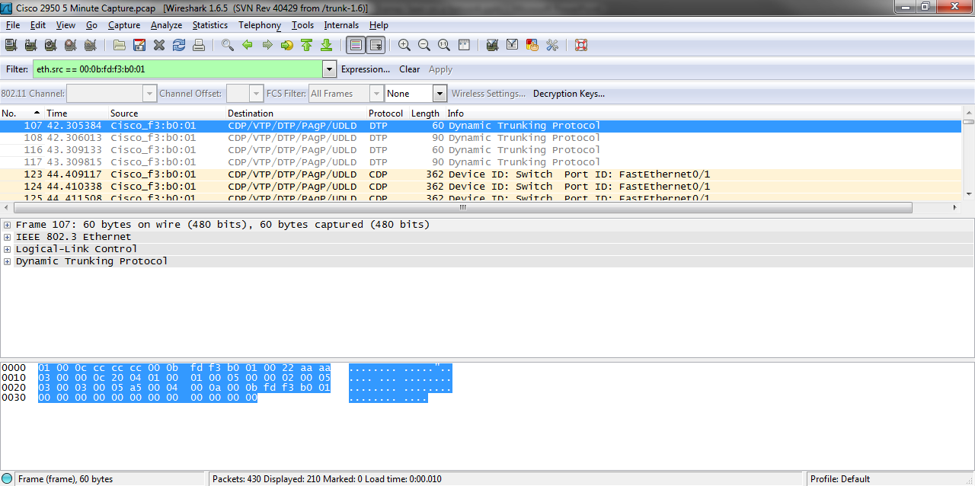
Switch Only

Slide 8
DTP
The first frame the switch sends out is one using DTP
Dynamic Trunking Protocol is a proprietary Cisco protocol that attempts to create a trunk link with a switch at the other end by using advertisements to contact the switch on the other end of the link, and auto-negotiate a switchport to either an access or trunk link

Slide 9
DTP
This is a normal frame for a Cisco switch

Slide 10
CDP
The next type of frame seen is a CDP – Cisco Discovery Protocol frame
CDP is used by Cisco devices to find each other
It also allows network management applications to discover Cisco devices
CDP sends periodic messages to a multicast address

Slide 11
CDP
Each device also listens to the messages sent by other devices to learn about neighboring devices
Here is an example of what it sends out
And then some of the detail

Slide 12
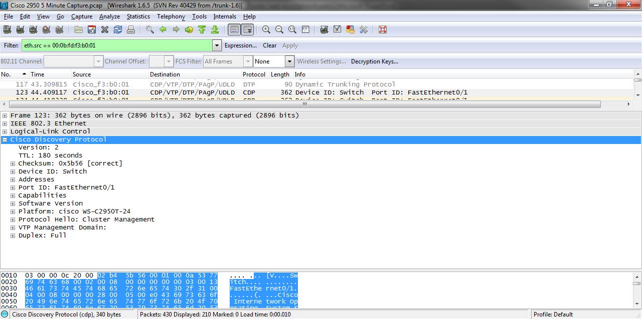
CDP

Slide 13
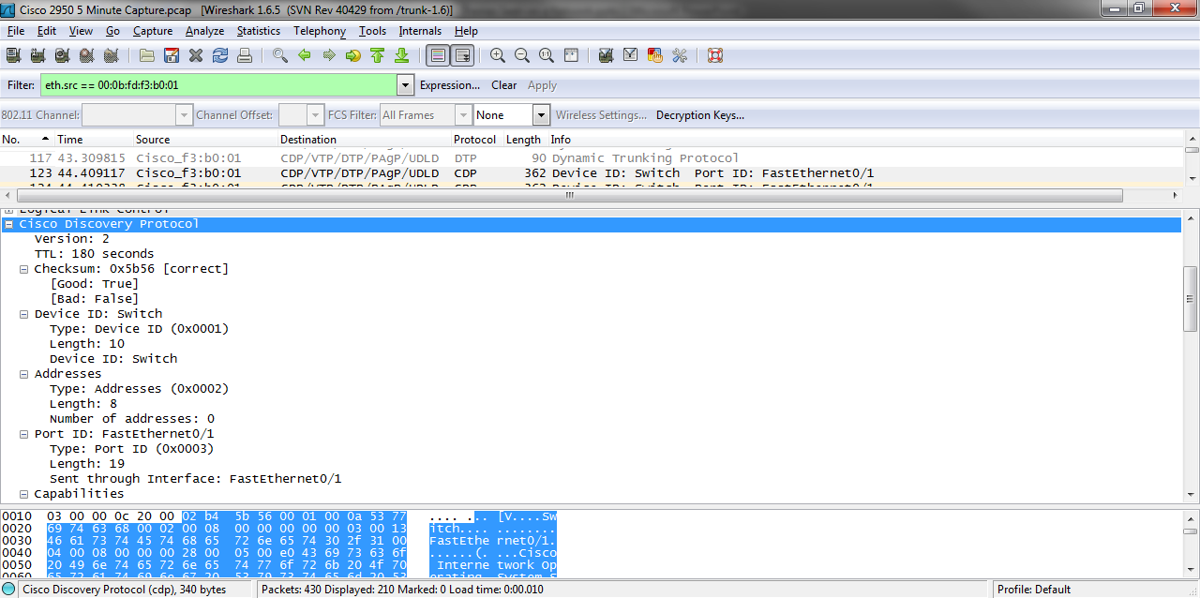
CDP

Slide 14
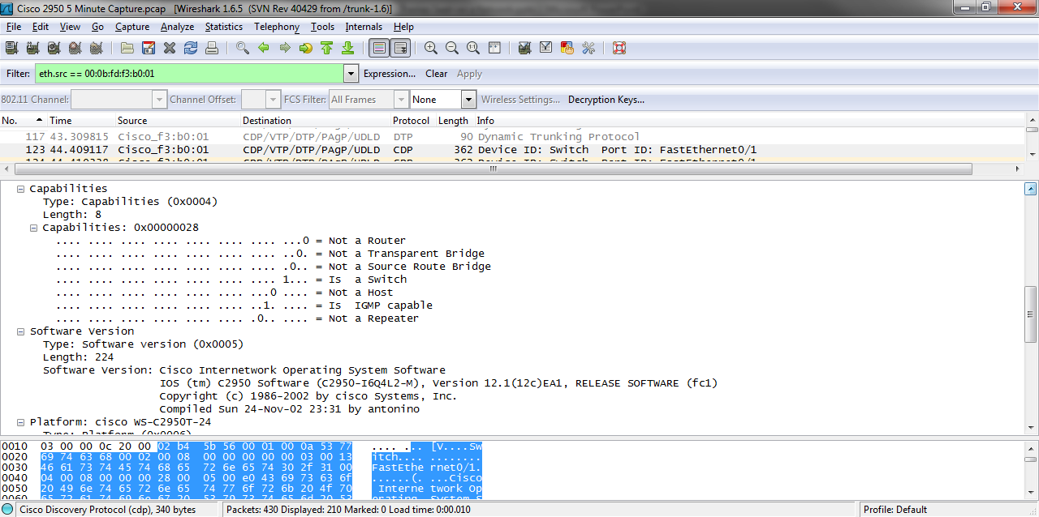
CDP

Slide 15
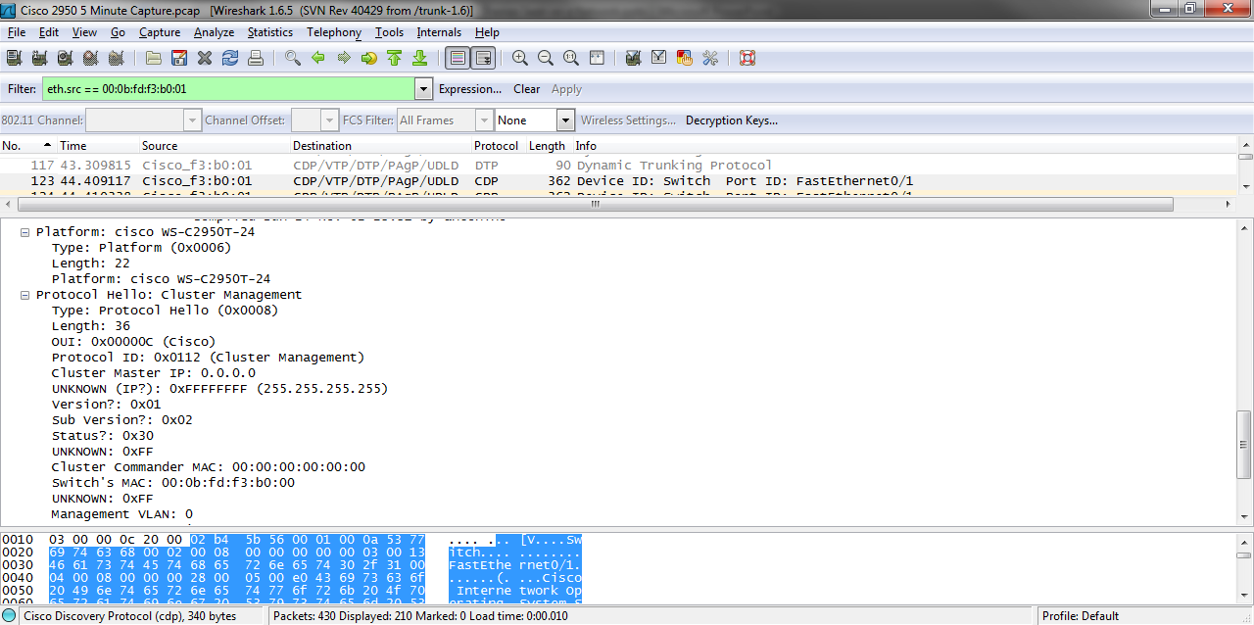
CDP

Slide 16
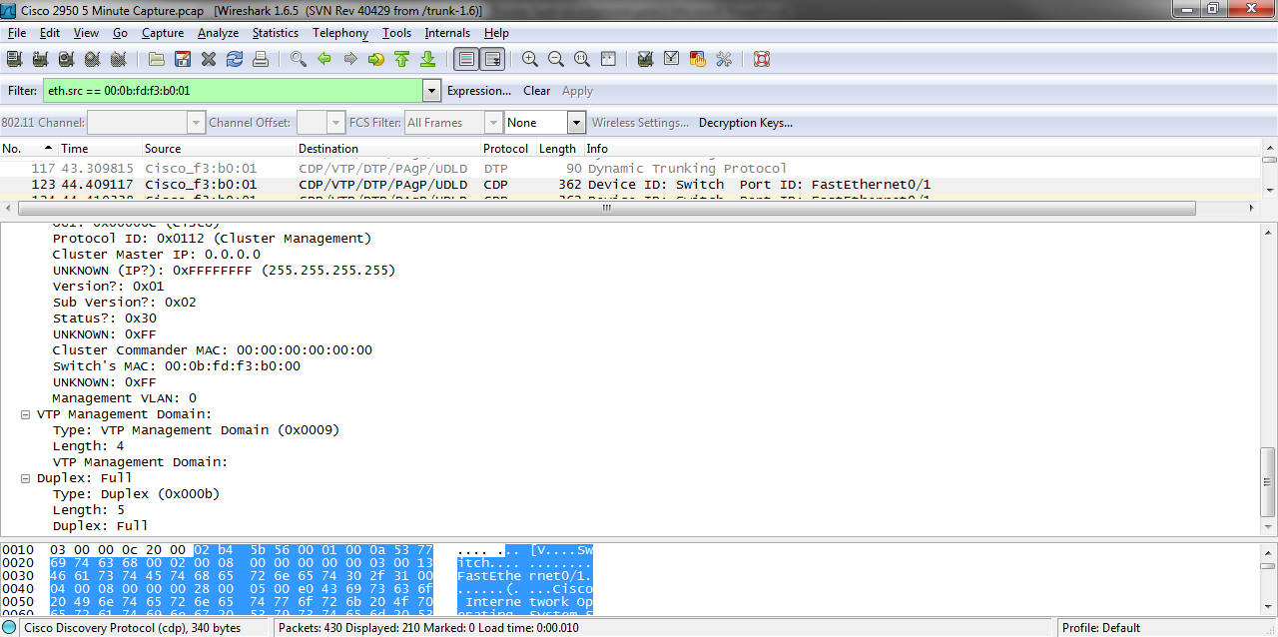
CDP

Slide 17
CDP
This is a normal frame for a Cisco switch

Slide 18
EAP
EAP – Extensible Authentication Protocol is used by the 802.1 standard to control access to a switch on a port basis
In this case the end device does not need to authenticate so it goes away
This is a normal frame for a Cisco switch

Slide 19
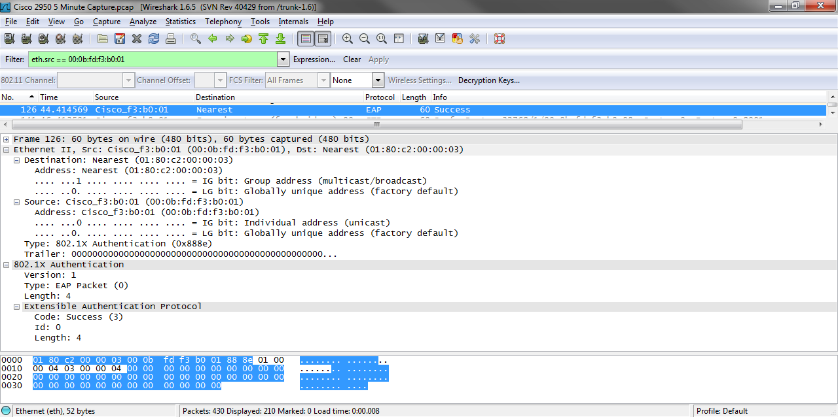
EAP

Slide 20
STP
Finally we get to a standard frame STP – Spanning Tree Protocol
802.1D is the IEEE specification for STP
STP creates a loop free path through the network by blocking unneeded ports from being used unless they are needed

Slide 21
STP
Even though Wireshark conveniently tells use this a STP frame it is really a Bridge Protocol Data Unit
The BPDU is the type of frame that tells a switch at the other end that it is talking to a switch, and therefore must speak STP in order to arrange for a loop free network
Let’s look at one

Slide 22
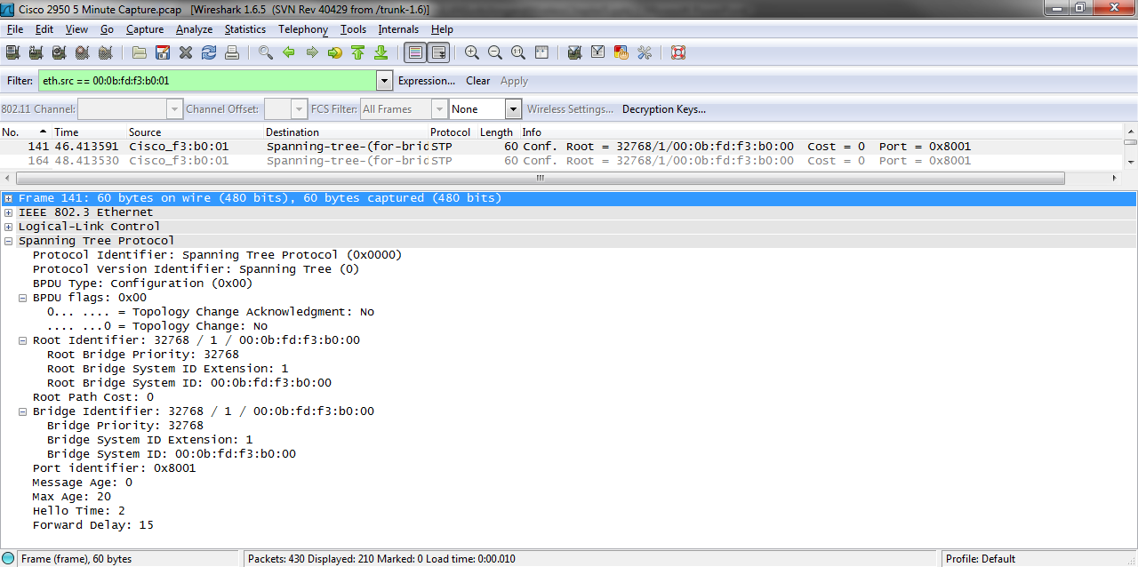
BPDU

Slide 23
STP
These are normal frames on any switch

Slide 24
Loop
The next frame seen is listed by Wireshark as a Loop
These are layer 2 keepalives used by the switch to see if the port should be placed in a line protocol down position
It does this when an interface misses three consecutive keepalives, the line protocol goes down

Slide 25
Loop
These go out every minute
Notice that the source and destination MAC addresses are the same
This is a normal frame for a Cisco switch

Slide 26
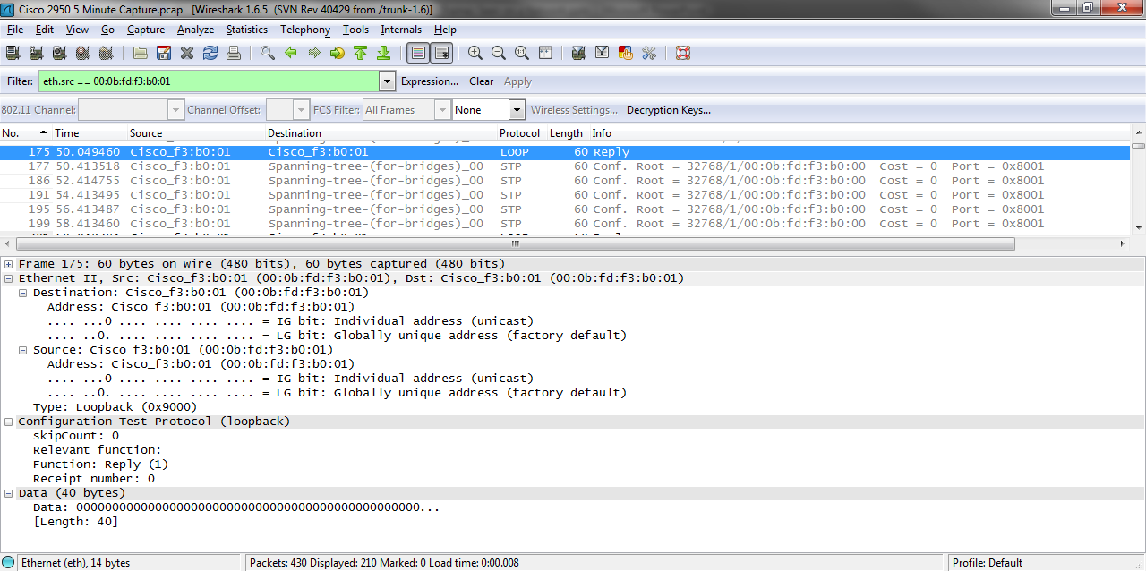
Loop

Slide 27
Frames on Cisco Switches
Notice that we have seen five different types of layer 2 frames generated by this switch
Of the five four are proprietary to Cisco
Only STP performs a standardized function

Slide 28
Frames on Cisco Switches
STP should be run on a switch by default even it is not needed just in case something other than an end device is plugged into one of the switch ports so there cannot be a loop in the network in that case

Slide 29
Frames on Cisco Switches
Modern switches produce a lot of unneeded traffic
This is one reason the broadcast domain will at some point need to be subdivided as the number of users on the LAN grows

Slide 30
Consumer Grade Switch
In comparison let’s look at a Cisco Linksys consumer grade switch
This is called a
Etherfast 10/100
5-Port Workgroup Switch
The Wireshark capture shows no traffic generated by the switch itself

Slide 31
Consumer Grade Switch
It does not look very switchy to me as there are not even any BPDUs flying around
What if we link this consumer grade switch to the Cisco 2950
The Cisco switch busily sends out BPDUs, but the Cisco Linksys switch still says nothing

Slide 32
Consumer Grade Switch
This is how loops and broadcast storms appear on a network

Slide 33
An Old Hub
Let’s try a genuine hub
The result is as expected
The hub as was the case with the consumer grade switch generates no traffic

Slide 34
DLink Non-Consumer Switch
How about one in between
A DLink CGS-1224T Web Smart Switch appears to be a real switch that could be used in a production environment
But Wireshark shows that nothing emanates from this switch
Not even BPDUs

Slide 35
DLink Non-Consumer Switch
The manual for the switch says
By default, Spanning Tree is disabled
If enabled, the Switch will listen for BPDU packets and its accompanying Hello packet
BPDU packets are sent even if a BPDU packet was not received

Slide 36
2950 to 2950
Finally let’s look at two Cisco 2950s uplinked to each other
The capture is done by plugging the cable for the NIC Wireshark is capturing to one 2950 and then to the other 2950
As expected from a proper switch we see BPDUs from both switches by default

Slide 37
When is a Switch Not a Switch
As we have seen sometimes what appears to be a switch is not a switch as we would understand such a thing
One must be careful about what one places on a network

Slide 38
Switch With One Device
As we have seen leaving out all of the proprietary Cisco layer 2 traffic leaves us with only BPDUs on a properly configured switch
So the normal traffic one would expect to see on a switch is just Spanning Tree Protocol frames
Let’s start adding devices to see if any additional traffic appears

Slide 39
Switch With One Device
Now we will add a single PC
This is Windows 7 Ultimate 64 bit PC connected to a Cisco 2950 switch
In this example the NIC has been disabled
When enabled with the capture running we will see the traffic it generates as unicast, multicast, and broadcast traffic as well as the switch generated frames

Slide 40
Switch With One Device
The switch has been running for a minute or so
Here is what we see

Slide 41
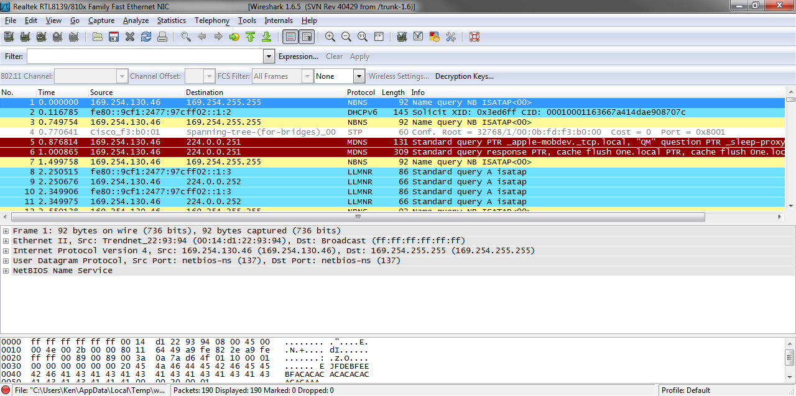
Switch With One Device

Slide 42
Switch With One Device
If we filter for just the traffic generated by the PC’s NIC we see

Slide 43
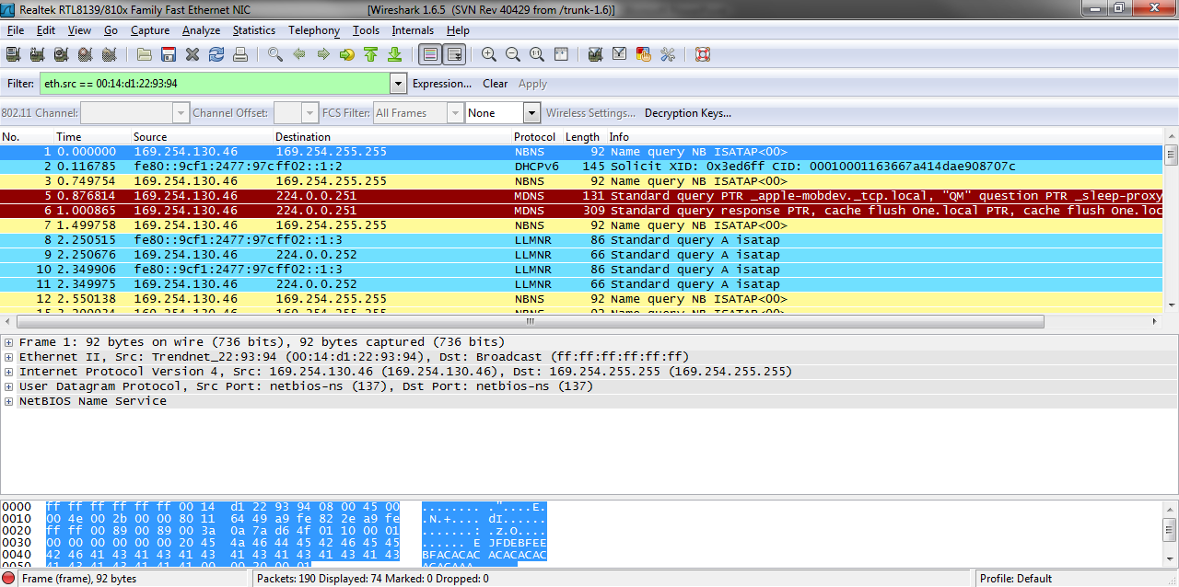
Switch With One Device

Slide 44
Switch With One Device
There is a lot more variety now
Let’s examine these new frame types from the top

Slide 45
NBNS
Ah, NBNS the NetBIOS service or in this case the NetBIOS over TCP/IP service that has never worked properly from the beginning of time to date
It is sadly normal on a network with Windows PCs on it

Slide 46
DHCPV6
DHCP is of course the Dynamic Host Configuration Protocol
V6 in this case is for IPv6
If no one is running IPv6 yet outside of backbone networks, why is this running on the network
Because since the Windows Vista days Microsoft has been running dual stacks by default

Slide 47
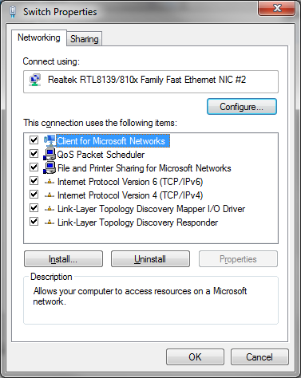
DHCPV6

Slide 48
DHCPV6
This is normal on a network with Windows PCs
Pointless at this point, but quite normal

Slide 49
MDNS
MDNS – Multicast Domain Name Service is a service that attempts to find services on the network it might use, such as another computer or a printer
In this case Microsoft is not responsible, but who is
Let’s examine the details shown next

Slide 50
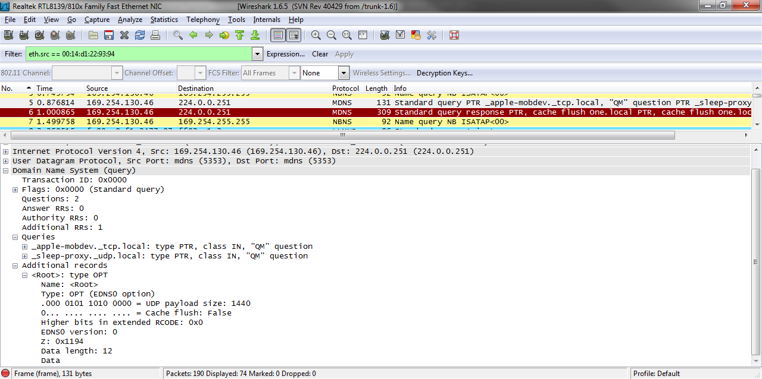
MDNS

Slide 51
MDNS
Ah, Apple is responsible
In this case it is iTunes used to talk to an iPhone about once a month
So why then is it talking all the time
Once must ask the application programmer that question
They care nothing about overhead on the network

Slide 52
MDNS
So this is normal and not normal depending on the software installed on the PC

Slide 53
LLMNR
Next is LLMNR – Link Local Multicast Name Resolution or as Microsoft explains
Link-local Multicast Name Resolution (LLMNR) is a new protocol that provides an additional method to resolve the names of neighboring computers
LLMNR is especially useful for networks that do not have a Domain Name System (DNS) server

Slide 54
LLMNR
LLMNR uses a simple exchange of request and reply messages to resolve computer names to Internet Protocol version 6 (IPv6) or IP version 4 (IPv4) addresses
IPv4 hosts can use NetBIOS over TCP/IP (NetBT) to resolve computer names to IPv4 addresses for neighboring hosts by broadcasting a NetBIOS Name Query Request message to the local subnet broadcast address

Slide 55
LLMNR
The node that owns the queried name sends back a unicast NetBIOS Name Query Response message to the requestor and the name is resolved
However, NetBT only works over IPv4, not IPv6

Slide 56
LLMNR
In other words this is another Microsoft protocol that is supposed to find resources on the network
It works no better than NetBIOS ever did
But it is quite normal on a network with PCs running Windows of some sort

Slide 57
DHCP
The last one we see is DHCP
This is used to receive an IP address from a DHCP server
In this case as there is no DHCP server on the network the NIC will eventually give up and assign itself an address from the Link Local set beginning with 169.254
In this case 169.254.130.46

Slide 58
DHCP
This is normal on almost any network unless the NIC has been given a static IP address assignment
If a DHCP server had been found, these frames would no longer be sent out once the address was received until time to renew the address lease

Slide 59
Switch With One Device
What then is normal when a device is added to a network
Nothing is really needed except the DHCP frames
Once the address is provided, these should cease

Slide 60
Switch With One Device
The others are just useless traffic generated by OSs that try to help, but do not and applications that do not know when to shut-up
Once again we see that the ideal traffic pattern after everything was configured would be to only see STP frames
But this never happens these days

Slide 61
Two Devices
Let’s give the PC someone to talk to by adding another one to the network
This PC is also running Windows 7 Ultimate 64 bit, but it has a static IP address
What new pops up

Slide 62
ARP
As we recall a local area network only operates at layers 1 and 2
What if a device has a layer 3 IP address it wants to use on the LAN
It must discover the MAC address associated with that IP address
This discovery is done by ARP – Address Resolution Protocol

Slide 63
ARP
What is ARP doing here
Several things
First, the PC that assigned itself the IP address of 169.254.130.46 wants to be sure this new network member is not using it so it asks who has IP address 169.254.130.46 several times
As no one else does it eventually stops

Slide 64
ARP
The new PC is using ARP to find its little lost printer
It has been told that a printer it can use has the IP address of 192.168.1.6
But it cannot find it
So it asks over and over for the MAC address of this printer
As the printer is not yet attached to the network, it never answers

Slide 65
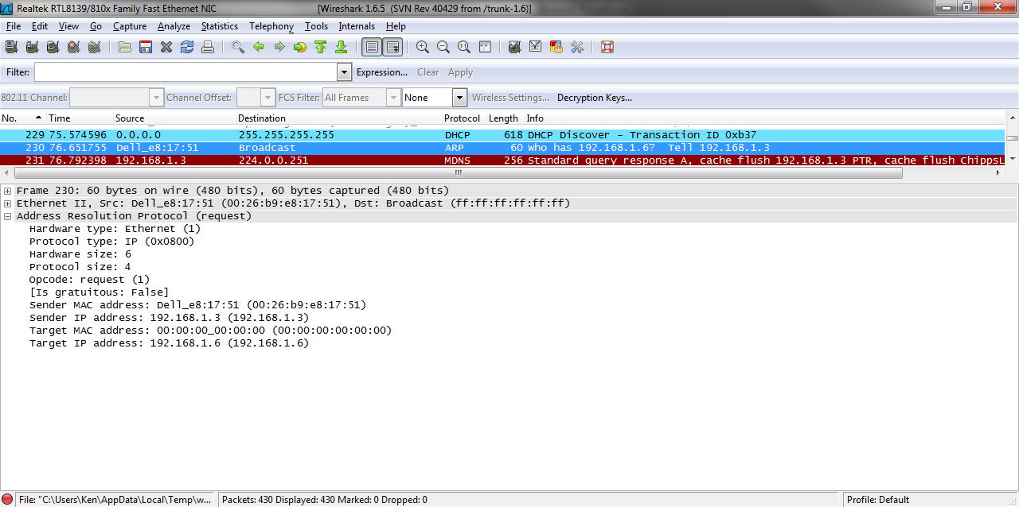
ARP

Slide 66
ICMPV6
Next that appears are several ICMP V6 frames
These are Internet Control Message Protocol frames used by IPv6 to self configure
As IPv6 is not running on this network, no one answers

Slide 67
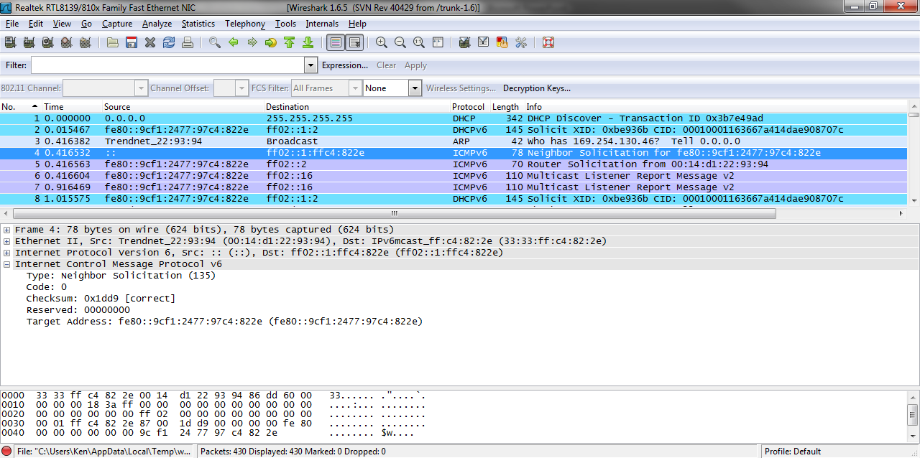
ICMPV6

Slide 68
IGMP
IGMP – Internet Group Management Protocol is used to provide a way for computers on a network to report multicast group membership to a router on the same network
As there is no multicast going on here these frames are doing nothing in this case
Here is one of them

Slide 69
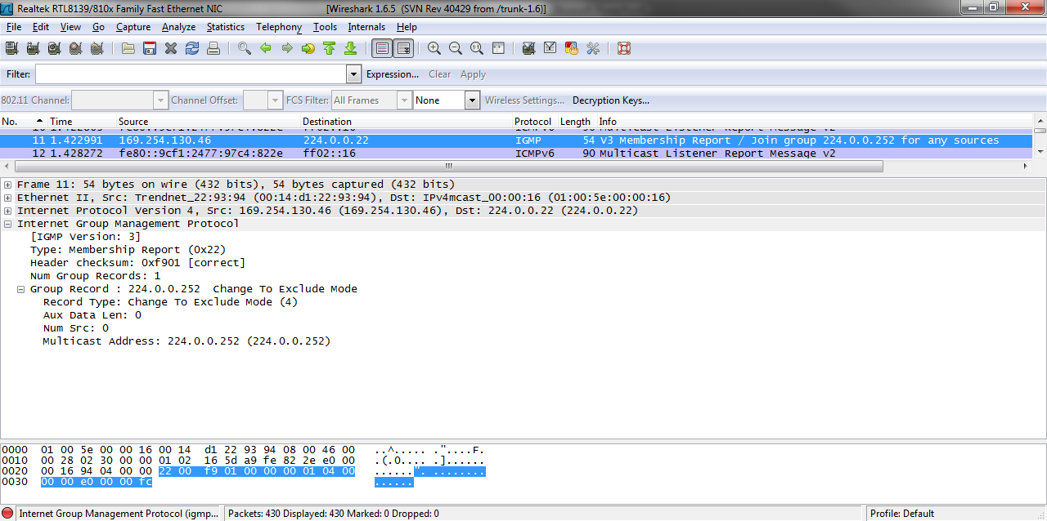
IGMP

Slide 70
BROWSER
We come back to Windows traffic when we encounter a Browser frame
This is the Windows Workgroup I am in charge, no I am in charge, no I am in charge, oh never mind since it never works anyway argument
As you can see, these frames are quite lengthy

Slide 71
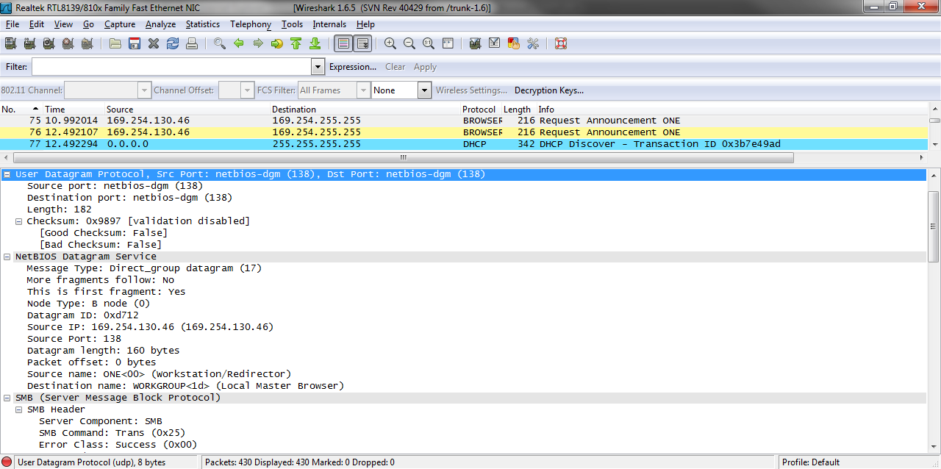
BROWSER

Slide 72
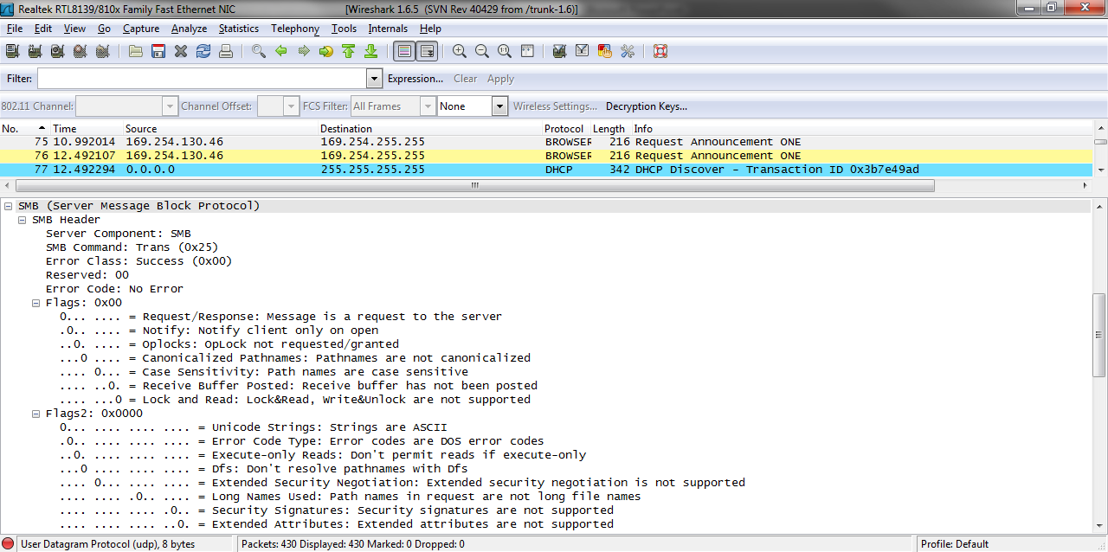
BROWSER

Slide 73
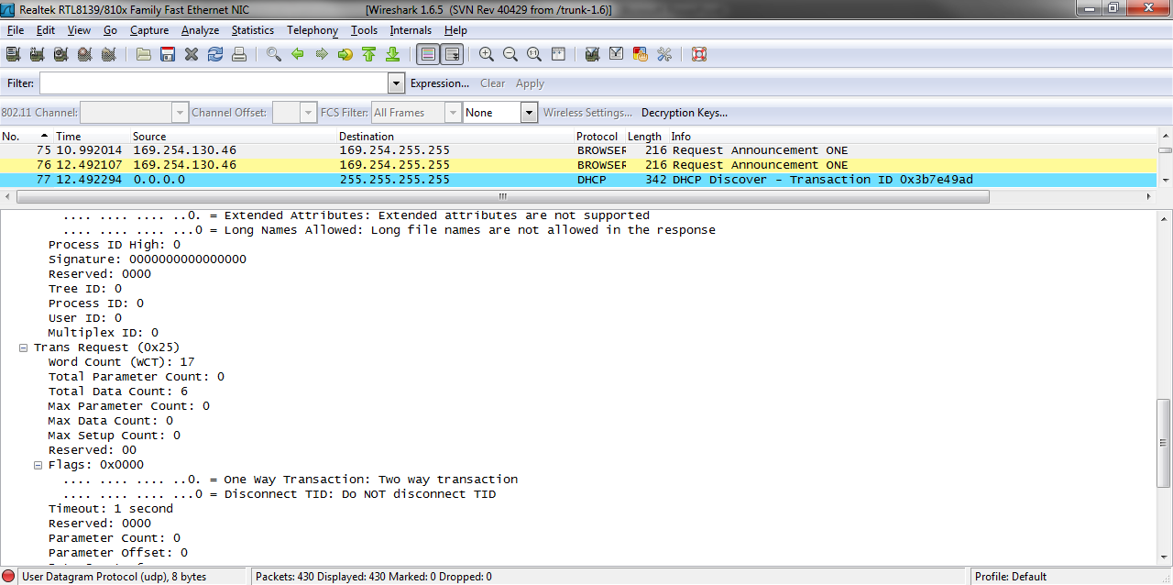
BROWSER

Slide 74
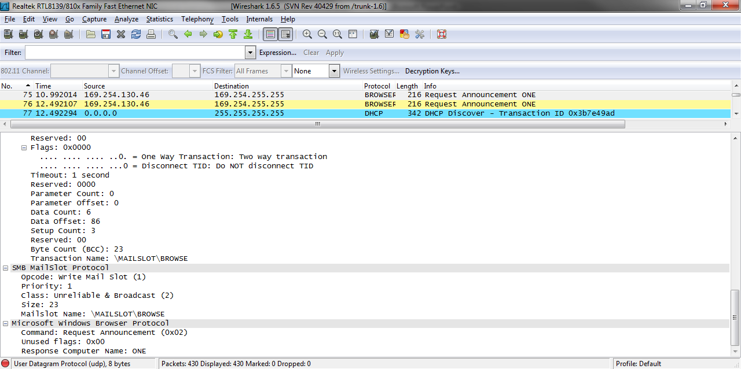
BROWSER

Slide 75
BROWSER
On a network with Windows PCs this is normal traffic

Slide 76
UDP
The last one is named UDP or User Datagram Protocol
One would think that UDP being a Transport layer protocol something next appear at the Application layer
It does not in this case
There is nothing else
See

Slide 77
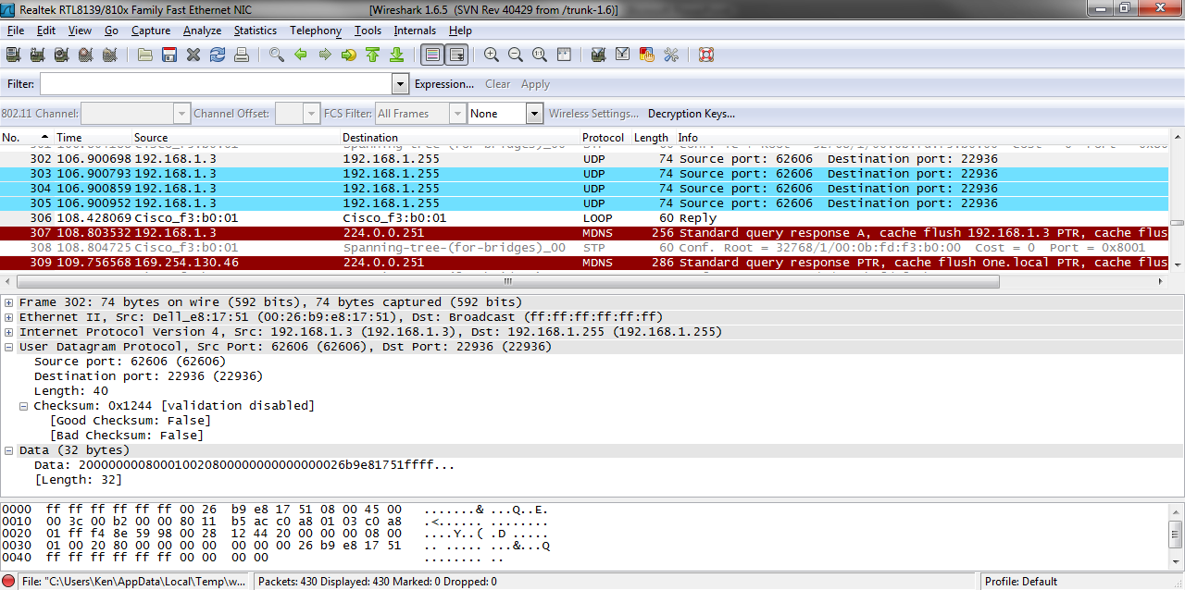
UDP

Slide 78
UDP
The clue in this case is the destination port being used by UDP, 22936
A little research reveals that this the configuration program for a NAS box looking for that NAS box
As the box is not attached the network, this search is in vain
It is just more junk using up network bandwidth

Slide 79
A Printer
Recall that the second PC was looking for a printer
Let’s add it to the network
As before the PC is looking for the printer at IP address 192.168.1.6

Slide 80
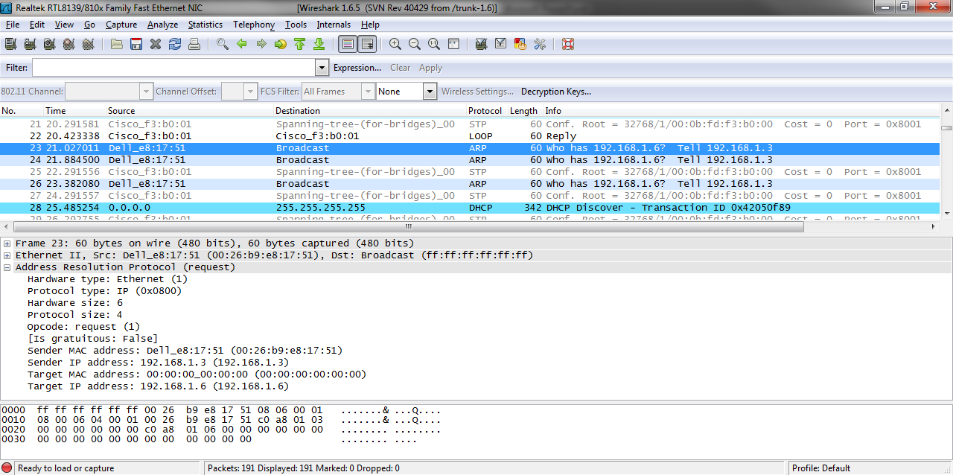
A Printer

Slide 81
A Printer
The printer answers as we can see in the ARP table
Its MAC address is 00:23:7D:8E:1D:50
The OUI of 00:23:7D tells us this is an HP device
As the printer is an HP printer the PC is happy it has found its device

Slide 82
A Printer
The printer is the best mannered device on the network
It does not add any traffic to the network

Slide 83
Summary
As we can see Cisco devices and PCs using the Windows OSs add a lot of overhead to the network
Whereas nice devices like the HP printer stay quiet
To know if your network is working correctly you must first know what it looks like when it is well
Then problems are easier to find

