Slide 1
Ethernet Last Update 2013.05.01 1.6.0

Slide 2
What is Ethernet
Ethernet is the most common network access method in use today
It will most likely rule the world from end to end in the next few years in one form or another

Slide 3
Development
Ethernet was started in the early 70s by Bob Metcalfe and David Boggs at the Xerox Palo Alto Research Center
Its official birthdate is May 22 1973 according to Metcalfe
It was patented in 1977 by Xerox
The first effort at standardizing it was in 1980 by DEC/Intel/Xerox

Slide 4
Development
In 1983 the IEEE released the 802.3 standard, which is the standard for Ethernet networks today

Slide 5
IEEE Ethernet Naming Rules

Slide 6
Ethernet and the OSI Model

Slide 7
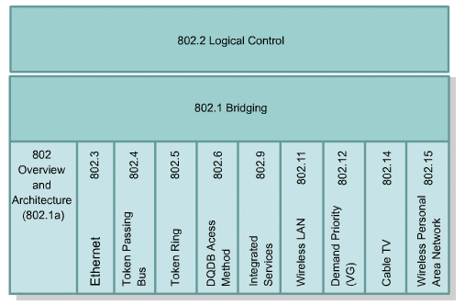
Ethernet and the OSI Model

Slide 8
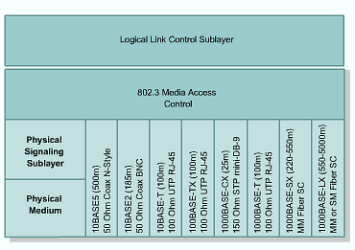
Ethernet and the OSI Model

Slide 9
How It Works
There are two forms of transmission in an Ethernet network
Half Duplex
The first and traditional form
Full Duplex
The newer and faster version

Slide 10
Half Duplex
Each network device has something that acts like a NIC – Network Interface Card
A NIC puts information onto the network and takes it off the network
Each NIC has an address burned into it
This is the MAC address

Slide 11
Half Duplex
Ethernet works by transmitting a frame out onto the network media, usually a copper cable, which in half duplex mode is shared by all devices on the network
Every device on the network copies this frame into their NIC’s buffer space
Each device then checks to see if the frame’s destination address is its MAC address

Slide 12
Half Duplex
If it is, it takes the frame in
If it is not, it discards it
But before any station can access the network in order to place a frame on the network it must follow the rules of CSMA/CD

Slide 13
Half Duplex
CSMA/CD - Carrier Sense Multiple Access/ Collision Detection is how half duplex Ethernet networks decide who gets first crack at this shared network that only one of them can use at a time
I’ll explain this with an example
Recall that a basic network consists of a NIC, a cable, a hub, another cable, and another NIC

Slide 14
Half Duplex
One NIC is in a device that needs to send something to the device with the other NIC
Let’s take this example and apply it to two classrooms

Slide 15
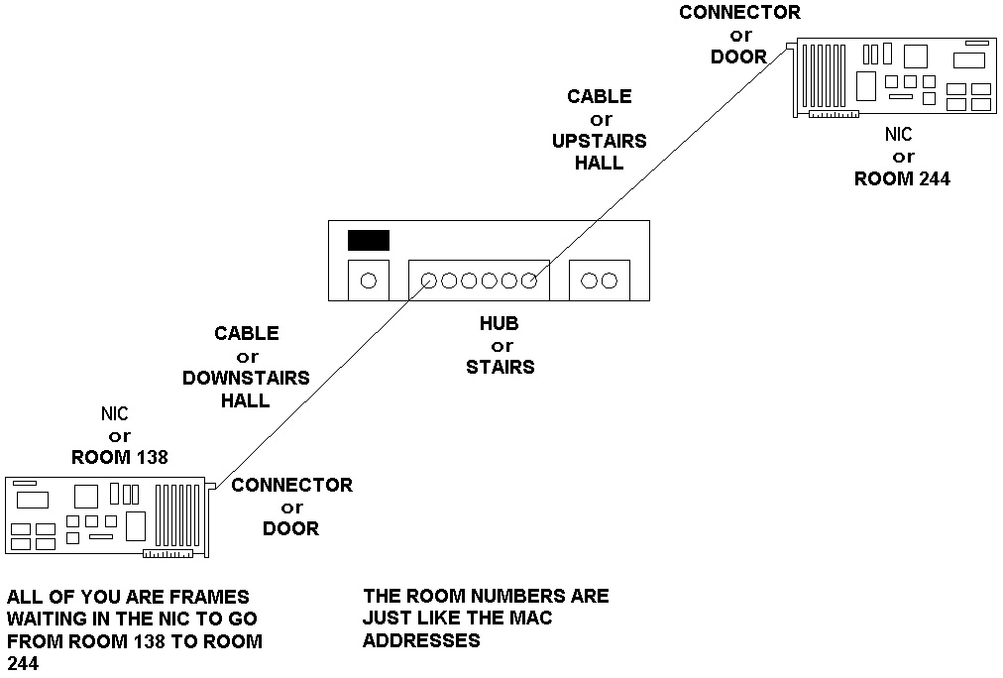
Half Duplex Ethernet Operation

Slide 16
Half Duplex Ethernet Operation
Carrier Sense means before a station talks, it listens for the carrier signal generated when another station is talking
If another station is talking, this station will wait until there is no carrier present, in other words when no one else is talking

Slide 17
Half Duplex Ethernet Operation
Multiple Access refers to the fact that when a station is done transmitting it is allowed to immediately transmit again or another station may access the network
Turns do not have to be taken
Everyone has an equal chance to transmit

Slide 18
Half Duplex Ethernet Operation
Collision Detection is the ability of an adapter to detect the collision of electrical signals that will result if two stations do start transmitting at the same instant
In a normally operating Ethernet network, sometimes two stations simultaneously detect no carrier and begin to talk
The two electrical signals will interfere with each other and result in a collision

Slide 19
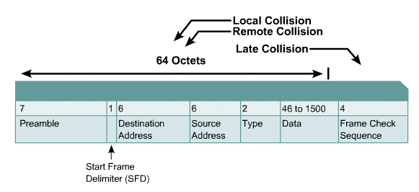
Types of Collisions

Slide 20
Types of Collisions

Slide 21
Half Duplex Ethernet Rules
The network is monitored for a carrier, or presence of a transmitting station – carrier sense
If an active carrier is detected, then transmission is deferred
The station continues to monitor the network until the carrier ceases

Slide 22
Half Duplex Ethernet Rules
If an active carrier is not detected, and the period of no carrier is equal to or greater than the interframe gap, then the station immediately begins transmission of the frame

Slide 23
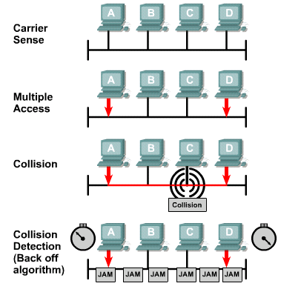
Collision Detection/Backoff

Slide 24
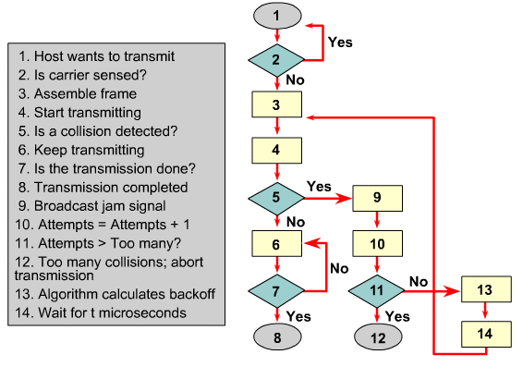
Collision Detection/Backoff

Slide 25
Half Duplex Ethernet Rules
While the transmitting station is sending the frame, it monitors the medium for a collision
If a collision is detected, the first transmitting station that detects the collision stops sending the frame data and sends a 32-bit jam sequence

Slide 26
Half Duplex Ethernet Rules
After sending the jam sequence the transmitting station waits a random period of time chosen using a random number generator before starting the transmission process over from the first step above

Slide 27
Interframe Spacing and Backoff

Slide 28
Interframe Spacing and Backoff

Slide 29
Jam Signal Specifics
As discussed above, when a collision is detected by a node, it immediately transmits a jam signal to ensure the other nodes on the shared network are aware of the problem
The problem is the frames sent out are now too damaged by the collision to be trusted
They must be ignored

Slide 30
Jam Signal Specifics
Specifically when a transmitter detects a collision, the transmitter continues to send the preamble - if the preamble has not completed - and it also sends 32 additional bits, which are called a jam signal
The jam signal extends the duration of the collision event to ensure that all stations hear about the collision

Slide 31
Jam Signal Specifics
The contents of the jam signal can be any pattern that is not intentionally designed to be the 32-bit CRC value corresponding to the partial frame already transmitted
Most implementations send all ones

Slide 32
Jam Signal Specifics
Completely sending the preamble and transmitting a jam signal guarantees that a signal stays on the media long enough for all transmitting stations involved in the collision to recognize the collision and react accordingly

Slide 33
Error Handling

Slide 34
Collision Domain
All stations that share a media are said to be in the same collision domain
This means that they must cooperate in sending messages over the media using the rules described above
Too many stations attempting to use the same media slows or stops the network
Layer 2 switches are used to breakup collision domains

Slide 35
Broadcast Domain
Another domain of importance in an Ethernet network is the broadcast domain
One way of looking at a broadcast domain in a half duplex Ethernet network is that information is sent by broadcasting it to all stations on the shared media

Slide 36
Broadcast Domain
That is once a station has access to the network even though it knows what station is to receive the message, it does not send it directly to that station and only that station
Rather all stations on the shared media pick it up

Slide 37
Broadcast Domain
Only the station it is intended for will process the message, but all will still receive it
Another aspect of broadcasting is that some messages must be broadcast
This occurs when the MAC address of the intended recipient is not known
In this case the message must be broadcast

Slide 38
Broadcast Domain
These broadcasts put traffic on the entire network
Broadcast domains are divided up using Layer 3 switches or routers

Slide 39
Slot Time
The slot time is a key parameter for half-duplex Ethernet network operation
It is defined as 512 bit times for Ethernet networks operating at 10 and 100 Mbps
It is 4096 bit times for Gigabit Ethernet, if it is operating in half duplex mode, which it never does

Slide 40
Slot Time
This also then defines the minimum frame size of 64 bytes for a 10 or 100 Mbps network
Since 64 x 8 = 512
The minimum frame size then takes 512 bit times to send it

Slide 41
Slot Time
For a NIC to detect collisions, the minimum transmission time for a complete frame must be at least one slot time, and the time required for collisions to propagate to all stations on the network must be less than one slot time
Thus, a station cannot finish transmission of a frame before detecting that a collision has occurred

Slide 42
Slot Time
Slot time is important because it
Establishes the minimum size of an Ethernet frame
Sets a limit on the size of a network
Ensures that if a collision is going to occur, it will be detected within the first 512 bits -4096 for Gigabit Ethernet - of the frame transmission
This simplifies the Ethernet hardware's handling of frame retransmissions following a collision

Slide 43
Interframe Gap
Ethernet devices must allow a minimum idle period between transmission of frames known as the IFG - interframe gap or IPG - interpacket gap
This gap provides a brief recovery time between frames to allow devices to prepare for reception of the next frame
In other words to switch from transmit mode to receive mode

Slide 44
Interframe Gap
The minimum interframe gap is 96 bit times, which is 9.6 microseconds for 10 Mbps Ethernet, 960 nanoseconds for 100 Mbps Ethernet, and 96 nanoseconds for 1 Gbps Ethernet

Slide 45
Ethernet Timing

Slide 46
Interframe Spacing and Backoff

Slide 47
Interframe Spacing and Backoff

Slide 48
Full Duplex Ethernet
The IEEE 802.3x standard introduced the idea of full duplex operation to Ethernet
In this mode a point-to-point connection is made between two devices
They may both transmit and receive at the same time
Since only two devices are talking at any one time, there can be no collisions

Slide 49
Full Duplex Ethernet
CSMA/CD no longer applies
Speed is instantly doubled in a full duplex Ethernet network, due to simultaneous transmitting and receiving
Segments lengths are increased dramatically, since the timing requirements of half-duplex no longer apply

Slide 50
Ethernet Speeds
There are several speeds at which Ethernet runs with many more to come

Slide 51
Ethernet Speeds
Common Name | Speed | Formal Name | IEEE Standard
Ethernet | 10 Mbps | 10BASE-T | 802.3
Fast Ethernet | 100 Mbps | 100BASE-TX | 802.3u
Gigabit Ethernet | 1000 Mbps | 1000BASE-T | 802.3ab
10Gigabit Ethernet | 10000 Mbps | 10GBASE | 802.3ae
40Gigabit Ethernet | 40000 Mbps | 40GBASE | 802.3ba
100Gigabit Ethernet | 100000 Mbps | 100GBASE | 802.3ba

Slide 52
Frames
At layer 2 just before the information goes to the physical layer where the bit stream will be put on the wire it must be defined
This definition – called a frame – tells the receiver where each portion of the information starts and where it stops

Slide 53
Frames
This formatting is needed since current systems cannot send an entire message such as - “Here is the current inventory of widgets you asked for” - intact
Each message must be broken up into predefined slices
These slices are called different things at different levels

Slide 54
Frames
At this level the slice is called a frame
There were once multiple types of Ethernet frames
Now there is only one commonly used
This is the Ethernet II frame

Slide 55
Frames
At one time there were four different Ethernet frame types out there
Novell will be referred to several times since they are the cause of much of this mess
The Ethernet frame types are

Slide 56
Ethernet Frame Types
Common Name | Cisco Name | Novell Name
Ethernet II | ARPA | Ethernet_II
802.3 Raw Novell Raw | Novell-Ether | Ethernet_802.3
IEEE 802.3 | SAP | Ethernet_802.2
IEEE 802.3 SNAP | SNAP | Ethernet_SNAP

Slide 57
Ethernet Frame Types
The background to this is
In 1980 a consortium of companies consisting of DEC, Intel, and Xerox first released Ethernet for widespread use
They used a frame format called Ethernet I
In 1982 they released a new version of the Ethernet frame which they called Ethernet II
Also in 1980 the IEEE meetings on developing a standards based version of Ethernet began

Slide 58
Ethernet Frame Types
In 1983, Novell NetWare was released, with a proprietary frame format based on a preliminary release of the 802.3 spec
Two years later, when the final version of the 802.3 spec was released, it had been modified to include the 802.2 LLC Header, making NetWare's proprietary format incompatible
Finally, the 802.3 SNAP format was created to address backwards compatibility issues between Version II and 802.3 Ethernet

Slide 59
Ethernet Frame Types
Which one to use
Of the four, the one to use today is the frame commonly called Ethernet II or just Ethernet
This is the one we will look at in detail

Slide 60
Ethernet Frame Structures

Slide 61
Ethernet II Frame Format
Field | Bytes
Preamble | 8
Destination Address | 6
Source Address | 6
Type | 2
Data | 46-1500
Frame Check Sequence | 4

Slide 62
Ethernet II Frame Format
Preamble
This is a sequence of 7 bytes or 56 bits of alternating ones and zeros
It is used for synchronization
It gives components time to detect the signal, and be ready before the frame arrives
It was set at this length because it took equipment used to take this long to sync up
A preamble is not required for speeds above 10 Mbps

Slide 63
Ethernet II Frame Format
SFD - Start Frame Delimiter
Also part of the preamble is a sequence of 1 byte or 8 bits having the bit configuration 10101011 that indicates the start of the frame
Note the similarity of the bit pattern between the Preamble and the SFD
The only difference is that the last two bits of the SFD are both 1’s
Many people do not separate the Preamble and Start Frame Delimiter

Slide 64
Ethernet II Frame Format
They consider it to all be the preamble
Because it takes a station an unknowable amount of time to lock on, it does not know how many bits of the Preamble have gone by
For this reason, it is said that the Preamble is lost in the synching up process

Slide 65
Ethernet II Frame Format
As such no part of the Preamble ever enters the NIC’s buffer
This is why the size of the Preamble/SFD is excluded when the minimum and maximum Ethernet frame sizes are discussed

Slide 66
Ethernet II Frame Format
Destination Address
This is the MAC address of the station the message is for
This address may specify either an individual address destined for a single station, a multicast address destined for a group of stations, or an address of all 1s bits that refers to all stations on the LAN and is called a broadcast address

Slide 67
Ethernet II Frame Format
Source Address
This is the MAC address of the sending station
Type
Type indicates the protocol type that the frame is destined for at the network layer, such as
0800 for TCP/IP
8137 for IPX
These are hexadecimal numbers

Slide 68
Ethernet II Frame Format
Data
This is the important stuff and has a maximum size of 1500 bytes
If the size is less than 46 bytes, then bytes are placed in the Pad field to bring the frame length up to at least 64 bytes
What goes into this data area is the original message and the headers placed in front of that message at each of those layers

Slide 69
Ethernet II Frame Format
CRC - Frame Check Sequence
This is used for error checking
When the source station assembles a MAC frame, it performs a CRC calculation on all the bits in the frame from the Destination MAC Address through the Pad fields
The source station stores the value in this field and transmits it as part of the frame
When the frame is received by the destination station, it performs an identical check

Slide 70
Ethernet II Frame Format
If the calculated value does not match the value in this field, the destination station assumes an error has occurred during transmission and discards the frame

Slide 71
Minimum Maximum Frames
The original Ethernet standards defined the minimum frame size as 64 bytes or 512 bits and the maximum as 1518 bytes
This includes all bytes from the Destination MAC Address field through the Frame Check Sequence field
Recall the Preamble and Start Frame Delimiter fields are not included when quoting the size of a frame

Slide 72
Minimum Maximum Frames
So without the preamble and SFD
64 to 1518 bytes
And with the preamble and SFD
72 to 1526 bytes
This makes the header 14 bytes, the trailer 4 bytes for a total overhead of 18 bytes
Regardless of the amount of data
Which can range from 46 to 1500 bytes

Slide 73
Minimum Maximum Frames
IEEE 802.3ac standard released in 1998 extended the maximum allowable frame size to 1522 bytes to allow a VLAN tag to be inserted into the Ethernet frame format
The minimum frame size of 64 bytes was set to this value to ensure that a sending station is still sending if a collision occurs on the opposite end of the network

Slide 74
Minimum Maximum Frames
The maximum frame size of 1518 bytes is an arbitrary selection based on four goals
Fairness in that no station can then take up the media for too long
To limit the size of the buffers that receivers must maintain
To keep overhead low so that most of the frame is the payload
To make the network efficient so if a frame is damaged not too much bandwidth is wasted

