Slide 1
Data Link Layer
Last Update 2012.04.17
2.0.0

Slide 2
The Data Link Layer
At the physical layer the information being sent across the network has no form
It is just a bit stream on the media
Once we reach the data link layer the message has some form
This form is called a frame

Slide 3
Ethernet Frame Types
There are two basic types of frames seen on an Ethernet network
These are
  Ethernet II
  Ethernet SNAP
For reasons lost to history, likely because the idiot that messed it up is still hiding out, Cisco calls an Ethernet II frame an ARPA frame

Slide 4
Ethernet Frame Types
ARPA of course refers back to DARPA – Defense Advanced Research Project Agency
This agency funded many projects that developed modern data networks
They just did not fund Ethernet
Therefore it makes no sense to call an Ethernet II frame by the name ARPA

Slide 5
Ethernet Frame Types
But they do
Along with these two still seen on networks are the some others that have existed in the past

Slide 6
Ethernet Frame Types
Common Name | Cisco Name | Novell Name
Ethernet II | ARPA | Ethernet_II
802.3 Raw Novell Raw | Novell-Ether | Ethernet_802.3
IEEE 802.3 | SAP | Ethernet_802.2
IEEE 802.3 SNAP | SNAP | Ethernet_SNAP

Slide 7
Ethernet II Frame
Let’s look at an Ethernet II frame

Slide 8
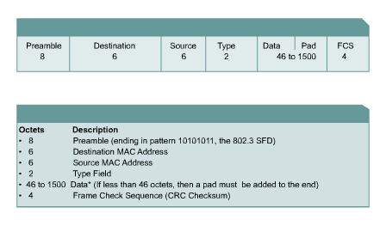
Ethernet II Frame Format

Slide 9
Ethernet II Frame Format
Field | Bytes
Preamble | 8
Destination Address | 6
Source Address | 6
Type | 2
Data | 46-1500
Frame Check Sequence | 4

Slide 10
Ethernet II Frame Format
Preamble
  This is a sequence of 7 bytes or 56 bits of alternating ones and zeros
  It is used for synchronization
  It gives components time to detect the signal, and be ready before the frame arrives
  It was set at this length because it took equipment in the old days that long to sync up
  A preamble is not required for speeds above 10 Mbps

Slide 11
Ethernet II Frame Format
SFD - Start Frame Delimiter
  Also part of the preamble is a sequence of 1 byte or 8 bits having the bit configuration 10101011 that indicates the start of the frame
Note the similarity of the bit pattern between the Preamble and the SFD
The only difference is that the last two bits of the SFD are both 1’s
Many people do not separate the Preamble and Start Frame Delimiter

Slide 12
Ethernet II Frame Format
They consider it to all be the preamble
Because it takes a station an unknowable amount of time to lock on, it does not know how many bits of the Preamble have gone by
For this reason, it is said that the Preamble is lost in the synching up process

Slide 13
Ethernet II Frame Format
As such no part of the Preamble ever enters the NIC’s buffer
This is why the size of the Preamble/SFD is excluded when the minimum and maximum Ethernet frame sizes are discussed

Slide 14
Ethernet II Frame Format
Destination Address
  This is the MAC address of the station the message is for
  This address may specify either an individual address destined for a single station, a multicast address destined for a group of stations, or an address of all 1s bits that refers to all stations on the LAN and is called a broadcast address

Slide 15
Ethernet II Frame Format
Source Address
  This is the MAC address of the sending station
Type
  Type indicates the protocol type that the frame is destined for at the network layer, such as
    0800 for TCP/IP
  These are hexadecimal numbers

Slide 16
Ethernet II Frame Format
Data
  This is the important stuff and has a maximum size of 1500 bytes
  If the data size is less than 46 bytes, then bytes are placed in the Pad field to bring the total frame length up to at least 64 bytes
  What goes into this data area is the original message and the headers placed in front of that message at each of those layers

Slide 17
Ethernet II Frame Format
CRC - Frame Check Sequence
  This is used for error checking
  When the source station assembles a frame, it performs a CRC calculation on all the bits in the frame from the Destination MAC Address through the Pad fields
  The source station stores the value in this field and transmits it as part of the frame
  When the frame is received by the destination station, it performs an identical check

Slide 18
Ethernet II Frame Format
  If the calculated value does not match the value in this field, the destination station assumes an error has occurred during transmission and discards the frame

Slide 19
Minimum Maximum Frames
The original Ethernet standards defined the minimum frame size as 64 bytes or 512 bits and the maximum as 1518 bytes
This includes all bytes from the Destination MAC Address field through the Frame Check Sequence field
Recall the Preamble and Start Frame Delimiter fields are not included when quoting the size of a frame

Slide 20
Minimum Maximum Frames
So without the preamble and SFD
  64 to 1518 bytes
And with the preamble and SFD
  72 to 1526 bytes
This makes the header 14 bytes, the trailer 4 bytes for a total overhead of 18 bytes
Regardless of the amount of data
Which can range from 46 to 1500 bytes

Slide 21
Minimum Maximum Frames
The IEEE 802.3ac standard released in 1998 extended the maximum allowable frame size to 1522 bytes to allow a VLAN tag to be inserted into the Ethernet frame format
The minimum frame size of 64 bytes was set to this value to ensure that a sending station is still sending if a collision occurs on the opposite end of the network

Slide 22
Minimum Maximum Frames
The maximum frame size of 1518 bytes is an arbitrary selection selected based on four goals
  Fairness in that no station can then take up the media for too long
  To limit the size of the buffers that receivers must maintain
  To keep overhead low so that most of the frame is the payload
  To make the network efficient so if a frame is damaged not too much bandwidth is wasted

Slide 23
Elevators
Before talking about the protocols that operate at each layer let’s consider how we move from one layer to another layer
In other words what elevators take us between floors

Slide 24
The Overall Context
Layer | Protocol
Application | HTTP/FTP and many others
 | Port
Transport | TCP and UDP
 | Protocol Number
Internet | IP
 | Ethertype Code
Network Access | Ethernet handles these functions
Network Access | Ethernet handles these functions

Slide 25
Ethertype Code
As a frame is being built at the data link layer and that frame is destined to leave its home network for some other far off network as a packet, something must tell the upper layers, above the frame level, what protocol will be used to carry this packet far, far away

Slide 26
Ethertype Code
In an Ethernet LAN, which is the only one of much importance these days, that is the Ethertype Code
This code is used to indicate what protocol stack the frame is destined for

Slide 27
Ethernet Frame Format
To understand this better let’s look again at the form of an Ethernet frame as we have seen it previously

Slide 28
Ethernet Frame Format
Field | Bytes
Preamble | 8
Destination Address | 6
Source Address | 6
Type | 2
Data | 46-1500
Frame Check Sequence | 4

Slide 29
Ethernet Frame Format
The field of interest is the Type field
  Type indicates the protocol stack that the frame is destined for at the next level up
  In other words, this is the Ethertype code
  Such as
    0800 for TCP/IP
    8137 for IPX
  These are expressed as hexadecimal numbers

Slide 30
Finding Ethertype Codes
Where are these codes kept
At www.iana.org
Several years back these numbers were shown here at the IANA web site this way
  Page down
  Select E
  Select Ethernet Numbers
  Page down again

Slide 31
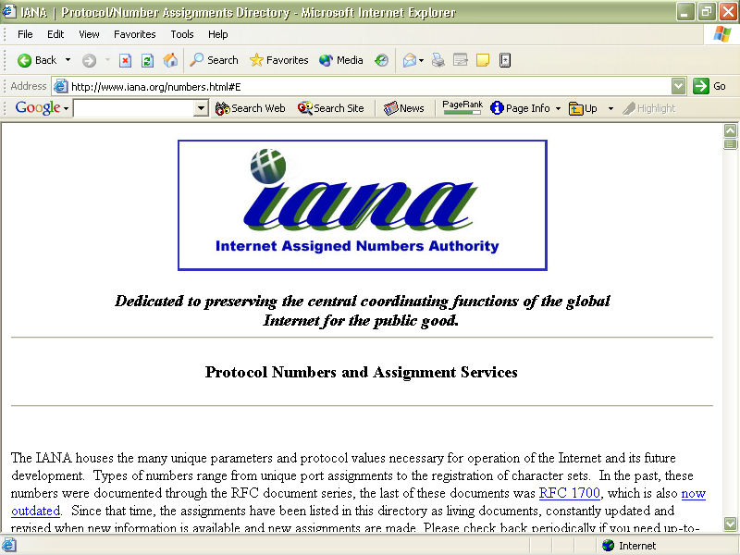
Finding Ethertype Codes

Slide 32
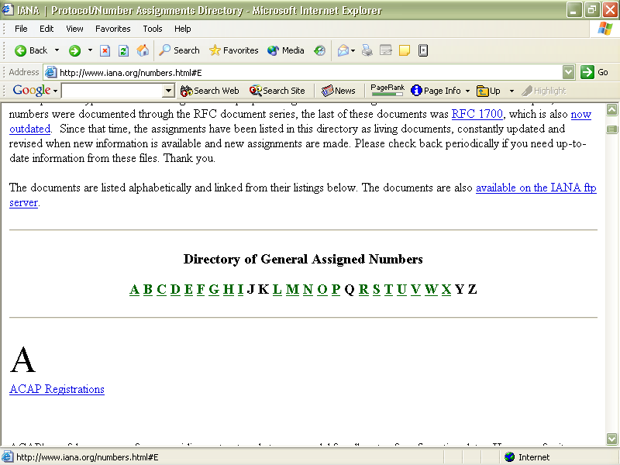
Finding Ethertype Codes

Slide 33
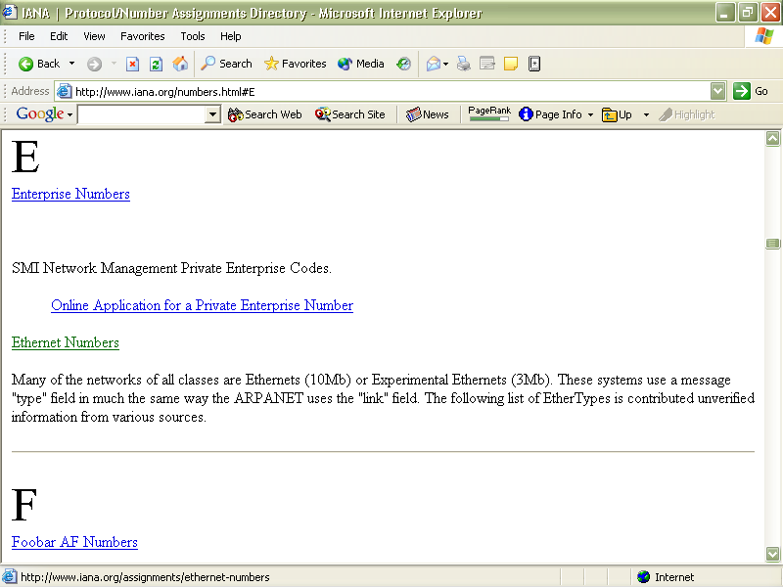
Finding Ethertype Codes

Slide 34
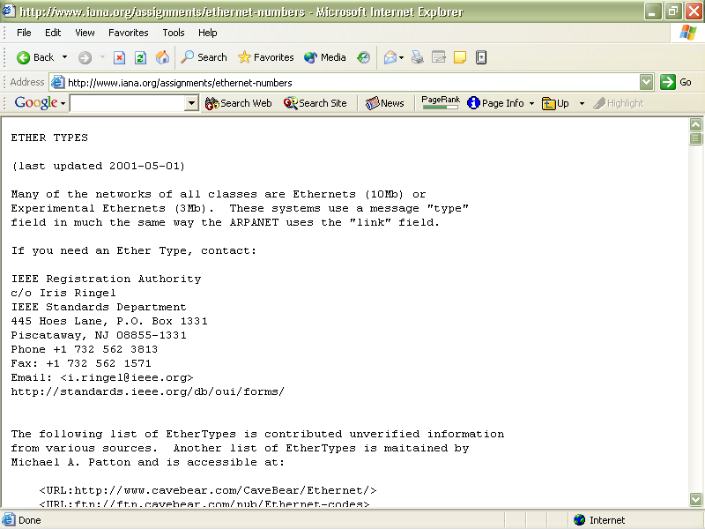
Finding Ethertype Codes

Slide 35
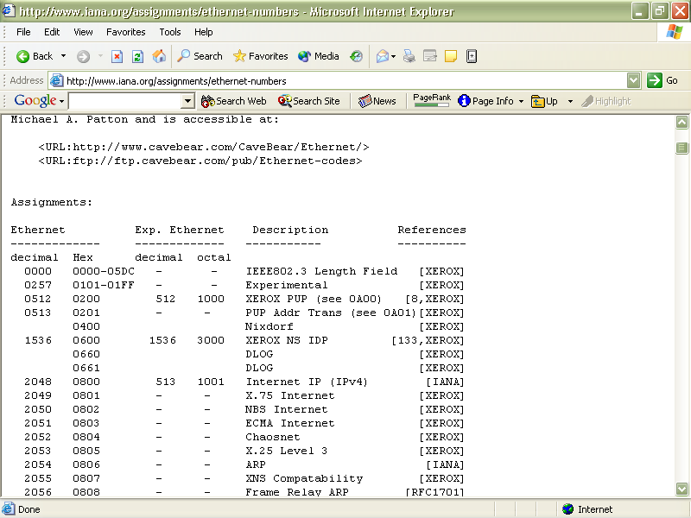
Finding Ethertype Codes

Slide 36
An Example
Finally let’s look at an example of the Ethertype code by examining a typical Ethernet frame

Slide 37
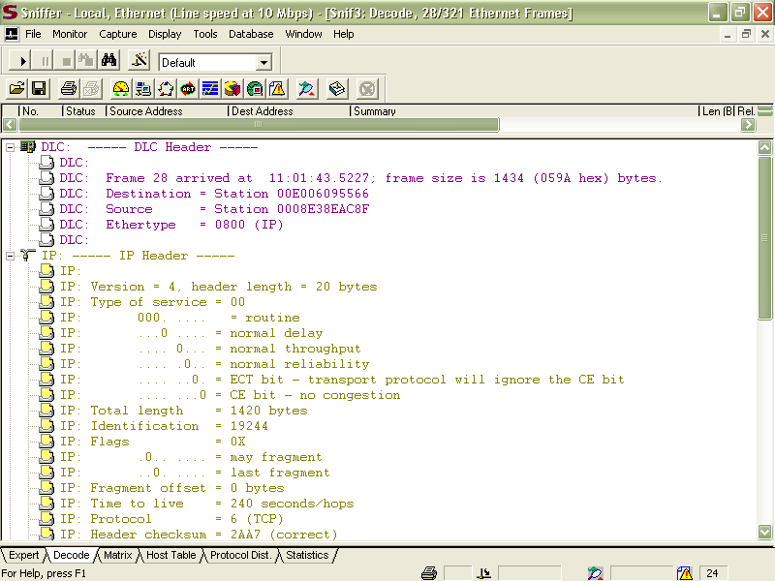
An Example

Slide 38
Ethernet SNAP Frame
The other type of frame commonly seen on an Ethernet based local area network is a SNAP or Subnetwork Access Protocol frame
The SNAP frame allows EtherType codes to be used with all IEEE 802 protocols, as well as supporting proprietary protocols

Slide 39
Ethernet SNAP Frame
We will focus on the differences between this frame type and the Ethernet II frame type
The SFD, preamble, data, and trailer are the same in the SNAP frame
Here is a nice graphic of the SNAP frame format from Cisco

Slide 40
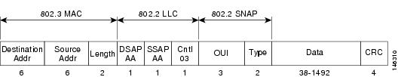
Ethernet SNAP Frame

Slide 41
Ethernet SNAP Frame
The Ethernet SNAP frame header is commonly divided into three sublayers as seen above
  802.3 MAC
  802.2 LLC
  802.2 SNAP
Let’s look at an actual Ethernet SNAP frame, and then at each of these sublayers in more detail

Slide 42
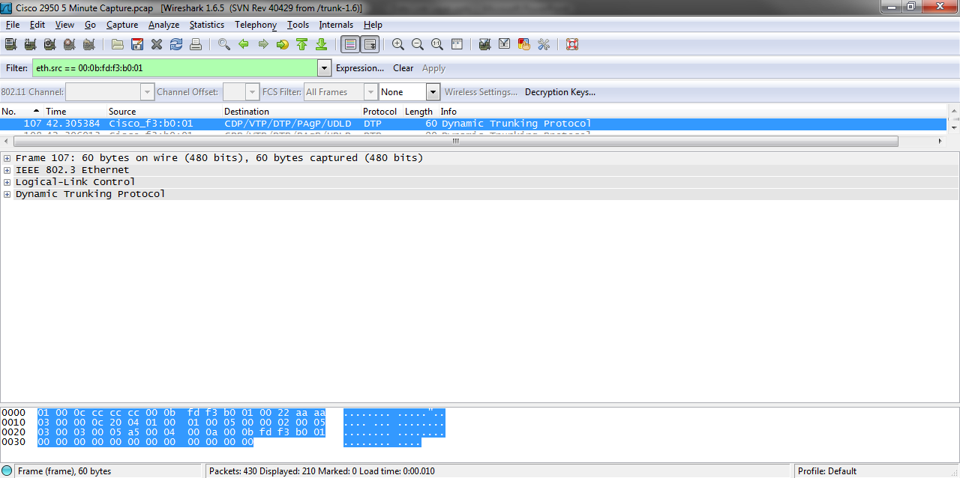
Ethernet SNAP Frame

Slide 43
802.3 MAC Sublayer
The 802.3 MAC sublayer contains the layer 2 address fields

Slide 44
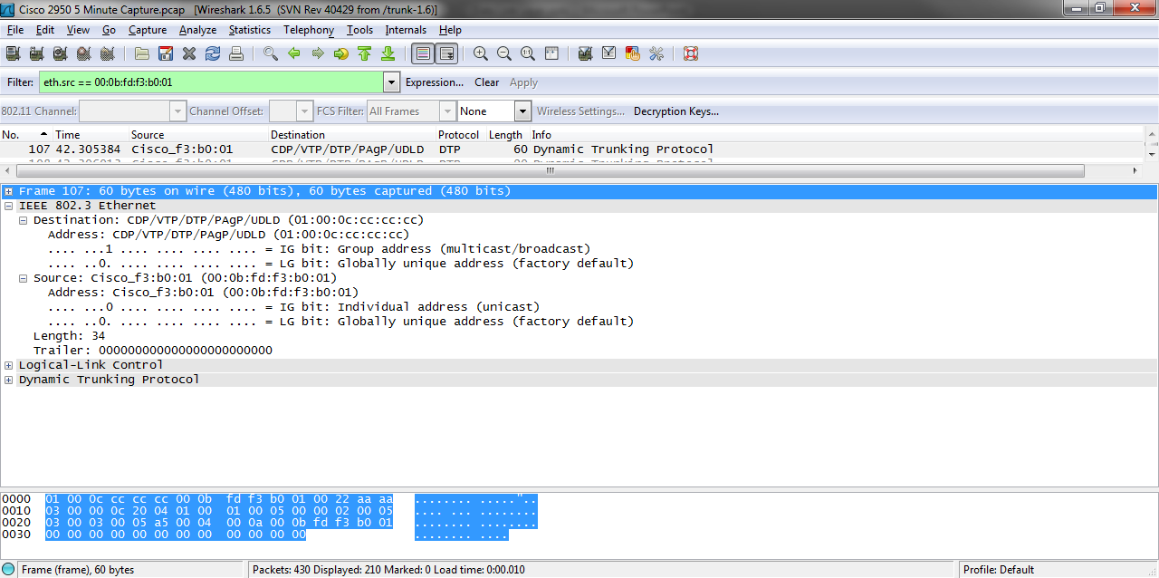
802.3 MAC Sublayer

Slide 45
802.3 MAC Sublayer
The destination address is in this example 01-00-0C-CC-CC-CC is a multicast address that is flooded out to all devices on the network
Cisco uses this address for proprietary protocols such as CDP, VTP, and so on
The source here is the MAC address of a Cisco 2950 switch

Slide 46
802.3 MAC Sublayer
The length filed shows the amount of data in the frame
In this case 34 bytes

Slide 47
802.2 LLC Sublayer
The next sublayer is the 802.2 LLC – Logical Length Control section
It contains the following main fields
  DSAP
  SSAP
  Control

Slide 48
802.2 LLC Sublayer
Wireshark shows this sublayer and the 802.2 SNAP sublayer as one section
The 802.2 LLC sublayer is outlined in the example below

Slide 49
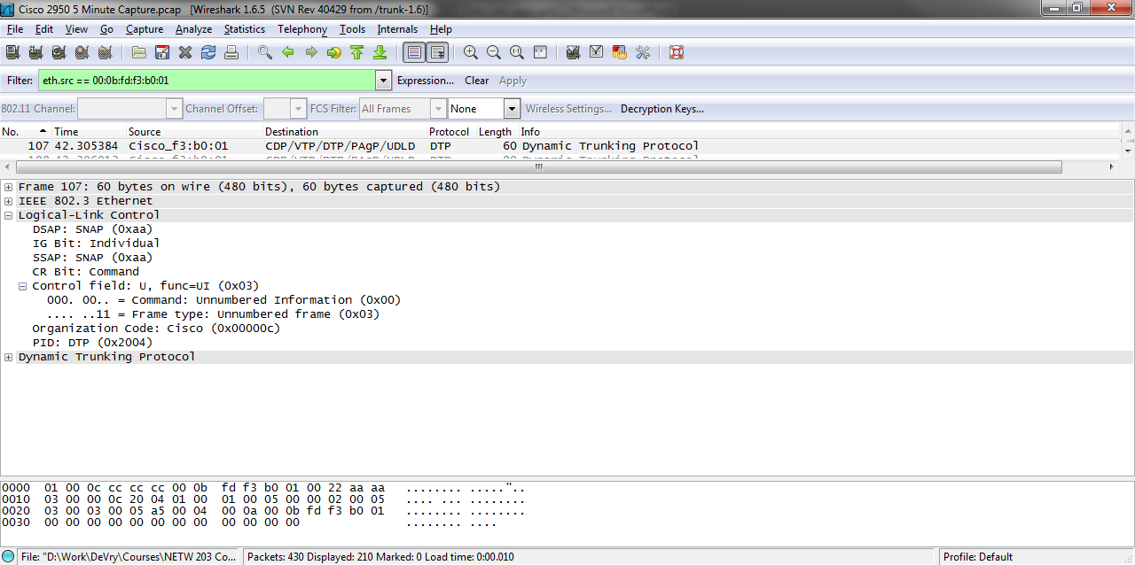
802.2 LLC Sublayer

Slide 50
802.2 LLC Sublayer
Let’s see what the IEEE says about the two SAP fields in a tutorial they published on this
  The LLC sublayer contains addressing information
  The Destination Service Access Point (DSAP) address field, and the Source Service Access Point (SSAP) address field
  Each of these is an 8-bit field and each is made up of two components

Slide 51
802.2 LLC Sublayer
  In the DSAP address field, the components are an address type designation bit, and seven bits of actual address
  When the address type designation bit is set to 0, it denotes that the actual address is an individual address
  When the address type designation bit is set to 1, it denotes that the DSAP actual address is a group address

Slide 52
802.2 LLC Sublayer
  In the SSAP address field, the components are the command or response identifier bit, and seven bits of actual address
  The actual address in the SSAP field is always an individual address
  In the general case, an individual actual address identifies a protocol, or set of protocols, in the next higher layer

Slide 53
802.2 LLC Sublayer
  In OSI environments, the next higher layer is the network layer
  In non-OSI environments, the next higher layer is dependent on the architecture in use

Slide 54
802.2 LLC Sublayer
Here is what Cisco says in part about the Control field
  The control field contains command, response, and sequence number information
  There are three types of frames
    I Frames
    Supervisory Frames
    Unnumbered Frames

Slide 55
802.2 LLC Sublayer
  Although each type has a different format for the control field, you can easily distinguish them through an examination of two bits in the control field
    X-X-X-X-X-X-X-0 = I Frame
    X-X-X-X-X-X-0-1 = Supervisory Frame
    X-X-X-X-X-X-1-1 = Unnumbered frame

Slide 56
802.2 SNAP Sublayer
The last sublayer is the 802.2 SNAP sublayer
It looks like this in Wireshark

Slide 57
802.2 SNAP Sublayer

Slide 58
802.2 SNAP Sublayer
This sublayer has two fields
The OUI field tells use who is responsible for the protocol that will follow
The PID or type field indicates what protocol that is
In this case it says the Cisco DTP is next
As we can see here sure enough it is

Slide 59
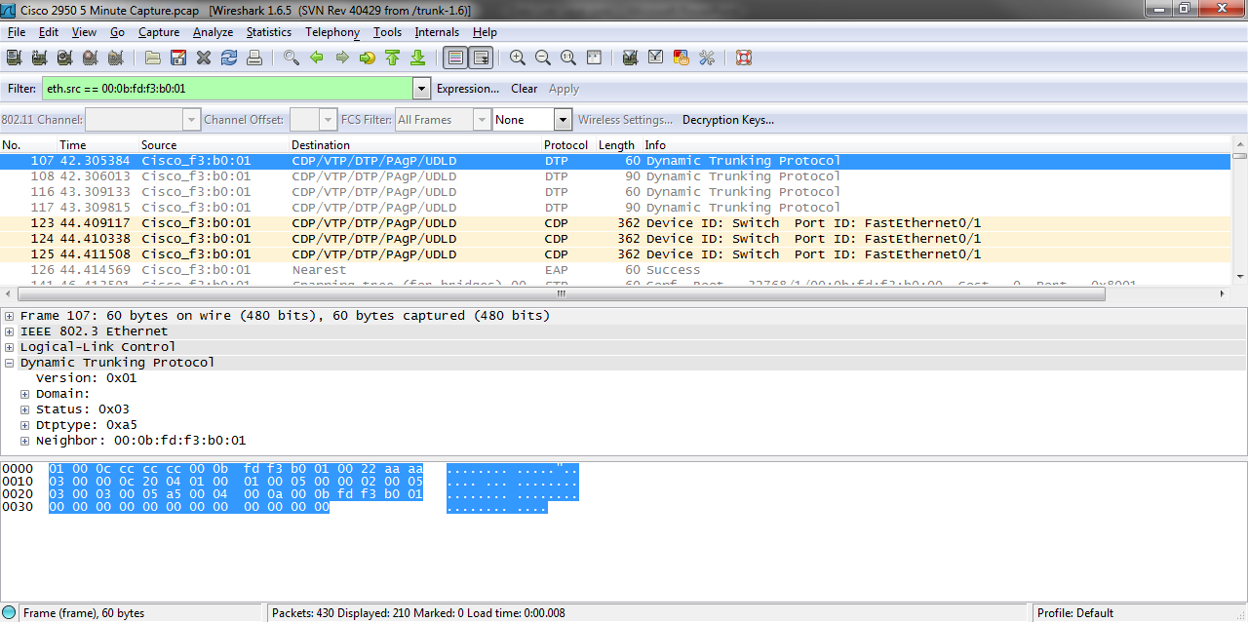
802.2 SNAP Sublayer

Slide 60
Ethernet SNAP Frame
This then is the structure and function of the second type of frame seen on an Ethernet based local area network
The frames do the work of the Data Link Layer

