Slide 1
Example of a CAN Last Update 2009.06.29 1.0.0

Slide 2
A CAN
A CAN can be created with wires or by using a wireless connection
As the LAN we looked at used wires let’s examine a typical wireless CAN

Slide 3
Use of Wireless
Wireless links can be used to create a CAN where the use of a cable connection is too costly or the ground between points does not allow it, such as not controlling the right of way
We will see an example of each

Slide 4
Example Connection
In this first example a tower is located over 400 feet from the network operations center
The right of way between the two is accessible
However for this application the cost of running a cable is prohibitive
Here is the path

Slide 5
Relationship of Facilities

Slide 6
Obstructions
Notice that the line of sight between the two points is obstructed by trees as the antennas are mounted at the height of the middle of the trees
This was done to avoid the need to hire a tower climber
Normally this would be a problem

Slide 7
Obstructions
In this case the short distance along with the high gain of the antennas allows this connection to be made

Slide 8
Obstructions

Slide 9
Obstructions

Slide 10
Tower

Slide 11
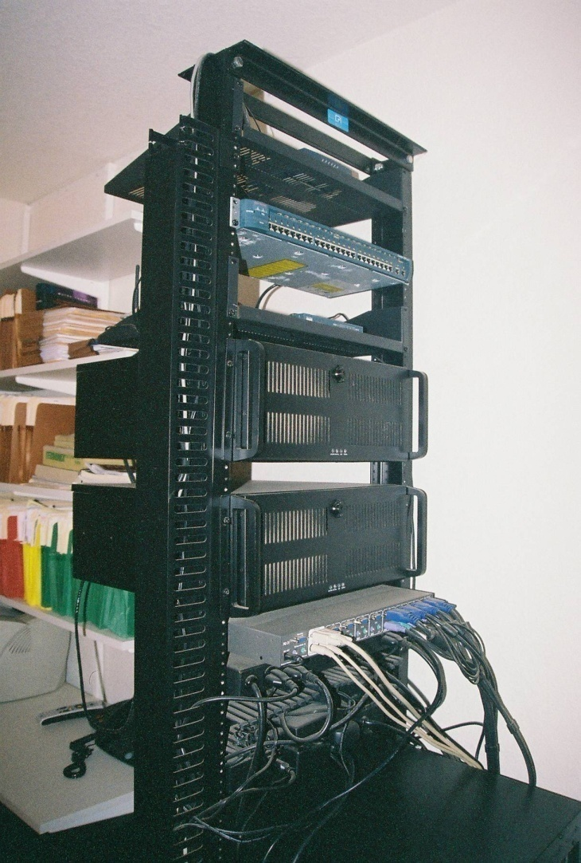
Network Operations Center

Slide 12
Method of Connection

Slide 13
Method of Connection

Slide 14
A Longer Connection
Here is another example of a wireless CAN where the distance is too great to punch through the obstructions

Slide 15
Front to Back CAN
The pasture for the horses used to be behind the house
This allowed us to check on the horses from the house by just looking out the windows
Due to changes in the yard and house the horse pasture is now down one side and at the front

Slide 16
Front to Back CAN
Now to check on the horses a set of cameras is used
These are mounted to a house in the middle of the horse pasture
To link this house to the main house in back another wireless CAN link is used
Here it is

Slide 17
Front to Back CAN

Slide 18
Front to Back CAN

Slide 19
Front to Back CAN

Slide 20
Front to Back CAN

Slide 21
Front to Back CAN
Here is the Tower
From the Roof of the
Front House
The Radio on the Tower is
Just at the Tree Line

Slide 22
Front to Back CAN
Here is the Tower
From the Roof of the
Front House
The Radio on the Tower is
Just at the Tree Line

Slide 23
Example Connection
The system illustrated here is used by the City of Joshua Texas to interconnect several of their facilities that are separated by a road and a railroad
In this case the right of way is not accessible
Here is the overhead view of the area

Slide 24
Relationship of Facilities

Slide 25
City Administration

Slide 26
Public Works

Slide 27
Fire Station

Slide 28
Animal Control

Slide 29
Typical Distance

Slide 30
Method of Connection

