Slide 1
Application Layer
Last Update 2011.09.05
1.4.0

Slide 2
Application Layer Detail
The application layer provides services to applications
In other words it is the redirector we talked about earlier
Whenever a request is made for a network service that the OS would not understand the application layer’s redirector redirects that request to the application layer

Slide 3
Common Services
What are some examples of these sorts of services

Slide 4
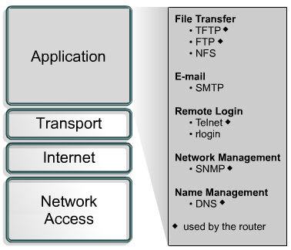
Common Services

Slide 5
What are Ports
As you can see there are many services that live at the application layer
To keep all of these separate port numbers are used
It is the next step above the IP address
To illustrate

Slide 6
The DeVry Building
Lets use the DeVry building as an example
In this case the address of 4800 Regent, Irving, Texas, 75063, USA is like the IP Address
Because with that address we can find this building from anywhere in the world
We’ll use Street Atlas to locate this building using that address

Slide 7
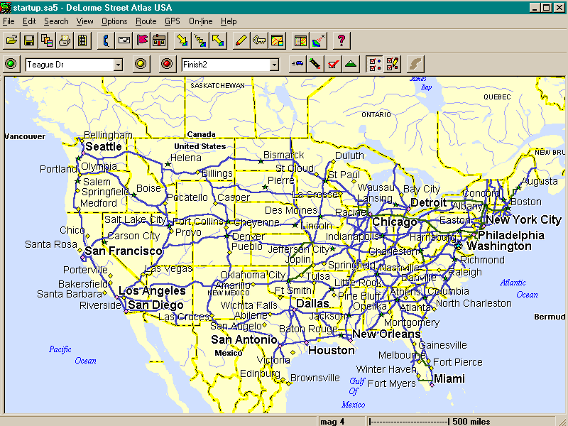
The DeVry Building

Slide 8
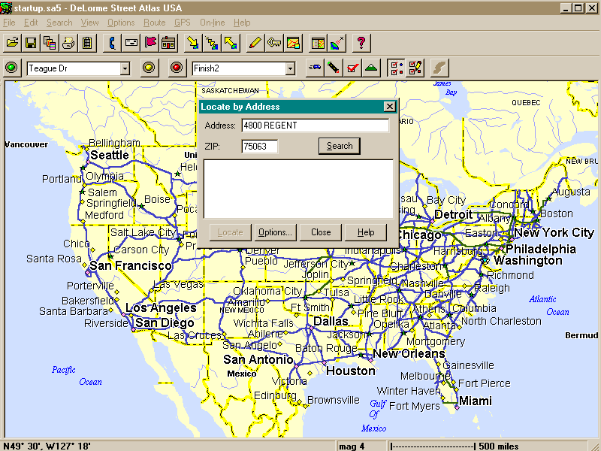
The DeVry Building

Slide 9
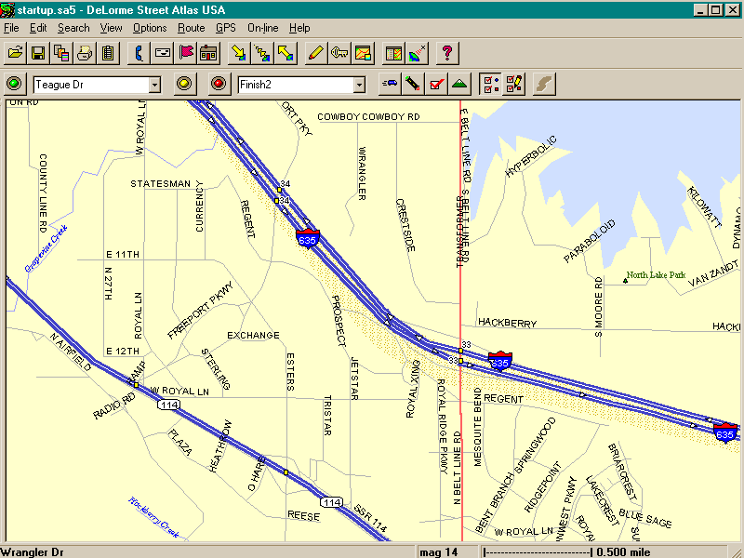
The DeVry Building

Slide 10
The DeVry Building
This gets us here

Slide 11
The DeVry Building
So it is a globally valid address
But it tells us nothing about where a particular class is being held
To know this we need more information

Slide 12
The DeVry Building
At DeVry we use a classroom number - which is just like a port - inside the building
So a complete address including the port would be
4800 Regent, Irving, Texas, 75063, USA:Room 138
Which is just like
168.35.2.11:80

Slide 13
Port Numbers
The port numbers were divided into three ranges
Well Known Ports
0 to 1023
Registered Ports
1024 to 49151
Dynamic or Private Ports
49152 to 65535

Slide 14
Well Known Ports
These ports are assigned by the ISI - under the authority of the IANA
To the extent possible, the same port assignments are used with TCP and UDP

Slide 15
Registered Ports
These ports are also registered by the ISI for the IANA
IANA registers uses of these ports as a convenience to the community
Again to the extent possible, the same port assignments are used with TCP and UDP

Slide 16
Dynamic or Private Ports
These are not tracked by anyone other than the programmer for a particular application
This is why they are called Private Port numbers
They may be used as desired

Slide 17
Dynamic or Private Ports
They are also called Dynamic Ports because they are assigned to a purpose, then unassigned dynamically as needed

Slide 18
Assignment of Port Numbers
The list at the IANA is the source for starting the process of determining what port numbers are used for
RFC 1700 once did this, but it has recently been moved to Historic status
However what it states concerning the role of the IANA is still relevant

Slide 19
Assignment of Port Numbers
It states in part
The IANA - Internet Assigned Numbers Authority is the central coordinator for the assignment of unique parameter values for Internet protocols
It is to assign and coordinate the use of numerous Internet protocol parameters

Slide 20
Assignment of Port Numbers
The Internet protocol suite contains numerous parameters, such as internet addresses, domain names, autonomous system numbers, protocol numbers, port numbers, management information base object identifiers, including private enterprise numbers, and many others

Slide 21
Assignment of Port Numbers
The common use of the Internet protocols by the Internet community requires that the particular values used in these parameter fields be assigned uniquely
It is the task of the IANA to make those unique assignments as requested and to maintain a registry of the currently assigned values

Slide 22
Tracking Down Port Numbers
The current list is found at http://www.iana.org, then clicking on Protocol Numbers and Assignment Services, then clicking on the P, then clicking on Port Numbers

Slide 23
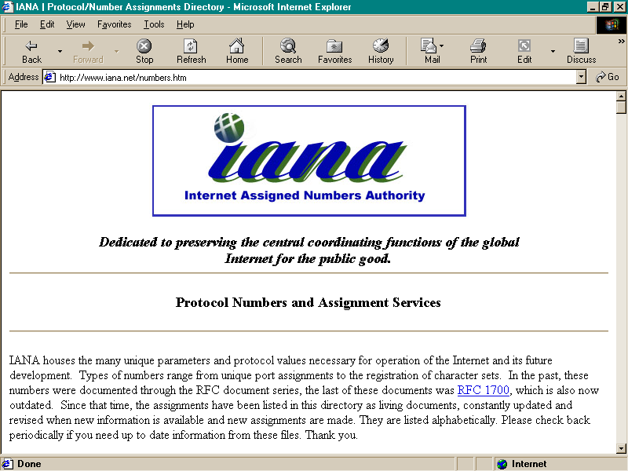
Tracking Down Port Numbers

Slide 24
Tracking Down Port Numbers
Click on the P on the following page, then click on Port Numbers, then scroll down to the number list itself

Slide 25
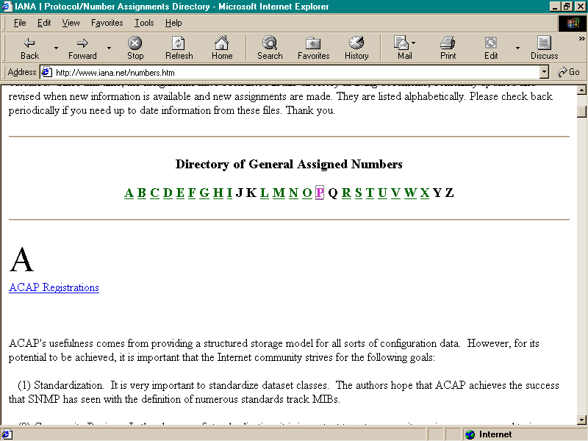
Tracking Down Port Numbers

Slide 26
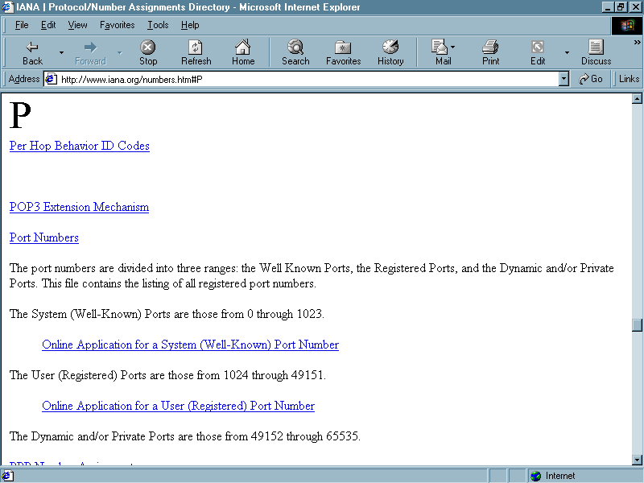
Tracking Down Port Numbers

Slide 27
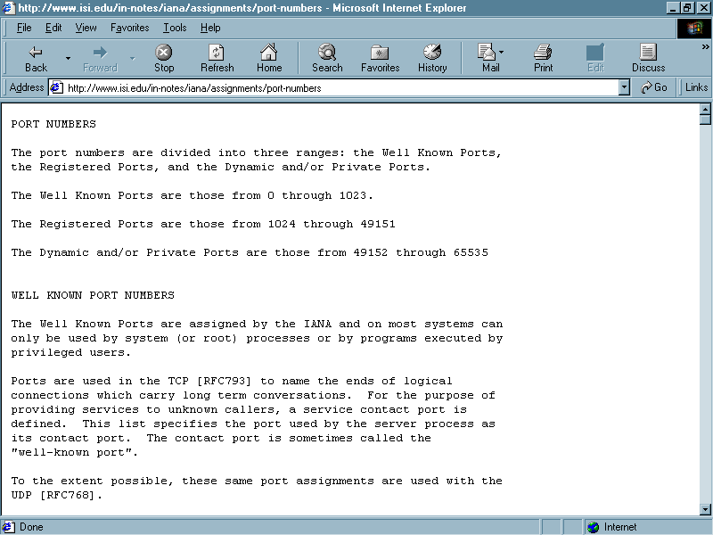
Tracking Down Port Numbers

Slide 28
Tracking Down Port Numbers
A major problem with port numbers is that there is no definitive source of information on exactly what a port is being used for
The list gives it a name and a contact, but it does not tell you why the host is listening to that port
In some cases you can tell by the name or the company that registered the number

Slide 29
Tracking Down Port Numbers
But in many cases you have no clue
Even worse the numbers between 1024 to 49151, even though registered, are often used just like the dynamic numbers

Slide 30
Tracking Down Port Numbers
Tracking a port back to an application is difficult
There are several tools that attempt to do this
One of these is netstat
For example this command sequence will map the open port back to the program that is using it
netstat –ano

Slide 31
Traffic Seen
What types of traffic are currently seen on networks worldwide
Sandvine produces reports on this periodically
In their report from March 2011 we see the following

Slide 32
Traffic Seen

Slide 33
Traffic Seen

Slide 34
Traffic Seen

Slide 35
Traffic Seen

Slide 36
Traffic Seen

Slide 37
Traffic Seen

Slide 38
Traffic Seen
As these tables show entertainment related traffic is increasing in all markets

